Slide 1
WGClimate-22 & GHG-TT-5
Roadmaps Combined: comprehensive monitoring of the carbon budget
Presenter, Organization
Agenda Item #

Slide 2

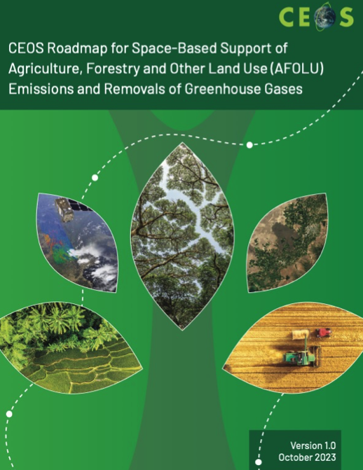
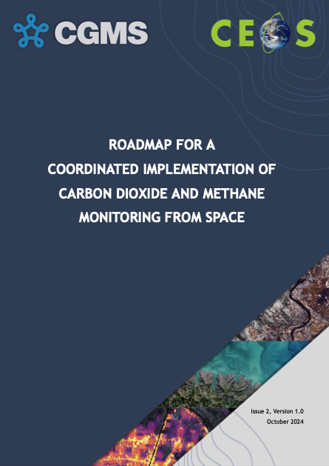

3 Roadmaps… 1 Carbon budget
CEOS SIT initiated an effort to coordinate activities.
There are good reasons and enough specificities to this state-of-play but some degree of convergence is needed:
on activities of similar nature
on interface activities
use of modelling / inverse modelling as an integrative tool and to identify key uncertainties & sensitivities
…
ToC and lead authors settled
Draft to be completed by Q3 2025
Aquatic Carbon From Space Roadmap
October 2023
October 2024
Early 2026 (target)

Slide 3
Built-in coordination already
GHG Carbon Roadmap
AFOLU Roadmap
Thematic activities
  Fostering Stakeholder Engagement
  Sensor development and Constellation Architecture
  Calibration and Level 1 Products
  Level 2 Products and Validation
  Flux inversion Modelling and Validation
  Best Practices
  System Development
  Capacity Building
Coordination of Aquatic, AFOLU and GHG Carbon Roadmap
Approaches to AFOLU-related emissions/removals
  IPCC approach
  Hybrid IPCC/EO approach
  Dynamic Global Vegetation Models
  Bookkeeping approaches
Perspective on GHG Roadmap
  Top-Down / Bottom-up
Capacity building and User Engagement

Slide 4
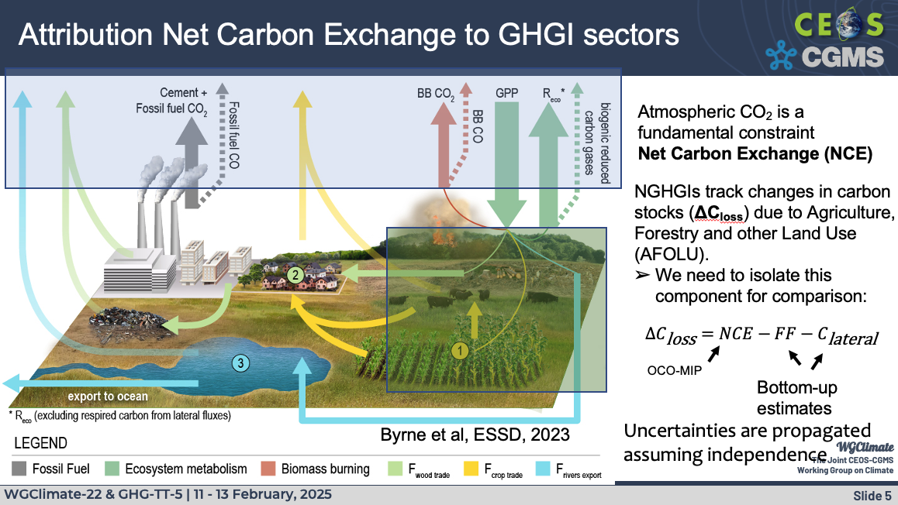
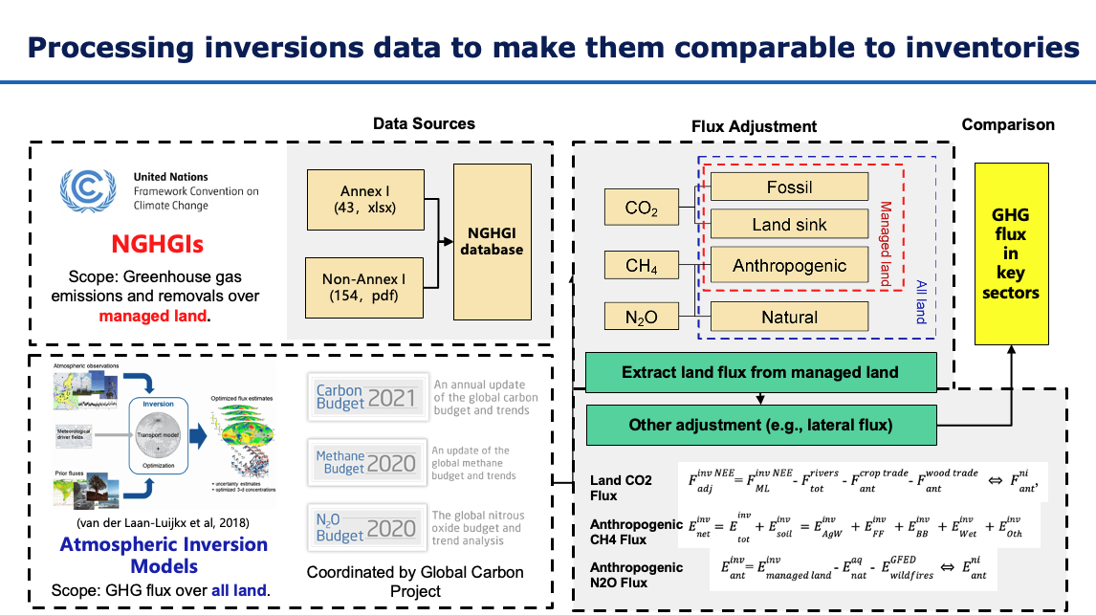
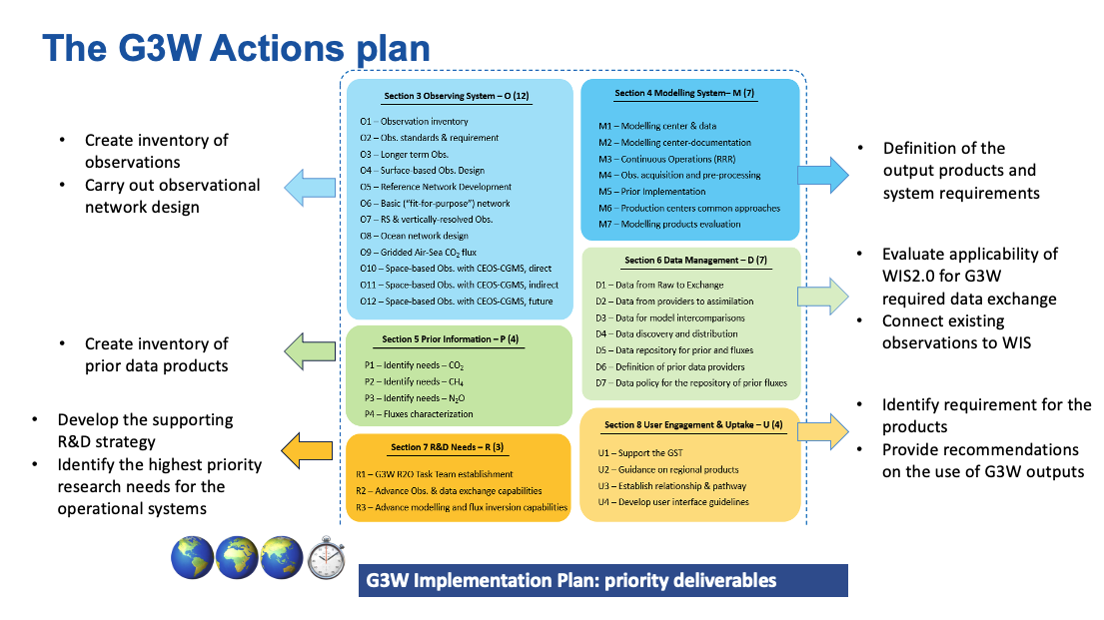
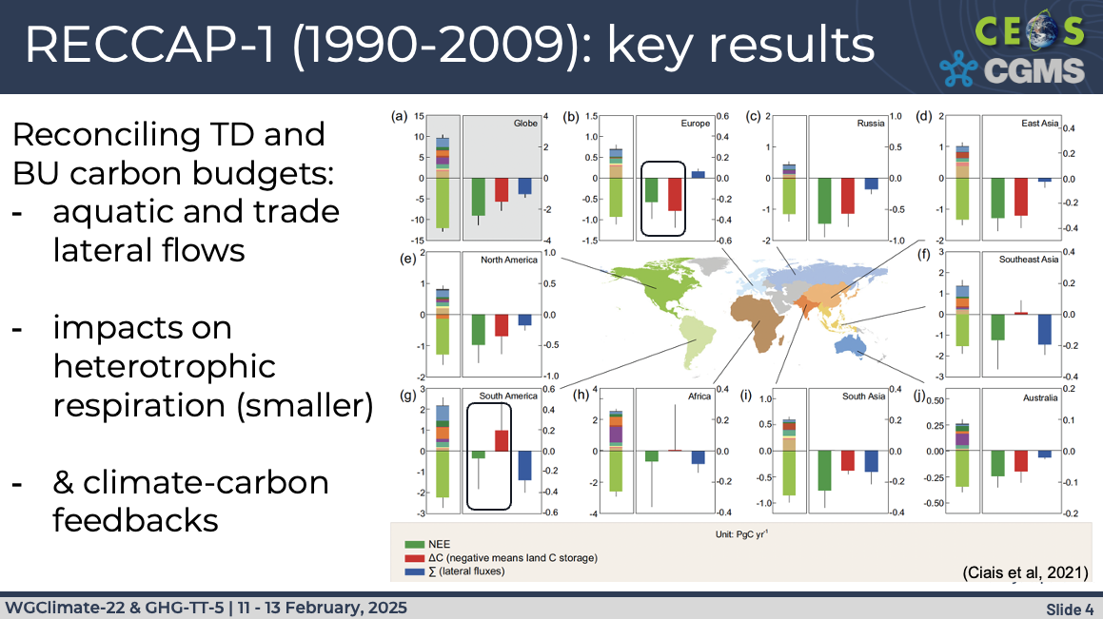
Top-Down, Bottom-Up and in-between
Presentation by Kevin (6.1)
Presentation by Philippe (6.3)
Presentation by Ben (6.2)
Presentation by Gianpaolo (5.1)
Incl. Task Team Modelling led by Lesley O.

Slide 5
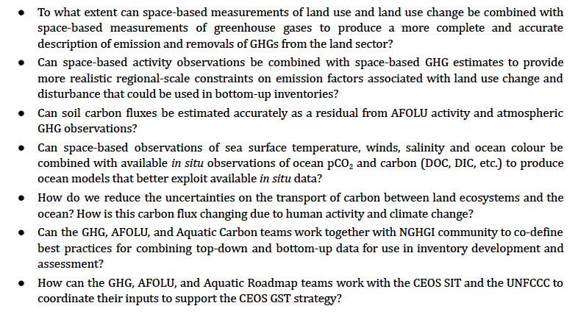
Use cases approach
Examples (from GHG Roadmap)
Are there useful new activities could WG Climate initiate or sponsor in coordination with G3W?

