Slide 1
A snapshot of activities in Norway
Glen Peters (CICERO)
WGClimate-22 & GHG-TT-5, 11–13 February, 2025, ESA ECSAT, Harwell, UK

Slide 2
Overview of presentation
Norwegian GHG emission inventory
Example applications using independent data and observations
Methane, LULUCF, coastal shipping, and agriculture
A Roadmap for CO2M/CO2MVS in Norway
Summary

Slide 3
Norwegian GHG emission inventory

Slide 4
Norway’s official GHG emission inventory
Norway follows IPCC Guidelines, generally Tier 3, for its emission inventory LULUCF is based on the National Forest Inventory (NFI)
Data: UNFCCC Greenhouse Gas Emission Inventories

Slide 5
Uncertainties
The largest relative uncertainties are for F-gases, but LULUCF has the largest absolute uncertainty. Inventory compilers are often interested in particularly uncertainties (e.g., SF₆, CH₄ from landfills, etc)
Absolute uncertainties:
GHG: 4.9MtCO₂
LULUCF: 5.0MtCO₂
Fossil CO₂: 1.2MtCO₂
CH₄: 0.6MtCO₂-eq
N₂O: 0.5MtCO₂-eq
HFC: 0.4MtCO₂-eq
SF₆: 0.03MtCO₂-eq
PFC: 0.03MtCO₂-eq
Note: Norway does not provide a specific estimate for LULUCF, but it was estimated here assuming errors sum in quadratic.

Slide 6
National GHG inventories, institutional responsibilities
Source: Norwegian National Inventory Report

Slide 7
Methane emissions

Slide 8
Comparisons with ‘independent’ inventories (EDGAR)
Norway has a large exports of natural gas relative to production, so ‘sectoral’ approach needed for CO₂ EDGAR has too high CH₄, since it uses global assumptions for oil and gas leaks (Tier 1 approach)

Slide 9
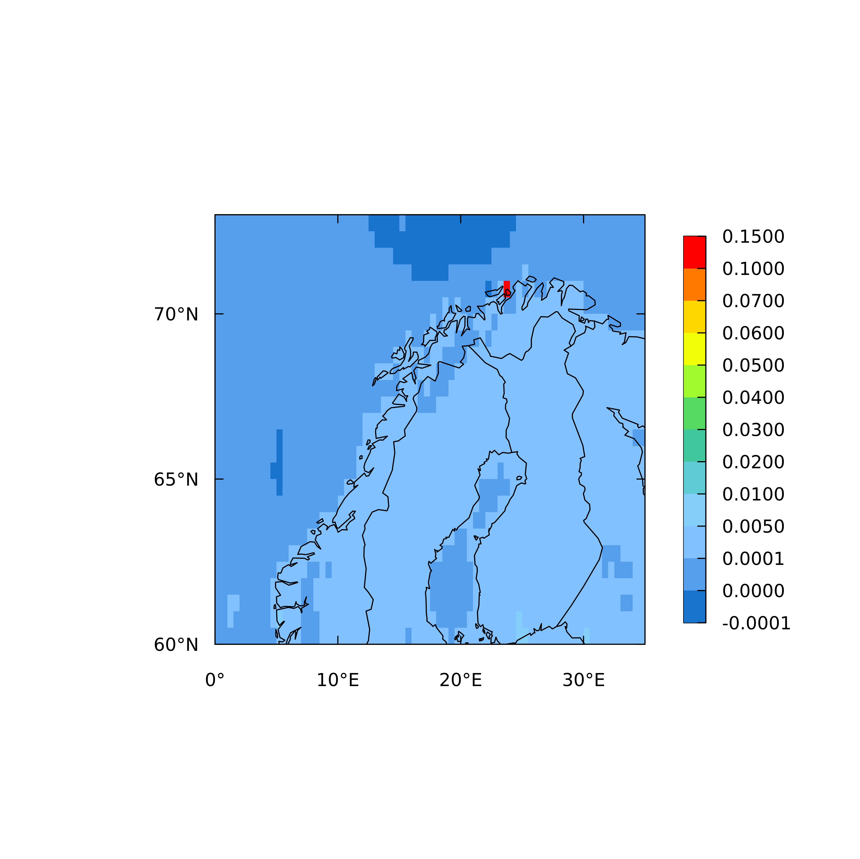
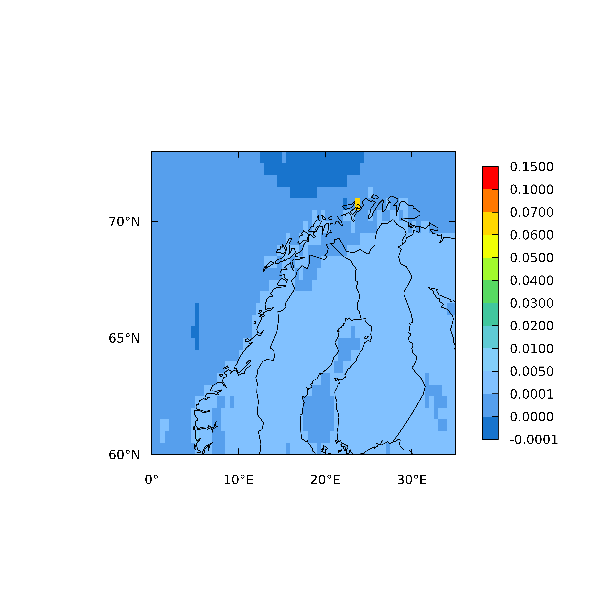
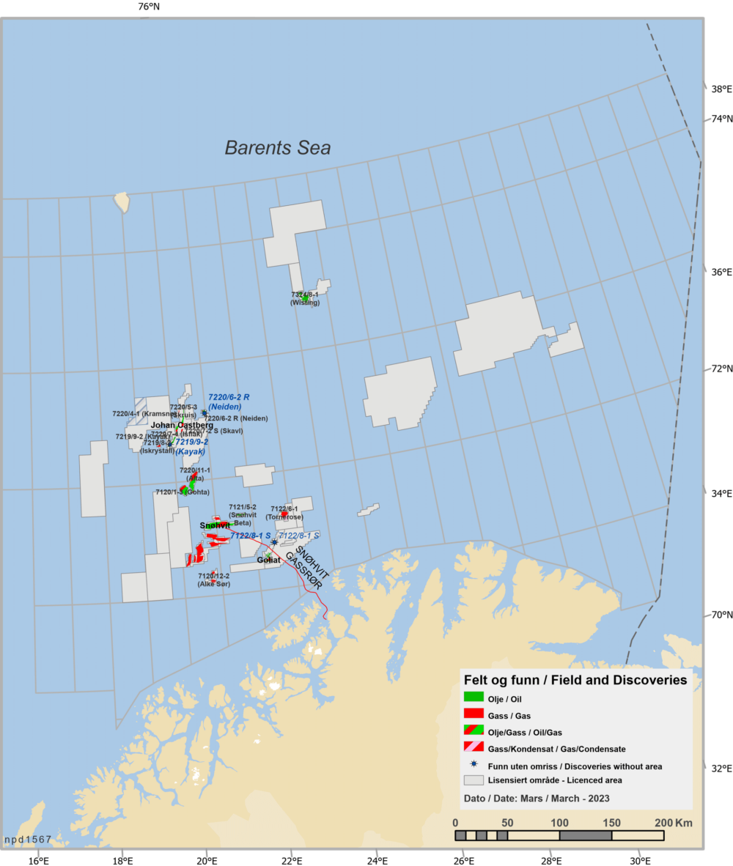
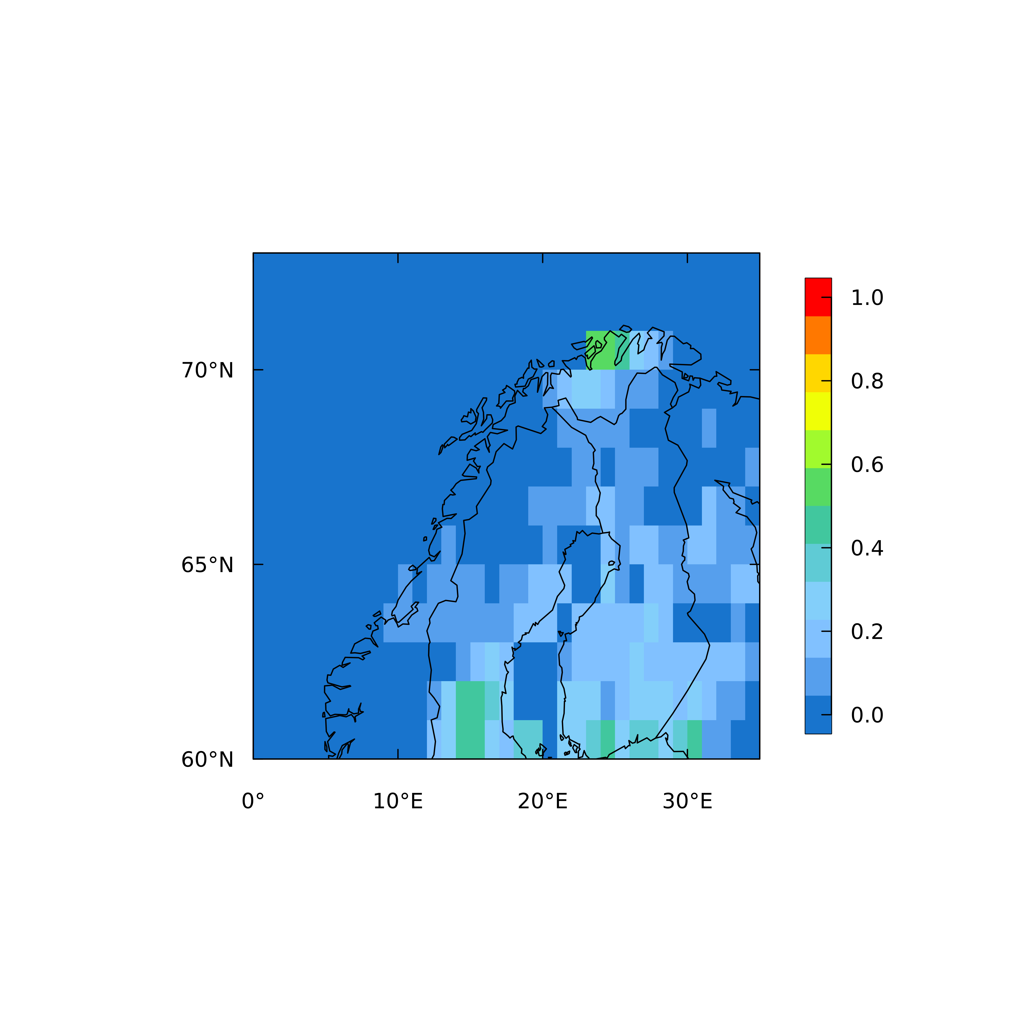
Methane inversions
Very large CH₄ source estimated in EDGAR inventory from Snøhvit gas facility in northern Norway (59 ton/h). Satellite observations do not detect any large source there and source reduced by factor two in inversions. Further work (such as with hyperspectral imagers) may be able to detect these sources.
Snøhvit
Prior (g m⁻² y⁻¹)
Posterior (g m⁻² y⁻¹)
Uncertainty reduction
Source: Rona Thompson (NILU)

Slide 10
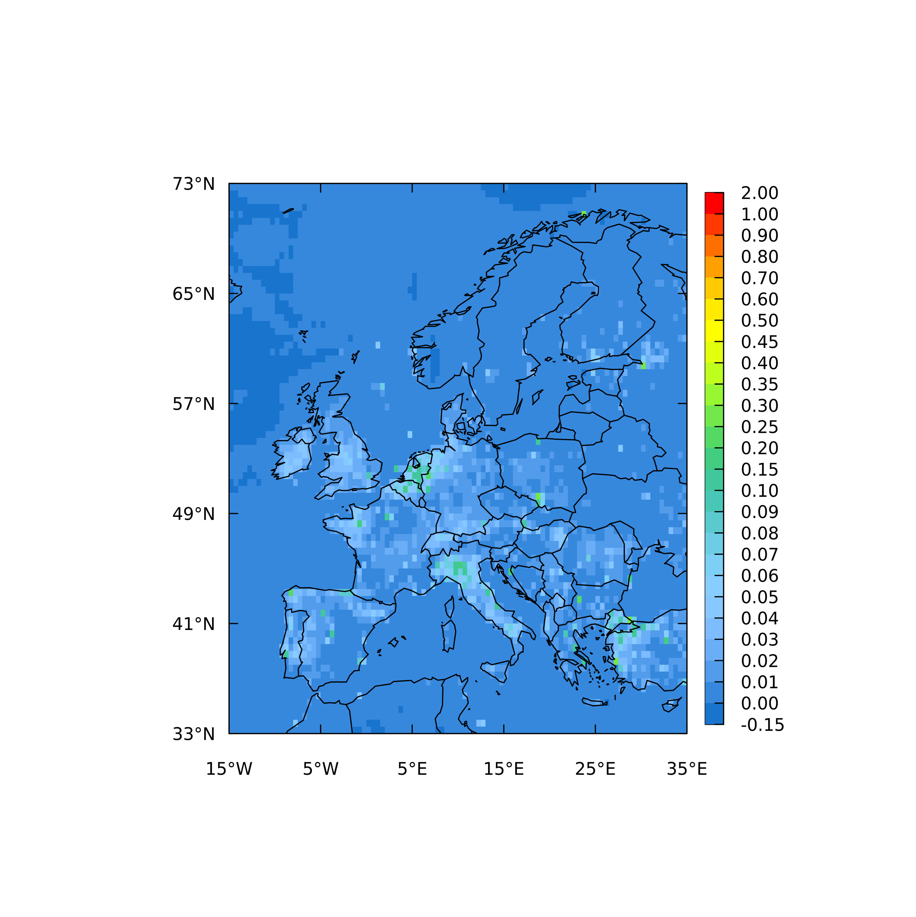
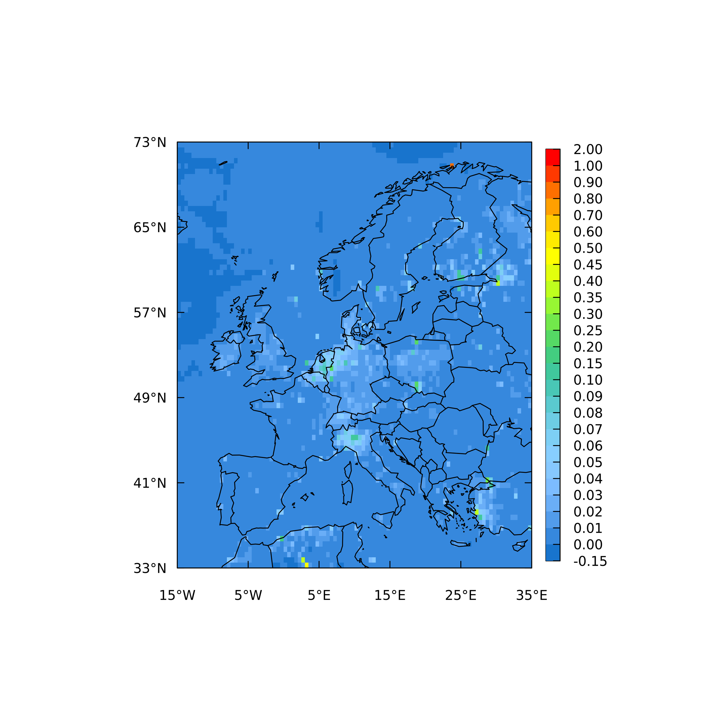
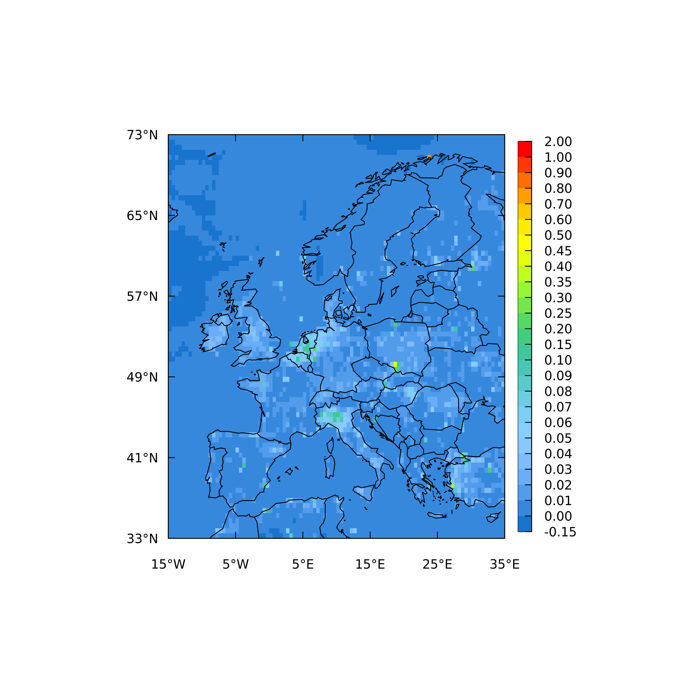
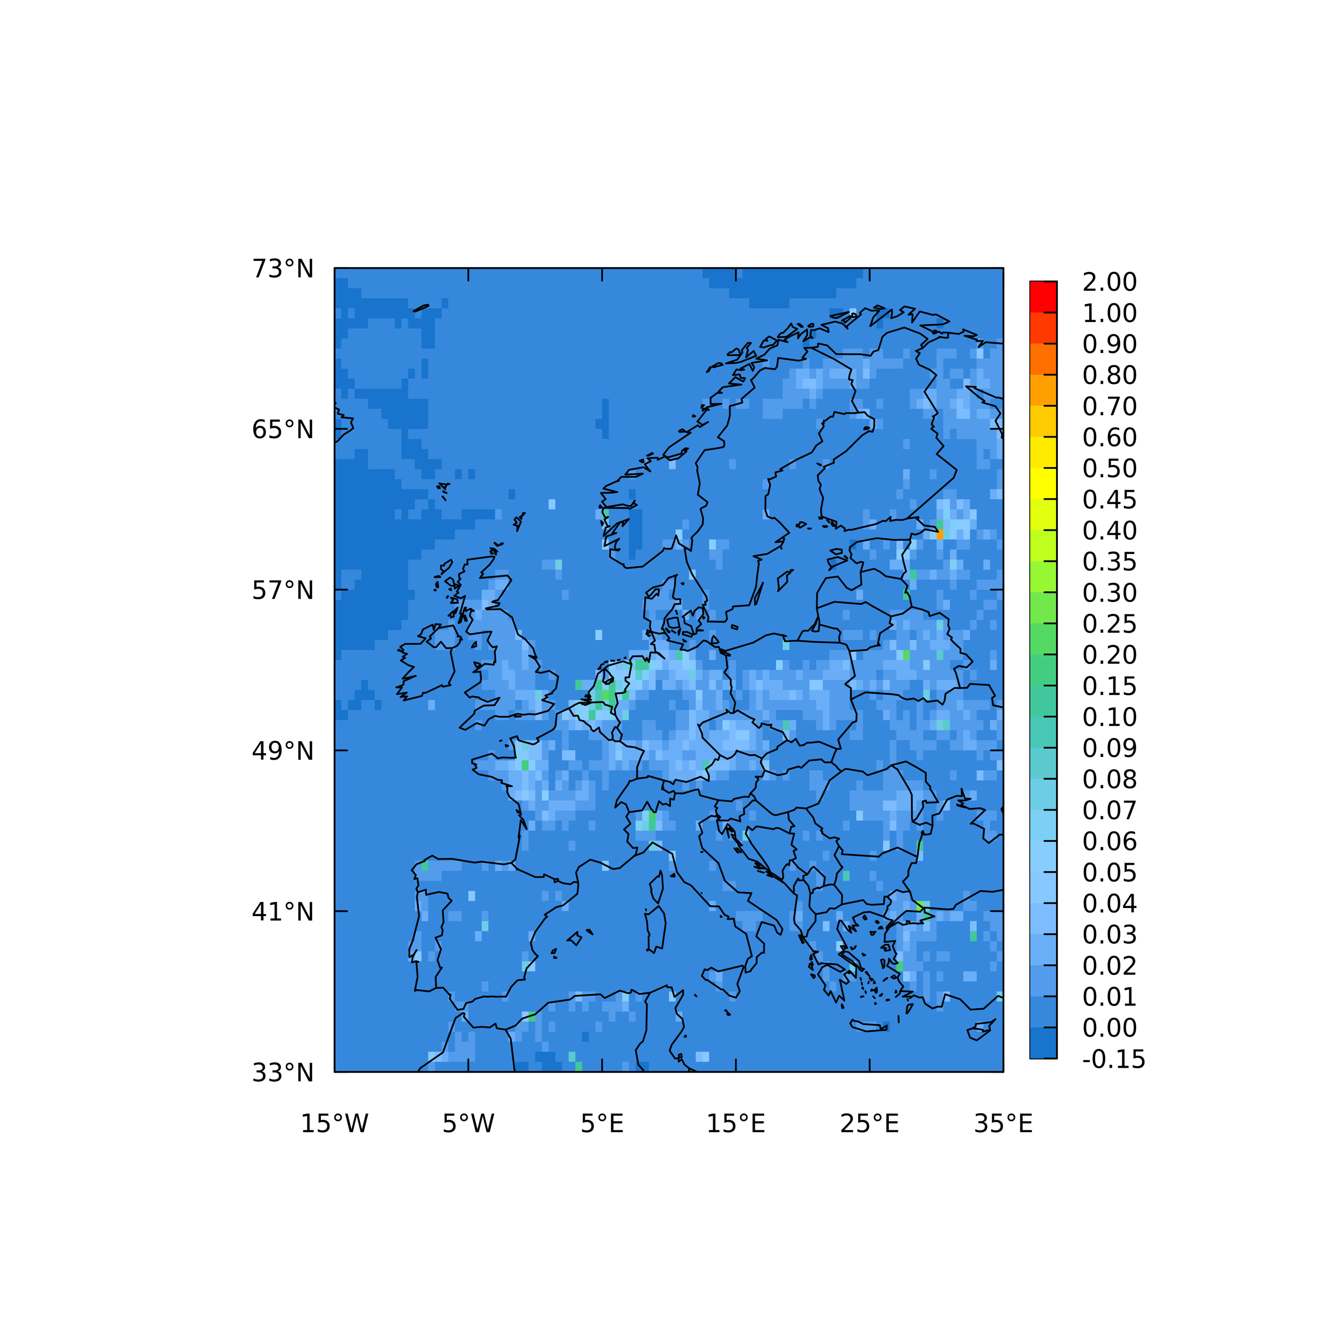
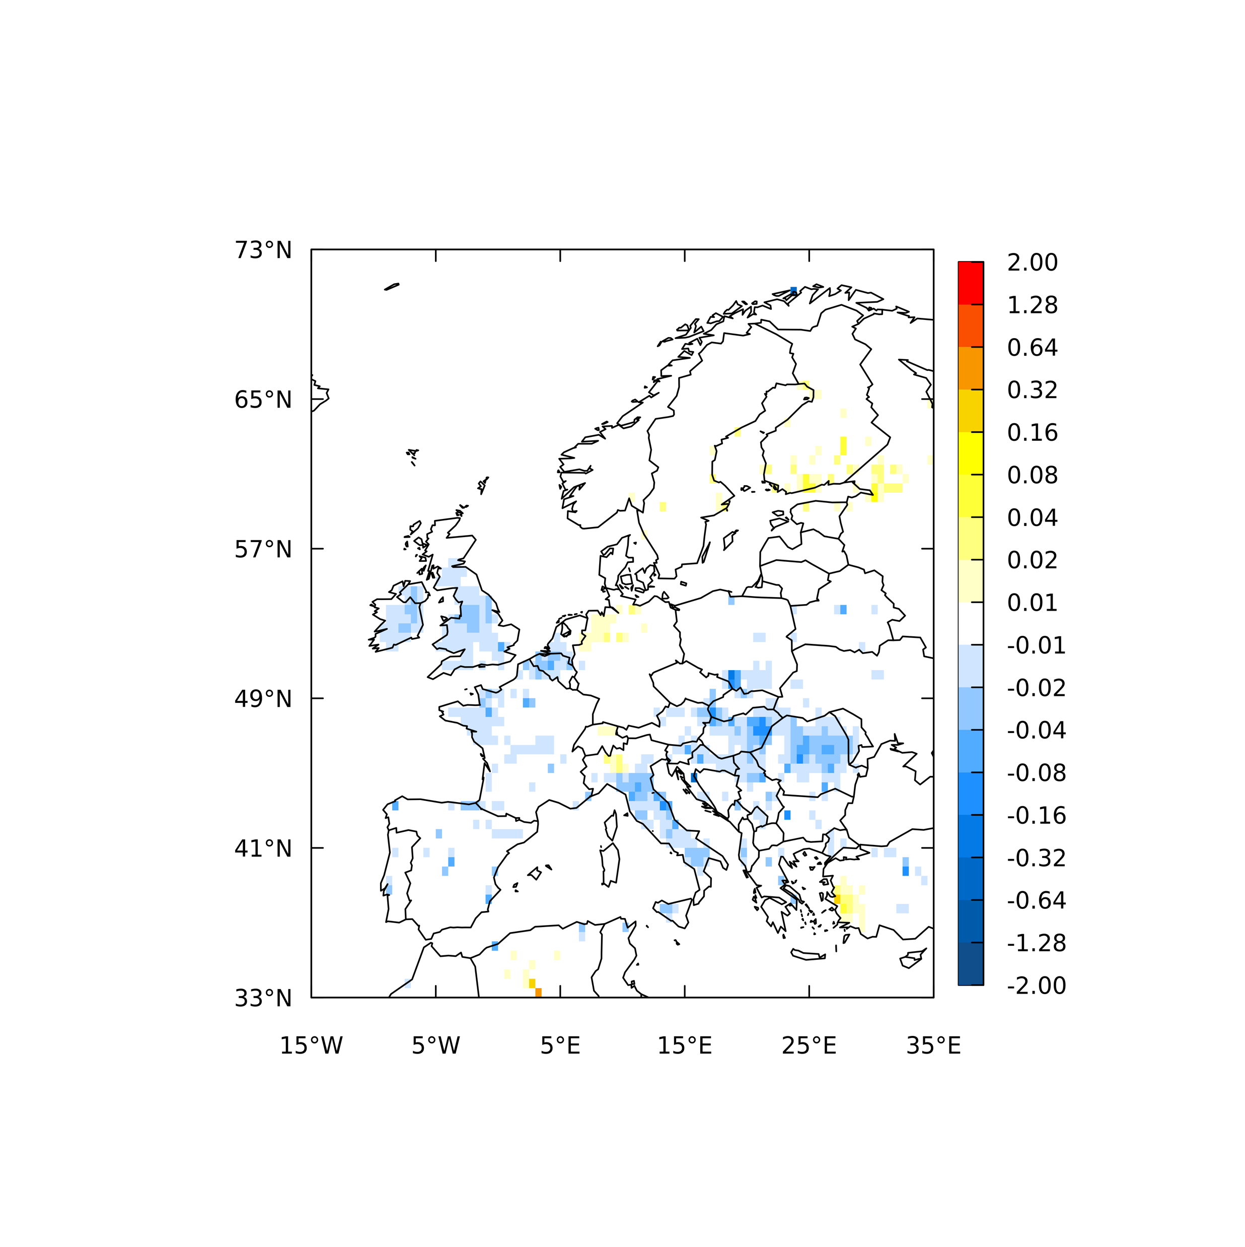
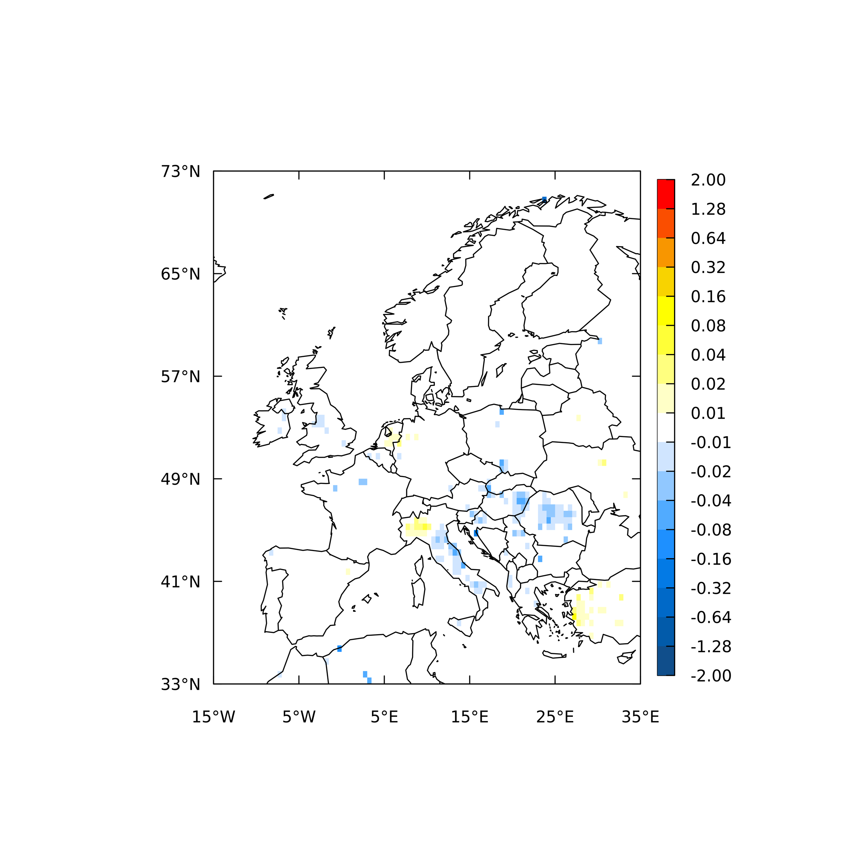
Methane inversions
Results of inversions using 3 different retrievals of XCH₄ from TROPOMI compared to using ground-based measurements from the ICOS network: the posterior fluxes using the official retrievals differ most from those using ICOS
Official, SRON (39 Tg/y)
WFMD (29 Tg/y)
S5P-BLND (35 Tg/y)
ICOS (33 Tg/y)
Prior: 39 Tg/y
Posterior
fluxes
Posterior - prior flux increments
Source: Rona Thompson (NILU)
Notes:
There are several retrievals of XCH4 from TROPOMI, the “Official” is that calculated by SRON and provided by ESA. “WFMD” is provided by University of Bremen and “S5P-BLND” is a blended project using TROPOMI and GOSAT-2 and is provided by Harvard University.
The inversions using the Official retrievals differ most from ICOS. In other words, the inversions using WFMD and S5P-BLND are closer to that using ICOS data. By “difference” I mean also with respect to the spatial distribution of the flux increments, and not only the total source over the domain.
Potentially an over correction for albedo in the official estimate, also found by Balasus et al., 2024

Slide 11
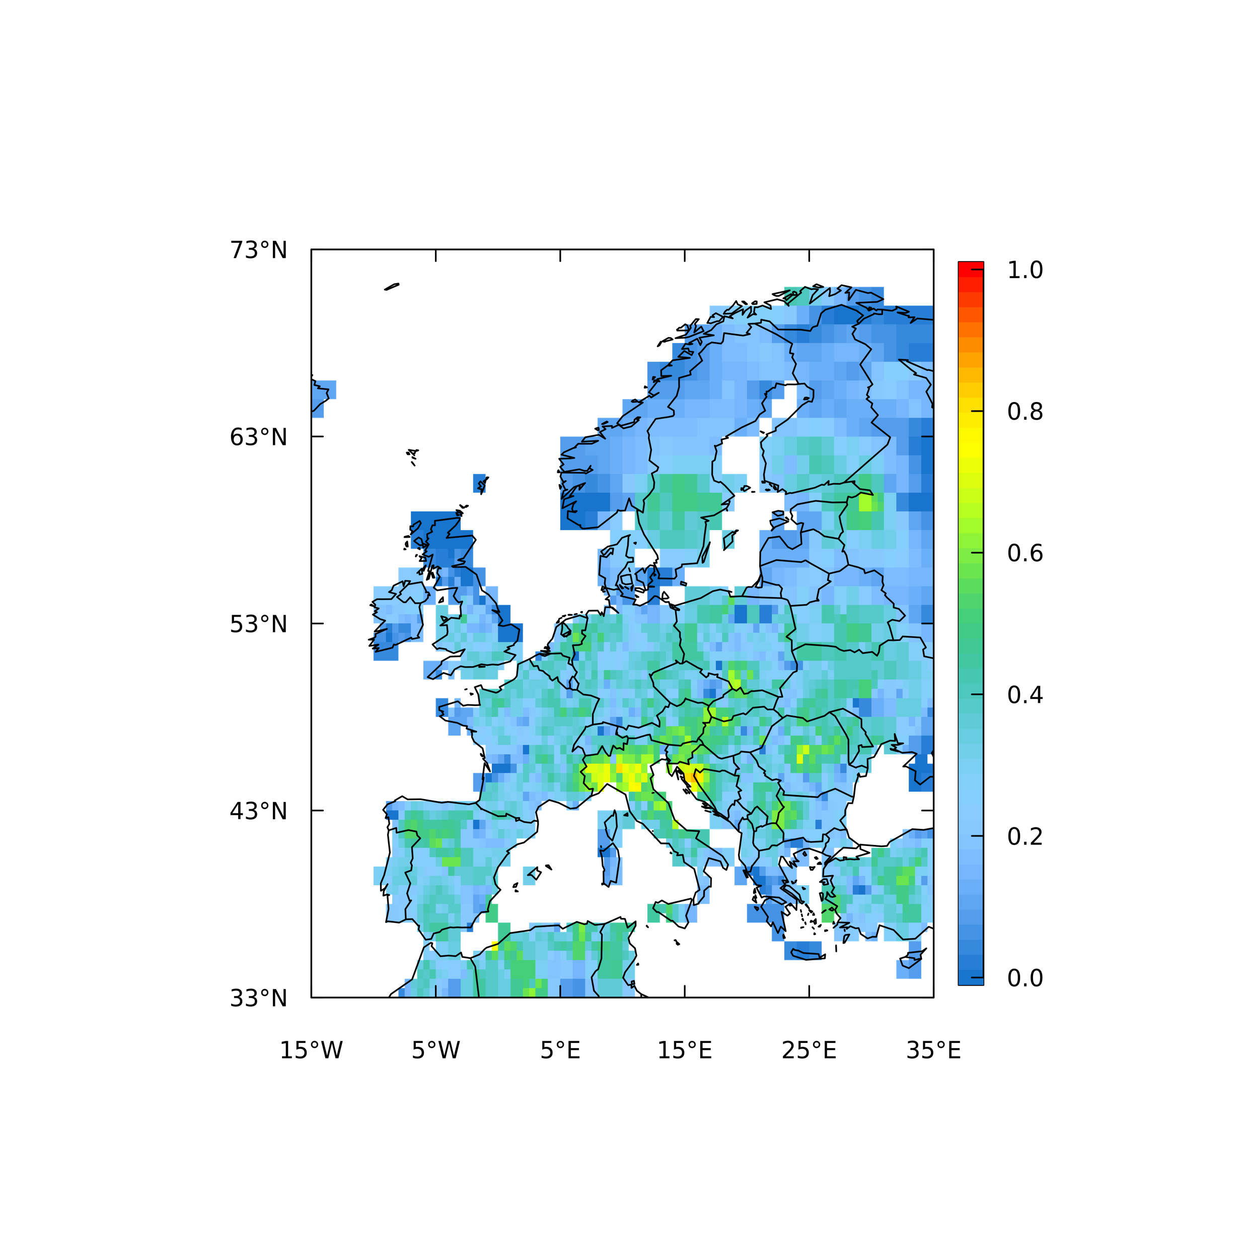
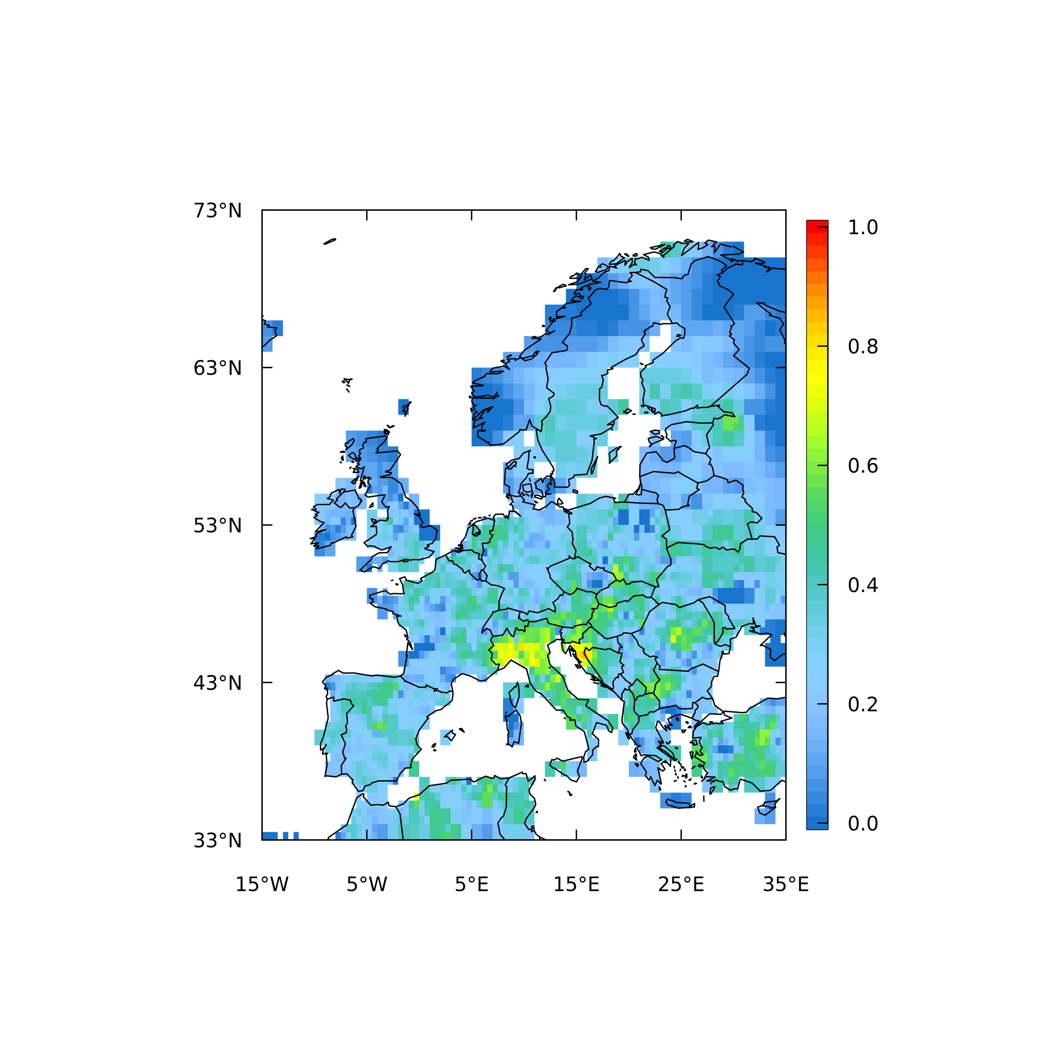
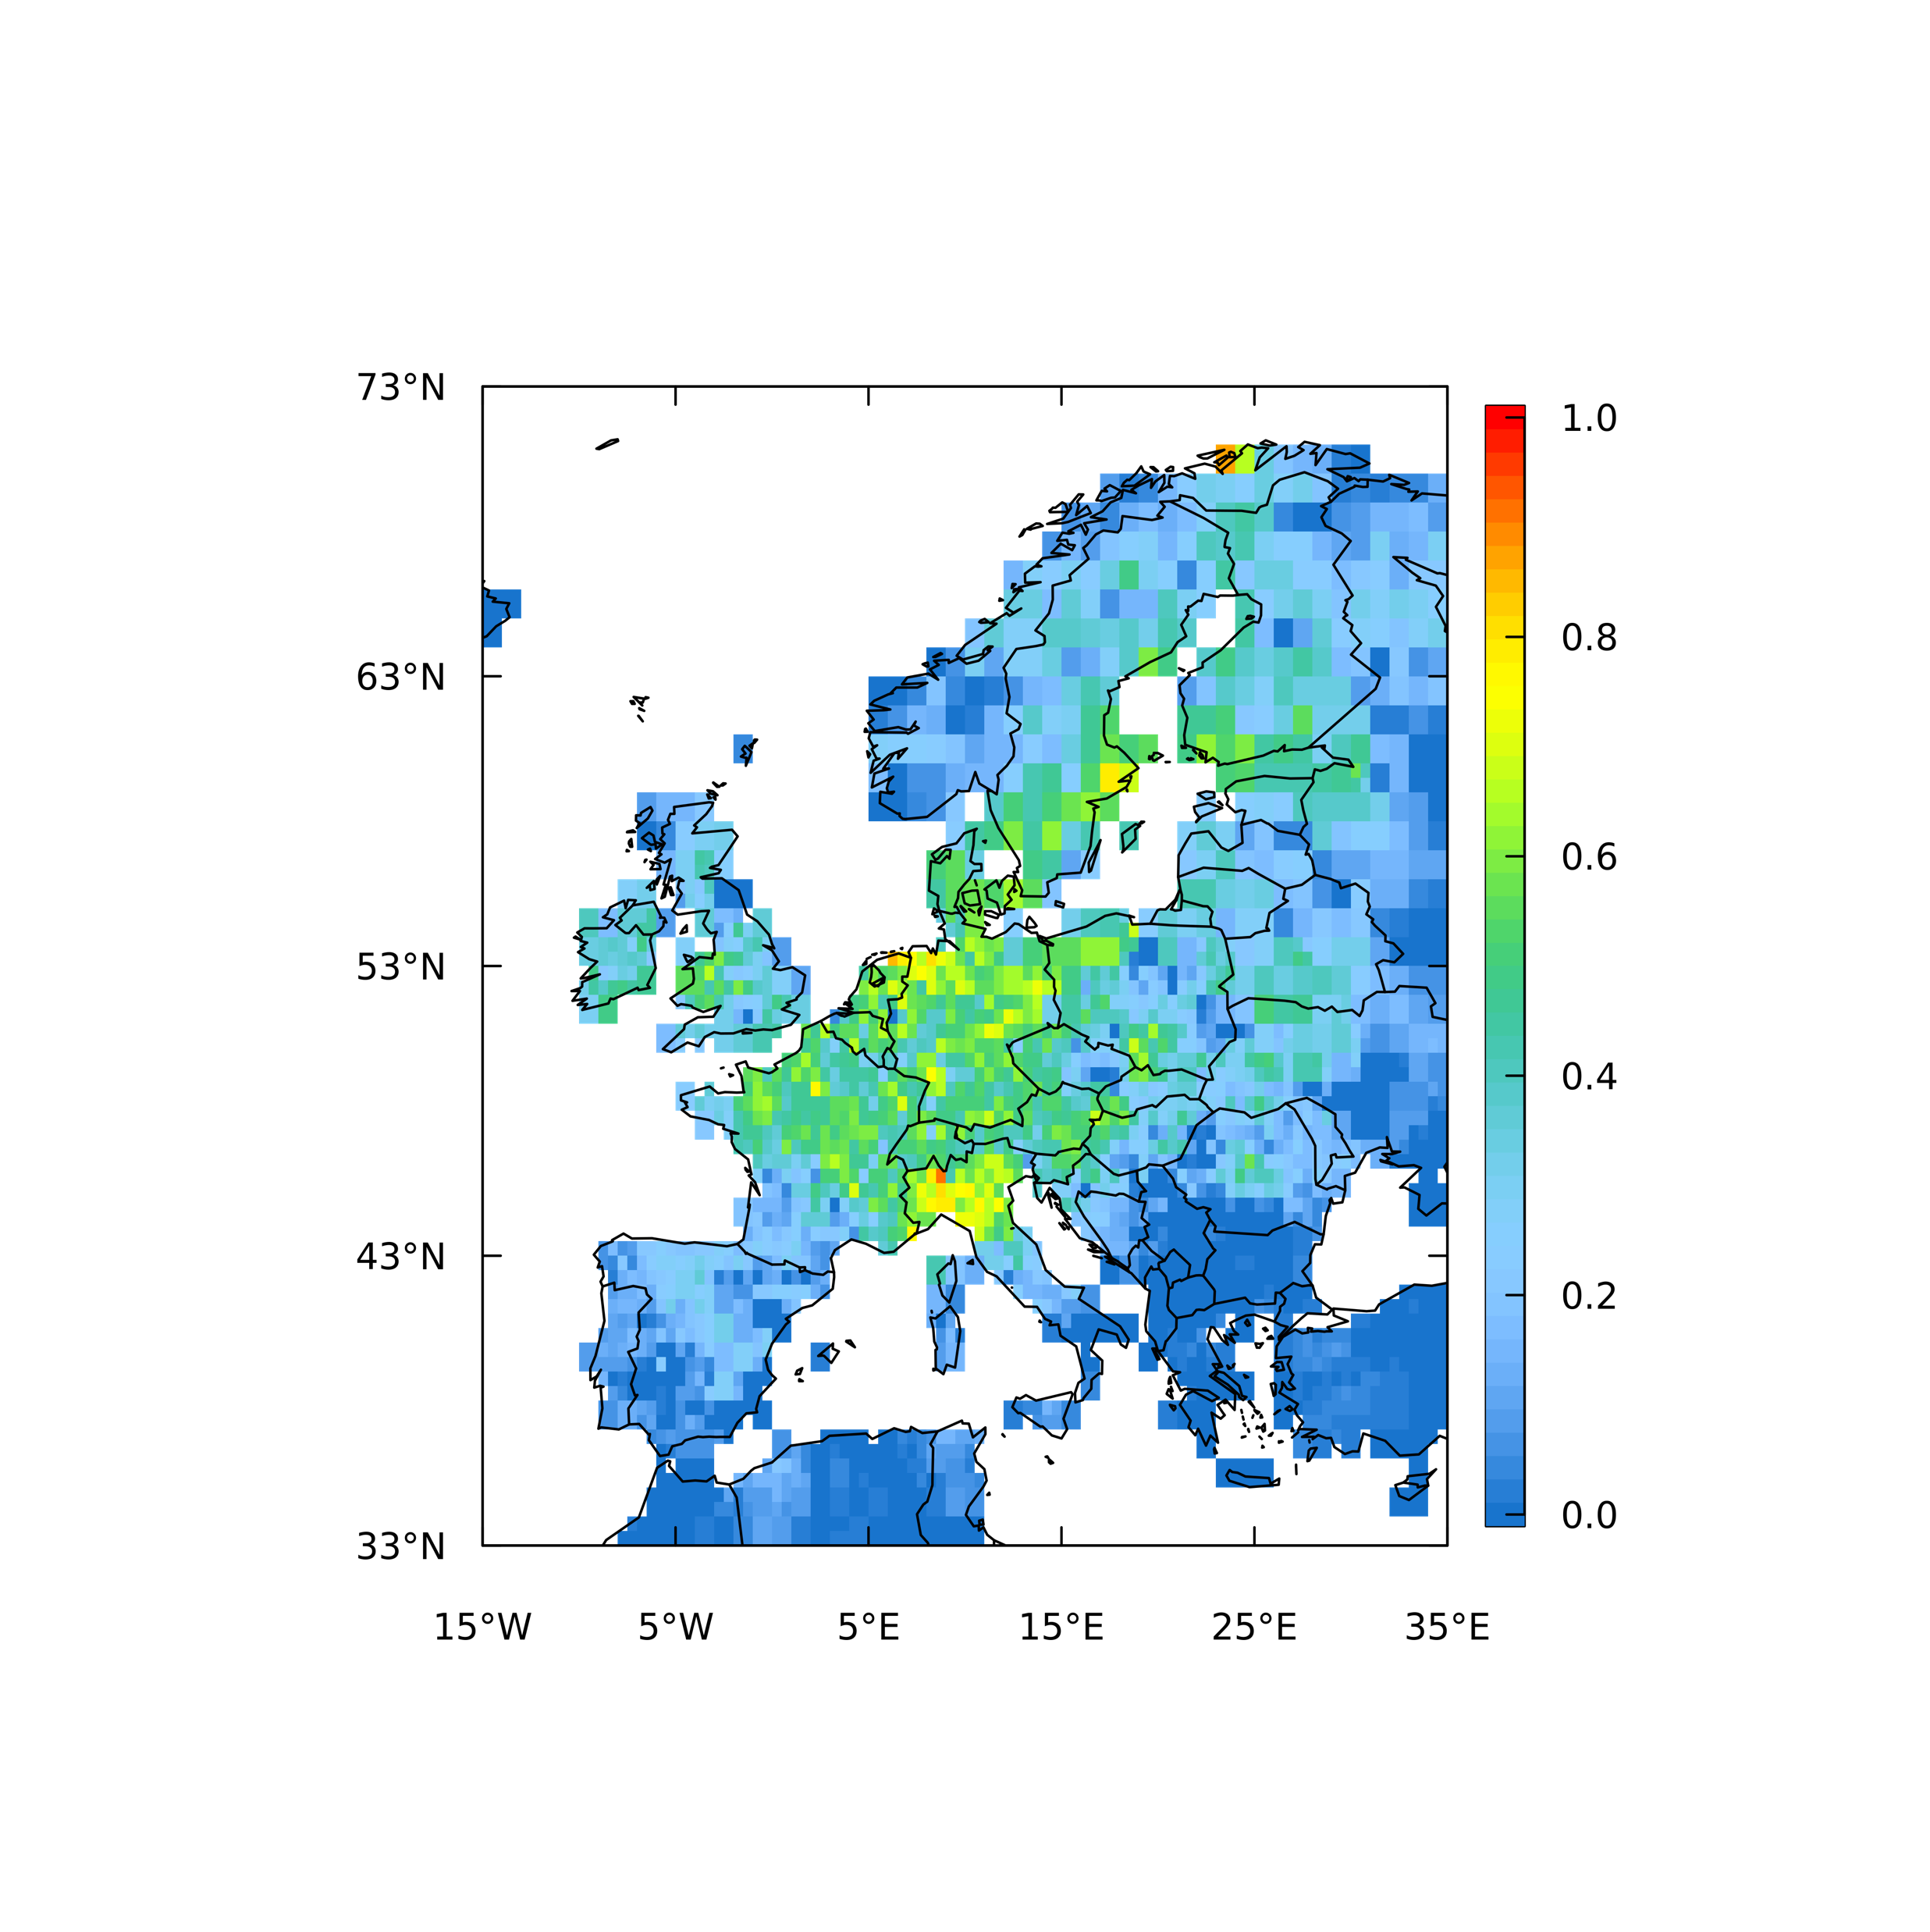
Methane inversions
Uncertainty reduction (1 - σ_{post}/ σ_{prior}) for different retrievals and compared to the ground-based ICOS network (summer). Poor coverage by satellite observations over the high northern latitudes even in summer (due largely to cloud) means there is little constraint provided on fluxes there
Official
WFMD
S5P-BLND
ICOS
Source: Rona Thompson (NILU)

Slide 12
Land use, land-use change, and forestry

Slide 13
LULUCF emissions much more uncertain
There are regular revisions in LULUCF estimates, despite using the NFI as the baseline data The last 1-5 years is much harder to estimate as the annual NFI covers 20% of plots
Data: Multiple releases of UNFCCC official GHG emission inventories

Slide 14
LULUCF emissions much more uncertain
Compared to Land-Surface Models (LSMs) in the ‘TRENDY’ simulations, with full land history and climate (S3), the Norwegian LULUCF estimates look consistent, though with large variability and uncertainties
Source: CoCO2 Deliverable 8.3

Slide 15
LULUCF emissions much more uncertain
Bookkeeping Models (BMs) with preindustrial accounting and land-use transitions, give much higher emissions (brown), suggesting the Norwegian sink is dominated by climate and CO₂ fertilization.
Potential climate and fertilisation effect
Source: CoCO2 Deliverable 8.3

Slide 16
LULUCF emissions much more uncertain
Global inversions (Global Carbon Budget) are broadly consistent with the Norwegian LULUCF estimates, but uncertainties are too large to have any confidence (Norway is too small relative to global inversions)
Source: CoCO2 Deliverable 8.3

Slide 17
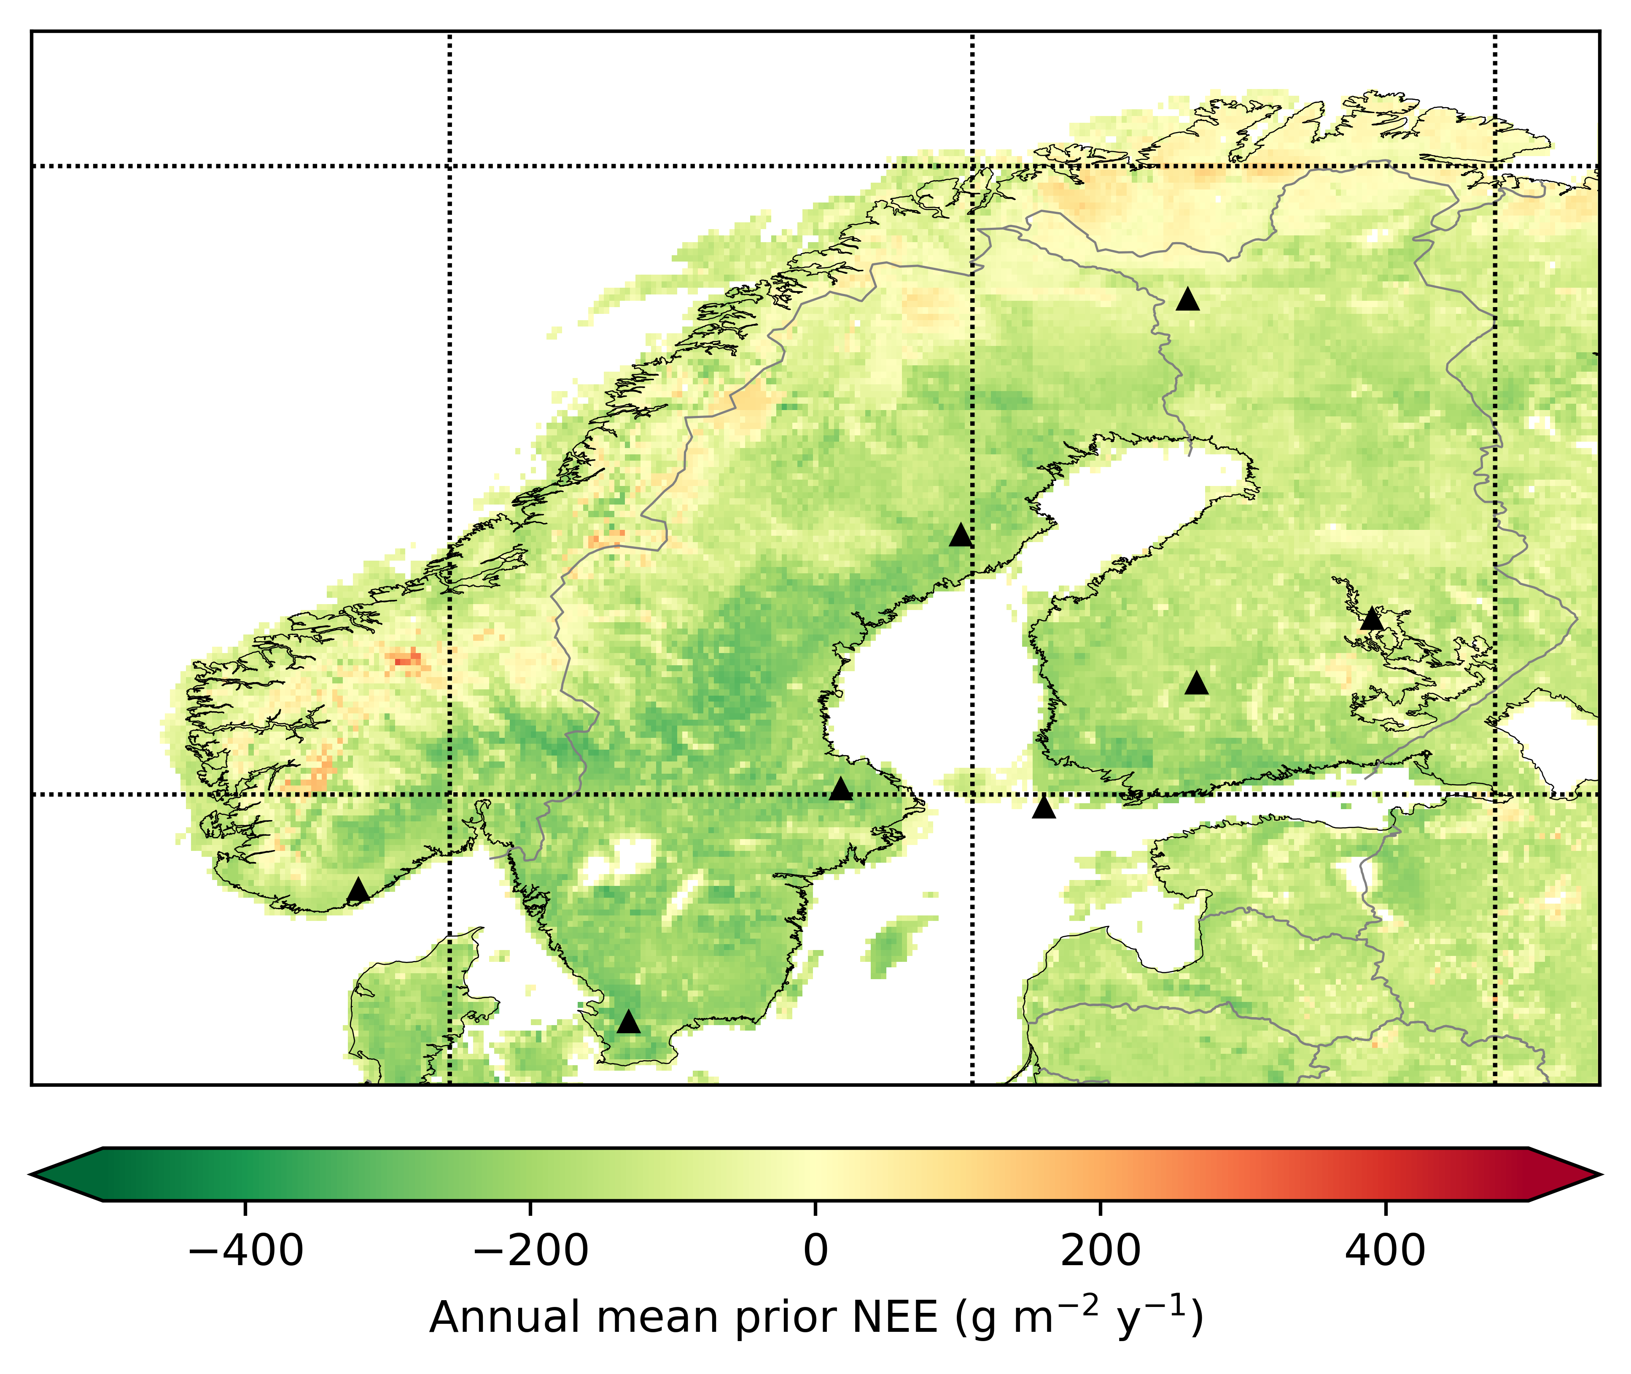
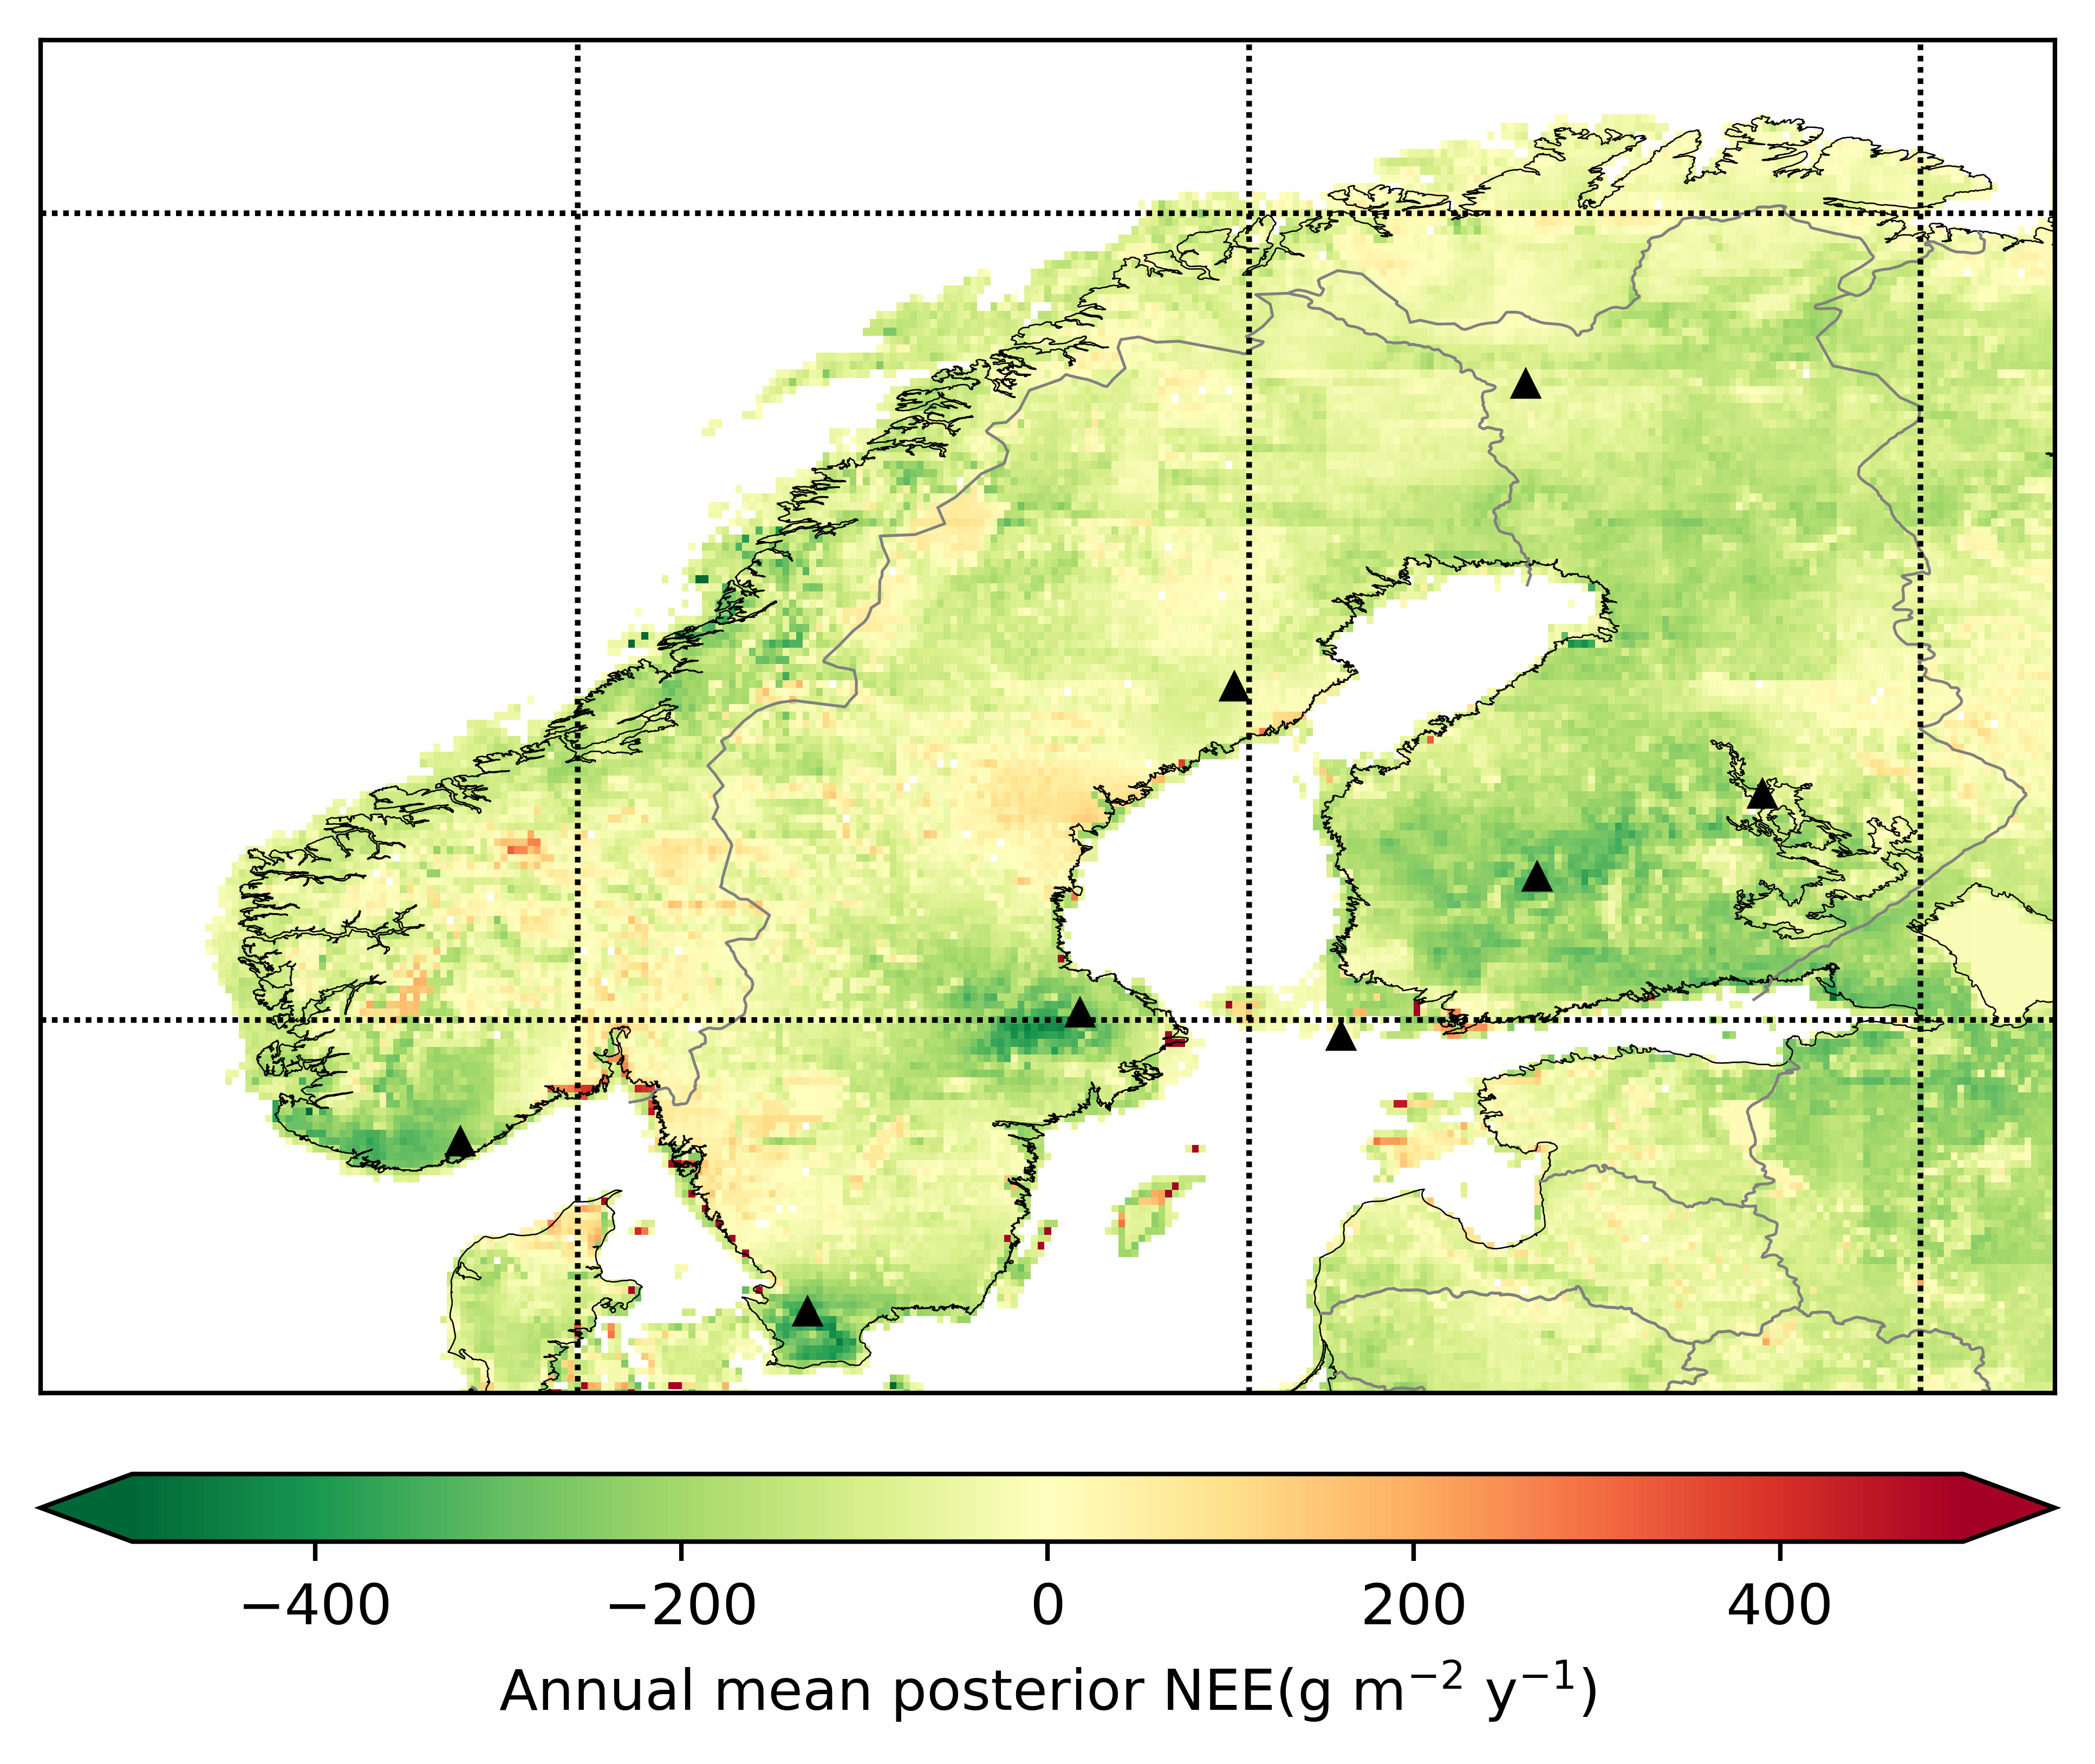
Regional inversions
Example of a regional inversion of the Net Ecosystem Exchange (NEE) in 2022 from ICOS-Norway
Prior
Posterior
Prior NEE based on the Community Land Model (CLM)
Posterior flux estimates from monthly inversions with FLEXPART & FLEXINVERT based on observations from the ICOS network (triangles)
Source: Christine Zwaaftink (NILU)
Notes:
Green colours carbon sink, red colours carbon source.
In coastal Norway and northern latitudes the inversion indicate the ecosystems are a larger sink than expected.
In southern Scandinavia, uptake is limited and some areas even become a source.
Preliminary results, preparing updates of these maps based on additional data from the ecosystem station Hurdal near Oslo.
Iris tried to split NEE from unmanaged land vs managed land, this was not exactly possible due to the setup of the CLM model. Her estimates indicate a contribution of unmanaged land (bare soil) <1% of total.

Slide 18
QA/QC and verification

Slide 19
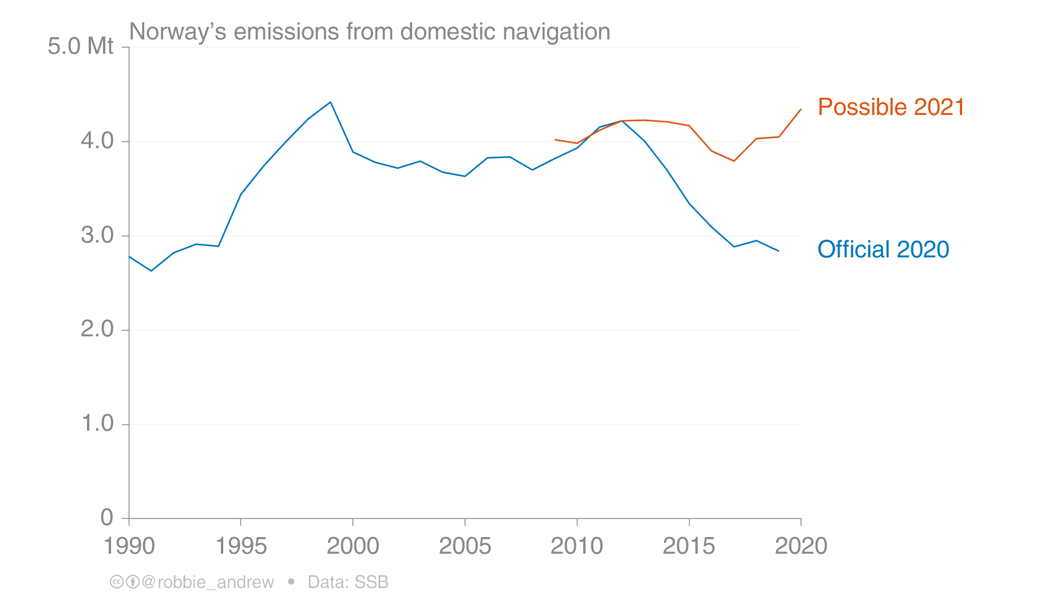
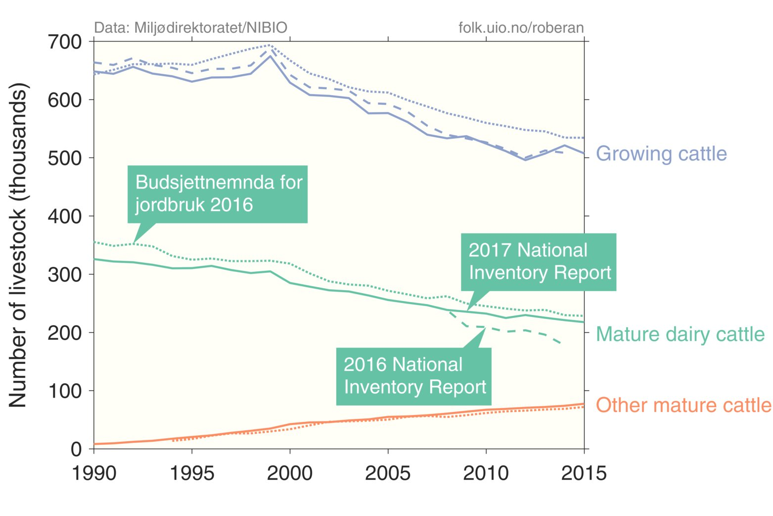
Sector-level “QA/QV and verification” important
Mistakes always creep in, because of changes in data sources, changes in personnel, scientific understanding, … The value of careful analysis of GHG inventory data, against other statistical sources, cannot be underestimated!
Left: A change in where the data was sourced led to an oversight, with some data not reported (but assumed reported). Right: A misunderstanding between the dairy cooperative and statistical agency led to an underreporting of the number of dairy cattle.

Slide 20
https://coco2-project.eu/node/406
https://coco2-project.eu/node/408

Slide 21
Norwegian roadmap for CO2M/CO2MVS

Slide 22
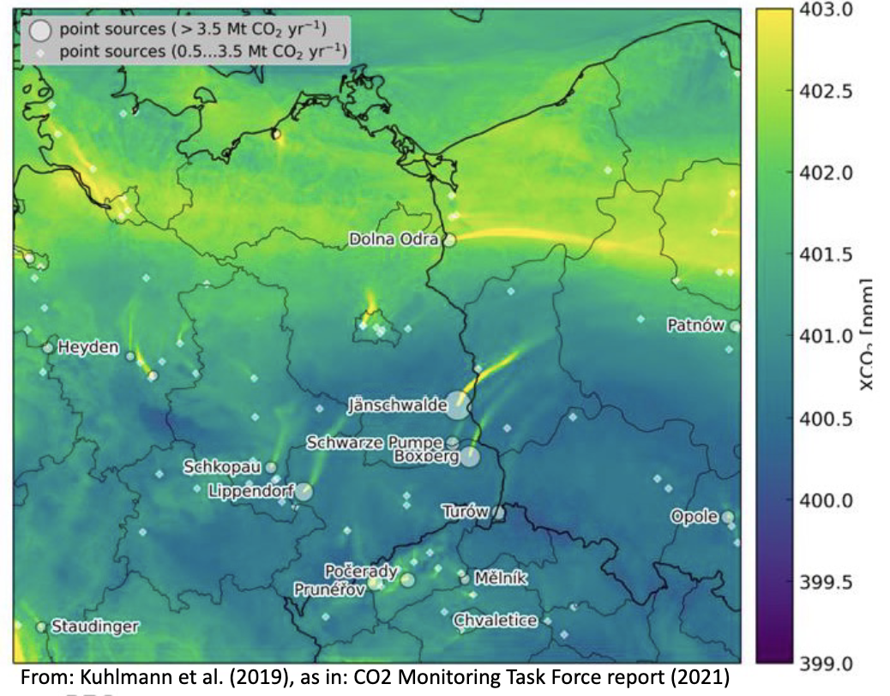
What is so special about Norway?
Less data during winter, in the dark months. Clouds. Topography.
Globally significant carbon storage in forests, marsh-land and arctic permafrost, but diffuse emission sources
Few large point sources, and often in challenging locations:
Offshore
Coastal
Between mountains (fjords)
Several government institutions and research centers involved in GHG emissions reporting and data collection
→ Need to prepare for local data applications to ensure user uptake
www.equinor.com/no/what-we-do/norwegian-continental-shelf-platforms/gullfaks.html
22
www.hydro.com/no-NO/om-hydro/hydro-locations-worldwide/europe/norway/sunndal/

Slide 23
Open call: A Norwegian roadmap to assess…
CO2M data availability, resolution and quality in Norway, land and ocean. Cal/Val needs.
Current and potential utilization for CO2M and similar data in Norway, within research, inventory, and commercial sectors
How CO2M data will/may/should be implemented in national and international reporting
User needs and commercial potential
Development of Norwegian services, data access
Recommendations:
Feasibility studies
Emission reporting
Service development

Slide 24
Norwegian roadmap for CO2M/CO2MVS (delivered by NILU/CICERO)
Key points
Mapped potential users
Challenges given small emissions & high latitude
Initial applications likely in research
Need to build competence across all elements of CO2MVS
Case studies focussing on applications in Norway
Need a meeting place

Slide 25
Summary

Slide 26
Verification of Norwegian GHG emissions
Norway currently does not have verification of national totals with independent data
All sectors / categories have elements of “QA/QC and verification”
Inventory compilers are often interested in specific uncertainties (e.g., F-gases, landfills, etc)
Comparisons with third-party inventories or data sources have potential, but national GHG inventories are usually best in class (Tier 3, well-resourced & operational groups)
Observation-based approaches are constrained in Norway
Sparse data (no F-gas measurements, insufficient in-situ CH₄ and CO₂ observations)
Remote sensing products challenging due to high latitude and cloud cover
Active research community working on observation-based verification
Support needed to develop operational approaches

Slide 27
Thank you
The EYE-CLIMA project has received funding from the European Union’s Horizon Europe Research and Innovation Programme under grant agreement No 101081395.
Glen Peters
CICERO Center for International Climate Research Oslo, Norway
@Peters_Glen, BlueSky: glenpeters.bsky.social

