Slide 1
Improving the UK GHG Inventory
Onoriode Esegbue
DESNZ, UK
Agenda Item 6.4

Slide 2
Content
Introduction
Drivers of Strategic Approach
In-depth Review
Improvement Programme
Verification Programme
GEMMA Programme
Digital Upgrade Programme
Conclusion

Slide 3
Introduction
The Inventory system is over 20 years old
Need significant improvement
The inventory has been shaped by an improvement programme which identifies methodological and data improvements to the quantification of emissions.
Previously, improvements to the GHGI are:
  proposed annually by contractors responsible for compiling the Inventory.
  recommended by expert review teams that undertake routine review of the GHGI for the UNFCCC; and
  put forward by stakeholders of the National Inventory Steering Committee (NISC).
We procure series of relatively small improvements projects yearly
UK Committee on Climate Change (2017)
“The methodology for constructing the GHG Inventory is rigorous but the process for identifying improvements could be strengthened.”
In addition, the CCC recommended that, “the process for prioritising improvements should be more transparent and should have a stronger focus on sources that contribute a large proportion of uncertainty and priorities needed for policy development.”
How do we futureproof the UK GHGI?

Slide 4
Drivers of Strategic Approach
Digital
Science & Technology
Evolving policy
GHG
Inventory
Changing emissions landscape
New sources & sinks

Slide 5












In-Depth Review
Energy
IPPU
Waste
LULUCF
All experts are UNFCCC accredited and don’t work on the UK GHG inventory. The in-depth review went way more than compliance. The reviewers looked into much more detail than would normally be done during a UNFCCC review, and also gave recommendations looking at future-proofing and developing methods that go beyond UNFCCC compliance.
Methodologies and data improvement focused on sectors/sub sectors which are either large, expected to be proportionally large in the 2030s and 2040s.
Where possible, recommendations is aggregated at sectorial level.
Improvement completed through the dedicated GHGIIP.
Ole-Kenneth Nielsen
Ils Moorkens & Juan Correa Laguna
Mark Hunstone
Alexandria Murray
Ole-Kenneth Nielsen
Julien Vincent
Barbara Gschrey
José Manuel Ramírez García
Sandro federici
Christian Böttcher
Sirintornthep Towprayoon
Hans Joosten
Prof. Dario Gomez
Hans Oonk

Slide 6







Improvement Programme
2022
2023
2024
2025
Key
Q4
Q1
Q2
Q3
Q4
Q1
Q2
Q3
Q4
Q1
Improvement projects (Batch 1)
P1. Biomass
Improvement projects (Batch 2)
P2. Fuels
Improvement projects (Batch 3)
P3A. Shipping
P4. Hydrogen
Quarterly steering group and technical board
P5a. Peat
P5b. Wildfires
P5c. Soil model
Programme update to NISC
P6. Uncertainty treatment
P7. Fugitive emissions
P8. DA Energy Balances
P9. CCUS
P10. Local Authority AD
P11. Pre 1950 LULUCF
P12. LULUCF EFs review
P13. Soil model testing
P14. DA improvements
P15. Waste Sector improvement
P16. Shipping

Slide 7
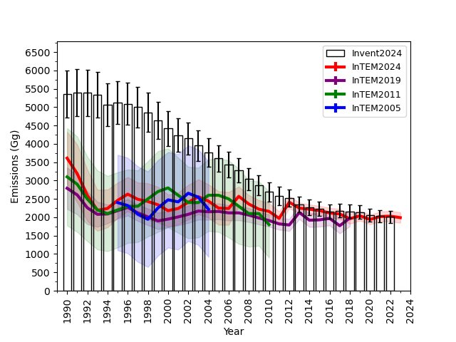
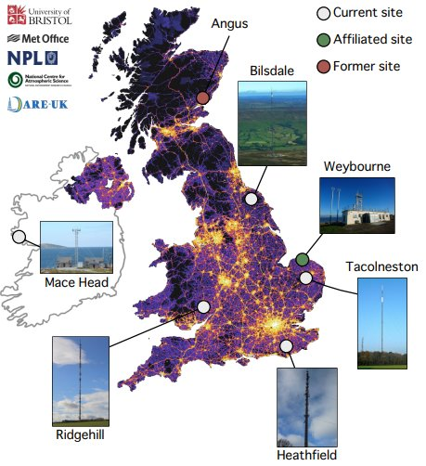
Verification Programme
Mis-match
Good Agreement
1990 – 2011; 2 sites used; Mace Head & Cabauw
2012-2023; 13 sites used.

Slide 8

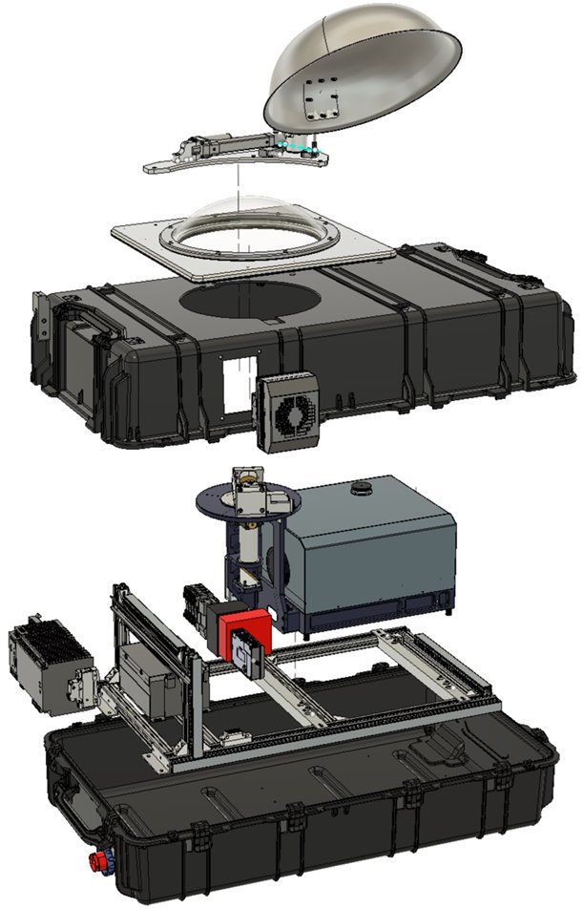




GEMMA Programme
Greenhouse Gas Emissions Measuring and Modelling advancement
Workstream​
WS1: Enhancement and expansion of the GHG in situ measurement network​
WS2: Deployment of ground-based remote sensing GHG capability​
WS3: Integration of space-based remote sensing GHG capability​
WS4: Integration of additional in-situ measurements​
WS5: Data harmonisation and quality assurance framework​
WS6: Data assimilation and inverse model integration​
WS7: Programme leadership, Stakeholder management and operational preparation​

Slide 9
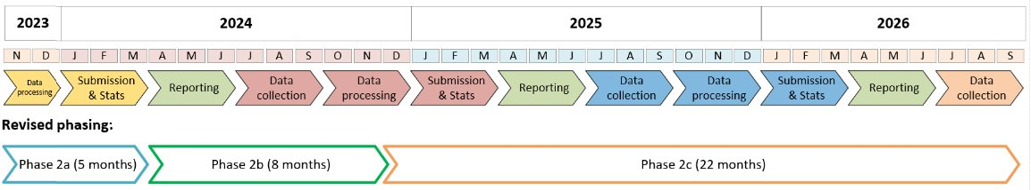
Digital Upgrade
Objective
Create a new platform with data tools that facilitate the efficient, flexible, transparent and traceable flow of information which supports National Atmospheric Emissions Inventory (NAEI) compilation from raw data to a single emissions database.
Phase 2a
Phase 2b
Phase 2c
Work Packages
Inventory Mapping
Schema Assessment
Solution Design
Validation
Work Packages
Platform Build
Model Process Design
Validation
Work packages
Model Translation
Documentation
Validation

Slide 10
Conclusion
Transparent, complete, and accurate GHG Inventory that is fit to track progress towards net-zero emissions.
Inventory with high-quality emissions estimates that can stand up to challenge and scrutiny.
Focus future improvements appropriately on key uncertainties and policy needs.
Expand Inventory delivery and assurance and help tackle uncertainty.
Reduce delivery risk, improve transparency and provide value for money.
Support appropriate use of the GHGI emissions estimates in the assessment of progress against net-zero emission targets and policy.
Co-produce GHGI research programmes with research funders, to generate the fundamental and translational evidence and data needed to estimate emissions.

