Slide 1




Global greenhouse gas reconciliation :
UNFCCC national greenhouse gas inventories and atmospheric inversions
Philippe Ciais
Laboratoire des Sciences du Climat et de l’Environnement
Zhu Deng
Tsinghua University

Slide 2
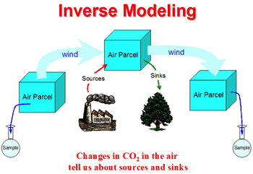
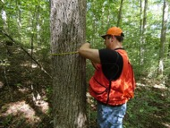

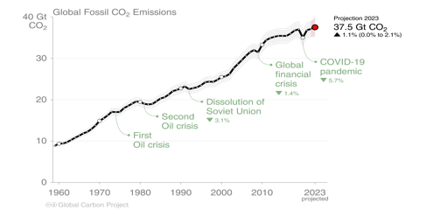
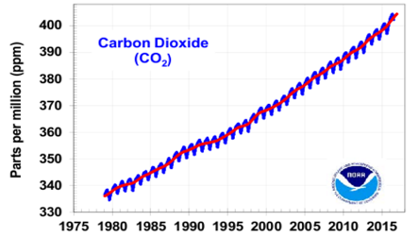
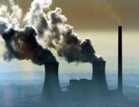
Bottom-up and top-down
National inventories NGHGIs
GHG emissions and sinks: activity data and emission factors
energy use data, biomass and soil C stock change national data and models …
Atmospheric inversions
GHG emissions and sinks :
prior flux maps, concentration measurements, and transport models
Official data, based on IPCC Guidelines
Different tiers
Not all countries have inventories compliant with IPCC Guidelines
Voluntary, as a quality control of inventories
IPCC guidelines Chapter 6
Used by Switzerland, UK …

Slide 3
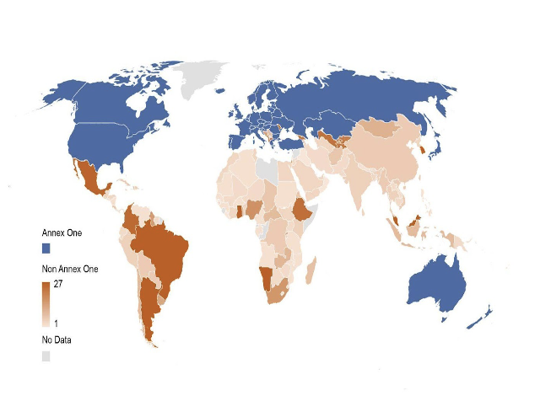
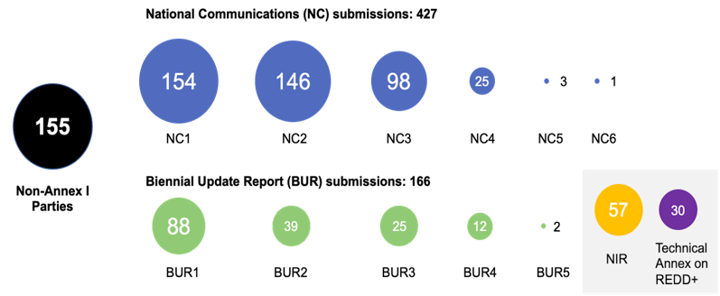
Compiling national reports
Many inventories lag behind time by up to 10 years
Number and progress of reporting submissions from non-Annex I parties
Number and progress of reporting submissions from non-Annex I parties

Slide 4
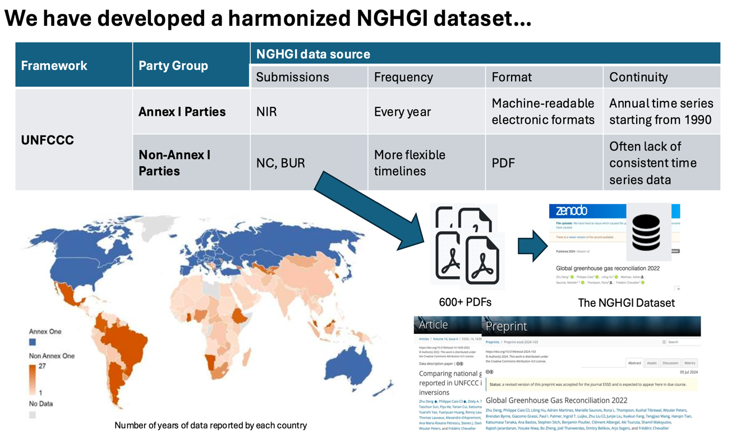

Slide 5
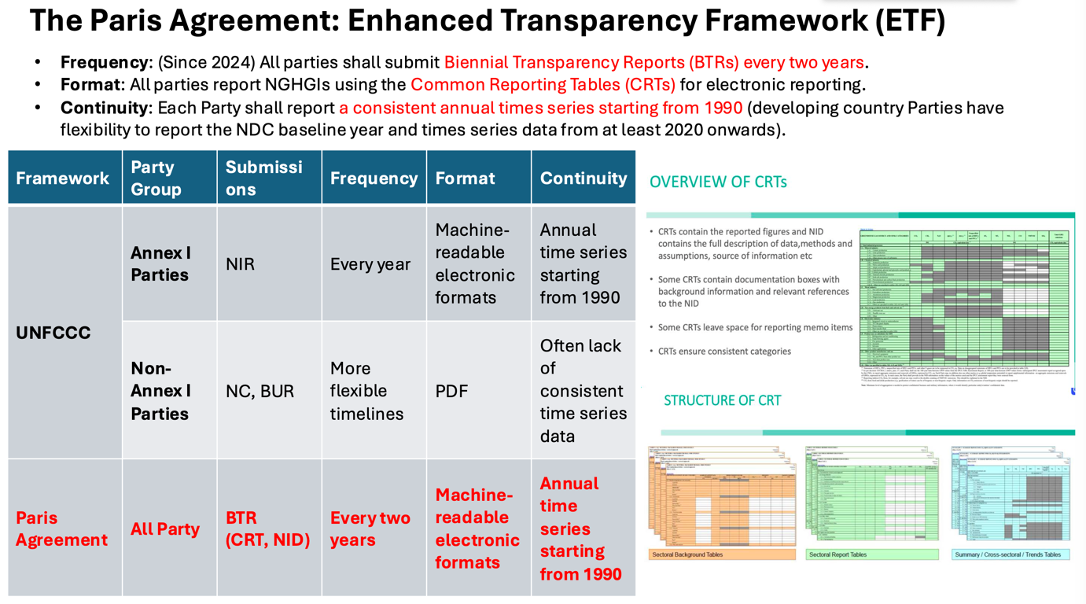

Slide 6
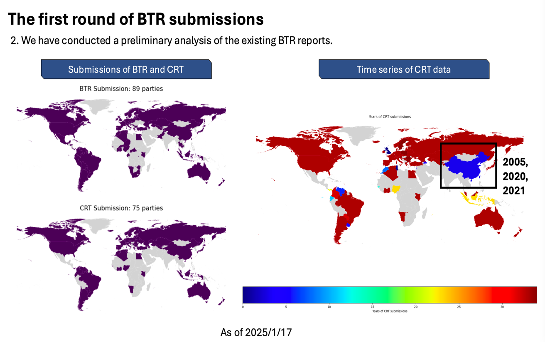

Slide 7
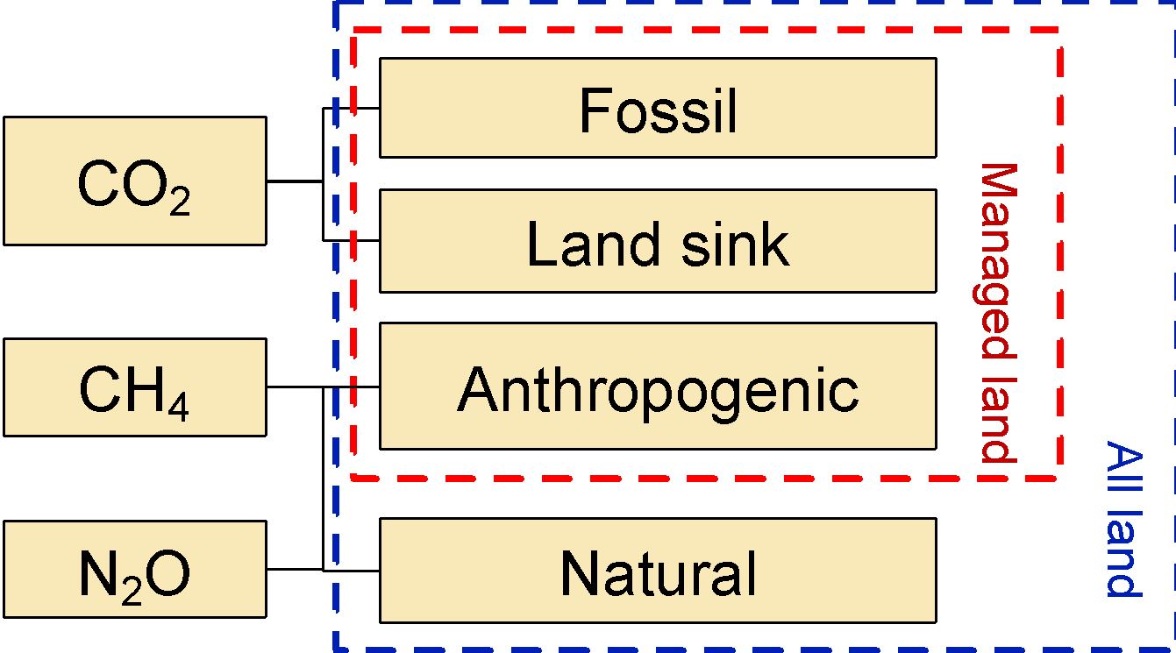

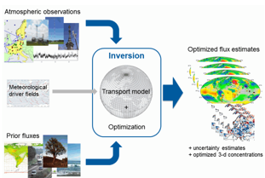






Processing inversions data to make them comparable to inventories
Data Sources
Flux Adjustment
Comparison
Annex I
(43，xlsx)
NGHGI
database
GHG
flux
in
key
sectors
NGHGIs
Non-Annex I
(154，pdf)
Scope: Greenhouse gas emissions and removals over managed land.
Extract land flux from managed land
Other adjustment (e.g., lateral flux)
Land CO2 Flux
(van der Laan-Luijkx et al, 2018)
Anthropogenic CH4 Flux
Atmospheric Inversion Models
Anthropogenic N2O Flux
Scope: GHG flux over all land.
Coordinated by Global Carbon Project

Slide 8
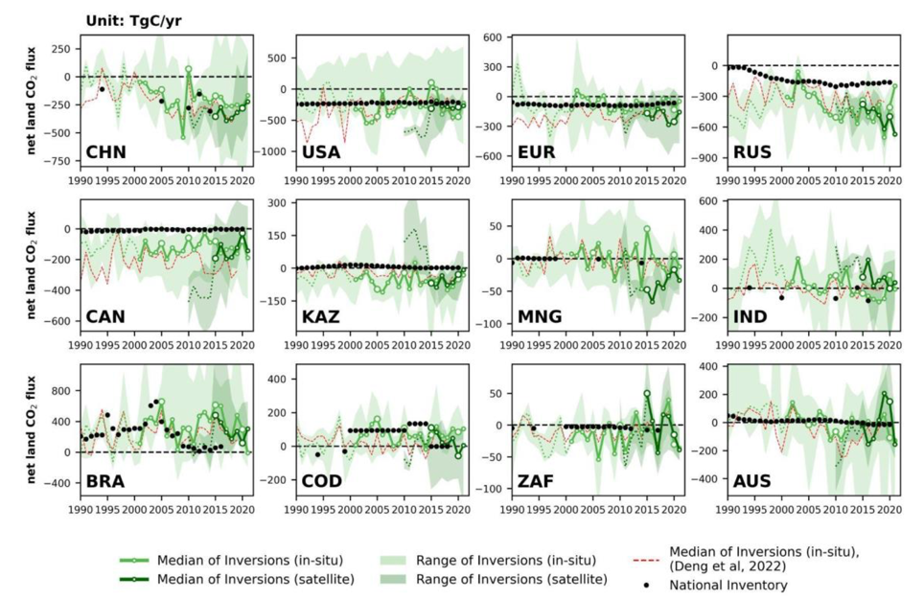
National net CO2 flux from land
Key findings:
More year on year changes in inversions than in inventories (inventories = multiyear mean)
Consistent year on year changes between satellite and surface inversions
Satellite inversion models have relatively smaller ranges than surface network inversions
Canada, Russia, EU, Kazakhstan : inversion C sink > inventories
Brazil, Indonesia, DRC: inversion C sink > inventories [but few atmospheric measurements]

Slide 9
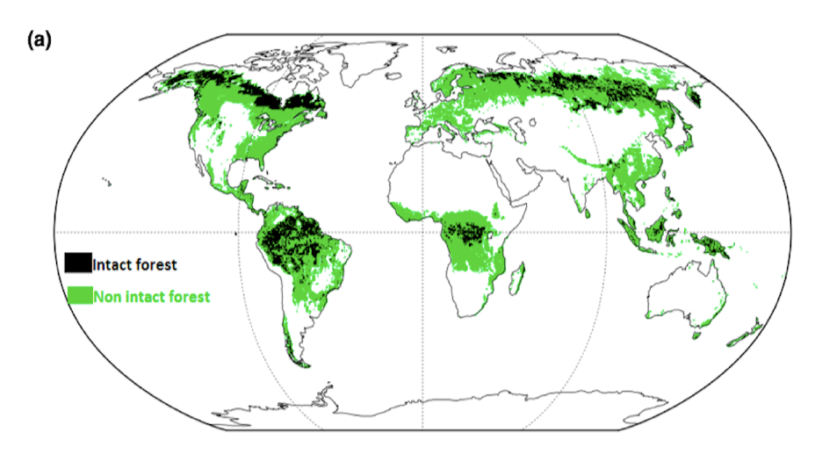
New map of managed land
unmanaged
Managed
Inventories only report fluxes over managed lands
So, inversions have to be sampled over managed lands

Slide 10
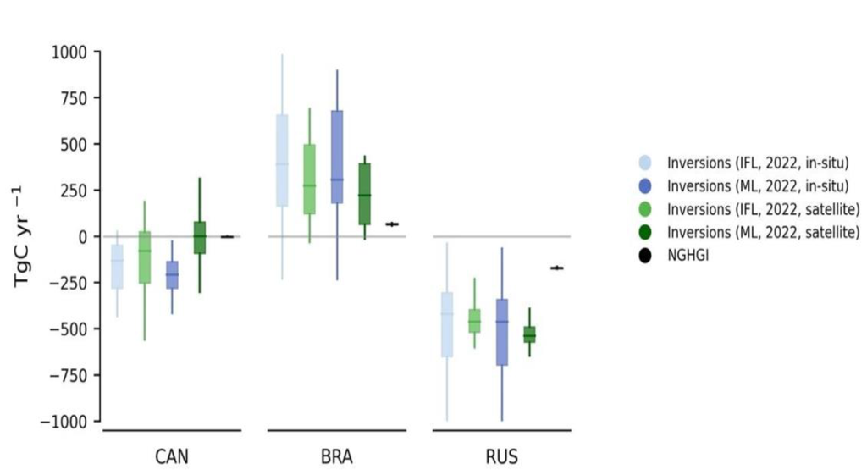
National net LULUCF carbon flux over managed land
Key findings:
[ Managed lands are larger sinks than unmanaged lands ]
Higher C emissions in inversions than inventories for Brazil [ possibly from natural disturbances and degradation ]
Higher C sink over managed by inversions than inventories for Canada, Russia

Slide 11
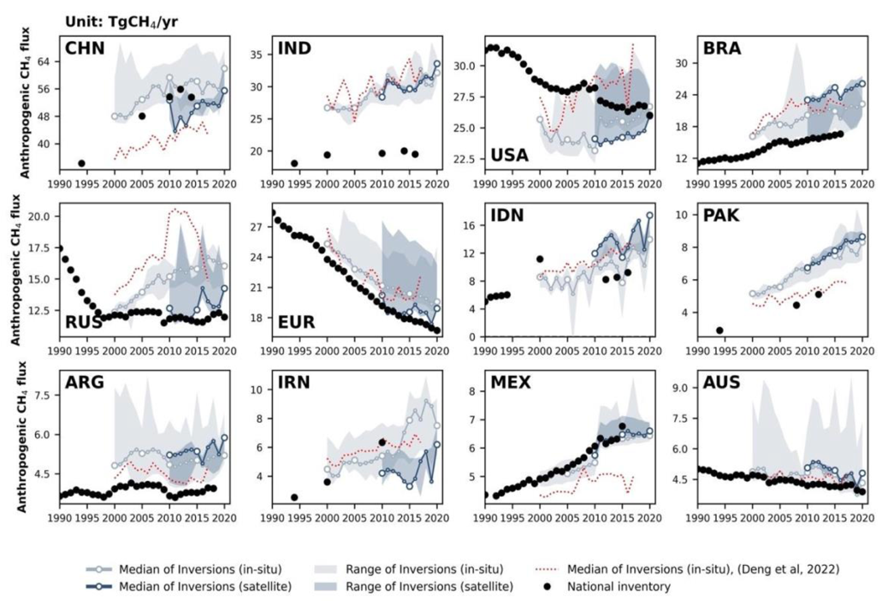
National CH₄ emissions
Key findings:
Uncertainties in separating natural and anthropogenic emissions in inversions
Underestimation of emissions by national reports in some countries : Persian Gulf region, India, Russia
Agreement between satellite and surface inversions for trends but inversion trends depend on priors (US case)

Slide 12

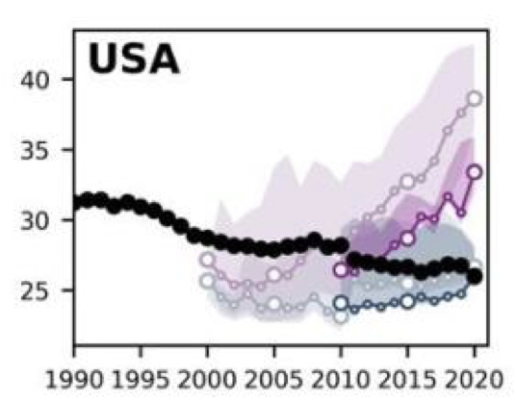
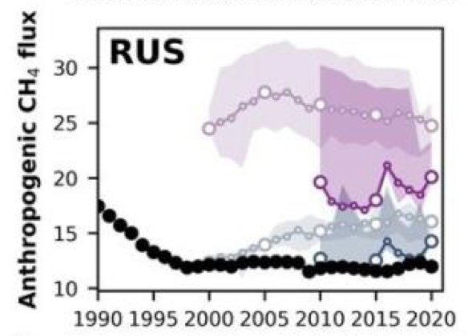
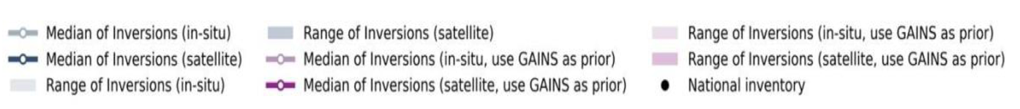
Influence of priors on CH₄ emissions from inversions in countries with large fossil emissions

Slide 13
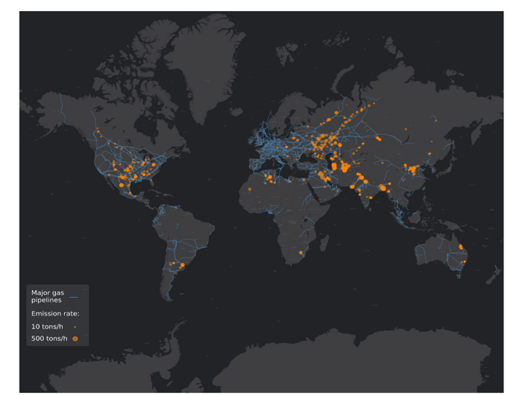
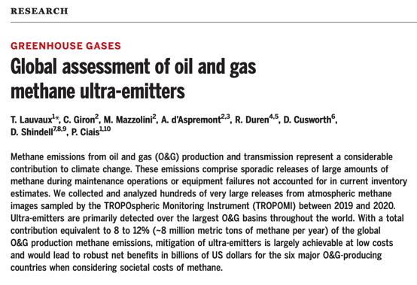


Sentinel-5P near-real time monitoring of large leaks
Only leaks larger than 20 tCH₄ per hour ≈ 5% of global emissions

Slide 14
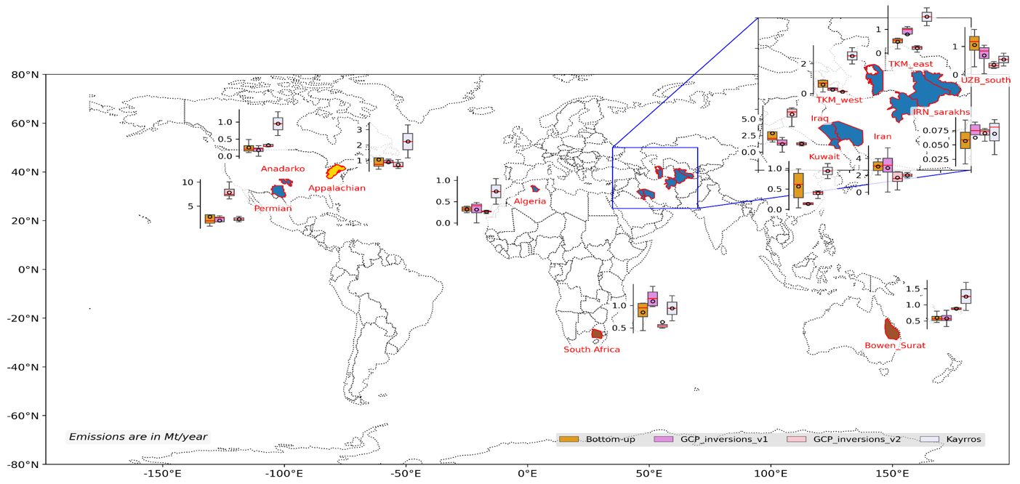
Methane emissions of major fossil fuel basins from TROPOMI images
These basins contribute ~20% to global methane emissions from fossil
Highest contributions from Permian, Appalachian, Iran, Iraq and Turkmenistan

Slide 15
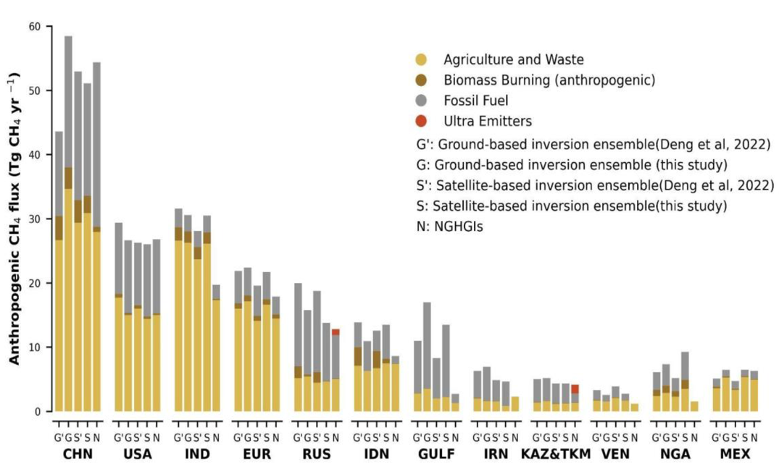
National anthropogenic CH₄ emissions
inversions
UNFCCC
inventories
Key findings:
Fair agreement between NGHGIs and inversions for most largest emitters
Consistency between surface and satellite inversions
Inversions emissions larger NGHGIs for Iran, Arabian Peninsula, India

Slide 16
Take home
National reports define the official data, now available in CRT format each 2 years for non Annex 1 countries
Inversions provide independent estimates of greenhouse gas emissions and removal
Atmospheric inversions help for the quality control of national reports
  Works better for large areas countries with global models
  Accuracy depends on surface network density ( no station in tropics )
  Satellites offer a more balanced sampling of all the countries
Need to carefully separate managed land and natural / anthropogenic emissions
Sensitivity of inversions to priors for fossil CH4 emissions
Potential to develop inversions with higher resolution for quality control of inventories
  Requires more accurate spatial maps of emissions from inventories (priors)
  Dense regional atmospheric networks combined with satellites

Slide 17
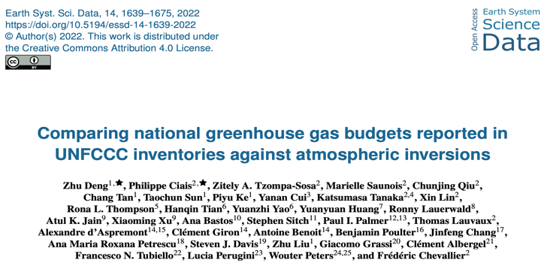
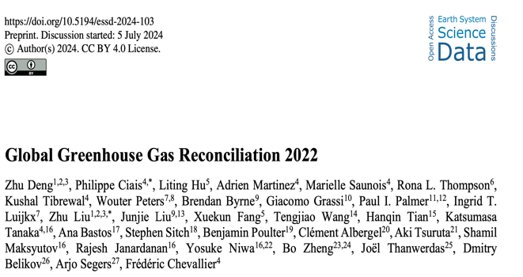
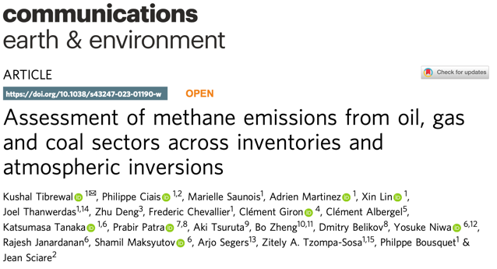
Recent publications

