Slide 1
GHG Budgets: results from RECCAP-2
Agenda Item 6.2

Slide 2
Take Home Message: RECCAP-2
By design, National Greenhouse Gas Inventories assess anthropogenic/managed emissions and removals and thus do not explain atmospheric GHG growth
Reconciling emissions and removals estimated by IPCC and other assessments is thus necessary for integrated understanding of GHG budgets
Climate-carbon feedbacks appear to have begun and the time to avoid exceeding remaining carbon budget is shrinking
RECCAP-2 aims to provide comprehensive, process-based attribution of GHG emissions and removals in a timely way
CEOS/CGMS can play a key role in identifying and sustaining key satellite products, algorithms, and strengthening partnerships at national and international (WMO G3W) scales

Slide 3
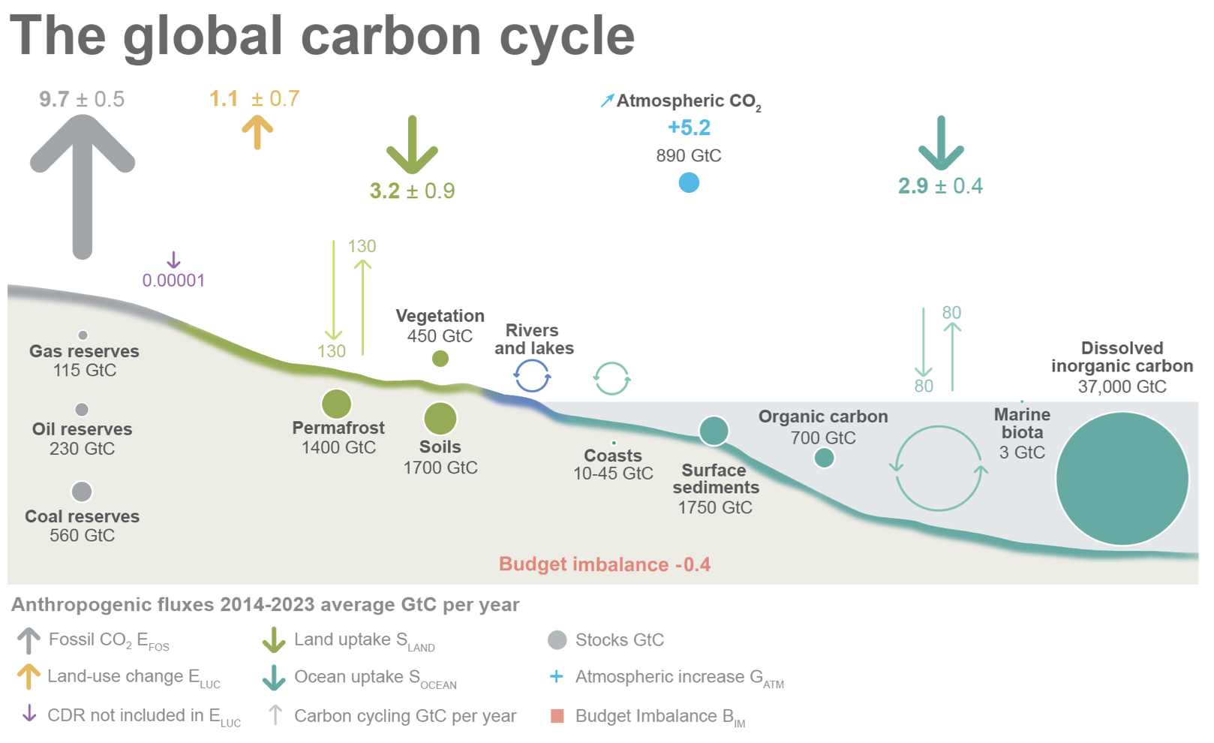
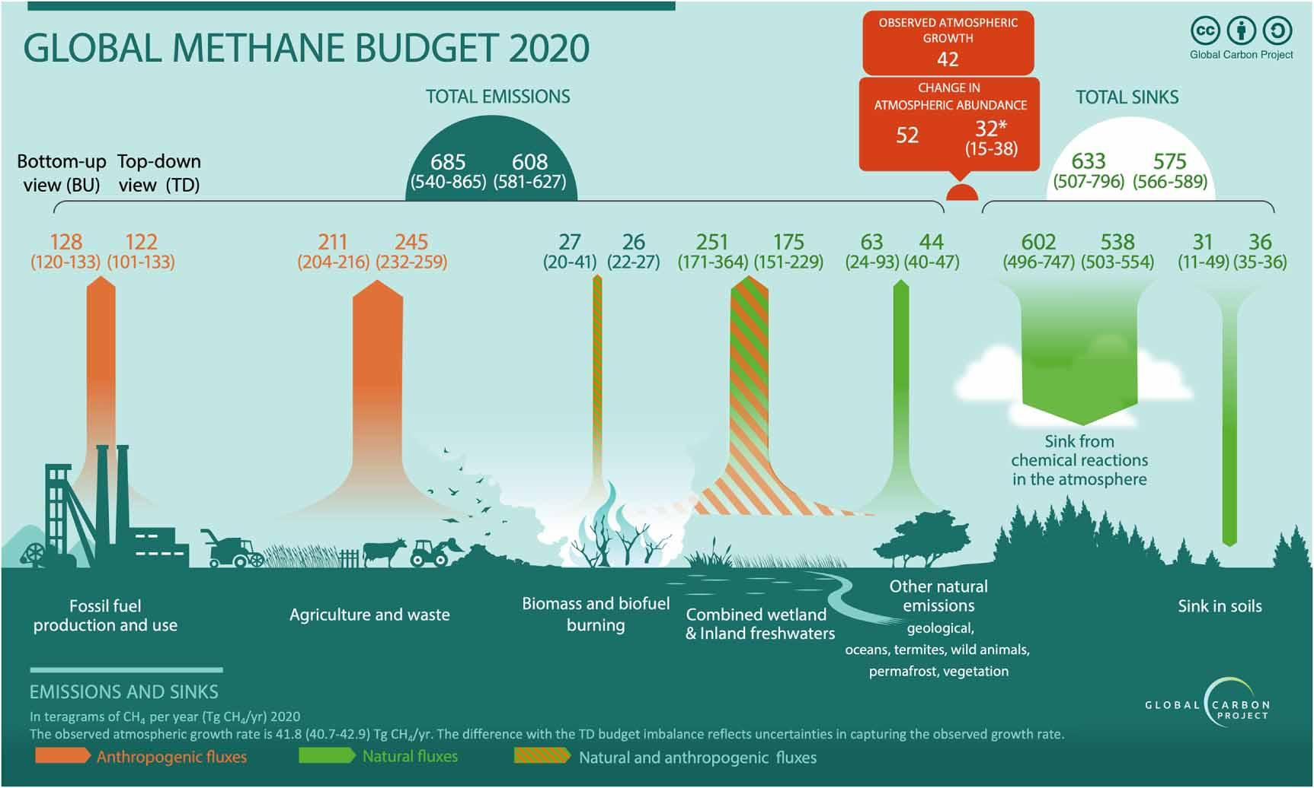
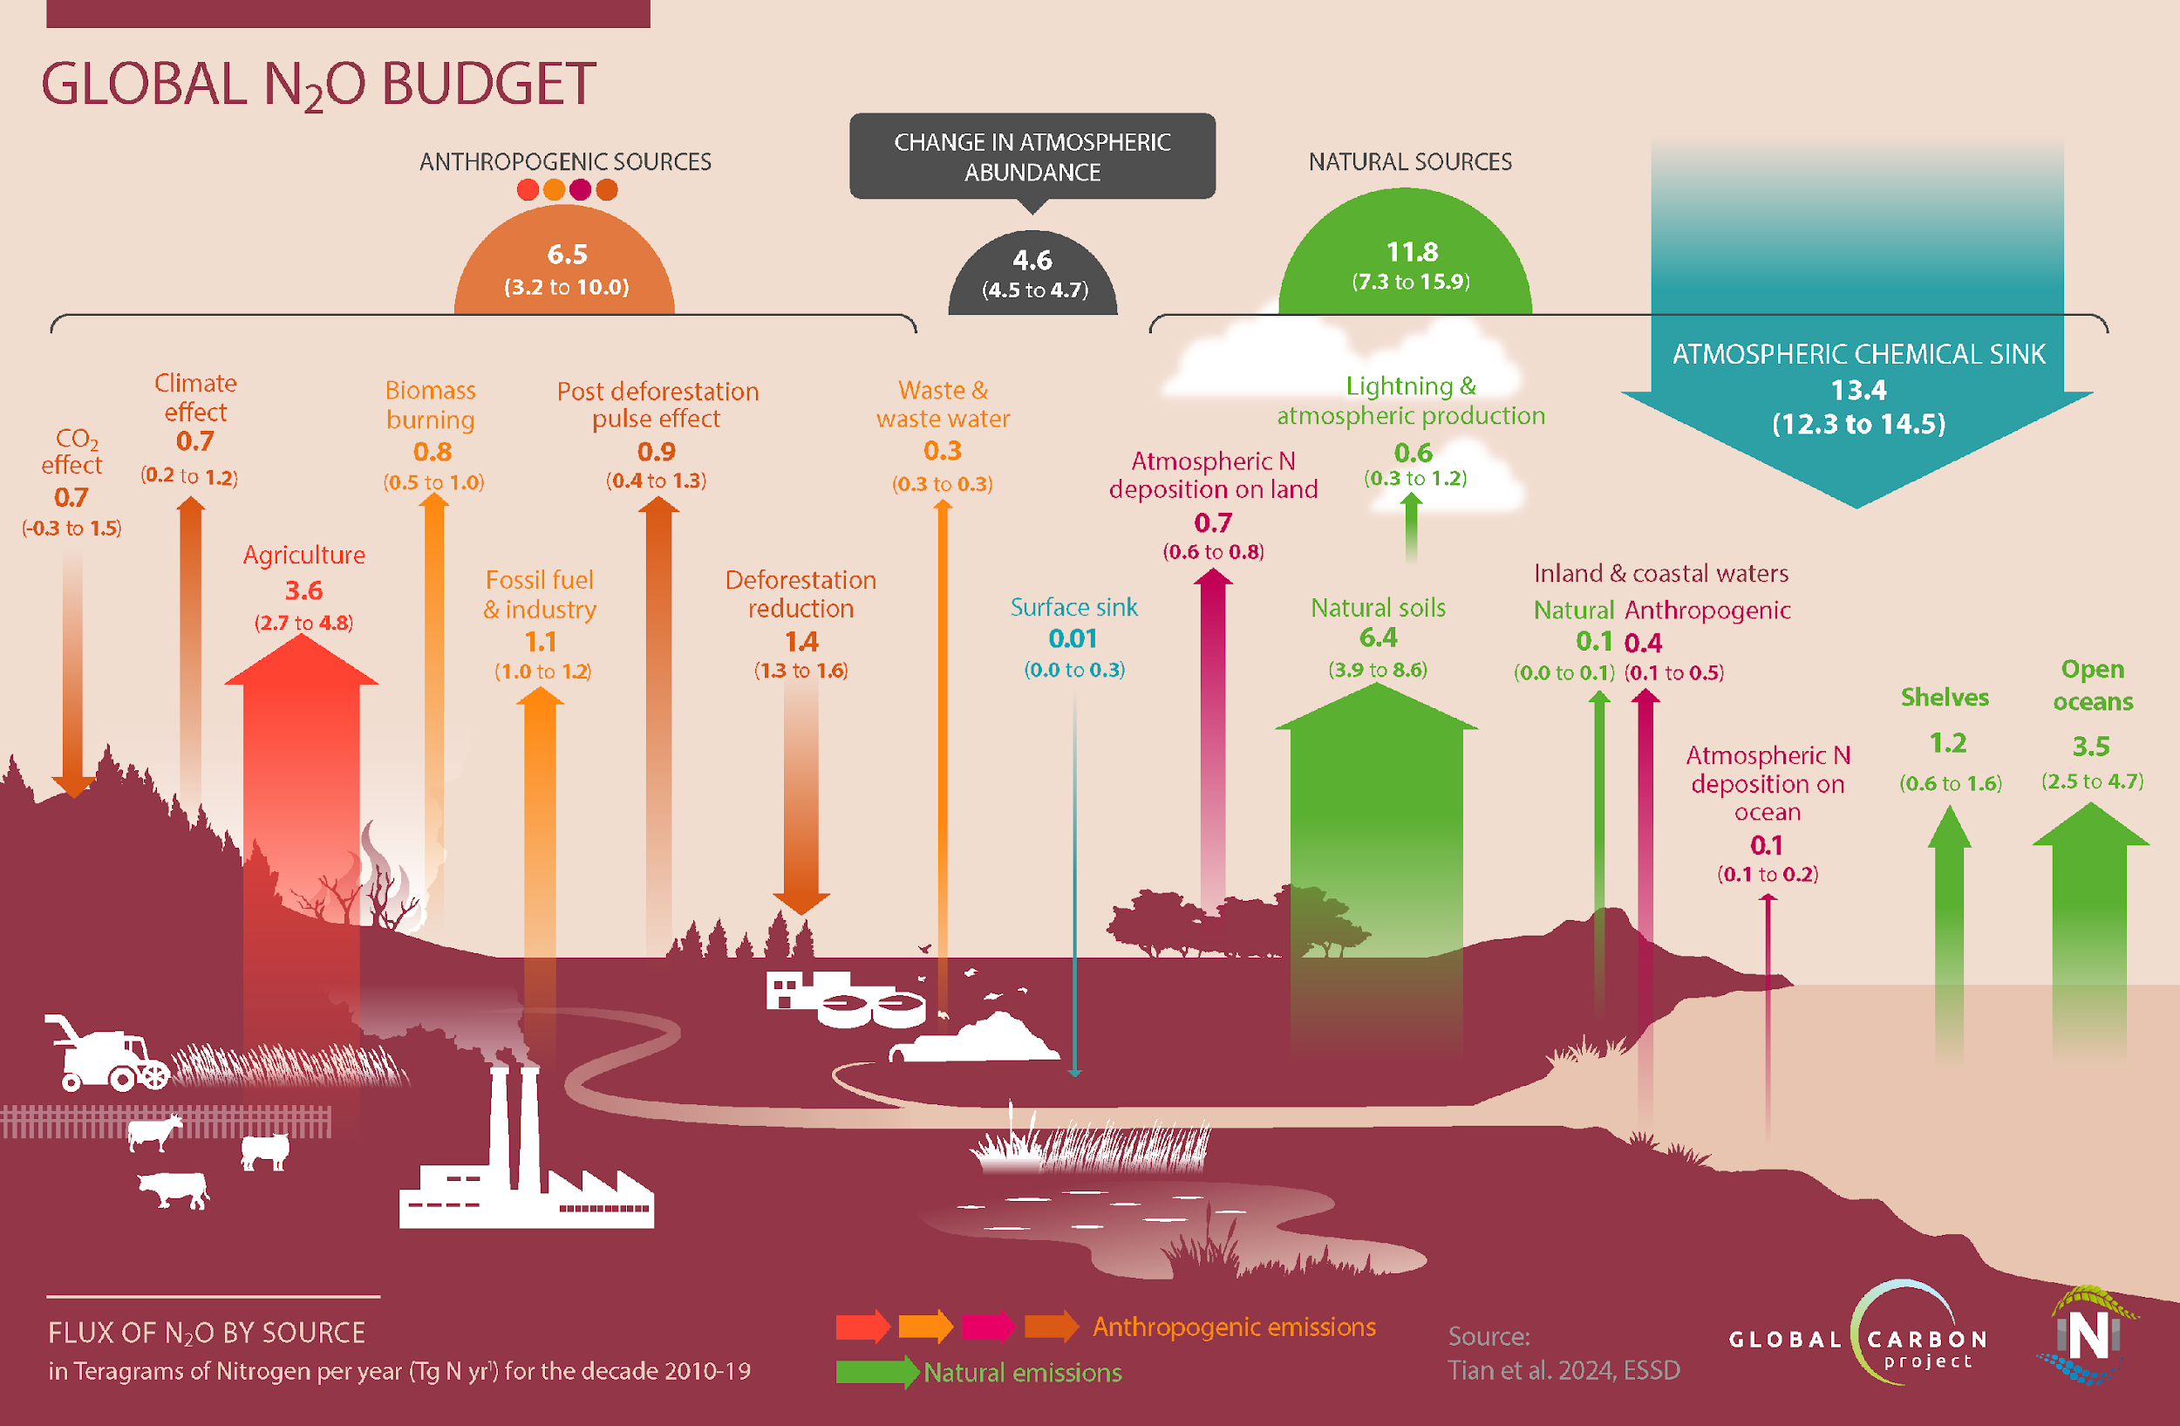
Key activities of GCP
Annual assessment of global carbon budget, trends in sources, remaining carbon budget to exceed 1.5-degrees warming
Five-year assessment of the global methane budget, deep dive into sources, sinks, uncertainties (role of wetlands)
Semi-annual nitrous oxide budget, now considered in recent super-pollutant assessments coordinated by UNEP & COP29
Reports are fundamental to annual WMO Bulletins, IPCC Assessment Reports, SOCCR-2
Friedlingstein et al., 2024
(Saunois et al., 2025)
(Tian et al., 2024)

Slide 4
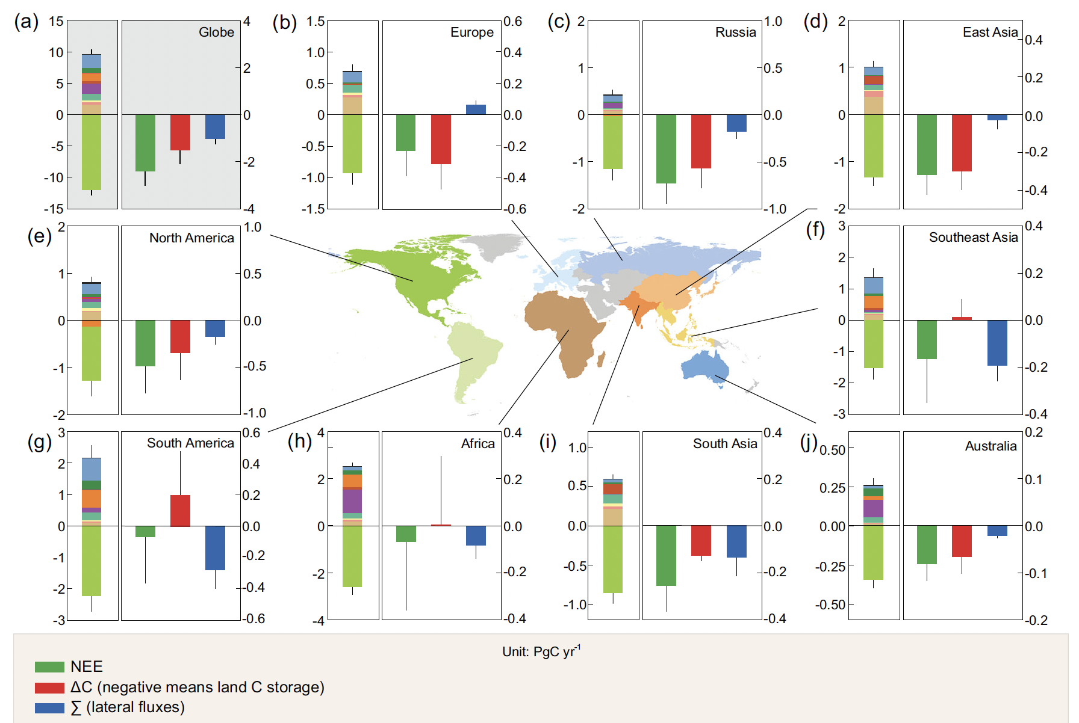
RECCAP-1 (1990-2009): key results
Reconciling TD and BU carbon budgets:
aquatic and trade lateral flows
impacts on heterotrophic respiration (smaller)
& climate-carbon feedbacks
(Ciais et al, 2021)

Slide 5
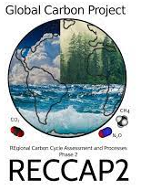
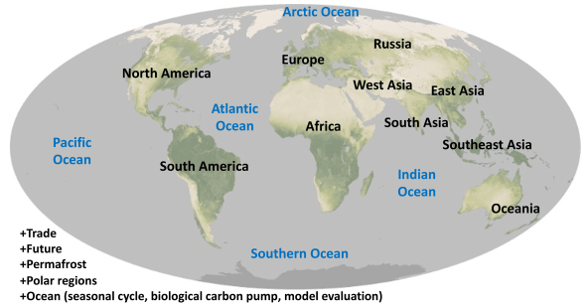
2nd REgional Carbon Cycle Assessment and Processes study (RECCAP2)
Proposed at the 10th International Carbon Dioxide Conference (ICDC) in fall of 2017, kick off in Gotemba, Japan (spring 2019)
Follow-up to RECCAP (1990-2009) CO₂ budgets
All 3 major greenhouse gases
Time period: 2010-2019
10 land regions & 5 ocean basins
Emphasis on lateral fluxes (inland waters, lateral transport, estuarine/coastal, continental shelf)
Special topics -> polar regions, permafrost, future GHGs
Flexibility in approach
Inventories, process-models, satellite-based data-driven models, atmospheric inversions
Involvement of ~200 people
(Poulter et al 2020)

Slide 6
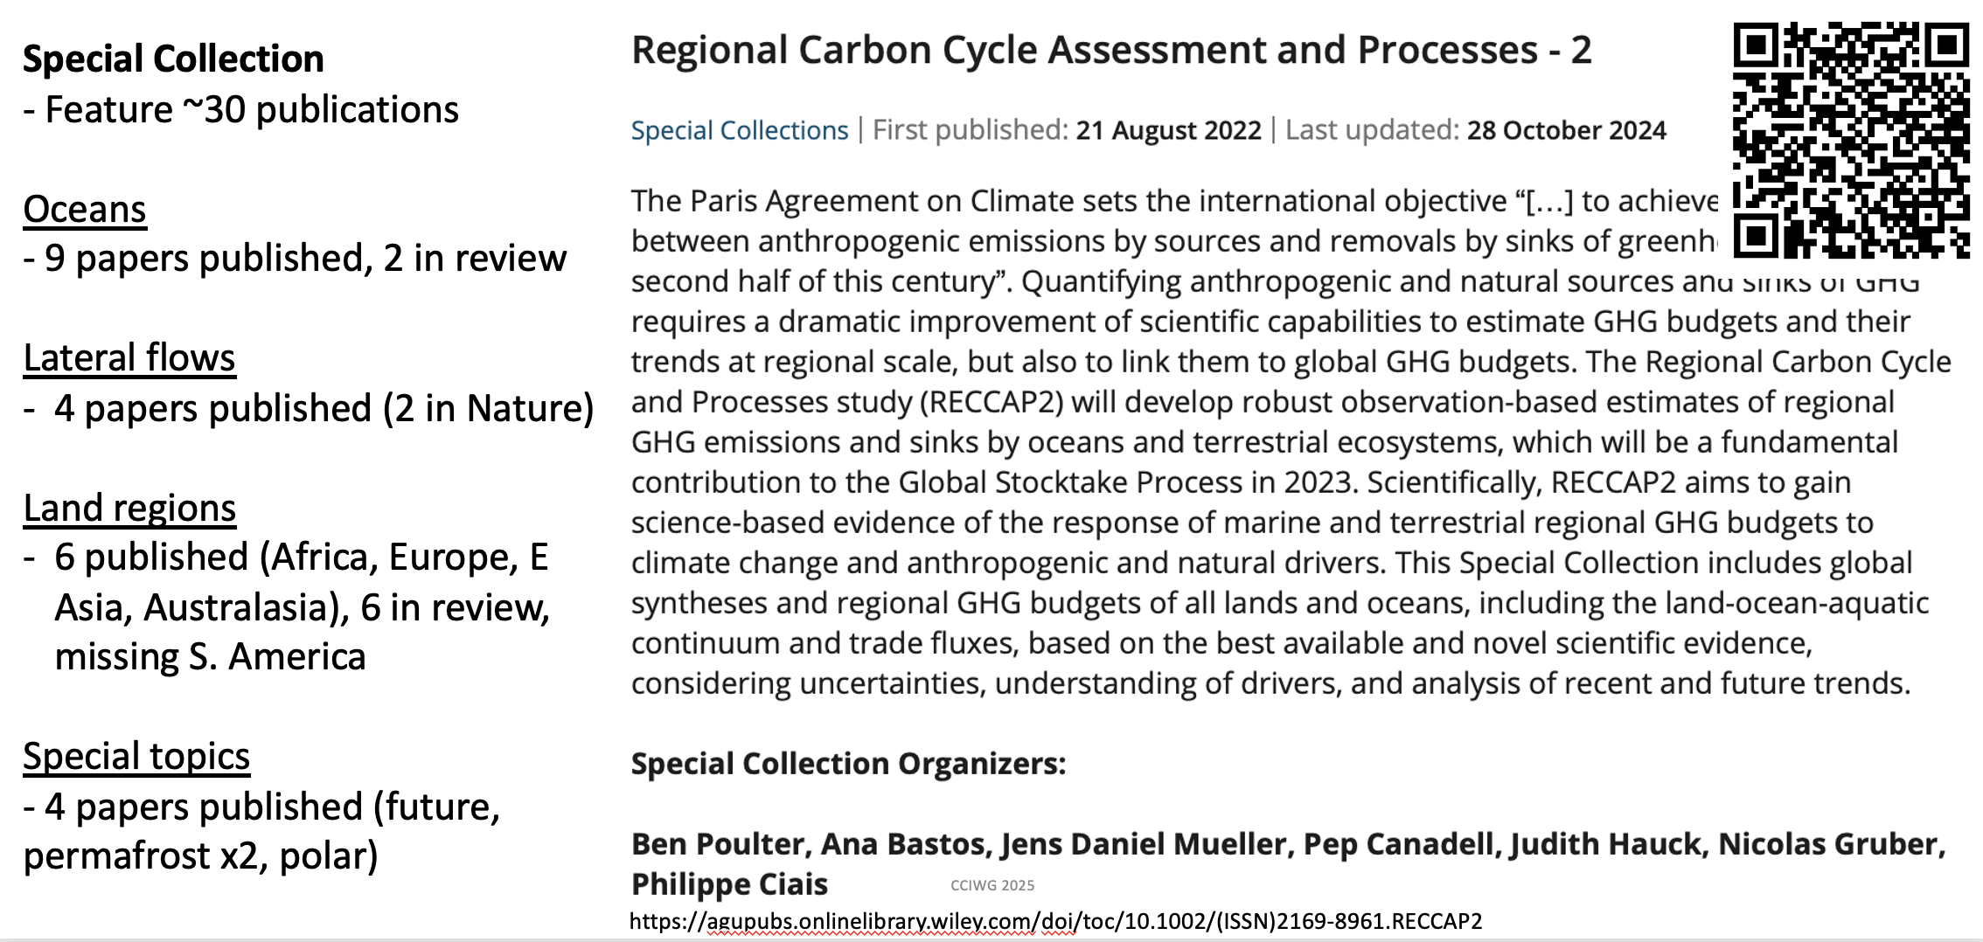
Current status for RECCAP-2
.
.
.

Slide 7
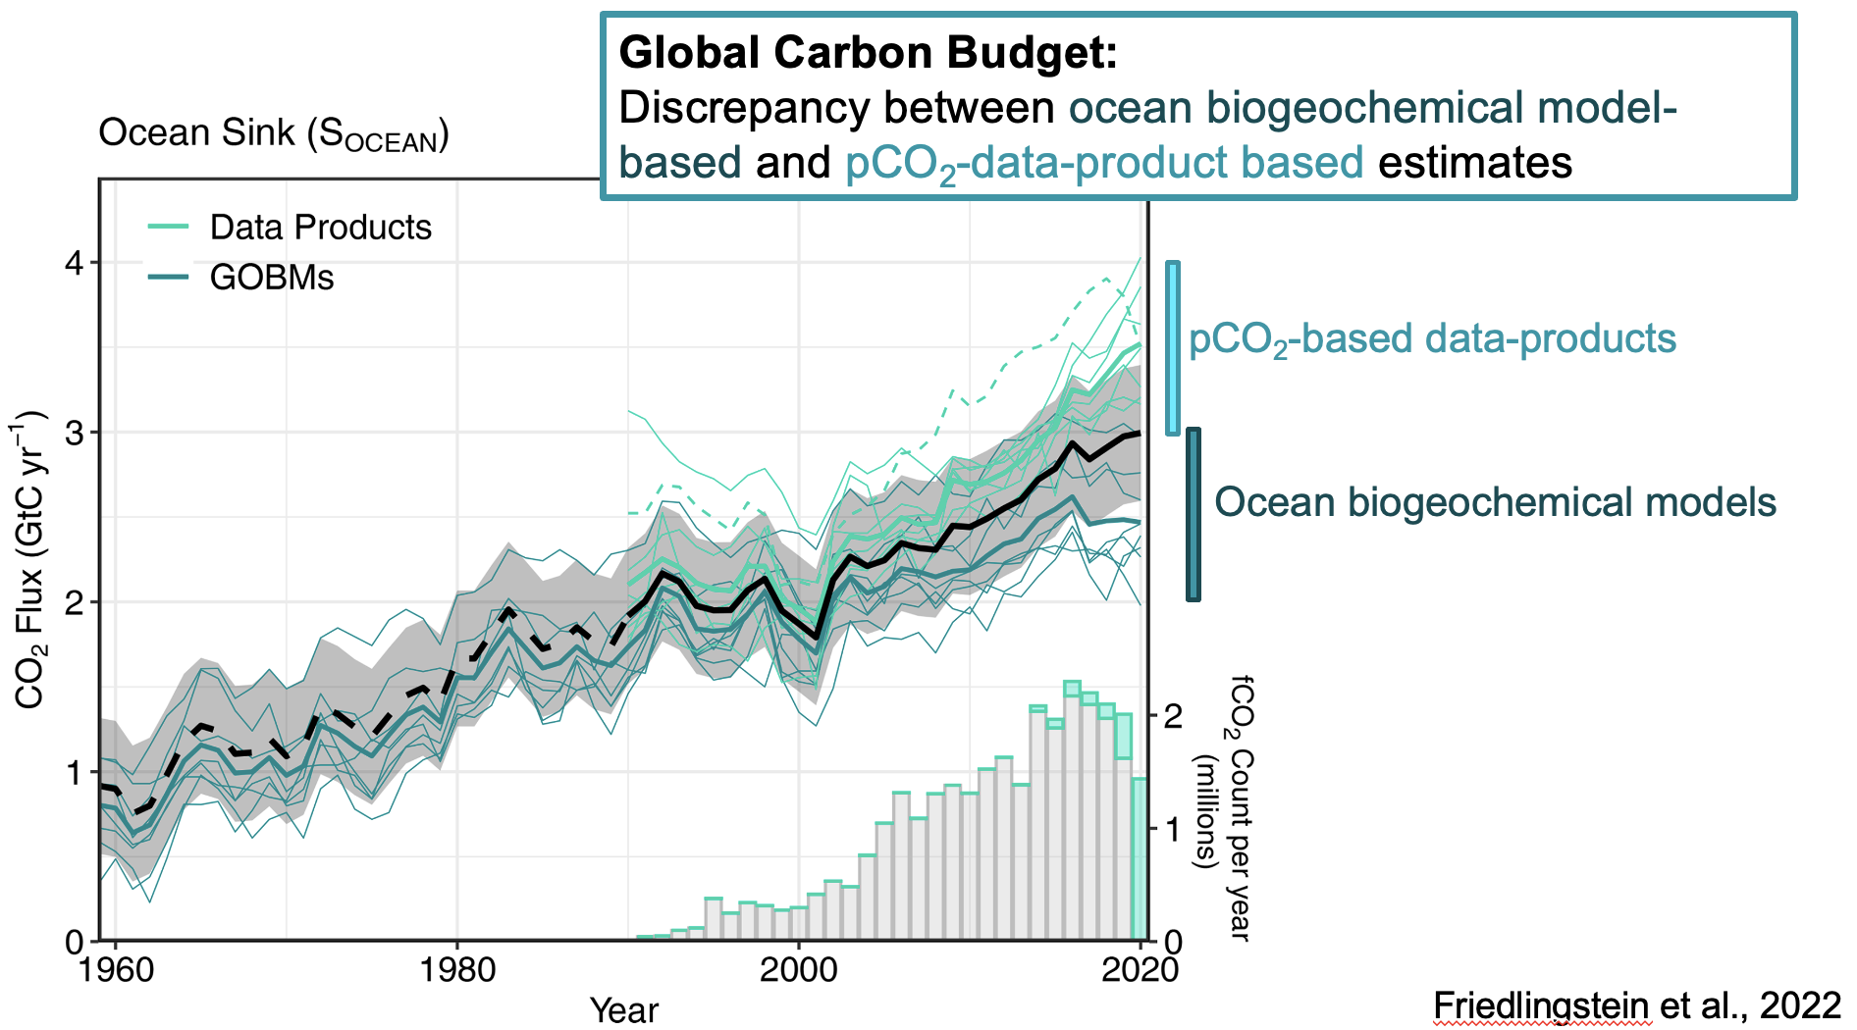
Ocean Assessments (12 papers)
(from J Hauck)

Slide 8
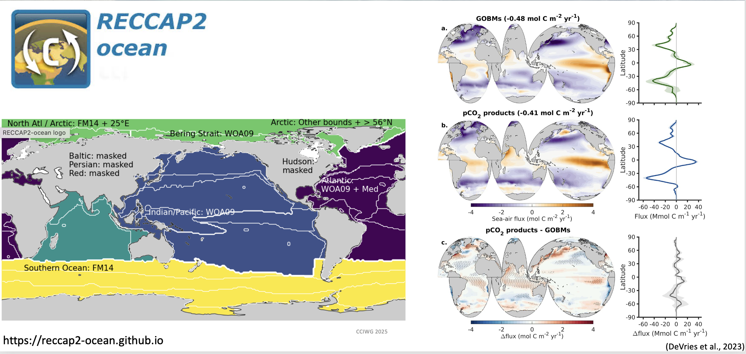
Ocean Assessments

Slide 9
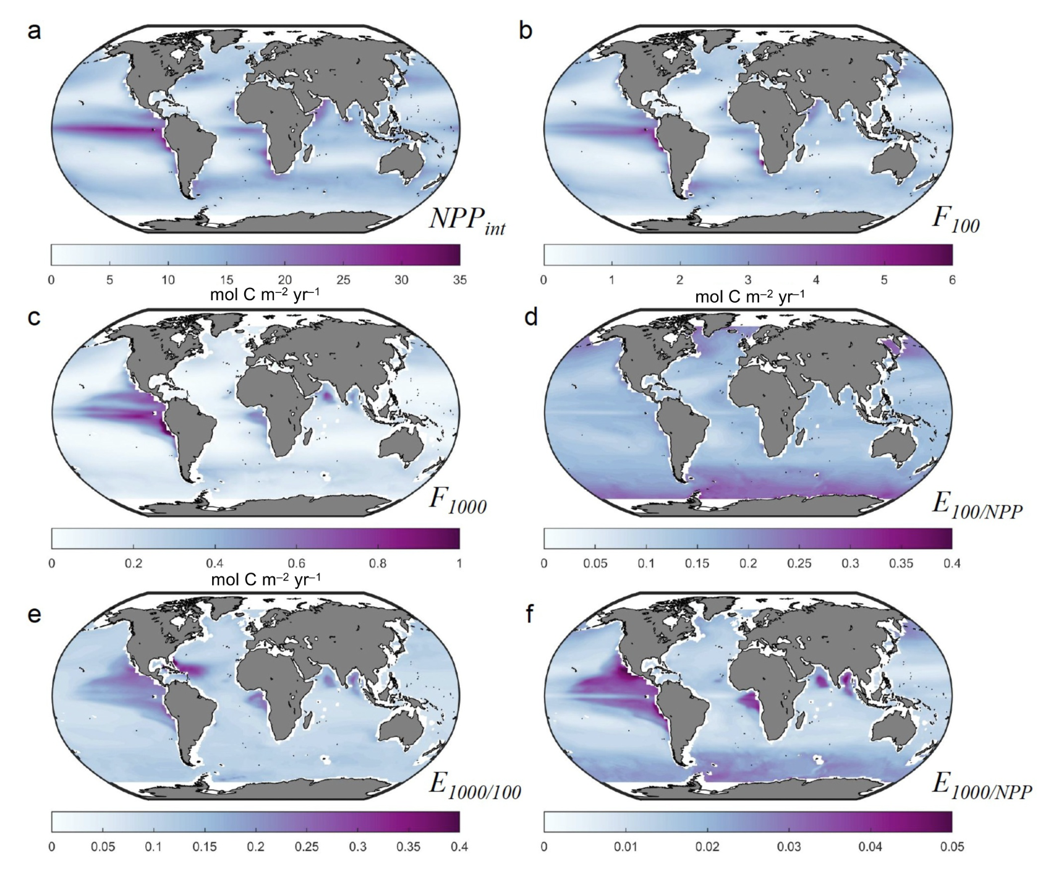
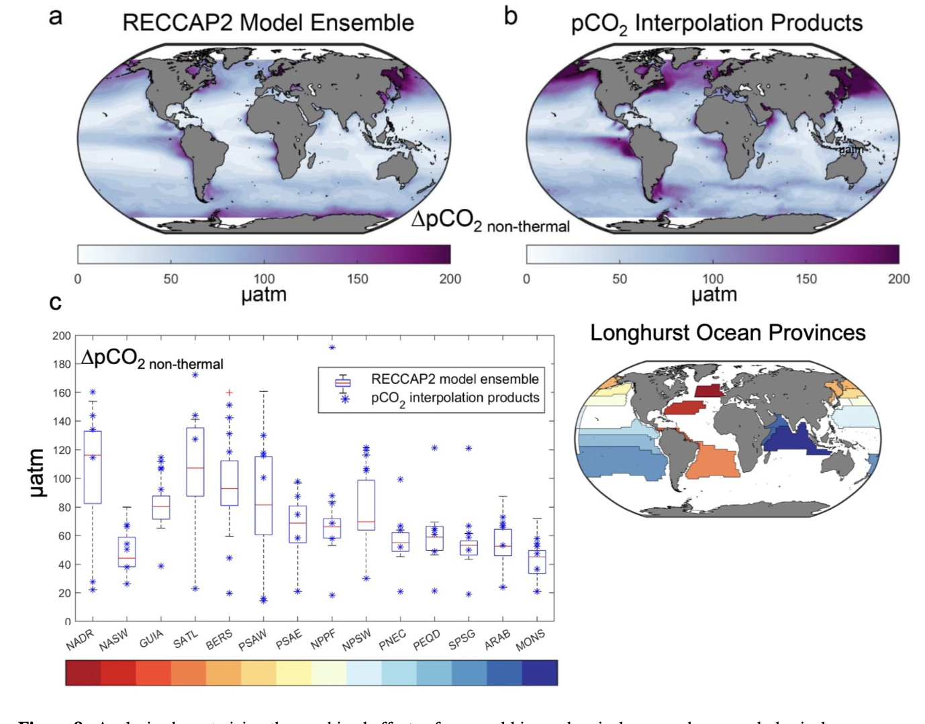
Ocean Assessments: biological pump
(Doney et al., 2024)

Slide 10
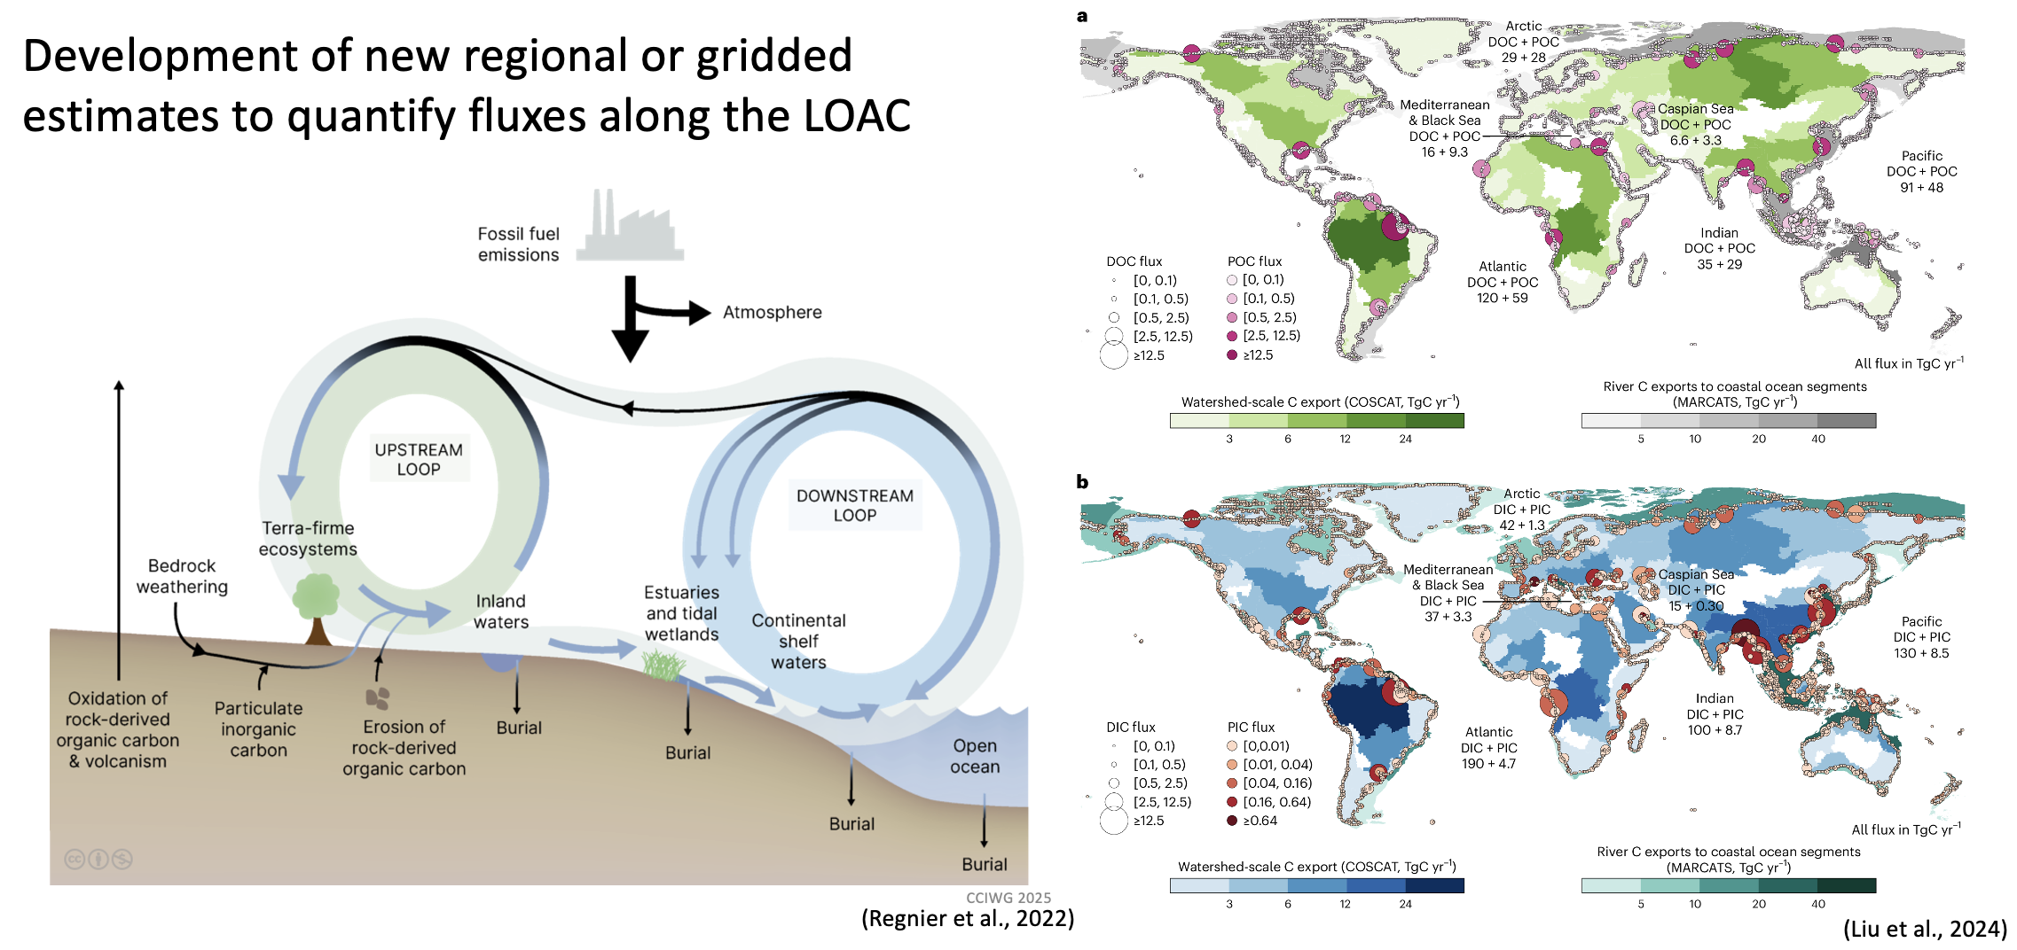
Lateral flux assessment: rivers

Slide 11
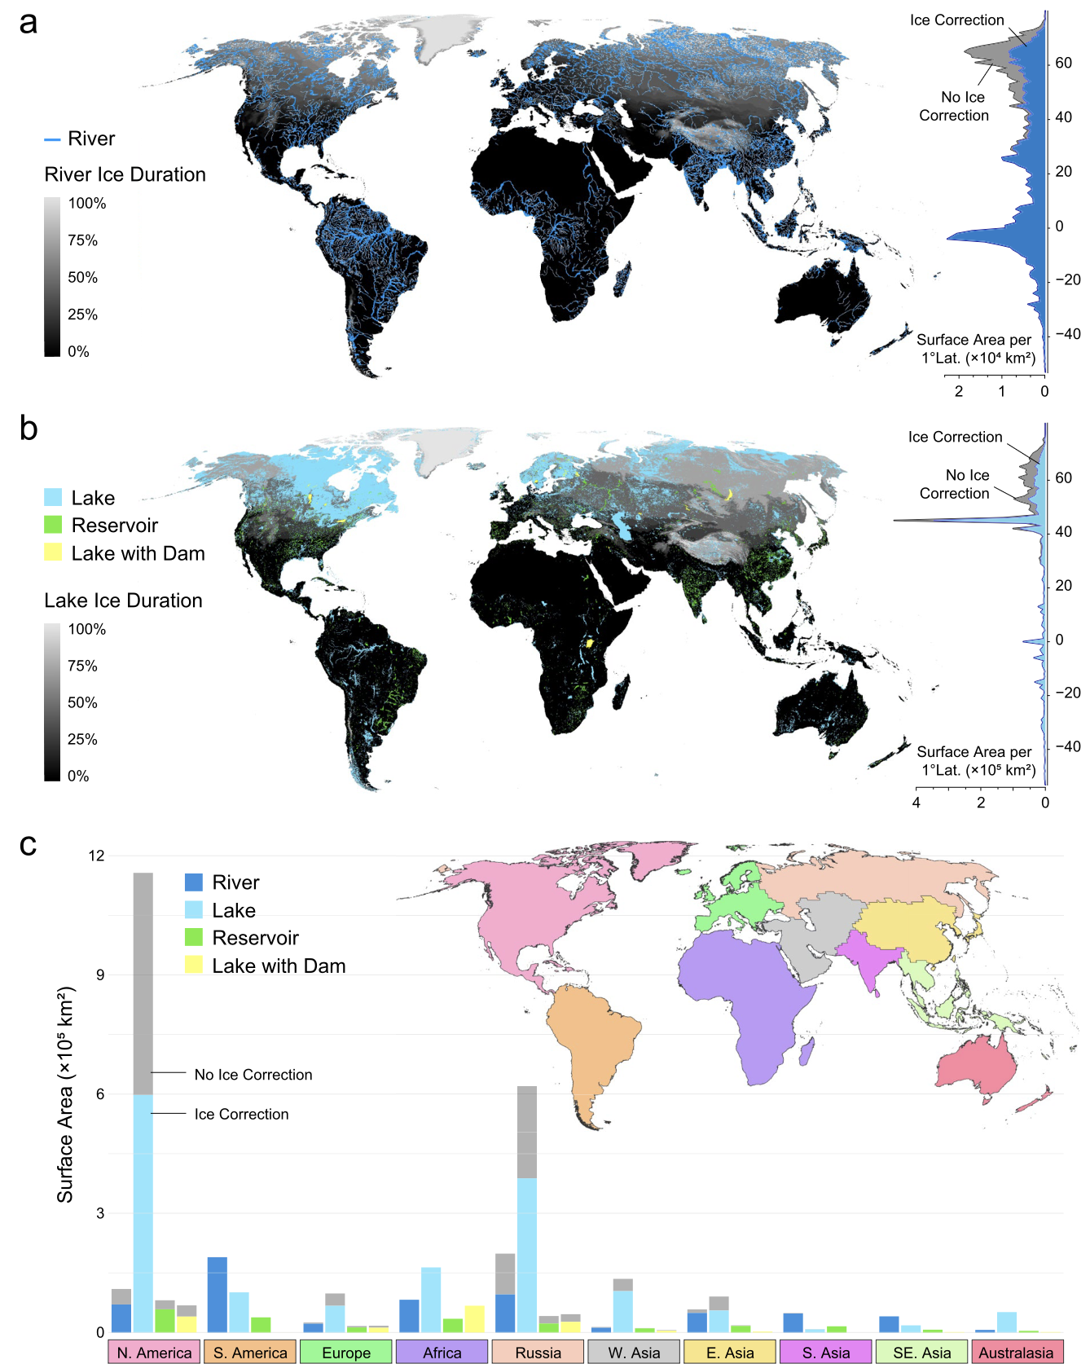
Lateral flux assessments: inland
Lauerwald et al., 2023

Slide 12
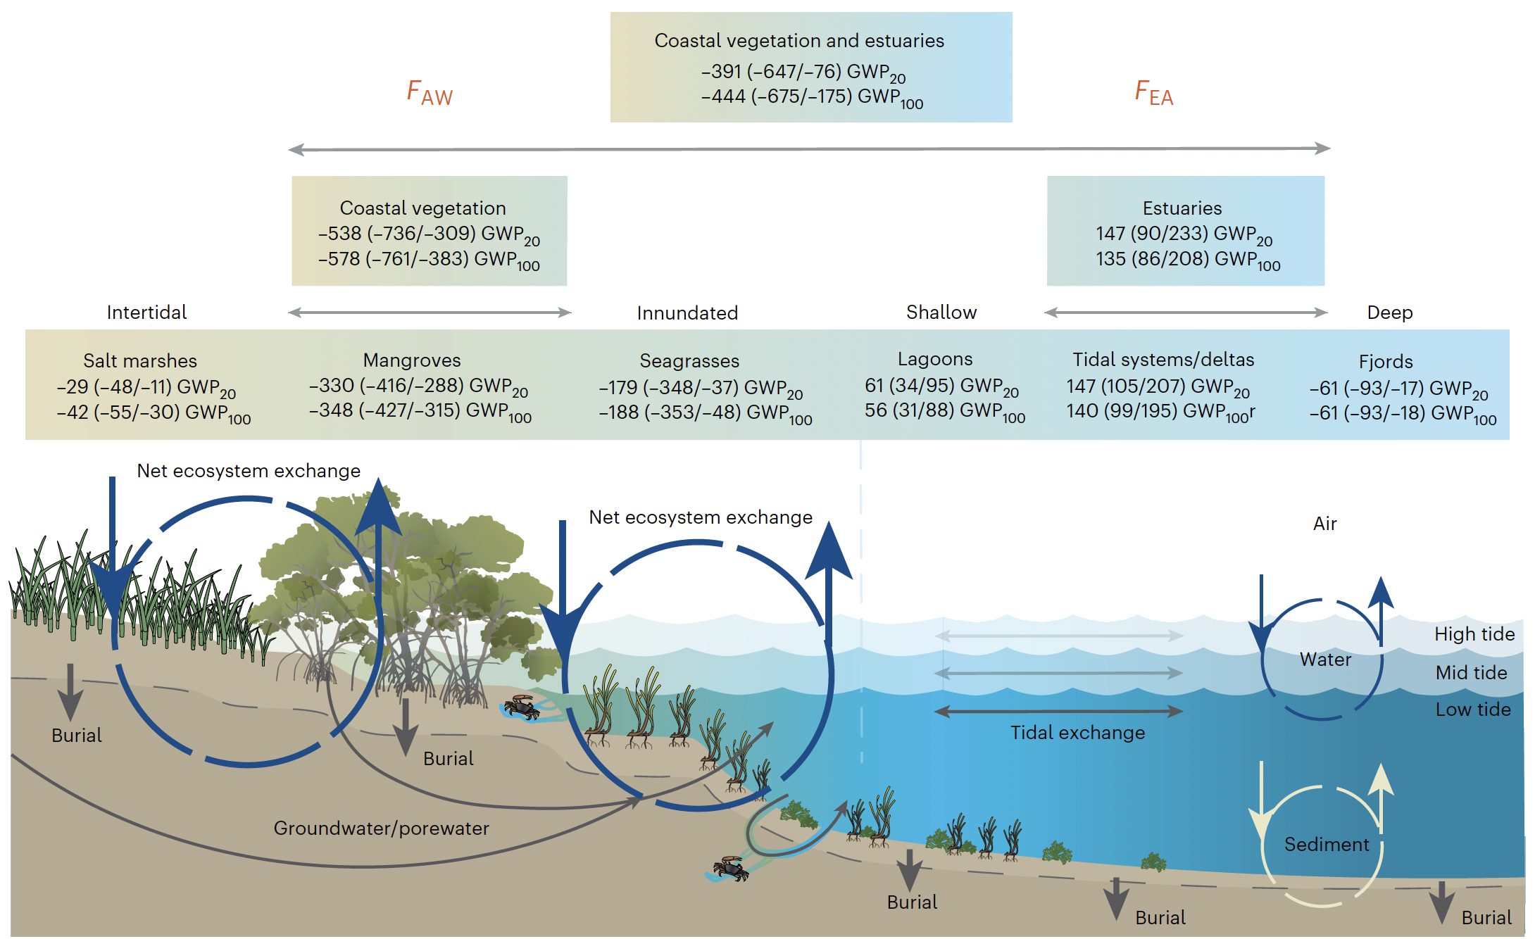
Lateral flux assessments: coastal
Rosentreter et al., 2023

Slide 13
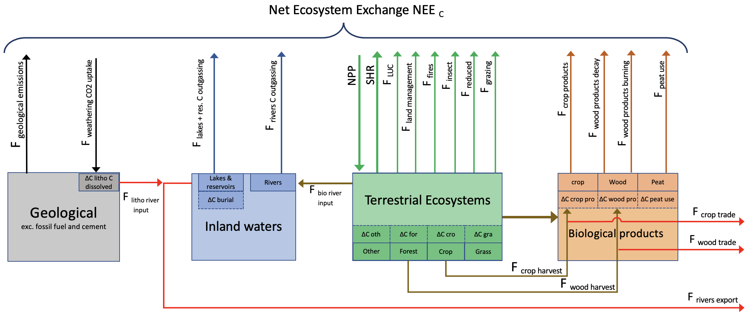
Land assessment: CO₂
Ciais et al., 2021

Slide 14
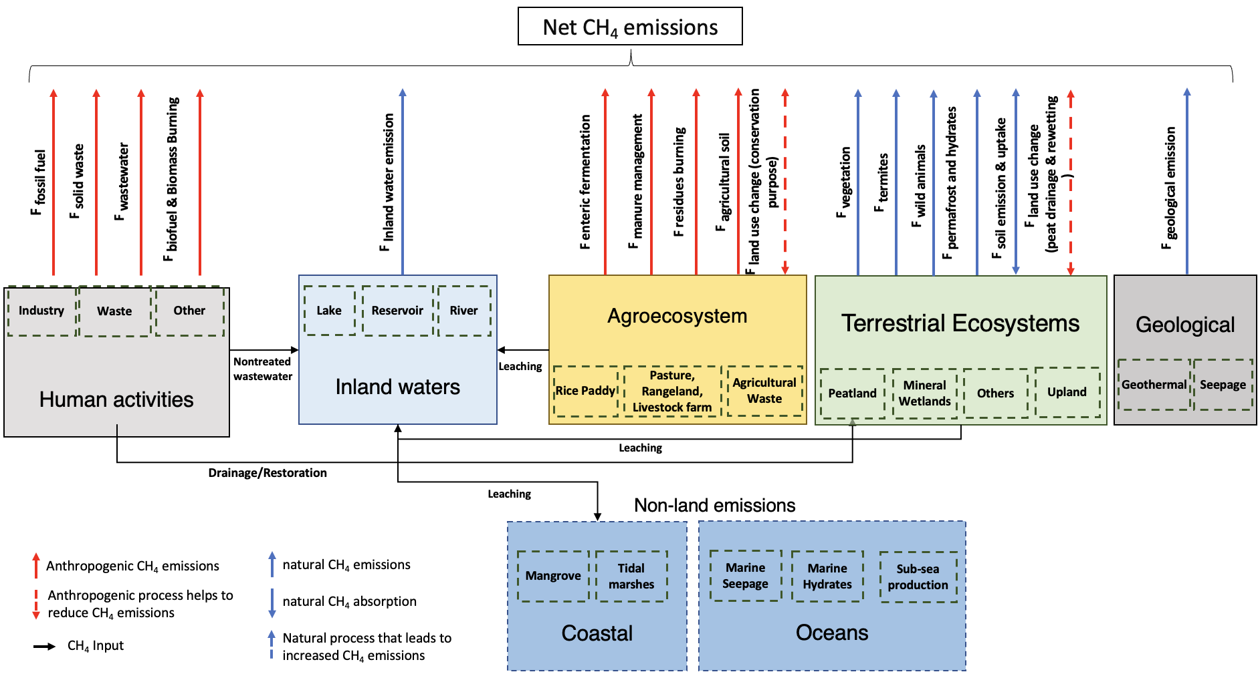
Land assessment: CH₄
Saunois et al., 2021

Slide 15
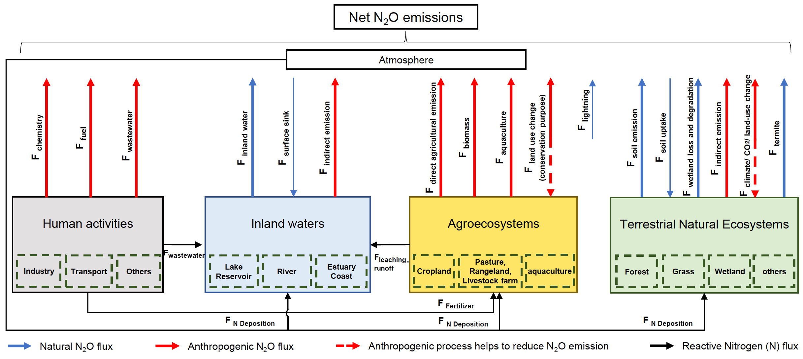
Land Assessment: N₂O
Tian et al., 2021

Slide 16
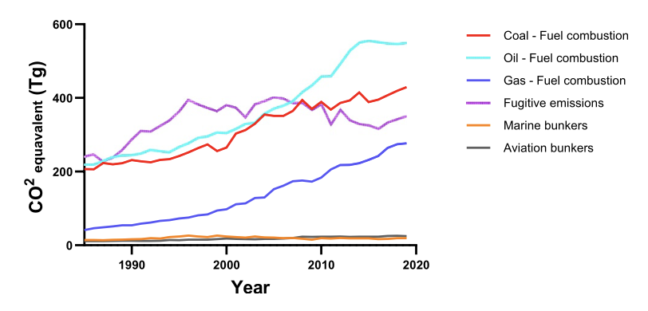
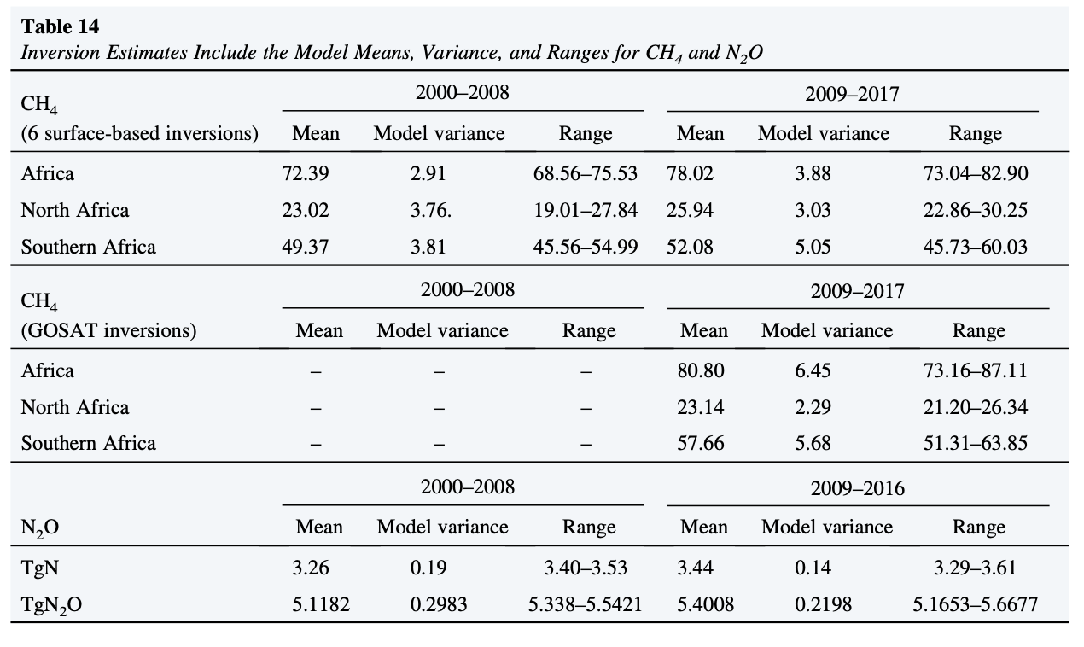
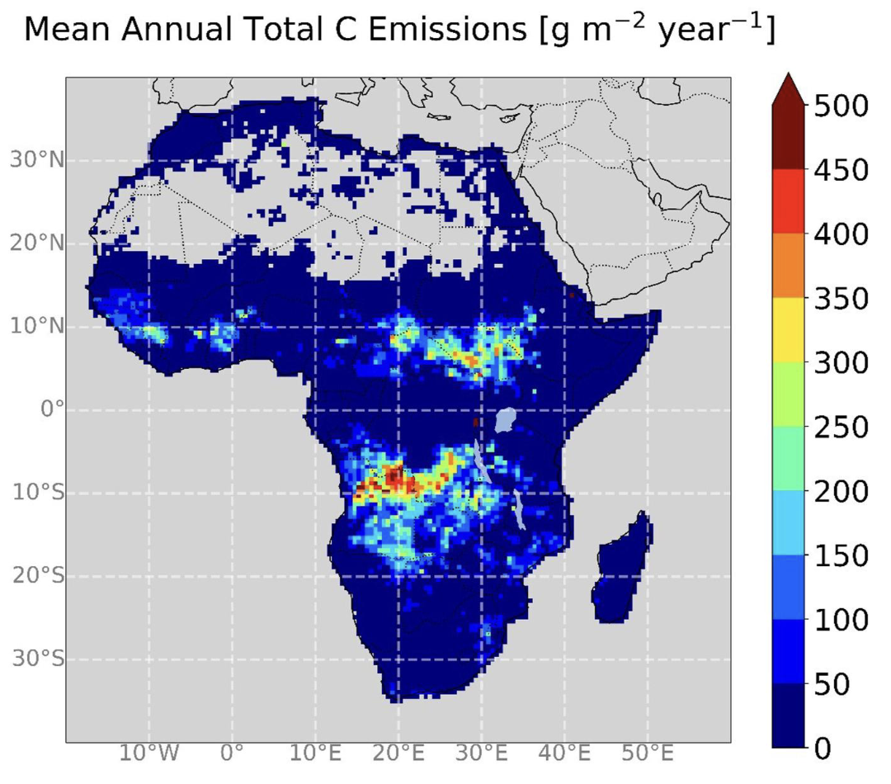
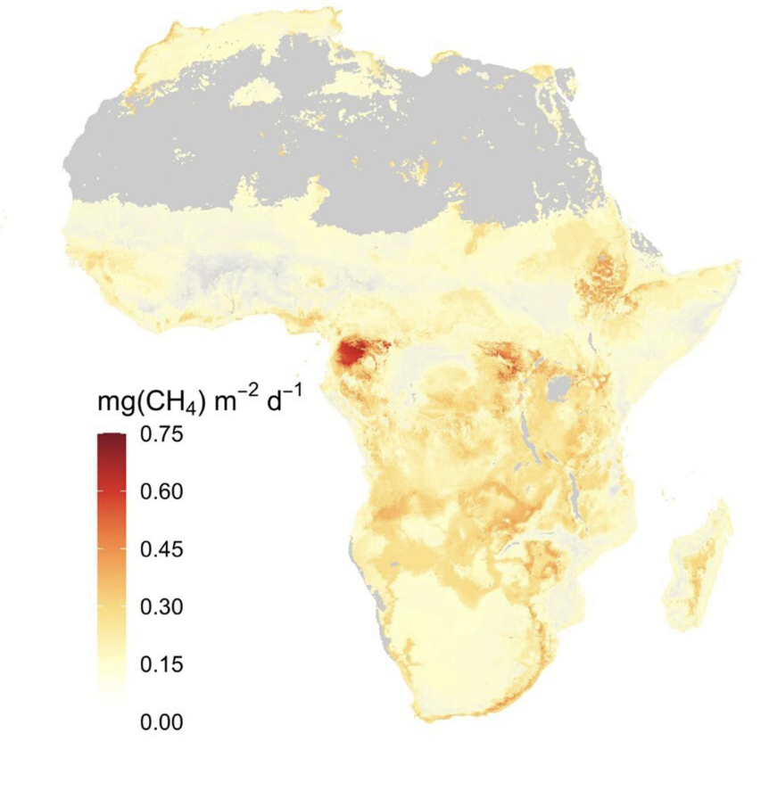
Land Assessment: Africa
Declining carbon uptake over past decade
Approx. neutral sink at present
Termite Methane Emissions
Ernst et al., 2024

Slide 17
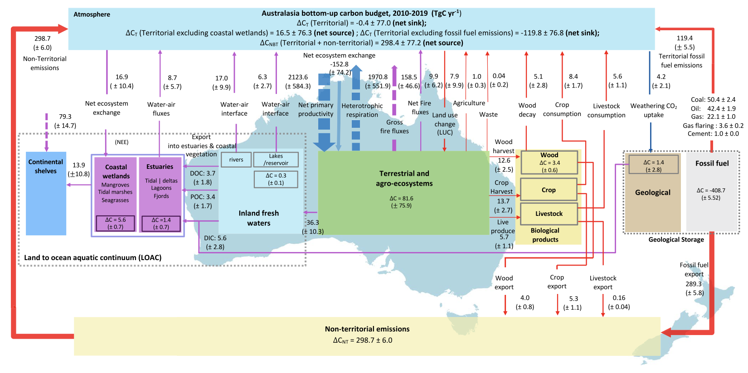
Land Assessment: Australasia
Villalobos et al., 2024

Slide 18
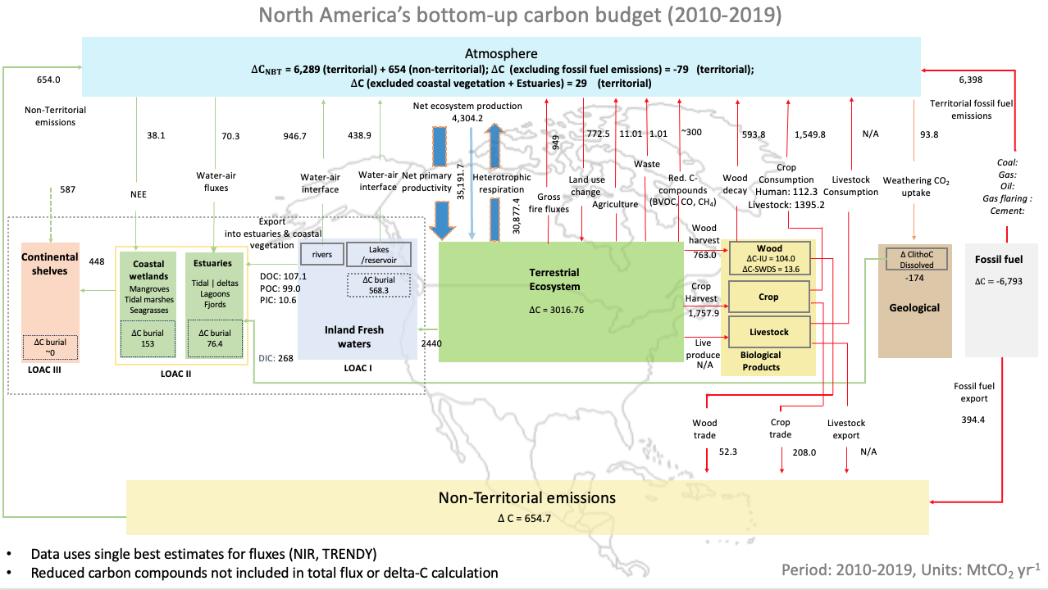
Land Assessment: North America
(Poulter et al., in revision)

Slide 19
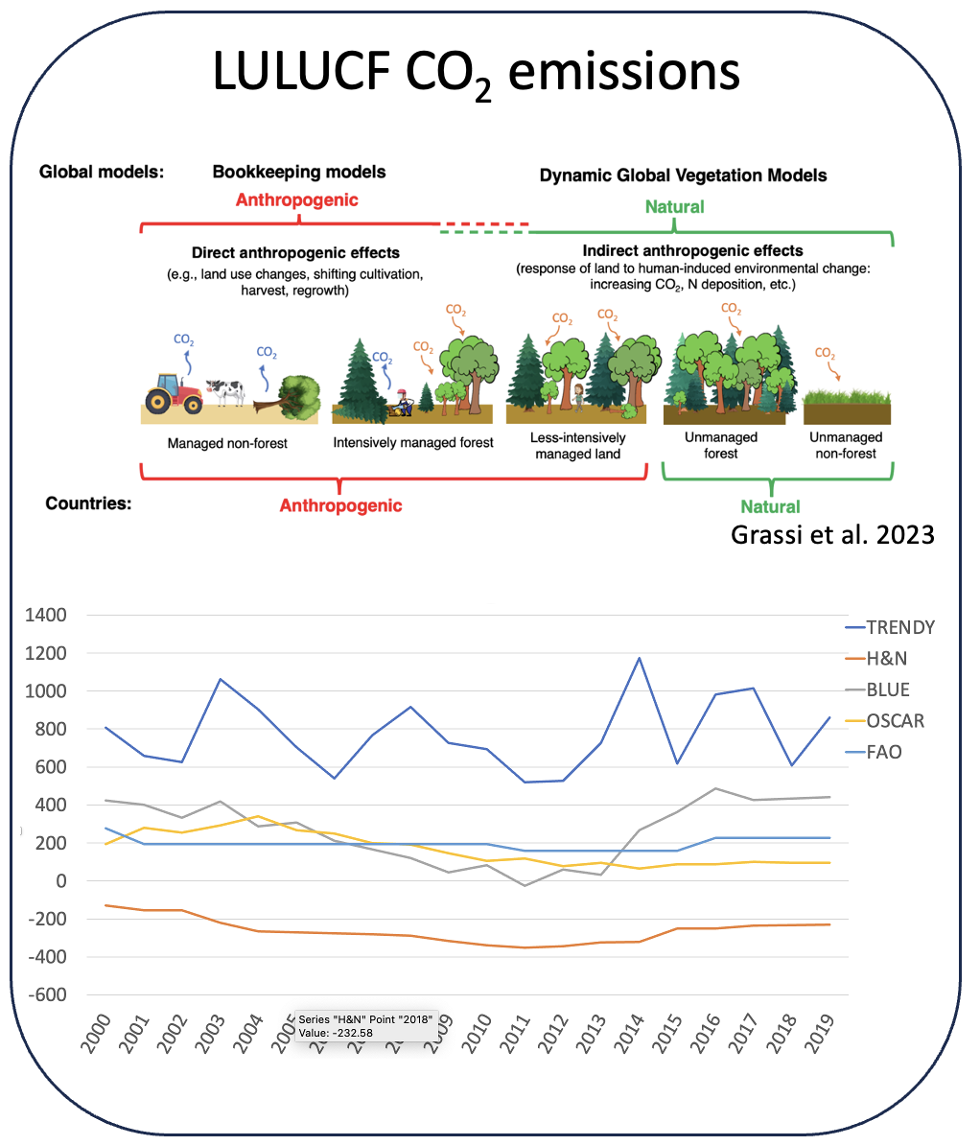
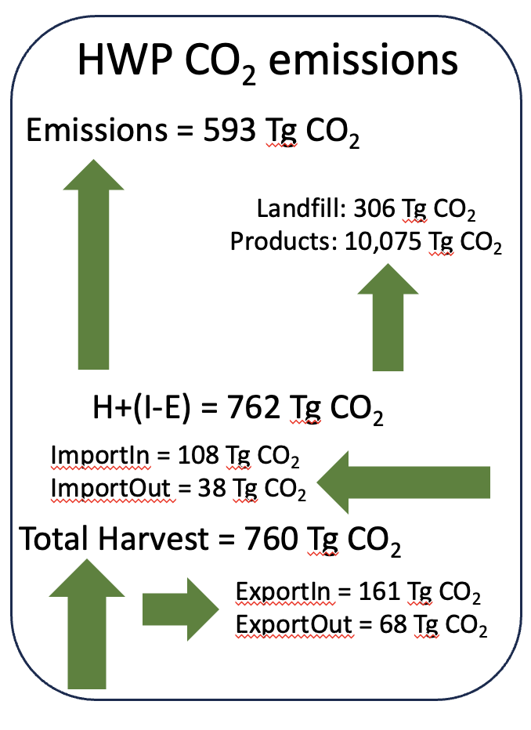
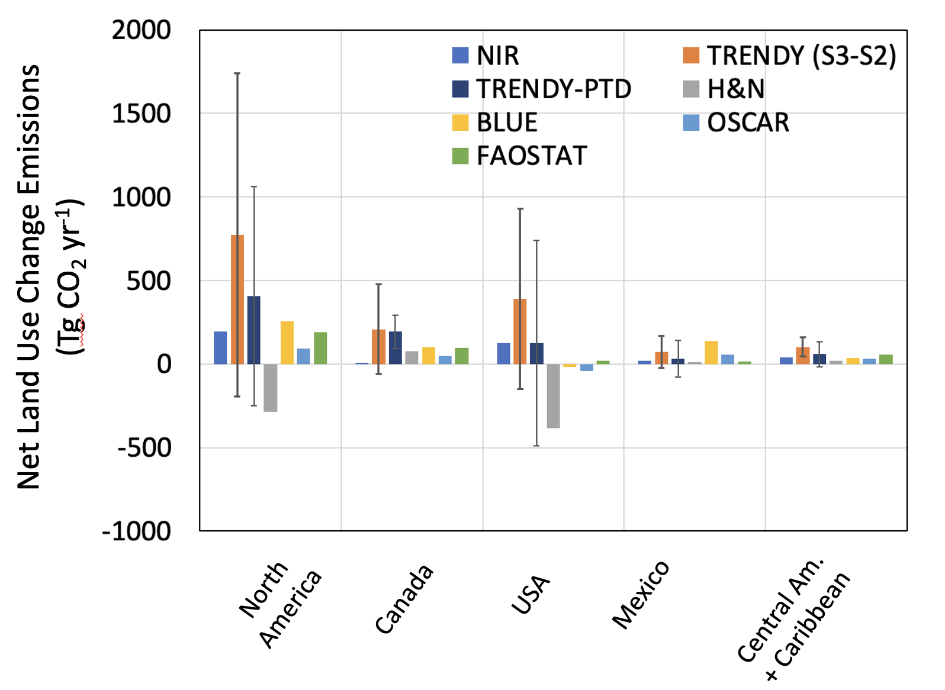
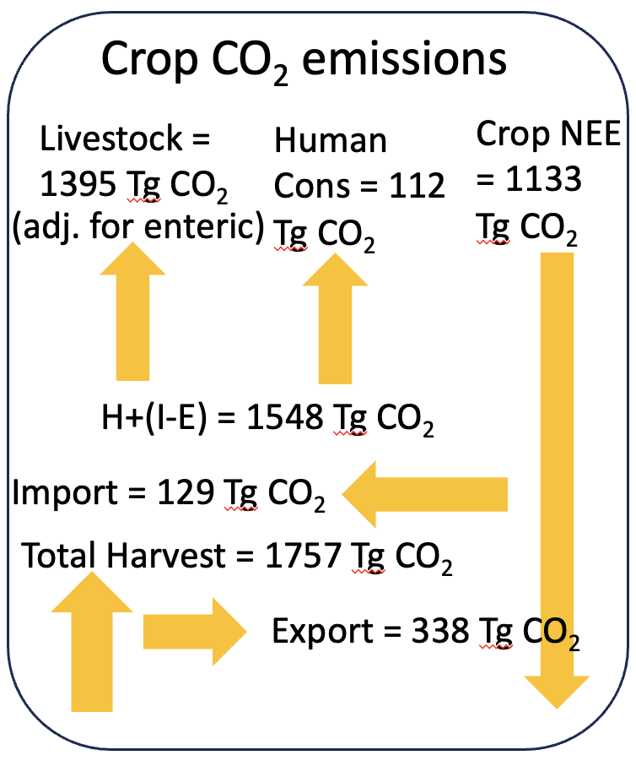
Land Assessment: North America
(Poulter et al., in rev)

Slide 20
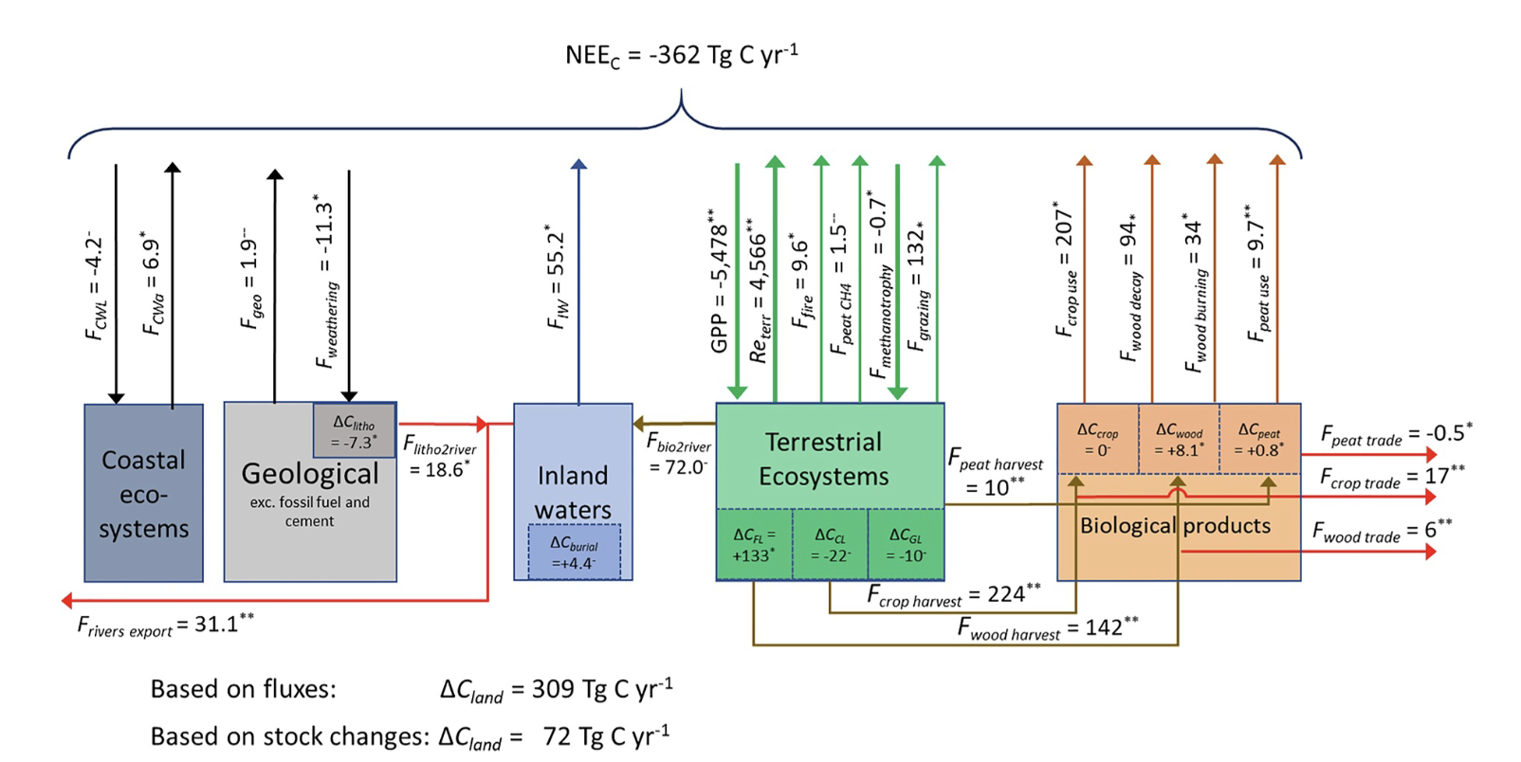
Land Assessment: Europe
Lauerwald et al., 2024

Slide 21
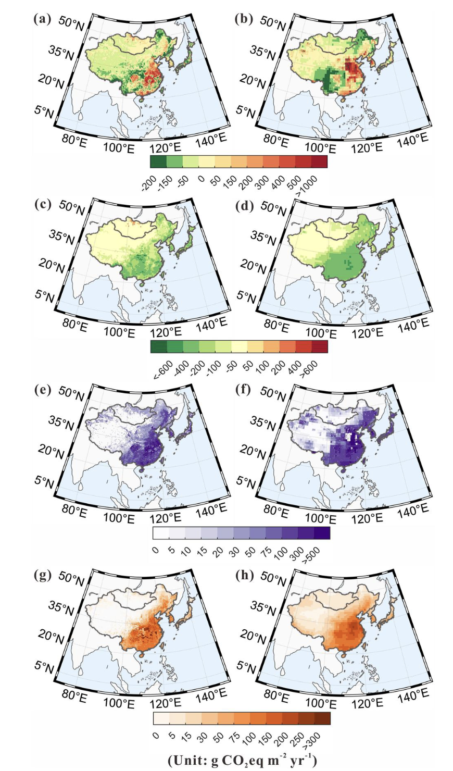
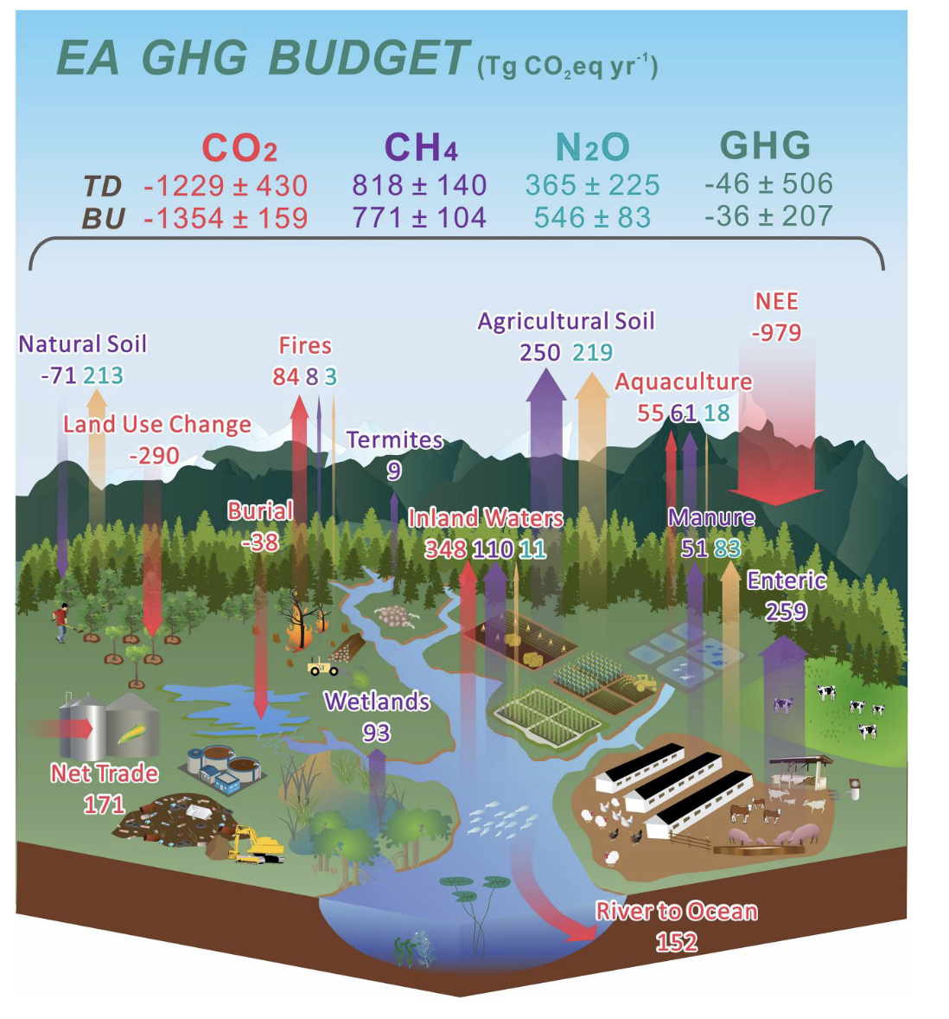
Land Assessment: East Asia
(Wang et al., 2024)

Slide 22
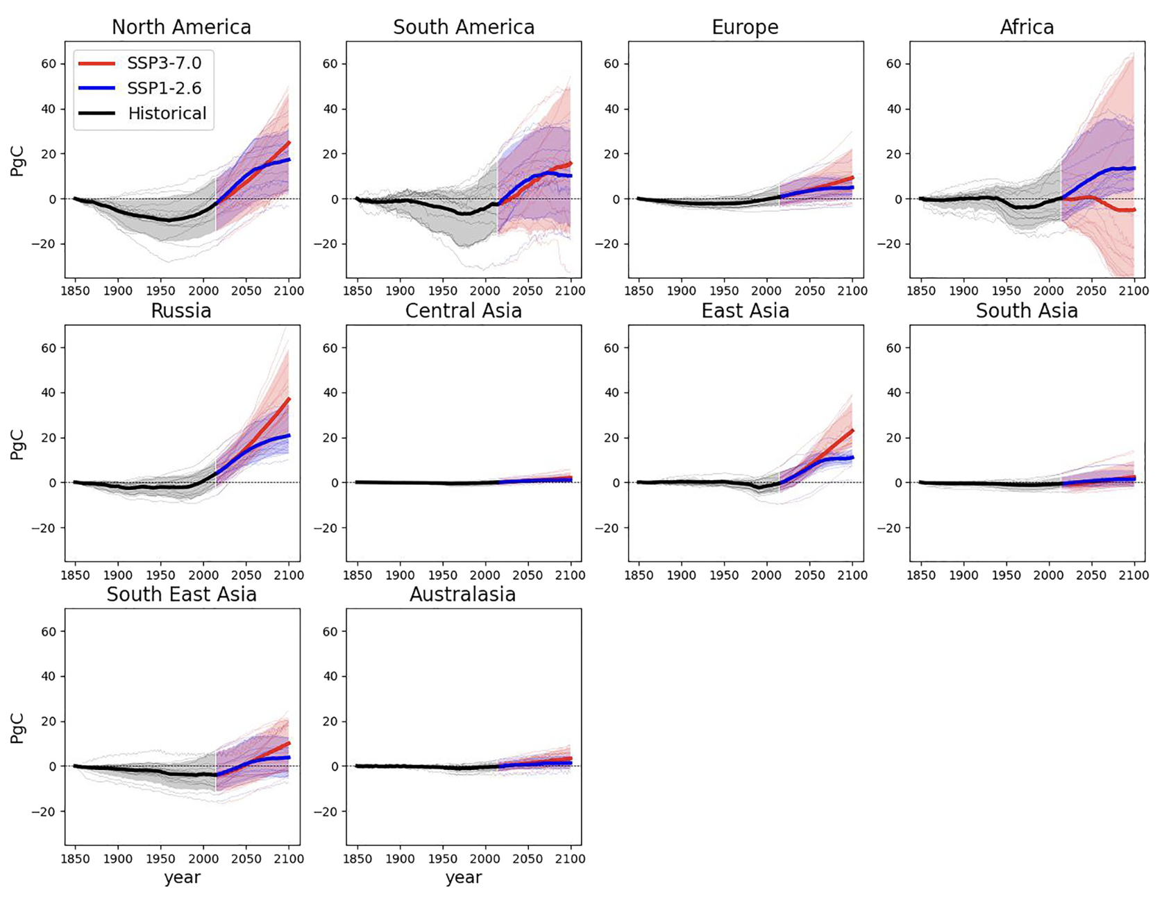
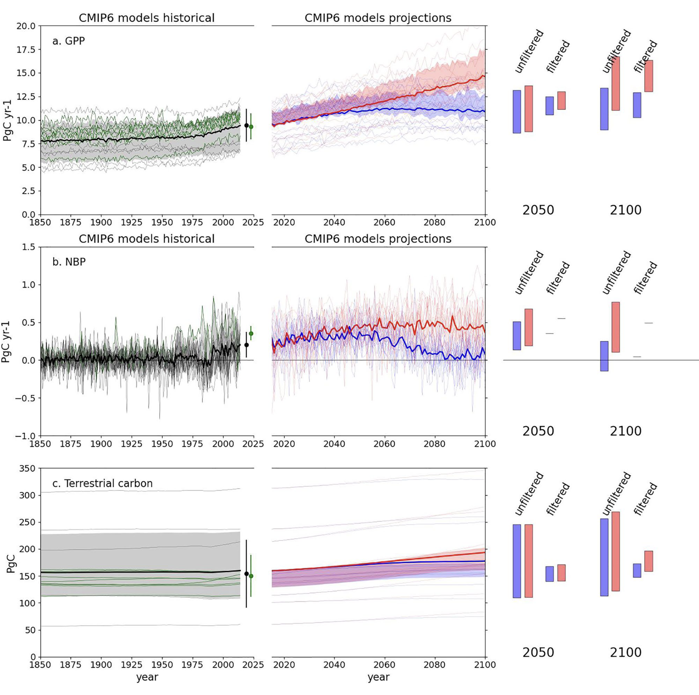
Land Assessment: Future
Jones et al., 2023

Slide 23
Synergies with RECCAP-2 and CEOS
Satellite remote sensing is deeply integrated within RECCAP-2 and provides
activity data
emissions factors
top-down constraints
data-driven estimates
However, traceability to precise L1-L4 satellite missions & products is obscured through ‘added value’ from modeling
Reconciling land-use change emissions
Opportunities to explore direct linkages will take place in RECCAP-3 (AI models, latency, sub-regional, etc.)

Slide 24
Lessons Learned & RECCAP-3
Key areas of interest in RECCAP3
Closing the gap between NGHGI’s and global GHG budgets
Going from regional to national budgets
Moving from research toward operational budgets to reduce latency
Need updated information on trade flows of embodied carbon
Expanding special topics and focus areas
Increasing the use of expanding monitoring networks
Supporting national and global GHG observing systems (i.e., WMO G3W)
Involving Early Career Scientists
NASA Earth Science Directorate and European Space Agency providing support for RECCAP-3 post-doctoral scientists and training workshops

Slide 25
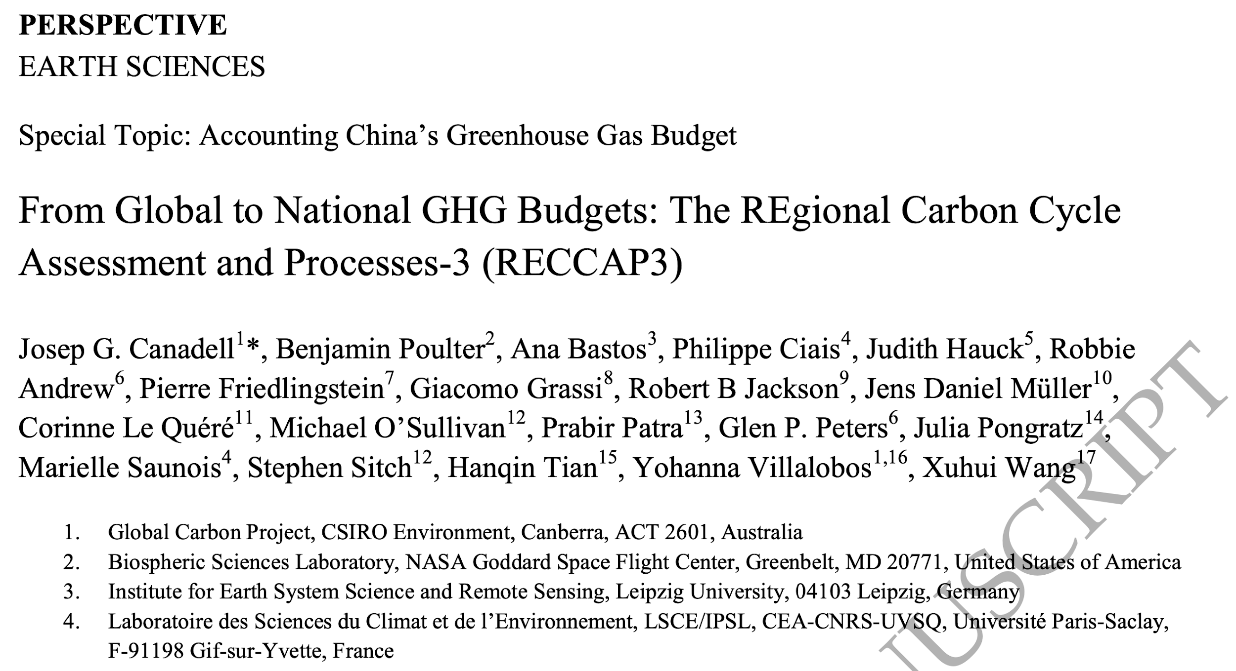
Lessons Learned & RECCAP-3
.
.
.

Slide 26
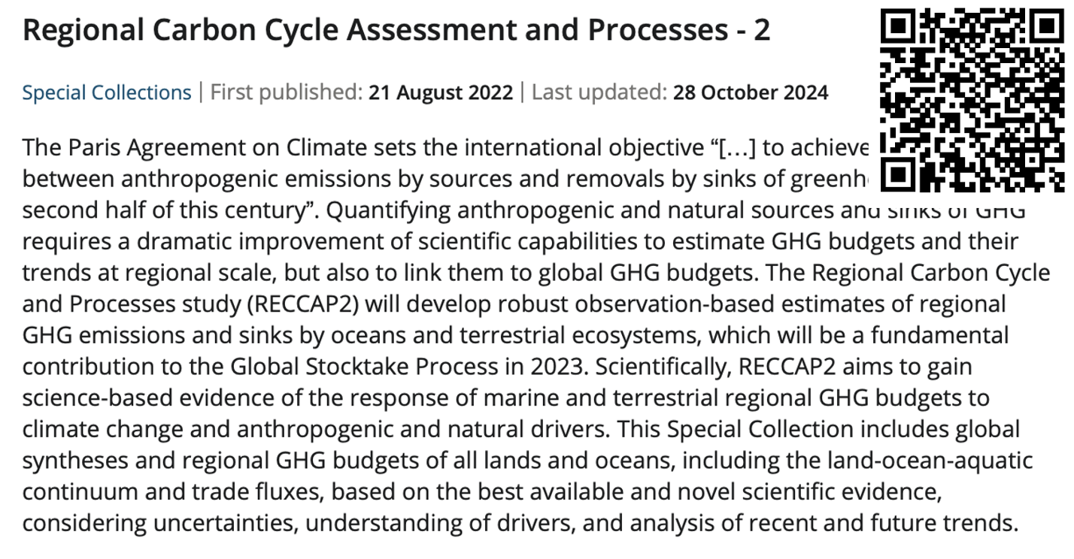
Thank you !

