Slide 1
Copernicus Atmosphere Monitoring Service
Hugo Zunker, European Commission
Richard Engelen, ECMWF
Agenda Item 5.2

Slide 2
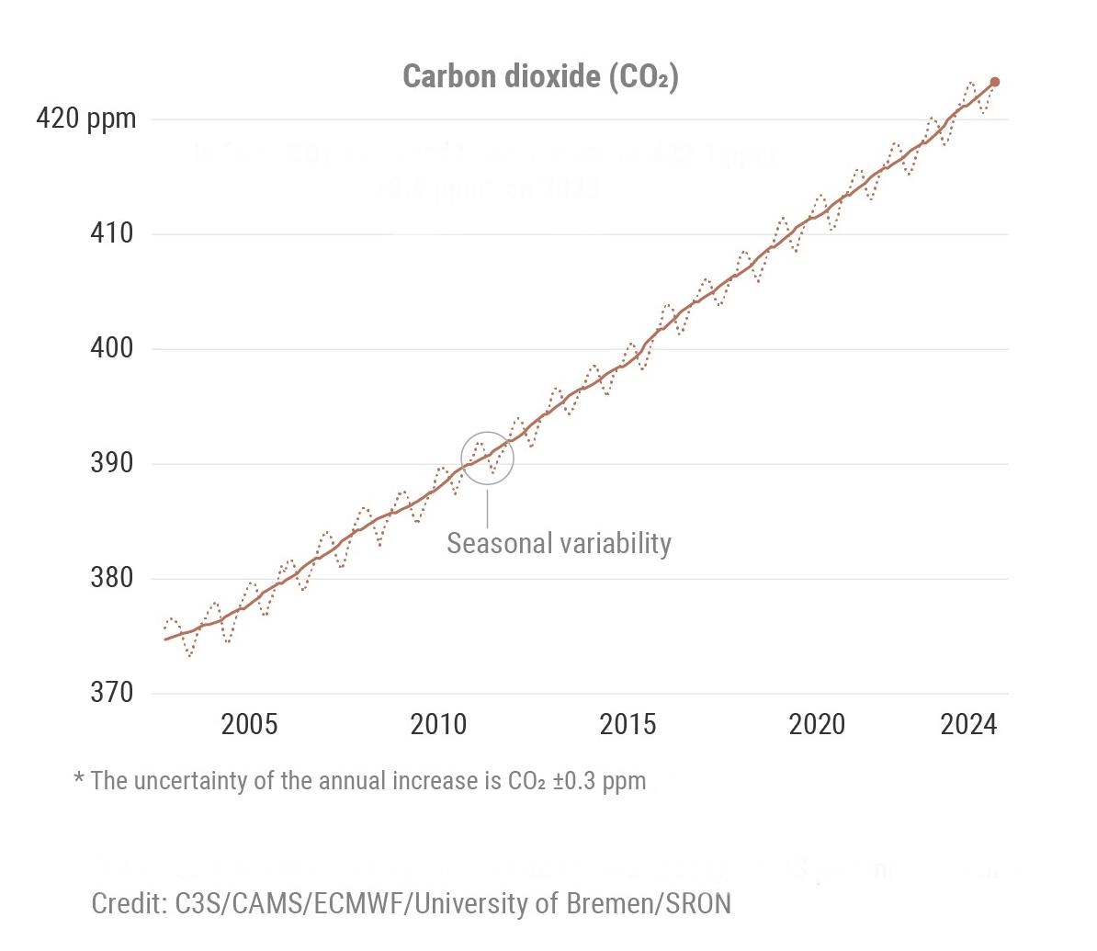

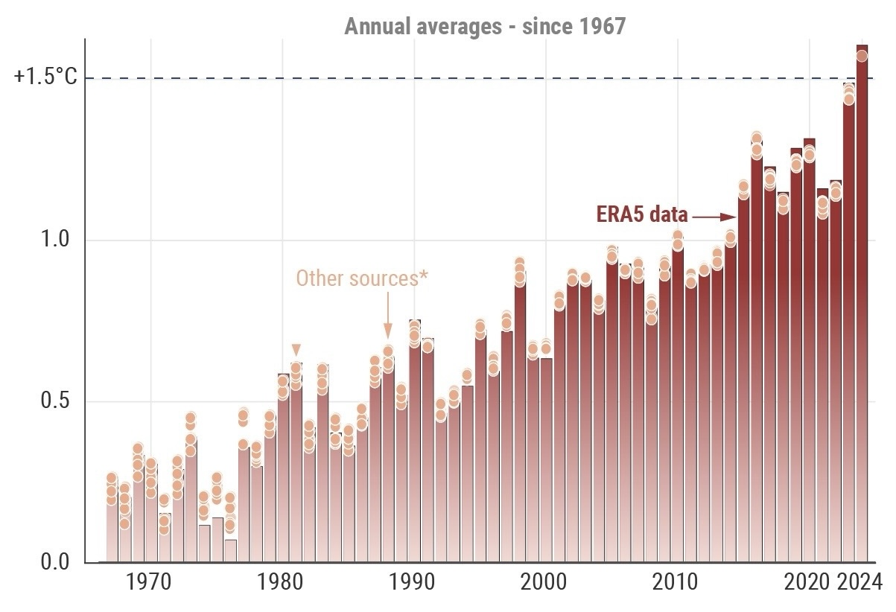

Slide 3
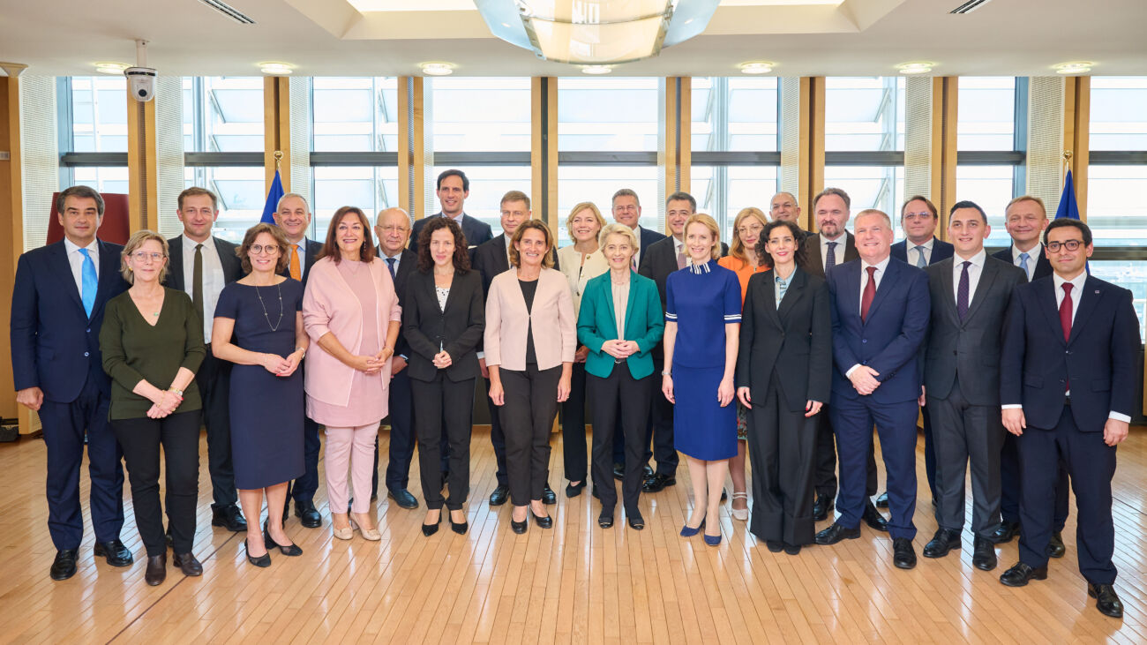
European Commission 2024-2029: Priorities
A new plan for Europe's sustainable prosperity and competitiveness
    A Clean Industrial Deal
        propose to set out a 90% emission-reduction target for 2040 in the European Climate Law
        continue to be a leader in international climate negotiations
        secure supplies of raw materials, clean energy and clean tech with the development of clean trade and investment partnerships
        support industries and companies through the transition by launching an Industrial Decarbonisation Accelerator Act, helping to speed up related planning, tendering and permitting
        reduce energy costs for households and businesses by completing the Energy Union
        invest in clean energy infrastructure and technologies

Slide 4
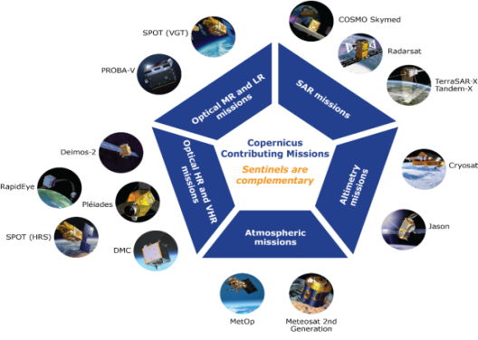
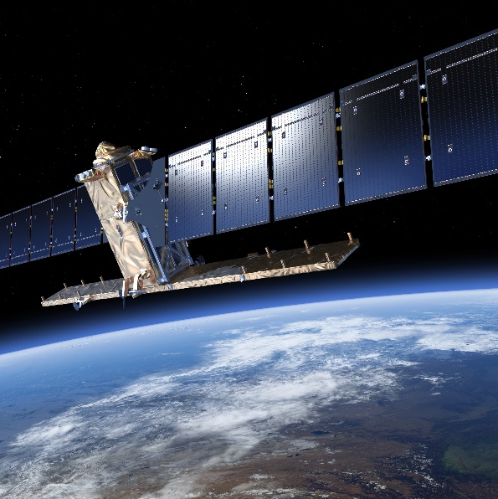

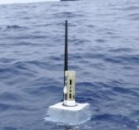

Copernicus Components
Six Copernicus Services
Contributing missions
Sentinels
In situ data
FULL, FREE AND OPEN
Value-added Services
Notes:
Space component = Sentinels + CCM
In-situ data
Services
Down-stream services/products
Users – core users, other end users

Slide 5
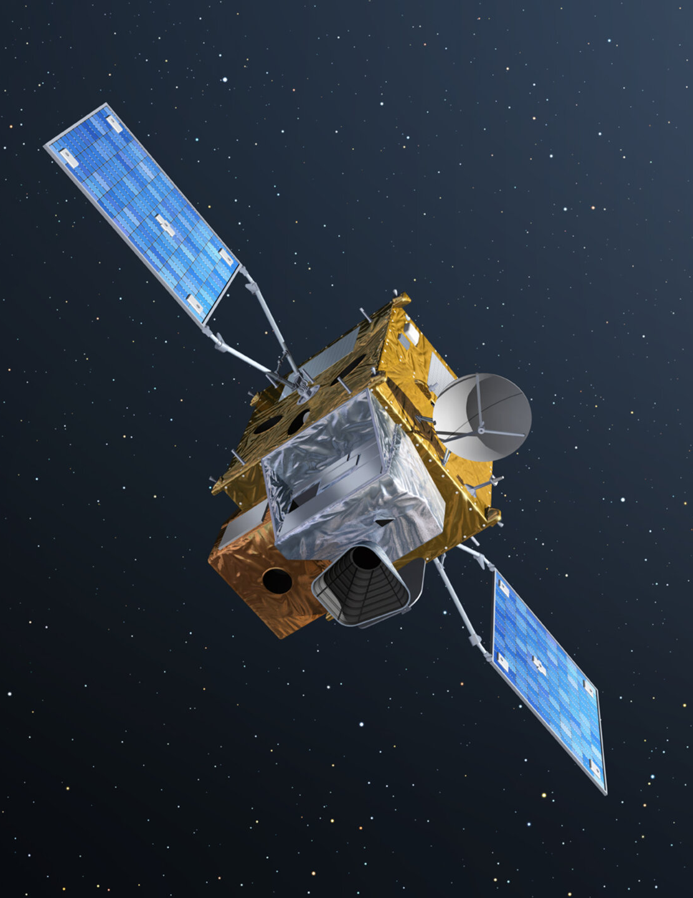
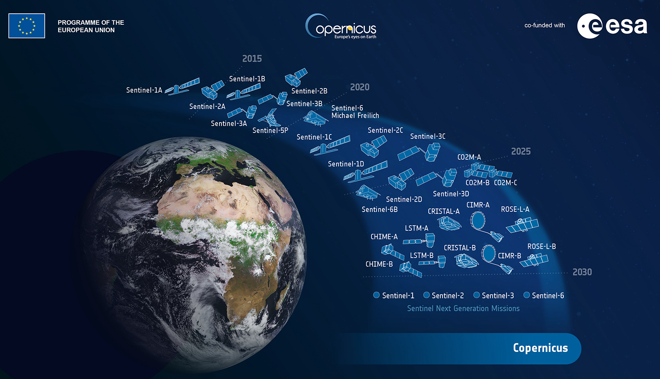
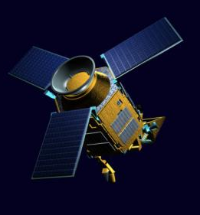
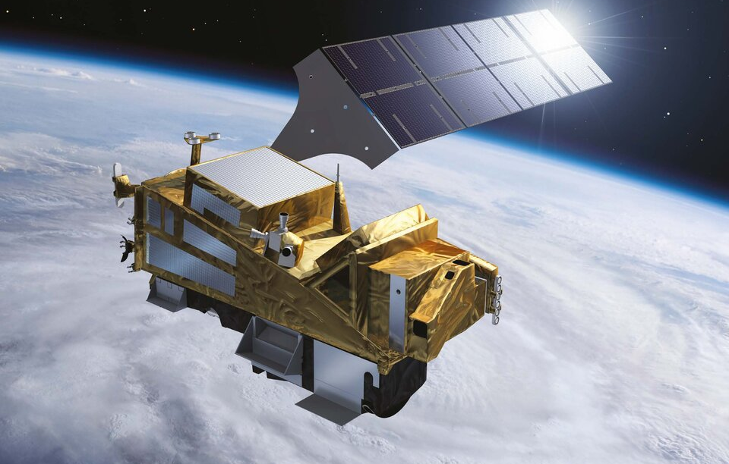
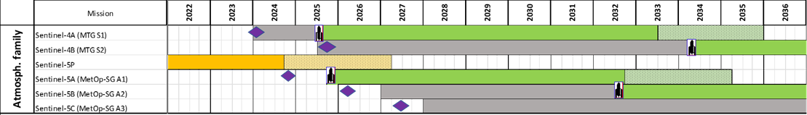
Copernicus Satellites
Sentinel 4
Sentinel 5p
Launch 2. July 2025
Sentinel 5
operational
Launch mid-August 2025

Slide 6
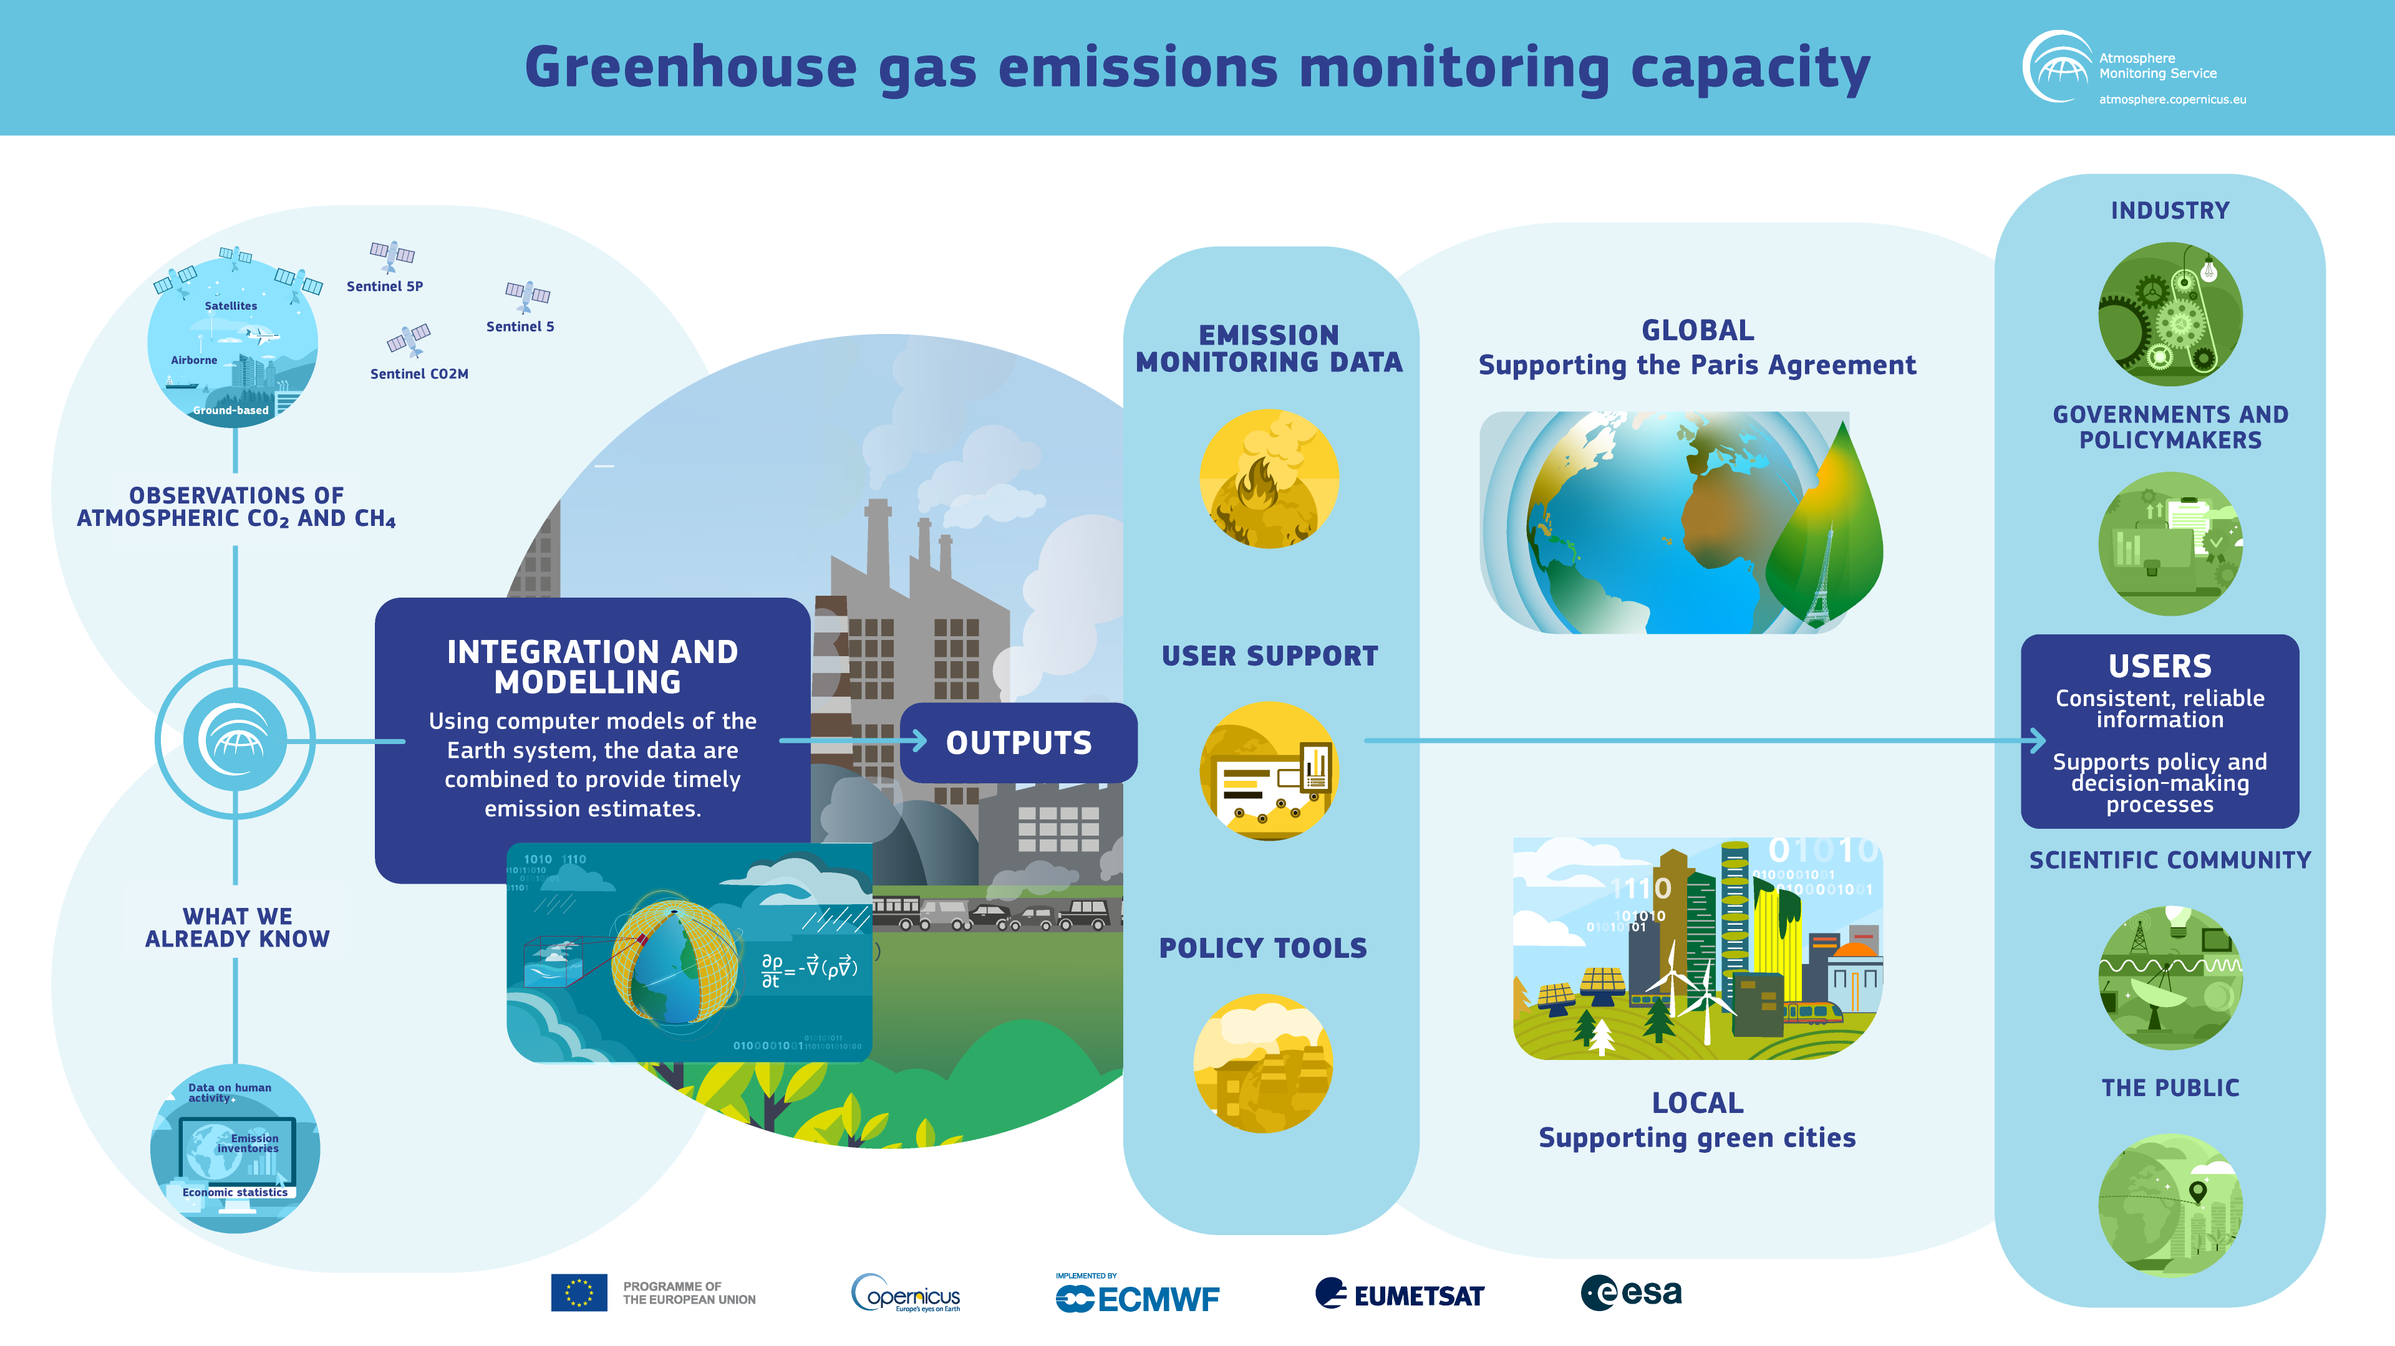
Emissions Monitoring and Verification Support (CO2 MVS)
Copernicus Atmosphere Monitoring Service (CAMS)

Slide 7
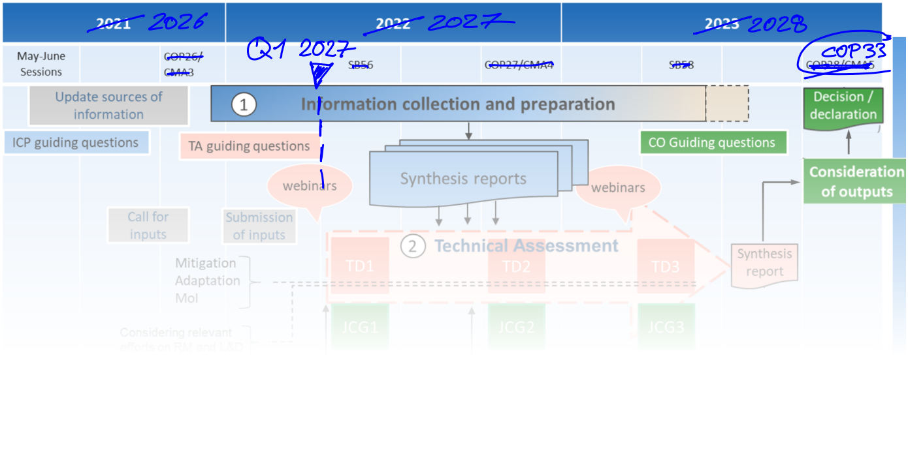
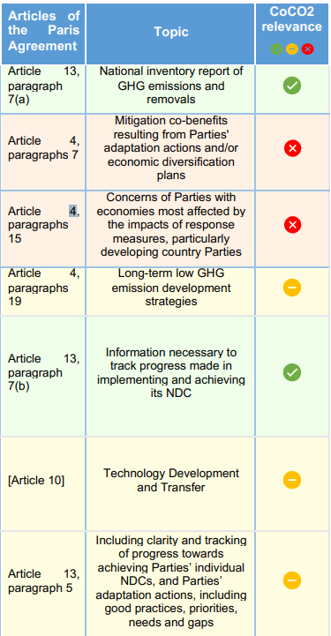
GLOBAL: Paris Agreement Global Stocktake
Emission Monitoring & Verification System (MVS) will contribute to GST1
MVS Roadmap to deliver timely information products for the Technical Assessment
Product Specification to be further iterated
Source: https://unfccc.int/sites/default/files/resource/The Global Stocktake.pdf, modified

Slide 8
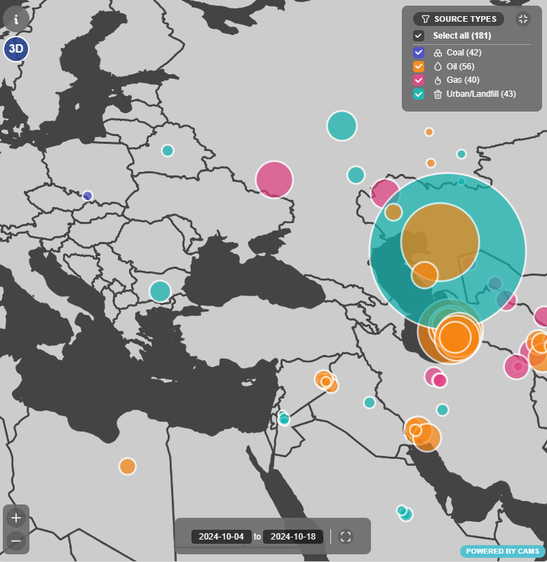
LOCAL: Methane hotspot detection
Characterisation of local sources
Verify local mitigation efforts
Validation of modelling
Tip & cue (with 3rd
party missions)

Slide 9
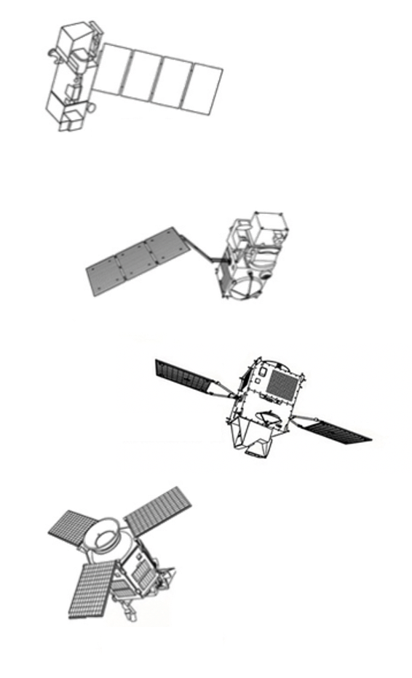
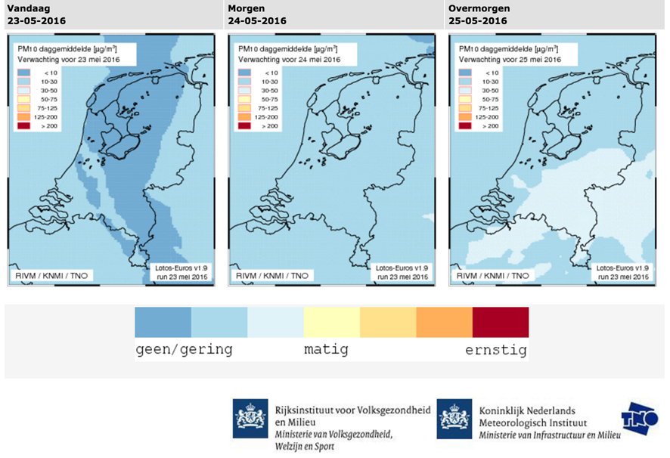
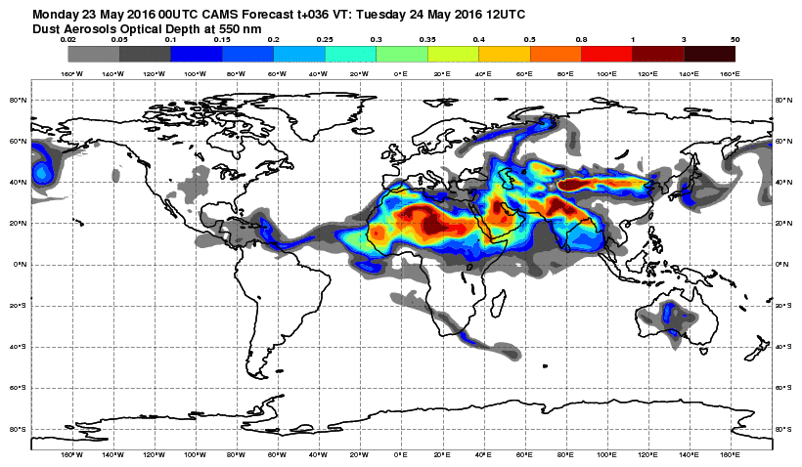
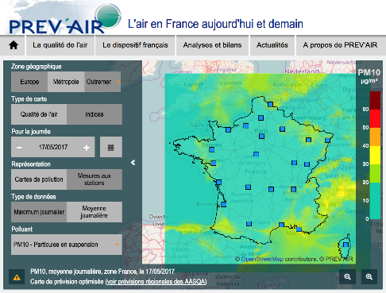
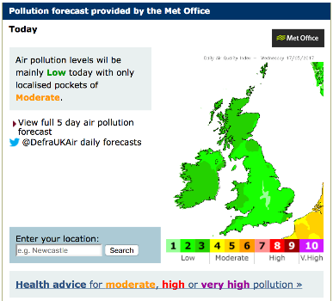
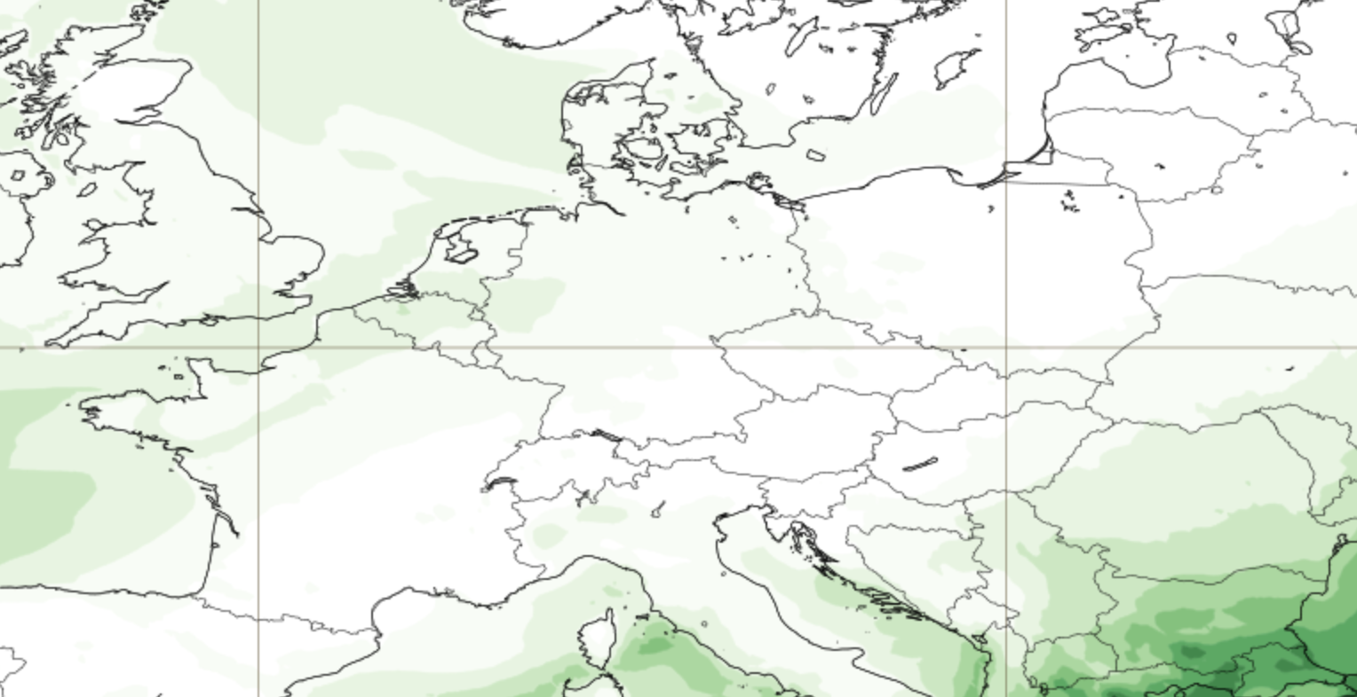
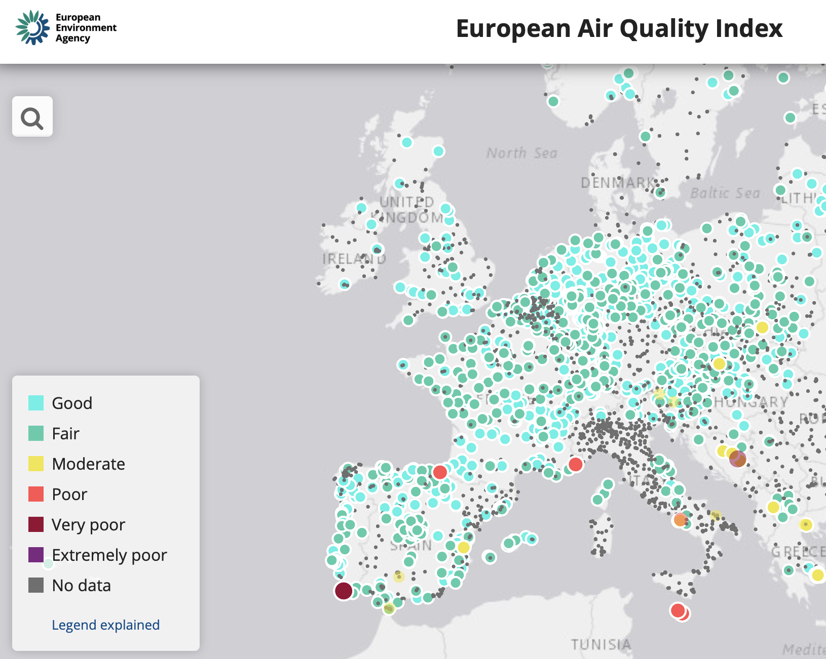
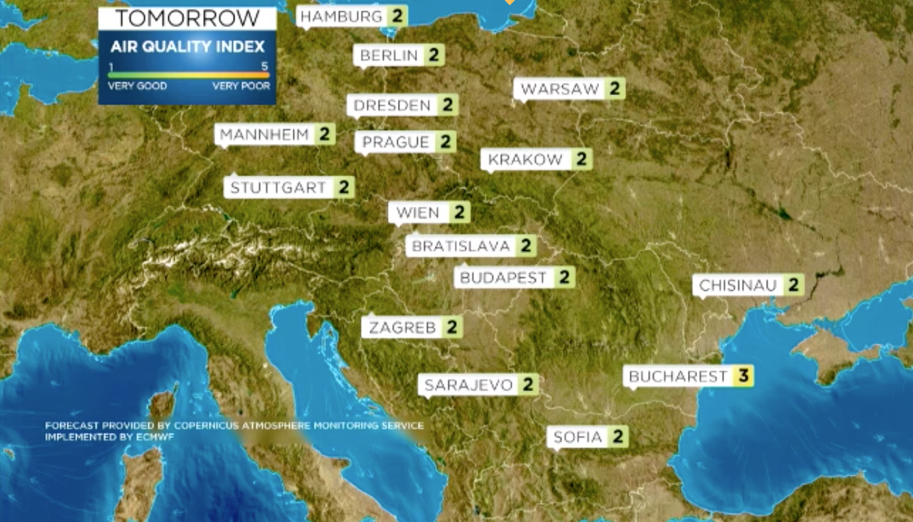
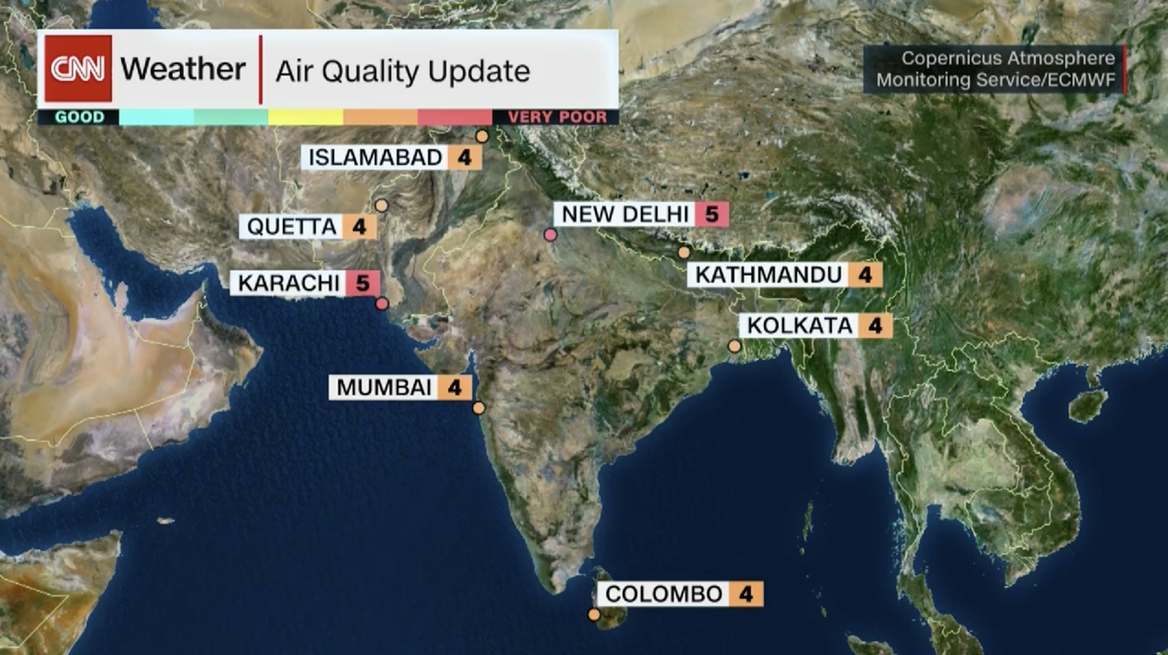



CAMS Workflow
CAMS users
∼36000
(∼3000 routine)
40km Globe (twice daily, d+5)
Earth Observation from satellite (>80 instruments) and in-situ (regulatory and research)
CAMS main operational data assimilation and modelling systems
Major multiplication factor
(100Mil+)
10km Europe
(daily, d+4)

Slide 10
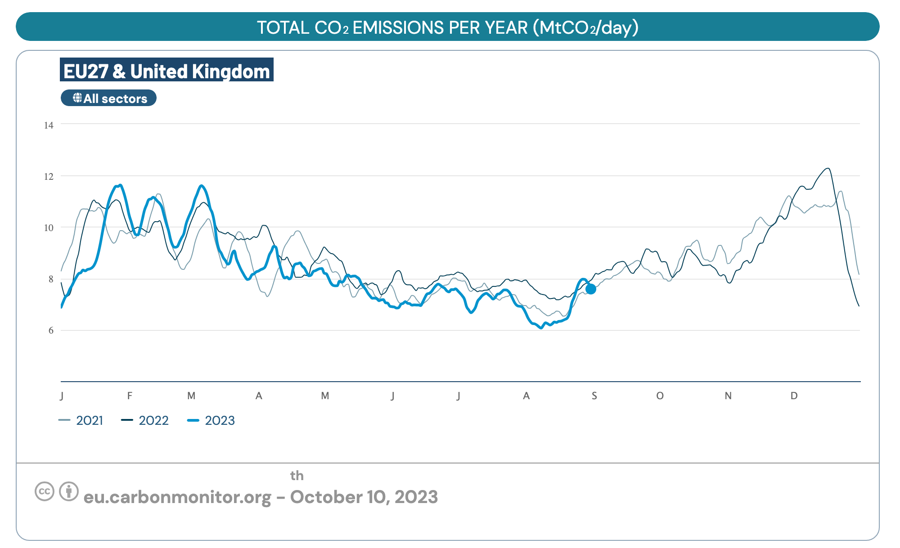
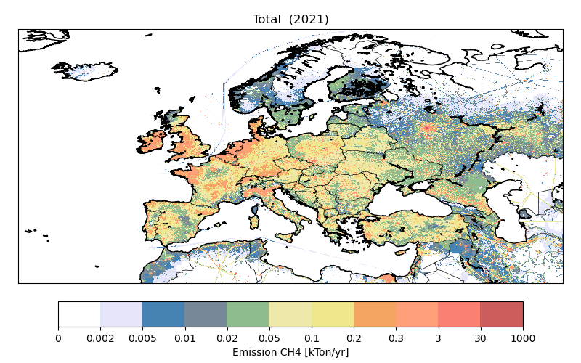
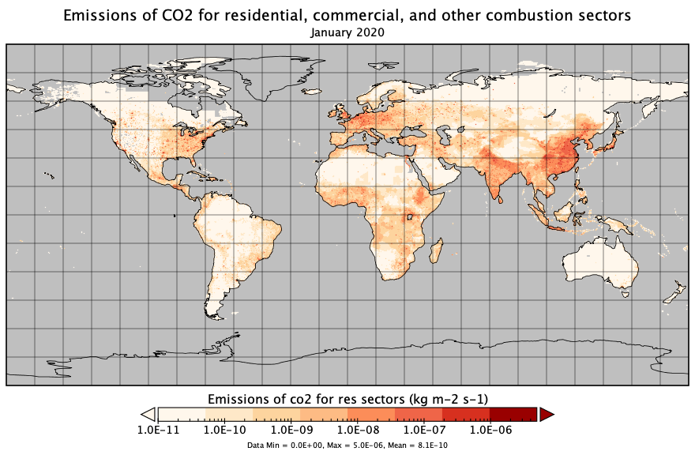
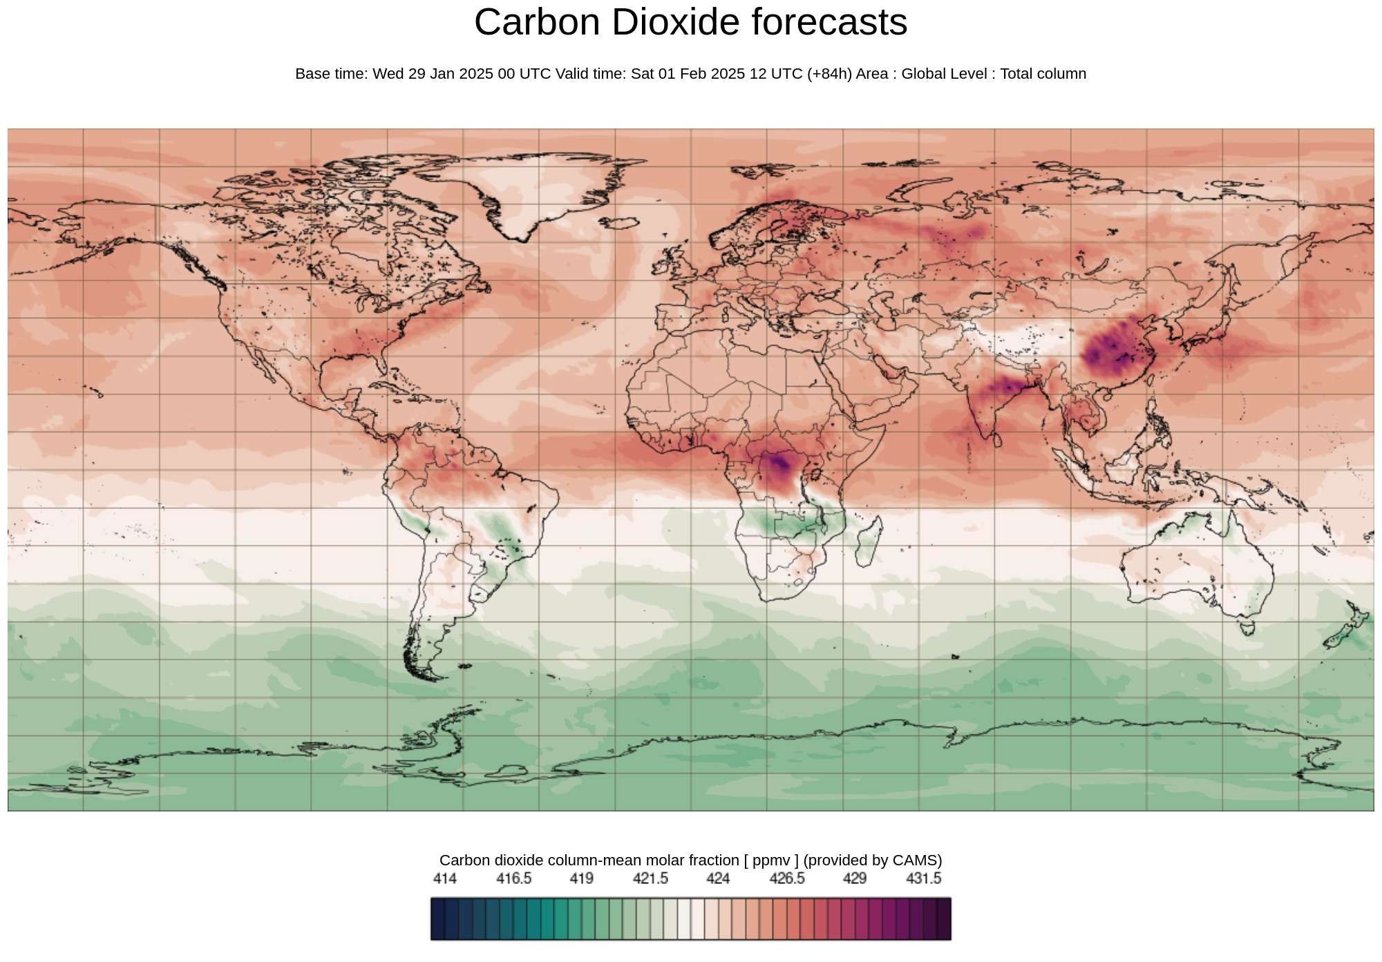
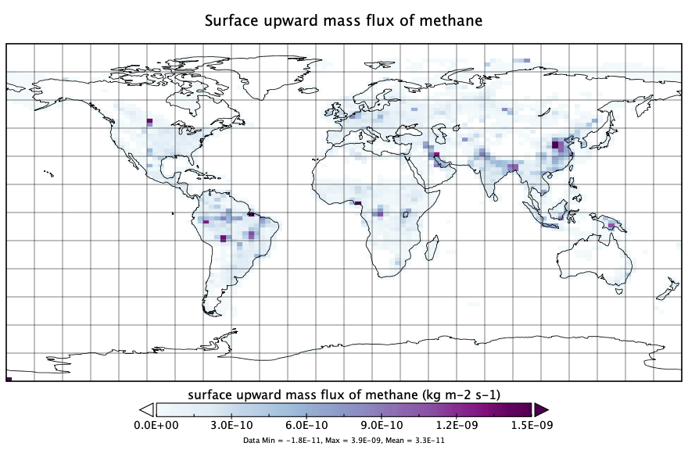
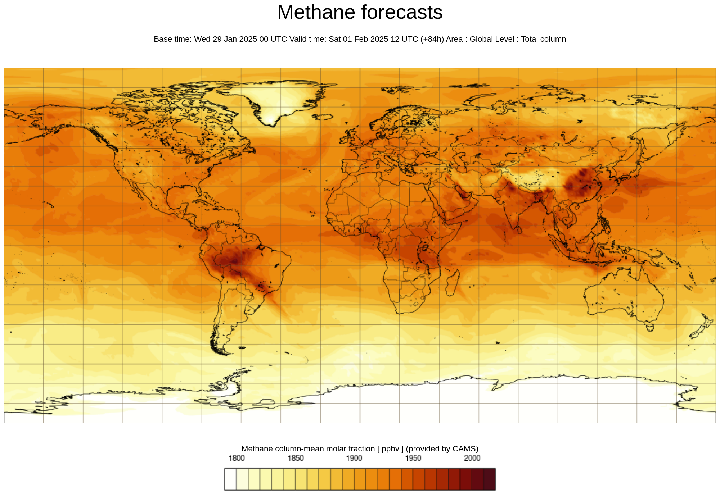
CAMS current offer on GHG information products
Inventory-based emissions
Activity-based emissions
Daily CO₂ and CH₄ analyses & forecasts
Annually updated flux inversions for CO₂, CH₄, and N₂O

Slide 11
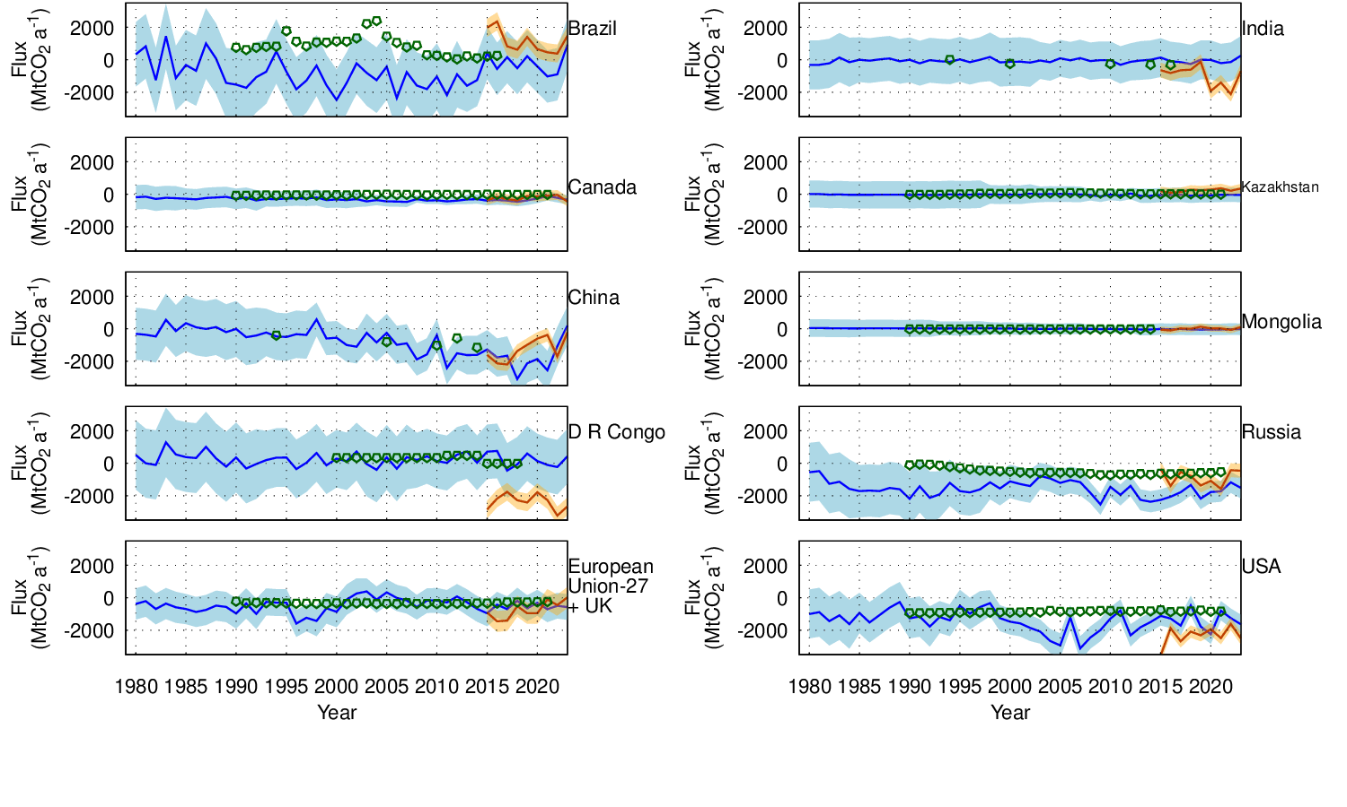
AFOLU fluxes
Estimates of CO₂ fluxes for AFOLU sector.
In-situ based
Satellite based
Reported to UNFCCC
The CAMS CO₂ atmospheric inversion data can be post-processed to provide policy relevant information.

Slide 12
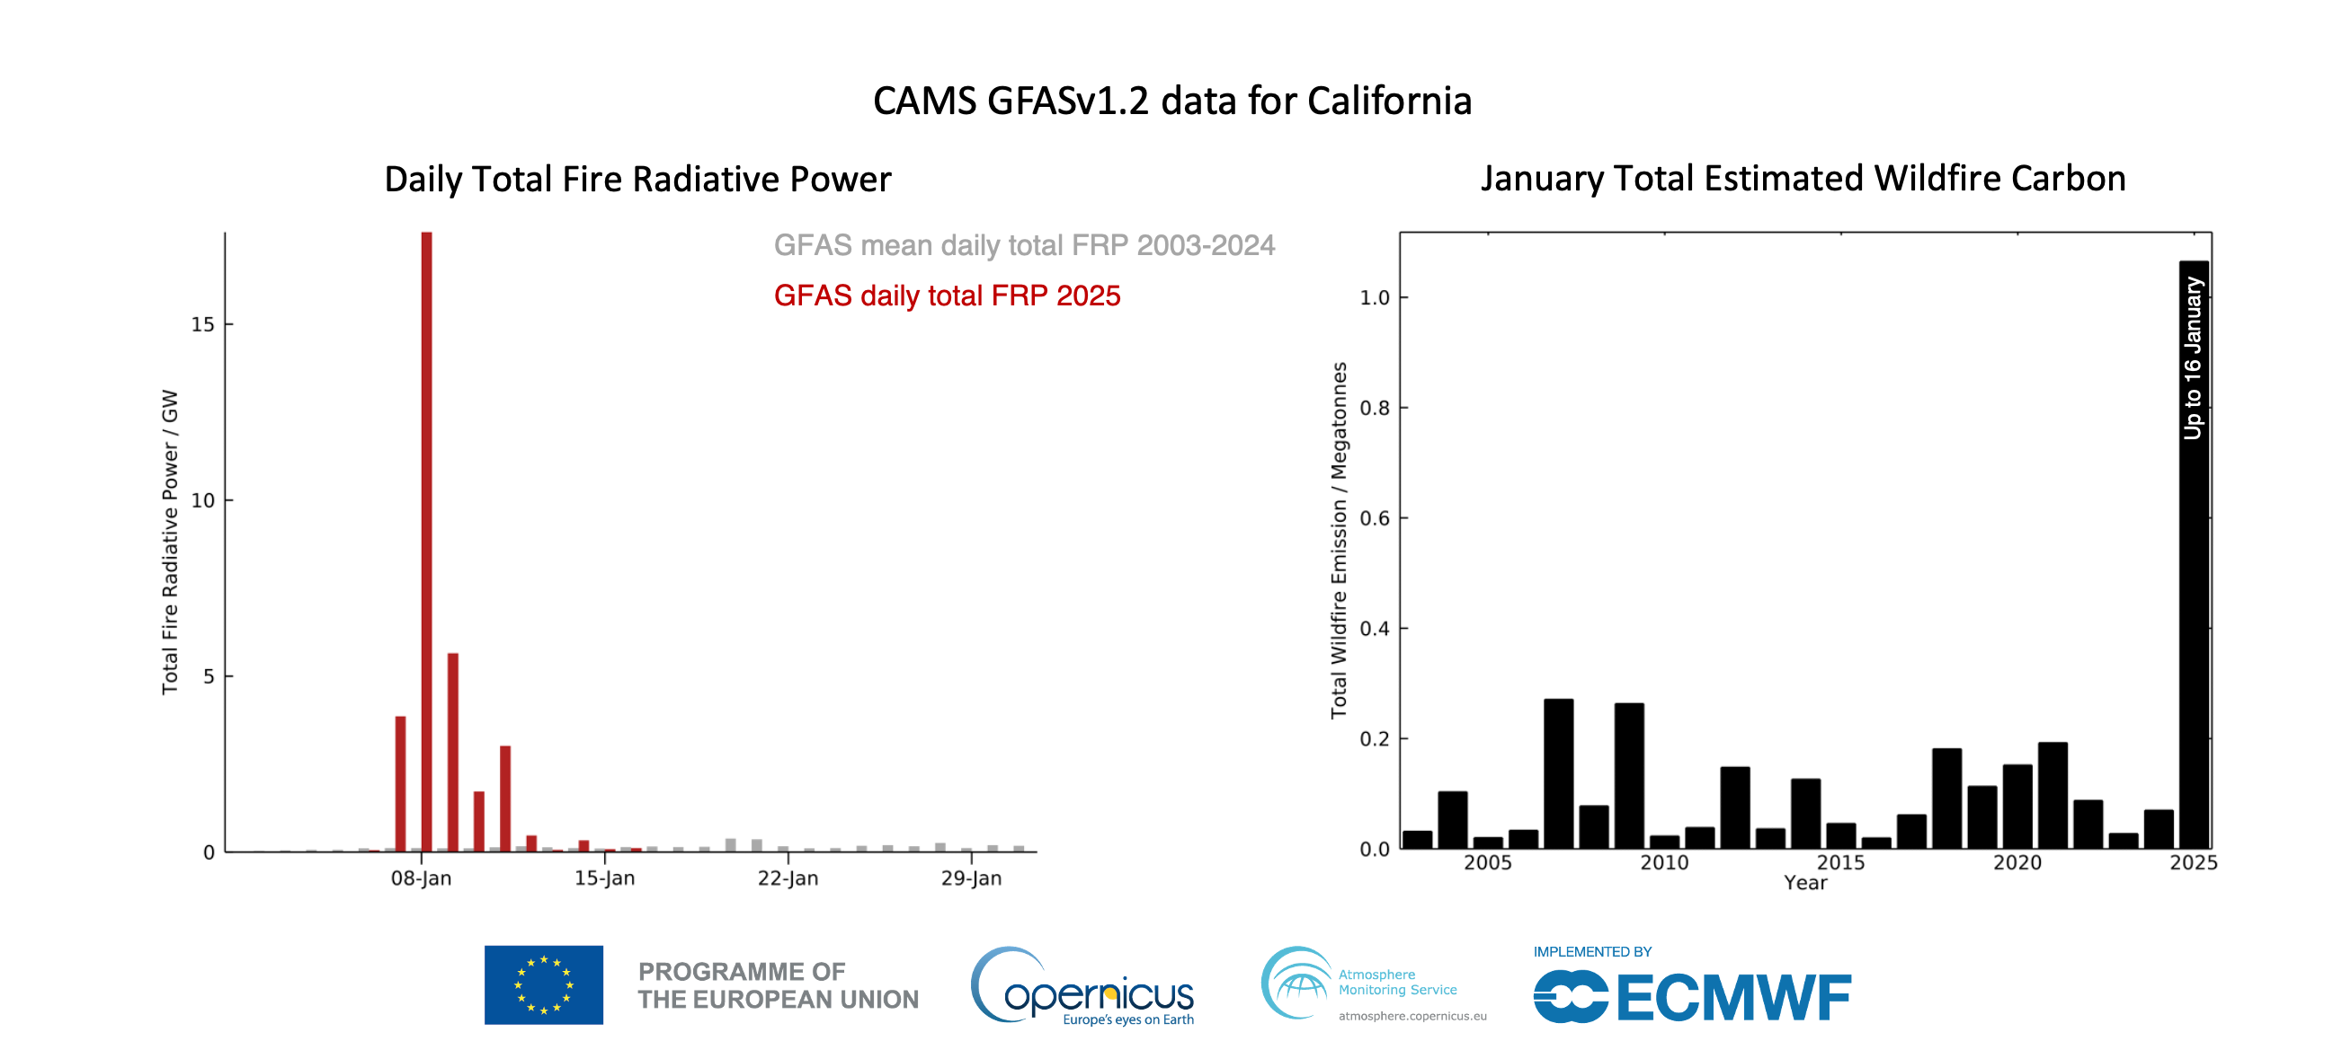
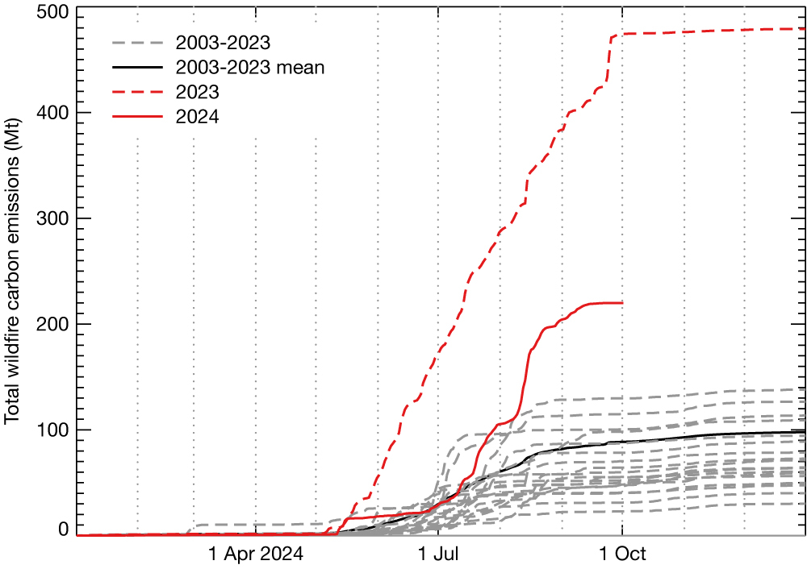
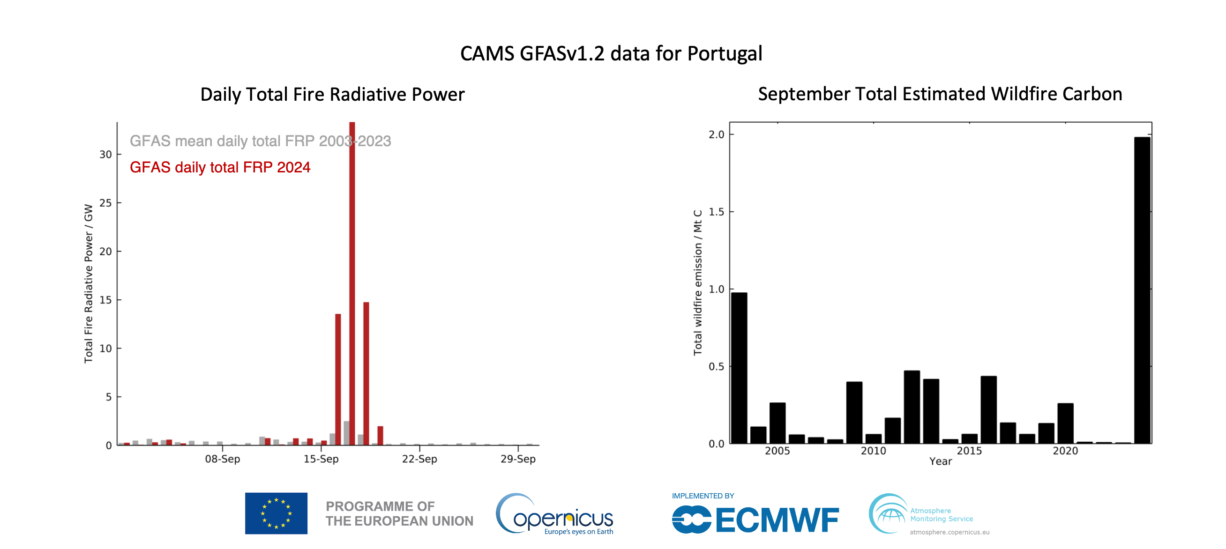
CAMS wildfire emissions
Canada wildfire carbon emissions. GFASv1.2 daily total cumulative wildfire carbon emissions for Canada in 2024 (red solid line) compared to 2023 (red dashed line) and the data for 2003–2022 (grey dashed lines, mean in black solid line).
Fire emissions are a (sometimes) important contribution to emissions. CAMS provides daily estimates (from Fire Radiative Power) that can be used to assess the impact of specific fire episodes.

Slide 13
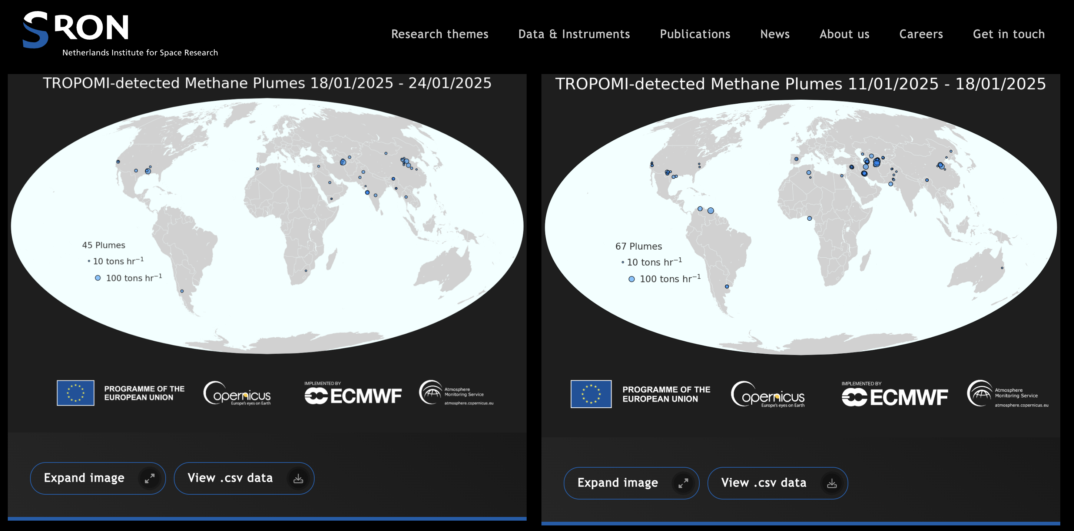
Operational methane monitoring with Sentinel satellites
As a next step in ramping up the new operational portfolio on emission monitoring products for CO₂ and CH₄, also contributing to IMEO and WMO G3W, CAMS has now implemented a CH₄ hotspot emission service.

Slide 14
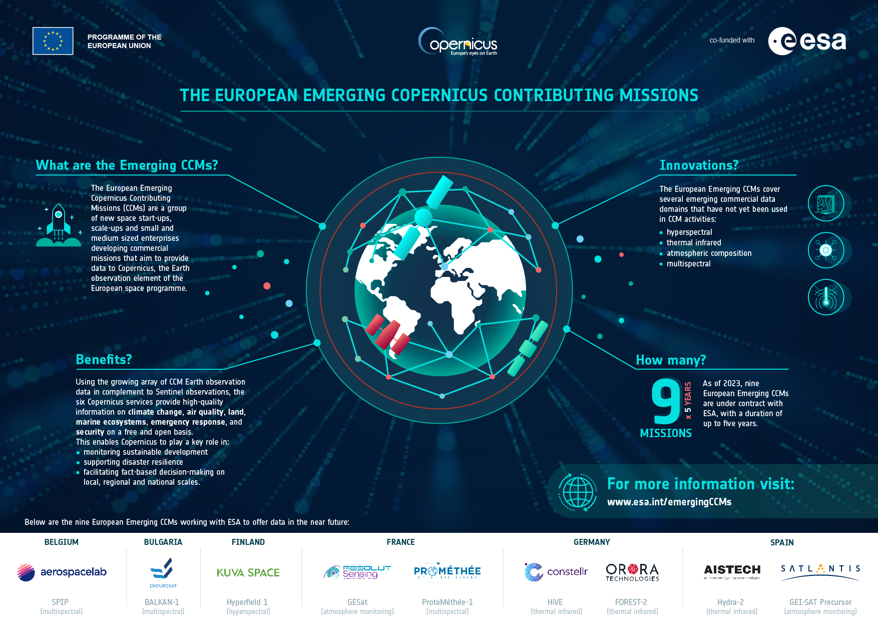
Copernicus Contributing Missions
CAMS also works with ESA’s Copernicus Contributing Missions programme with a particular focus on methane emission detection with new European small-sat missions.
Use cases have been set up with GHGSat, Satlantis, and Absolute Sensing to explore the maturity and quality of these new observations.

Slide 15
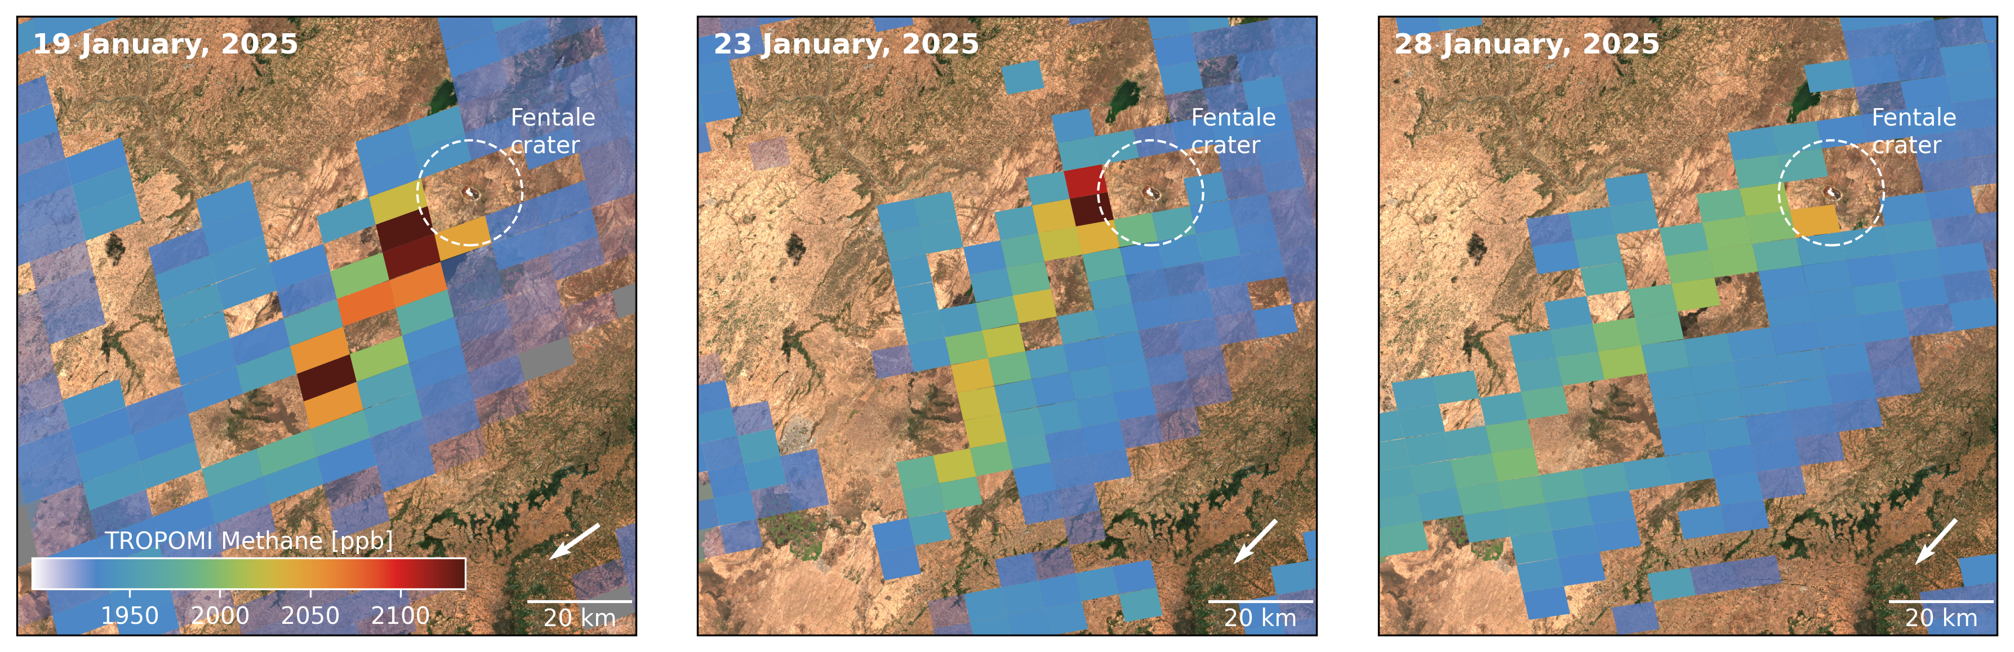
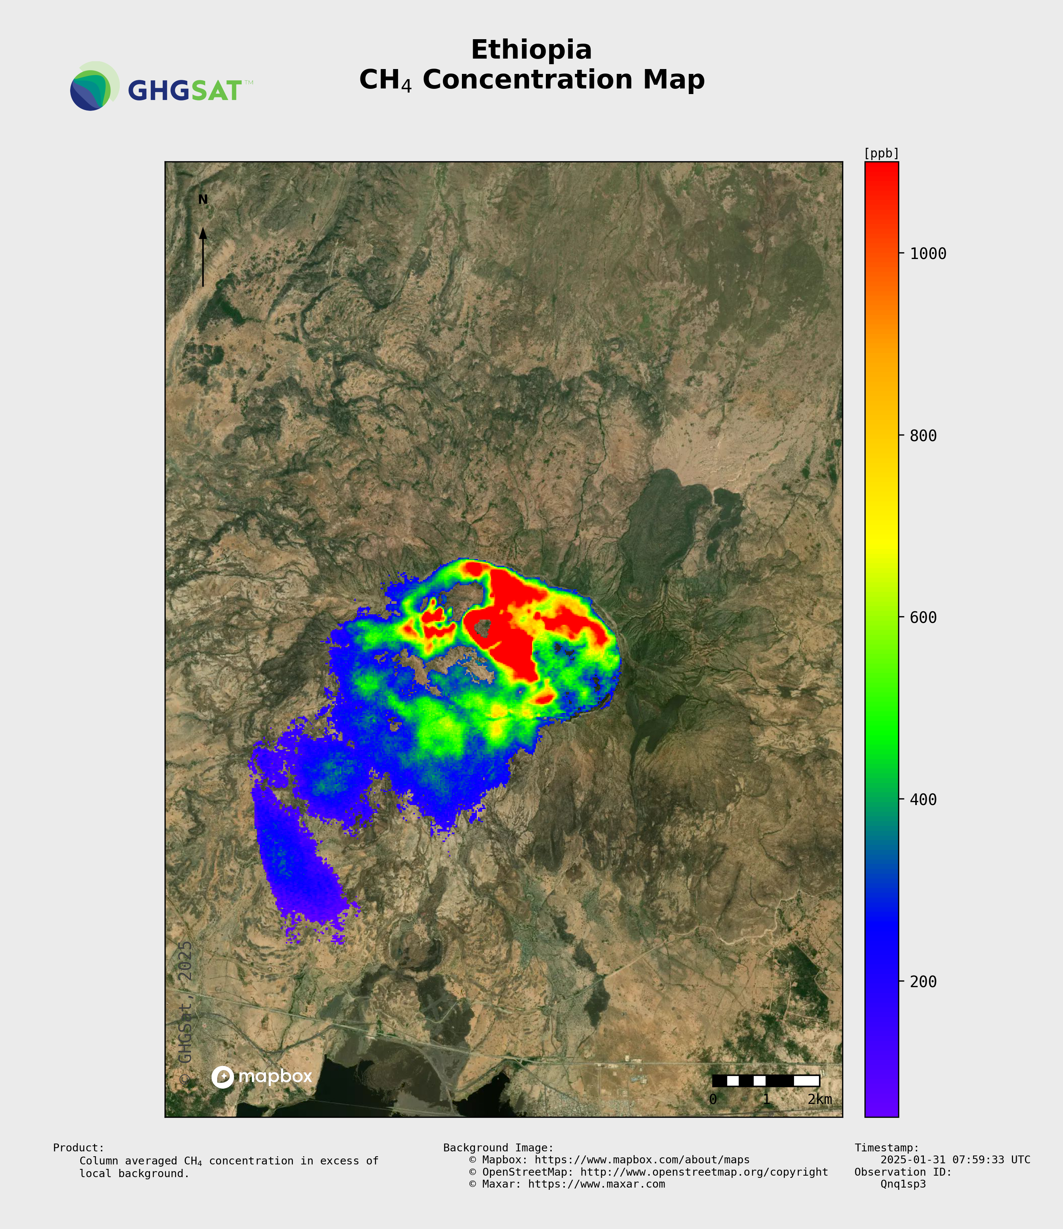
Methane Emission from Ethiopia’s Mount Fentale Volcano
CAMS TropOMI-based CH₄ detections
The CAMS TropOMI-based service provides methane detections with a short latency (< 1 week) that can detect unexpected events.
Working with GHGSat (and other CCM missions in the future) then allows to zoom in.

Slide 16
A global integrated system

Slide 17
Summary
CAMS is ramping up its emission monitoring services with a first portfolio to become operational in 2026/2027.
Mature elements are already introduced, currently focused on bottom-up estimates and CH₄ hotspot monitoring.
CO₂ emission monitoring requires increase in observations: MicroCarb, GOSAT-GW, CO2M. Exciting times, but very significant work ahead.
Services will consist of routine near-real-time monitoring and (multi-)annual reprocessing. Exact configurations will depend on user requirements.
Within Europe, CAMS is already interacting with several member states to explore the requirements and uptake.
Strong link to emission monitoring for atmospheric pollutants.

