Slide 1
CEOS GST Strategy
2025 Update to reflect Lessons Learned
Osamu Ochiai, JAXA
SIT Chair Team
Agenda Item 4.4

Slide 2
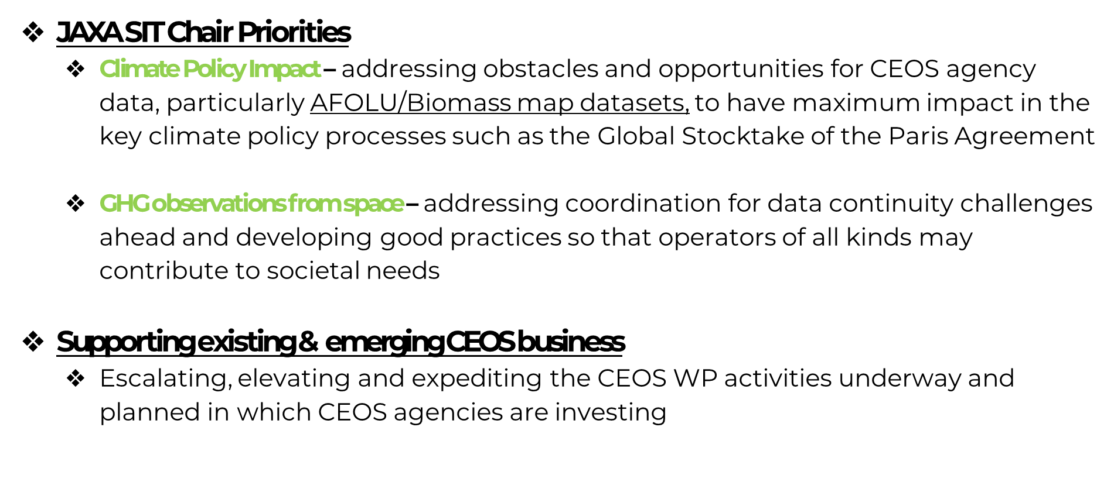
JAXA SIT Chair Priorities

Slide 3

CEOS GST Strategy
Issue 1 published in 2021 under the Australian SIT Chair Team
Focused on the first GST in 2023
Nine recommendations

Slide 4
Issue 2 of the CEOS GST Strategy
Goals:
  Address Lessons Learned study outcomes
    take forward priority recommendations
  Understand the changing landscape with UNFCCC, GEO, WMO, etc. and optimal CEOS engagement
  Define next steps to improve the representation of systematic observations in the GST process and possibly beyond
  Engage relevant CEOS agency experts and groups on the way for implementation capacity

Slide 5
Timeline
2024
2025
SIT-39
SIT-TW
Plenary
Canada
SIT-40
SIT-TW
Plenary
UK
COP-30
GST STRATEGY
GST 1 LESSONS LEARNED
GST STRATEGY UPDATE
Draft
Draft & CEOS WP actions
WGClimate LL paper circulated by SIT Chair to CEOS agencies and groups for any comments
GST 1 Lessons Learned endorsed at SIT-40 (April 2025)
  Kick off GST Strategy update
Draft GST Strategy Issue 2 presented for discussion at SIT TW (Sept 2025)
Final GST Strategy Issue 2 presented for endorsement at CEOS Plenary (Nov 2025)

Slide 6
Next steps
Looking for champions to help draft Issue 2 of the GST Strategy, including many from WGCimate naturally:
  Volunteers welcome, please contact SIT Chair team.
WGClimate and LSI-VC/Forest Biomass SG discussion invited
SIT-40 discussion to be scheduled to support remote participation of key individuals

Slide 7
Preliminary ideas - from the LL
More proactive, strategic and long-term UNFCCC engagement
  Tiger team to develop and implement a plan
  More coordinated RSO community prep (CEOS, WMO ++)
  Secondment to UNFCCC SEC

Slide 8
Preliminary ideas - from the LL
More emphasis on country engagement and uptake
  twinning exercise of space agencies and their national inventory counterparts (WGClimate trial in Harwell)
  greater emphasis on and coordination of our in-country work for data uptake - SilvaCarbon type model.
  GFOI MGD approach to develop more of corporate memory and faster and shared progress
Plan to convene further Climate Policy Impact calls to up the bandwidth on these topics - starting early March

Slide 9
GST Strategy Recommendations
Recommendation 1: WGClimate GHG Task Team should consult with the relevant elements of CEOS, including Associates such as ISC, WCRP and GCOS, together with modelers, to check the GHG Implementation roadmap on completeness concerning requirements for terrestrial observation (SIF; NPP, land cover, biomass, etc.) for supporting mitigation actions through the development of MVS. The actions in Annex C of the roadmap shall be complemented as needed.
Recommendation 2: The need for parallel inputs to ocean models deemed necessary for the support of MVS and for a wider validation of carbon flux estimates globally should be considered and appropriately combined into the actions in Annex C of the GHG roadmap. This should also be led by the WGClimate GHG TT in cooperation with Ocean VCs and modeling groups, together with GCOS, GOOS, WCRP and individual agencies.
Recommendation 3: The results of the actions from the above recommendations should inform (a) the report of CEOS to UNFCCC/RSO discussion on observation to support the implementation of the Paris Agreement and should proactively flow into (b) the consultancy process of the UNFCCC / Ad hoc group for the Synthesis Report on Observations for the GST. CEOS should also report on this at the Earth Information Day at COP26. CEOS and its Agencies should argue to be a primary source of consistent global land and ocean surface data (land cover type, biomass, phenology…) in the discussion with UNFCCC/RSO, in addition to providing the integrated measurements of GHG and co-emitted species in the atmosphere.

Slide 10
GST Strategy Recommendations
Recommendation 4: CEOS should consider, in conjunction with modelers, setting up one or more focused observational campaigns in the areas suggested above, or others, as a major contribution to the understanding of the trends of GHG emissions from natural sources in key areas.
Recommendation 5: The AFOLU Roadmap Team should continue the work it has started for CEOS, reflecting the decisions taken at CEOS Plenary 2020. The AFOLU Roadmap Team and WGClimate GHG Task Team should work together to ensure consistency between data for emissions reported via AFOLU and for prior biogenic terrestrial emissions, and those due to changing land use, in implementing monitoring and verification systems. These need to be consistent on both temporal and spatial scales. The WGClimate GHG Task Team should ensure that their Roadmap is consistent with the outcomes of this discussion.
Recommendation 6: It is recommended that to help in ensuring the take-up of satellite-based methods for AFOLU (and indeed in the context of MVS) CEOS should work with a few selected demonstrator countries to assist them in their national reporting under AFOLU (the model of GFOI can be compared). USGS through its SilvaCarbon programme has volunteered to lead this work, together with relevant CEOS bodies (LSI-VC, AFOLU Roadmap Team, CEOS member contributions).

Slide 11
GST Strategy Recommendations
Recommendation 7: CEOS should work with the various partners set out above to identify data requirements and actions for CEOS in relation to adaptation, including participation of relevant CEOS groups such as WGClimate and WGDisasters. Case studies might be of value to demonstrate competence and relevance. Partnership with specific countries in implementing their NAPs could be of value, as in the case of AFOLU above, both to demonstrate worked examples and to strengthen support for this approach at UNFCCC, including at CoPs.
Recommendation 8: CEOS should maintain a watch over the implementation of projects funded through climate fund mechanisms to ensure that all appropriate assistance is given by agencies in their implementation and governance.
Recommendation 9: CEOS must continue all efforts to provide the necessary climate data records which support the assessment of the actual status of the climate and the prediction and projection of future climate change, its response to changing GHG emissions and other drivers, and impacts of climate change.

