Slide 1
3.6 Flux Inversion Modelling:
Assess adaptation of current
CEOS practices for G3W applications (INV-01)
David Crisp (SIT Chair Team)
for AC-VC GHG Flux Team
Agenda Item 3.6

Slide 2
GGGW
Many of the existing international and national activities dealing with greenhouse gases
Supported mainly by the research community, relying on availability of research funds.
G3W provides a platform for timely international exchange of surface and space-based greenhouse gas observations and modelling products.
In its initial set-up the Global Greenhouse Gas Watch will deliver the following products:
Monthly CO₂ net fluxes between the Earth surface and the atmosphere with 1° x 1° horizontal resolution delivered with maximum a delay of one month,
Monthly CH₄ net fluxes between the Earth surface and the atmosphere with 1° x 1° horizontal resolution delivered with a delay of one month,
3-Dimensional fields of CO₂ and CH₄ abundance with hourly resolution and data latency to be defined (tentatively on the order of a few days), and
N₂O abundances and net fluxes with resolution and latency still to be defined.

Slide 3
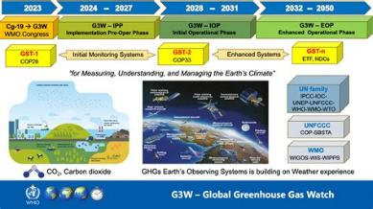
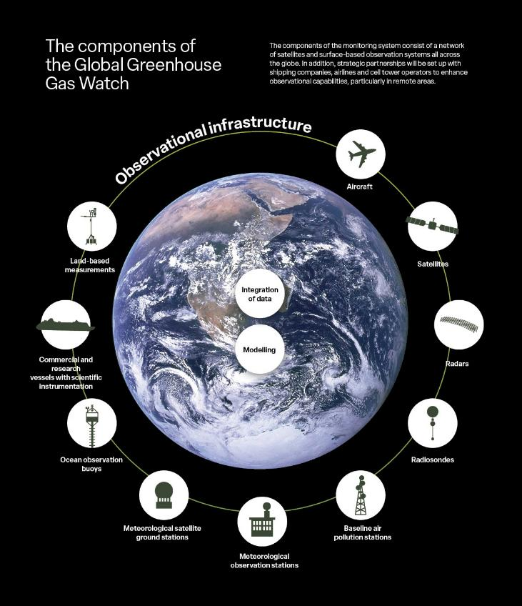

CEOS impacts on G3W
CEOS members will provide the bulk of satellite data for CO2 and CH4 at global scales
  CEOS is also helping to integrate private GHG suppliers within the broader observing system
  To meet G3W satellite data will need to be:
              Low-latency
              Consistent calibration
              Well-characterized sampling
CEOS has led development of modeling and assimilation methods to integrate satellite data
The impacts of latency, retrieval consistency, and spatio-temporal sampling of these satellite data will need to be assessed.

Slide 4
How consistent are CEOS L2 products and how do they impact flux estimates?
Consistent, interoperable global products are essential for meeting the G3W objectives
This requires consistent, harmonized L2 products
It also requires consistent, traceable, interoperable flux inversion modeling systems
Consistency between CEOS L2 products can be evaluated in a number of different ways.
Application of a common algorithm to multiple sensors
Data fusion between sensors
Progress toward these objectives is summarized here

Slide 5





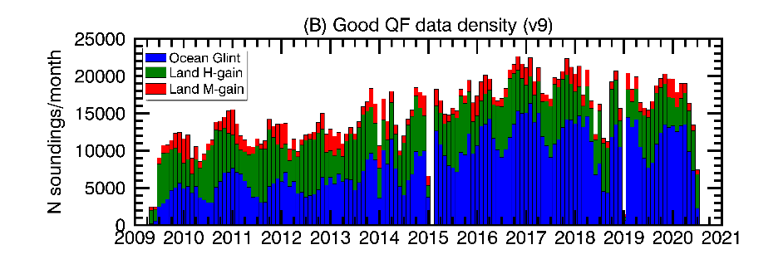
Into the multi-satellite XCO₂ era:
Creating the ACOS/GOSAT version 11 product
Background
The OCO-2 XCO₂ version 11 data product (2014-present) is the gold standard for satellite CO₂ retrievals.
GOSAT is a similar, high-quality instrument that begins in 2009, but currently has no similarly high-quality XCO₂ product.
CSU is processing the entire GOSAT record through the ACOS version 11 full-physics retrieval.
ACOS/GOSAT v9 product, 2009-2020
The ACOS/GOSAT product supplements the OCO-2 product by adding 5 years to the record, and provides global coverage.
Start of OCO-2 record

Slide 6
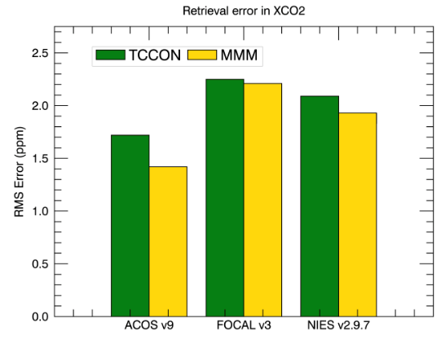
Into the multi-satellite XCO₂ era:
Creating the ACOS/GOSAT version 11 product
GOSAT XCO₂ errors from 3 retrievals
Impacts
The ACOS/GOSAT v11 XCO₂ product will be delivered to the GES-DISC; NRT processing of it will enable assimilation into GMAO’s carbon models.
This will both extend the satellite record back to 2009, and enable testing of a multi-satellite CO₂ assimilation system for the first time.
Knowledge gained in this process will be critical as we enter an era of multiple CO₂ monitoring satellites: GOSAT-GW, CO2M, Carbon-I, etc.
Fosters collaboration between NASA and JAXA.
The ACOS XCO₂ product has superior error statistics as compared to two other algorithms: FOCAL v3 (Univ of Bremen), and the operational NIES v2.9.7 retrieval. Here, errors are determined either by colocations with TCCON or a multi-model median (MMM).

Slide 7
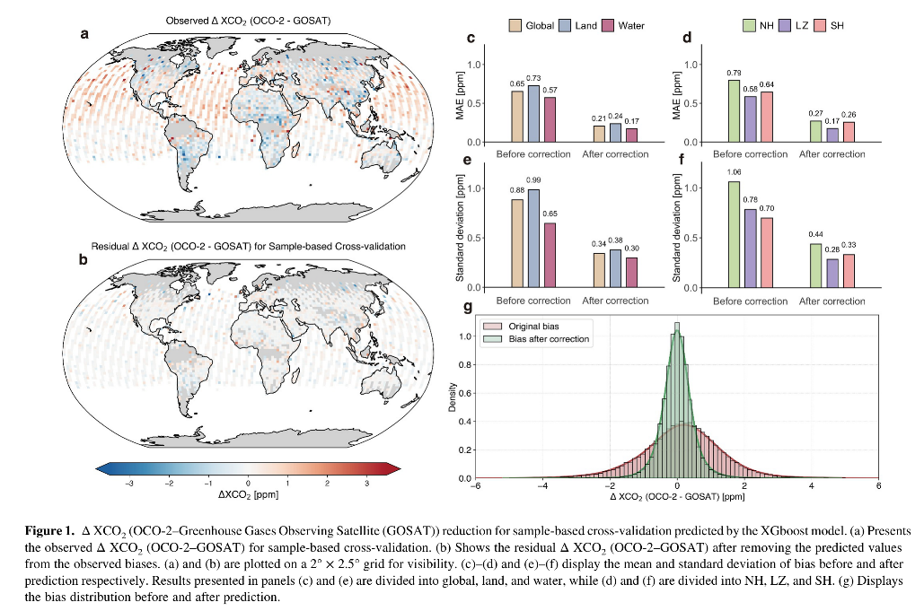
Multi-instrument calibration through Machine Learning
Machine learning approaches are being used to harmonize OCO-2 and GOSAT data.
• Machine learning reduced GOSAT-OCO-2 XCO₂ bias by 71.5%.
• Annual observation coverage increased by 53.6% (84.7K new observations).
• Adjusted dataset closely matches TCCON ground-based observations (bias: 0.06 ppm).
• The method can be applied to future satellite missions for carbon flux monitoring.

Slide 8
Low-Latency L2 products

Slide 9
OCO-2 & OCO-3 forward, retrospective streams
Forward stream:
  Typically delivered within one week of acquisition
  Processes around 6% of soundings through L2
  å
The OCO satellites deliver two data streams:
Forward stream:
      Relies on extrapolated calibration data
      Processes around 6% of soundings through L2
      Current time: No bias correction, filtering applied to forward stream L2
      Typically delivered within one week of acquisition
Retrospective stream:
  Uses refined calibration coefficients (informed by analysis of forward stream)
  Processes all cloud-free soundings through L2
  Used to generate bias corrected and quality filtered “Lite” products that we recommend for science use
  Typically delivered at monthly intervals
Work is underway to release bias corrected and filtered forward stream products for OCO-2 and OCO-3 to reduce data latency

Slide 10
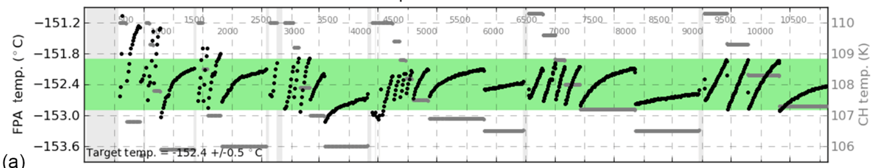
How bad/good is the OCO-2 forward stream?
Figure from Crisp et al. (2017), showing thermal performance of the OCO-2 instrument focal plane arrays early in the mission
Ice accumulation from outgassing of water necessitates periodic actions
  Decontamination cycles: Instrument warmed to near room temperature for few days (gray vertical lines on figure)
  Temp. of focal plane array maintained by adjustments to cryocooler cold head temp. (horizontal gray lines on figure)
Early in the OCO-2 mission: “Forward stream bad”
  Frequent adjustments needed, forward stream radiances show issues with calibration across time boundaries
Retrospective processing allows thermal adjustments to be properly accounted for in L1B calibration
Ice accumulation has slowed over time
  10+ years in, calibration is far more stable
  Cal and ops teams recently implemented updated processes to avoid boundary issues in forward stream L1B calibration
Current day in OCO-2 mission: “Forward stream good!”

Slide 11
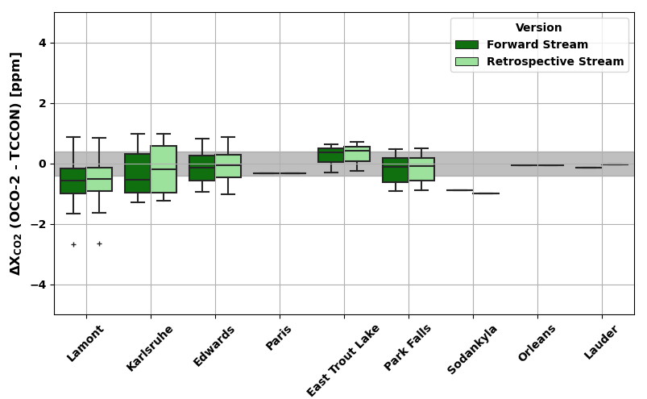
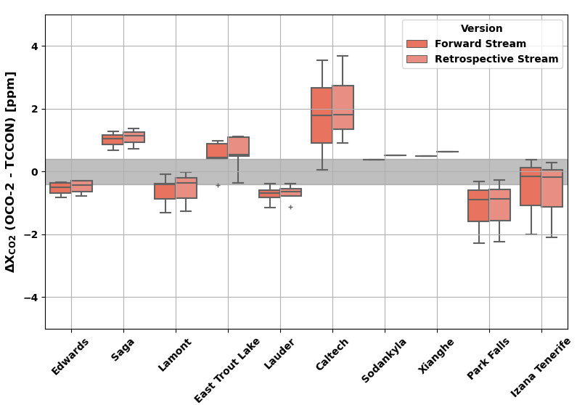
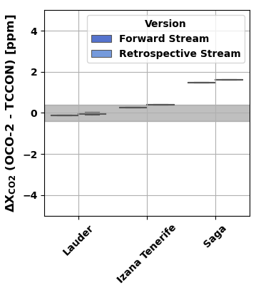
OCO-2 vs TCCON: Forward and retrospective now comparable in accuracy, precision
Land Nadir/Glint
Target
Figures from S. Das (JPL) OCO-2 v11.1
Retrospective stream
  Publicly available “Lite” L2 product
  Date range: 09/2014 – 12/2022
Forward stream
  Bias-corrected and filtered L2 files generated by C. O’Dell (CSU)
  Date range: 03/2022 – 03/2022
Ocean Glint

Slide 12
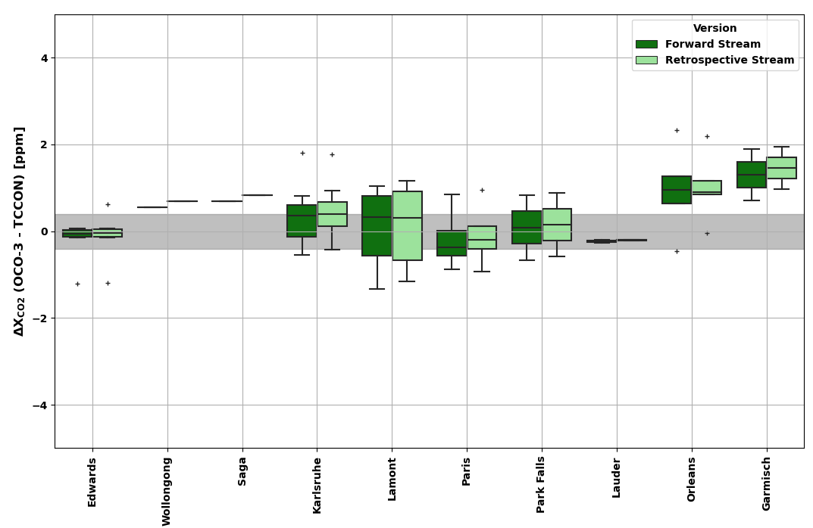
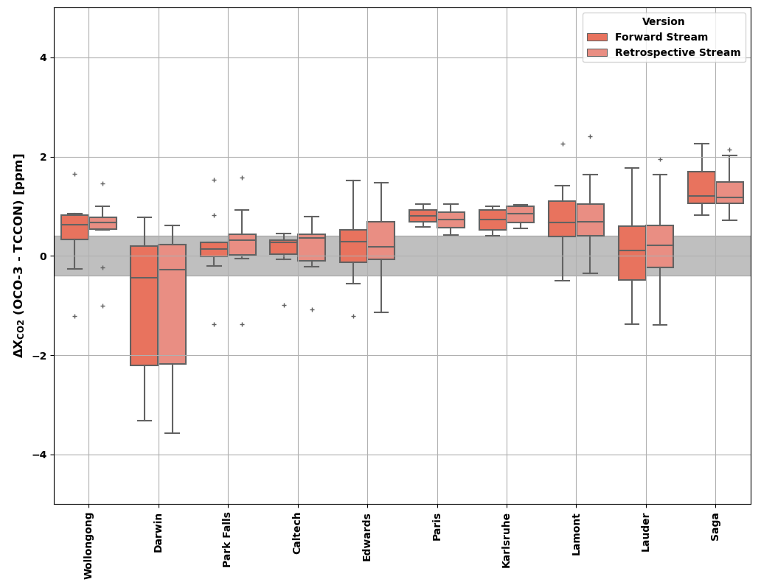
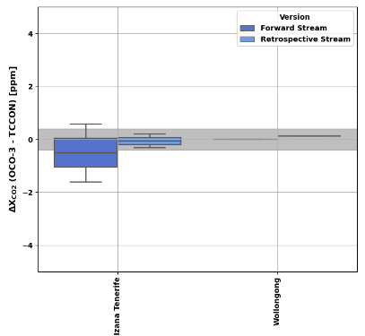
OCO-3 vs TCCON: Forward and retrospective also comparable in accuracy, precision
Land Nadir/Glint
Target
Ocean Glint
Figures from S. Das (JPL) OCO-3 v10.4
Retrospective stream
  Publicly available “Lite” L2 product
  Date range: 08/2019 – 02/2023
Forward stream
  Bias-corrected and filtered L2 files generated by C. O’Dell (CSU)
  Date range: 07/2021 – 02/2023
?

Slide 13
Low-latency products
TROPOMI can provide xCH4 with about a 2-day latency.
From Nesser et al, 2019

Slide 14
Future missions-GOSAT-GW
GOSAT GW will have two
Modes: Focus and Wide.
The latency will differ:
Wide Mode – 1-1.5 month
Focus Mode – 2-3 days to week
(at most)
Tanimoto et al, Prog Earth Planetary Sci. 2025

Slide 15
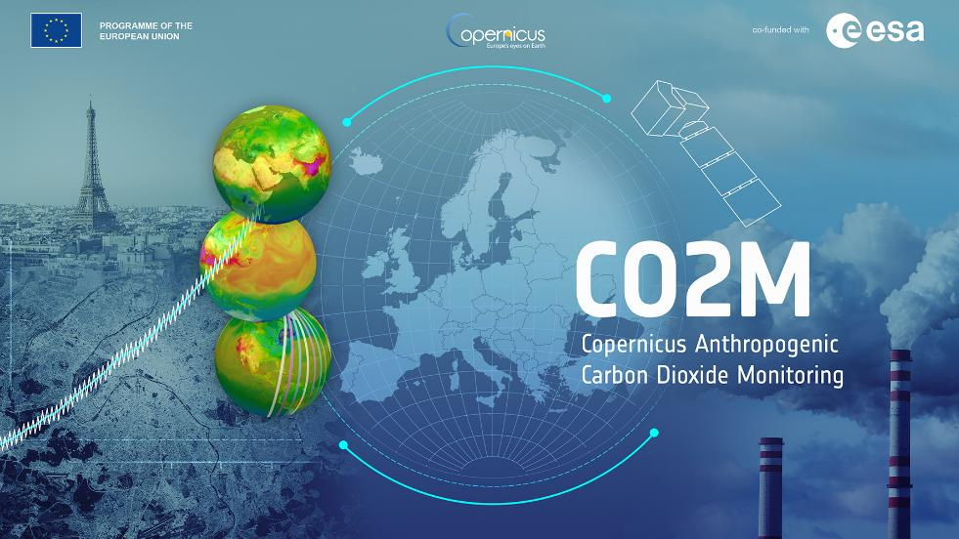
CO2M
CO2M will use:
3 full-physics based algorithms and will fuse data from three satellites:
RemoTAP (SRON)
Fusional-P (IUP Bremen)
FOCAL (IUP Bremen)
The time for the retrievals is expected to be
60 seconds for Fusional-P (4-6 seconds for FOCAL and 23 seconds for RemoTAP).
All data will be delivered within 24 hours.
Fusing the data from the three CO2M satellites to produce a harmonized L2 product that can be used for flux inversions is a large challenge

Slide 16
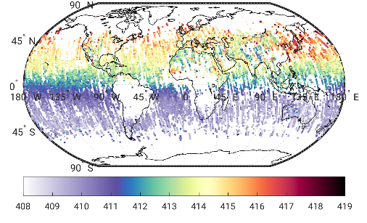
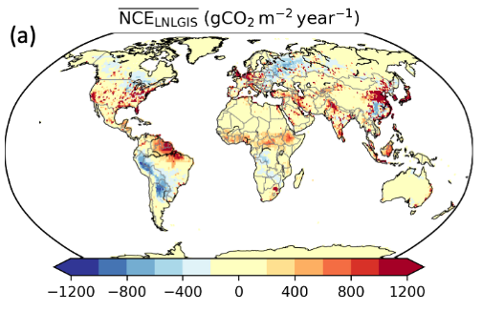
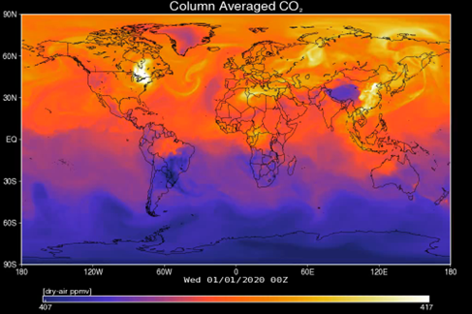
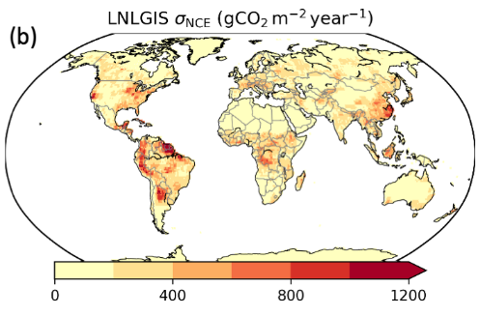
Estimating CO₂ and CH₄ emissions and removals from atmospheric measurements
As CO₂, CH₄, and other GHGs are added or removed from the atmosphere by surface sources and sinks, the modified air masses are transported away by the winds.
Atmospheric inverse models assimilate GHG concentration measurements to estimate net GHG additions and removals (fluxes) in the presence of these winds.
GHG Data
Net Carbon Exchange
Inverse Algorithm
Transport
Uncertainty

Slide 17
Fluxes: The Art of inverse modeling
Modern GHG inversion systems estimate the conditional distribution function.
Under certain assumptions, the optimal estimate is calculated by optimizing cost function
control/
state
forward model
data
prior
model-data error covariance
prior error covariance
Posterior estimate
Posterior covariance
Information content
Choices and approximation made for each component distinguishes inverse models
R&D prioritizes one or more of these elements.

Slide 18
Bottom-up and Top-Down methods are complementary
Bottom-Up Inventories of Greenhouse Gas Emissions and Removals
  Provide the best method for tracking emissions and removals by known sources with well-characterized activity data and emission factors
  Can yield direct insight into the effectiveness of emissions reduction policies for specific categories of specific sectors included in the inventory
  Provide prior information needed for top-down atmospheric inversions
Top-Down Estimates of Net Greenhouse Gas Emissions and Removals
  Exploit the best available science for assessing collective progress toward the greenhouse gas emissions reduction targets
  Offer a partially independent approach for assessing completeness of standard inventory methods based on activity data and emission factors
  Can track emissions changes on unmanaged lands associated with human activities or climate change, which are not included in inventories
  Improve traceability of emissions policies, to greenhouse gas abundances to climate

Slide 19
Challenges for Flux inversion to meet growing scientific and operational needs
Harmonized, validated, interoperable L2 datasets are critical, but not sufficient
Reliable, timely estimates of atmospheric transport, at the appropriate spatial resolution are also needed
Advances in computational capacity, and methodological approaches are needed to meet the G3W objectives
Strong coordination among CEOS/CGMS agencies, national laboratories and university communities is needed to meet these needs

