Slide 1
3.2 Calibration and Level 1
Products:
Annual vicarious calibration campaigns
Hiroshi Suto, JAXA
Agenda Item 3.2

Slide 2






RRV2024 and plan for RRV2025
In the 2024 Railroad Valley (RRV) campaign, 5 instruments joined (GOSAT/OCO-2/TROPOMI/GOSAT-2/TEMPO). (OCO-3 started its second in-orbit check-out during that campaign period)
15 years of campaign data (mainly surface reflectance) were reprocessed with an improved processing algorithm
The spectral radiance for each sensor was evaluated using the common campaign data and forward model (LIDORT)
Coordination of the 2025 campaign initiated with JPL team
Summer and Fall campaigns are being considered.
TEMPO
7 Apr 2023
Spectrometer : Grating (Geostationary)
Target Gas : NO2, O3, HCHO, SO2
Resolution : 2.1km(NS) x 4.7km (EW) rectangle@36.5N, 100W
OCO-3
4 May 2019
Spectrometer : Grating (ISS payload)
Target Gas : CO2
Resolution : 1km x 2.25km rectangle
GOSAT-2/FTS-2
29 Oct 2018
Spectrometer : FTS-2
Target Gas : CO2, CH4, CO
Resolution : 10km diameter
Sentinel-5P/TROPOMI
13 Oct 2017
Spectrometer : Grating
Target Gas : CH4, CO, NO2, O3, SO2
Resolution : 7km x 3.5km rectangle
OCO-2
2 Jul 2014
Spectrometer : Grating
Target Gas : CO2
Resolution : 3km x 2.25km rectangle
GOSAT/FTS
23 Jan 2009
Spectrometer : FTS
Target Gas : CO2, CH4
Resolution : 10km diameter

Slide 3
2024 Campaign Summary
Five days of clear sky data were acquired during 2024 campaign period.
Based on these co-incident observations, the spectral radiance for each sensors was evaluated.

Slide 4
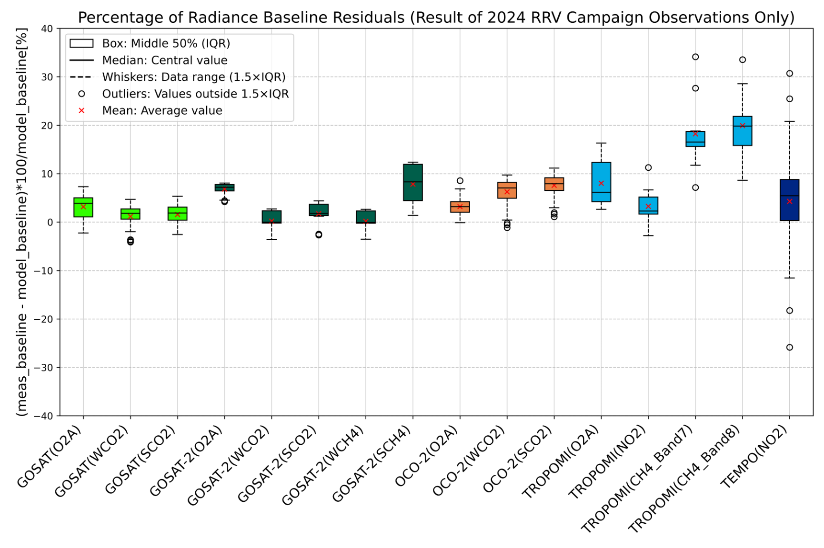





Evaluation of Multiple Sensors Using Common Processing and Ground Data for 2024 Campaign
Radiance spectra measured from space that were degradation-corrected by individual sensor teams were compared using a common forward processing algorithm with a common surface reflectance and BRDF model at the overpass time.
+/-5% variation
Used the common forward model, LIDORT 3.6.
Used MODIS BRDF model (MCD43A1) for observation geometry and IFOV corrections.
Evaluation with large off-nadir observation angles (TROPOMI, TEMPO) is challenging.

Slide 5
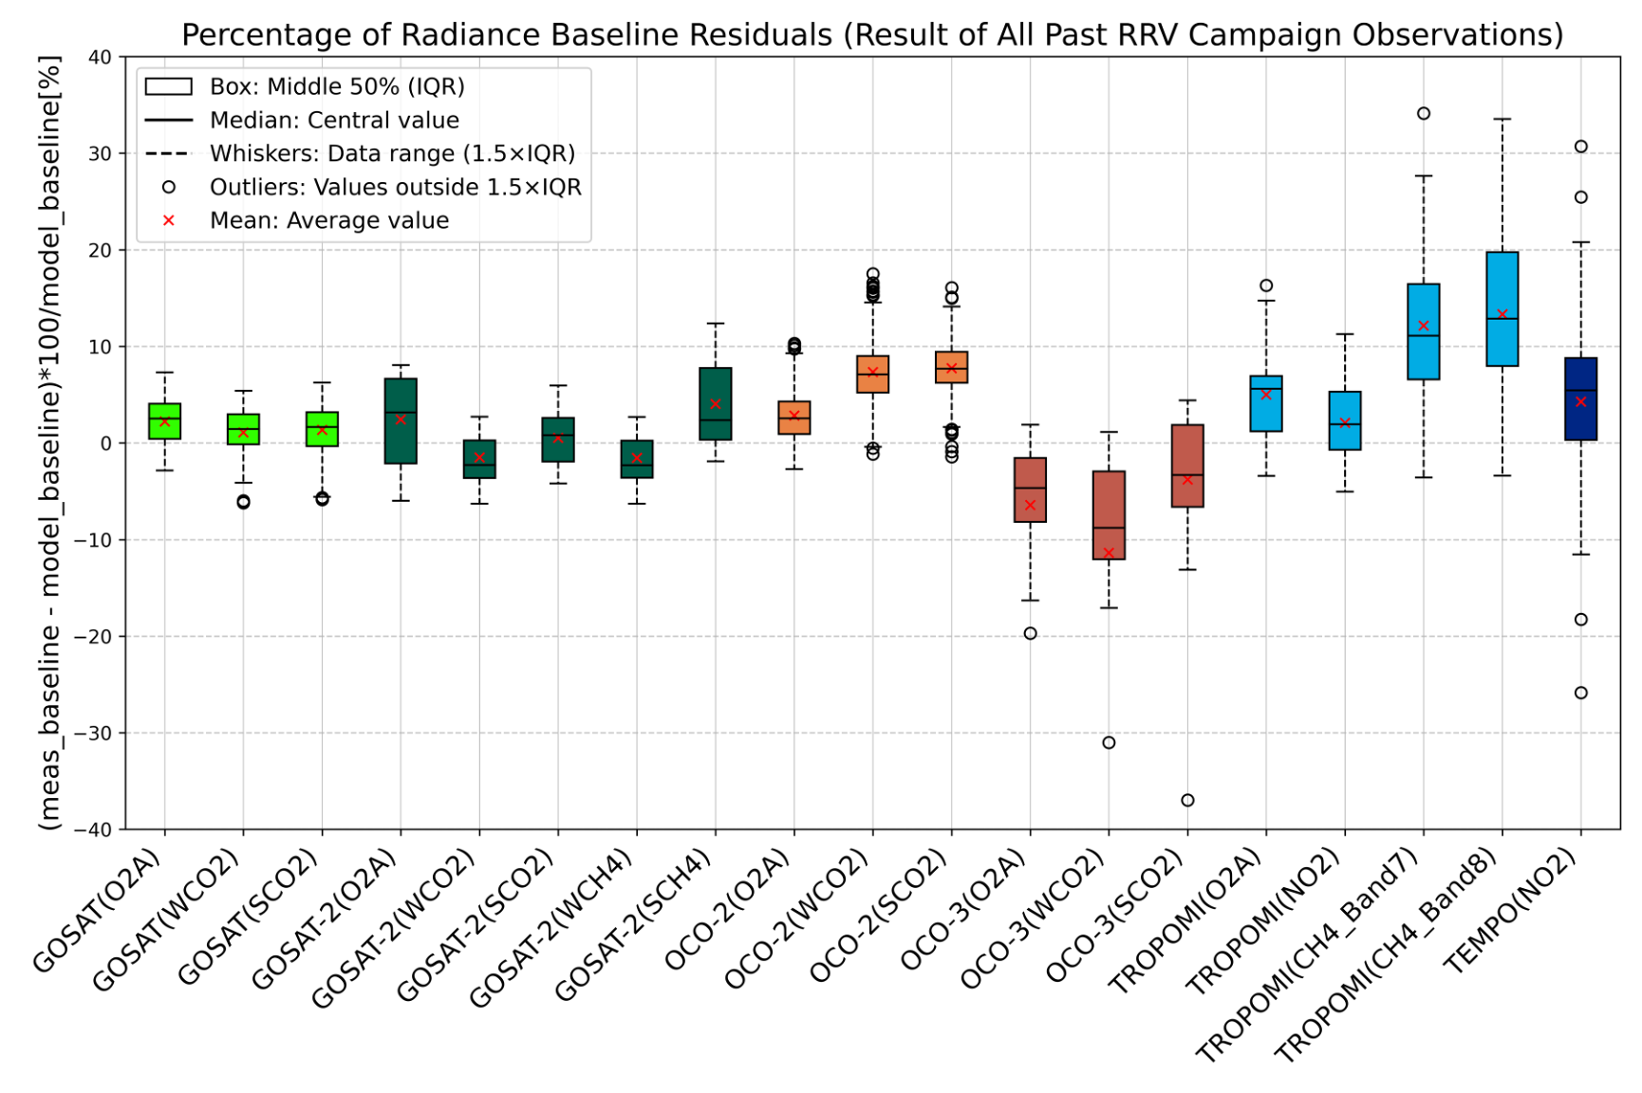

Evaluation of Multiple Sensors Using Common Processing and Ground Data for past year mean
Evaluation periods:
GOSAT: 2019 – 2024 (except 2020)
OCO-2: 2019 – 2024 (except 2020)
GOSAT-2: 2019 - 2024
TROPOMI: 2021 -2024
OCO-3: 2021
TEMPO: 2024
+/-5% variation
Re-qualification for ground observation data will be required.
Some ground datasets (surface reflectance data) might be removed for processing.
Re-evaluation of all the campaign data is ongoing.

Slide 6
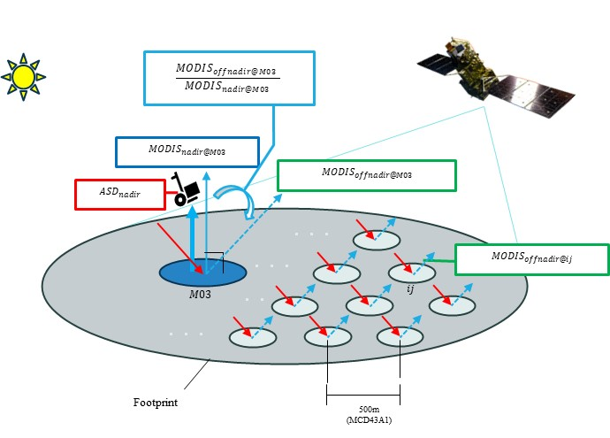
Error Budget of the change in radiance degradation factor (RDF)
How to reduce largest error sources and improve the BRDF correction
Our goal: 3% to minimize the radiometric error
Error budget for VCAL: 10% (at the beginning of the campaign: 2009)
Estimation after RRV2019: 7.3 % (O₂A), 6.2% (WCO2) 5.5% (SCO2) (Maximum) for GOSAT high sun (solar zenith angle < 25 deg ) and small off nadir observation angles (< 25 deg)
The present best estimation : 2.6 % (O₂A), 0.3% (WCO2), 1.2% (SCO2) at RRV2022@MODIS site
We use the MODIS BRDF product to calculate the surface reflectance for footprints and observing geometry of multiple sensors.

Slide 7
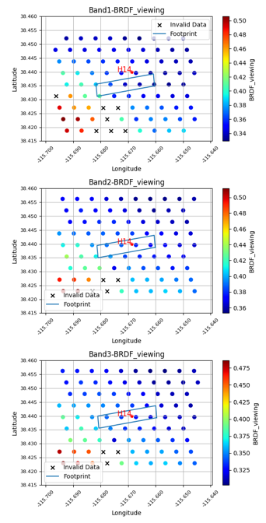
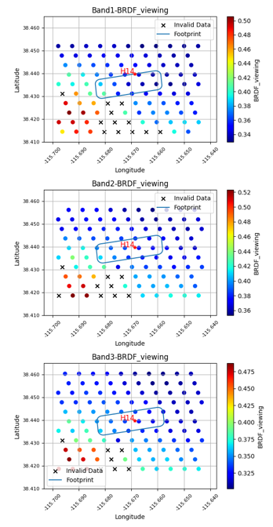
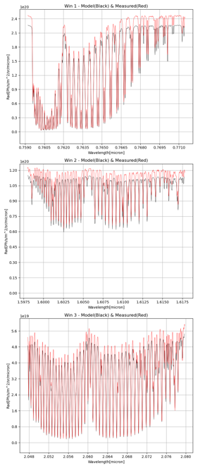
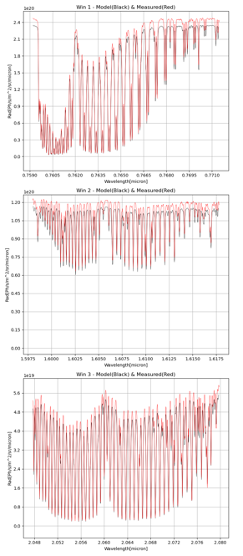
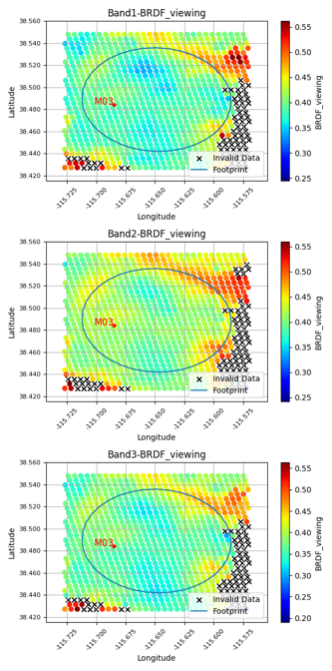
Improvement of Spectral Fitting by Applying Footprint Expansion Technique
Limited numbers for MODIS products (500m grid) available to correct BRDF for small footprint sensor (OCO-2).
To increase the amount of data, the footprints were slightly expanded (+200m) and used for BRDF processing.
The agreement between OCO-2 observed spectra and forward calculation is much better.
O₂A
Ratio of mean residuals
9.09%
5.26%
BRDF for GOSAT
Expanded by 200m
Expanded by 200m
WCO₂
6.34%
4.88%
SCO₂
9.26%
7.6%
OCO-2 on Jun 16th, 2024, at 20:43:27

Slide 8
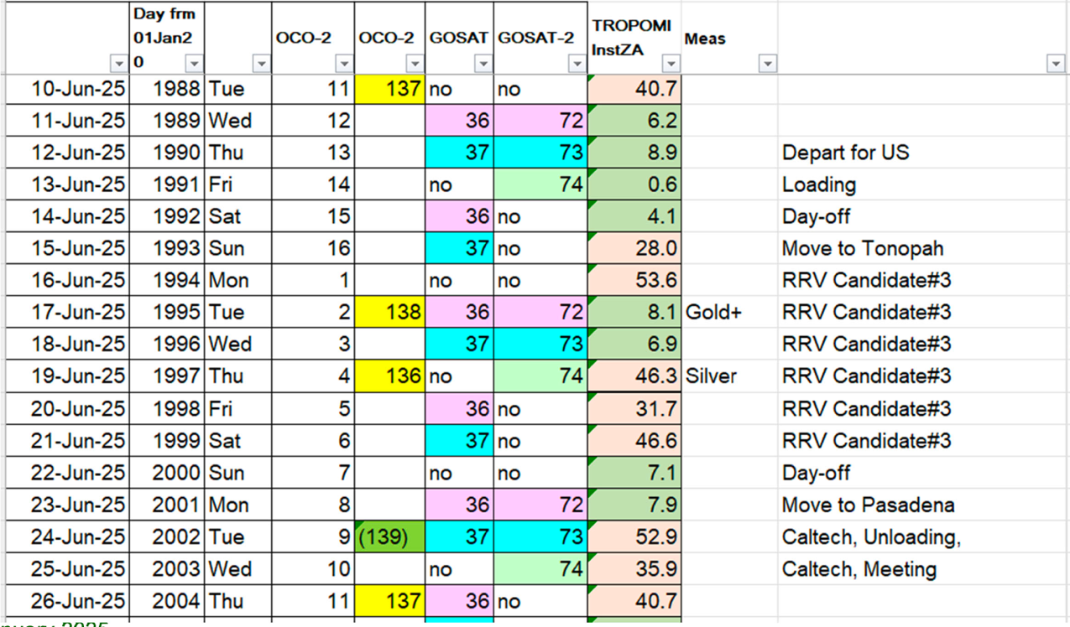
Plan for 2025 Summer campaign
Latest coordination plan (TBC)
US and Japanese team members will visit the RRV playa and conduct surface measurements
An EM27SUN will be used to take simultaneous GHG concentration measurements over playa.
Improved, spectrally dependent polarization observations will be collected with new optics added to the ASD FieldSpec spectrometers.

Slide 9
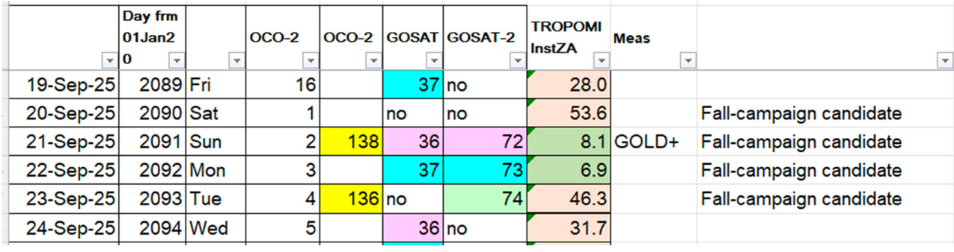
Plan for 2025 Fall Campaign
Fall-campaign candidate (still under discussion)
GOSAT-GW/TANSO-3 will be launched in the first half of JFY2025 (April to October time frame)

Slide 10
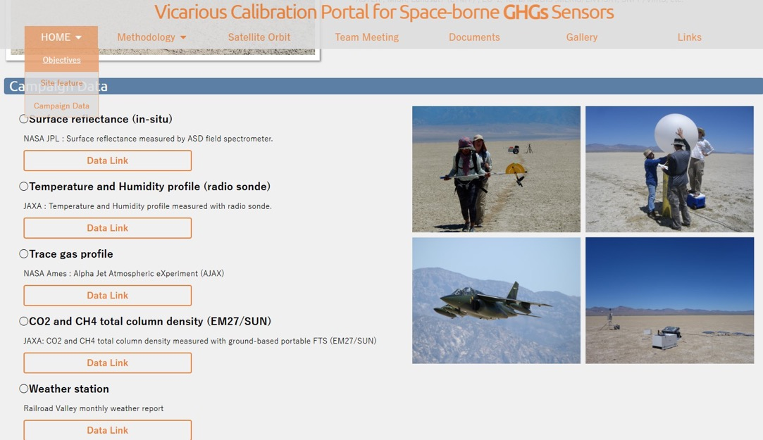
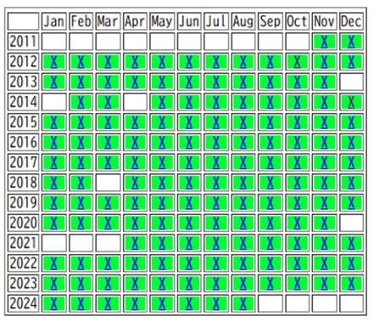
GHG Vicarious calibration portal
Links:
https://www.eorc.jaxa.jp/GOSAT/GHGs_Vical/index.test.2.html
https://www.eorc.jaxa.jp/GOSAT/GHGs_Vical/weather_station/rrv_calendar_report.html
JPL does not require clearance to make weather station data public as they are geophysical measurement.
FOR A MONTHLY REPORT CHOOSE A MONTH IN A GIVEN YEAR
Updated
New
Added JPL Weather Station data + Surface reflectance data (reprocessed)

Slide 11
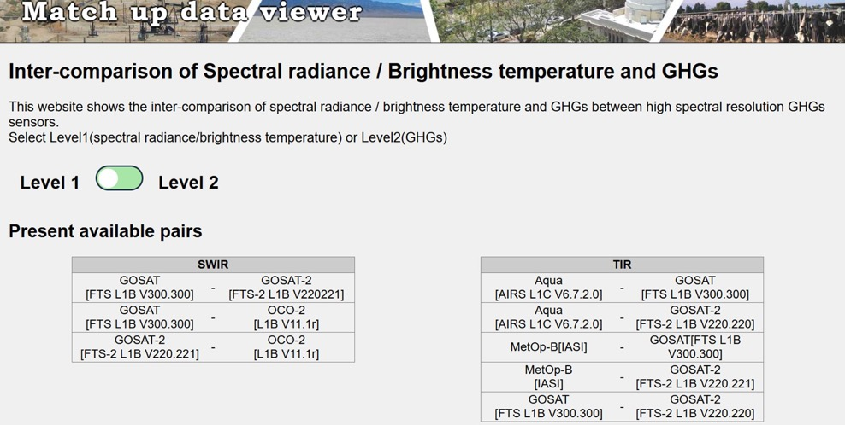
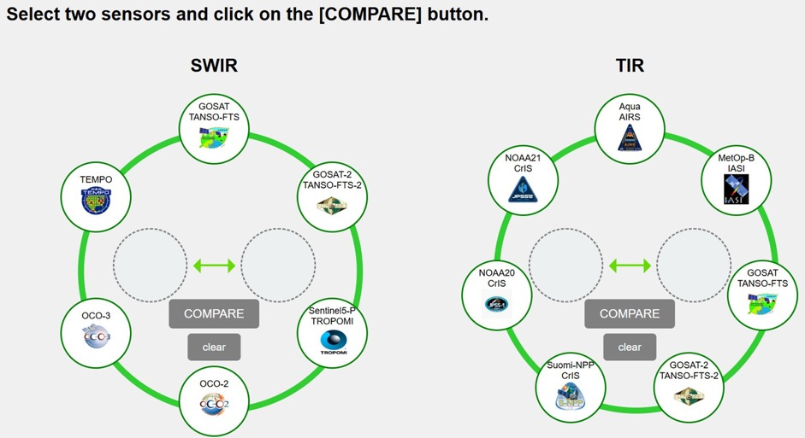
Match up dataset released
https://www.eorc.jaxa.jp/GOSAT/Matchup_forCal/top_matchup_viewer.html
Including following parameters for data viewer
SWIR
(1) Calibrated radiance
(2) XCO2, XCH4, SIF, AOT
TIR
(1) Calibrated radiance
(2) Brightness temperature

