Slide 1
Common Practices for Reporting Satellite-derived Facility Scale Methane Emissions
Paul Green, NPL
& the wider GHG team
#3.1

Slide 2
Motivation
The Global Methane Pledge (now signed by 155 countries) seeks to reduce methane emissions by 30% between 2020 and 2030
Fugitive emissions / high emitters (emissions t> 100 kg / hr) represent a substantial fraction of fossil and waste emissions
Public and New Space observations of CO₂ and CH₄ are increasingly being used to identify high emitters to improve production efficiency of drilling, support regulation, and are likely needed for a functioning reporting obligations and carbon market
Currently there are 3 missions dedicated to facility scale emissions monitoring, with another 10 expected in few years – in addition to the products generated from public data.
We need a set of “common” practices for reporting VVUQ and QA for facility scale emissions so that producers of these data know what is expected by the community and (new) users know how the data should be generated and reported so that it can be trusted

Slide 3
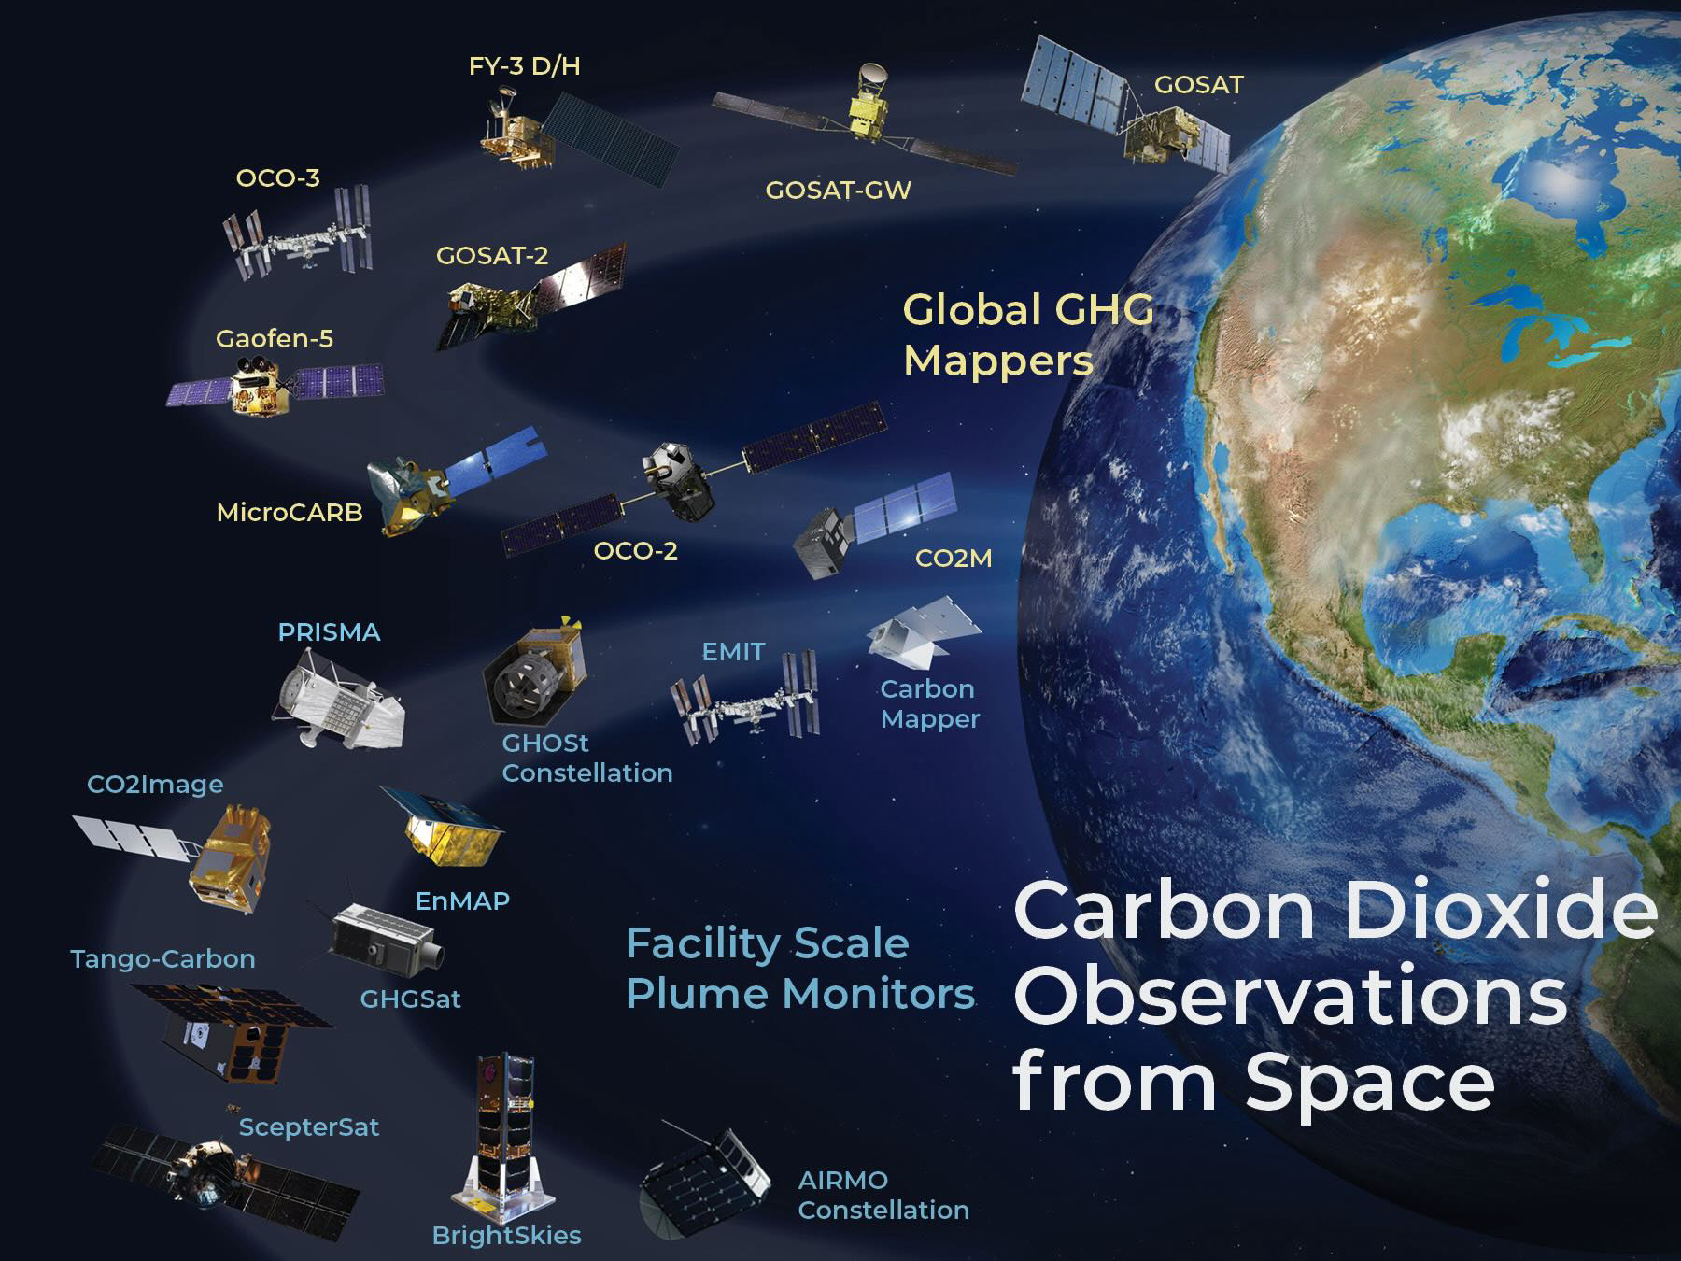
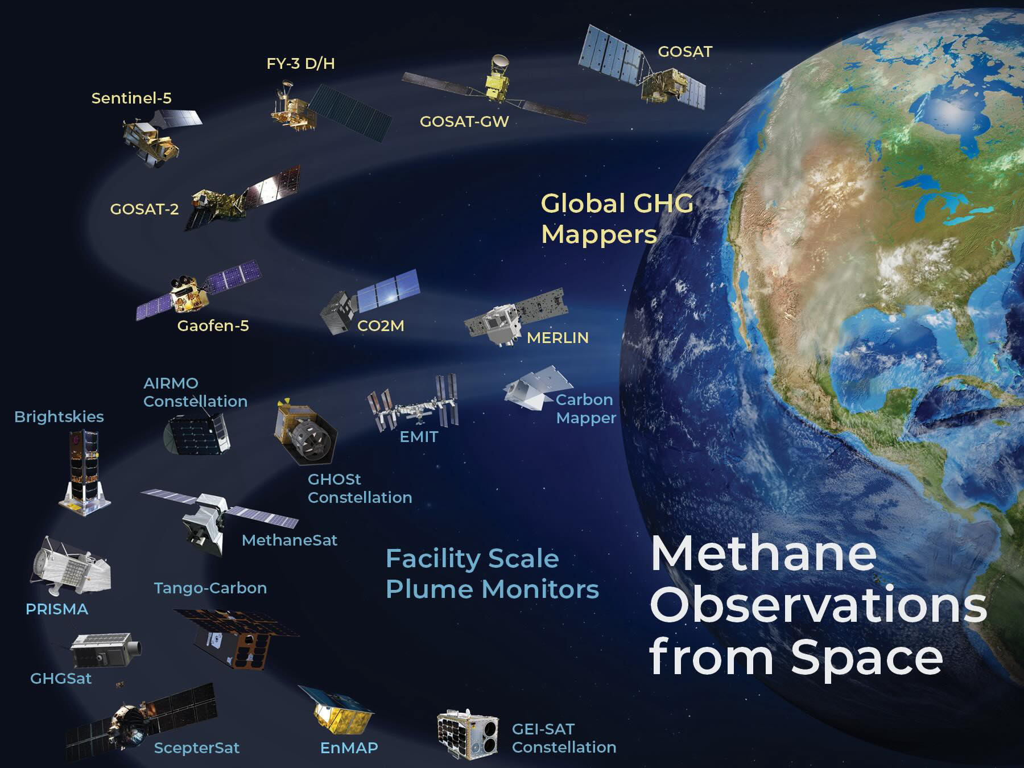
Growing constellation of GHG concentrations observations from the global to the facility scale
These are now being used to derive carbon dioxide and methane emission (flux) estimates on a range of spatial and temporal scales

Slide 4
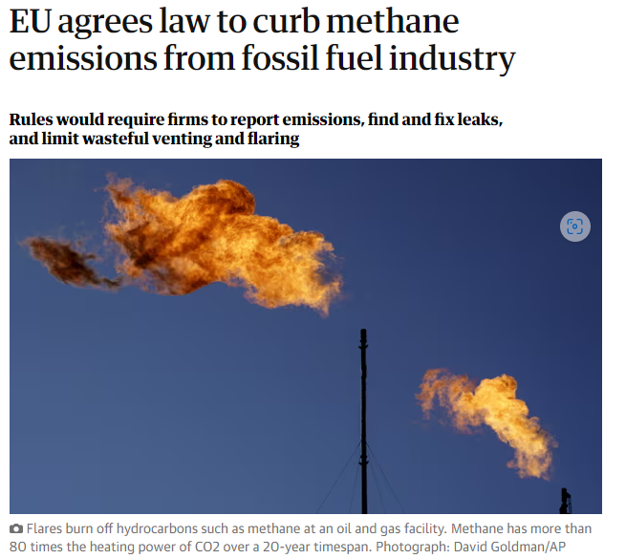
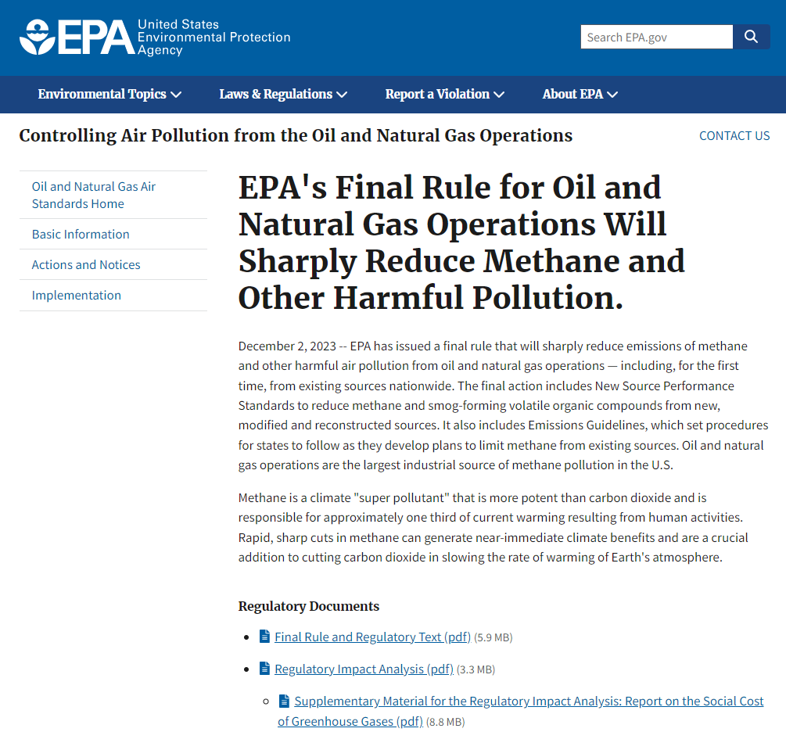
New rules on Energy sector
https://www.epa.gov/controlling-air-pollution-oil-and-natural-gas-operations/epas-final-rule-oil-and-natural-gas
https://oeil.secure.europarl.europa.eu/oeil/popups/ficheprocedure.do?reference=2021/0423(COD)&l=en

Slide 5
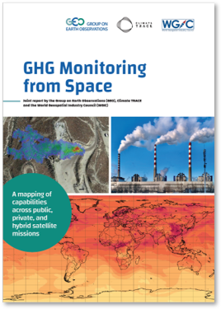
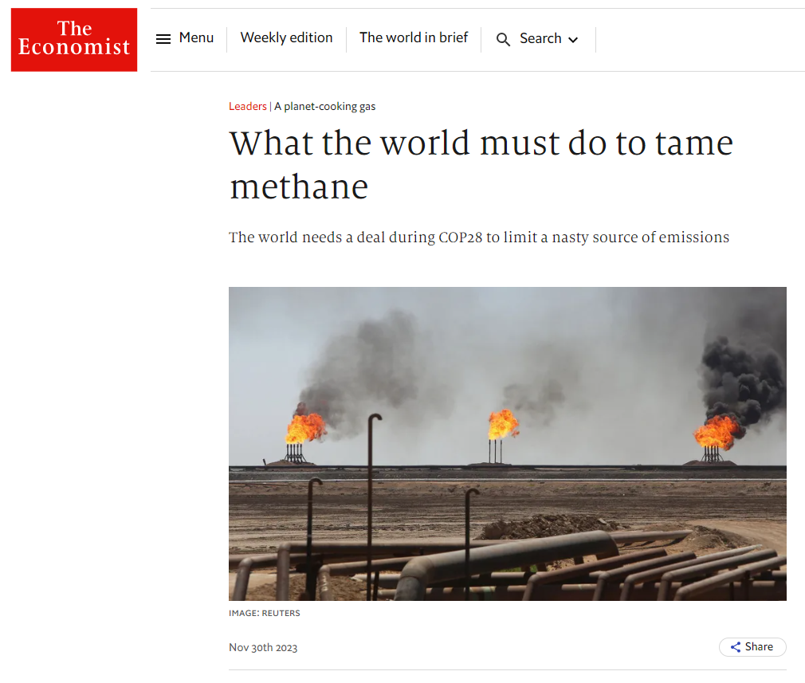
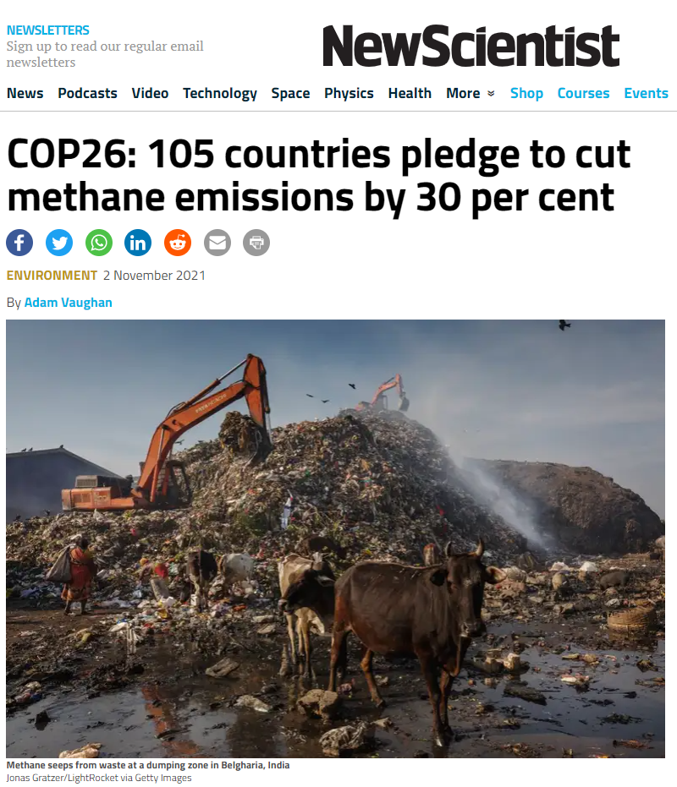
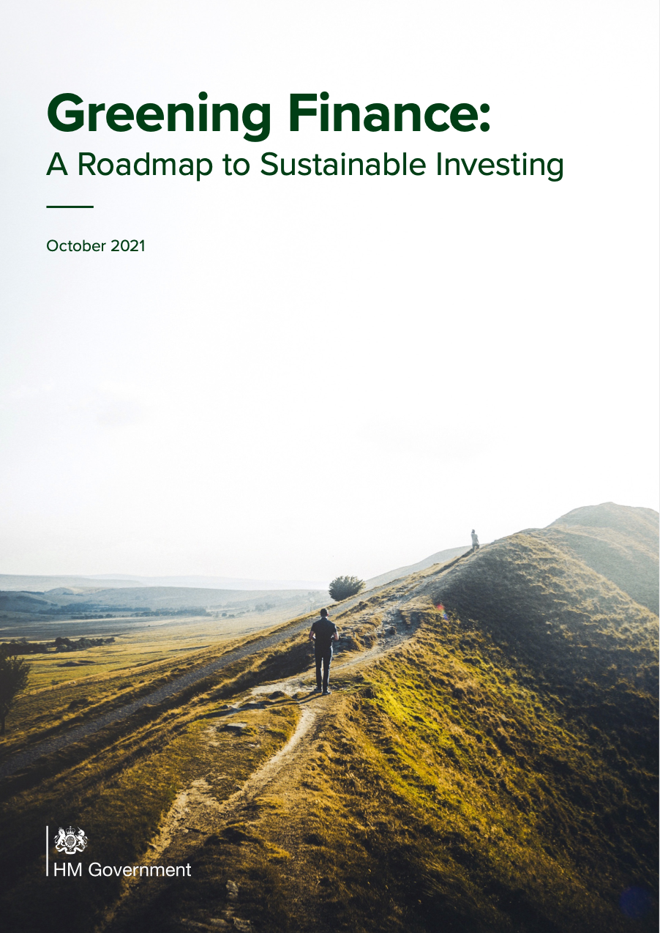
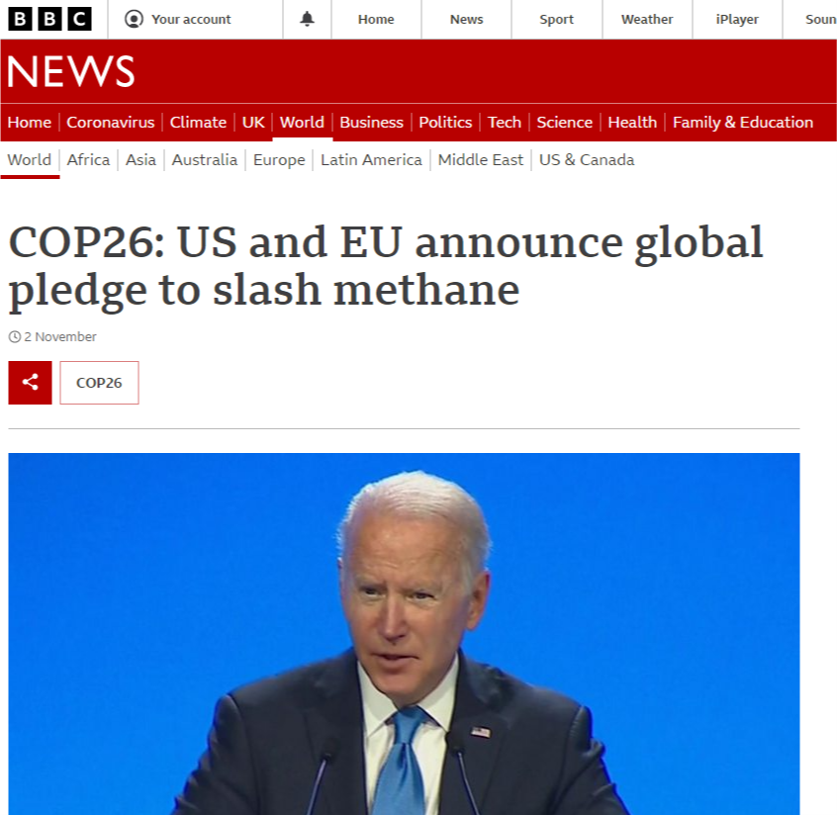
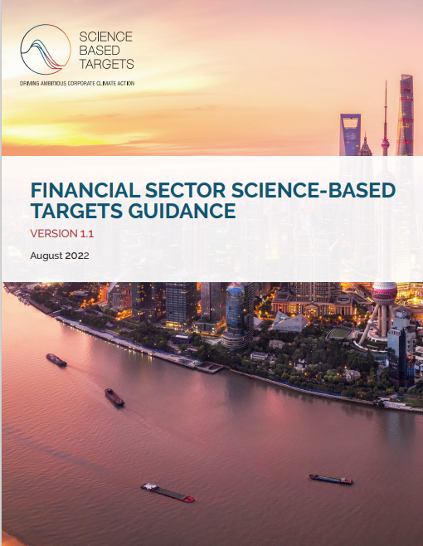
Corporate emissions and climate risk reporting
TCFD
Compulsory emissions & climate risk reporting for listed companies in US and UK, together with voluntary schemes to maintain market competitiveness aligned with customer climate expectations

Slide 6
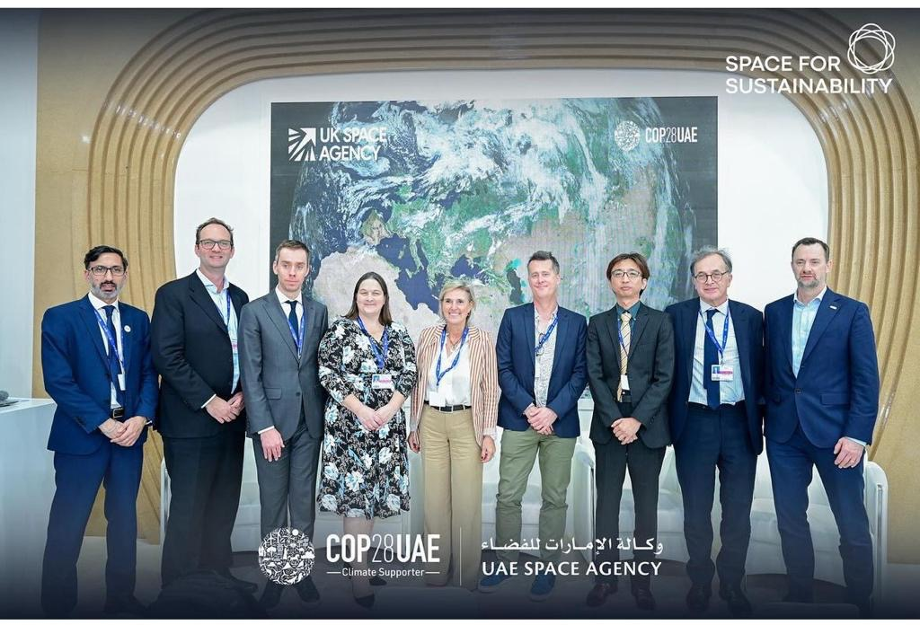
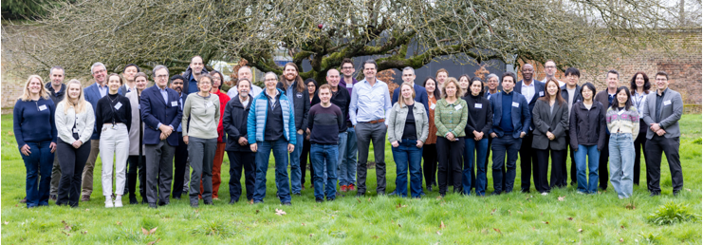
Identified community appetite with international buy-in
COP28 - UKSA-hosted event on the UAE-Space Agency Space Sustainability stand within the first ever COP ‘Space Pavilion’
Monitoring Methane from Space: Towards an Internationally Recognised Standard
NPL hosted a UKSA-sponsored methane reporting standards workshop Feb 2024
Representation from CEOS member, commercial suppliers and academia
NIST-sponsored workshop for L0-L4 common practise – Jan 2024

Slide 7
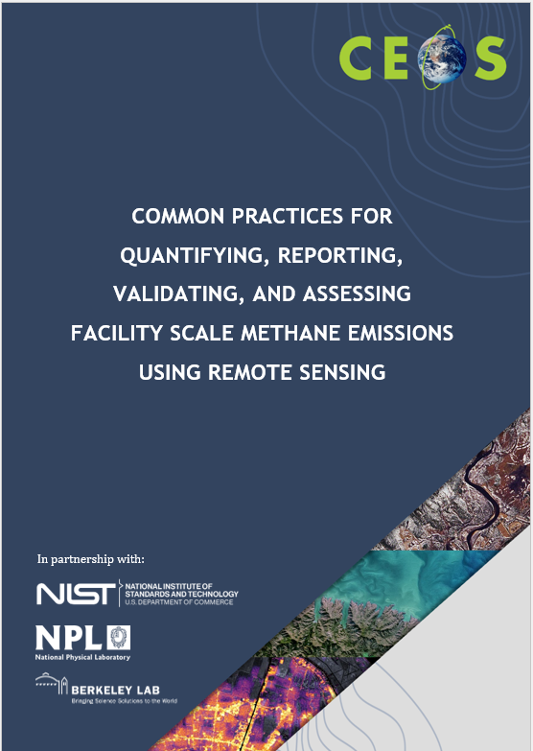
Common practise structure & contributors
Common practices intended users are
producers of these data (to know what is expected by the community)
users of these data (to understand how it should be generated and know how to use)
Overall structure
Motivation, remit and timeliness
Common practise for L0 to L4
Validation current art
Quality assessment framework
Integrates efforts across multiple agencies

Slide 8
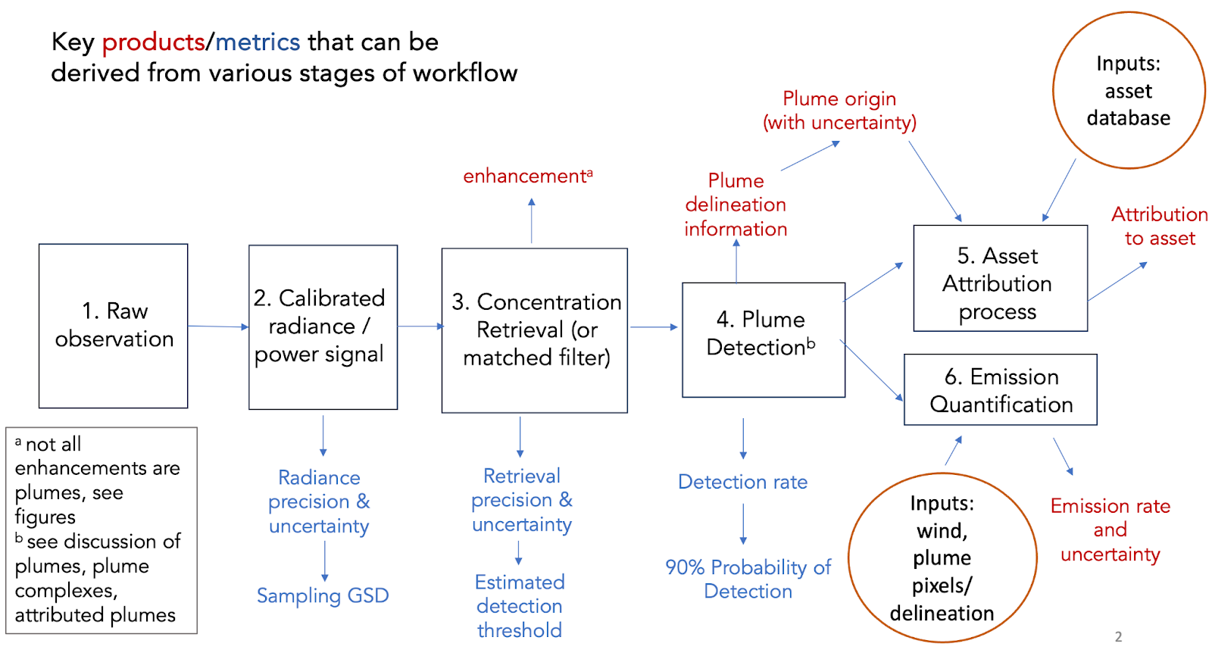
Workflow Common Practise
At a high level, all practitioners use the same sequence of steps in their workflows
The details of implementation vary, increasingly later in the process (from concentration/enhancement to emissions estimates)
Later plume detection, delineation and emission quantification steps require a human in the loop

Slide 9
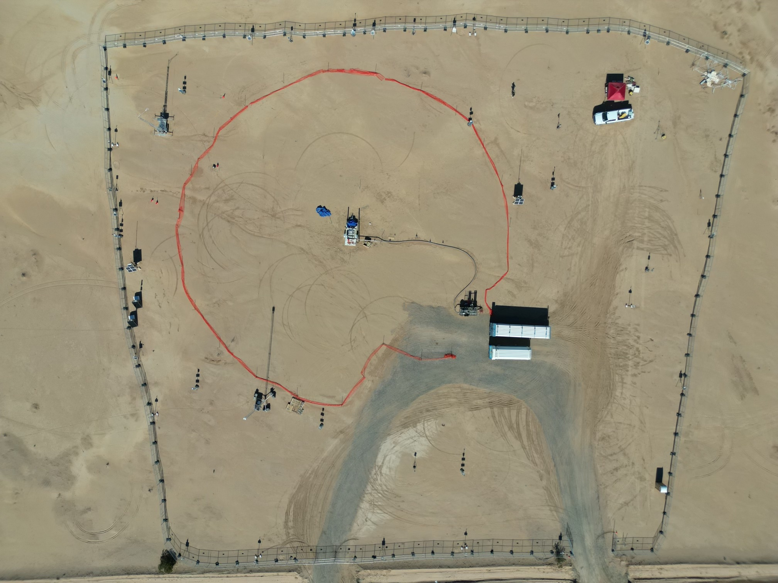
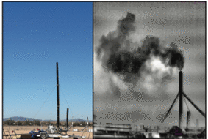
State of Practice for Validation –
controlled release
First-of-a-kind controlled and blind* testing of super emitter quantification and satellite detection
Tests teams’ detection and quantification ability
10 m ultrasonic winds
and meteorological station
Work station
?
Metering and
release point
Gas trailers and
pressure reg
Credit: A Brandt Stanford tinyurl.com/stanford-methane
*Participants know location but not [on/off] or volume flow rate. Coriolis flow metering for leaks between 3 kg/h and 1500 kg/h

Slide 10
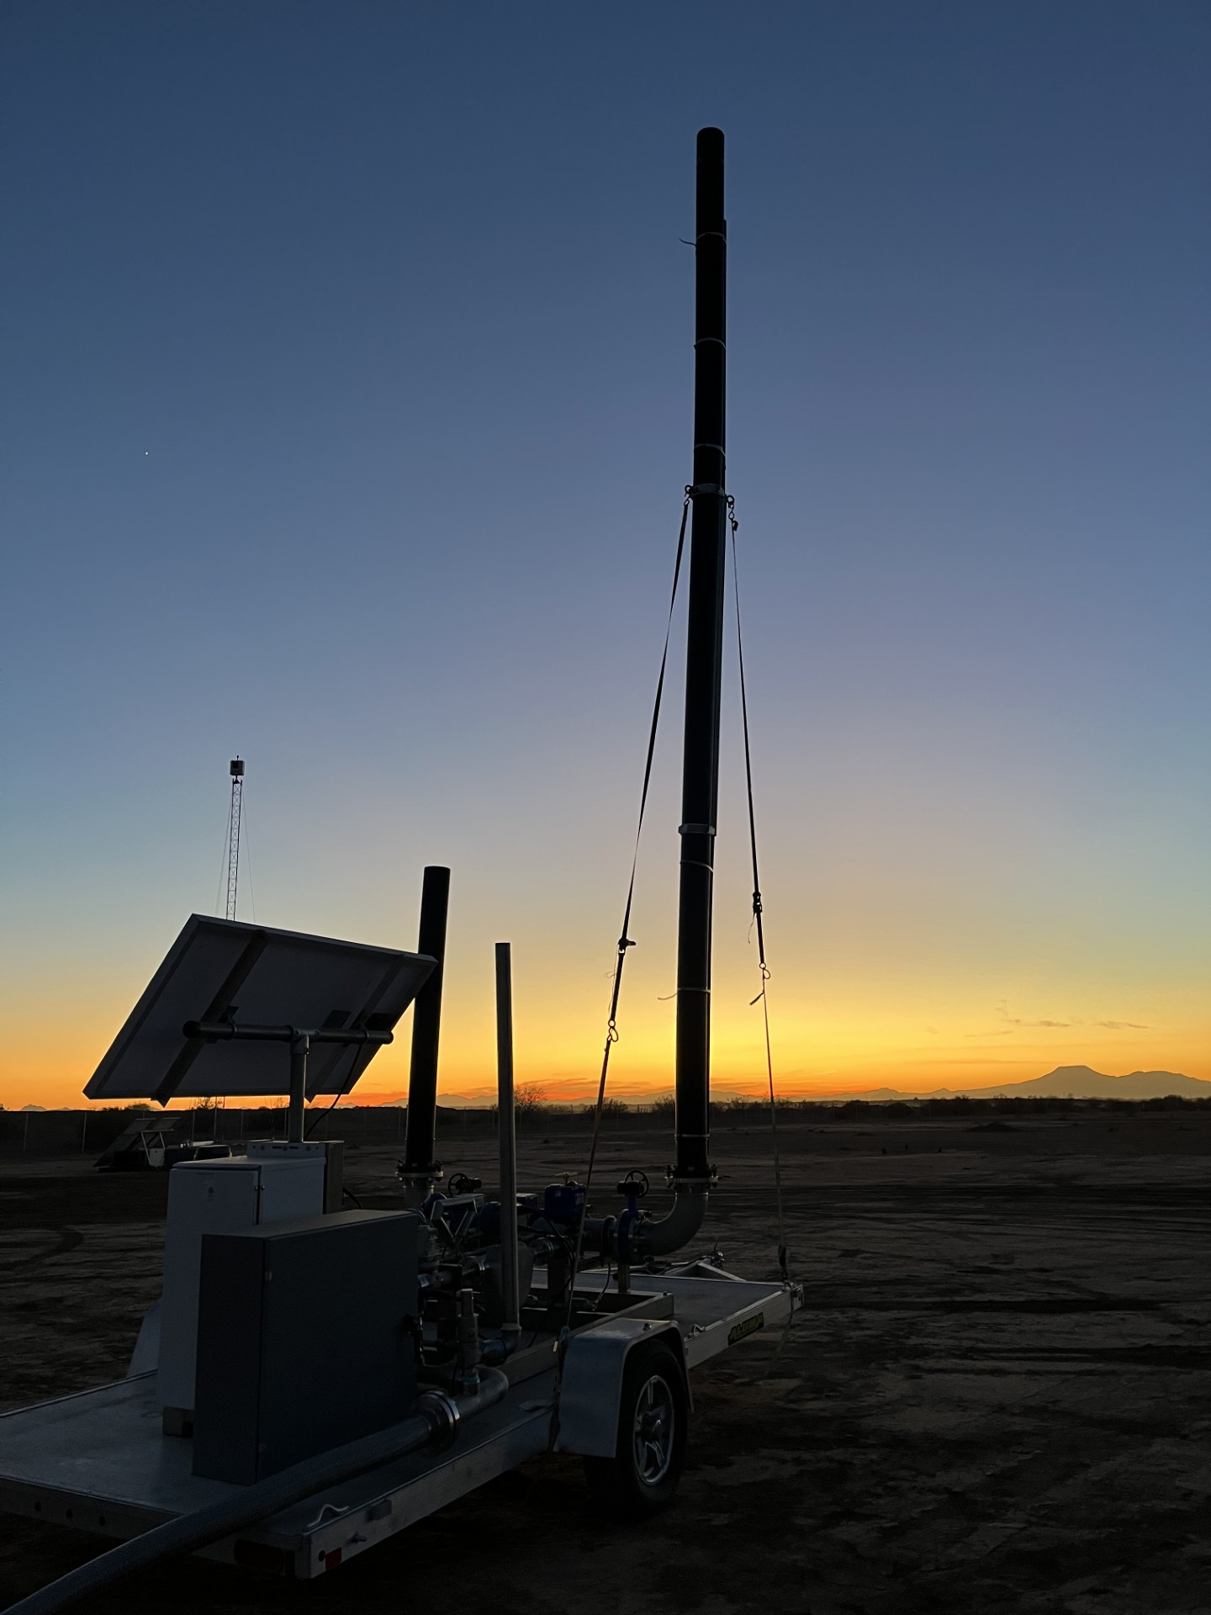
Large scale controlled methane release 2024 -2025
Independent testing of space-based methane detection needed, including several new satellite programs launched last year
Cooperative and single-blind controlled release tests, building on 5+ years of satellite, airplane and ground sensor tests
Expanded participation to 12+ methane satellite platforms and 15 analysis teams
Remotely controlled gas flow enables higher sample sizes and better characterization of methane detection and quantification performance plus improved local meteorological measurements
Current activity
~150 release (10-1500 kg/h) cooperative stage being analysed
First single-blind stage “Phase 1” is ongoing in Q1 2025, data to be unblinded on May 1
Subsequent phases to follow with alternate testing configurations
Credit: A Brandt Stanford & E Sherwin LBL

Slide 11
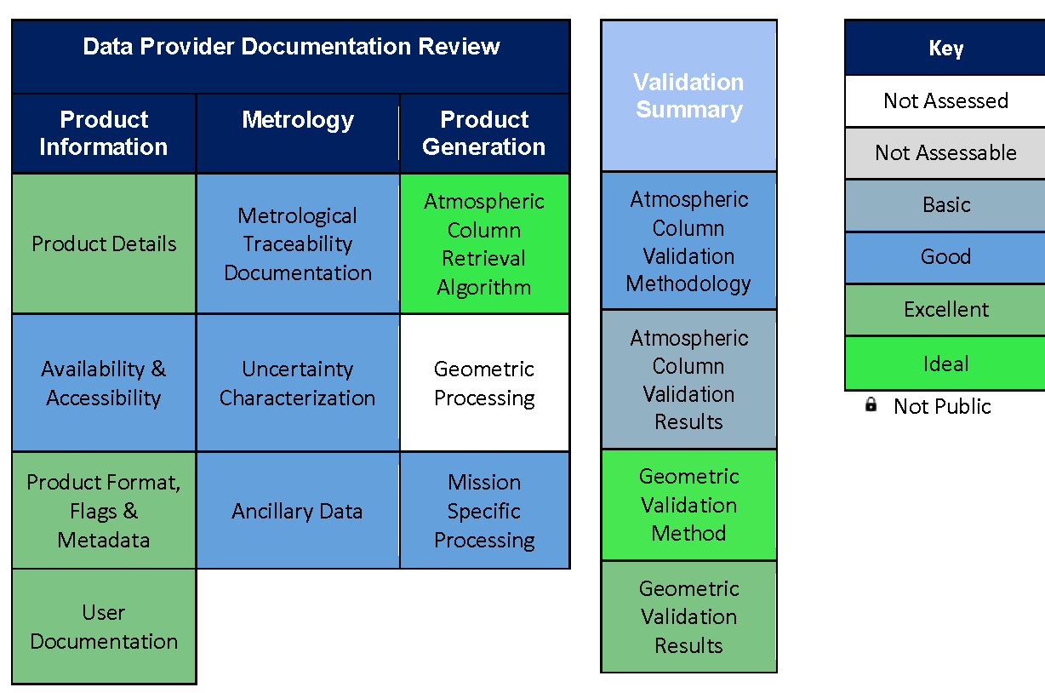
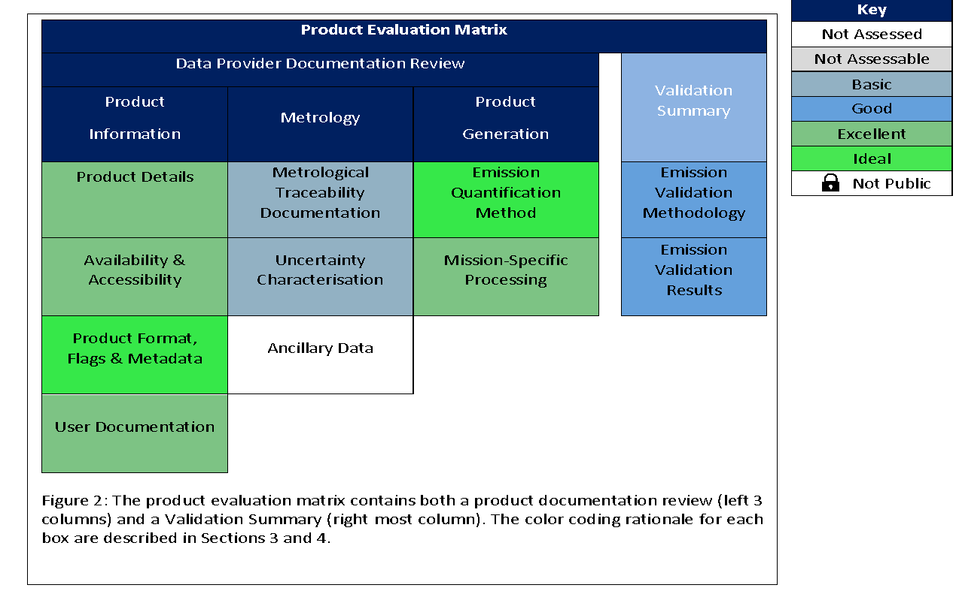
Quality Assessment framework
Quality Assessment framework aligned with that developed within EDAP / CSDA for consistency across GHGs and other ECVs
Column Enhancement
Emissions

Slide 12
Progress and timeline
Commercial mission drivers demand a relatively short timescale for a working first version of documentary standards.
2024 – outline development & peer review
2025 – detailed development, peer review & v1 finalisation for end 2025

Slide 13
Summary
Public and New Space observations of CO₂ and CH₄ are increasingly being used to identify high emitters for regulation (in addition to science) and are likely needed for a functioning reporting obligations and carbon market
Currently there are 3 dedicated to facility scale emissions monitoring, with another 10 expected in few years – in addition to the products generated from public data.
We need define the common practices for reporting VVUQ and QA for facility scale emissions so that producers of these data know what is expected by the community and (new) users know how the data should be generated and reported so that it can be trusted

Slide 14
Requests & Next Steps
Please comment on the document – by end of February
CEOS_CommunityPractices_FacilityScaleEmissions v0.2 - Google Docs
Continued support of effort to define best practices for quantifying and reporting emissions - in time this effort is handed off to an appropriate ”operational” focused organization after agreement between vested parties
Identified need to extend a Best Practices to Area Flux Mappers to better support the Global Stock Take and Global Methane Pledge as well as diffuse point sources and other sectors.
Producer engagement is good but need to increase user engagement beyond IMEO to ensure uptake.
Best practices actions added into the wider GHG TT roadmap

