Slide 1
GCOS guideline for generating climate data records: review?
Stephan Bojinski, GCOS AOPC and EUMETSAT
Agenda Item 2.7

Slide 2
GCOS 2010 Guideline on CDRs
Guideline for the Generation of Datasets and Products Meeting GCOS Requirements (GCOS-143) (10 pages)
Quoted in the WGClimate Terms of Reference: “WGClimate will… assess the compliance of satellite missions and products with the GCOS Climate Monitoring Principles and with the “Guideline for the Generation of Datasets and Products…””.

Slide 3
GCOS 2010 Guideline on CDRs
Written to guide producers of climate data records from all observing systems
Satellites
In-situ
To make producers of data records aware of GCOS principles for generating climate data records, and
Give producers a way to self-certify their activity – rather than GCOS awarding approvals (there were numerous such requests at the time)
Enable users to judge the quality and fitness for purpose
Follow-up to “GCOS Implementation Plan 2010”
Recognised WMO guidance and QA material (e.g., GAW, WIGOS), QA4EO

Slide 4
GCOS 2010 Guideline on CDRs
Terminology: “FCDR”, “Product”, “Accuracy”, “Stability”, “Calibration”, “Validation”, “Repeat Cycle”, …
12 “needs”:

Slide 5
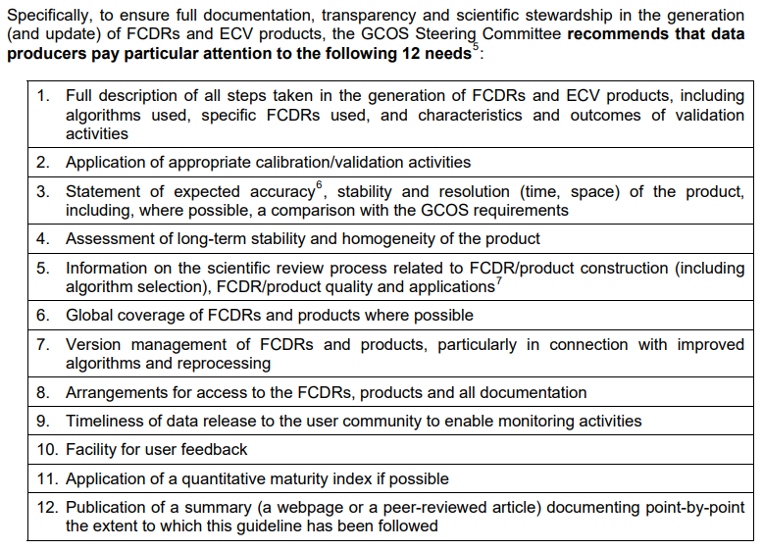
GCOS 2010 Guideline on CDRs

Slide 6
GCOS 2010 Guideline on CDRs
Missing:
concepts such as ICDRs,
new definition of CDR by WGClimate - broadly applicable?
regard to broader range of climate data applications,
findings from science and peer-reviewed literature,
ECV inventory documentation practice,
results from uncertainty characterisation projects, lessons from applying the maturity model, C3S EQC
other documentation?
Notes:
Along the lines of: “A CDR is a time series of Earth environmental data of sufficient length, quality and characteristic (description) to be useful in a climate-related application.”

Slide 7
Summary of content
GCOS guidance has had significant impact
WGClimate as major “user” of GCOS guidance to advise on way forward with Guideline:
Obsolete
Covered elsewhere (as part of next GCOS IP?)
Outdated and needs Review
...

