Slide 1
WGClimate-22 & GHG-TT-5
Caterina Tassone - GCOS
Agenda Item 2.3

Slide 2
Outline
GCOS Activities 2025
Address IP actions
WMO related activities
ECV rationalization
Reference Networks
EU Project
Stations for cal/val
Eumetsat-GRUAN project
Next meetings: SC32 and JPM

Slide 3
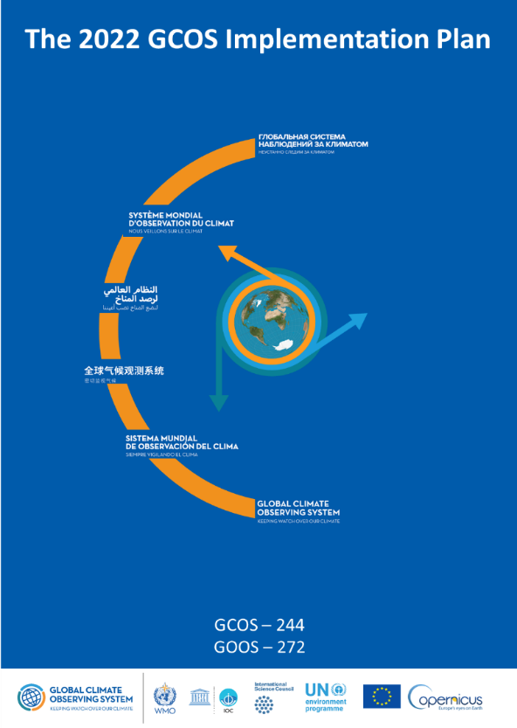
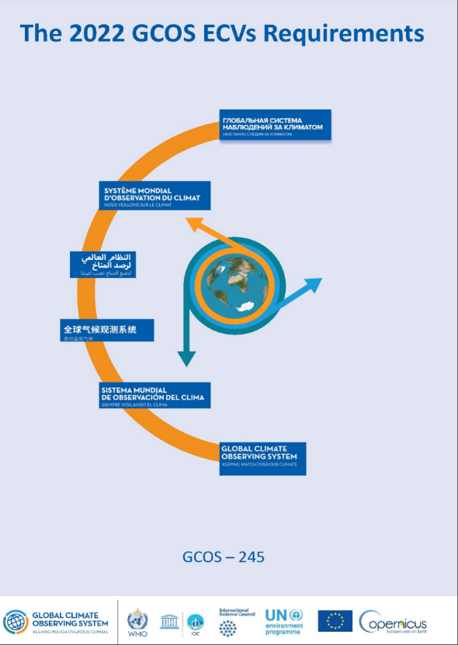
Address IP actions
Last Implementation Plan was published in 2022, last Status Report in 2021
Actions for addressing gaps and improvements of a fit for purpose global observing system for climate
Published jointly with the 2022 GCOS ECV Requirements
Provides the observational requirements for 55 ECVs (and more ECV products)
2025 - Being updated:
Additional explanation of requirements
Revised requirements for snow

Slide 4
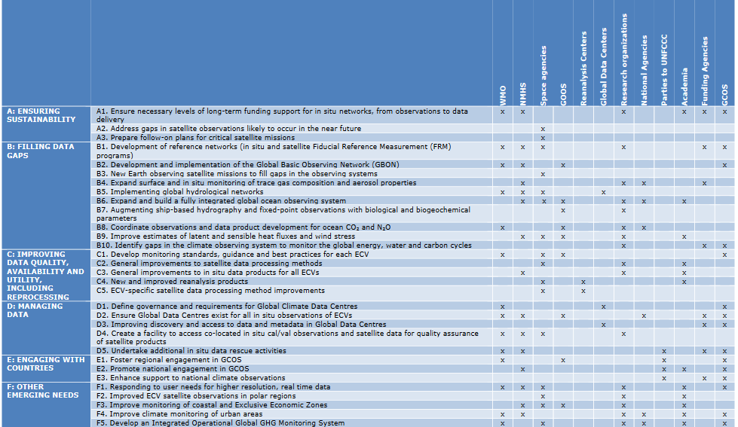
GCOS IP
Theme Actions Implementing Bodies
GCOS workplan is defined by the IP actions
All actions started and showing good progress – F4 not started – A1 completed
Notes:
Satellite actions have been addressed by WGClimate – expected comments from panels by 14th February. A subset of the non –satellite actions are being addressed by the individual panels or by cross-cutting groups. At this point, there is some progress on all actions and only a few have not been started, It will be most likely impossible to address all actions and a possibility is that the ones not started or for which we did not have the time will be repeated in the next IP. So, all actions are started a part of 1. I will be showing some of these actions in the next few slides. Progress has been made also for theme E, with new TOR for National Coordinators and work done to update the list. No regional workshop were held as requested by the actipons for a question of money.

Slide 5
Action D1: . Define governance and requirements for Global Climate Data Centres
Cross-Panel Group at the GCOS Joint Panels Meeting, Bonn, 26-30 June 2023
Participants were representatives of: AOPC, OOPC and TOPC, WMO Data and Information Management Division and various data centers and specialised climate archives: GTN-H; GTN-P; EUMETSAT; C3S; NCEI; IQUOD; GRDC; Global Ocean database; RCC; NMHS.
The group decided:
To use the term ‘data-repository’ rather than data-center;
To use the existing CoreTrustSeal requirements as a reference process for certification (needed for the WDS – World Data System – membership);
That the data repositories represented at that meeting will undergo a self-assessment using the CoreTrustSeal requirements process.
Main conclusions from a preliminary assessment of the CoreTrust Seal Requirement:
It is not easy to fulfil all the 16 CTS requirements and obtain the related certification and support would be required for the application process, especially for small data centers
Define different “tiers”: few (e.g. 3) categories of requirements. The highest category could match the requirements needed for the CTS certification. Lower categories will have a reduced number of easier requirements.

Slide 6
WMO Related Activities
GCOS and INFCOM: many joint activities and functional connections
GCOS networks embedded in WIGOS
GCOS promoting the concept of Tiered Networks
GCOS developing and maintaining Reference Networks
GCOS involved in the expansion of GBON
GCOS in charge of Climate monitoring requirements in RRR (collaboration with GOOS and GCW)
GCOS involved in the development and implementation of WMO Data Policy (climate data)
GCOS in charge of sections of WIGOS manual concerning climate monitoring
GCOS Deputy Chair involved on the newly formed Climate Infrastructure Task Team

Slide 7
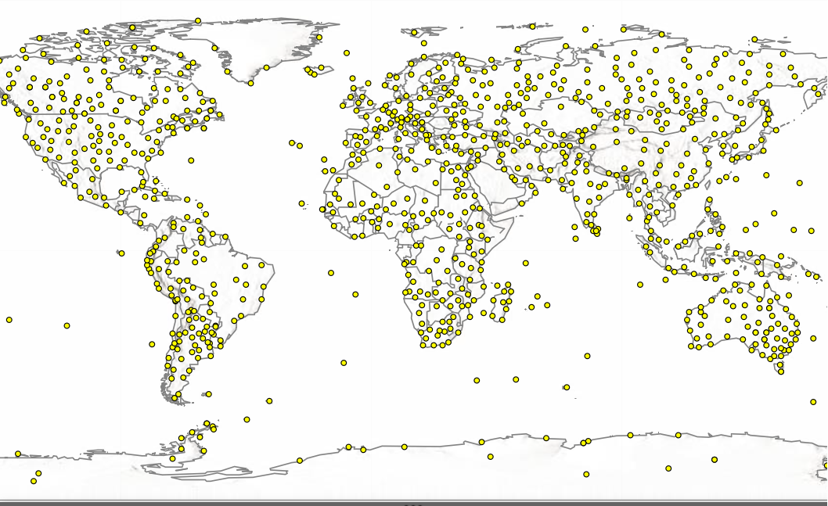
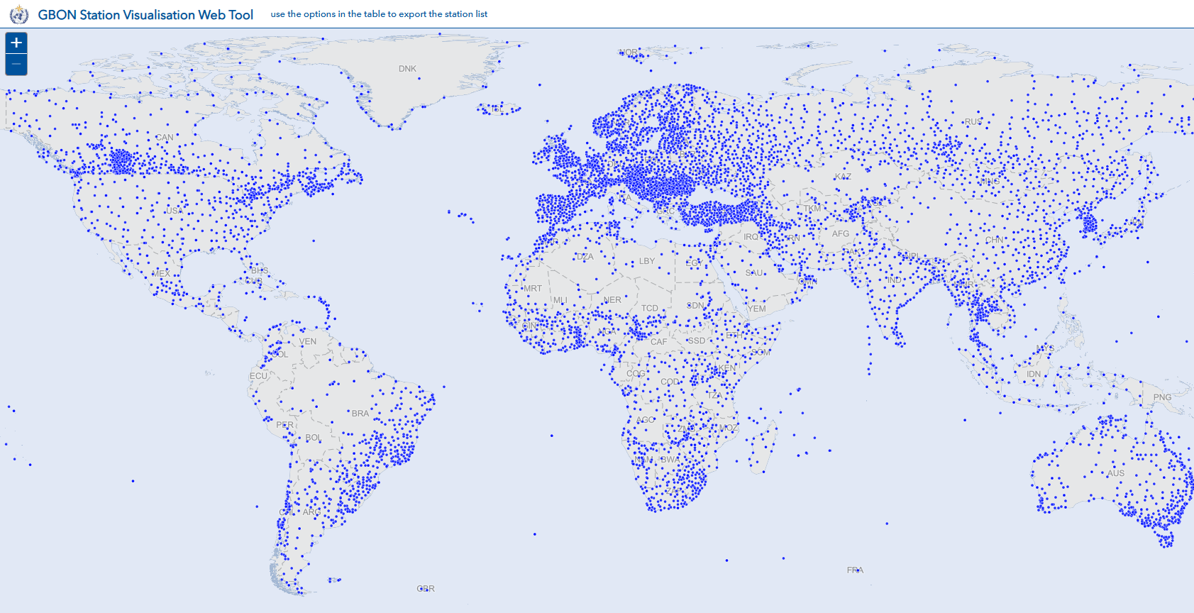
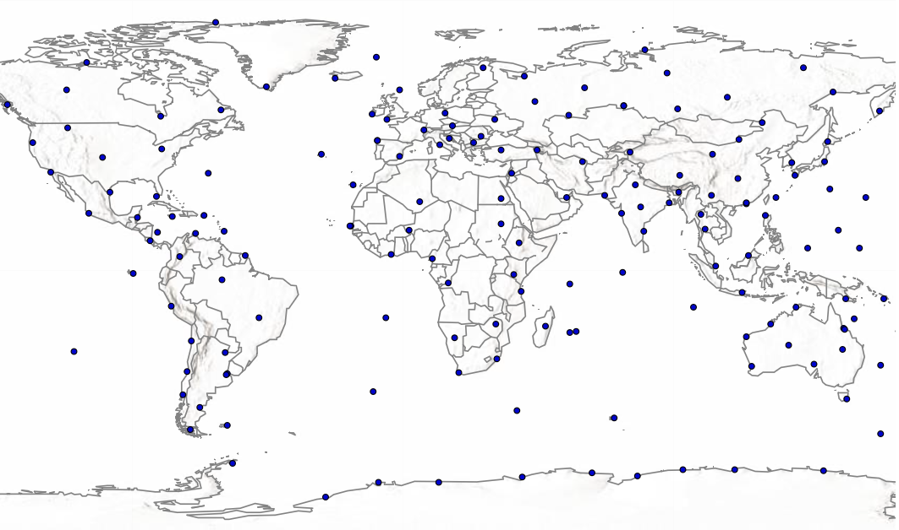
GCOS Atmospheric Networks working with WIGOS(INFCOM)
GCOS Surface Network (GSN) : 1024 stations
Global Basic Observing Network
SOFF
(1) Working with SOFF and WMO ensure that gaps in the GUAN are addressed by SOFF capital investment. (Target 2 ‘silent’ GUAN per year).
(2) Working with SOFF and WMO encourage the reporting of CLIMAT and DAYCLI for relevant surface stations (GSN & former RBCN).
(3) Develop a strategy with SOFF to support climate reference stations (GRUAN and GSRN)
(4) Data rescue?
GCOS Upper-Air Network (GUAN) : 178 stations
CLIMAT & DAYCLI
Lead Centres for GCOS

Slide 8
WMO Climate Infrastructure Task Team
Established at the INFCOM Management Group Meeting in October 2024 – 1st Meeting January 2025
Identify gaps and overlaps in the existing infrastructure, regulations and guidance materials related to the production, exchange and archiving of Climate observation at the global, regional and national levels - the WIGOS, WIS and WIPPS components needed for Climate monitoring, including reanalysis needs.
Identify needed actions of INFCOM to close the identified gaps in the Climate Infrastructure, regulations and guidance materials and resolve overlaps and conflicts
Propose to INFCOM management group prioritization of the identified needed actions and appropriate working mechanisms (INFCOM subsidiary bodies and other working bodies and mechanisms) to take forward the required activities.
The Task Team will report to the INFCOM Management Group and will provide a report identifying gaps and overlaps within the WMO infrastructure components supporting climate applications and services, including identification and prioritization of required actions to address the gaps identified, by Q3 2025.
Notes:
Working on atmospehric observations for now and extending it later

Slide 9
Definition of Climate Infrastructure
Climate Infrastructure encompasses all processes and systems involved in the collection, preservation, curation, and dissemination of fundamental raw climate observations along with all associated metadata. This infrastructure should ensure the availability and exchange of climate data in support of the creation of derived data products... which facilitate the development of value-added climate products such as reanalysis and services for diverse user communities.
Practically, Climate Infrastructure would cover:
Data rescue
Climate specific requirements for existing observing networks
Specialized climate networks (generally reference networks)
National database creation, curation and management
Exchange of historical or delayed mode observations
Global and regional data repositories
Data policy for historical observations
Integration of all of the above into regulatory materials

Slide 10
ECV Rationalization
Scope
Are all the 55 Essential Climate Variables still essential? Are we missing anything? ​
Is the current grouping the best possible one? Is it balanced? Is it consistent across domains and across earth cycles?​
Is there enough transparency and coherence in the process that leads to including a new ECV in the list? ​
Approach
GCOS experts working across panels for 9 months have come up with a revised list of ECVs. Consultation with selected stakeholders and public review before finalization
The ECV Rationalization process comprises:
revising the governance (formalising how ECVs are selected);
the definitions (ECVs and ECV quantities);
the list of ECV (and ECV quantities) itself
Plans for 2025
Q2 2025 – Public review
Q4 2025: Draft 0 of an ECV paper describing the process and introducing new procedures

Slide 11
OVERVIEW
CURRENT | FUTURE
Number ECV (Total = 55)
AOPC =16 | OOPC = 19 | TOPC = 20
Number ECV (Total 42)
AOPC =11 | OOPC = 12 | TOPC = 15 | CP = 4
ECV quantities (Total = 177)
AOPC = 76 | OOPC = 44 | TOPC = 57
ECV quantities (Total =170)
AOPC = 70 | OOPC = 39 | TOPC = 45 | CP = 16
23 out of 55 ECVs remain
All new ECVs are the result of combining/moving previous ECVs

Slide 12
Updates on ECV Rationalization
Consultations have completed with about 10 key stakeholders (NMHSs, WMO, ESA, Copernicus, WCRP etc.)
Feedback from these consultations is being analysed
The biggest potential suggestion with implications for AOPC would be to move surface temperatures to be a x-panel ECV and include temperatures of the true surface plus reasonable distance either side of that surface
LSAT, SST, MAT, ocean skin temperature, land surface temperature, soil temperature, ice surface temperature, lake surface temperature
For atmospheric temperatures this proposition means ECV losing near-surface temperature to the new ECV
Once all documents agreed by the Task Team we will go to a public consultation. We will alert you to this and would appreciate your efforts to ensure broad community engagement
The TT will meet a final time at the end of the year to finalise all aspects.

Slide 13
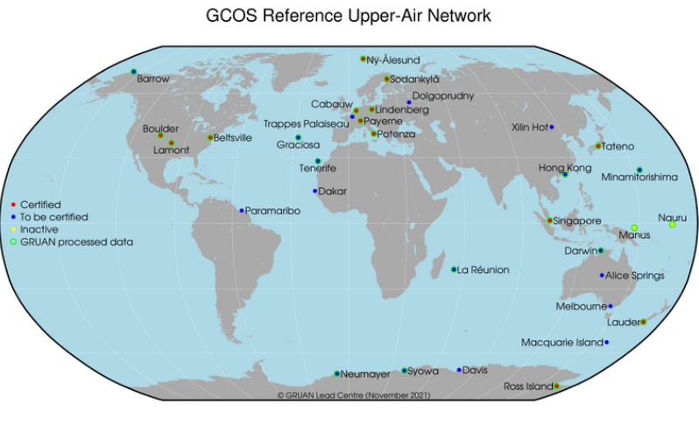
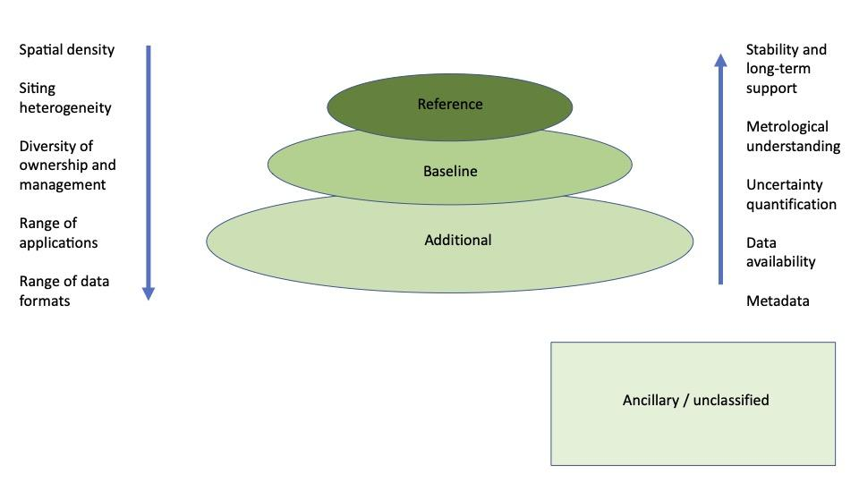
Reference Networks
Tiered Network approach
GRUAN (30 stations)
GUAN (161 stations)
GRUAN:
Ground based network for reference upper air observations for climate under GCOS and integrated into WIGOS - Priority 1: Water vapor, temperature; Currently 33 sites
Maintain consistent reference observations over decades
Standardization and traceability
Deliberate measurement redundancy
Quality management and change management
Validation of satellite systems
A reference network provides metrologically traceable observations, with quantified uncertainty, at a limited number of locations, or for a limited number of observing platforms.
Notes:
Three tiers, “Reference”, “Baseline”, “Additional” supplemented by a 4th tier “Ancillary” for networks not belonging to the first 3 tiers (useful observations that do not fulfil the requirements of the first three tiers, i.e. poor metadata, unknown/heterogeneous ownership etc.) or which could not be assessed, called Ancillary / Unclassified.

Slide 14
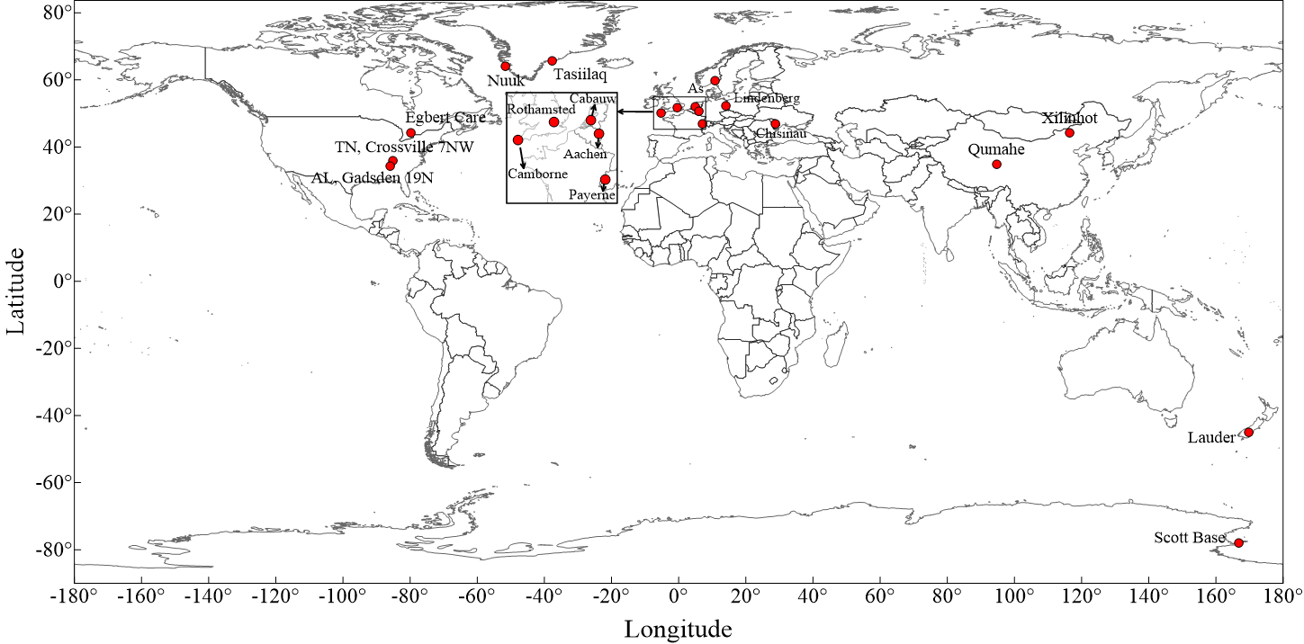
GSRN (Pilot)
GSRN Ref No. | Station Name | Country
01 | Egbert CARE | CANADA
02 | TN, Crossville 7NW | USA
03 | AL, Gadsden 19N | USA
04 | Cabauw | THE NETHERLANDS
05 | Chisinau | Republic of Moldova
06 | As | NORWAY
07 | Aachen | Germany
08 | Lindenberg | Germany
09 | Camborne | UK
10 | Rothamsted | UK
11 | Qumahe | China
12 | Xilinhot | China
13 | Payerne | Switzerland
14 | Scott Base | New Zealand
15 | Lauder | New Zealand
16 | Nuuk | Denmark
17 | Tasiilag | Denmark
Implementation of Pilot (GSRN)
Mandatory variables: Temperature and Precipitation
17 pilot GSRN station across 11 countries: Canada, China, Denmark, Germany, Moldova, Netherlands, New Zealand, Switzerland, UK, USA
LC/TT-GSRN working with station contact to ensure:
Station and measurement level metadata and data transfer (CSV, BUFR, WIS2.0)
Working together with SC-MINT ET-MU to calculate uncertainties for temperature

Slide 15
EU Project - iClimate Action
The iClimateAction project addresses the need of increased coordination and synergies among the GCOS), GEO and WMO to improve the international alignment across organisations regarding creation, management and utilization of climate data
Assessment of the current in-situ ECV observation data chains
• Assessment of space-based ECV observation data availability
• Systemic analysis of current ECV observation system (GAP Analysis)
WP no | Work Package Title | Lead Participants
1 | Analysis of WMO, GCOS and GEO strategies and work programmes for climate data in support of international convention and EU green deal | WMO
2 | Streamlining the surface-based and space-based ecv data | GCOS
3 | Demonstrators for establishing the science-to-services across WMO-GCOS-GEO interfaces | GEO
4 | Enhancing and facilitating the exploitation of climate data and delivery of information services | WMO, GCOS, GEO
5 | Strategic guidance for enhancing coordination across the organisations | WMO
 | Communication and outreach | WMO, GCOS, GEO
7 | Project coordination and management | WMO
Fostering exploitation of EO data and data products.
• Fostering exploitation of EO data and data products through a joint GCOS-WMO-GEO strategy on AI.
• Guidance for the governance and coordination of climate data center and climate data hubs.
• Key findings on the data journey from ECVs to Services demonstrators for adaptation and mitigation.
• Roadmap for more integrated EO exploitation strategy supporting WMO, GEO and EU priorities

Slide 16
Calibration and Validation Stations
GCOS Steering Committee 31 – July 2024
Action Number | Description
A31/1 | GCOS to invite Space Agencies to enter a dialogue to establish permanent calibration/validation stations to make sure that the increasing amount of data that is being generated can be validated. Participate/do a presentation on GCOS (reference) networks in WGCV - WGClimate/CEOS Working Group on Cal/Val. GCOS Secretariat – Next WGClimate Meeting (February 2025).
Permanent calibration/validation stations could be established, providing the needed long-term series.
There are working groups within WGClimate and CEO already working on that but collaboration on network design should be enhanced so that this validation can be undertaken.
The issue has different implications including proper training to staff working at the validation/calibration sites.

Slide 17
EUMETSAT Proposal for radiosonde validation campaign
The EUMETSAT Polar System-Second Generation (EPS-SG) B satellite instruments MWI/ICI identify a need for a dedicated radiosonde campaign, to support their Cal/Val activities
Several other EPS-SG instruments plan to use radiosondes within their Cal/Val activities, as do other EUMETSAT satellite instruments
Radiosondes are also highly beneficial for instrument long term monitoring
=> EUMETSAT started to look into options for radiosonde provision (high quality, including uncertainties)
=> started to have regular discussions with GRUAN/WMO/GCOS / NOAA and others regarding a possible setup

Slide 18
The CNR, running the Potenza GRUAN station, will be the single Service Provider/Point of Contact for EUMETSAT; CNR has approached GRUAN and non-GRUAN stations and will ask for dedicated measurements, paying on a per launch basis.
Planned activities:
Activity 1: Service Setup and first Proof of Concept (2025Q3)
Activity 2: Monitoring activities, support to Cal/Val - 2025Q4-2026Q3 and 2026Q4-2027Q4
Activity 3: Monitoring activities and support to EUMETSAT missions (~2028)

Slide 19
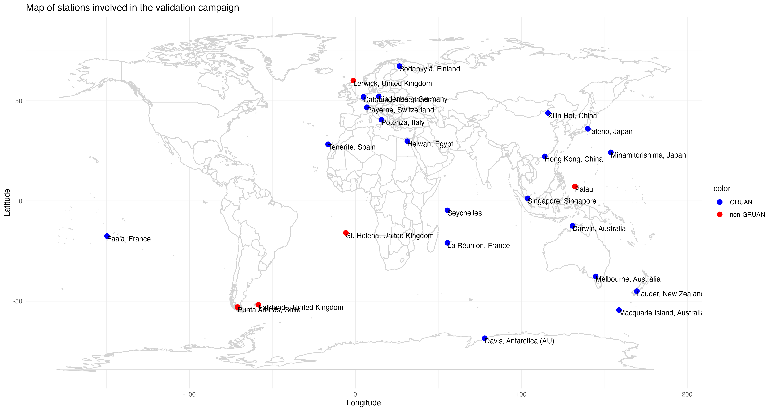

Slide 20
GCOS Timeline
GCOS 5-year timeline
GCOS Clim Conf-3 ?
ECV Rat.
Febr. 27: Status Report
Aug 2028: GCOS IP
GSRN-TT-3
GSRN-TT-FP
GSRN-TT-5
Writing team IP
OOPC-29
SC-32
SC-33
AOPC-31
SC-34
AOPC 29
TOPC25
OOPC27
JPM
TOPC-27
Brazil (INPE)
7-10 July)
Drafting SR
Drafting IP
Q3 2024 | Q4 2024 | Q1 2025 | Q2 2025 | Q3 2025 | Q4 2025 | Q1 2026 | Q2 2026 | Q3 2026 | Q4 2026 | Q1 2027 | Q2 2027 | Q3 2027 | Q4 2027 | Q1 2028 | Q2 2028 | Q3 2028 | Q4 2028
COP 29
SBSTA
COP 30
SBSTA
COP 31
SBSTA
COP 32
SBSTA
COP 33
SR to COP
IP to COP
INFCOM IV
Cg-extr
Cg-20
Notes:
GSRN yearly (starting)
Panels every 18 months
Status Report and GCOS IP (proposal clear from our side)
Climate Conference: a bit more open, we think it would be good to do it as input for GCOS Implementation Plan
Things are missing for readiblity like IOC Assembly etc, WGClimate.....
Next SC in Brazil: starting thonking at the SR, how do we want it? More interative, etc

Slide 21
Joint Panel Meeting 2026
Next Joint Panel Meeting: 3 panels + WGClimate
Location: TBD – Any suggestions?
One of the first two weeks of February 2026 –
Kick-off meeting for the Status Report and the Implementation Plan
Initial thoughts:
1 day: Plenary and topics of interest for GCOS and WGClimate (e.g. Cal/val; ECV data repository, gaps in remote sensing)
3 days for individual panel meetings – Status Report: Assessment of IP actions; gap analysis; brainstorming for IP
1 day of cross-panel groups
Expected outcomes:
WGClimate/GCOS Joint sessions
Draft gap analysis for each of the ECVs (satellite observations) ;
Identification of some common activity WGClimate/GCOS in the area of cal/val
.......
GCOS cross panel sessions
Assessment of 2022 GCOS IP Action where GCOS is implementer or that are cross-domain finished and agreed between the panels; First draft for the 4 cross-panel ECVs factsheets

Slide 22
However
Financial contribution of US represented over 50% of GCOS revenue
Given the political situation there is a lot of uncertainty – In the worst case scenario, GCOS would not have funds to continue beyond the beginning of 2028.
Thelma (GCOS SC Chair) and Nir (GCOS Director) are going to seek funds from other sources.
Depending on their success, and on the consequences of the actual political situation in the US, GCOS will need to reduce the in person meetings in order to be able to go through with the next Status Report and Implementation Plan

Slide 23
GCOS and WGClimate
GCOS and WGClimate work closely together:
Monthly meetings between WGClimate Chairs and GCOS Secretariat
AOPC and TOPC: ex-officio members from WGClimate
WGClimate invited to participate to GCOS Steering Committee
Where to do better:
From WGClimate: better involvement in the production of the GCOS Implementation Plan (and SR). We need to discuss how to achieve – last time WGclimate was given a longer period for the review, not sufficient?
GCOS: how to work towards a better solution for cal/val stations?
Planning of JPM – This is OUR meeting

Slide 24
Thank you

