Slide 1
Space Agencies’ Response to the 2022 GCOS Implementation Plan
WGClimate
Agenda Item 2.2

Slide 2
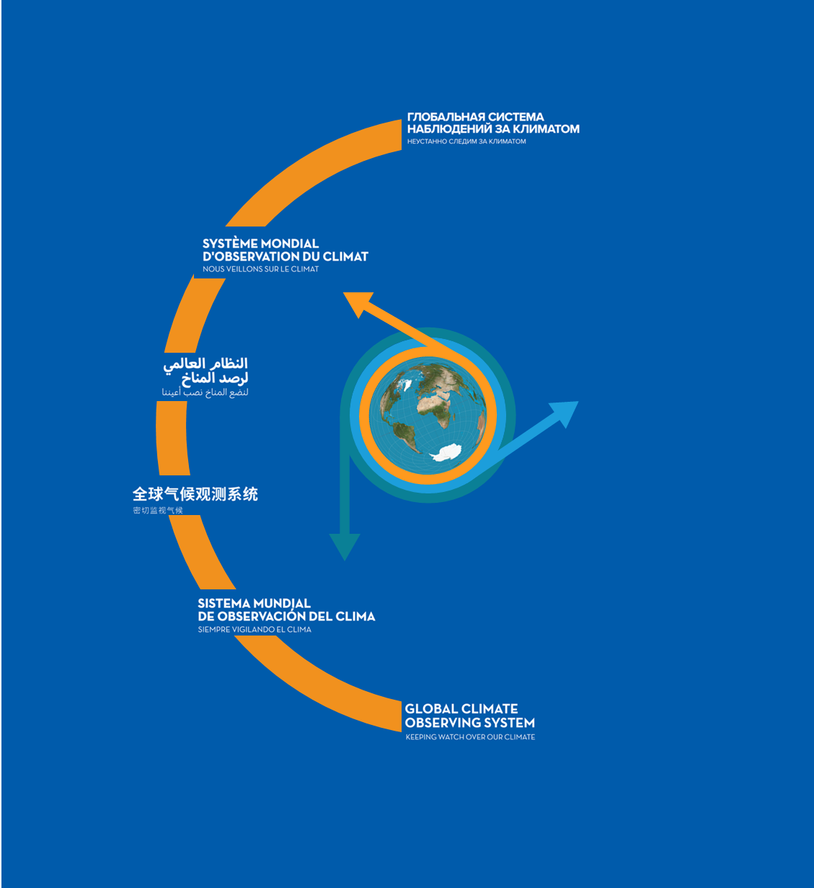
GCOS Implementation Plan
Produced every 5-6 years, GCOS Implementation Plans:
Are submitted to UNFCCC and the GCOS sponsors.
Provide recommendations for a sustained and fit for purpose Global Climate Observing System.
Cover climate monitoring needs over the entire Earth system from the atmosphere to the oceans, from the cryosphere to the biosphere.
Encompass the water, energy and carbon cycles.
This 2022 GCOS Implementation Plan has a different form to earlier plans, it has:
Fewer, more focused, and integrated actions.
Clearer means of assessment.
Clearer identification of the stakeholders who need to respond to the actions.
The updated ECVs requirements are presented in a separate document - The 2022 GCOS ECVs Requirements (GCOS 245).

Slide 3
Actions in the GCOS IP space agency supplement
A total of 16 actions, each may contain multiple activities

Slide 4
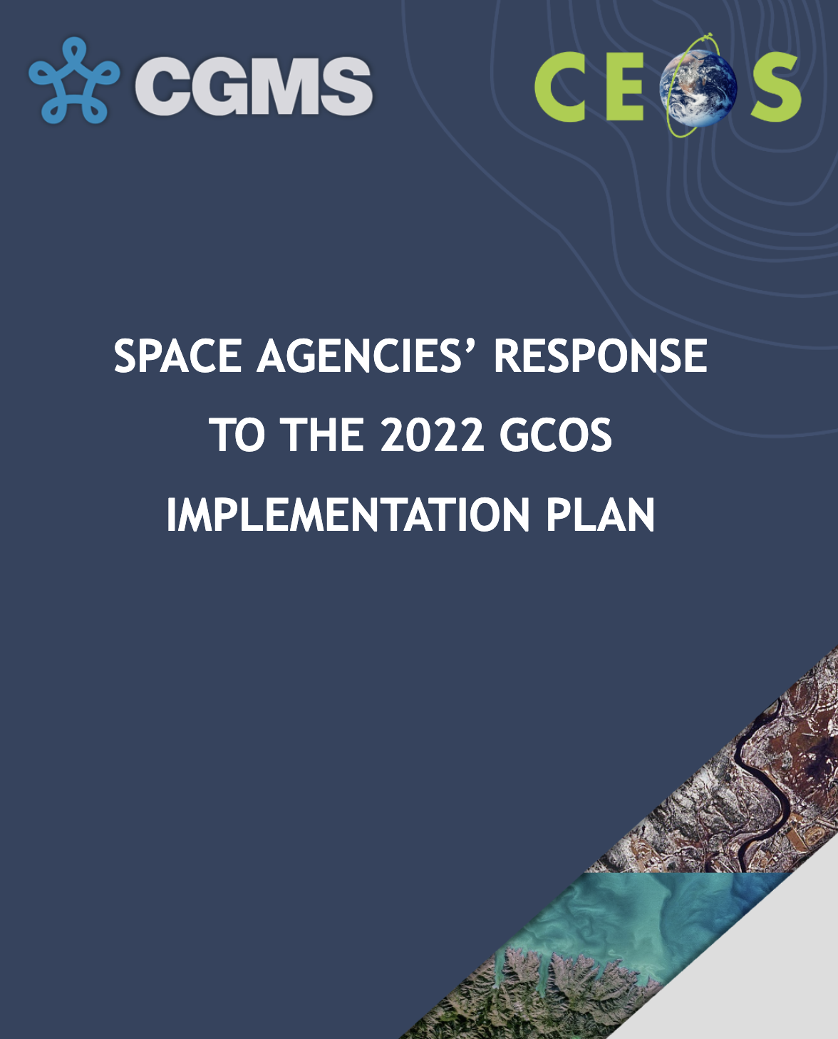
Status
Provided responses to 21 activities in 2023.
Provided responses to 27 activities in 2024.
These responses represents collective efforts from major space agencies, with the goal to provide a comprehensive response to each of those activities.
Appreciate the comments and clarification that we have received so far from the GCOS panels.

Slide 5
Action A2: Address gaps in satellite observations likely to occur in the near future
Altimetry in the polar regions
Gravimetry missions
Biomass measurements
Limb-sounding missions capable of measuring several ECVs in the UTLS and stratosphere
Sea surface salinity measurements
Wind lidar
Global scale ice surface elevation

Slide 6
Action A3: Prepare follow-on plans for critical satellite missions
Earth Radiation Budget measurements
Cloud profiling
Cloud lidar
Global precipitation measurement consisting of a dual-frequency precipitation radar and passive microwave measurements to provide sufficient temporal and spatial sampling of rain areas
Sea ice and icebergs (or floating ice)

Slide 7
Action B1: Development of reference networks (in situ and satellite Fiducial Reference Measurement (FRM) programs)
Better align the satellite FRM program to the reference tier of tiered networks and enhance/expand FRM to fill gaps in satellite cal/val
Establish a long-term space-based reference calibration system to enhance the quality and traceability of earth observations. The following measurables are to be considered: high-resolution spectral radiances in the reflected solar and infrared wave bands, as well as GNSS radio occultations.

Slide 8
B3: New Earth observing satellite missions to fill gaps in the observing systems
Improve diurnal sampling of observations and coverage of GHGs, precursor aerosols, and solar-induced fluorescence (SIF) to improve estimation of emissions and vegetation carbon update
Explore new ways to improve estimates of Earth’s energy imbalance (EEI) with novel remote sensing techniques and with very well calibrated hyperspectral measurements over the full spectrum of the outgoing longwave and shortwave radiations
Provide direct measurements of ocean surface currents from space
Explore and demonstrate the feasibility of satellite missions based on new satellite technologies for climate monitoring.
Develop operational techniques to estimate permafrost extent: significant amount of feedback

Slide 9
C5: ECV-specific satellite data processing method improvements
Generate timely permafrost, land cover change, burnt area, and fire severity/burning efficiency products from high resolution satellite observations (e.g., Sentinel-1 /-2 and LandSat).
Produce harmonized and validated AGB and change datasets from different satellite data streams, for enhancing AGB estimation at global and sub-national level.
Ensure that the Bidirectional Reflectance Distribution Function (BRDF) parameters are provided together with surface albedo.
Reprocess the NASA LEO 25+ year Lightning Imaging Sensor (LIS) dataset from the Optical Transient Detector (OTD, 1995-2000), LIS on TRMM (1997-2015) and ISS (2017-present).
Reprocess the GEO Geostationary Lightning Mapper (GLM) on GOES-16/17/18 (2017-present).
Improve consistency of the inter-dependent land products.

Slide 10
F1: Responding to user needs for higher resolution, near real time data
Improve biomass, land cover, land surface temperature, and fire data with sub-annual observations and improved local detail and quality.

Slide 11
F2: Improved ECV satellite observations in polar regions
Sea surface salinity of polar oceans
GHG at high latitudes with a focus on the permafrost regions in wintertime
Sea-ice thickness
Surface temperatures of all surfaces (sea, ice, land)
Atmospheric ECVs at the very highest latitudes (describing climate change including forcing and feedback effects)
Albedo for all surfaces (land and sea-ice)

Slide 12
F5: Develop an integrated operational global GHG monitoring system
Design a constellation of operational satellites to provide near-real time global coverage of CO2 and CH4 column observations (and profiles to the extent possible)
Improve and coordinate measurements of relevant ECVs at anthropogenic emission hotspots (large cities, powerplants) to support emission monitoring and the validation of tropospheric measurements by satellites

Slide 13
Next steps
Report was shared with GCOS panels in mid-January. Feedbacks are expected by Feb. 14.
WGClimate will incorporate feedback from the GCOS panels and share the revised “Space Agencies’ Response to the 2022 GCOS IP” with the CEOS and CGMS communities for review by early March 2025.
WGClimate will seek endorsement of the Space Agency Response to the GCOS IP at SIT-40 in April 2025.

Slide 14
Inputs to the 2027 GCOS Status Report
Update the ““Space Agencies’ Response to the 2022 GCOS IP” before our joint meeting with GCOS panels in Feb. 2026.
Ensure that we provide the most up-to-date information for the 2027 GCOS Status Report.
The goal of the joint meeting with GCOS panels is to collaboratively develop the GCOS Status Report and Implementation Plan.

Slide 15
Additional Slides

Slide 16
B9: Improve estimates of latent and sensible heat fluxes and wind stress
Develop new approaches and improved methods to better exploit relevant ECV measurements to estimate ocean surface heat, moisture and momentum flux including
Better integration of in situ and satellite measurements, data assimilation, fusion techniques, ensuring consistency between different types of measurements and their harmonization
Development and deployment of new satellite missions that are tuned to maximize the sensitivity to the state variables needed to estimate heat flux over the ocean and land
Increase and improvements in satellite observations that target both the surface parameters and the near-surface air-parameters
Simultaneously use of an approach based on high resolution numerical models (LES) to augment satellite product validations
Include in future intercomparison campaigns of latent and sensible heat fluxes measurements inferred from simultaneous observations with a water vapor differential absorption lidar, a doppler wind lidar and temperature from rotational Raman lidar.

Slide 17
C2: General improvements to satellite data processing methods
Improve radiance measurement records and Radiative Transfer models for simulating them.
Improve uncertainty quantification of satellite retrievals.
Periodically reprocess full satellite data records whenever an update of underlying methods occurs, especially when those risks introducing discontinuities into the time series.
Consolidate satellite observations into instrument-independent space-time grids for easy intercomparisons and fusion.
Ensure harmonization and quality of ancillary data used to generate satellite products such as solar irradiance and meteorological data.
Notes:
25

Slide 18
C4: New and improved reanalysis products (mainly for reanalysis centers)
Implement new production streams using improved data assimilation systems and better collections of observations, particularly aiming at:
Further increasing resolution;
Improving handling of systematic observational and model biases;
Providing (improved) estimates for the uncertainty in the mean state;
Improve quality control in data sparse areas.
Develop coupled reanalysis (ocean, land, sea-ice)
Improve the capability of sparse-input reanalysis that covers the entire 20th century and beyond
Develop and implement regional reanalysis and other approaches to regionalization
Reduce data latency

Slide 19
D4: Create a facility to access co-located in situ cal/val observations and satellite data for quality assurance of satellite products
Improve access to co-located satellite and reference quality in situ observations, as well as tools for evaluation purposes. This facility will use data from reference networks and FRM programs for a broad range of ECVs for cal/val of satellite programs
Develop tools to use the co-located data collection developed under activity 1 to undertake various analyses of satellite-based measurements.

Slide 20
F3: Improve monitoring of coastal and exclusive economic zones
Expand global ocean climate in situ observations and satellite products into exclusive Economic Zones (EEZs) and coastal zones
Develop new satellite-based products for coastal biogeochemistry
Produce land cover datasets in coastal areas without land surface masks and in near real time, including uncertainties

