Slide 1
Future plan for ECV inventory and support for gap analysis and coordinated action plan
Jörg Schulz, EUMETSAT
Alexandra Nunes, Innoflair
G. Scardapane, Innoflair
M. Grant, EUMETSAT
Agenda Item 2.1

Slide 2
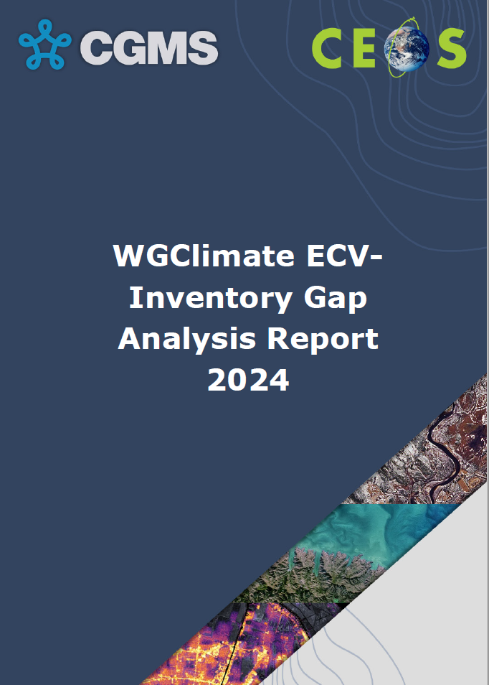
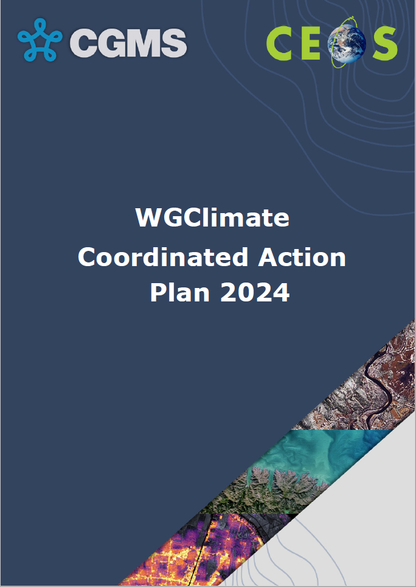
Context & History
ECV Inventory and Process is baseline for WGClimate to:
provide a comprehensive and accessible view of existing and planned Climate Data Records
deliver further climate data records through best use of available data
optimise the planning satellite missions
WGClimate decided to transition the ECV Inventory into a CDR Inventory:
new technical baseline
simplified process to populate and verify it
continuous publication, individual time tags used for record updates.
EUM and EC continue to fund activities until mid-2029.
ECV Inventory (reference versions)
v2.0, October 2017 (917 records, 31 ECVs)
…
v5.0, October 2024 (1289 records, 36 ECVs)
ECV Inventory
WGClimate & Data Producers
Climate Experts
Improved CDRs
Gap Analysis
Gap Analysis &
Coordinated Action Plan
2018, based on ECV Inv v2.0
2024, based on ECV Inv v3.0 + v4.1
Data producers
Improved observing system
Coordinated Action Plan
WGClimate
CEOS / CGMS

Slide 3
Transition to CDR Inventory
Publication timeline:
v2.0: October 2017
v3.0: August 2020
v4.0: October 2021
v4.1: November 2022
v5.0: 31.10.2024 (backlog since V4.1)
1289 entries (918 existing + 371 planned)
119 entries added / updated
minimal adaptation to GCOS-244
hybrid approach to “verification”
[v5.i] 🡪 v6.0: Q2.2025
integration of backlog and clean-up
complete update with respect to GCOS-244
small updates to registered entries (eg URLs)
[incremental] publication with frozen v6.0
Maintenance and critical updates of current system + database
Ingestion and review* of backlog input into current database (*hybrid approach)
Development and evolution of new system and database (new and enhanced support functionalities, wider scope, …)
Current database clean-up, data sanitization, data migration, …
Continuous update and publication of new database, refinement of workflow
vX.#: > Q2.2025
new database structure, system, UI
enhanced user experience and reporting capabilities
new workflow (input and verification)
continuous update and publication
focussed harvesting as needed (GA
adaptation to emerging priorities
v5.0
[v5.i] 🡪
🡨 v6.0
vX.# 🡪
Preview of new UI
WGC-22
11-13 Feb 2025
Public release of new UI and database
Late Q2.2025
(Focussed harvesting as needed (GA) and preparation for support to emerging priorities)
Q3-Q4.2025

Slide 4
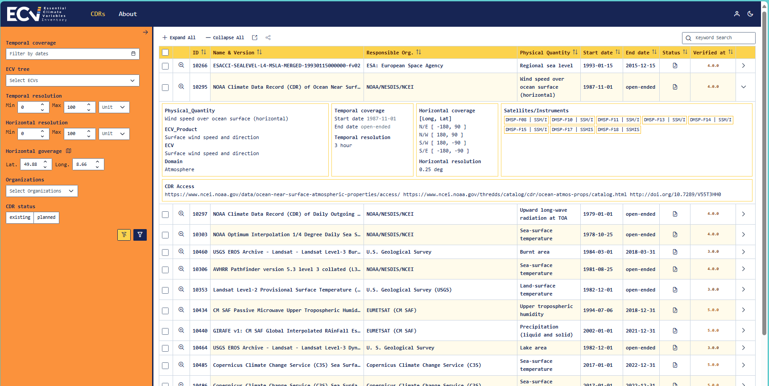
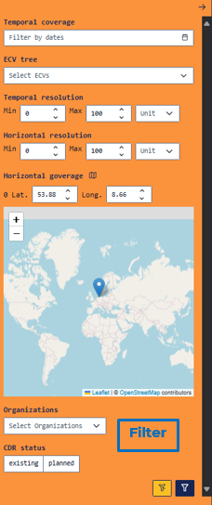
CDR Inventory: New UI and DB
Bulk expand / collapse
Sort
General search
Bulk expand / collapse
Sort
Row view
Expanded view
Active links to WMO OSCAR / Space
Formatted data
Formatted data
Select
Select
Detailed view
Detailed view ( > new page)

Slide 5
CDR Inventory: Evolution
System, UI, DB [+]
Modular system, mostly based on off-the-shelf tools --
flexible and easily expandable;
Flexible GCOS ECV Tree (nodes, edges, layers), easily adaptable to changes in framework;
Connection between related datasets (“families”, but also* TCDR –FCDR);
WMO OSCAR data retrieval via API, updated frequently; Inventory data open and publicly exposed through standard REST API;
Content focus on actionable information (WGClimate and external users); improved analysis and reporting capabilities*; improved user experience;
Entry points for users: domains, cycles*, applications* (TBC)
* work in development
Expansion in support of emerging priorities
Can Support FCDR (or better best possible radiance records) inventory (Coordinated Action #5);
Want to enhance discoverability and uptake of ECV Inventory by external users / stakeholders of EO data – a decision / selection tree for space-based CDRs;
Stepwise approach:
(simpler): Identify different Application/Stakeholder ”groupings” and then map relevant ECV Inventory products onto these;
(less simple): Develop targeted user interface (decision/selection tree, LLM, etc.) to provide an interface to users to identify relevant CDR product in the ECV Inventory.
Discussion topic for Thursday!
8.2 – Expanding the Utility of the ECV Inventory (M. Dowell & J. Schulz)

Slide 6
Comments on the GA Report and CAP
Gap Analysis Report
Report summarises all analyses done during the pandemic
Received 11 comments from NOAA on GA (mostly editorial)
Text of GA is updated, can publish and send reviewers a thank you e-mail
Coordinated Action Plan
9/28 Actions from 2018, 6 Actions from 2024
Received comments from CSA and NOAA on the CAP
Decision on way forward for 2 comments
Notes:
CSA provided a brief for WGClimate signalling support to open actions (5 existing and 4 new actions) to which CSA may contribute and sees value for national discussions.
Old actions:
F(C)DR Inventory
better link ECV user requirements to climate applications,
FCDR generation as programmatic activity of an agency,
addressing measurement gap for stratospheric CH4 profiles,
further assessment of C-band and L-band SAR data availability
New actions:
GCOS ECV consolidation process aiming to turn GCOS ECV Products into physical quantities that match WMO definitions.
keeping GHG fluxes between Earth’s surface and atmosphere containing both natural and anthropogenic sources,
ECV gap analysis if transitions to more operational production of globally consistent AGB data records appear,
leverage community expertise for future GCOS Implementation Plans and WGClimate gap analysis on the GCOS ECVs.

Slide 7
Comments on CAP from NOAA – CH₄
Recommendation #12: The AC-VC to develop a plan to address the measurement of stratospheric CH₄ profiles in order to fill the gap for the related FCDR/CDRs.
Action #2018-13: The AC-VC, in collaboration with WGClimate, to develop a plan to address the measurement gap for stratospheric CH₄ profiles in order to provide FCDR/CDR in the future. This plan shall be subject to endorsement by WGClimate.
Status: Open
WGClimate #20 decided to keep the action open as no specific consideration of CH₄ profiling has been undertaken. This is because the focus was on surface emissions to which such measurements are not contributing. Nonetheless several measurement systems exist that could deliver parts of the CH₄ profile [RD-10] but no plan how this could be turned into a long-term data record has been considered yet.

Slide 8
Comments on CAP from NOAA – CH₄
Comment NOAA: The lack of progress in developing a plan for stratospheric CH₄ profiles is concerning, as these profiles provide critical insights into upper-atmosphere methane dynamics, transport, and long-term climate impacts. Recommendations: Consider a workshop or task force involving agencies with relevant measurement systems to evaluate the feasibility of leveraging existing sensors to initiate a pilot study for long-term FCDRs/CDRs.
Connected to GCOS Action F5: Develop an integrated operational global GHG monitoring system: Design a constellation of operational satellites to provide near-real time global coverage of CO₂ and CH₄ column observations (and profiles to the extent possible)
Suggestion: Chairs to ask AC/VC for evaluation of the comment and potential action on a WS in 2025/26.
Notes:
Laurie Rokke

Slide 9
Comments on CAP from NOAA - FCDRs
Recommendation #8: CEOS and CGMS agencies to add the delivery of FCDRs for each individual satellite instrument (linked to relevant precursor instrument series) to their agency remit.
Action #2018-09: CEOS and CGMS agencies with interest in and/or mandate for the development of climate data records are requested to include FCDR generation into their agency remit to ensure future availability of consistent Level-1 data for climate data records.
Status: Open
WGClimate #20 decided to keep this action open with the understanding it describes a long-term goal for the community. Recent years saw some progress on this item, but it is still a long way to a sustained production of FCDRs for every mission. Before this can be successfully addressed the FCDR definition needs to be acknowledged and largely followed by agencies. In addition, the inventory of FCDR and FDR production by agencies (see Action #2018-05) may help to foster generation of FCDRs also in international collaborations such as the recent EUMETSAT and NOAA project on FCDR for observations from the geostationary ring of satellites that is also supported by JMA and IMD
Comment NOAA: Given the required international coordination, I would recommend an action for all agencies with geostationary imagers to support the GEO-Ring efforts.
Suggestion: In principle it is covered by the existing action, but we could add this as a second action to the recommendation.
Notes:
Andrew Heidinger

Slide 10
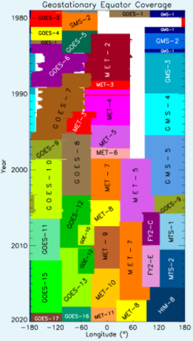
GEO-Ring Fundamental Radiance Record
~1980-2025 and beyond, 30 minutes, ~4-5 km² resolution
6 years (2019-2024) of test data available in 2025
Plan to amend with polar orbiting data towards the poles

Slide 11
Future of Gap Analysis - Request
Need to systematically implement open actions into the CEOS workplan
Gap Analysis is listed as routine task in CEOS work plan and CGMS High Priority Plan. Given the issues experienced we may bring it back to specific actions
It is proposed to exercise gap analysis together with GCOS based on their IP Actions. We provided answers, mostly on space segment but not ECV data records. Next good stop point is to reassess in 2026 for GCOS Status Report in 2027 prior to next IP. Use the next joint meeting with GCOS to facilitate that.
Shall encourage people to do their own analysis based on the new CDR Inventory. Discussion on item 8.2 may also lead to such analysis in a sense of fitness for purpose.
Concrete plan should be discussed in 23rd WGClimate session

Slide 12
SPARE

Slide 13
ECV Inventory: Acting on lessons learnt
Workflow
Input: external (data producers and curators).
Verification: EUM Support Team + external, via a long iterative process.
Publication: bulk, on a yearly basis at best.
Heavy workload for internal and external actors; lack of control of process (timelines, progress, updates) and increased backlog; long hauls between public versions of DB.
Database / questionnaire
Complex questions; inhomogeneous input; unformatted information.
Low turn-out for some questions; inhomogeneous input; information not readily accessible for analysis.
System and UI
Complex system difficult to maintain and evolve; UI unappealing for public end-users.
Hindrance of usage of resource to its full potential; low uptake from end-users.
Input: EUM Support Team, mostly based on publicly available information.
Verification: External (via agencies focal points), as needed (completion, correction) and feasible -- should not prevent publication.
Publication: Continuous, individual update time tags for records.
Low workload for external actors; EUM Support Team controls process and manages backlog and content; public version of database more up to date questionnaire]
Simplified set of questions; focus on actionable information (WGClimate needs, public end-users); streamlined database; formatted information.
More homogeneous content; workable information; database easier to evolve and expand.
Modular system, mostly based on off-the-shelf tools -- flexible and easily expandable; new UI with improved appearance and tools.
Improved analysis and reporting capabilities; Improved user experience also for end-users; easier adaptability to emerging needs.

