Slide 1
The skill of Earth Observation for Tipping Points research
Tim Lenton
University of Exeter
Lenton, U of Exeter
Agenda Item 1.6

Slide 2

Passing a tipping point

Slide 3
Early warning signals
Arctic sea-ice
September extent
Central western
Greenland Ice Sheet
Atlantic Meridional
Overturning Circulation
Variance
AR(1) auto-correlation
Boers et al. (in revision); Boers & Rypdal (2021) PNAS; Boers (2021) Nature Climate Change

Slide 4
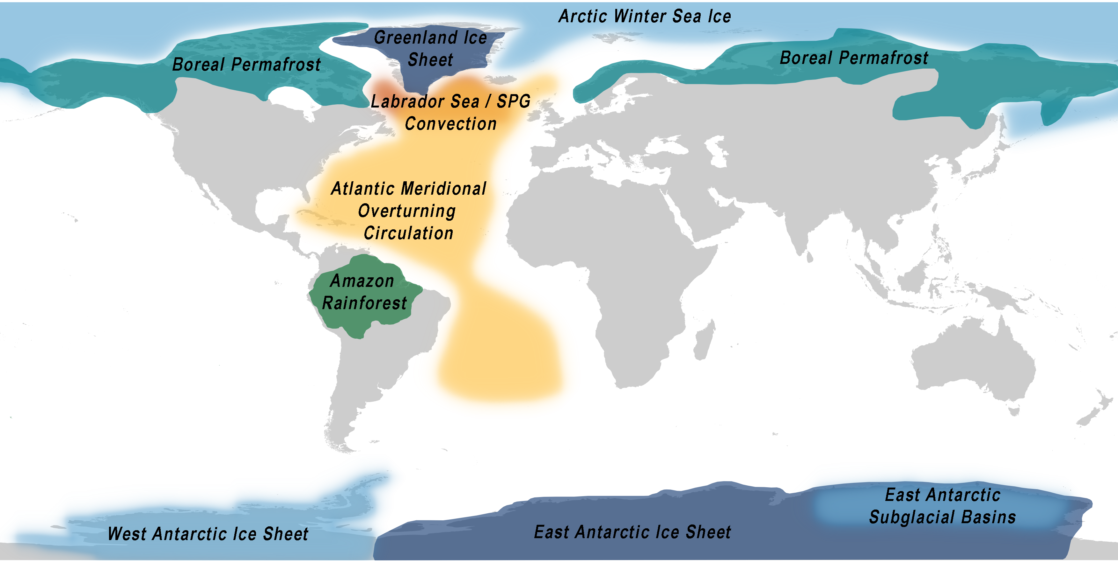
Global core tipping elements
Armstrong McKay et al. (2022) Science

Slide 5
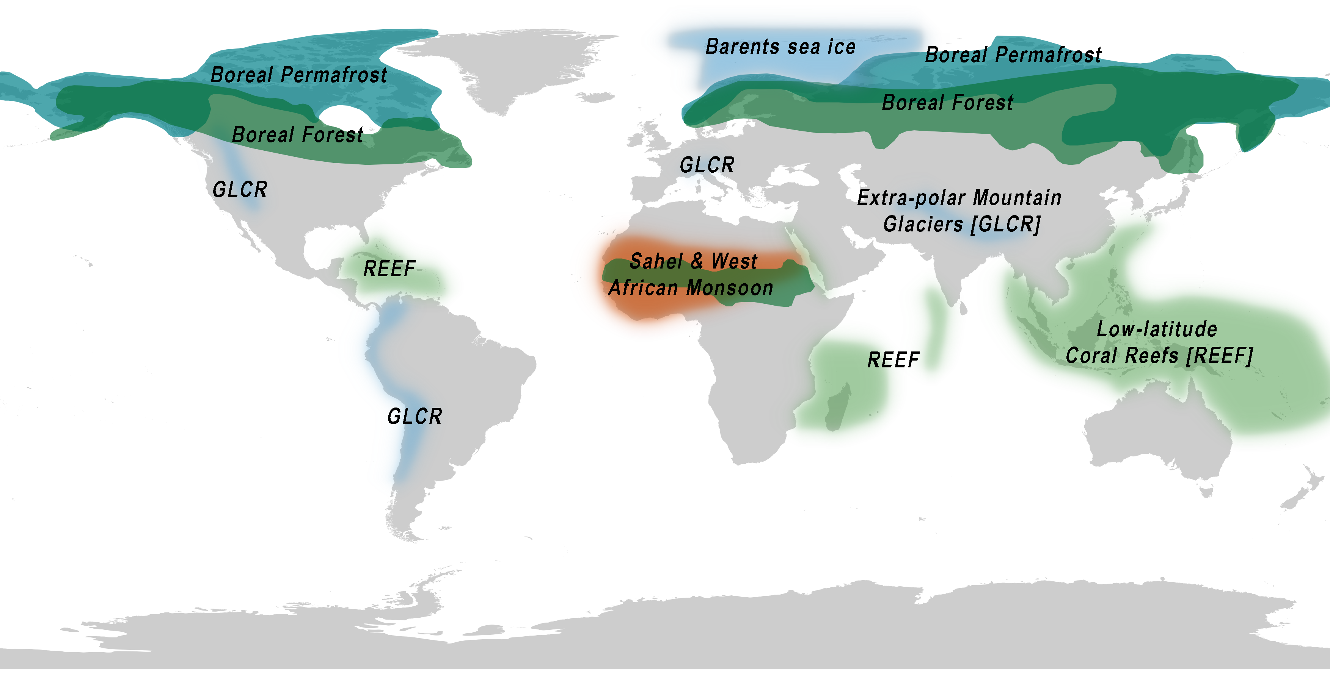
Regional impact tipping elements
Armstrong McKay et al. (2022) Science

Slide 6
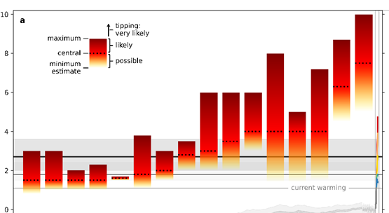
Estimates of tipping points
Global warming (C)
E Antarctic ice sheet
Permafrost collapse
Arctic winter sea ice
E Antarctic basins
Atlantic (AMOC)
Subpolar gyre
Sahel monsoon
Boreal forest N
W Antarctic
Alpine glaciers
Boreal forest S
Barents Sea
Greenland
Permafrost
Coral reefs
Amazon
Armstrong McKay et al. (2022) Science

Slide 7
Tipping cascade risk
Lenton et al. (2019) Nature

Slide 8
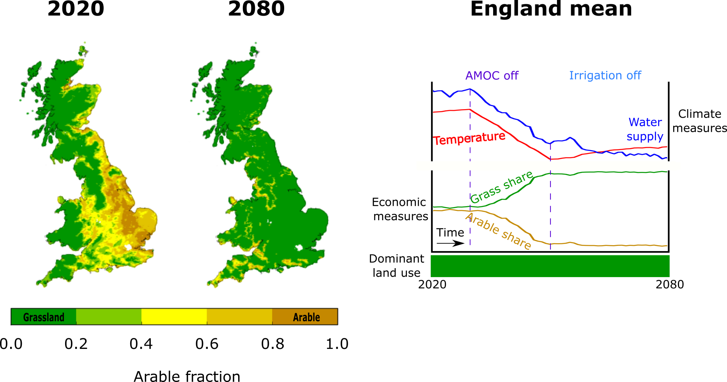
Impacts of AMOC tipping point
Ritchie et al. (2020) Nature Food

Slide 9
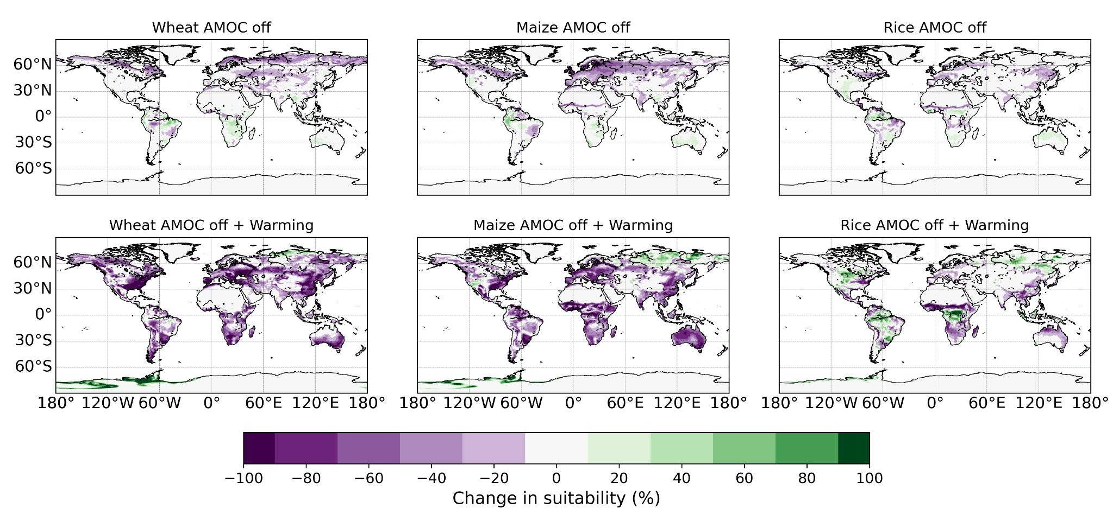
Effect on suitability for staple crops
2.5C global warming + AMOC tipping point
Wheat
Maize
Lenton et al. (contribution to OECD report 2022)

Slide 10
EO targets for tipping points
Monitor relevant feedback processes to improve process understanding.
Detect alternative stable states and abrupt changes.
Establish how alternative stable states and their stability depend on climate variables.
Observe system dynamics over time, including changes in resilience and associated early warning signals.
Calibrate, constrain and evaluate models of tipping systems to improve predictions.
Lenton et al. (2024) Nature Communications

Slide 11
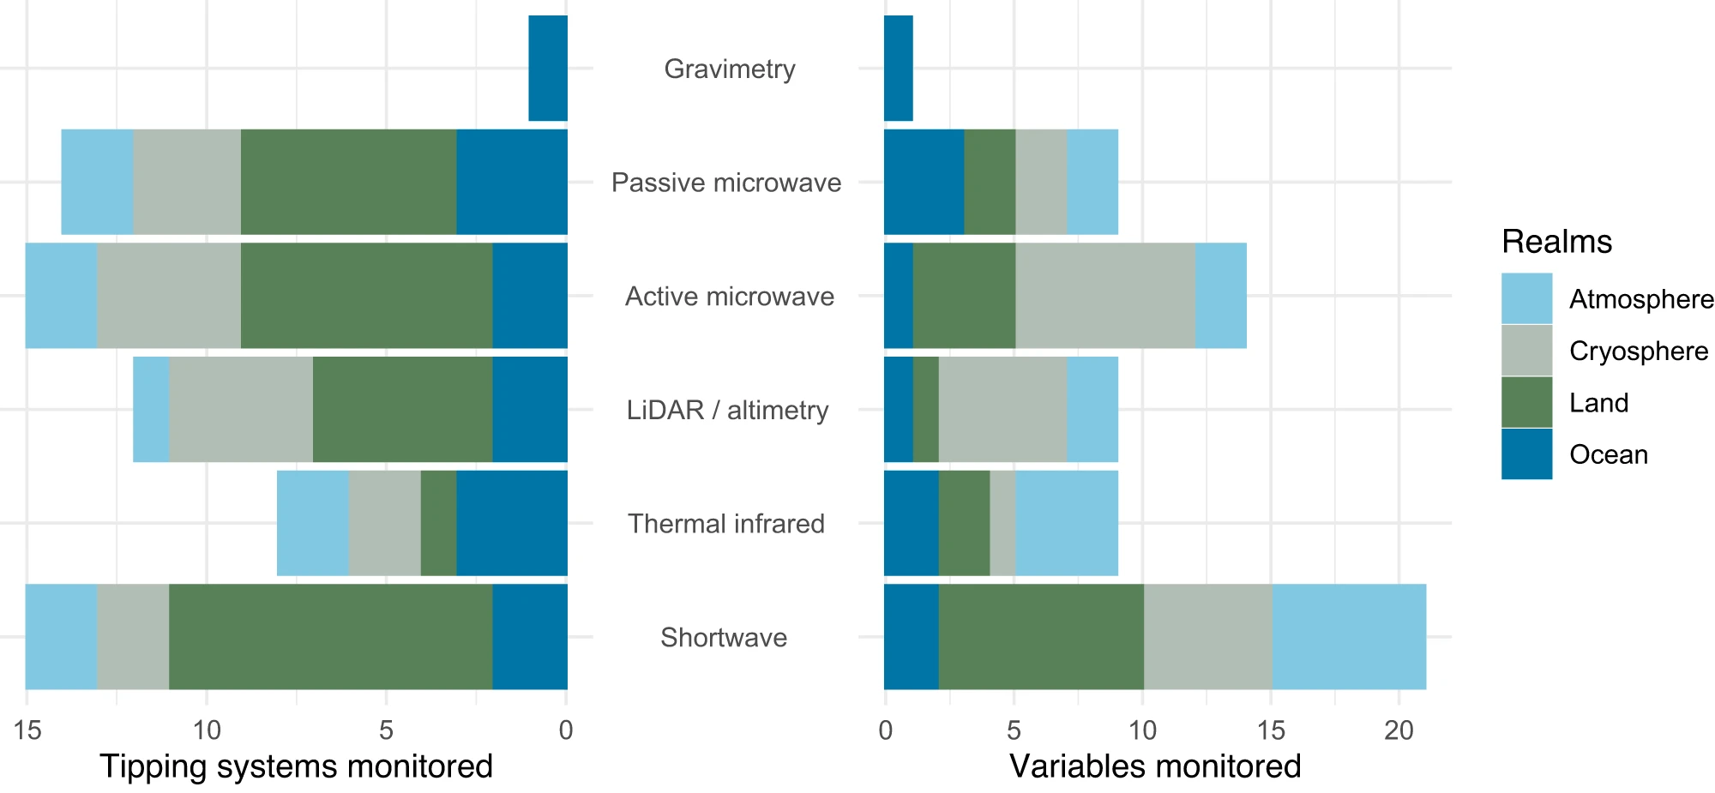
Capacity to monitor tipping systems
Lenton et al. (2024) Nature Communications

Slide 12
Criteria for EO datasets to be useful
Salient variables correlated with key processes underlying tipping dynamics
Accurate analysis-ready data
Spatial coverage of the tipping systems of interest
Spatial resolution sufficient to resolve key feedbacks involved in tipping dynamics
Temporal resolution sufficient to resolve timescales of tipping or recovery
Temporal duration sufficient to estimate system resilience, and ideally changes thereof
Low data latency to support timely detection and/or early warning of tipping points
Lenton et al. (2024) Nature Communications

Slide 13
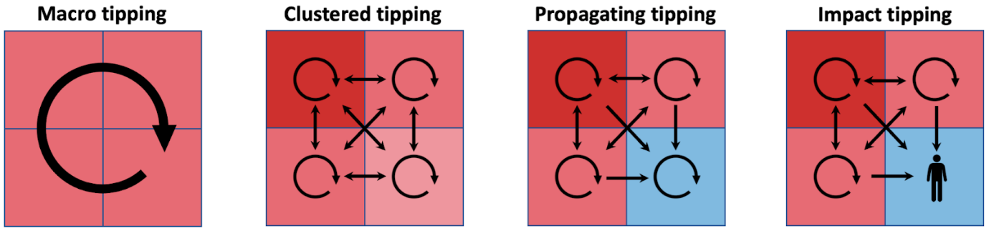
Types of tipping
Macro tipping
  Where key reinforcing feedback mechanisms operate across large spatial scales
  E.g. monsoons; ocean circulation; ice sheets
Clustered tipping
  Where localised tipping occurs in clusters near-synchronously across a large area due to spatially coherent forcing reaching a common threshold
  E.g. coral bleaching (Great Barrier Reef); thermokarst and lake formation
Lenton et al. (2024) Nature Communications

Slide 14
Types of tipping
Propagating tipping
  Where tipping starts at small spatial scales but cascades causally to larger scales
  E.g. Pine Island Glacier => Amundsen Basin => WAIS
Societal impact tipping
  Where localised tipping has unusually large societal impacts
  E.g. loss of Himalayan glaciers
Lenton et al. (2024) Nature Communications

Slide 15
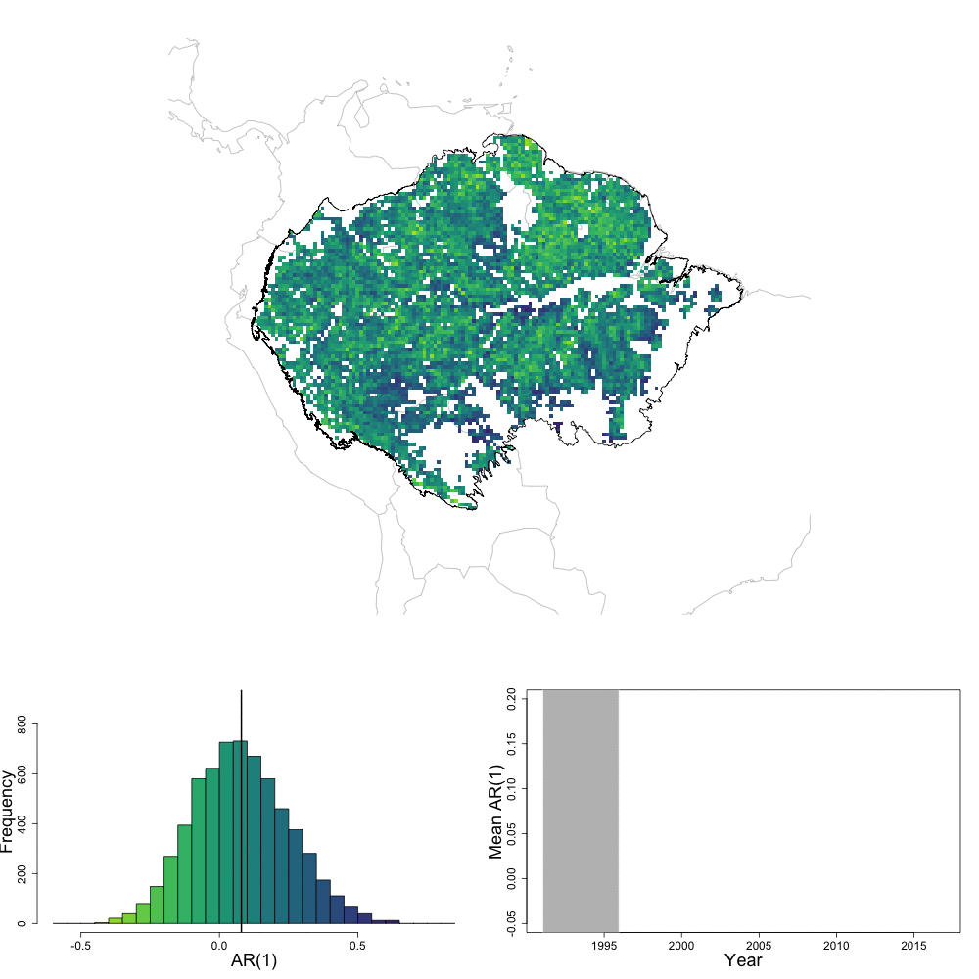
Remotely sensing resilience
AR(1) of Vegetation Optical Depth (VOD)
Key:
Paler = more resilient
Darker = less resilient
Boulton, Lenton, Boers (2022) Nature Climate Change

Slide 16
Losee of resilience of the Amazon
Trend in AR(1) of VOD
since the early 2000s
Boulton, Lenton, Boers (2022) Nature Climate Change

Slide 17
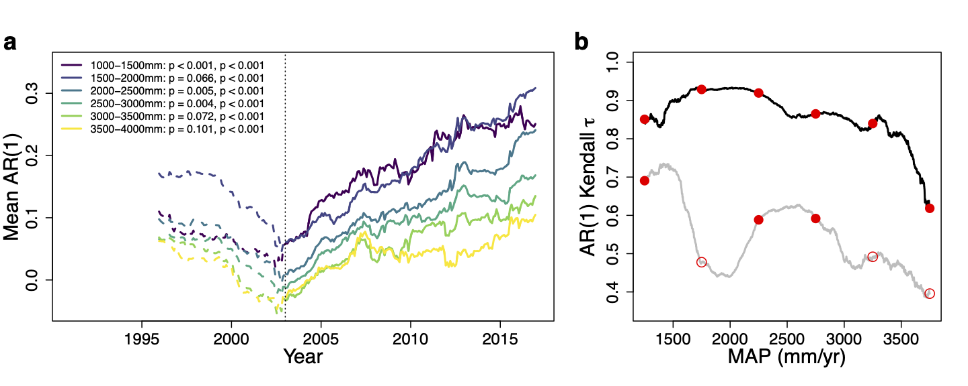
Dependence on precipitation
Boulton, Lenton, Boers (2022) Nature Climate Change

Slide 18
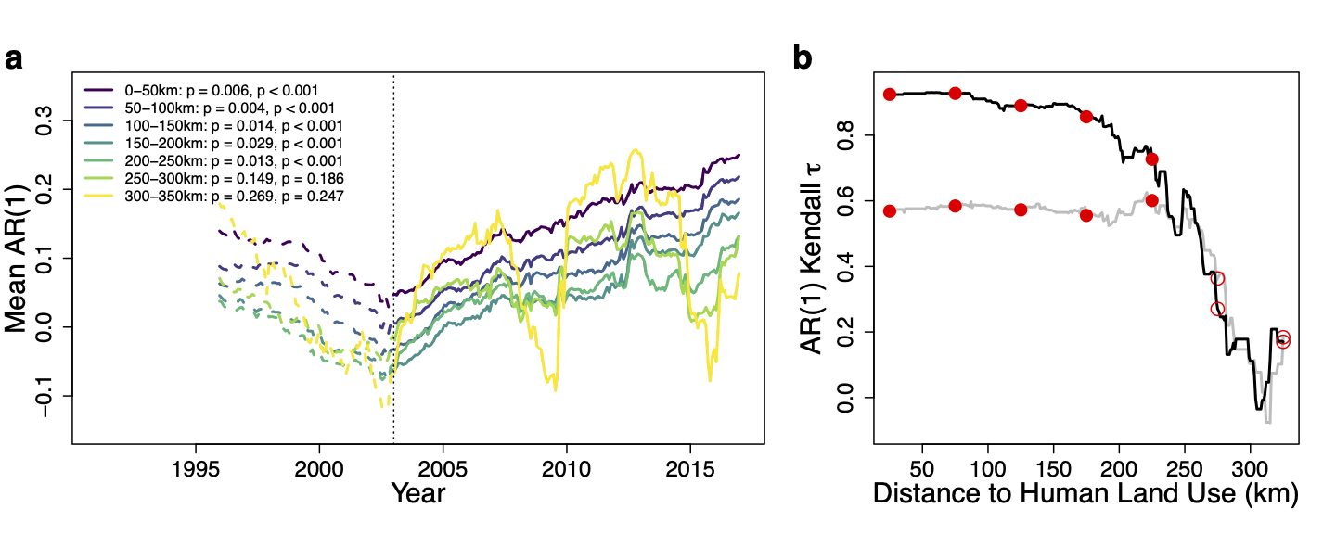
Dependence on human proximity
Boulton, Lenton, Boers (2022) Nature Climate Change

Slide 19
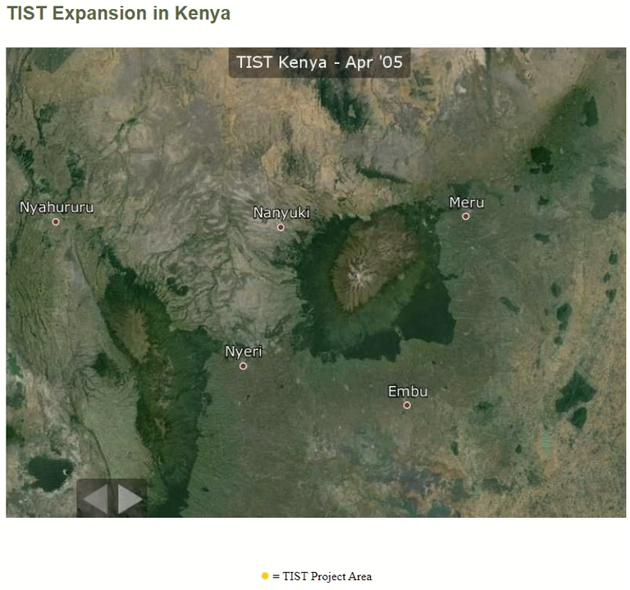


A positive tipping point
The International Small-group Tree planting initiative (TIST)

Slide 20
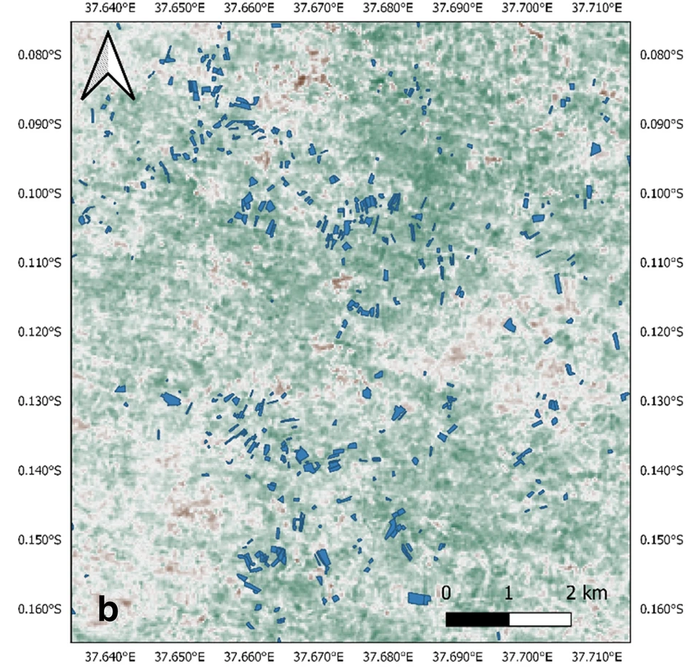
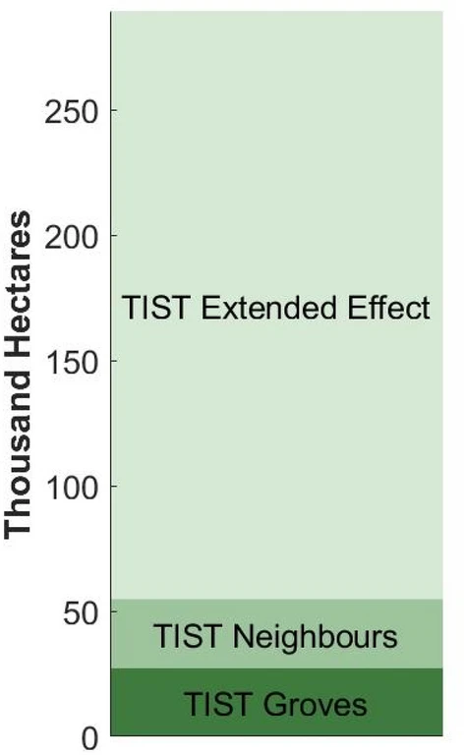
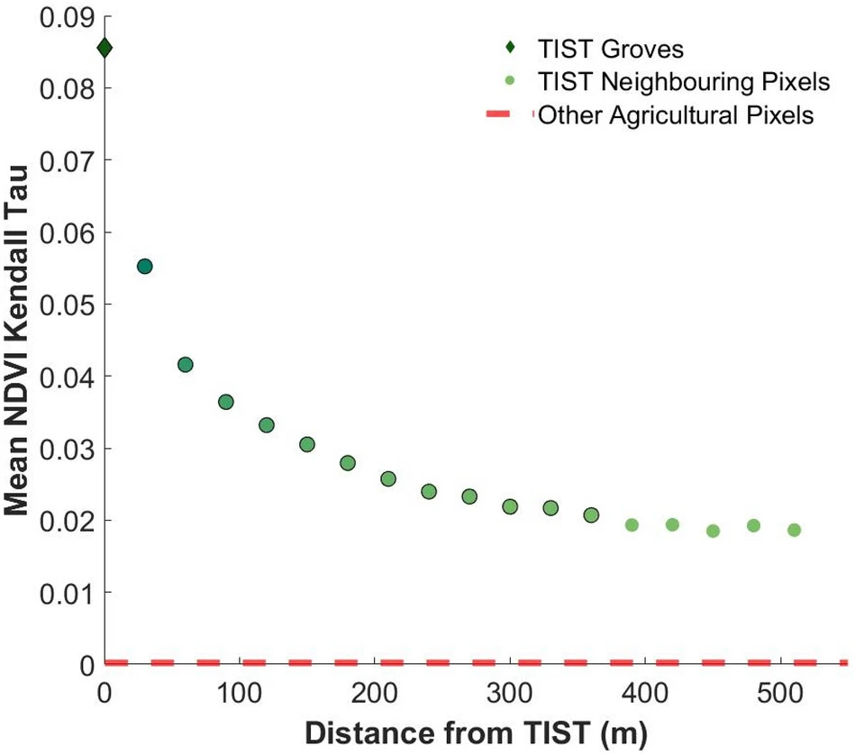

TIST greens surrounding landscape
Buxton et al. (2021) Scientific Reports

Slide 21
Summary
EO can advance the understanding, detection and anticipation of tipping points, and their interactions, across scales
A tipping point sensing system could be established bringing together the Earth system and Earth observation communities
This can provide vital information to support policy-making and risk management at regional, national, and international scales

Slide 22

global-tipping-points.org

