Slide 1
Review of UNFCCC COP-29 and Earth Information Day
WGClimate
Agenda Item 1.4

Slide 2
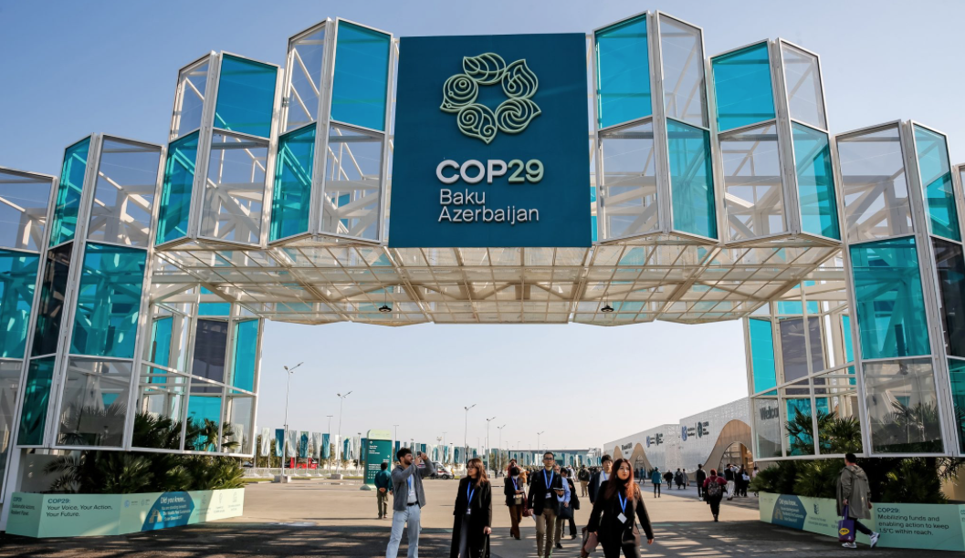
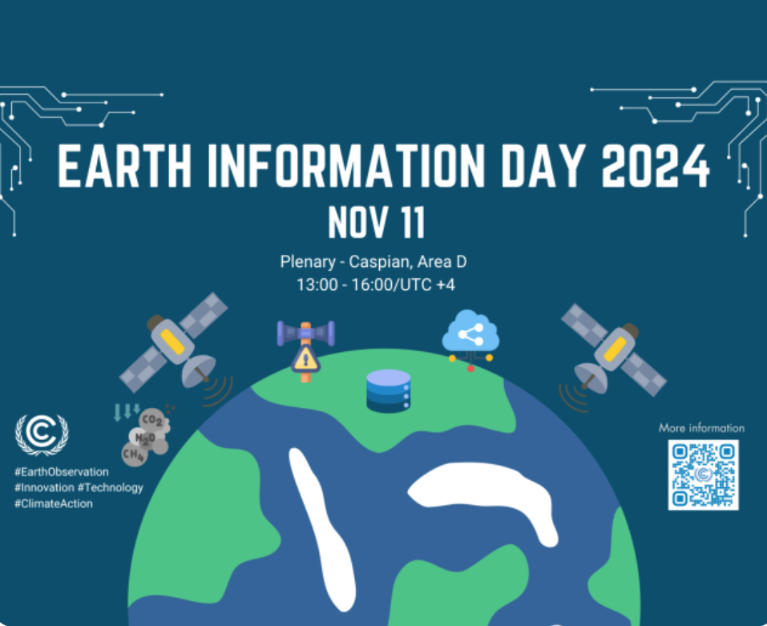
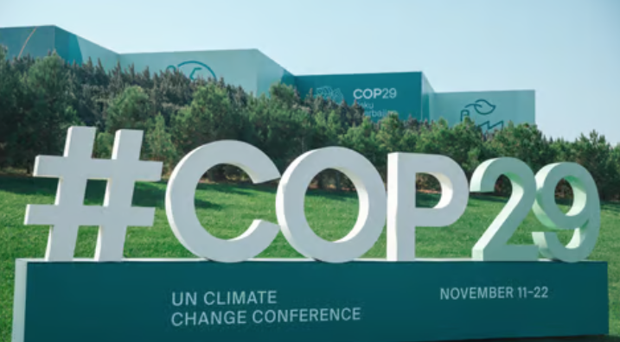
COP-29
COP-29 was held in Baku, Azerbaijan from Nov. 11-22, 2024.
Earth Information Day (afternoon) was held on Nov. 11.

Slide 3
WGClimate Submission on Possible Themes for EID
Sustained and systematic space observations have been providing long-term climate data records for many Essential Climate Variables defined by GCOS.
Space observations have been transformative in our ability to monitor and understand climate change and inform sound policy.
The Global Greenhouse Gas Watch (G3W) initiative of WMO provides a framework for the establishment of operational monitoring and information services about the atmospheric concentrations of the main greenhouse gases and their surface fluxes.

Slide 4
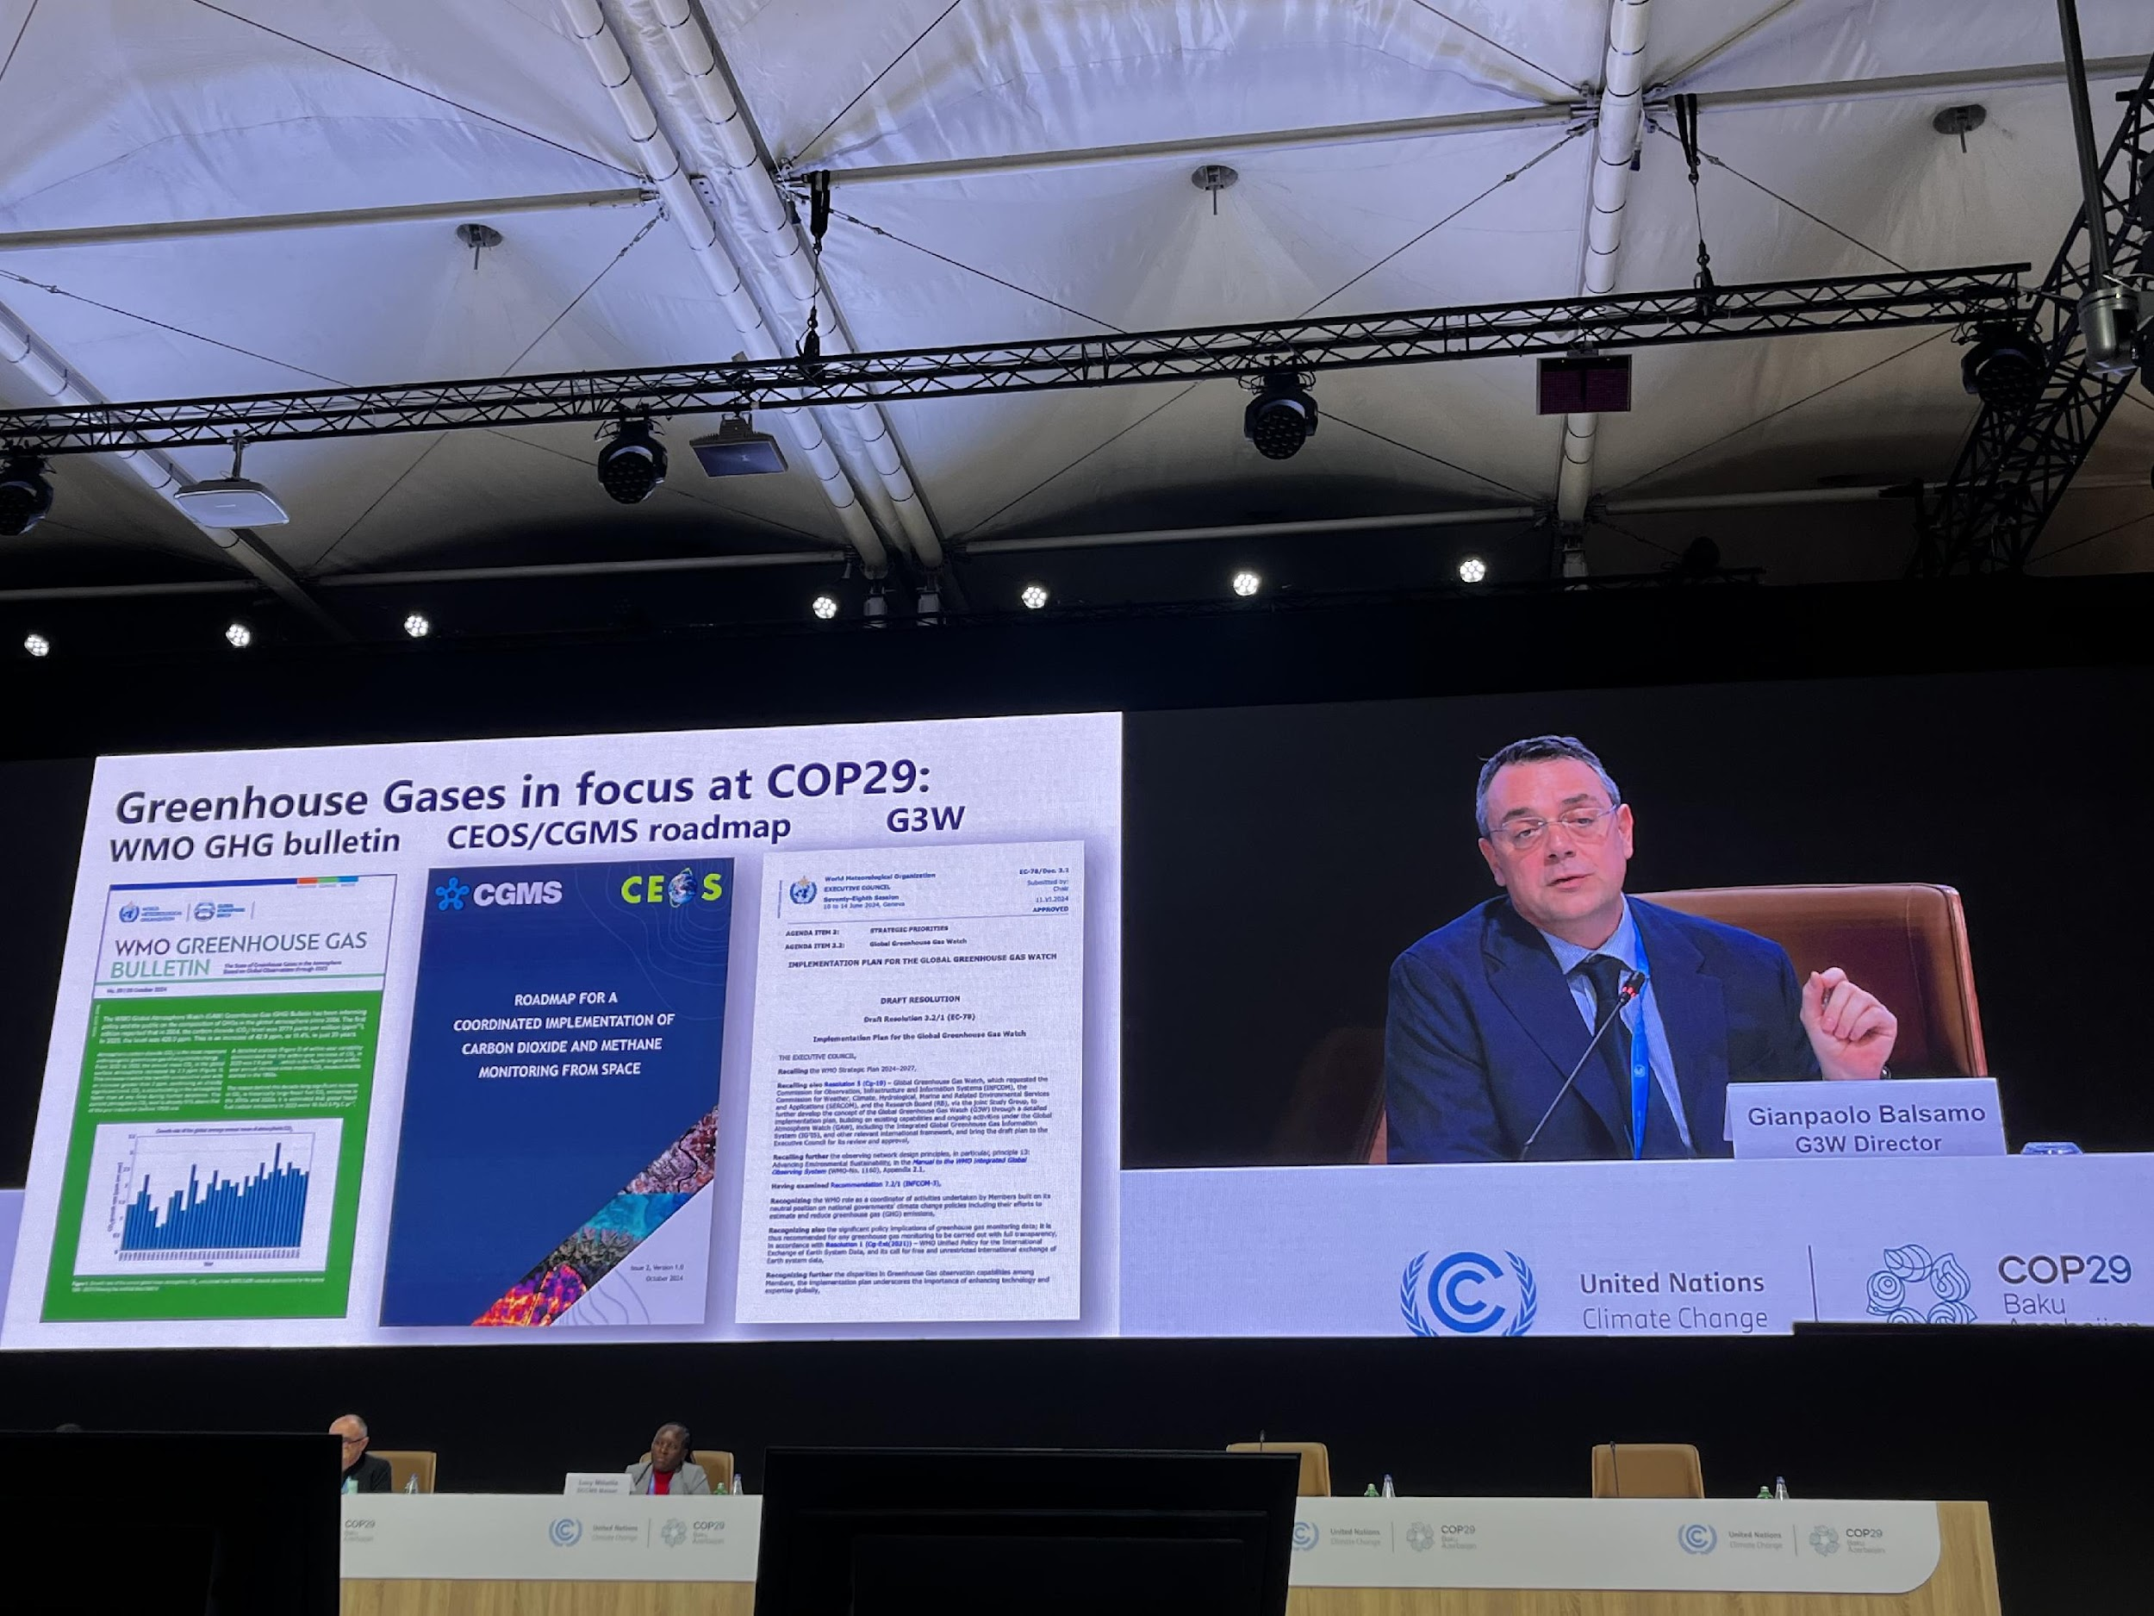
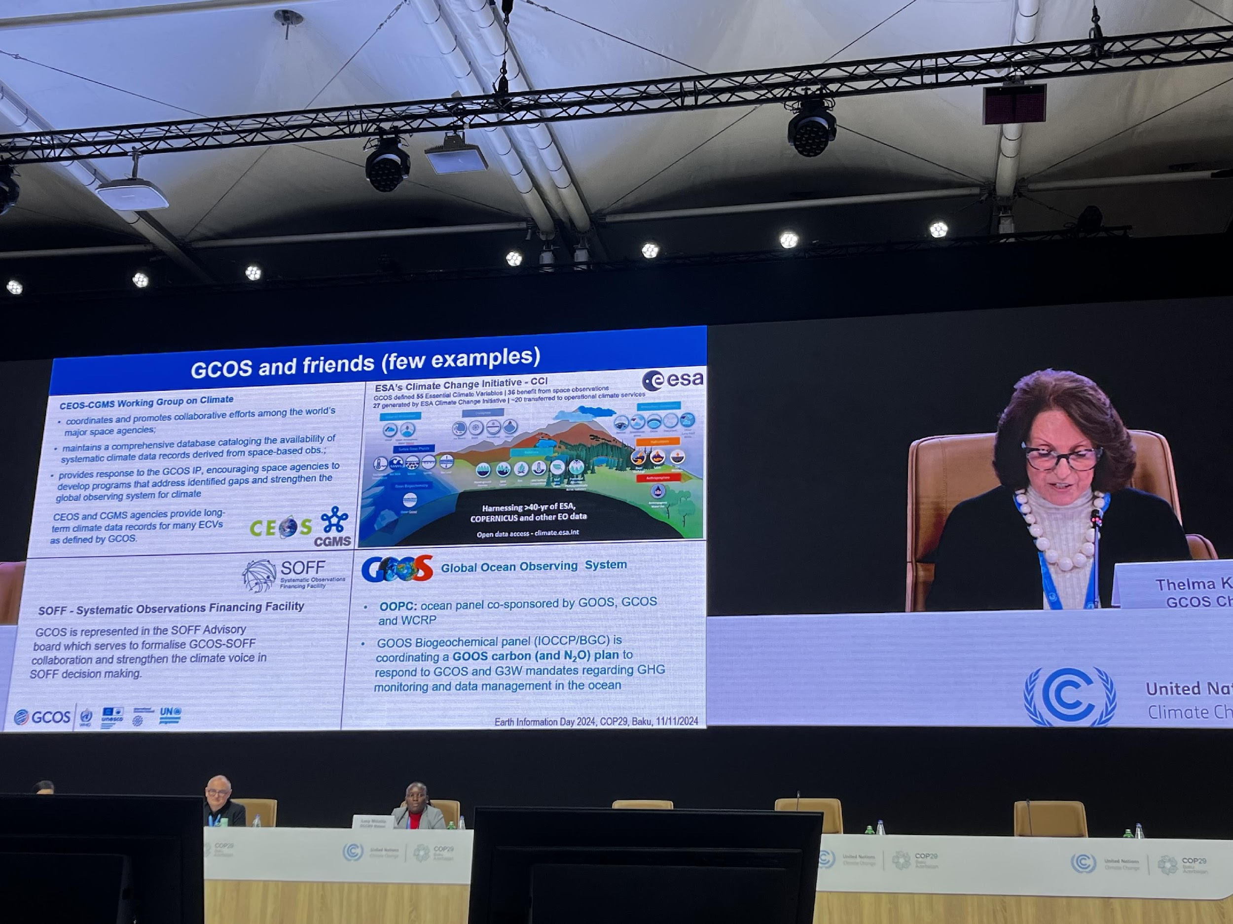
Overview of EID
Opening remarks were given by SBSTA chair (Harry Vreuls), WMO Secretary General (Celeste Saulo), IPCC chair (Jim Skea), and UNFCCC Intergovernmental Support and Collective Progress Division Direction (Cecilia Kinuthia-Njenga).
Updates on the state of the climate highlighted:
WMO 2024 State of the Climate Update
Global Climate Observing System
Global Greenhouse Gases Monitoring and Research
Early Warning for All initiative
Bridging Observation gaps, role of SOFF and innovative financing models
Role of AI and ML in Earth observation
WGClimate work was referenced in GCOS and G3W presentations.
Moderated the breakout session on “Observations for climate change mitigation”.

Slide 5
Moderated the breakout session on “Observations for climate change mitigation”
To ensure long-term satellite and in-situ greenhouse gas observations to support the vision of Global greenhouse gas monitoring, sustained investment is needed to fill critical gaps in greenhouse gas monitoring, and to enhance both in-situ and satellite observations for comprehensive coverage. We also need to focus on moving from research-driven to operational GHG monitoring systems to provide near-real-time, high-quality data that directly supports climate policy and international climate commitments.
To maximize the utility of Earth observation for climate monitoring and mitigation, strong collaborations among international, regional, and national agencies to ensure interoperability and consistency of observational data are critical. Activities and progresses of the coordination organizations of systematic observation should be regularly reported at the UNFCCC event to keep Parties informed.
To support wider use of in-site and space-based GHG data across sectors, enabling effective policy and regulatory application at all levels, capacity-building with user communities is vitally important. Sustained efforts to support capacity-building is encouraged.

Slide 6
Statement by CEOS-CGMS on Progress in Supporting UNFCCC Needs for Global Observations
The statement highlights the vital role that systematic satellite data plays in observing and understanding Earth’s Climate.
Six key areas where satellites have significantly advanced climate knowledge were highlighted:
Greenhouse gas
Changes in land cover and use
Global temperature trends
Melting polar ice and sea level rise
Extreme weather events
Ocean health and acidification

Slide 7
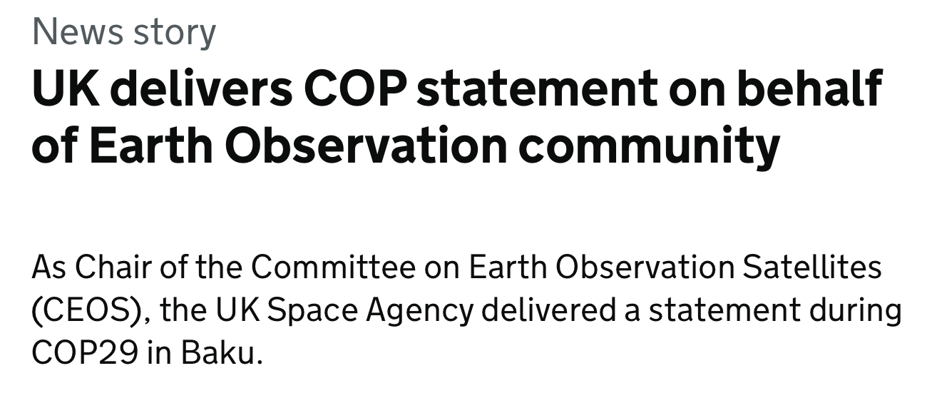
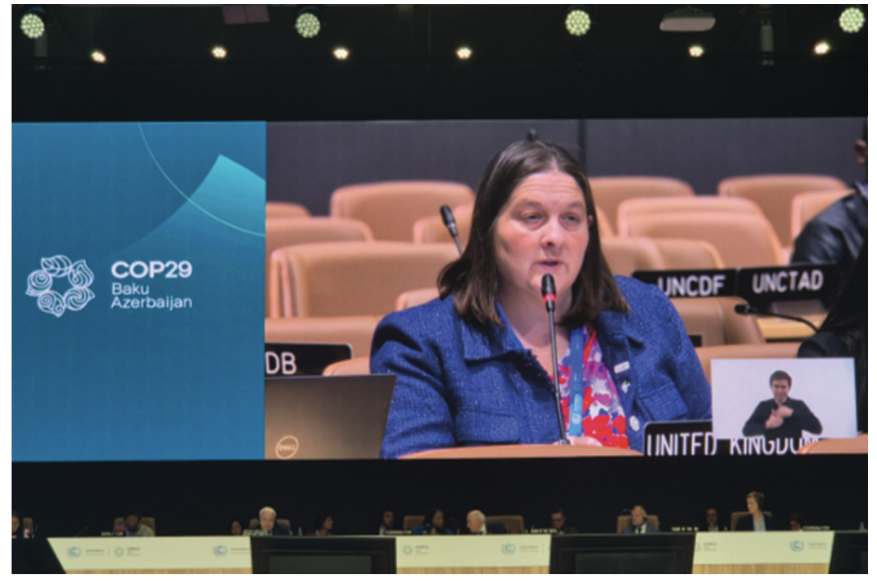
The UK Space Agency (UKSA) delivered the CEOS-CGMS Statement at the opening of SBSTA 61.
UKSA also released a video on social media highlighting the vital role of Earth observation in supporting climate monitoring and decision-making.
A short news story about the CEOS statement was published.

Slide 8
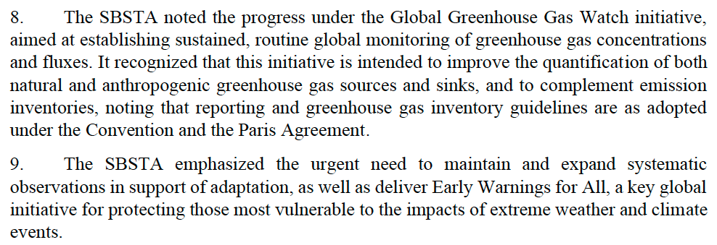
SBSTA-61 Conclusions on RSO

Slide 9
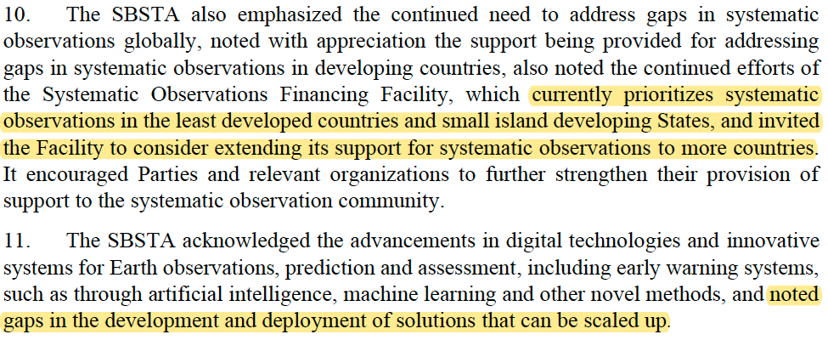
Gaps identified in SBSTA-61 Conclusions on RSO

Slide 10
Next step

