Slide 1
GHG Roadmap and Activities
Yasjka Meijer, ESA
Agenda Item 1.3

Slide 2
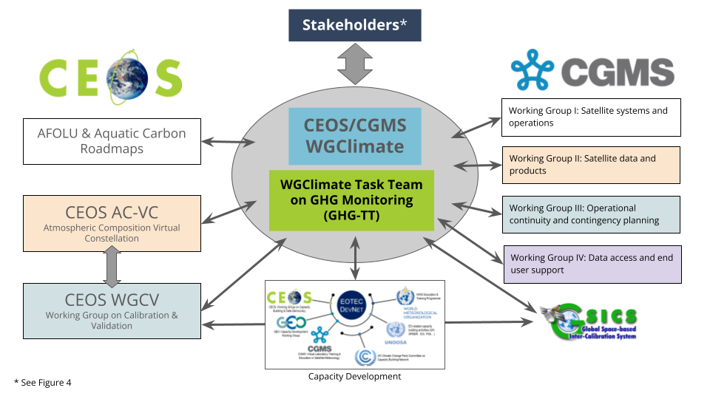
GHG Task Team - Recall
Greenhouse Gas Task Team (GHG TT) is part of joint CEOS-CGMS WGClimate
Responsible for maintaining and implementation of the GHG Roadmap
Coordinates GHG related activities across various CEOS & CGMS WGs
GHG Roadmap issue 1 is from Mar. 2020
and followed from recommendations in
GHG White Paper
Decision to update GHG Roadmap

Slide 3
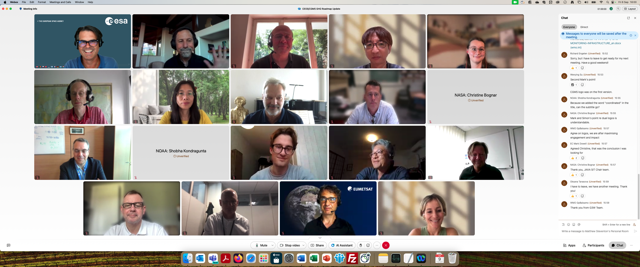
GHG Roadmap – Issue 2 – drafting
Since SIT-39 in Tokyo, an outline was drafted and
followed by biweekly GHG TT meetings
Coordinating with CGMS WGs in June
CGMS-52 appointed Simon Elliott
as PoC to coordinate CGMS’ input
Issue 2 has been established In
coordination with G3W and IMEO
A real team effort and until the
last telecon well attended →
Special thanks to Dave Crisp &
Libby Rose for drafting issue 2

Slide 4

GHG Roadmap – Issue 2 – final
Draft issue 2 circulated on 9 Sep (CEOS & CGMS)
Feedback received at SIT-TW, Sydney
Final issue 2 delivered on 8th October
Endorsement of issue 2 decision at CEOS Plenary
Endorsement of issue 2 requested to CGMS

Slide 5
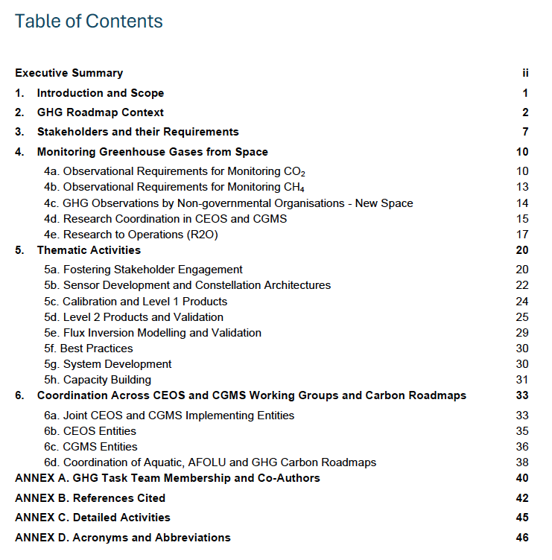
GHG Roadmap – Issue 2
Includes (1-page) executive summary
This version has been expanded in its scope to support the rapid evolution of the international GHG science, policy and regulatory communities. The updated Roadmap describes specific thematic areas where CEOS and CGMS are working with (new) stakeholders and partners to develop improved, fit-for-purpose space-based GHG products. As in issue 1, detailed activities and action items which are continuously evolving, are described in an Annex.
With these changes, the GHG Roadmap should foster the coordination of space-based GHG products that better address the needs of an increasingly diverse stakeholder community and be more resilient to the future evolution of this rapidly evolving field.
Table of contents →
Specific detailed actions tracked in Annex C and maintained online (living document)

Slide 6
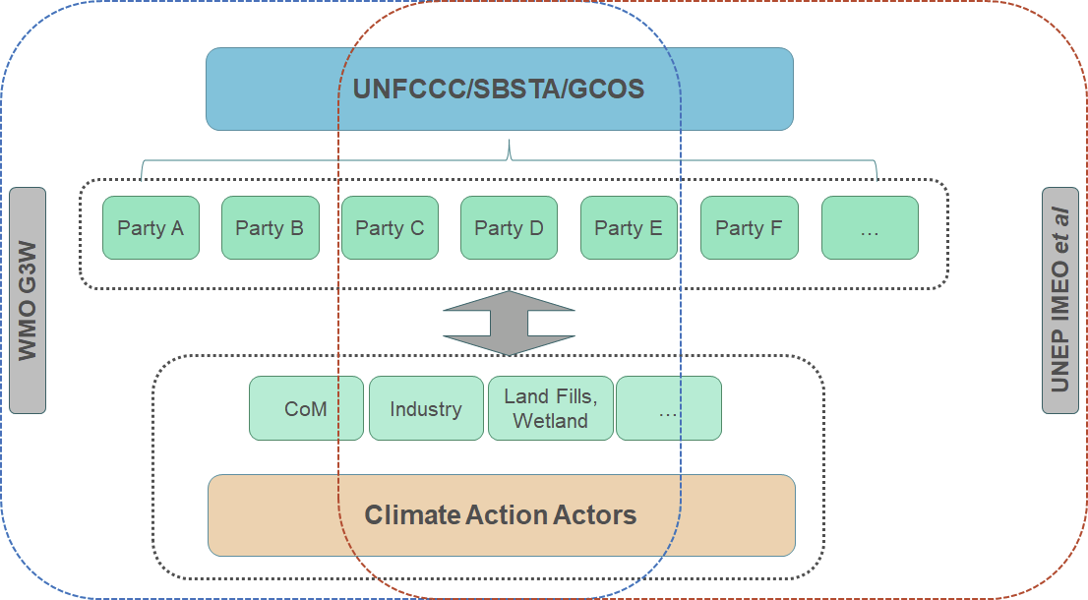
GHG Roadmap – Stakeholder
Issue 2 has specific focus on co-developing activities with stakeholders
Section 3 covers “Stakeholders and their Requirements”, which explicitly includes WMO G3W and UNEP’s IMEO
Section 5a describes the thematic activity for “Fostering Stakeholder Engagement”
John Worden (NASA) is the GHG TT PoC vis-à-vis IMEO
Vincent-Henri Peuch (ECMWF) is the GHG TT PoC vis-à-vis G3W
Collaboration with IMEO is part of planned activities
Intention to have a follow-up meeting of the joint CEOS-IMEO Harvard meeting “International Coordination Workshop on Detection of Anthropogenic Methane Emissions from High-resolution Satellites”, which was held in June 2023

Slide 7
GHG TT – Next steps
Thematic activities (long-term goals) described in section 5 with leads (plus deputies):
Fostering Stakeholder Engagement - Mark Dowell (John, Wenying)
Sensor Development and Constellation Architectures – John (AC-VC) (Yasjka)
Calibration and Level 1 Products – Hiroshi (Kuze)
Level 2 Products and Validation – Ruediger & Dave
Flux Inversion Modelling and Validation – Kevin (Frederic)
Best Practices – John (Paul Green)
System Development – Richard (John, Kevin)
Capacity Building – TT
Focus is now on updating short-term actions (to be) described in online GHG Roadmap Annex C
Required resources are similar to current level (current activities)
Additional resources for specific new/larger activities will be reflected in CEOS Work Plan and/or CGMS HLPP

Slide 8
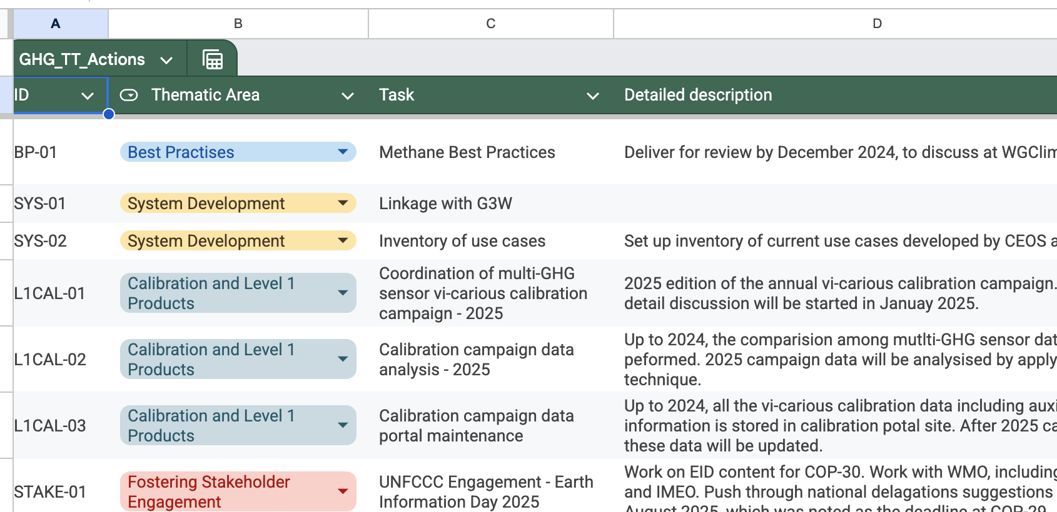
Objectives of this meeting
For the meeting in the next days, thematic leaders were tasked to define short-term actions with a specific ask for support. Focus on fit-for-purpose serving stakeholders
With support of Libby (and Harvey), we will capture all actions and make them as specific as possible
New Annex C of the Roadmap issue 2 is online here

Slide 9
Time for questions,
discussion and actions
THANKS!

