Slide 1
WGClimate
Work Plan
Activities and Deliverables for 2025-2027
WGClimate Chair
Agenda Item 1.2

Slide 2
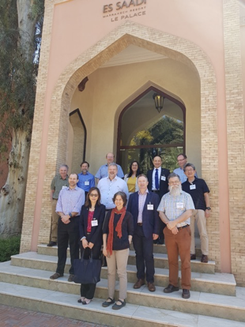
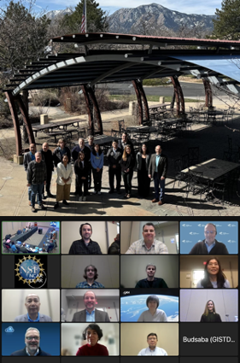
WGClimate Background
Established in 2010 (right here in Harwell!)
Joint Working Group of both CEOS & CGMS
Initial focus: Essential Climate Variables & Climate Data Records
Focus has expanded over time to include policy support & other topics

Slide 3
ECV Inventory *
Publication timeline:
v2.0: October 2017
v3.0: August 2020
v4.0: October 2021
v4.1: November 2022
v5.0: 31.10.2024 (backlog since V4.1)
1289 entries (918 existing + 371 planned)
119 entries added / updated
minimal adaptation to GCOS-244
hybrid approach to “verification”
[v5.i] 🡪 v6.0: Q2.2025
integration of backlog and clean-up
complete update with respect to GCOS-244
small updates to registered entries (eg URLs)
[incremental] publication with frozen v6.0
Maintenance and critical updates of current system + database
More details on this topic:
2.1 – Future Plan for the ECV Inventory
8.2 – Expanding the Utility of the ECV Inventory
Ingestion and review* of backlog input into current database (*hybrid approach)
Development and evolution of new system and database (new and enhanced support functionalities, wider scope, …)
Current database clean-up, data sanitization, data migration, …
Continuous update and publication of new database, refinement of workflow
vX.#: > Q2.2025
new database structure, system, UI
enhanced user experience and reporting capabilities
new workflow (input and verification)
continuous update and publication
focussed harvesting as needed (GA
adaptation to emerging priorities
v5.0
[v5.i] 🡪
🡨 v6.0
vX.# 🡪
Preview of new UI
WGC-22
11-13 Feb 2025
Public release of new UI and database
Late Q2.2025
(Focussed harvesting as needed (GA) and preparation for support to emerging priorities)
Q3-Q4.2025
* Support contract of 1.5 FTE until mid-2029 (funded by EUMETSAT and EC Copernicus)

Slide 4
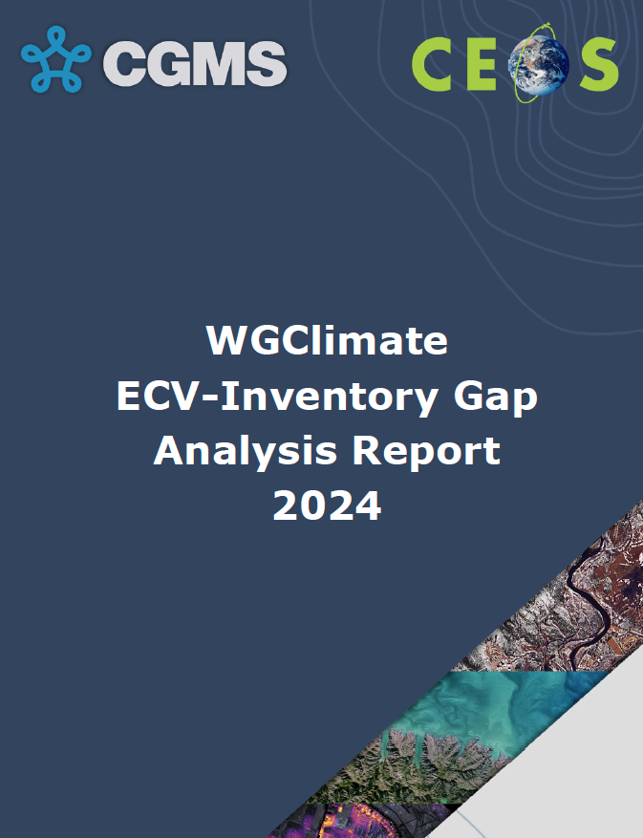
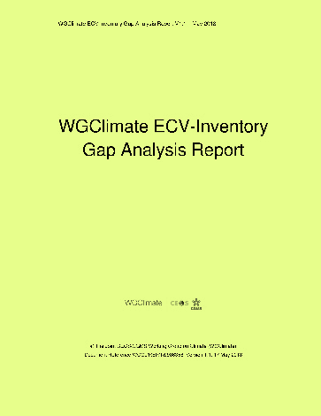
Overarching Workflow
ECV Inventory
WGClimate
Climate Experts
Improved CDRs
Gap Analysis
Data producers
Improved observing system
Coordinated Action Plan
WGClimate
CEOS / CGMS

Slide 5
Gap Analysis
Identify shortcomings for climate monitoring in the current and future space architecture
Identify opportunities to improve CDR production supporting GCOS ECVs and Fundamental CDRs
Informs WGClimate’s Coordinated Action Plan designed to address gaps and weaknesses

Slide 6
2024-2026 Deliverables
CMRS-24-01: Update and align WGClimate website instances (CEOS, CGMS, climatemonitoring.info)
Expected completion: end of 2025
CMRS-24-02: Update ECV Inventory content with previously-submitted records (~50)
Closed end of last year
CMRS-24-03: Restructure ECV Inventory architecture and processes for population, review, gap analysis
See item 2.1 (In progress)
Expected completion: mid-2025
CMRS-24-04: Submit manuscript with updated definitions of FCDR; CDR; ICDR
See item 2.5 (next steps TBD)
CMRS-24-05: Submit Merged Gap Analysis Report to CGMS and CEOS Principals for approval
Closed - endorsed by CEOS & CGMS end of last year

Slide 7
2024-2026 Deliverables
CMRS-24-06: Submit 2024 Coordinated Action Plan to CGMS and CEOS Principals for approval
Closed - endorsed by CEOS & CGMS end of last year
CMRS-24-07: Document GST1 lessons learned and GST2 recommendations
See item 4.3
Draft circulated for comment
Expected completion: SIT-40 (April 2025)
CMRS-19-06: Implement Coordinated Actions 5 on FCDR Inventory; 6 on nomenclature document for CDRs; 10 on metadata standards
Status TBD
CMRS-23-04: Provide Agency Response to 2022 GCOP IP
See item 2.2
Almost complete - endorsement by CEOS anticipated for SIT-40 (April 2025), by CGMS via virtual endorsement around the same time

Slide 8
New Deliverables
Expanding the utility of the ECV Inventory
Specifics TBD - to be discussed during item 8.2
Supporting SIT Chair Team on delivering Issue 2 of the GST Strategy
Following GST1 Lessons Learned
Expected completion: CEOS Plenary 2025 (November 2025)
Country Engagement
See session 6
+ more to be discussed this week

Slide 9
Timeline of activities
WGClimate-22
CGMS WG
CGMS Plenary
Bonn CC
GCOS SC
CEOS Plenary
SIT-40
SIT TW
WGClimate-23
COP-30
 | Jan | Feb | Mar | Apr | May | Jun | Jul | Aug | Sept | Oct | Nov | Dec
Space Agency Response to GCOS IP | To GCOS for review |  | To CEOS & CGMS for review | Endorse
ECV Inventory |  | New system preview |  |  |  | Release of new system
CDR Term Definition
GST |  | 1st Draft of LL |  | Endorse LL |  | GST coordination call |  | GST coordination call | GST Strategy draft complete | GST coordination call | Endorse GST Strategy
UNFCCC |  |  |  |  | Preparation for Bonn Conference |  | First draft of SBSTA statement | COP EID Theme Due |  | SBSTA Statement endorsed
ToR & Website |  |  | Draft ToR update shared |  | Update Webpage |  |  |  |  |  | Endorse ToR Update

Slide 10
CEOS Work Plan
2025-2027 CEOS Work Plan currently under development
Inputs due by 20 February (next Thursday)
Longer-term deliverables for the 2026-2027 timeframe should also be proposed

