Slide 1
WGClimate-22 & GHG-TT-5
Welcome
Agenda Item 1.1

Slide 2
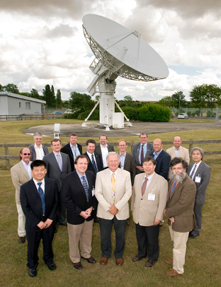
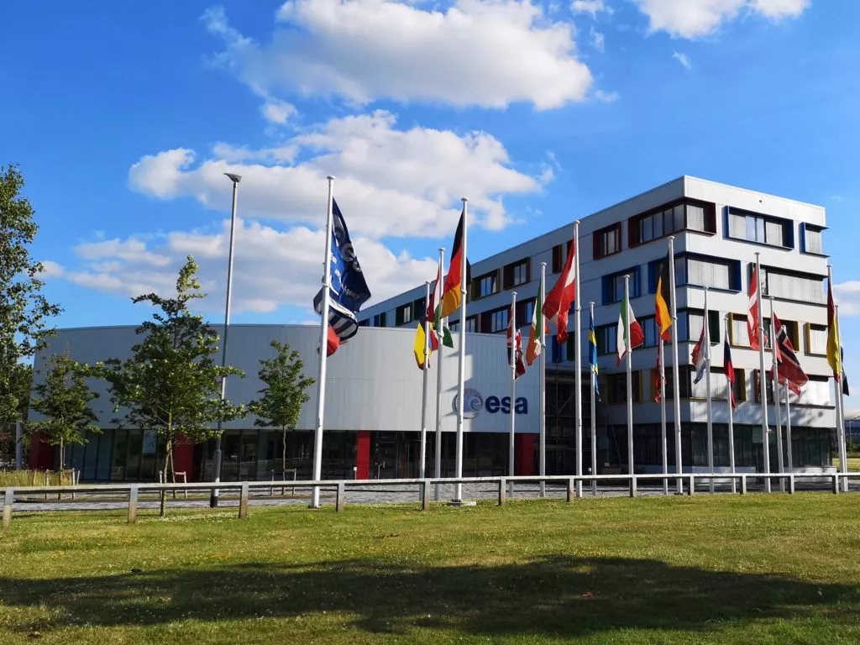
Welcome to ECSAT
Birthplace of WGClimate!
Thank you to ESA for hosting

Slide 3
Welcome remarks from UKSA
2025 CEOS Chair

Slide 4
Tour de table
All participants to introduce themselves:
Name
Organisation
Role

Slide 5
Logistics: meeting
Please be mindful to adhere to the allotted time on the agenda
Please use the microphones in the room when speaking to ensure that online attendees can hear clearly

Slide 6
Logistics: transport
Bus will depart on Wednesday and Thursday from Oxford at 8am
Bus will return this evening after the cocktail reception (Time TBC)
Bus will take participants tomorrow directly to the dinner venue. Make your own way home after dinner
On Thursday: no return bus has been arranged. Show of hands for who is:
Going to the airport
Going back to Oxford
Has made their own arrangements
Taxis will be booked accordingly

Slide 7
Logistics: Venue
Bring your ID every day
Breakout sessions: GHG TT will stay here, WGClimate will go to the Mars Room (upstairs)
Presentations: presenters should join the webex line, and share their own screen to present.
If this isn’t possible, let Libby know in advance

