Slide 1
Space Agency Response to GCOS IP 2022
Wenying Su
NASA
20th Joint CEOS/CGMS WGClimate, 26-28, Mar. 2024, Boulder

Slide 2
GCOS session agenda
MDT | CET | Title | Presenter
10:00-10:20 | 17:00-17:20 | GCOS overview: current status and future plan | Caterina Tassone
10:20-11:00 | 17:20-18:00 | Status update of space agency response to GCOS IP | Wenying Su
11:00-11:15 | 18:00-18:15 | Break
11:15-11:30 | 18:15-18:30 | Response to cal/val related GCOS IP actions | Philippe Goryl
11:30-11:45 | 18:30-18:45 | Response to reanalysis related GCOS IP actions | Vincent-Henri Peuch
11:45-12:00 | 18:45-19:00 | Response to latent and sensible heat fluxes actions | Jeff Privette
12:00-12:15 | 19:00-19:15 | Discussion | All
20th Joint CEOS/CGMS WGClimate, 26-28, Mar. 2024, Boulder

Slide 3
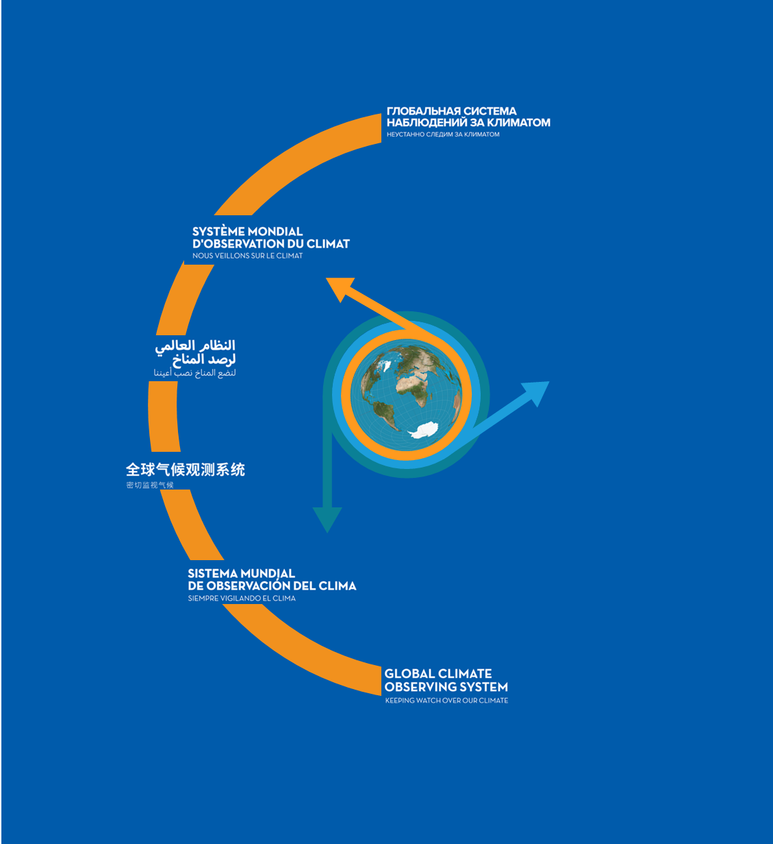
GCOS Implementation Plan
Produced every 5-6 years, GCOS Implementation Plans:
Are submitted to UNFCCC and the GCOS sponsors.
Provide recommendations for a sustained and fit for purpose Global Climate Observing System.
Cover climate monitoring needs over the entire Earth system from the atmosphere to the oceans, from the cryosphere to the biosphere.
Encompass the water, energy and carbon cycles.
This 2022 GCOS Implementation Plan has a different form to earlier plans, it has:
Fewer, more focused, and integrated actions.
Clearer means of assessment.
Clearer identification of the stakeholders who need to respond to the actions.
The updated ECVs requirements are presented in a separate document - The 2022 GCOS ECVs Requirements (GCOS 245).
20th Joint CEOS/CGMS WGClimate, 26-28, Mar. 2024, Boulder

Slide 4
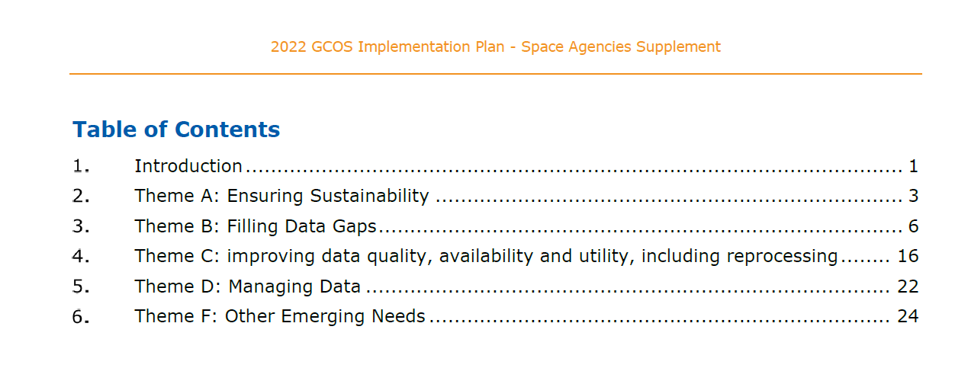
The 2022 GCOS Implementation Plan Space Agencies Supplement
20th Joint CEOS/CGMS WGClimate, 26-28, Mar. 2024, Boulder

Slide 5
Actions in the GCOS IP space agency supplement
A total of 16 actions, each may include multiple activities.
Space agencies play minor role in 3 actions (B6/C1/C4).
Space agencies collaborate with other on 2 actions (B5/F2).
20th Joint CEOS/CGMS WGClimate, 26-28, Mar. 2024, Boulder

Slide 6
Approach
Action XX:
Activity XX.Y
Means of assessing progress
GCOS IP rapporteur(s)
Priority for WGClimate | Level of priority for WGClimate
Feasibility | Is this activity feasible, will it be successful? If not, what are the reasons that would make this activity not feasible (technical, budget..). Is it only partially implementable? If this is the case, reformulate feasible part of activity If it is totally feasible, by when can the action be accomplished?
Collaboration with GCOS | Would this activity benefit or require a tight collaboration with GCOS? If yes, how (see above)
Connections with other IP actions | Are there any connections to other GCOS IP actions and activities? If yes, would it be better to address these activities together? If yes, reformulate
Implementers | Which is/are the space agencies that would better address this action. Identify a responsible person within these space agencies.
Timeline and milestone for this activity
Date | Milestone
Working closely with GCOS secretariat: develop the response template, clarify actions
Tiered approach to split the work into 2023/2024
WGClimate members collaborate on responses via google doc
Delivered 21 activities in 2023
19th Joint CEOS/CGMS WGClimate, 16-17, Oct. 2023, Frascati
20th Joint CEOS/CGMS WGClimate, 26-28, Mar. 2024, Boulder

Slide 7
Status
Completed the responses of 21 activities in 2023
Sent the draft response to GCOS secretariat for panel review in 2023
Addressed all but one (B3.5 permafrost extent) GCOS panel feedback
There are 28 remaining activities, many of them are cross cutting
Started collaboration with LSI-VC (C5, F1), Working group on Cal/Val, and COAST (F3) to formulate responses, and close collaboration with GCOS is needed to address some of the activities as well.
19th Joint CEOS/CGMS WGClimate, 16-17, Oct. 2023, Frascati
20th Joint CEOS/CGMS WGClimate, 26-28, Mar. 2024, Boulder

Slide 8
Action A2: Address gaps in satellite observations likely to occur in the near future
Altimetry in the polar regions: need to address OOPC and TOPC comments
Gravimetry missions: TOPC comments addressed
Biomass measurements
Limb-sounding missions capable of measuring several ECVs in the UTLS and stratosphere
Sea surface salinity measurements
Wind lidar
Global scale ice surface elevation
18th Joint CEOS/CGMS WGClimate, Feb. 28 -- Mar. 2, 2023, Tokyo
19th Joint CEOS/CGMS WGClimate, 16-17, Oct. 2023, Frascati
20th Joint CEOS/CGMS WGClimate, 26-28, Mar. 2024, Boulder

Slide 9
Action A3: Prepare follow-on plans for critical satellite missions
Earth Radiation Budget measurements
Cloud profiling
Cloud lidar
Global precipitation measurement consisting of a dual-frequency precipitation radar and passive microwave measurements to provide sufficient temporal and spatial sampling of rain areas
Sea ice and icebergs (or floating ice)
18th Joint CEOS/CGMS WGClimate, Feb. 28 -- Mar. 2, 2023, Tokyo
19th Joint CEOS/CGMS WGClimate, 16-17, Oct. 2023, Frascati
20th Joint CEOS/CGMS WGClimate, 26-28, Mar. 2024, Boulder

Slide 10
Action B1: Development of reference networks (in situ and satellite Fiducial Reference Measurement (FRM) programs)
Better align the satellite FRM program to the reference tier of tiered networks and enhance/expand FRM to fill gaps in satellite cal/val
Establish a long-term space-based reference calibration system to enhance the quality and traceability of earth observations. The following measurables are to be considered: high-resolution spectral radiances in the reflected solar and infrared wave bands, as well as GNSS radio occultations.
18th Joint CEOS/CGMS WGClimate, Feb. 28 -- Mar. 2, 2023, Tokyo
19th Joint CEOS/CGMS WGClimate, 16-17, Oct. 2023, Frascati
20th Joint CEOS/CGMS WGClimate, 26-28, Mar. 2024, Boulder

Slide 11
B3: New Earth observing satellite missions to fill gaps in the observing systems
Improve diurnal sampling of observations and coverage of GHGs, precursor aerosols, and solar-induced fluorescence (SIF) to improve estimation of emissions and vegetation carbon update
Explore new ways to improve estimates of Earth’s energy imbalance (EEI) with novel remote sensing techniques and with very well calibrated hyperspectral measurements over the full spectrum of the outgoing longwave and shortwave radiations
Provide direct measurements of ocean surface currents from space
Explore and demonstrate the feasibility of satellite missions based on new satellite technologies for climate monitoring.
Develop operational techniques to estimate permafrost extent: significant amount of feedback
18th Joint CEOS/CGMS WGClimate, Feb. 28 -- Mar. 2, 2023, Tokyo
19th Joint CEOS/CGMS WGClimate, 16-17, Oct. 2023, Frascati
20th Joint CEOS/CGMS WGClimate, 26-28, Mar. 2024, Boulder

Slide 12
C5: ECV-specific satellite data processing method improvements
Generate timely permafrost, land cover change, burnt area, and fire severity/burning efficiency products from high resolution satellite observations (e.g., Sentinel-1 /-2 and LandSat).
Produce harmonized and validated AGB and change datasets from different satellite data streams, for enhancing AGB estimation at global and sub-national level.
Ensure that the Bidirectional Reflectance Distribution Function (BRDF) parameters are provided together with surface albedo.
Reprocess the NASA LEO 25+ year Lightning Imaging Sensor (LIS) dataset from the Optical Transient Detector (OTD, 1995-2000), LIS on TRMM (1997-2015) and ISS (2017-present).
Reprocess the GEO Geostationary Lightning Mapper (GLM) on GOES-16/17/18 (2017-present).
Improve consistency of the inter-dependent land products.
18th Joint CEOS/CGMS WGClimate, Feb. 28 -- Mar. 2, 2023, Tokyo
19th Joint CEOS/CGMS WGClimate, 16-17, Oct. 2023, Frascati
20th Joint CEOS/CGMS WGClimate, 26-28, Mar. 2024, Boulder

Slide 13
F2: Improved ECV satellite observations in polar regions
Sea surface salinity of polar oceans
GHG at high latitudes with a focus on the permafrost regions in wintertime
Sea-ice thickness
Surface temperatures of all surfaces (sea, ice, land)
Atmospheric ECVs at the very highest latitudes (describing climate change including forcing and feedback effects)
Albedo for all surfaces (land and sea-ice)
18th Joint CEOS/CGMS WGClimate, Feb. 28 -- Mar. 2, 2023, Tokyo
19th Joint CEOS/CGMS WGClimate, 16-17, Oct. 2023, Frascati
20th Joint CEOS/CGMS WGClimate, 26-28, Mar. 2024, Boulder

Slide 14
F5: Develop an integrated operational global GHG monitoring system
Design a constellation of operational satellites to provide near-real time global coverage of CO2 and CH4 column observations (and profiles to the extent possible)
Improve and coordinate measurements of relevant ECVs at anthropogenic emission hotspots (large cities, powerplants) to support emission monitoring and the validation of tropospheric measurements by satellites
18th Joint CEOS/CGMS WGClimate, Feb. 28 -- Mar. 2, 2023, Tokyo
19th Joint CEOS/CGMS WGClimate, 16-17, Oct. 2023, Frascati
20th Joint CEOS/CGMS WGClimate, 26-28, Mar. 2024, Boulder

Slide 15
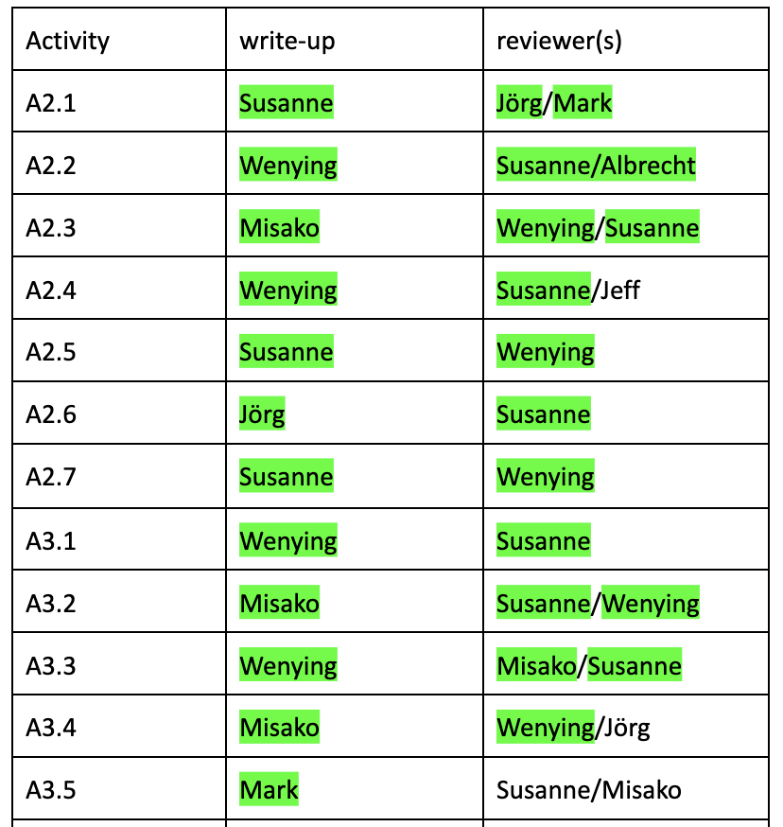
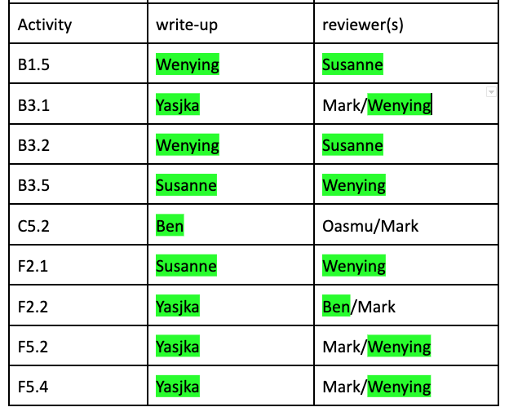
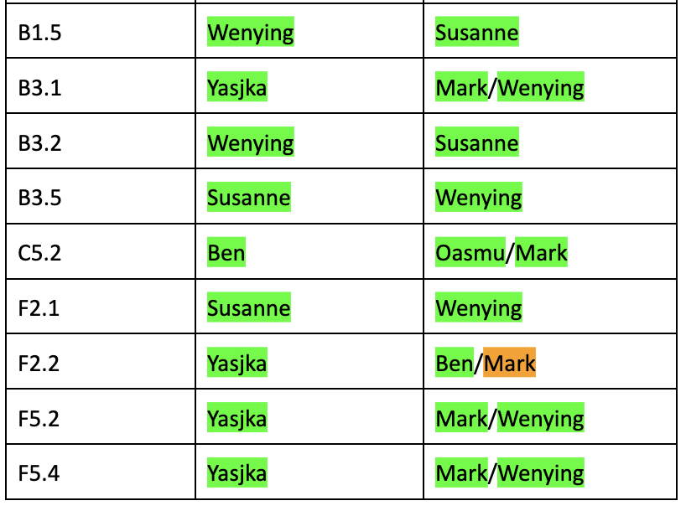
On track to finish 21 activities in 2023
19th Joint CEOS/CGMS WGClimate, 16-17, Oct. 2023, Frascati
20th Joint CEOS/CGMS WGClimate, 26-28, Mar. 2024, Boulder

Slide 16
Remaining activities
20th Joint CEOS/CGMS WGClimate, 26-28, Mar. 2024, Boulder

Slide 17
B3: New Earth observing satellite missions to fill gaps in the observing systems
Provide direct measurements of ocean surface currents from space
Currently, space-based estimates of near-surface currents are produced by combining surface geostrophic currents derived from altimetry and Ekman Current derived from ocean-surface wind stress (e.g., from scatterometers). They are more representative of mixed-layer currents than surface currents. Moreover, the geostrophic and Ekman theories break down near the equator, preventing reliable estimates of the currents from altimetry and scatterometry measurements. Direct measurements of surface currents from space are thus needed.
Explore and demonstrate the feasibility of satellite missions based on new satellite technologies for climate monitoring.
It is important to take climate related requirements directly into account during the development and implementation of new satellite missions. Therefore, it is necessary to proceed with exploration and demonstration of new satellite missions to be compatible with climate monitoring needs (Stephens et al., 2020).
18th Joint CEOS/CGMS WGClimate, Feb. 28 -- Mar. 2, 2023, Tokyo
19th Joint CEOS/CGMS WGClimate, 16-17, Oct. 2023, Frascati
20th Joint CEOS/CGMS WGClimate, 26-28, Mar. 2024, Boulder

Slide 18
B9: Improve estimates of latent and sensible heat fluxes and wind stress
Develop new approaches and improved methods to better exploit relevant ECV measurements to estimate ocean surface heat, moisture and momentum flux including
Better integration of in situ and satellite measurements, data assimilation, fusion techniques, ensuring consistency between different types of measurements and their harmonization
Development and deployment of new satellite missions that are tuned to maximize the sensitivity to the state variables needed to estimate heat flux over the ocean and land
Increase and improvements in satellite observations that target both the surface parameters and the near-surface air-parameters
Simultaneously use of an approach based on high resolution numerical models (LES) to augment satellite product validations
Include in future intercomparison campaigns of latent and sensible heat fluxes measurements inferred from simultaneous observations with a water vapor differential absorption lidar, a doppler wind lidar and temperature from rotational Raman lidar.
18th Joint CEOS/CGMS WGClimate, Feb. 28 -- Mar. 2, 2023, Tokyo
19th Joint CEOS/CGMS WGClimate, 16-17, Oct. 2023, Frascati
20th Joint CEOS/CGMS WGClimate, 26-28, Mar. 2024, Boulder
Notes:
Do we need to address this→ GCOS

Slide 19
C2: General improvements to satellite data processing methods
Improve radiance measurement records and Radiative Transfer models for simulating them.
Improve uncertainty quantification of satellite retrievals.
Periodically reprocess full satellite data records whenever an update of underlying methods occurs, especially when those risks introducing discontinuities into the time series.
Consolidate satellite observations into instrument-independent space-time grids for easy intercomparisons and fusion.
Ensure harmonization and quality of ancillary data used to generate satellite products such as solar irradiance and meteorological data.
18th Joint CEOS/CGMS WGClimate, Feb. 28 -- Mar. 2, 2023, Tokyo
19th Joint CEOS/CGMS WGClimate, 16-17, Oct. 2023, Frascati
20th Joint CEOS/CGMS WGClimate, 26-28, Mar. 2024, Boulder
Notes:
Radiance measurement records need to be carefully assessed, characterised, and calibrated. This is related to B1.5: Establish a long-term space-based reference calibration system to enhance the quality and traceability of earth observations. Radiative Transfer (RT) schemes for simulating them also need to be improved, as this is a key component of processing radiance measurements and quality evaluation/assessment. Line-by-line radiative transfer models are critical and need to be available as reference for faster RT schemes.
Improve uncertainty quantification of satellite retrievals on all processing levels. Specifically (i) consider more carefully non-linearities and non-Gaussian uncertainties in the retrievals and (ii) consider and report spatially correlated uncertainties. Presently these are not properly considered in the satellite retrievals. Proper characterization of the uncertainties is key when data are further used e.g., in assimilation (e.g., in inverse modelling for emission estimation).
The quality of retrieved quantities also depends critically on the methods, ancillary, and auxiliary data used in the retrieval algorithm. As all these dependencies improve or ECV requirements changes, the satellite observations can (and should) regularly be reprocessed to ensure that the satellite data record is as useful as it can be (i.e., information content is fully exploited).
The typical lifetime of individual satellite instruments is shorter than the time scale required for climate applications. Therefore, satellite observations need to be consolidated across multiple instruments and satellites into high-quality estimates with long-term continuity in order to maximise their value for the climate community. This consolidation must be done in an optimal and standardised way, ensuring consistency across multiple instruments and satellites.
Products with consistent traceability to ancillary data and associated quality assessment. → Need clarification, not sure that does it mean exactly. No further elaboration in “additional details”.

Slide 20
C4: New and improved reanalysis products (mainly for reanalysis centers)
Implement new production streams using improved data assimilation systems and better collections of observations, particularly aiming at:
Further increasing resolution;
Improving handling of systematic observational and model biases;
Providing (improved) estimates for the uncertainty in the mean state;
Improve quality control in data sparse areas.
Develop coupled reanalysis (ocean, land, sea-ice)
Improve the capability of sparse-input reanalysis that covers the entire 20th century and beyond
Develop and implement regional reanalysis and other approaches to regionalization
Reduce data latency
18th Joint CEOS/CGMS WGClimate, Feb. 28 -- Mar. 2, 2023, Tokyo
19th Joint CEOS/CGMS WGClimate, 16-17, Oct. 2023, Frascati
20th Joint CEOS/CGMS WGClimate, 26-28, Mar. 2024, Boulder
Notes:
1. Reanalysis centres should regularly upgrade their products by introducing improved data assimilation techniques and better collections of observations (including reprocessed and data rescued data). Use of ensemble approaches will help to provide users with information on the uncertainty of products. Increased computational capacity will enable production at a higher spatial resolution and greater complexity (e.g., coupled systems, interactive chemistry). Use of homogenised, recalibrated or reprocessed observations is important in order to mitigate the impact of disruptions in instrument technology or processing algorithms. Use of advanced methods for dealing with data discontinuities will help improve the reliability of historical reanalyses.
2. A coupled data assimilation technique has a potential advantage over separate data assimilation in terms of consistency across the Earth system components. A proven benefit so far is that it can improve the SST field in a sparse observing system setting such as in the mid-20th century and earlier, but clear benefits in the current dense observing system setting have yet to be demonstrated.
3. Another type of reanalysis is a sparse-input reanalysis that only assimilates surface observations and covers a significant portion of the instrumental record, extending back into the 19th century. For this type of reanalysis, further improvement can be expected through data rescue for early instrumental meteorological observations and refinement of data assimilation systems.
4. There is a growing demand for datasets with higher resolution and accuracy, particularly for surface variables, for local and regional applications such as adaptation and monitoring of climate extremes. This demand should be met through regional reanalysis and other approaches for regionalising global data products.
5. Reduced latency of reanalysis data products should be aimed for, since it increases reanalyses’ potential for applications. It also helps to reduce latency of other climate products that rely on reanalysis as input data, e.g. satellite retrievals.

Slide 21
C5: ECV-specific satellite data processing method improvements
Generate timely permafrost, land cover change, burnt area, and fire severity/burning efficiency products from high resolution satellite observations (e.g., Sentinel-1 /-2 and LandSat).
Ensure that the Bidirectional Reflectance Distribution Function (BRDF) parameters are provided together with surface albedo.
Reprocess the NASA LEO 25+ year Lightning Imaging Sensor (LIS) dataset from the Optical Transient Detector (OTD, 1995-2000), LIS on TRMM (1997-2015) and ISS (2017-present).
Reprocess the GEO Geostationary Lightning Mapper (GLM) on GOES-16/17/18 (2017-present).
Improve consistency of the inter-dependent land products.
18th Joint CEOS/CGMS WGClimate, Feb. 28 -- Mar. 2, 2023, Tokyo
19th Joint CEOS/CGMS WGClimate, 16-17, Oct. 2023, Frascati
20th Joint CEOS/CGMS WGClimate, 26-28, Mar. 2024, Boulder
Notes:
This activity focuses on generating improved permafrost, land cover and burnt area products that can be used for adaptation and mitigation. Rapid updating and delivery of data is important to serve such applications. Consistency between existing/historical and new products should be considered, and existing products might be updated based on new methods where possible. Monitoring programs (i.e. from Copernicus, NASA, ESA etc.), respective expert communities and reference networks should focus on generating timely, high-resolution and validated land cover change, permafrost, burnt area, and fire severity/burning efficiency products from medium resolution data satellite observations (e.g. Sentinel1/-2 and Landsat). Have discussed with LSIVC, and encourage our USGS colleagues to take the lead on this one.
Provision of the isotropic BRDF spectral parameters used in surface albedo retrieval at the same spatial and temporal scale of the products and the uncertainties error budget associated to the surface albedo products. Have discussed with LSIVC, and encourage our USGS colleagues to take the lead on this one.
Jeff
Jeff
The issue is that currently some satellite-based products are developed separately with different data sets and processing streams despite several ECVs being closely inter-related (e.g. surface albedo, Fire, FAPAR and LAI). Consistency between these products needs to be ensured so that data from multiple sources can be used together. This will improve the interoperability and the stability of long-term satellite data and has an impact in the reanalysis when they are assimilated together. The end results are maps of all biospheric ECVs using a common geographic definition, at the same temporal/spatial scale as climate models with plant functional types. This can also be part of the gap analysis report. → USGS

Slide 22
D4: Create a facility to access co-located in situ cal/val observations and satellite data for quality assurance of satellite products
Improve access to co-located satellite and reference quality in situ observations, as well as tools for evaluation purposes. This facility will use data from reference networks and FRM programs for a broad range of ECVs for cal/val of satellite programs
Develop tools to use the co-located data collection developed under activity 1 to undertake various analyses of satellite-based measurements.
18th Joint CEOS/CGMS WGClimate, Feb. 28 -- Mar. 2, 2023, Tokyo
19th Joint CEOS/CGMS WGClimate, 16-17, Oct. 2023, Frascati
20th Joint CEOS/CGMS WGClimate, 26-28, Mar. 2024, Boulder
Notes:
This activity addresses the need to improve the exploitation of the high-quality data needed to calibrate and validate satellite observations by making these data easily available: access is currently a major barrier to their use. A more coordinated, centralised approach to the storage and provision of data for satellite cal/val, with greater involvement of and partnership with reference networks (Action B1), along with the development of associated tools would yield cost efficiencies as well as scientific benefits. Users could come to centralised repositories which serve data for multiple satellite missions, enabling their usage in a more seamless manner. Tools could be shared between similar missions and made available to users.
The centralised repository would serve to highlight the presence of critical gaps in provision of high-quality in situ data to inform the quality of ECVs measured from space. This, in turn, would help inform the strategic further investment in new reference networks and FRM programs to fill these gaps.
Further details are given in Sterckx et al. (2020)15.

Slide 23
F1: Responding to user needs for higher resolution, near real time data
Improve biomass, land cover, land surface temperature, and fire data with sub-annual observations and improved local detail and quality. -- USGS
18th Joint CEOS/CGMS WGClimate, Feb. 28 -- Mar. 2, 2023, Tokyo
19th Joint CEOS/CGMS WGClimate, 16-17, Oct. 2023, Frascati
20th Joint CEOS/CGMS WGClimate, 26-28, Mar. 2024, Boulder
Notes:
High-resolution and near-real time information of ECV-based climate information at global, regional and local scales allows planning to consider the full range of possible impacts.
High-resolution data (in space and time), which, for many ECVs are currently not available, will allow rapid monitoring of changes in the climate system. This will allow the tracking of sustainable mitigation and adaptation measures. Improved high-resolution and near-real-time ECV data will allow improved understanding of CIDs (Climate impact-Drivers).
Addressing availability of key terrestrial ECVs at resolutions of 10-30 m stored in long term archives; b) Availability of Near Real Time (NRT) sub-annual data for critical land changes and to identify extremes stored in long term archives.
Have started the conversation with LSIVC, USGS colleagues please consider take the lead on this.
IP indicated that “The GCOS expert panels have already identified some specific high-resolution, near real time datasets that have been requested by users and that the existing monitoring systems are able to support within the next 5 years. ” We need to ask for the list of datasets.

Slide 24
F2: Improved ECV satellite observations in polar regions
GHG at high latitudes with a focus on the permafrost regions in wintertime
Sea-ice thickness
Surface temperatures of all surfaces (sea, ice, land)
Atmospheric ECVs at the very highest latitudes (describing climate change including forcing and feedback effects)
Albedo for all surfaces (land and sea-ice)
18th Joint CEOS/CGMS WGClimate, Feb. 28 -- Mar. 2, 2023, Tokyo
19th Joint CEOS/CGMS WGClimate, 16-17, Oct. 2023, Frascati
20th Joint CEOS/CGMS WGClimate, 26-28, Mar. 2024, Boulder
Notes:
Sea-ice thickness is a highly spatially variable parameter. Its derivation at hemispheric scale requires composition and averaging of multiple satellite overpasses when using currently employed altimetry. For thin ice (< 0.5 m thickness) alternative satellite sensors must be used. These are imaging sensors supporting finer temporal sampling at hemispheric scale. Combination of both types of sensors can add value. Currently, sea-ice thickness retrieval is considerably more mature for the Arctic than the Antarctic. This fact is due to, on the one hand, a larger amount of data used for evaluation in the Arctic than Antarctic. On the other hand, sea-ice thickness retrieval in the Antarctic is complicated by ice and snow conditions being different from the Arctic. Improving sea-ice thickness retrieval also requires improving observing snow-depth and sea-ice age (proxy for sea-ice thickness and density), among others
There is a need to improve sensing of temperatures of the surface for all surface types across the polar regions. This can inform assessments of warming of the polar regions for which in situ measures of near-surface air temperature are sparse and hard to maintain.
Knowledge gaps exists at highest latitudes for atmospheric ECVs describing climate change including forcing and feedback effects and there is a need for further analyses to address these gaps with satellite observations (e.g. monitoring solid precipitation). True polar orbiters would improve coverage at the highest latitudes. True polar orbiters like TRUTHS enable simultaneous Nadir Overpass (SNO) type observations at all latitudes with sun-synchronous polar orbiter-payloads thus improving and supporting atmospheric ECV observations from current and future satellite constellations and/or instrument combinations.
There is a need to improve the accuracy and consistency of observations of albedo for ice and snowy surfaces across domains (terrestrial snow, land ice, sea-ice and its snow cover) to improve the characterization of the Earth Energy cycle. Ask USGS to take the lead on this.
The albedo of iced and snowy surfaces varies rapidly and drastically in the event of melting. This requires frequent observations and the attribution of albedo changes to the melt processes.

Slide 25
F3: Improve monitoring of coastal and exclusive economic zones
Expand global ocean climate in situ observations and satellite products into exclusive Economic Zones (EEZs) and coastal zones
Develop new satellite-based products for coastal biogeochemistry
Produce land cover datasets in coastal areas without land surface masks and in near real time, including uncertainties
18th Joint CEOS/CGMS WGClimate, Feb. 28 -- Mar. 2, 2023, Tokyo
19th Joint CEOS/CGMS WGClimate, 16-17, Oct. 2023, Frascati
20th Joint CEOS/CGMS WGClimate, 26-28, Mar. 2024, Boulder
Notes:
Many national programs (e.g., Ocean Networks Canada, US Ocean Observatories Initiative, UK and Australia’s IMOS) deliver near real time sensor data and quality controlled archived datasets for coastal regions <2000m in depth. These networks provide automated data from in-water fixed buoys and mobile assets (gliders, wire-following profilers and auvs). The near-real-time observations made vary by program and location, but generally include atmospheric gases and meteorological data, as well as surface/subsurface sensor-based geolocated and depth corrected physical (temperature, currents and flow rates, wave height, and chemical data (fluorometric chlorophyll, CDOM, and backscattering; spectral irradiance; spectral total absorption, at(λ), and spectral absorption of dissolved materials, ag(λ); UV-sensor nitrate/nitrite; dissolved oxygen; pH and climate-quality air/subsurface pCO2) . Biological and some chemical analysis data (eDNA, extracted chlorophylls, and hydrophone files) are available after unpredictable and long latencies. COAST does not know if there are any data and/or any plans to reprocess existing satellite records in coastal regions to generate global products which include the coastal regions (e.g., altimetry and wind data records), and suggested to check with other VCs.
“There are currently no biogeochemical operational products from high resolution satellites (e.g., Sentinel 2AB, Landsat 8) in coastal areas. Satellite observations need to be reprocessed to provide products for variables such as the temperature, turbidity, chlorophyll, and chromophoric dissolved organic matter (CDOM). Experimental Products for some biogeochemical parameters listed (SPM, CDOM) are advancing but still require improvements, and the same can be said for chlorophyll products within 1km of the coastline. The launch of several new missions (SWOT, PACE) and commercial data might lead to improvements in land use cover, water quantity/quality (e.g., chlorophyll, turbidity, CDOM), and SST. CEOS COAST is also building capacity and co-designing coastal products, including those mentioned here, in key pilot regions around the world (Bay of Bengal, Chesapeake Bay, Rio de La Plata estuary, west coast of continental Africa, and small island nations in the Pacific and Caribbean). Sentinel 2 chla products are in development at NOAA, but are not yet operational. Applications of these data products are in development and are expected to be operational within the foreseeable future. We will reach out to OCR-VC and others for status. Currently, NOAA is working in collaboration with other United States federal areas to develop large-scale, operational products of coastal biogeochemical processes for all United States’ coastal areas, with a particular emphasis on chlorophyll-a and turbidity, using data from Sentinel-2A and -2B. Additionally, efforts are underway to assess the utility of the Landsat legacy of satellites for water temperature following successful demonstration in inland waters.
This is what in the GCOS IP explaining what they want space agencies to address: “Land cover datasets should be reprocessed without masking to allow the detection of changes at the coastline. This activity will allow extremes and long-term trends such as sea-level rise to be captured (e.g. changes in the coastline and neighboring land areas). Currently, impacts of changes in the sea level at the coast are not monitored because the way satellite observations are processed obscures these details.” Are there any updates to the process?

Slide 26
Cal/Val related actions
B1.3 Better align the satellite FRM program to the reference tier of tiered networks and enhance/expand FRM to fill gaps in satellite cal/val
B5.1 Increase the number of in situ river level observations that are exchanged internationally and can be used to calibration satellite observations of water levels
D4. Create a facility to access co-located in situ cal/val observations and satellite data for quality assurance of satellite products
Improve access to co-located satellite and reference quality in situ observations, as well as tools for evaluation purposes. This facility will use data from reference networks and FRM programs for a broad range of ECVs for cal/val of satellite programs
Develop tools to use the co-located data collection developed under activity 1 to undertake various analyses of satellite-based measurements.
18th Joint CEOS/CGMS WGClimate, Feb. 28 -- Mar. 2, 2023, Tokyo
19th Joint CEOS/CGMS WGClimate, 16-17, Oct. 2023, Frascati
20th Joint CEOS/CGMS WGClimate, 26-28, Mar. 2024, Boulder

Slide 27
20th Joint CEOS/CGMS WGClimate, 26-28, Mar. 2024, Boulder

