Slide 1
Next WGClimate Vice-Chair
Issued Call for Nominations on January 16th
Due by March 6th
New Vice Chair will assume duties at the CEOS 2024 Plenary.
Current Vice Chair rotates to Chair.
Both serve two-year terms, then Vice Chair is nominated to become next Chair
Stipulations from the Working Group's Terms of Reference
Chair alternately drawn from meteorological and non-meteorological space agencies
Wenying Su, the current Vice Chair, is from a non-meteorological agency (NASA).
Next Vice-Chair must be from a meteorological agency
One nomination received: Vincent-Henri Peuch (ECMWF)

Slide 2
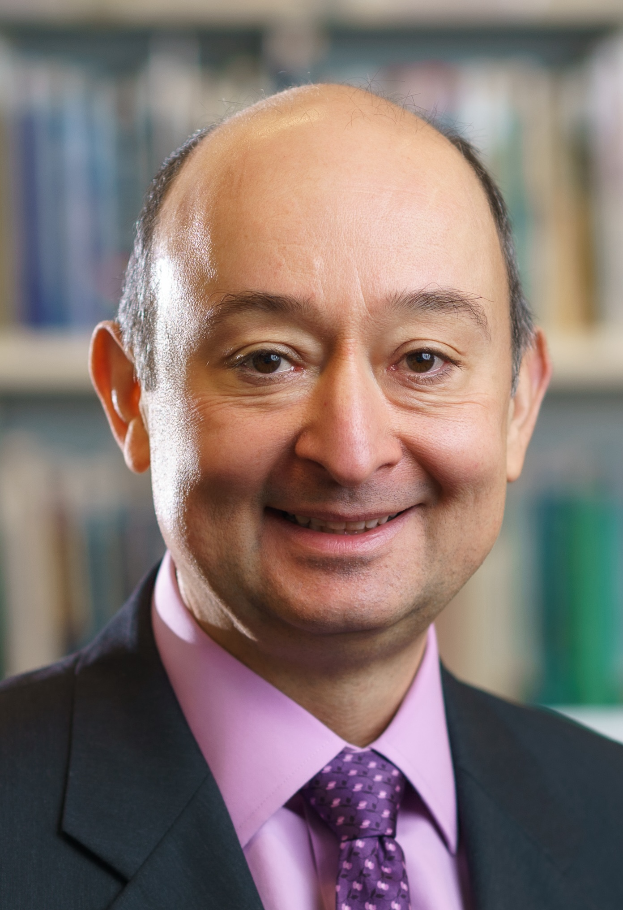
Official Nomination of Vincent-Henri Peuch (ECMWF)
Joined ECMWF in 2011. Led initiation and implementation of Copernicus Services at ECMWF. Founding Director of the Copernicus Atmosphere Monitoring Service for 10 years.
Current member of ECMWF Directorate as Director for engagement with the European Union and Head of ECMWF Bonn (190 staff) -- the centre of gravity for ECMWF EU activities including Copernicus and Destination Earth.
30-years experience in atmospheric composition modelling, composition-climate interactions and data assimilation of observations of atmospheric constituents (>105 publications, h-index: 48).
Active in international scientific and steering bodies including WMO’s Global Atmospheric Watch and Global Greenhouse Gas Watch Study Group (co-chair) and ESA’s Advisory Committee for Earth Observation and Climate Science Advisory Board.
ECMWF representative to CEOS-CGMS Joint Working Group on Climate and ECMWF’s CEOS contact since 2022. Contributes to Greenhouse Gas aspects, Space Agencies response to GCOS IP and provides liaison with relevant ECMWF/C3S/CAMS/DestinE activities: reanalyses, link to policy stakeholders, data stores, use cases…

