Slide 1
Inventory, Gap Analyses & Action Plan
Jörg Schulz
EUMETSAT

Slide 2
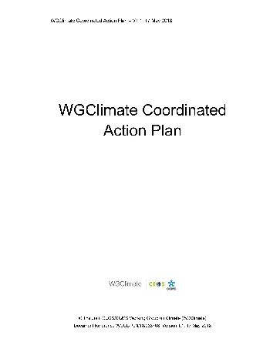
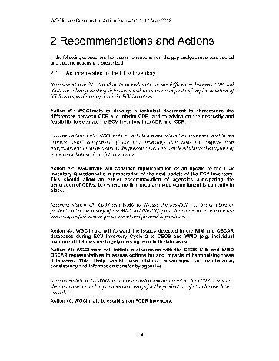

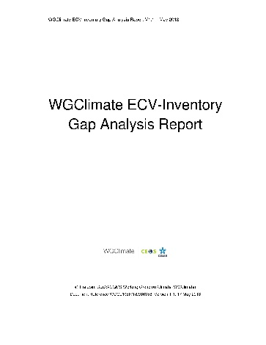
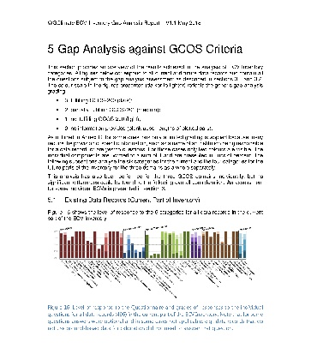
Context
ECV Inventory
Gap Analysis
Coordinated Action Plan
Improved observing system
Improved CDRs
WGClimate
Climate Experts
Data producers
WGClimate
CEOS / CGMS

Slide 3
Inventory continuation (1)
EUMETSAT will establish new contract starting in April 2024
It retains a level of 1.5 FTE with funding by EUMETSAT and the EC Copernicus
Will follow the agreed simplified process for the update of the Inventory to reduce the workload needed for publishing an update, namely:
  Agency focal points nominated by WGClimate provide access points for information to EUMETSAT, e.g., central hub pages such as the Copernicus Climate Data Store
  EUMETSAT derives the actual information and updates the Inventory
  EUMETSAT provides the updated information to be published for verification to the Focal Points for review
  Agency focal points provide corrections (if any) and may fill gaps
  EUMETSAT publishes inventory
Propose to rename it to Satellite Agency Climate Data Records Inventory (SACDRI)

Slide 4
Inventory continuation (2)
Updating/publishing, enhancing and maintaining the ECV Inventory
  Adapting to GCOS IP2022 ECV products and looking forward to GCOS ECV rationalisation activity
  Researching new datasets from contributing agencies, and their insertion into the ECV inventory.
  Quality control, scientific and technical correctness and consistency of the updates to the ECV Inventory
Support of the gap analysis work
  Assessment of the ECV Inventory readiness for the gap analysis process
  Participation in inventory and gap analysis activities of the WGClimate, ensuring availability of required documentation per given schedules
  Analysis of results of the gap analysis for specific priority areas and compilation of the gap analysis results
  Provision of support to the generation of a coordinated action plan to address gaps, etc.
  Cross-fertilisation/promotion of gap analysis best practices amongst the expert teams
Simplification and refresh the online database and its interface
Notes:
Mention that we have no direct involvement in the GCOS activity but should have consultations. It doesn’t help if GCOS constructs something that costs us a fortune in addressing in the Inventory and also maybe in WMO OSCAR space and CEOS MIM. But also say that it may helps resolving the issue with non GCOS data records.

Slide 5
Inventory evolution since 2018
Domain | Version | Total | Existing | Planned
All | V2.0 | 913 | 496 | 417
 | V3.0 | 1137 | 766 | 371
 | V4.1 | 1251 | 870 | 381
Atmosphere | V2.0 | 658 | 376 | 282
 | V3.0 | 801 | 535 | 266
 | V4.1 | 851 | 587 | 264
Land | V2.0 | 135 | 56 | 79
 | V3.0 | 203 | 141 | 62
 | V4.1 | 262 | 191 | 71
Ocean | V2.0 | 120 | 64 | 56
 | V3.0 | 133 | 90 | 43
 | V4.1 | 138 | 92 | 46
V2.0: October 2017
V3.0: August 2020
V4.0: October 2021
V4.1: November 2022
V4.1 was an incremental update with respect to v4.0 with focus on the ECVS selected for the Gap Analysis workshop in 2022.
Notes:
Caveat I: on numbers is that they contain also interim CDRs (mostly for domain atmosphere) and particularly from V3 to V4 some have been redefined by data providers leading to more individual quantities records.
Caveat II: Some records were still left out from V4.1, e.g., from C3S, because information arrived too late to be verified. Thus a next version will see more records. It also further increases the imbalance of provision of records to Europe
Caveat III: We were generous in letting data records in applying a rule of thump on 10 year length as a minimum, also opting for taking a record that is not a CDR if there is no other, but certainly some content does not qualify to be in the Inventory
Number of records has increased from version to version mostly indicating more completeness and some competed records (mostly from Europe) and some new planning
Biggest increase is in domain atmosphere, mostly on provided not on planned, which either points to the periodicity of plans, e.g., ESA and EUMETSAT new programmes or to a lack of responses. One cannot decide what the reason is, maybe both
For the land domain we see a big increase in the existing, which is mostly due to the fact we covered more. High fluctuation in planned, which is related to the level of response.

Slide 6
ECV Gap Analysis vs. Inventory versions
  Inventory v2.0, 8 ECVs addressed in 2018 report
    Atmosphere: CO2*, CH4*, and other GHG*, Precipitation
    Land: LST, LAI*, AGB*
    Ocean: SST, SSS
  Inventory v3.0, 10 ECVs addressed:
    Atmosphere: Aerosols, Surface winds, Upper-Air Winds, Water Vapour
    Land: Fire*, Land Cover*, Soil Moisture
    Ocean: Sea Level, Sea State, and Ocean Surface Heat Flux
Inventory v4.1, 9 ECVS:
    Atmosphere: Greenhouse Gases (GHGs)
    Land: Anthropogenic GHG fluxes, Above ground Biomass (AGB), Land cover, Leaf Area Index (LAI), Fraction of Absorbed Photosynthetically Active Radiation (FAPAR), Fire, Permafrost
    Ocean: Ocean Colour
*readdressed in workshop 2022 with V4.1

Slide 7
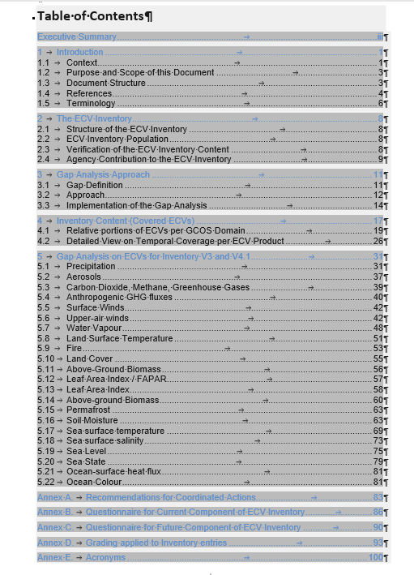
Gap Analysis report
https://docs.google.com/document/d/13oD-Xr_q5qBYr_1V6DvIMkAJVbAMl3t7h44sPcAB6MY/edit

Slide 8
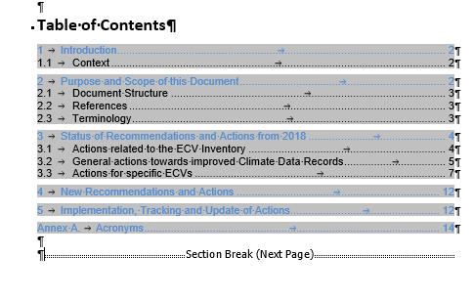
Coordinated Action Plan
https://docs.google.com/document/d/1tBNlg5bZvv0vHzxtboEJiOjRTcMQRG2lbby42xcuDLo/edit

Slide 9
Steps for the detailed analysis per ECV in 2022
  GCOS ECV definition adequacy (using draft of GCOS-IP 2022 as reference)
  ECV coverage in ECV Inventory (existing/planned) identifying gaps in the inventory (based on extract of work database pre v4.1)
  Situation of the space segment for the ECV products
  Situation of the ground segment for the ECV products
  Situation of the science to exploit the measurements
  Everything that is important in addition
  Recommendations to space agencies if needed
  Was slightly different before and entries for ECVs vary according to this.
  Some overlap with response to GCOS IP 2022 – have used those for some reassessed ECVs such as precipitation.

Slide 10
In medias res
Goal is to move the docs to review with agencies at CEOS SIT or shortly after to reach endorsement at CGMS-Plenary 4-6 June (and for CEOS in writing)
Need to identify:
  reviewers for macroanalysis
  people that fix entries for specific ECVs
Update Coordinated Action Plan:
  go through now and look at the actions and decide what to do with it
Notes:
Topics for future GA exercises:
Action A2 points out a few candidates [issues with continuity]: Altimetry in the polar regions, Gravimetry missions, Biomass measurements, Limb-sounding missions capable of measuring several ECV species in the Upper Troposphere/Lower Stratosphere (UTLS) and stratosphere, Sea Surface Salinity (SSS) measurements, Wind lidar, Global scale ice surface elevation. And Action C1 has a couple of points that could be included in any Gap Analysis exercise: “Review existing monitoring standards, guidance and best practices for each ECV, ensuring these reflect current state-of-the-art. Maintain a repository of this guidance for ECVs.” and “Ensure the development of monitoring standards, guidance and best practices, including intercomparison procedures, for those ECVs where such guidance does not exist.”

Slide 11
Inventory adaption unfinished
https://docs.google.com/spreadsheets/d/16eSb1AboFi_BoNd8GkPtfw9A1LTYnSw9/edit#gid=1760919568
Notes:
Simplifications shall not violate needs of gap analysis
Targets for simplification: Data base
GCOS-143 guidelines outdated and no sign that GCOS would update in near future – not taking it into consideration makes a set of questions irrelevant
Complex questions (e.g. concerning documentation) should be reformulated
Information difficult to interpret or verify might be dropped (e.g. numeric values for uncertainty and stability)
Focus should be on main needs for GA and added value for space agencies and users (e.g. connection between CDRs and space segment, climate applications and higher level usage)
Possible extensions such as Fundamental Data Records impossible

