Slide 1
Welcome and Meeting Goals
Jeff Privette, Chair (NOAA)
Wenying Su, Vice-Chair (NASA)
20th Meeting of the Joint CEOS-CGMS Working Group on Climate
Boulder
26 March 2024

Slide 2
Logistics
WGClimate-20 Support Team
WGClimate Secretariat: Kyle Wohlwend (NOAA)
Facility and Audio-Visual Support: Kelvin Tavarez (UCAR), Fletcher Ryan (UCAR)
Facility
Security and Gate Pass
Parking
Restrooms
Lunch
Videoconferencing, speaking and recording
In-room: Connect to Zoom, use table microphone only (mute laptop microphone), use cursor to point
Remote: Connect to Zoom, use laptop microphone only
Stay on schedule; Kyle will show time remaining cards
Lunch and refreshments
Walk to lunch as a group; UCAR campus cafeteria is 10’ walk
Refreshments: Coffee breaks (coffee, water, fruit, snacks)
Group photo
Day 2 (Wednesday, Likely at morning coffee break, depending on weather)

Slide 3
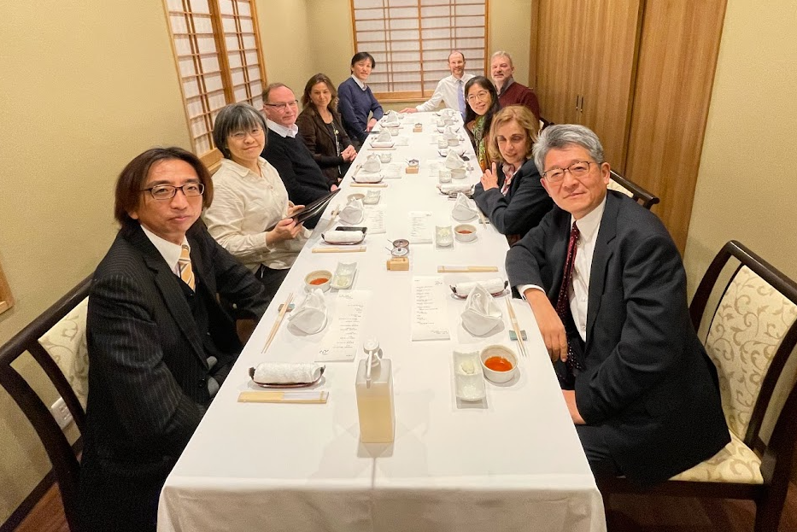
2023: WGClimate-18 and -19
WGClimate-18 (Feb-March, Japan) and -19 (October, Italy)
Top 2023 Priorities
Work Plan Development, Assignments
Space Agency Response to GCOS Implementation Plan (2022)
Gap Analysis Report (v3/4.1)
Coordinated Action Plan (© 2016)
ECV Inventory update and restructuring
Statement for UNFCCC COP-28
Contributions to Earth Information Day
Greenhouse Gas Task Team: Update Roadmap

Slide 4
WGClimate-20 Key Goals
Finalize 2024 Work Plan
Nominate and Approve next Vice-Chair
Kick-off Year 2 (2024) of Space Agency Response to GCOS IP
Finalize Gap Analysis Report for release at SIT-39 (April)
Finalize Coordinated Action Plan
Coordinate with Partners
…and for the scientist in you: Lightning talks by pioneers of NOAA’s climate CDR portfolio

Slide 5
Agenda – Day 1
Day 1 (Tuesday, March 26th)
Time (MDT) | Duration | Topic | Speaker
9:00:00 AM | 0:10 | Welcome, Tour de Table, and Meeting Goals | Jeff Privette, NOAA
9:10:00 AM | 0:20 | Introduction of New Members and Their Priorities | Jeff Privette, NOAA
9:30:00 AM | 0:30 | 2024 WGClimate Work Plan | Jeff Privette, NOAA
10:00:00 AM | 1:00 | GCOS IP Space Agency Response + GCOS (Part 1: WGCV) | Wenying Su, GCOS; WGCV
11:00:00 AM | 0:15 | Coffee
11:15:00 AM | 1:00 | GCOS IP Space Agency Response + GCOS (Part 2) | Wenying Su; GCOS
12:15:00 PM | 0:15 | Vice Chair Nomination | Jeff Privette, NOAA
12:30:00 PM | 1:30 | Lunch
2:00:00 PM | 0:30 | CDR Lightning Talk 1: Microwave Sounder/Imager FCDR | Christian Kummerow, CSU
2:30:00 PM | 0:30 | Merged Gap Analyses & WGClimate Coord. Action Plan- Part 1 | Jörg Schulz, EUMETSAT
3:00:00 PM | 0:15 | Coffee
3:15:00 PM | 1:00 | Merged Gap Analyses & WGClimate Coord. Action Plan- Part 2 | Jörg Schulz, EUMETSAT
4:15:00 PM | 0:30 | Templates for WGClimate presentations | Jeff Privette, NOAA
4:45:00 PM | 0:15 | Actions review, Evening homework assignments | Jeff Privette, NOAA
5:00:00 PM |  | Close of Day 1

Slide 6
Agenda – Day 2
Day 2 (Wednesday, March 27th)
Time (MST) | Duration | Topic | Speaker
9:00:00 AM | 0:10 | Opening Day 2, Recap of Day 1 | Jeff Privette, NOAA
9:10:00 AM | 0:30 | GEO Member Engagement | Sara Venturini, GEO Secretariat
9:40:00 AM | 0:30 | Update on WMO Global Greenhouse Gas Watch | Gianpaolo Balsamo, WMO
10:10:00 AM | 0:30 | GHG TT and WGClimate Communications: Policies, Protocols | Joerg Schulz, EUMETSAT
10:40:00 AM | 0:20 | Coffee
11:00:00 AM | 0:35 | GHG Task Team Update and Activities | Yasjka Meijer, ESA
11:35:00 AM | 0:55 | Climate Policy Impact (SIT-39 Session Preview) | Mark Dowell, EC/JRC Wenying Su, NASA
12:30:00 PM | 1:30 | Lunch
2:00:00 PM | 0:30 | CDR Lightning Talk 2: Earth's Radiation Budget & Libera | Peter Pilewskie, CU/LASP
2:30:00 PM | 0:45 | Analysis Ready CDRs and AI Considerations | Douglas Rao, NCState/CISESS, Rob Redmon, NOAA
3:15:00 PM | 0:15 | Coffee
3:30:00 PM | 0:30 | CDR Lightning Talk 3: Sea Ice Concentration, Extent, & Index | Walt Meier, CU/CIRES/NSIDC
4:00:00 PM | 0:30 | Considerations on COP-29 Side Event by WGClimate | Jeff Privette, NOAA
4:30:00 PM | 0:30 | Actions review, Evening homework assignments | Jeff Privette, NOAA
5:00:00 PM |  | Close of Day 2

Slide 7
Agenda – Day 3
Day 3 (Thursday, March 28th)
Time (MST) | Duration | Topic | Speaker
9:00:00 AM | 0:10 | Opening Day 3, Recap of Day 1 | Jeff Privette, NOAA
9:10:00 AM | 0:30 | Pillar 4: User Engagement: New SCO Projects and Progress | Laurence Monnoyer-Smith, CNES, Frederic Bretar, CNES
9:40:00 AM | 0:30 | Working session 1: Tie-up Work Plan, CAP, SARGIP, Gap Analy. | Jeff Privette, NOAA
10:10:00 AM | 0:30 | Update: CDR Terms and Definitions | Jeff Privette, NOAA
10:40:00 AM | 0:15 | Coffee
10:55:00 AM | 0:30 | Working session 2: Tie-up Work Plan, CAP, SARGIP, Gap Analy. | Jeff Privette, NOAA
11:25:00 AM | 0:35 | Review of Actions | Jeff Privette, NOAA
12:00:00 PM |  | Close Day 3 and Meeting | Jeff Privette, NOAA

Slide 8
Tour de Table
Please provide:
Your name and agency/organization
Relevant positions to WGClimate, if any (e.g., Representative to GEO Climate Team)
Order of Introductions
In-room participants
Virtual participants (roughly going west around globe from Colorado)

Slide 9
Day 1a: Key Points and Actions
CDR Definitions
Eliminate duplicity in meaning of “F” in taxonomy
Resolve whether to replace “Forward-processed” with “Unreprocessed”, or eliminate
FCDRs: Replace use of “physical quantities” with term for at-sensor energy units
TCDRs: Consider replacing “geophysical quantities” with more general term
Emphasize the “sufficient” length and quality is driven by applications/uses
Should definition allow more model- or derived products (Level 4 and 5 products; fluxes, reanalysis, plumes, hurricanes/floods/fires, atmospheric rivers, etc)?

Slide 10
Day 1b: Key Points and Actions
NewSpace - Antonio
White Paper complete, ready for endorsement (at least Ben and Jeff contributed sections)
GHG TT concerned NewSpace is overhyped (currently views v. small amount of CH4)
SCO – Frederic
Now at 43 signatories, Call for project proposals, international review team, IGARSS
Jorg: SCO should engage beyond projects -- Signatories should bring along ministries involved in applications, e.g., hydrological agencies
AFOLU - Ben
AFOLU Roadmap in final stages, ready for endorsement
Some nations doing inventories moving away from satellite data – overwhelmed by data sets
Need to extend more CDRs back to 1990 – e.g., USGS/Landsat – Action to ECV Inventory work
AGB instruments measure different things, irreconcilable values; creates user confusion
Mark: need “user roadmap” that shows what will be coming online/useable in the future

Slide 11
Day 1c: Key Points and Actions
GHT TT – Yasjka
Not revising entire Roadmap, just Annex C; Area Leads revising; nearly complete
Capacity-building Area can leverage similar WGs in CGMS (WG4) and CEOS WGCapD
Will split out CH4 and CO2 sections – very different approaches; NewSpace only helps CH4
Will split by scales, point/area and national/regional
Pushing on GCOS to justify Actions – some will be expensive, not clear cost/benefit returns
Engaging with WMO G3W, but CEOS should handle the space observations entirely
GCOS and Agencies’ Response – Antonio and Wenying
ECVs Rationalization--define ECVs & products, governance, process for defining, revising ECVs
13 person international team, open to having a WGClimate member
Climate Monitoring Principles; 20 years old, revising and consolidating in situ and satellite
Jeff has draft for review

Slide 12
Day 1d: Key Points and Actions
SARGIP - Wenying
IP: 16 actions for Agencies in 5 areas, typically multiple activities (about 48) in each action
2023: WGClimate responding on 21 though individual teams, coordinating w/ Panel Secretariats
Response at 100 pp, internally due 10/20; draft to GCOS on 10/25; final to CEOS/CGMS in Feb. 2024
Most remaining ones are cross-cutting, more complicated
Joerg: Some Actions seem driven by individual researchers – value to wider community seems limited
GEO activities – Sara
COP-28
Messaging: EO and frontier technologies for climate adaptation, early warnings for all, and nature protection
Want to have a GEO person at EID
Early warnings for all
Disaster risk knowledge and forecasting
Recommends WGClimate Statement mention the EO Handbook, more than Stocktake

Slide 13
Statement to UNFCCC COP-28
Role: Advocate Agencies’ observation needs and findings
Goal: Impact RSO section of SBSTA Report to COP-28
Current draft vetted through WGClimate and GCOS
Currently under review by the CEOS and CGMS SECs
Will be presented at the SIT TW for all CEOS Agencies to consider
All suggested edits due by October 23
CSA will read it (shortened likely) to SBSTA Plenary at start of COP-28
WGClimate Chair will support Tracy/SBSTA throughout process

