Slide 1
Greenhouse Gas (GHG) Task Team
Yasjka Meijer, ESA
GHG Task Team Lead
20th WGClimate Meeting

Slide 2
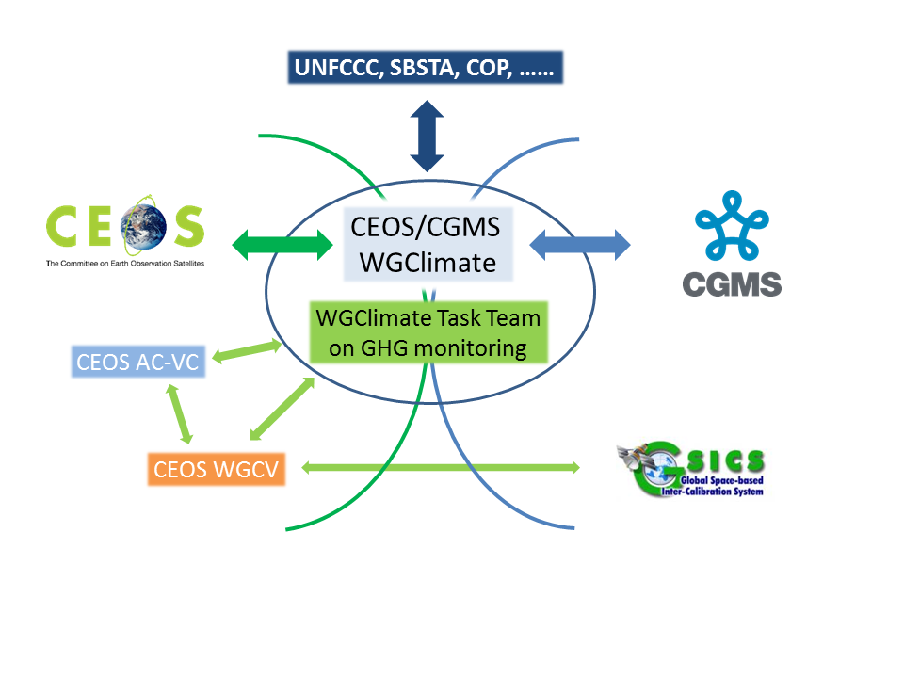
GHG Task Team
Responsible for maintaining and implementation of the GHG Roadmap
Interfaces with, stimulates and monitors GHG related activities across various (CGMS &) CEOS WGs: WG-Climate, WG-CalVal, AC-VC, WG-CapD, NewSpace Task Team, etc
Actively ensure representation of CEOS and CGMS bodies by identifying Points of Contact (PoCs) for tasks to be executed by these bodies

Slide 3
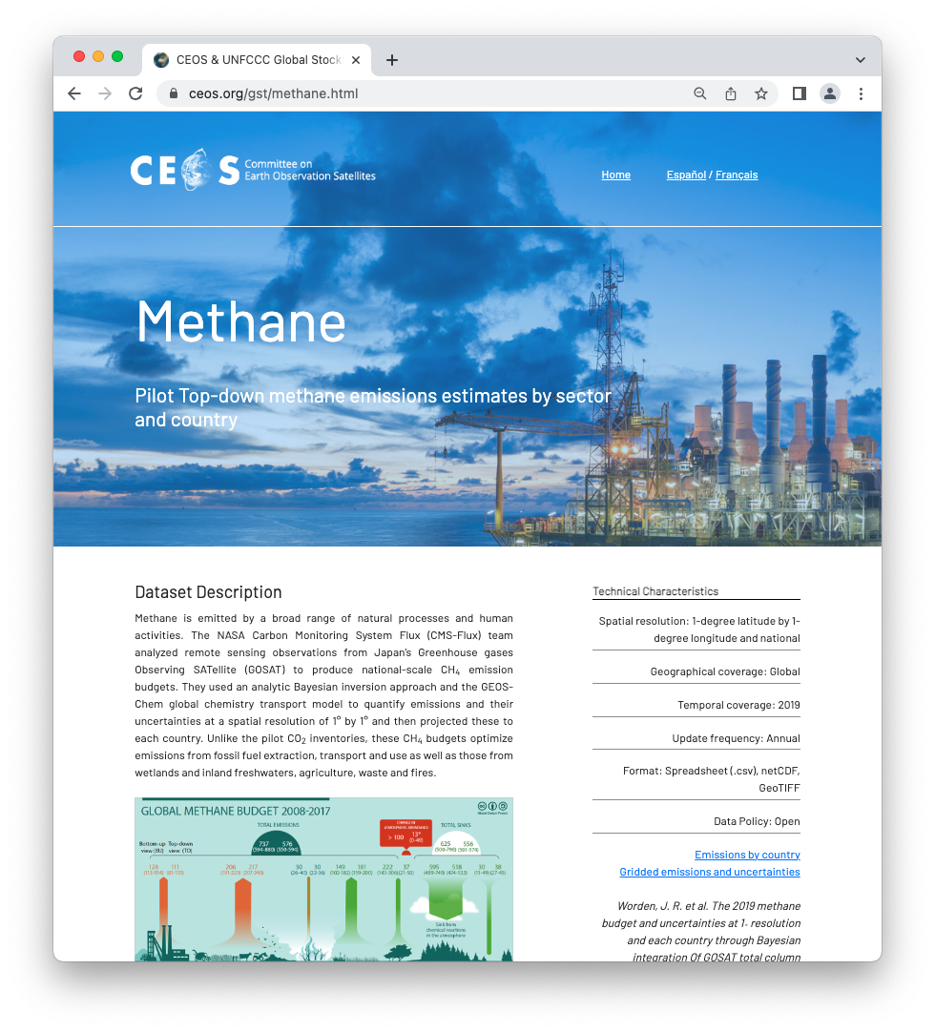
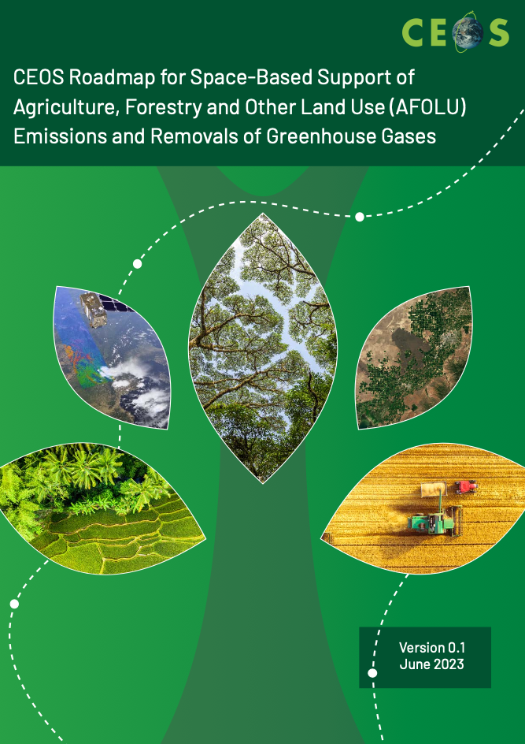
CEOS Carbon Roadmaps
Roadmaps/pillars of CEOS on carbon
GHG
AFOLU
Aquatic Carbon (TBD)
Individual pillars need to be connected → define interfaces
New action to collaborate

Slide 4
GHG Task organisation
Area leads (plus deputies) have been appointed using the thematic areas of Annex C (actions) in the GHG Roadmap:
Stakeholder Engagement - Mark (John, Wenying)
System Development Facilitation – Richard (John, Kevin)
Operational Preparation and Training – TT discuss
Sensor Development – John (AC-VC) (Yasjka)
L1 & L2 GHG Product Development – Ruediger & Dave
Flux Inv. Model Development – Kevin (Frederic)
Calibration & Validation – Hiroshi (Kuze)
Leads mailing list has been set-up ghg-tt-leads@googlegroups.com
GHG TT mailing list has been set-up ghg-tt@googlegroups.com
Work continues to be supported by Symbios!
Points of Contact still missing toward CapD and CGMS WGs

Slide 5
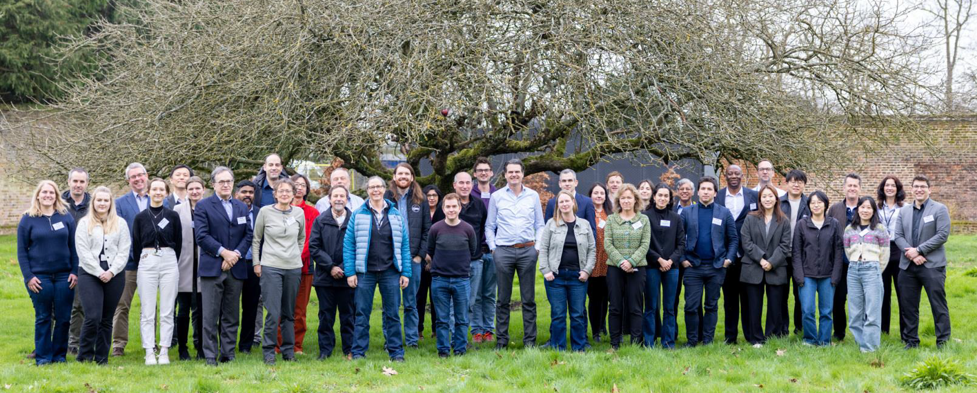
Recent Achievements
Soft update GHG Roadmap
Action list has been updated through a thorough review per Area
Product standardization → several meetings took place and is work in progress
GHG observations from space is one of JAXA’s headline prioritites as new CEOS SIT chair for 2024–2025
CEOS GHG Missions Portal; centralized overview of GHG Missions in one Portal ceos.org/ghg
New Space; Significant steps have been taken and progress followed by J. Worden
International Engagement
WMO’s Global GHG Watch. CEOS representatives in Study Group supporting the implementation plan
IMEO (members participating in WGs) & collaboration to intensify further.
International Methane Standards Workshop by NPL in Teddington, UK. Report will be generated with Recommendations & timeline summary

Slide 6
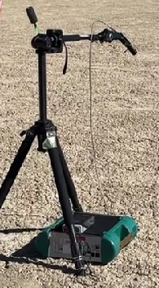
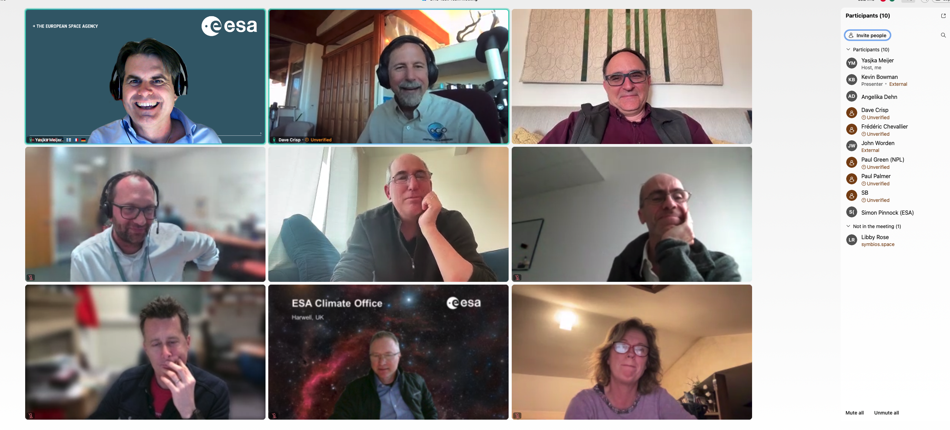
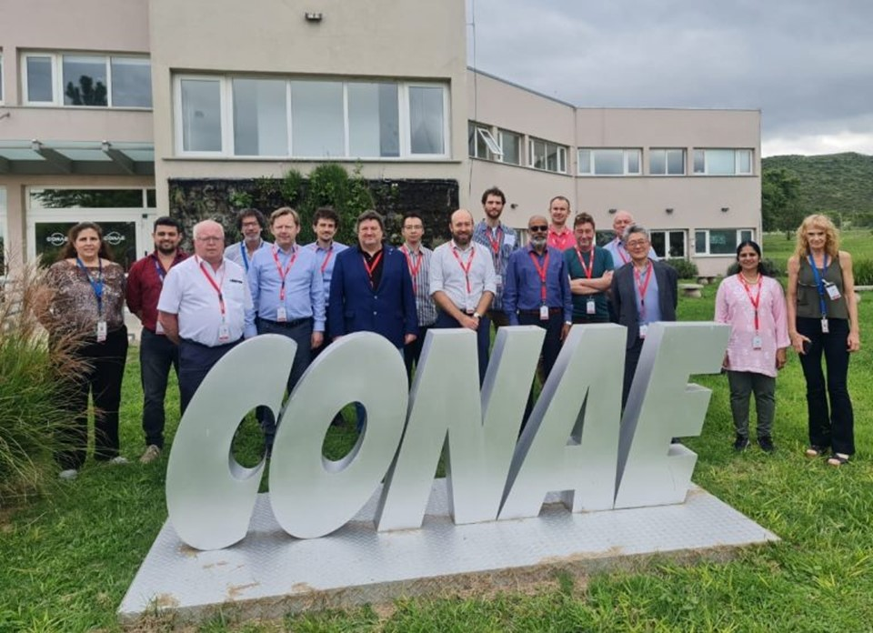
Recent GHG Task Meeting-4
Operational systems under implementation by various entities, such as CAMS and US GHG Center. WMO G3W is putting these initiatives in a coordinated international UN framework.
Several actions were identified as to be pursued more practically under G3W
WG-Cal/val has been very active. One key challenge is to resolve natural CO₂ fluxes which are varying by about 0.2 ppm/100 km and ocean fluxes varying by less than 0.1 ppm/100 km while the current XCO₂ accuracy remains 0.8 ppm
16th Joint Vicarious Calibration Campaign June 12-17, 2024 in Rail Road Valley
Need to coordinate controlled release experiments of methane
WGCV-53
GHG-TT 4

Slide 7
WMO’s Global GHG Watch
G3W Implementation Plan v1.0
Aim has been to position CEOS as the trusted partner for space-based observations up to L2
Expectation is that stakeholders, like G3W, will gradually operationalize L2+ aspects
Section 3.5 → Theme: Space-based observations of GHGs and related variables
Three specific actions were included:
O10: Liaise and prioritise with CEOS-CGMS for direct GHG observations from space
O11: Liaise and prioritise with CEOS-CGMS for indirect GHG observations from space (required to infer GHG fluxes)
O12: Liaise and prioritise with CEOS-CGMS for required space-based observations to monitor changes in the carbon cycle in a (future) changing climate
Some of the activities listed in GHG Roadmap can be (gradually) taken over by G3W
In implementation phase, there is a need to work on CEOS ← → G3W operational interfaces

Slide 8
UNEP’s IMEO
IMEO Working Groups
Several working groups were established and met twice
Clear need to continue this work of some of the working groups
Aim has been to position CEOS as the trusted partner for space-based observations up to L2
Expectation is that stakeholders, like IMEO, will gradually operationalize L2+ aspects
Three specific activities were already identified:
An automated tip-and-cue system. This basically implies automated messages based global mappers (like S5p, S5 and CO2M) to indicate to IMEO areas of potential interest for plume mappers.
An automated hyperspectral ‘L2’ processing request. IMEO would like to investigate/follow-up on observed plumes by investigating for signs in S2, S3, prisma and similar missions. As this is not part of the standard processing of these missions, we would need to foresee an automated process vis-à-vis satellite agencies. We think ESA could lead the way on this topic.
In its further evolution, there is a need to improve CEOS ← → IMEO operational interfaces

Slide 9
Proposed agency contributions
The mentioned IMEO elements are already or could become part of on-going ESA projects like:
WorldEmission, https://eo4society.esa.int/projects/world-emission/
MEDUSA, about to start, with KO on 10-4.
SMART-CH4 (https://eo4society.esa.int/projects/smart-ch4/), a part of this project to improve fine-scale emission detection from the high resolution satellites.
AI4CH4, kicked off in January (https://eo4society.esa.int/projects/ai4ch4/), they are aiming to develop advanced end-to-end AI model for automatic plume detection and quantification using the range of satellite data available
ESA is looking seriously at what we can do to respond to the L2 intercomparison roadmap action, which could fall under the CLIMATE SPACE programme, with the aim to KO an activity in the next ~12 months.
Any other contributions?

Slide 10
Next steps – GHG Roadmap
Toward GHG Roadmap Update v2
While Action list has already been updated
Recent developments require a full update of the GHG Roadmap
Split between various scales (point/area vs national/regional)
Split between CO₂ & CH₄
Need to integrate (among others) G3W and IMEO in the Roadmap
Seek and better understand new stakeholders
Aim is to position:
CEOS for up to L2 (including all related aspects, like cal/val, algos, product standardization, collecting new reqts. etc.)
Facilitate and enable stakeholders to gradually operationalize L2+ aspects

Slide 11
Stakeholder Landscape and Actions
UNFCCC/SBSTA/GCOS
Stake1
Party A
Party B
Party C
Party D
Party E
Party F
…
Stake2
Stake4
Stake3
WMO G3W
UNEP IMEO et al
CoM
Industry
Land Fills, Wetland
…
Stake5
Climate Action Actors

Slide 12
Challenges & Way forward
Challenges:
User engagement/stakeholders:
UNFCCC (GST)
CO₂: policymakers at smaller spatial and temporal scales (covenant of mayors, finance)
CH₄: (policymakers) on non-O&G related emissions, e.g. landfills, wetlands
Mission delays, Space Agencies false notion that New Space could do it all
Tackle the aquatic (mainly coastal & open ocean) aspect of the carbon cycle
Timely switch to missions capable to monitor the carbon cycle in a changing climate
Next steps of GHG Task Team:
Coordinate GHG TT activities with the AFOLU and Aquatic Carbon Roadmap Ensure continuity to earlier/existing missions
Actively interface with G3W and IMEO

Slide 13
SIT 2024–25 headlines
JAXA SIT Chair Priorities:
Climate Policy Impact – addressing obstacles and opportunities for CEOS agency data, particularly AFOLU/Biomass map datasets, to have maximum impact in the key climate policy processes such as the Global Stocktake of the Paris Agreement
GHG observations from space - addressing coordination for data continuity challenges ahead and developing good practices so that operators of all kinds may contribute to societal needs
Next step is a dedicated GHG side meeting on 9 April, and SIT-39 meeting with GHG session on 10-11 April in Tokyo

