Slide 1


AI-Ready Open Environmental Data at NOAA
Douglas Rao (douglas.rao@noaa.gov)
Rob Redmon (rob.redmon@noaa.gov)
Acknowledgement: Stacie Koslovsky, Stacie Robinson, ESIP Data Readiness Cluster, NASA ESDS Data Interoperability Working Group, Julie Demuth, Ann Bostrom, Jason Hickey, and others.
2024-03-27

Slide 2

You’re Not AI-ready Until Your Data Is
The biggest roadblock to implementing a proof of concept for machine learning or deep learning is sourcing, organizing, and feeding the right kind of data into your model.
That’s why organizations leading the AI charge today are those who have built their strategies around data.
– Intel

Slide 3

“Your Plan v.s. Reality”
Problem Definition
Data Preparation
Model Training
Model Evaluation
Operation & Monitoring
Problem Definition
Data Preparation
Model Training
Model Evaluation
Operation & Monitoring
Self-defending disclaimer: Not 1:1 to scale with real effort.

Slide 4
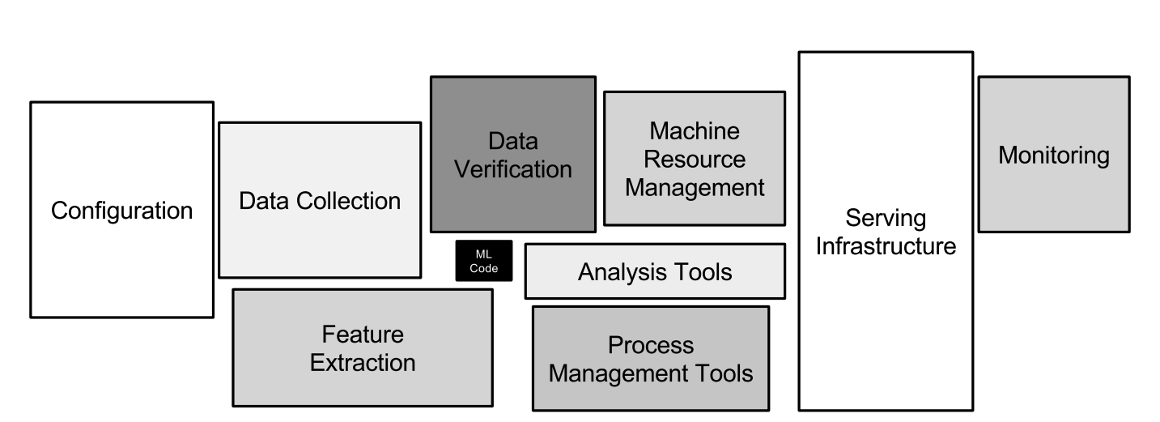
High Technical Debt of AI System
Sculley et al. (2015) “Hidden technical debt in machine learning systems.”

Slide 5
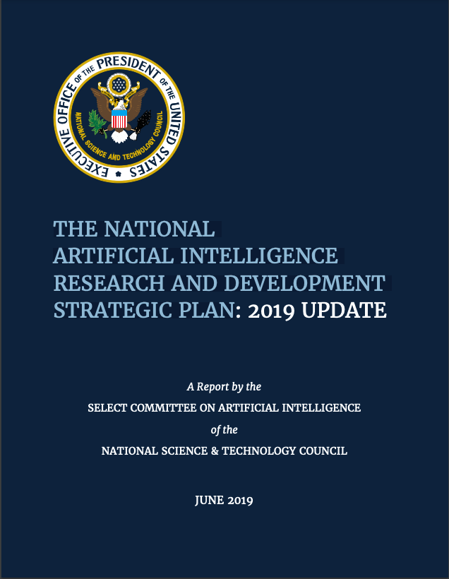
The Top-Down Requirements
Strategy 5: Develop Shared Public Datasets and Environments for AI Training and Testing.
(In 2019 EO) Specifically, agencies shall improve data and model inventory documentation to enable discovery and usability, and shall prioritize improvements to access and quality of AI data and models based on the AI research community’s feedback.
https://www.nitrd.gov/pubs/National-AI-RD-Strategy-2019.pdf

Slide 6
Earth and Space Science Responses
The NOAA AI Strategy will provide a more coordinated approach across NOAA to effectively develop the AI-ready data and tools for reliable and efficient processing, interpretation, and utilization of Earth observations.
NASA SMD has an opportunity to enable greater sharing of AI-ready data and models. AI-ready datasets significantly lower the barrier to entry to using AI for science and allow for easier reproducibility of the results
NOAA AI Strategic Plan (2021)
NASA SMD AI Report (2021)

Slide 7

But… what is AI-ready data?
Data foundations…are data that is fit for purpose, recorded in standardised formats on modern, future-proof systems and … FAIR.
– UK’s National AI Strategy
Modeling techniques
Data Types
Use Cases

Slide 8
Understanding Users’ Needs
In general, there is very little research done on best practices for data curation / cleaning / annotation, even though these steps have far more impact on applications than incremental architecture improvements.
Preparing the data is an exercise left to the reader.
– François Chollet (Creator of Keras)
‘Deep Learning with Python’
Modeling techniques
Data Types
Use Cases

Slide 9
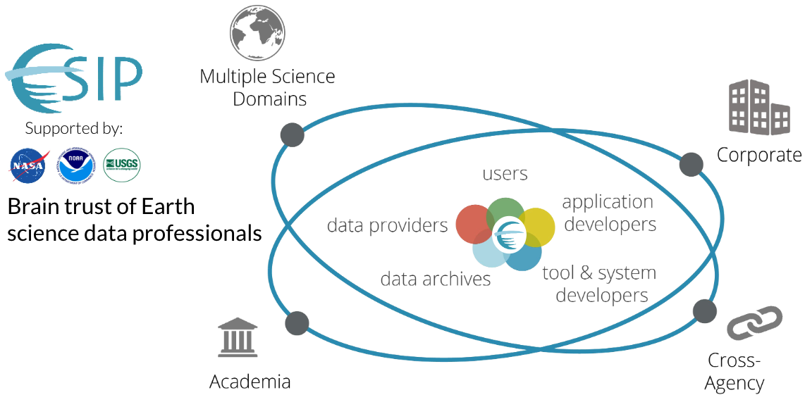
Leveraging Community Expertise

Slide 10
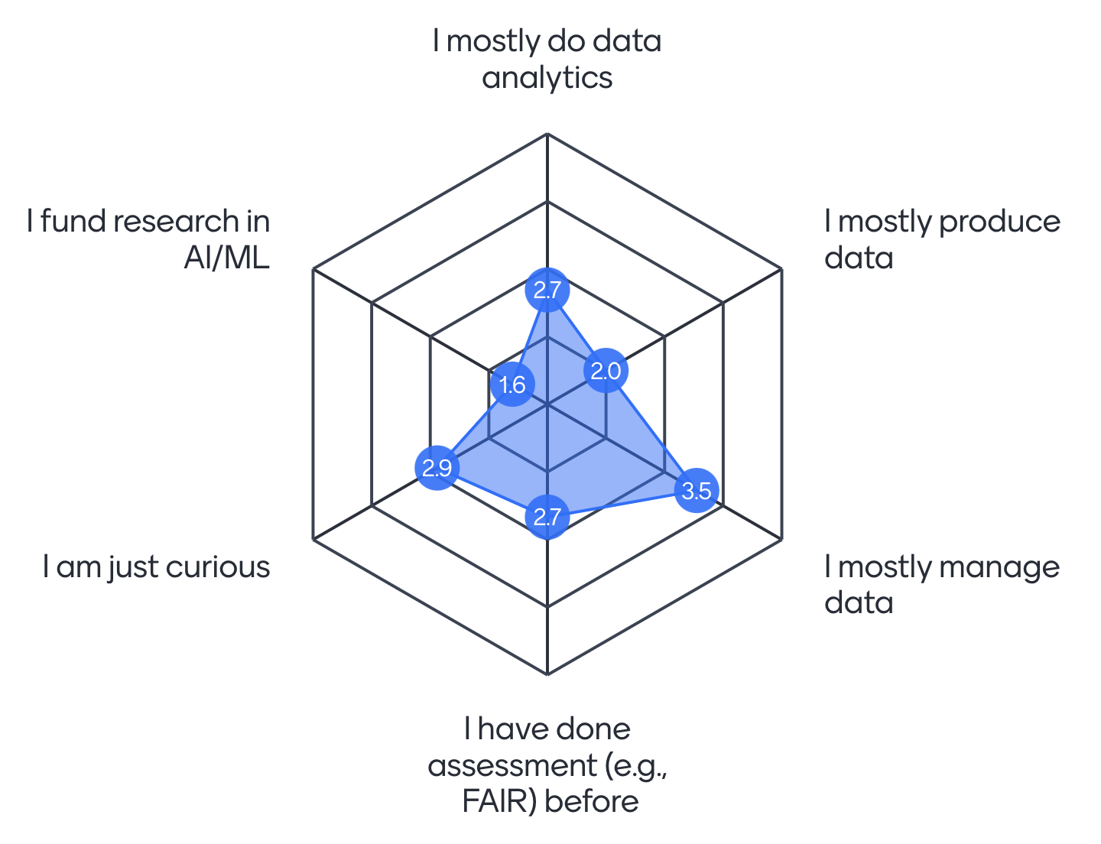
ESIP Data Readiness Cluster
Coordinate the development of community guidelines/standards
Enable the exchange of experiences for data curation, management & service
Promote the development of tools and services for AI-ready data
https://github.com/ESIPFed/data-readiness

Slide 11
Community-driven AI-Ready Data Initiative
Documentation enables users to understand the contents of a data set and should provide information and tools to increase data usability.
Preparation
AI-Ready Data
Quality information determines the dataset’s “fit-for-purpose” for AI & affects the trustworthiness of AI applications.
Access
Documentation
Access affects the efficiency & reproducibility for AI R&D process.
Quality
Preparation help identify common data services and tools to reduce preprocessing burden for users including AI practitioners.
Earth Science Information Partners (ESIP) Data Readiness Cluster is a forum for community members from agencies (NOAA, NASA, USGS, DOE, USAF, Met Office, etc.), private sectors, and academia to:
- Understand users’ data need for AI/ML R&D with environmental data
- Develop community standards, leading practices & tools for AI-ready data
- Open collaboration via Github for AI-ready data checklist https://github.com/ESIPFed/data-readiness

Slide 12
AI-Ready Data Characteristics
Quality
Completeness
Consistency
Unbiasedness
Timeliness
Uncertainty information
Provenance
Documentation
Standard/common metadata
Tools & examples (codes, softwares, notebooks)
Data dictionary
Identifiers
License information
Access
Data format (prefer variety)
Delivery options (prefer variety)
Security & privacy
Usage right
Preparation
Labels/targets identified
Recommended data splits
Missing values & outliers
Recommended (or not-suitable) for (which techniques would be suitable and which would not)
Past usage (links to documents and/or tutorials)
Current effort on manual assessment to mature the AI-ready data checklist with the plan to automate the assessment which requires machine-actionable metadata.

Slide 13
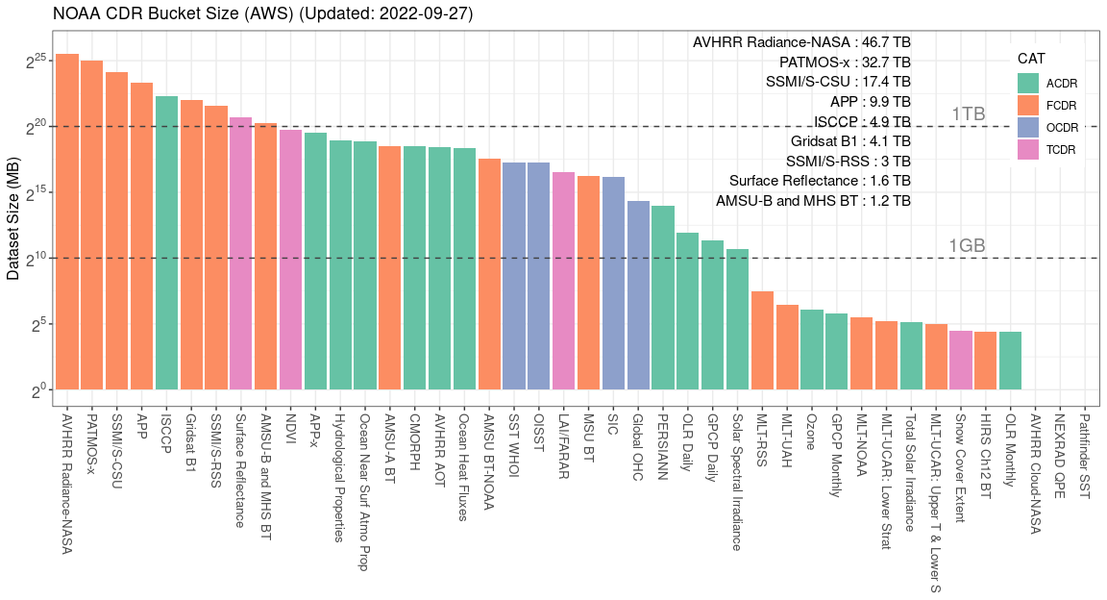
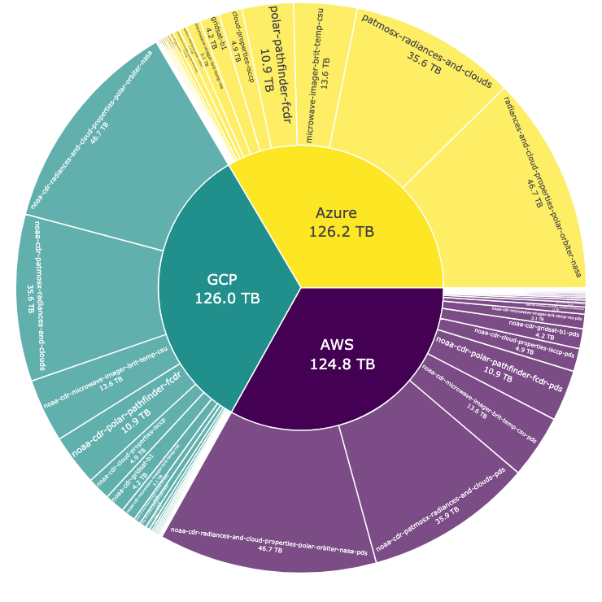
NOAA Climate Data Records
NOAA CDRs are available via all three CSPs.

Slide 14
Expected Data Access Patterns
Time series extraction
z
Local/regional analysis
Lat
T
Lon
Global mapping

Slide 15
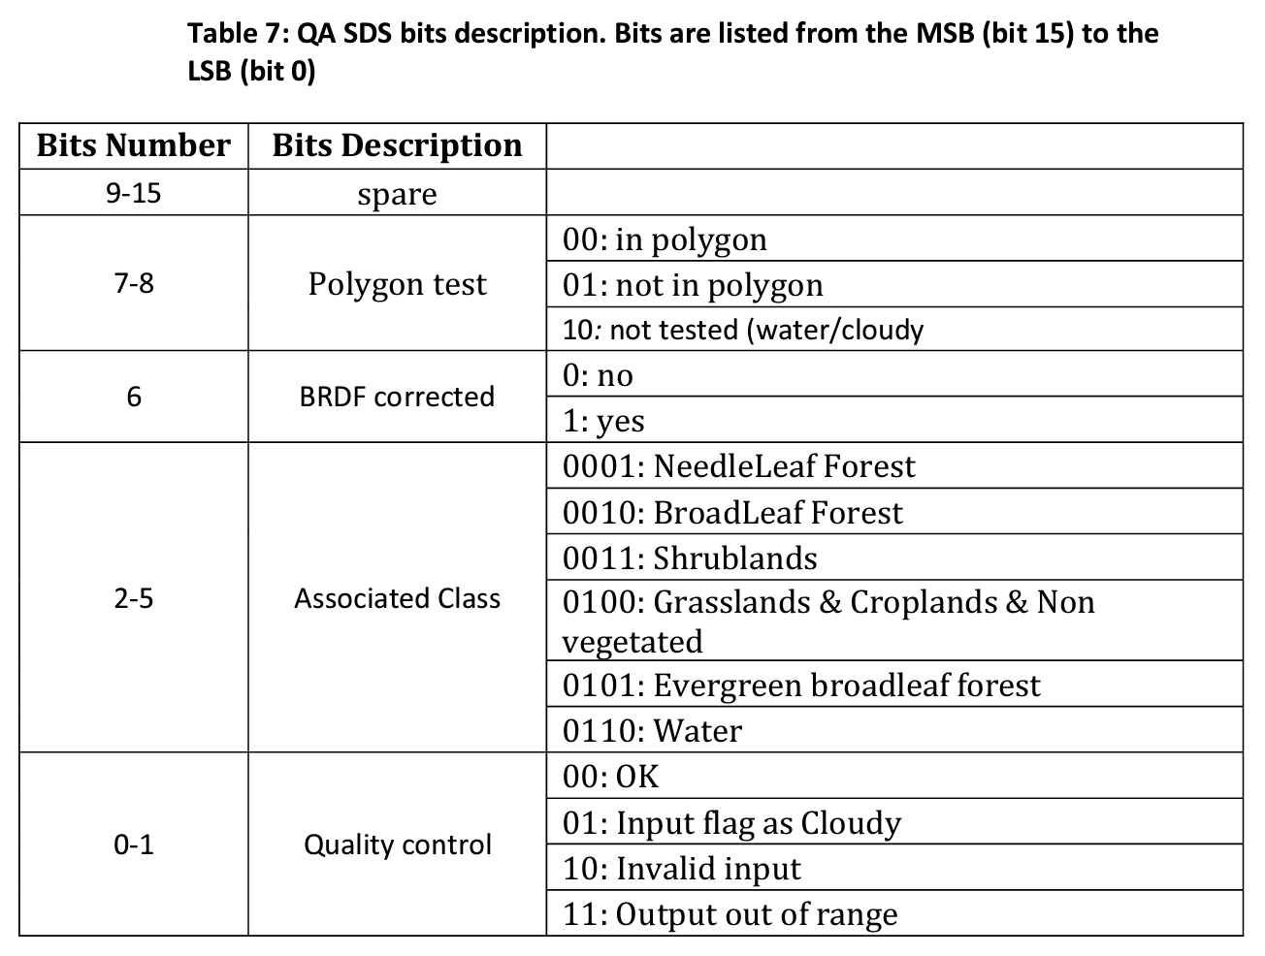
Heritage Data Format and Delivery
  short LAI(time, latitude, longitude) ;
        LAI:scale_factor = 0.001 ;
        LAI:add_offset = 0. ;
        LAI:long_name = "Leaf Area Index" ;
        LAI:units = "1" ;
        LAI:valid_range = 0s, 7000s ;
        LAI:_FillValue = -100s ;
        LAI:standard_name = "leaf_area_index" ;
        LAI:grid_mapping = "crs" ;
No proper chunking for global daily files
The mismatch between the data format designed in 2010s and current data access and processing tools creates friction for data users.

Slide 16




Pilot Improvement for CDRs
With support for Bipartisan Infrastructure Law & NOAA Center for AI AI-ready data pilot, we are improving the NOAA CDR with three different focuses.
Workshop: Analysis-ready cloud optimized data
Studio: Notebook-based tutorial for learning
Dashboard: Customizable data visualization interface

Slide 17
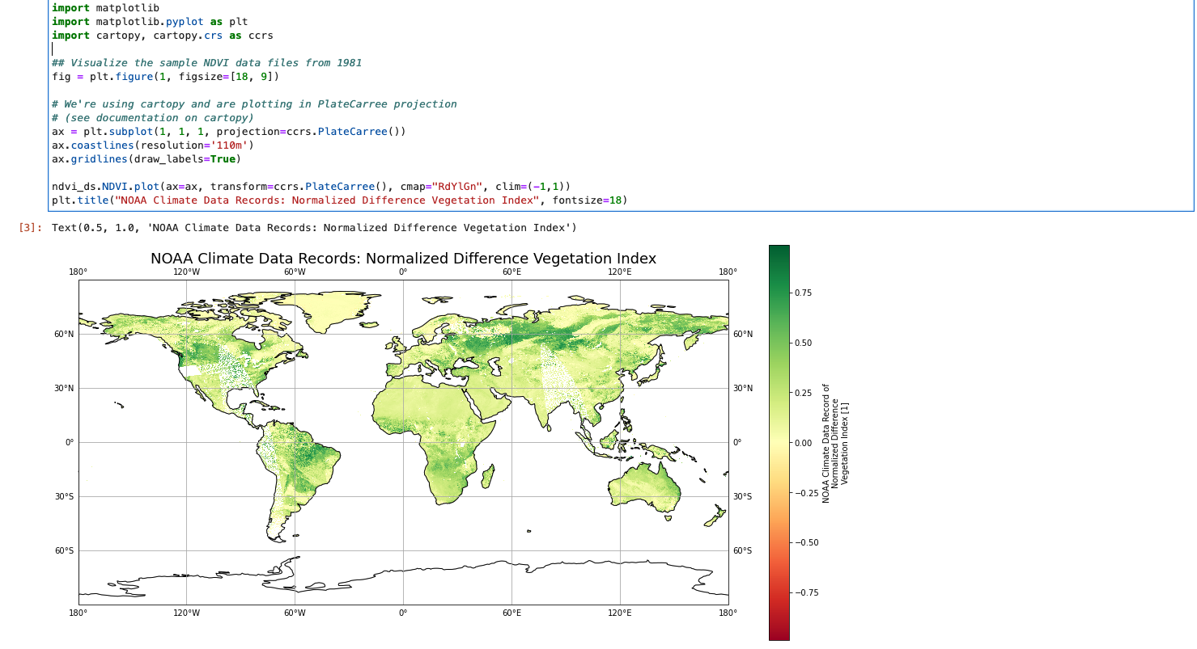
Studio: Notebook-based tutorial for learning
Baseline notebook contents
Access
Visualize
Analytics

Slide 18
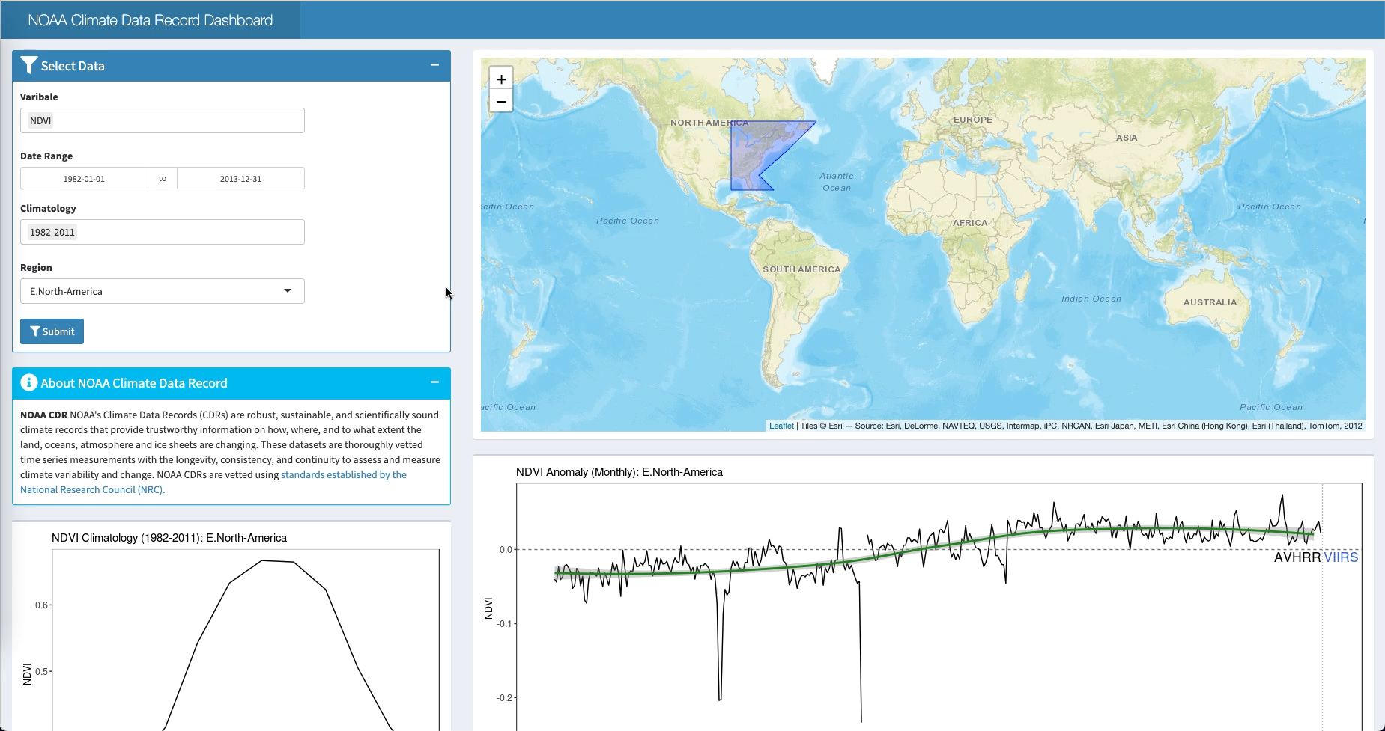

Slide 19
Development & Improvement Needs
Data service improvement: Provide data services for commonly requested data processing & enable community actions.
Capacity development: Modern documentation (interactive notebooks) to support diverse users.
Preparation
AI-Ready Data
Access
Documentation
Access modernization: Adapt to the data access technology evolution; balance with the need for archive/stewardship.
Quality
Quality distillation: Make quality information “FAIR” to easily aid users’ decision-making process.

Slide 20
AI-Ready Data Roadmap
01
Short term: Review of common domain data standard
Mid term: Develop proposed AI-ready data standard for publishing process
Long term: Publish and maintain AI-ready data standard
Develop and maintain AI-ready data standards
02
Short term: Update assessment form based on user feedback
Mid term: Develop metrics to display & synthesize AI- readiness assessment results
Long term: Develop automatic AI-readiness assessment tool
Develop automatic tools for AI-readiness assessment
03
Short term: Uplift a pilot set of thematic AI-ready data
Mid term: Develop tools and leading practices to improve data readiness at scale for community adoption
Long term: Provide AI-ready data discovery tools and services
Develop and improve AI-ready open environmental data
04
Short term: Increase the engagement with private sectors
Mid term: Develop primers for AI-ready data checklist / standards for different user personas
Long term: Develop and maintain training materials on AI-ready data and tools for different user personas
Sustain the engagement with user and capacity building

Slide 21











NOAA Center for Artificial Intelligence
Our Vision
Benefiting NOAA’s mission by proliferating the use of Responsible AI at NOAA.
How?
We’ll do this by lowering the cost of engaging curiosity for our Community of Practice
noaa.gov/AI
21

Slide 22
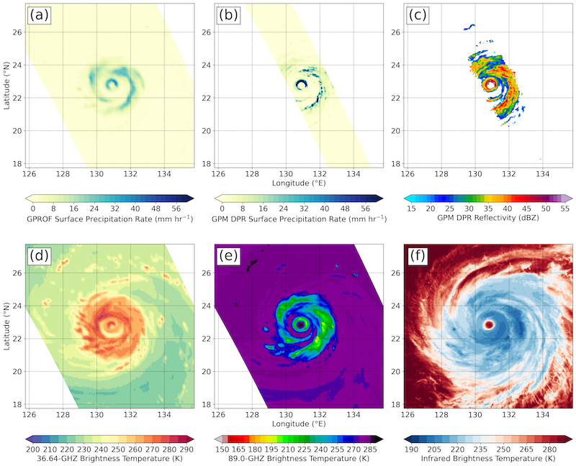
NCAI Pilot Project:
Create Tropical Cyclone Model Training Dataset
Challenge
AI-ready and accessible benchmark satellite datasets are needed to drive the future of tropical cyclone trajectory, intensity and coastal impact prediction (e.g. coastal flooding and other infrastructure damage).
Description and Expected Outcomes
Evaluate a new dataset’s AI-readiness against NCAI draft standards and make necessary changes to brand it as AI-ready. The new dataset, Tropical Cyclone PRecipitation, Infrared, Microwave, and Environmental Dataset (TC PRIMED), collocates and subsets LEO/GEO satellite imagery with ancillary model information to create a 22-yr dataset of TC-centric scenes. This dataset will supersede NCEI’s HURSAT.
NCAI Benefits
AI-ready standard maturation; Lesson Learned via interactive Python notebook (“Learning Journey"); increased collaboration with NOAA’s NODD (previously BDP).
POC: Chris Slocum (NOAA/NESDIS/STAR), christopher.slocum@noaa.gov
A sampling of TC PRIMED products from Typhoon Maria (2018) at 10:13 UTC on 9 July 2018 in the western Pacific, where a) is GPROF, b) is GPM DPR precipitation rate, c) GPM DPR reflectivity, d) 36.6 GHz, e) 89 GHZ, and IR from Himawari-8.
Notes:
TRL: 6 (start), 8 (end)

Slide 23
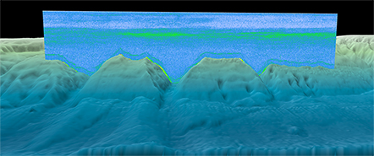
NCAI Pilot Project:
Cloud Optimized Data Lake of Archived Water Column Sonar
Challenge
AI-ready Water Column Sonar (WCS) data are needed to extract the full potential of the ocean soundscape.
Description and Expected Outcomes
Develop a data lake of archived WCS data translated into cloud-friendly formats to improve interoperability and scaled processing.
The complex, binary, and proprietary formatted data are hosted on AWS currently through the NODD and are not AI-ready.
Data will be transformed and made AI-ready and an interactive notebook will be developed for others to learn from.
Benefits
This effort will lower the learning curve to analyze the data more easily, especially in a cloud environment.
NCAI Benefits
AI-ready data, lessons learned as interactive notebook for NCAI’s Learning Journey library.
POC: Carrie Wall Bell (NOAA/NESDIS/NCEI and CIRES), carrie.wall@noaa.gov
Water column sonar data collected on the NOAA Okeanos Explorer in the North Atlantic Ocean. Sonar data are overlaid onto coastal relief model bathymetry. (Source)
Updated: September 15, 2022

Slide 24
Backup Slides

Slide 25
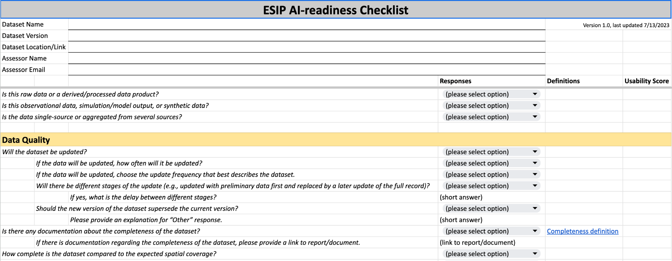
Updated AI-Readiness Checklist
Updated dropdown options
General dataset information
Uplifted quality section
Proposed usability score

Slide 26
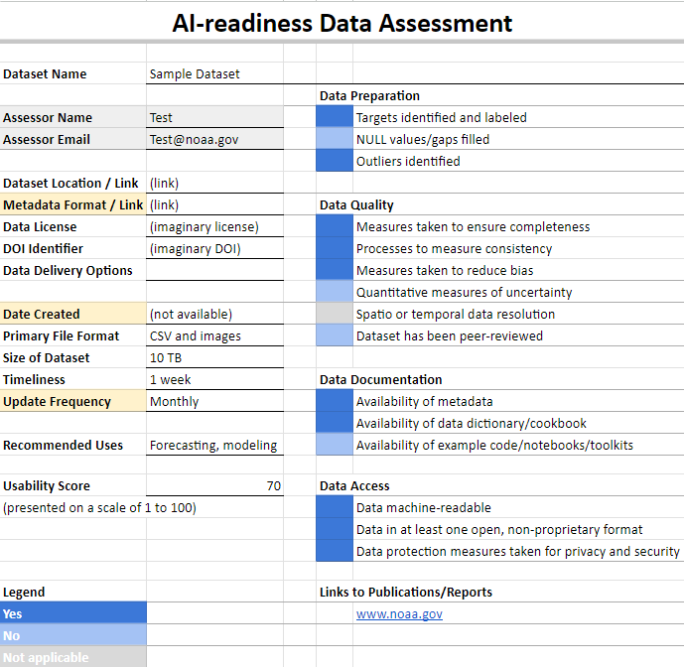
Proposed draft AI-ready data card
Motivation: Provide a quick reference with human-readable information for the assessment results and basic dataset information.
Labels/tags to help users to find proper datasets.

Slide 27
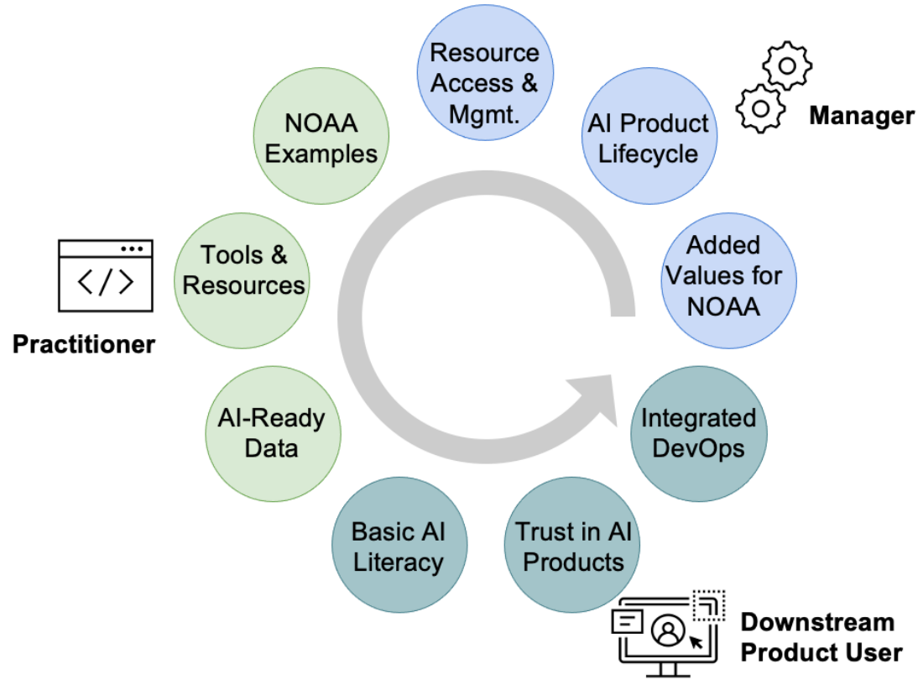
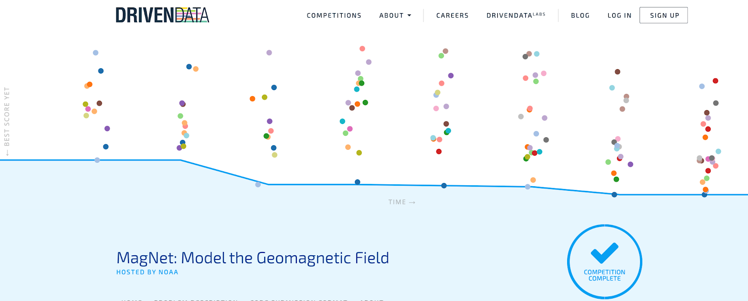
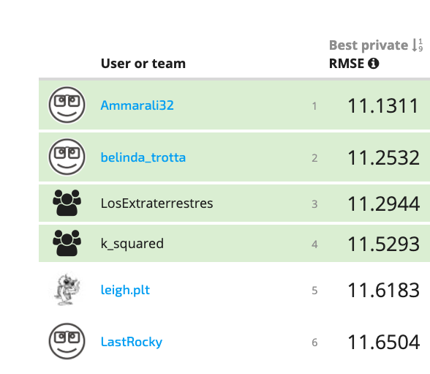
AI-Ready Data to Enable Development
Preparation
Capacity Development
AI-ready data can accelerate the innovation process using public data through data challenges and other activities.
AI-Ready Data
Access
Documentation
Quality
https://noaa.gov/AI
AI-ready data can better facilitate collaboration in development and transition of AI applications to support agency’s mission. 5th NOAA AI Workshop will focus on the benchmarking framework as one of the major topic.

