Slide 1
Greenhouse Gas (GHG) Task Team
Y.Meijer, ESA
GHG Task Team Lead
WG Climate
16th – 17th October 2023, ESA/ESRIN

Slide 2
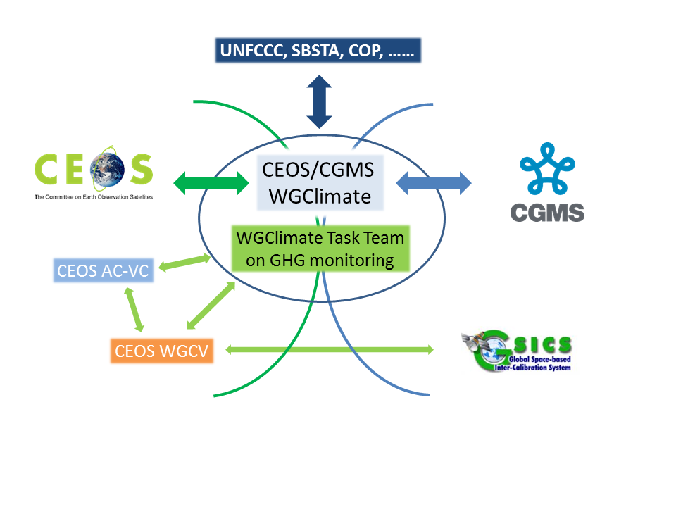
GHG Task Team Role
Responsible for maintaining and implementation of the GHG Roadmap
Interfaces with, stimulates and monitors GHG related activities across various (CGMS &) CEOS WGs: WG-Climate, WG-CalVal, AC-VC, WG-CapD, NewSpace Task Team, etc
Actively ensure representation of CEOS and CGMS bodies by identifying Points of Contact (PoCs) for tasks to be executed by these bodies

Slide 3
GHG Task organisation
Area leads (plus deputies) have been appointed using the thematic areas of Annex C (actions) in the GHG Roadmap:
Stakeholder Engagement - Mark (John, Wenying)
System Development Facilitation – Richard (John, Kevin)
Operational Preparation and Training – TT discuss
Sensor Development – John (AC-VC) (Yasjka)
L1 & L2 GHG Product Development – Ruediger & Dave
Flux Inv. Model Development – Kevin (Frederic)
Calibration & Validation – Hiroshi (Kuze)
Leads mailing list has been set-up ghg-tt-leads@googlegroups.com
Points of Contact of all WGs have been obtained
GHG TT mailing list has been set-up ghg-tt@googlegroups.com
Work has been supported by Symbios!

Slide 4
Meetings in 2023
General Meetings
02 FEB: GHG Task Team meeting #2, at WMO, Geneva
12 SEP: Leads discussion (telecon)
17 OCT : GHG Task Team meeting #3, at ESRIN
Contributions to various CEOS and CGMS (WG) meetings
Topical meetings
7-8 JUN (Joint CEOS/IMEO) International Coordination Workshop on Detection of Anthropogenic Methane Emissions from High-Resolution Satellites, Harvard Uni., USA
03 JUL Emission Uncertainties Workshop, Paris, France

Slide 5
Recent Achievements – 1/2
GHG Roadmap Update
Only soft update through Annex C of the GHG Roadmap
Action list has been updated through a thorough review per Area coordinated by Area Leads (add more milestones & specific (SMART) actions)
Split along various scales (point/area vs national/regional)
Split between CO₂ & CH₄
GCOS IP
Contributed to the Space Agency Response to “GCOS IP 2022”, specifically to activities: B3.1, F2.2, F5.2 & F5.4
Response quite well covered by current or planned GHG TT activities
Main activity gap is for observations in difficult areas and challenging circumstances, e.g. Polar regions (esp. winter)
Engagement with WG-CV on sustainability of GHG Cal/Val networks

Slide 6
Recent Achievements – 2/2
International Engagement
CMS Application Workshop
WMO Global GHG Watch (G3W)
IMEO (members participating in WGs)
CEOS GHG Missions Portal; centralized overview of GHG Missions in one Portal ceos.org/ghg
New Space
Significant steps have been taken, reported in tomorrow’s meeting by J. Worden.
IMEO seeks expertise to coordinate facility scale observations (in general) and then especially for the ‘tip-and-cue. This would be across various operators (commercial, NGOs, philanthropic, public and mixes thereof) → ROLE for CEOS?

Slide 7
CEOS Work Plan
Status GHG Task Team actions in CEOS Work Plan
CARB-23-01: Lessons learnt from pilot CO₂ and CH₄ products (delivered for GST-1) → closed
CARB-23-02: Standards for uncertainty monitoring of flux estimates → closed*
CARB-23-03: GCOS IP response for GHG-related activities → closed
CARB-23-04: Update GHG Roadmap (focus on Action List) → closed
CARB-23-05: New Space and GHG product development and standards setting → closed*
* This will evolve further as normal work in GHG TT

Slide 8
Challenges & Way forward
Challenges:
User engagement:
UNFCCC (GST)
CO₂: policymakers at smaller spatial and temporal scales (covenant of mayors, finance)
CH₄: (policymakers) on non-O&G related emissions, e.g. landfills, wetlands
Mission delays, Space Agencies false notion that New Space could do it all
Tackle the aquatic (mainly coastal & open ocean) aspect of the carbon cycle
Timely switch to missions capable to monitor the carbon cycle in a changing climate
Next steps of GHG Task Team:
Coordinate GHG TT activities with the AFOLU Roadmap Coordinate with New Space TT
Ensure continuity to earlier/existing missions
Engage with and ensure CEOS expertise is used in WMO’s G3W and UNEP’s IMEO

