Slide 1
Welcome and Meeting Goals
Jeff Privette, Chair (NOAA)
Wenying Su, Vice-Chair (NASA)
18th Meeting of the Joint CEOS-CGMS Working Group on Climate
Tokyo, Japan
28 February 2023

Slide 2
Thank You
The Joint CEOS-CGMS Working Group on Climate (WGClimate) expresses its great appreciation to the Japanese Space Agency (JAXA) for graciously hosting this meeting.
Mr. Takeshi Hirabayashi
Dr. Riko Oki
Ms. Misako Kachi
JAXA’s organizing and support teams

Slide 3
High Level Agenda
Day 1
Opening and Charge
Core Business
Inventory, Gap Analysis, Use Cases, Definitions, CEOS Work Plan, Space Agency Response to GCOS IP
Day 2
New Initiatives
Carbon and Paris (GHG / AFOLU / GST)
Day 3
Working Session: Paths forward for key 2023 activities
Space Agencies’ Response to 2022 GCOS IP
COP-28: Space Agency Statement for SBSTA, Earth Information Day

Slide 4
High Level Agenda
Day 1
Opening and Charge
Core Business
Inventory, Gap Analysis, Use Cases, Definitions, CEOS Work Plan, Space Agency Response to GCOS IP
Day 2
New Initiatives
Carbon and Paris (GHG / AFOLU / GST)
Day 3
Working Session: Paths forward for key 2023 activities
Space Agencies’ Response to 2022 GCOS IP
COP-28: Space Agency Statement for SBSTA, Earth Information Day
Featured:
JAXA science presentations sprinkled throughout meeting

Slide 5
Tour de Table
Please provide:
Your name and agency/organization
Relevant positions, if applicable (e.g., WGC representative to GEO Climate Team)
What you want from this meeting
Order of Introductions
In-room participants
Virtual participants (roughly going west around globe from Japan)

Slide 6
Welcome from JAXA
Mr. Takeshi Hirabayashi
Mr. Takeshi Hirabayashi is the Senior Chief Officer of Earth Observation Missions and the Director of Satellite Applications and Operations Center (SAOC) at the Japan Aerospace Exploration Agency (JAXA). He is currently responsible for promoting satellite applications in the field of Earth observation and analysing Earth observation satellite data. Formerly, Mr. Hirabayashi was the Project Manager of GOSAT-2 Project Team (Greenhouse Gases Observing Satellite-2 Project Team) from 2014-2019 and has held various management posts in JAXA including Satellite System Technology Group, Positioning Satellite System Technology Office and Strategic Planning and Management Department.

Slide 7
Meeting Goals, Charge to Members
Meeting Goals
WGClimate members are current on internal and key partner initiatives
Learn more about JAXA’s team and activities
Determine WGClimate activity leads and representatives to partner initiatives
Establish 2023 WGClimate work plans
Develop strategies, initiate project planning and kick off activities as possible
Schedules and staffing
Charge to Members
Stay present, participate
Hybrid format enables richer discussions
Stay mindful of new and virtual participants (provide context, define acronyms)
Reassess your role and volunteer(!)
WGClimate is a team sport
Equitably distribute the workload among member agencies
Hold ourselves accountable for achieving meeting objectives

Slide 8
Acronyms
AC-VC CEOS Atmospheric Composition Virtual Constellation
CARD or CARD4L CEOS Analysis Ready Data team (4L=For Land)
CEO CEOS Executive Officer
CEOS Committee on Earth Observation Satellites
CGMS Coordination Group for Meteorological Satellites
COAST AHT CEOS Coastal Observations Applications Services and Tools ad hoc Team
COP UNFCCC Conference of the Parties
COVERAGE CEOS Ocean Variables Enabling Research and Applications for GEO
EID UNFCCC COP Earth Information Day
GCOS Global Climate Observing System
GEO Group on Earth Observations
GHG TT Greenhouse Gas Task Team (part of WGClimate)
IP GCOS Implementation Plan
LSI-VC CEOS Land Surface Imaging Virtual Constellation
NewSpace Evolving private-sector, mostly small concerns with high innovation, fast, higher-risk development & launch
OCR-VC CEOS Ocean Colour Radiometry Virtual Constellation
OST-VC CEOS Ocean Surface Topography Virtual Constellation
OSVW-VC CEOS Ocean Surface Vector Winds Virtual Constellation
P-VC CEOS Precipitation Virtual Constellation
SBSTA Subsidiary Body Scientific and Technical Advice (part of UNFCCC)
SCO Space for Climate Observations
SEC CEOS Secretariat
SEO CEOS Systems Engineering Office
SIT CEOS Strategic Implementation Team
SIT TW CEOS SIT Technical Workshop
SST-VC CEOS Sea-Surface Temperature Virtual Constellation
TT CEOS Task Team
UN United Nations
VC CEOS Virtual Constellation
WCRP World Climate Research Programme
WG CEOS Working Group
WG I,II,III,IV CGMS Working Group 1-4
WGC Joint CEOS-CGMS Working Group on Climate (a.k.a. WGClimate)
WGCapD CEOS Working Group on Capacity Building and Data Democracy
WGClimate Joint CEOS-CGMS Working Group on Climate (a.k.a. WGC)
WGCV CEOS Working Group on Calibration and Validation
WGDisasters CEOS Working Group on Disasters
WGISS CEOS Working Group on Information Systems and Services
WMO World Meteorological Organization

Slide 9
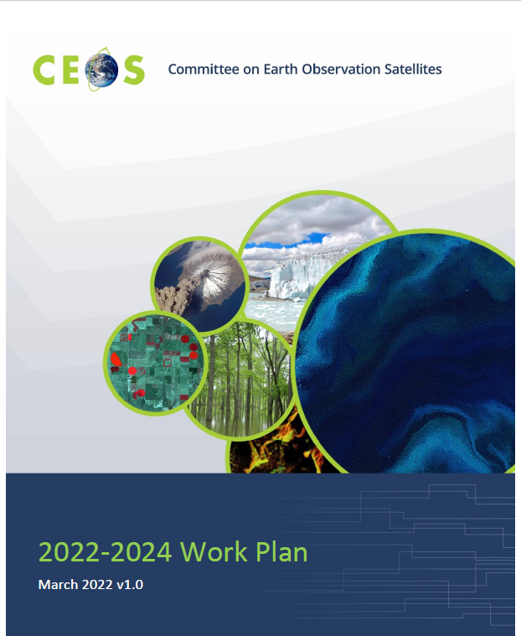
CEOS 2023-2025 Work Plan
CEOS Executive Officer coordinates annual updates
CEOS/SIT Chairs, VCs, WGs, AHGs, TTs, offices provide sections
Defines major activities and deliverables
Presented to SIT for approval in March
Draft v1 currently out for review

Slide 10
WGClimate Work Plan Elements
During 2023, WGClimate will:
• Update and exploit the comprehensive Essential Climate Variable (ECV) Inventory of Climate Data Records (CDRs) and implement actions arising from Gap Analysis.
• Complete the Version 4 Gap Analysis Report, and deliver it to the Agriculture, Forestry and Other Land Uses (AFOLU) Team, GHG Task Team, and CEOS Oceans
• Examine the Inventory to identify issues in the future availability of measurements for ECVs as described in the 2022 GCOS Implementation Plan. As issues are found, WGClimate will initiate mitigation actions by improving coordination on long-term mission planning.
• Coordinate CEOS and CGMS activities towards the definition and implementation of an integrated operational global carbon observing system, and coordinate progress on and provide updates to tasks in the Greenhouse Gas Roadmap (v2.4) Annex, including partnering with UNFCCC/SBSTA.
• Continue the activity on demonstration of use cases for climate data records
• Complete a CDR Definitions manuscript, conduct review with peer organizations (e.g., GCOS, WGCV), and submit for publication.
• Develop and provide the Space Agency Response to the 2022 GCOS Implementation Plan.
• Provide oversight to continuing implementation of GHG monitoring activities (2018 Coordinated Action Plan: Actions 11 (coordinate CO2 CDRs); 13 (plan for stratospheric CH4 profiles); and 14 (coordinate CH4 CDRs).

Slide 11
WGClimate Work Plan Elements
During 2023, WGClimate will:
• Update and exploit the comprehensive Essential Climate Variable (ECV) Inventory of Climate Data Records (CDRs) and implement actions arising from Gap Analysis.
• Complete the Version 4 Gap Analysis Report, and deliver it to the Agriculture, Forestry and Other Land Uses (AFOLU) Team, GHG Task Team, and CEOS Oceans
• Examine the Inventory to identify issues in the future availability of measurements for ECVs as described in the 2022 GCOS Implementation Plan. As issues are found, WGClimate will initiate mitigation actions by improving coordination on long-term mission planning.
• Coordinate CEOS and CGMS activities towards the definition and implementation of an integrated operational global carbon observing system, and coordinate progress on and provide updates to tasks in the Greenhouse Gas Roadmap (v2.4) Annex, including partnering with UNFCCC/SBSTA.
• Continue the activity on demonstration of use cases for climate data records
• Complete a CDR Definitions manuscript, conduct review with peer organizations (e.g., GCOS, WGCV), and submit for publication.
• Develop and provide the Space Agency Response to the 2022 GCOS Implementation Plan.
• Provide oversight to continuing implementation of GHG monitoring activities (2018 Coordinated Action Plan: Actions 11 (coordinate CO2 CDRs); 13 (plan for stratospheric CH4 profiles); and 14 (coordinate CH4 CDRs).
• Proposed: Update WGClimate’s Coordinated Action Plan

Slide 12
WGClimate Work Plan Elements
During 2023, WGClimate will:
• Update and exploit the comprehensive Essential Climate Variable (ECV) Inventory of Climate Data Records (CDRs) and implement actions arising from Gap Analysis.
• Complete the Version 4 Gap Analysis Report, and deliver it to the Agriculture, Forestry and Other Land Uses (AFOLU) Team, GHG Task Team, and CEOS Oceans
• Examine the Inventory to identify issues in the future availability of measurements for ECVs as described in the 2022 GCOS Implementation Plan. As issues are found, WGClimate will initiate mitigation actions by improving coordination on long-term mission planning.
• Coordinate CEOS and CGMS activities towards the definition and implementation of an integrated operational global carbon observing system, and coordinate progress on and provide updates to tasks in the Greenhouse Gas Roadmap (v2.4) Annex, including partnering with UNFCCC/SBSTA.
• Continue the activity on demonstration of use cases for climate data records
• Complete a CDR Definitions manuscript, conduct review with peer organizations (e.g., GCOS, WGCV), and submit for publication.
• Develop and provide the Space Agency Response to the 2022 GCOS Implementation Plan.
• Provide oversight to continuing implementation of GHG monitoring activities (2018 Coordinated Action Plan: Actions 11 (coordinate CO2 CDRs); 13 (plan for stratospheric CH4 profiles); and 14 (coordinate CH4 CDRs).
• Proposed: Update WGClimate’s Coordinated Action Plan
For 2024-2025, significant outputs will be:
• Updated versions of the ECV Inventory, Gap Analysis Report and Coordinated Action Plan.
• Continue enhanced engagement with UNFCCC/SBSTA to better facilitate CEOS contributions beyond atmospheric CO2 monitoring, including AFOLU.
• The publication of use cases on the ECV inventory web portal

Slide 13
WGC’s Open CEOS Deliverables
number | completion_date | title | description
CMRS-19-04 | 9/30/2026 | Provide oversight to the implementation of the greenhouse gas monitoring activities (Coordinated Actions 11;13;and 14). | Three tasks: 1. Establish a roadmap for the development of a GHG monitoring system, 2. Deliver first data from a prototype GHG monitoring system to the Global Stocktake 2023 and engage users with it, 3. Develop the initial operational GHG monitoring system
CMRS-19-05 | 6/30/2023 | Document new/updated definitions for FCDR;CDR;ICDR (2018 Coordinated Action Plan: Action 1) | Update defininitions for Fundamental Climate Data Records;Climate Data Records for GCOS ECVs and Interim Climate Data Records for both typs of data records.
CMRS-19-06 | 6/30/2024 | Provide cost-benefit recommendations and path forward of Coordinated Actions 5 (establish FCDR Inventory) and 10 (international CDR metadata standards) | Assess value on technical upgrade to ECV Inventory for Level 1 base data records (FCDRs) and on working with CEOS agencies on documenting CDR meta data standards
CMRS-22-02 | 9/30/2023 | Provide condensed feedback from the Gap Analysis to the GHG task team and AFOLU allowing refinement of their work plan | A dedicated excerpt shall be condensed to support GHG task team&nbsp;and AFOLU in updating their roadmap/work plan. The excerpt shall be genrated in close cooperation with both teams.
CMRS-22-03 | 9/30/2023 | Provide condensed feedback from the Gap Analysis in support of the Ocean community within CEOS in support of the CEOS GST Strategy | A dedicated excerpt shall be condensed to support the CEOS Ocean tasks reletd to GST in close cooperation with the stakeholders of other CEOS entities.

Slide 14
WGC’s New CEOS Deliverables
Title | Completion Date | Description
Provide COP-27 SBSTA Statement for CEOS Chair Delegation | 9/30/2023 | Annual deliverable
Provide COP-28 SBSTA Statement for CEOS Chair Delegation | 9/30/2024 | Annual deliverable
Provide COP-29 SBSTA Statement for CEOS Chair Delegation | 9/30/2025 | Annual deliverable
Provide Agency Response to GCOP IP | 11/13/2023 | Status updates and comments focused on Space Supplement

Slide 15
Definitions Work
Presented poster at AMS in Denver in January
Led to some additional changes in definitions and inputs
Not many visitors to the poster, but those that visited were very engaged and supportive
Some research teams had run into same problem
One issue raised by Joerg and also by visitors:
Use of “CDRs” to denote both the general category and thematic CDRs
Request: converge on the definitions here/now so only need to finish manuscript

Slide 16
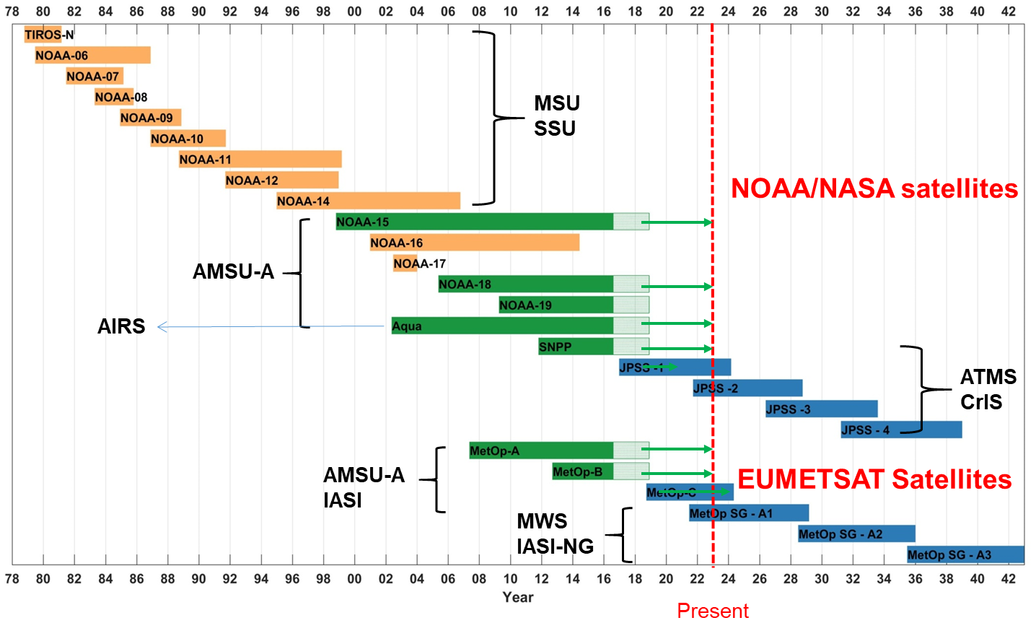
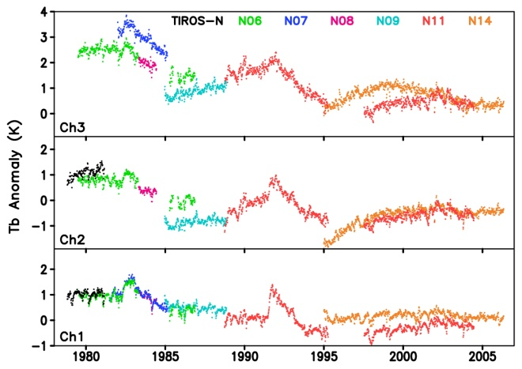
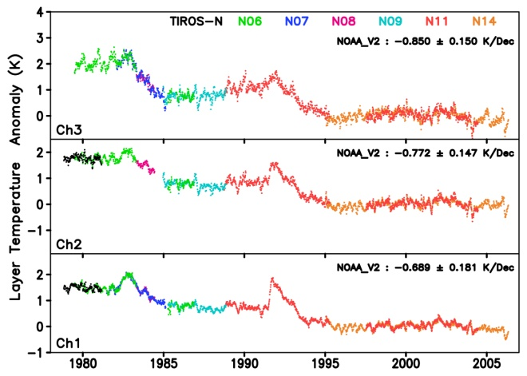
AMS’s 36th Conference on Climate Variability and Change: Poster #66
A Definitions Taxonomy for Satellite Climate Data Records and Time Series Data Sets
Jeffrey L. Privette (NOAA), Wenying Su (NASA), Jörg Schulz (EUMETSAT), Christopher J Merchant (University of Reading)
Introduction
Problem: Inconsistent and Incomplete Naming of Satellite Time Series Data Sets
Sustained and consistent space-based observations began in the 1970s with satellites from NOAA, EUMETSAT, NASA, USGS and the U.S. Department of Defense.
Climate Data Records -- consistent time series data merged from successive satellites -- are used to characterize, monitor and model the environment, conduct scientific analyses, and with industry, social or economic data to reveal relationships and develop predictive models.
Various groups have proposed definitions for these data, including the U.S. National Academies of Science, the Global Climate Observing System (GCOS), the Committee for Earth Observation Systems (CEOS), the Coordination Group for Meteorological Satellites (CGMS), as well as some research teams (e.g., Mittaz et al., 2019).
Existing terminology is inconsistent, incomplete, ad hoc or has become inadequate as remote sensing and climate science have evolved.
The Joint CEOS-CGMS Working Group on Climate (WGClimate) is developing new definitions within a self-consistent taxonomy. The draft definitions will be reviewed by other international organizations before publication.
Community adoption of the final taxonomy will facilitate more effective communication among CDR developers, producers and users.
 |  | Raw Data | Lowest Latency Time Series |  |  | Single Mission Reprocessed Time Series |  |  | Complete Period of Record Time Series
Description |  | Instrument Data | General Category | Calibrated Observations | Retrieved Geophysical Variable | General Category | Calibrated Observations | Retrieved Geophysical Variable | General Category | Calibrated Observations | Retrieved Geophysical Variable | Early estimate of CDR values using different production system
Typical Characteristics |  | Unprocessed | Low latency or NRT | NRT, calibrated radiances, brightness or antenna temperatures | NRT, geophysical | Consistent Processing | Consistent Processing | Consistent Processing | Merged multi-satellite, Homogeneous | Merged multi-satellite, Homogeneous | Merged multi-satellite, Homogeneous | Produced on CDR-like system with algorithm, inputs or ancillary data adjustments to reduce latency
Colloquial Terms |  | Raw | Operational Products | Calibrated Products | Geophysical Products | Reprocessed Data | Reprocessed Calibrated Products | Reprocessed Geophysical Products | Multi-satellite Records | Multi-satellite Records | Multi-satellite Records | -
NOAA |  | RDR | Operational Products | SDR | EDR | Reprocessed Mission Data | Reprocessed SDR | Reprocessed EDR | CDR | FCDR | TCDR | ICDR
NASA |  | Level 0 | Products | L1, L1b | L2-L4 | Reprocessed Collections | L1, L1b | L2-L4 | ESDR | L1, L1b | L2-L4 | -
Nat’l Academy |  | - | - | - | - | - | - | - | CDR | FCDR | TCDR | -
GCOS |  | - | - | - | - | - | - | - | CDR | FCDR | TCDR | -
EUMETSAT |  | Level 0 | Operational Products | L1, L1.5 | L2, EDR | Reprocessed Mission Data | FDR | Reprocessed L2 | CDR | FDR/FCDR | CDR | ICDR
Proposed here (defined below) |  | RDR | FDR | FFDR | TFDR | MDR | FMDR | TMDR | CDR | FCDR | TCDR | ICDR
Proposed: A Coherent Taxonomy of Satellite Time Series Data Set Definitions
A Forward-processed Data Record (FDR) is a time series of data, located in time and space, processed and released for the first time from a given input data set and production system. Subtypes are Fundamental (FFDR) and Thematic (TFDR).
A Mission-reprocessed Data Record (MDR) is a consistently-processed time series of data, located in time and space, produced using observations from instrument(s) on one observing platform that improves upon a previously-released version of the record. Subtypes are Fundamental (FMDR) and Thematic (TMDR).
A Climate Data Record (CDR) is a consistently-processed time series of uncertainty-quantified data, located in time and space, of sufficient length and quality to be useful for climate time-scale uses.
A Fundamental CDR (FCDR) is a consistently-processed time series of uncertainty-quantified sensor observations calibrated to physical units, located in time and space, of sufficient length and quality to be useful for climate time-scale uses.
A Thematic CDR (TCDR) is a consistently-processed time series of uncertainty-quantified values of a geophysical variable or related indicator, located in time and space, of sufficient length and quality to be useful for climate time-scale uses.
An Interim CDR (ICDR) is a consistently-processed time series of uncertainty-quantified data, located in time and space, processed with a system approximating an baselined CDR system but operating at lower latency.
Figure 1. Atmospheric sounders on NOAA operational and NASA research satellites have continuously observed upper-air temperatures with global coverage for more than 40 years, enough time to depict both short term variability and longer-term trends and patterns.
Figure 2. Zou et al. (2014) co-calibrated and re-calibrated (right, top panel) NOAA’s Stratospheric Sounding Unit (SSU) Raw Data Record (RDR) and transformed it into (right, bottom panel) consistent, intercalibrated and merged Thematic Climate Data Records (TCDRs) of Stratospheric Mean Layer Temperatures suitable for climate time-scale applications. The TCDRs were similarly merged with other sounder data, including that currently-operational CrIS and ATMS sounders on JPSS satellites, to extend the TCDRs to span more than 40 years.
December 2022

Slide 17
 |  | Raw Data | Lowest Latency Time Series |  |  | Single Mission Reprocessed Time Series |  |  | Complete Period of Record Time Series
Description |  | Instrument Data | General Category | Calibrated Observations | Retrieved Geophysical Variable | General Category | Calibrated Observations | Retrieved Geophysical Variable | General Category | Calibrated Observations | Retrieved Geophysical Variable | Early estimate of CDR values using different production system
Typical Characteristics |  | Unprocessed | Low latency or NRT | NRT, calibrated radiances, brightness or antenna temperatures | NRT, geophysical | Consistent Processing | Consistent Processing | Consistent Processing | Merged multi-satellite, Homogeneous | Merged multi-satellite, Homogeneous | Merged multi-satellite, Homogeneous | Produced on CDR-like system with algorithm, inputs or ancillary data adjustments to reduce latency
Colloquial Terms |  | Raw | Operational Products | Calibrated Products | Geophysical Products | Reprocessed Data | Reprocessed Calibrated Products | Reprocessed Geophysical Products | Multi-satellite Records | Multi-satellite Records | Multi-satellite Records | -
NOAA |  | RDR | Operational Products | SDR | EDR | Reprocessed Mission Data | Reprocessed SDR | Reprocessed EDR | CDR | FCDR | TCDR | ICDR
NASA |  | Level 0 | Products | L1, L1b | L2-L4 | Reprocessed Collections | L1, L1b | L2-L4 | ESDR | L1, L1b | L2-L4 | -
Nat’l Academy |  | - | - | - | - | - | - | - | CDR | FCDR | TCDR | -
GCOS |  | - | - | - | - | - | - | - | CDR | FCDR | TCDR | -
EUMETSAT |  | Level 0 | Operational Products | L1, L1.5 | L2, EDR | Reprocessed Mission Data | FDR | Reprocessed L2 | CDR | FDR/FCDR | CDR | ICDR
Proposed here (defined below) |  | RDR | FDR | FFDR | TFDR | MDR | FMDR | TMDR | CDR | FCDR | TCDR | ICDR

Slide 18
A Forward-processed Data Record (FDR) is a time series of data, located in time and space, processed and released for the first time from a given input data set and production system. Subtypes are Fundamental (FFDR) and Thematic (TFDR).
A Mission-reprocessed Data Record (MDR) is a consistently-processed time series of data, located in time and space, produced using observations from instrument(s) on one observing platform that improves upon a previously-released version of the record. Subtypes are Fundamental (FMDR) and Thematic (TMDR).
A Climate Data Record (CDR) is a consistently-processed time series of uncertainty-quantified data, located in time and space, of sufficient length and quality to be useful for climate time-scale uses.
A Fundamental CDR (FCDR) is a consistently-processed time series of uncertainty-quantified sensor observations calibrated to physical units, located in time and space, of sufficient length and quality to be useful for climate time-scale uses.
A Thematic CDR (TCDR) is a consistently-processed time series of uncertainty-quantified values of a geophysical variable or related indicator, located in time and space, of sufficient length and quality to be useful for climate time-scale uses.
An Interim CDR (ICDR) is a consistently-processed time series of uncertainty-quantified data, located in time and space, processed with a system approximating an baselined CDR system but operating at lower latency.

Slide 19
Thank You

