Slide 1
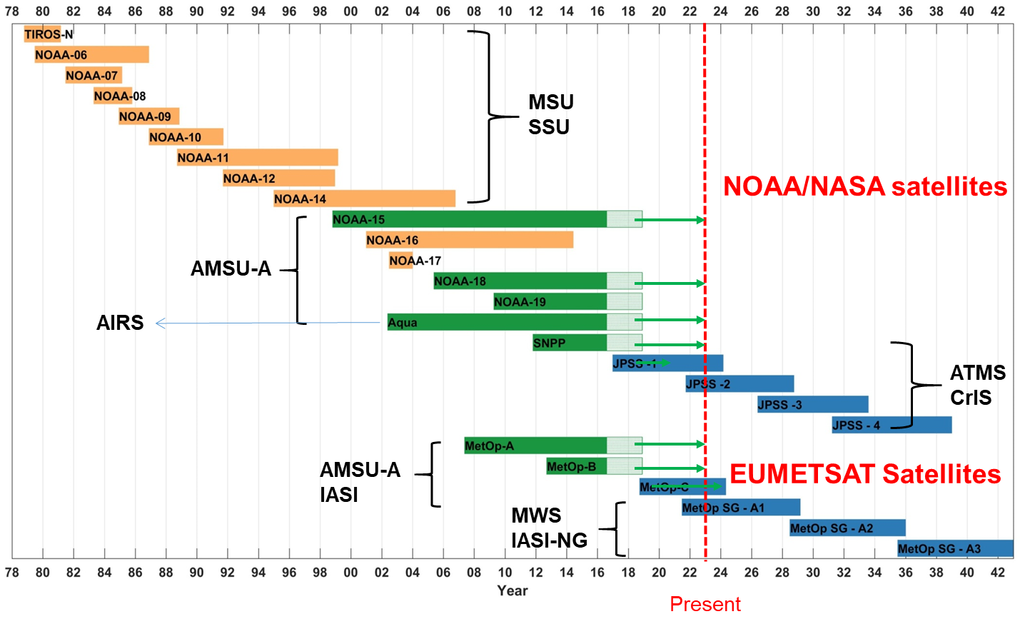
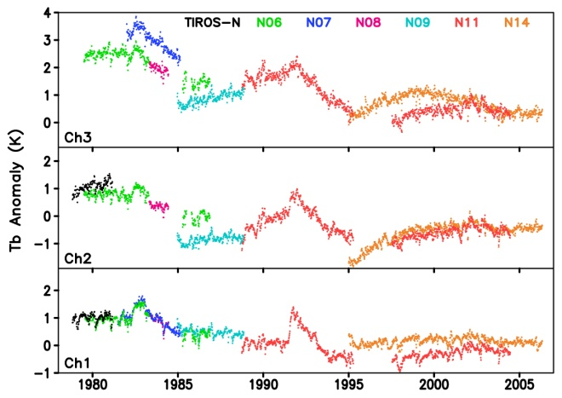
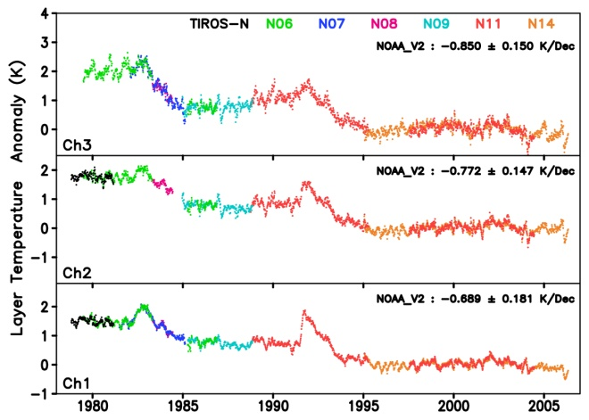
AMS’s 36th Conference on Climate Variability and Change: Poster #66
A Definitions Taxonomy for Satellite Climate Data Records and Time Series Data Sets
Jeffrey L. Privette (NOAA), Wenying Su (NASA), Jörg Schulz (EUMETSAT), Christopher J Merchant (University of Reading)
Introduction
Problem: Inconsistent and Incomplete Naming of Satellite Time Series Data Sets
Sustained and consistent space-based observations began in the 1970s with satellites from NOAA, EUMETSAT, NASA, USGS and the U.S. Department of Defense.
Climate Data Records -- consistent time series data merged from successive satellites -- are used to characterize, monitor and model the environment, conduct scientific analyses, and with industry, social or economic data to reveal relationships and develop predictive models.
Various groups have proposed definitions for these data, including the U.S. National Academies of Science, the Global Climate Observing System (GCOS), the Committee for Earth Observation Systems (CEOS), the Coordination Group for Meteorological Satellites (CGMS), as well as some research teams (e.g., Mittaz et al., 2019).
Existing terminology is inconsistent, incomplete, ad hoc or has become inadequate as remote sensing and climate science have evolved.
The Joint CEOS-CGMS Working Group on Climate (WGClimate) is developing new definitions within a self-consistent taxonomy. The draft definitions will be reviewed by other international organizations before publication.
Community adoption of the final taxonomy will facilitate more effective communication among CDR developers, producers and users.
 |  | Raw Data | Lowest Latency Time Series |  |  | Single Mission Reprocessed Time Series |  |  | Complete Period of Record Time Series
Description |  | Instrument Data | General Category | Calibrated Observations | Retrieved Geophysical Variable | General Category | Calibrated Observations | Retrieved Geophysical Variable | General Category | Calibrated Observations | Retrieved Geophysical Variable | Early estimate of CDR values using different production system
Typical Characteristics |  | Unprocessed | Low latency or NRT | NRT, calibrated radiances, brightness or antenna temperatures | NRT, geophysical | Consistent Processing | Consistent Processing | Consistent Processing | Merged multi-satellite, Homogeneous | Merged multi-satellite, Homogeneous | Merged multi-satellite, Homogeneous | Produced on CDR-like system with algorithm, inputs or ancillary data adjustments to reduce latency
Colloquial Terms |  | Raw | Operational Products | Calibrated Products | Geophysical Products | Reprocessed Data | Reprocessed Calibrated Products | Reprocessed Geophysical Products | Multi-satellite Records | Multi-satellite Records | Multi-satellite Records | -
NOAA |  | RDR | Operational Products | SDR | EDR | Reprocessed Mission Data | Reprocessed SDR | Reprocessed EDR | CDR | FCDR | TCDR | ICDR
NASA |  | Level 0 | Products | L1, L1b | L2-L4 | Reprocessed Collections | L1, L1b | L2-L4 | ESDR | L1, L1b | L2-L4 | -
Nat’l Academy |  | - | - | - | - | - | - | - | CDR | FCDR | TCDR | -
GCOS |  | - | - | - | - | - | - | - | CDR | FCDR | TCDR | -
EUMETSAT |  | Level 0 | Operational Products | L1, L1.5 | L2, EDR | Reprocessed Mission Data | FDR | Reprocessed L2 | CDR | FDR/FCDR | CDR | ICDR
Proposed here (defined below) |  | RDR | FDR | FFDR | TFDR | MDR | FMDR | TMDR | CDR | FCDR | TCDR | ICDR
Proposed: A Coherent Taxonomy of Satellite Time Series Data Set Definitions
A Forward-processed Data Record (FDR) is a time series of data, located in time and space, processed and released for the first time from a given input data set and production system. Subtypes are Fundamental (FFDR) and Thematic (TFDR).
A Mission-reprocessed Data Record (MDR) is a consistently-processed time series of data, located in time and space, produced using observations from instrument(s) on one observing platform that improves upon a previously-released version of the record. Subtypes are Fundamental (FMDR) and Thematic (TMDR).
A Climate Data Record (CDR) is a consistently-processed time series of uncertainty-quantified data, located in time and space, of sufficient length and quality to be useful for climate time-scale uses.
A Fundamental CDR (FCDR) is a consistently-processed time series of uncertainty-quantified sensor observations calibrated to physical units, located in time and space, of sufficient length and quality to be useful for climate time-scale uses.
A Thematic CDR (TCDR) is a consistently-processed time series of uncertainty-quantified values of a geophysical variable or related indicator, located in time and space, of sufficient length and quality to be useful for climate time-scale uses.
An Interim CDR (ICDR) is a consistently-processed time series of uncertainty-quantified data, located in time and space, processed with a system approximating an baselined CDR system but operating at lower latency.
Figure 1. Atmospheric sounders on NOAA operational and NASA research satellites have continuously observed upper-air temperatures with global coverage for more than 40 years, enough time to depict both short term variability and longer-term trends and patterns.
Figure 2. Zou et al. (2014) co-calibrated and re-calibrated (right, top panel) NOAA’s Stratospheric Sounding Unit (SSU) Raw Data Record (RDR) and transformed it into (right, bottom panel) consistent, intercalibrated and merged Thematic Climate Data Records (TCDRs) of Stratospheric Mean Layer Temperatures suitable for climate time-scale applications. The TCDRs were similarly merged with other sounder data, including that currently-operational CrIS and ATMS sounders on JPSS satellites, to extend the TCDRs to span more than 40 years.
December 2022

