Slide 1
GHG Task Team – Status Overview
Yasjka Meijer
Virtual for WG Climate in Tokyo
01-03-2023

Slide 2
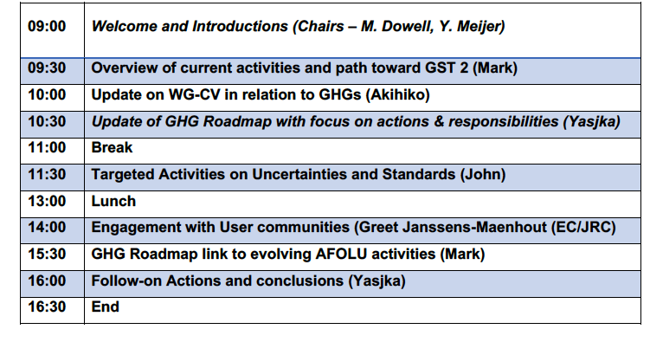

Recent GHG Task Team meeting on 02-02-’23
Following the WMO GHG Monitoring Workshop at WMO, we had a one-day hybrid meeting at WMO
In total 30 participants
Presentation & Minutes on CEOS website: https://ceos.org/meetings/wgclimate-ghg-task-team-meeting-2/

Slide 3
Update GHG Roadmap → Actions & responsibilities
Review of Roadmap, then especially Annex C
  What has been achieved?
  How did reality change?
  Where are we?
  Where do we want to go?

Slide 4
Update GHG Roadmap → Actions & responsibilities
Roadmap Annex C existing Areas
with identified lead (contributor(s):
Stakeholder Engagement (2) - Mark (John)
System Development Facilitation (5) – Richard (John, Kevin)
Operational Preparation and Training (3) – TT discuss
Sensor Development (6) – John (AC-VC) (Yasjka)
L1 & L2 GHG Product Development (9) – Ruediger & Dave
Flux Inv. Model Development (9) – Kevin (Frederic)
Calibration & Validation (7) – Hiroshi (Kuze offline)
    → Area lead and contributors
Review of Actions → Rephrase to SMART
Responsibility and what to achieve & monitor
Explicit near term TT action plus due date
Extract elements specific for other groups
Drop down: 1. action;
2. on-going & monitor*;
3. completed
Person in TT to act or to monitor
* If the status is to monitor or actions can be split in several steps, then indicate a specific Next Milestone under the “Due Date” of that activity.

Slide 5
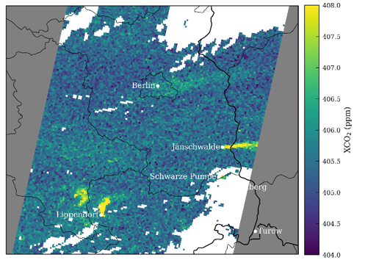

Measuring CO₂ in the atmosphere
CO₂ has roughly ~420 parts per million in air
Atmospheric lifetime is very long (long-lived trace gas)
Biogenic fluctuations are large; 5–10 ppm (unstable background)
Credits: EMPA
Sentinel-5-Precursor
NO₂
Simulated CO₂ plumes of Berlin and East German power plants.
City anomaly 1 ppm (0.25%)
Power plant anomaly 2 ppm (0.5%)
We are looking for ripples (emissions) in an ocean with large waves.
Observing the ocean is the easy part.
Detecting the ripples is a challenge, but characterizing them allowing emission quantification is the major challenge

Slide 6
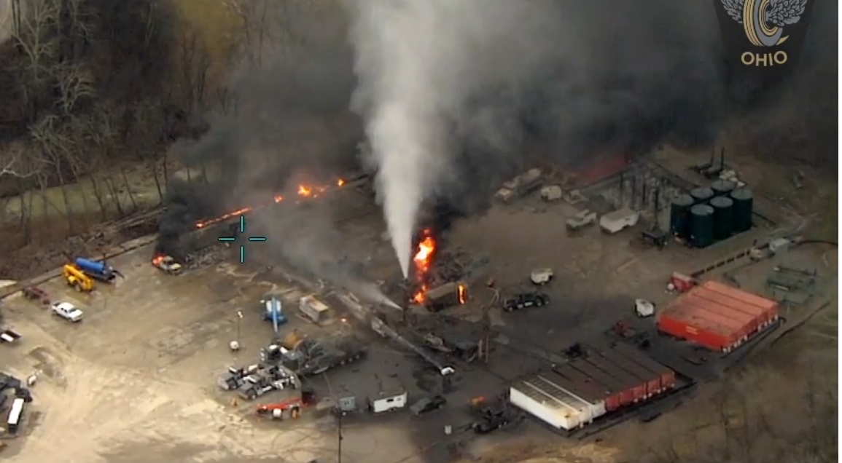
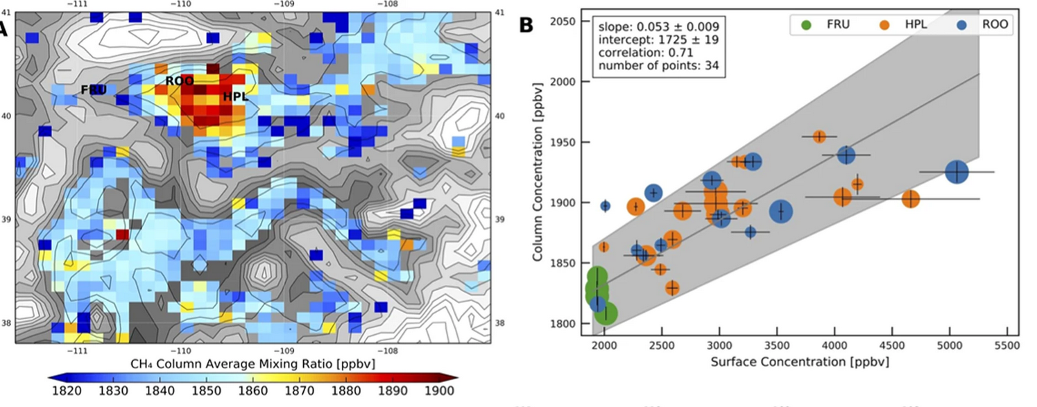
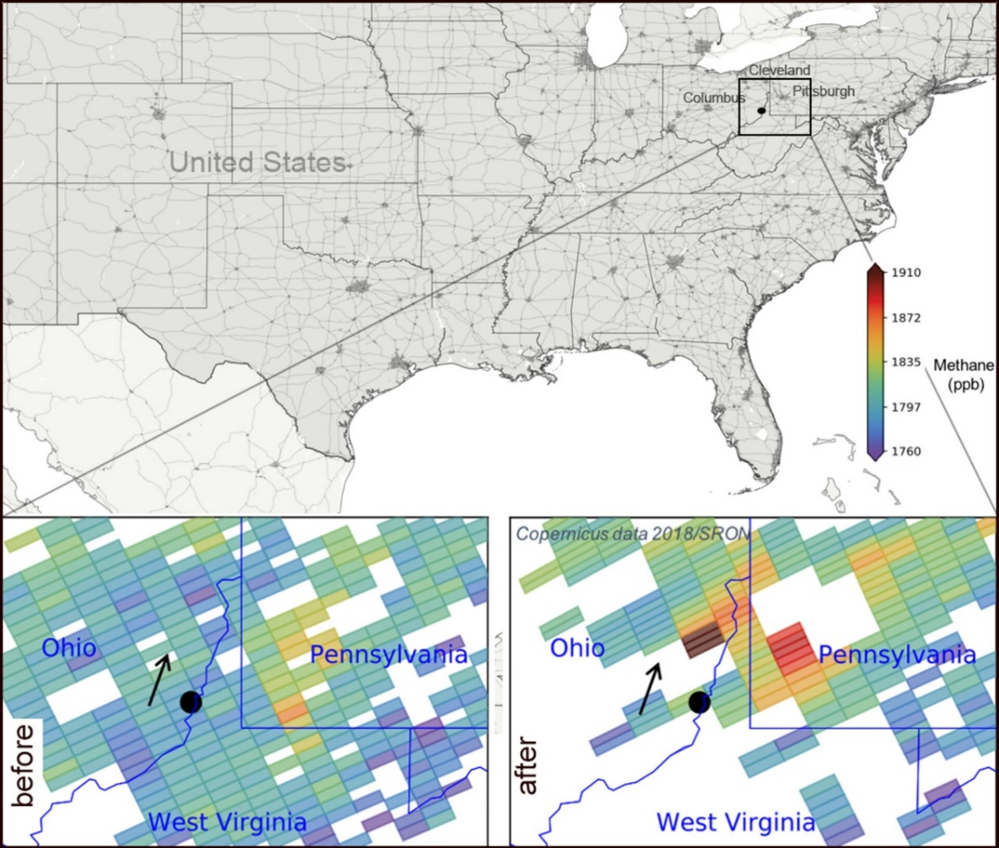
Measuring CH₄ in the atmosphere
CH₄ has ~1800 parts per billion in air.
Atmospheric lifetime around 12 years
No significant biogenic fluxes leading to a stable background.
Sentinel-5-Precursor
NO₂
Methane leaks by S-5p, in footprints of 40 km² with an anomaly up to ~90 ppb (5%)
NB smaller footprints will give higher anomalies
Courtesy: I. Aben, SRON

Slide 7
Monitoring & Verification Support (MVS) Capacity
End-to-end System requirements to monitor CO₂
Detection of emitting hot spots such as megacities or power plants
Monitoring the hot spot emissions
to assess emission reductions/increase of the activities
Assessing emission changes against local reduction targets
to monitor impacts of the NDCs
Assessing the national emissions and changes
in 5-year time steps to estimate the global stock take
Notes:
Key messages:
System has 4 main objectives, which are contrasting in terms of spatial-temporal scale and accuracy
User requirements were described in the Blue & Red CO₂ reports

Slide 8
Monitoring & Verification Support (MVS) Capacity
End-to-end System requirements to monitor CO₂
Detection of emitting hot spots such as megacities or power plants
→ high precision CO₂ data, high spatial resolution, no local biases
Monitoring the hot spot emissions
to assess emission reductions/increase of the activities
→ quantify emissions (plume info), frequent revisit
Assessing emission changes against local reduction targets
to monitor impacts of the NDCs
→ no regional biases, separate biogenic from anthropogenic fluxes
Assessing the national emissions and changes
in 5-year time steps to estimate the global stock take
→ no long-term drifts, high accuracy data, inter-calibrated
Notes:
Key messages:
System has 4 main objectives, which are contrasting in terms of spatial-temporal scale and accuracy
User requirements were described in the Blue & Red CO₂ reports

Slide 9
Overview of GHG Satellite Missions – GENERIC

Slide 10
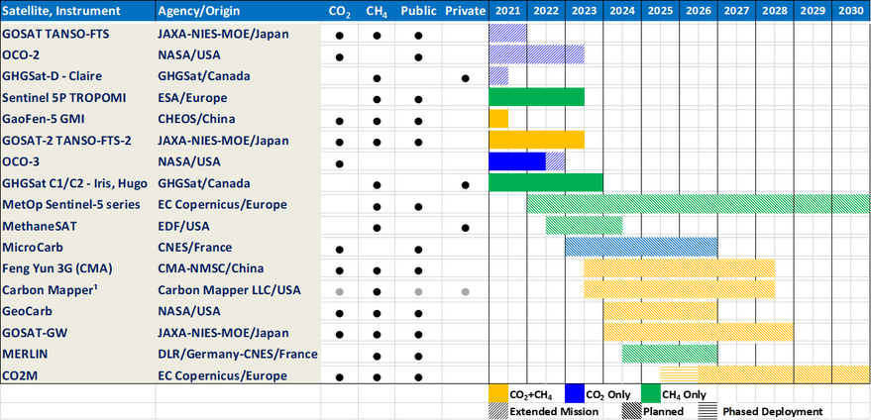
CO₂ Missions – Detection of Local Scale Emissions
At least some background compared to an enhancement should be detectable by these missions.
Not addressing frequency of observations or coverage.
DISCLAIMER: exemplary assessment & based on old overview
Not capable Capability unknown

Slide 11
CO₂ Missions – Quantification of Power Plant Emissions
At least some observations lead to quantification of (strong) sources for these missions.
Not addressing frequency of observations or coverage.
DISCLAIMER: exemplary assessment & based on old overview
Not capable Capability unknown

Slide 12
CO₂ Missions – Quantification of City Emissions
At least some observations lead to quantification of megacities for these missions.
Not addressing frequency of observations or coverage.
DISCLAIMER: exemplary assessment & based on old overview
Not capable Capability unknown

Slide 13
CO₂ Missions – Monitoring of Anthropogenic Emissions
Frequent revisit and global coverage of major sources
→ GEO orbit
DISCLAIMER: exemplary assessment & based on old overview
Not capable Capability unknown

Slide 14
Split Actions by Scale & GHG
        The (Annex C) Area Leads are tasked to thoroughly consider splitting actions, as issues, missions, etc, are not the same:
        Split along various scales (point/area vs national/regional)
        Split between CO₂ & CH₄
        Possibly also along national agencies & commercial providers

Slide 15
CEOS Work Plan & Way forward 1/2
        Next steps in GHG Task Team & new (?) actions in CEOS Work Plan (2023–2025):
        Review, revise & update Annex C GHG Roadmap (Action list)
        Reflect on the GCOS IP 2022 for GHG TT activities
        Align for GHG TT activities and converge with the AFOLU Roadmap
        (covered in CARB-20-01 & GST-2022-06, I assume)
        Reflect on role of New Space and commercial sector (plume mappers) in GHG observations from space & propose standards for New Space
        Prepare the community for the products of new upcoming satellite missions & ensure continuity to earlier/existing missions
        Generate a set of standards for uncertainty reporting of flux estimates (side mtg. @IWWGMS)
        Secure and support sustainability, quality of, and timely access to GHG ground networks in support of the CO2 MVS, such as TCCON and COCCON.

Slide 16
CEOS Work Plan & Way forward 2/2
        Reflection of GHG Task Team on exisitng actions CEOS Work Plan (2023–2025):
What is the status of CMRS-22-02 vis-a-vis the GHG TT?
Appears to me that CARB-20-02 need to remain open or will it be closed?
The CARB-21-01 can be considered closed for GHG TT
(unless UNFCCC needs our guidance,)
Seems that GST-22-02 can only be properly started once AFOLU Roadmap available and hence due date probably needs to be extended
        Closing comments:
GHG Task Team welcomes the potential WMO initiative aiming to develop a GHG Monitoring Infrastructure. Our role is likely to continue, as space expertise lies within CEOS/CGMS.
We greatly thank Mark Dowell for leading the GHG Task Team in the past period!

Slide 17
BACKUP SLIDES

Slide 18
Carbon Cycle at Various Scales
Atmospheric CO₂ and CH₄ fluxes at weekly intervals to monitor trends at regional scale
Separation of biogenic and anthropogenic fluxes at the scale of medium-sized countries
Image plumes from point sources and large cities with sufficient accuracy to estimate their emissions

Slide 19
MVS Capacity Overarching Objectives
Overarching system level objectives:
Provide input to meet all 4 objectives simultaneously
→ focus on anthropogenic component but with contrasting instrument requirements
Independent / self-standing system
→ rely as little as possible on external information, self-calibrated
Robust /mature
→ rely on mature concepts & allow to have observations under various conditions
Operational / systematic
→ no exploratory modes and build a very systematic data flow for all 4 objectives
Global coverage
→ no selection of targets and provision of systematic coverage everywhere

Slide 20
Assessing a Mission Capability
The following parameters are of consideration when assessing a greenhouse gas satellite mission
Geometric: spatial resolution, spatial sampling, swath width, geolocation knowledge
Spectral: resolution, sampling, bandwidth, ISRF knowledge
Radiometric: SNR, reference scenario, absolute radiometric accuracy
Product requirements: (targeted) precision, systematic bias, CO₂ and/or CH₄, proxy, need for bias correction
Coverage: LEO or GEO, continuous/target, ocean/land, number of obs. per orbit, timeliness
Mission objective: biogenic and/or anthropogenic, operational/exploratory,
Support observations: aerosol, clouds, NO₂, H₂O, solar-induced fluorescence
Further the (among others) the following instrument aspects:
Treatment of polarization
Treatment of heterogeneous scenes
Straylight and possibly required corrections
Radiometric calibration

