Slide 1
Update from Working Group
CLIMATE
CHANGE
CEOS – CGMS WGClimate-18
29 February 2023
Sara Venturini, Climate Coordinator at GEO Secretariat

Slide 2
GEO CC-WG Subgroups

Slide 3
Climate focus at GEO Week 2022
2 Plenary sessions on climate: “Future proofing National Adaptation Plans” and “Collective action on Oceans, Climate and Biodiversity” -----> Launch of new GEO Supplementary NAP Guidance
Side events on climate: Oceans, and Mountains and Polar Regions
Informal meeting of the CC-WG jointly with DRR-WG and CD-WG

Slide 4
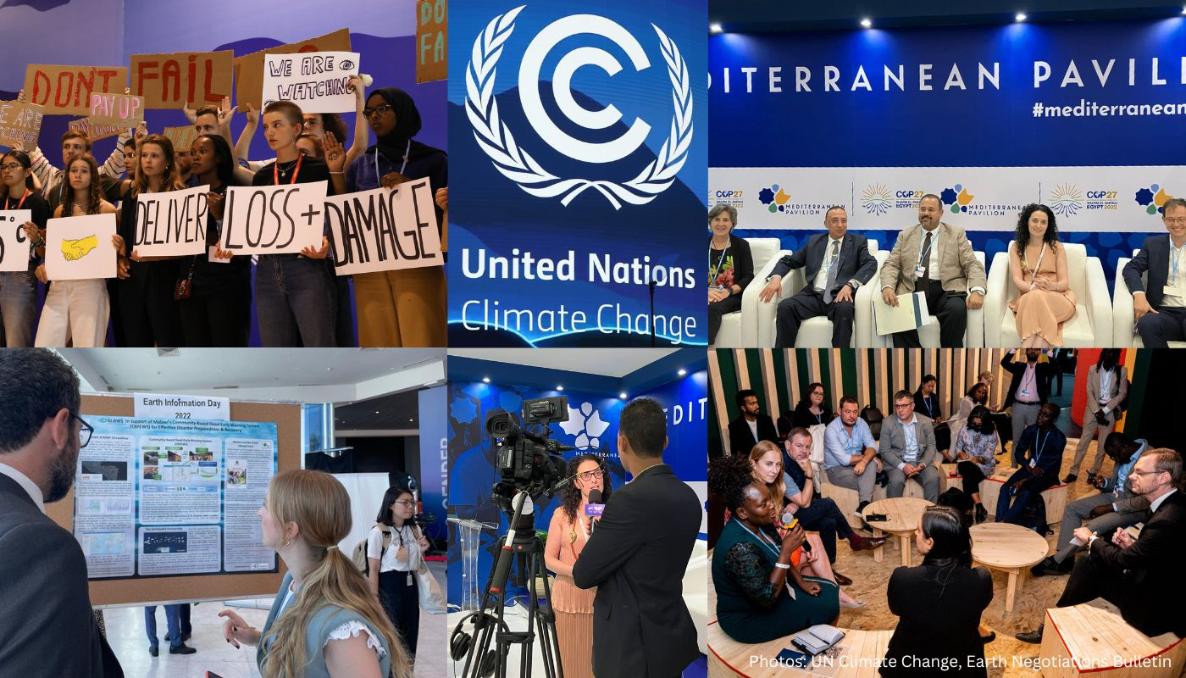
GEO's participation in COP27
GEO COP annual briefing:
submitted to GEO principals, UNFCCC delegates in October 2022
Advocates for "action-oriented framework" and "global goal on observations"
Side events and bilateral meetings around the themes of early warning, adaptation and nature-based solutions
Participated in NAP Technical Working Group
Participated in Earth Information Day 2022 under Research and Systematic Observation negotiations
Blog post: https://www.earthobservations.org/geo_blog_obs.php?id=588
Notes:
GEO initiatives: GEOGLAM, GEOGloWS, GEO Blue Planet with focus on early warning systems and adaptation
GEO partners: WMO, CEOS, GCOS, GOOS…
Final outcome is a COP decision on RSO that welcomes efforts to achieve a sustained and fit-for-purpose global climate observing system, as well as related essential climate variables requirements, and encourages Parties and relevant organizations to work on implementation. Also it recognizes the need to enhance the coordination of activities by the systematic observation community and improve its ability to provide useful and actionable climate information for mitigation, adaptation and early warning systems, as well as information to enable understanding of adaptation limits and of attribution of extreme events.
Language retained and elevated in COP cover decision.
Not a fully satisfactory outcome for GEO, more entry points to be sought

Slide 5
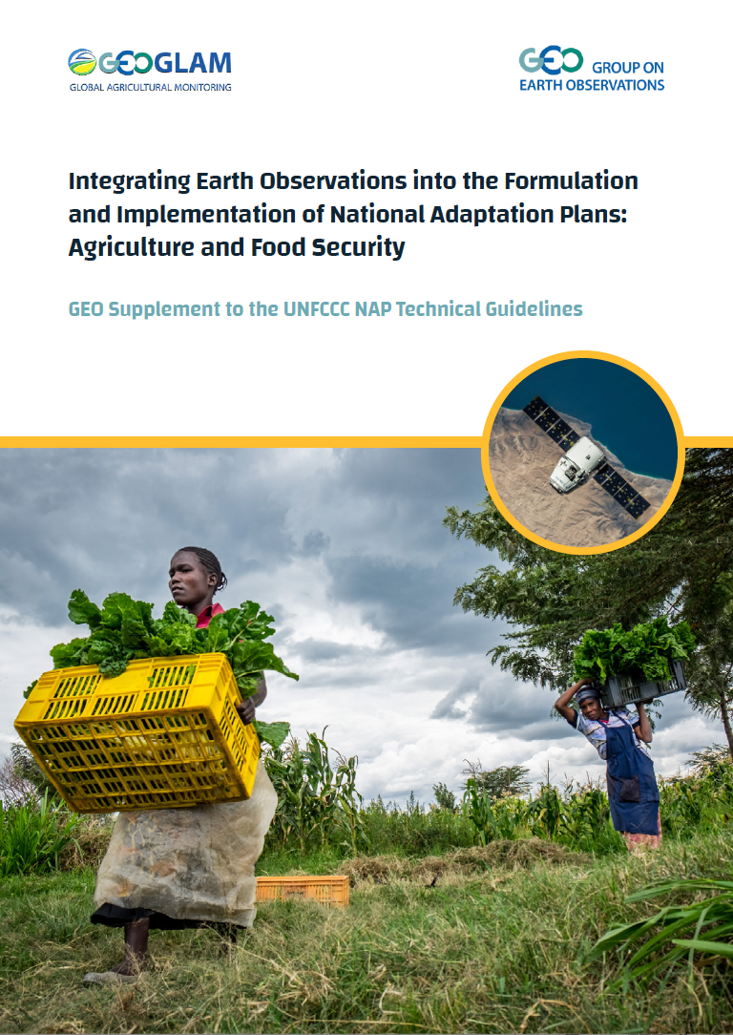
Launch of the GEO NAP Guidance
NAP Expo 2022 – multiple sessions in August 2022, Gaborone, Botswana
GEO Week 2022 - GEO Plenary session “Future-proofing National Adaptation Plans” in November 2022, Accra, Ghana
COP27 - Earth Information Day 2022 with GEOGLAM poster in November 2022, Sharm El-Sheikh, Egypt
→ GEO NAP guidance submitted to NAP Central (the main landing page on NAPs)
Download:
https://earthobservations.org/documents/cc_wg/GEO_NAP_Supplement_final.pdf

Slide 6
GEO Climate Change WG deliverables in 2023
Publication of Info note on mitigation
February – October
Report and launch event
Participation in GEO Week 2023
Climate sessions / events (tbd)
6-10 November, Cape Town
Participation in UNFCCC COP28
Earth Information Day
COP briefing
Side events (tbc)
30 November – 12 December, Dubai
Contribution to WMO State of Climate Services report /Health
GEO blog post
March 2023
Participation in UNFCCC SB
SB session, side events (tbd)
5-15 June, Bonn
Dissemination of GEO NAP guidance
NAP Expo 2023
27-30 March, Santiago
Participation in GEO Symposium 2023
Side events (tbd)
14-15 June, Geneva
Notes:
Renew: UNFCCC, NAP guidance
Drop: IPCC, Regional webinars?
New topics: Loss and Damage, Finance, country engagement via NAP, GHG monitoring via WMO
Publication of the Info note on Mitigation reporting requirements under the UNFCCC –> professional design and publication on GEO website
Dissemination of GEO NAP guidance to countries (GEOGLAM) and new guidance to be developed (GEOGloWS, GEO Blue Planet) ---> participation in NAP Expo 2023, 27-30 March 2023, Santiago de Chile
Participation in UNFCCC Subsidiary Bodies session on 5-15 June
Contribution to WMO Status of Climate Services Report 2023, with focus on Health
TO BE DISCUSSED:
Organisation of stakeholder workshop on EO and reporting requirements, as side event during GEO Symposium 13-14 June 2023?
Preparation of GEO response of EO gaps in IPCC reports? (still relevant?)
Participation of GEO in the new Global GHG Monitoring Infrastructure? (emerging deliverable)

Slide 7
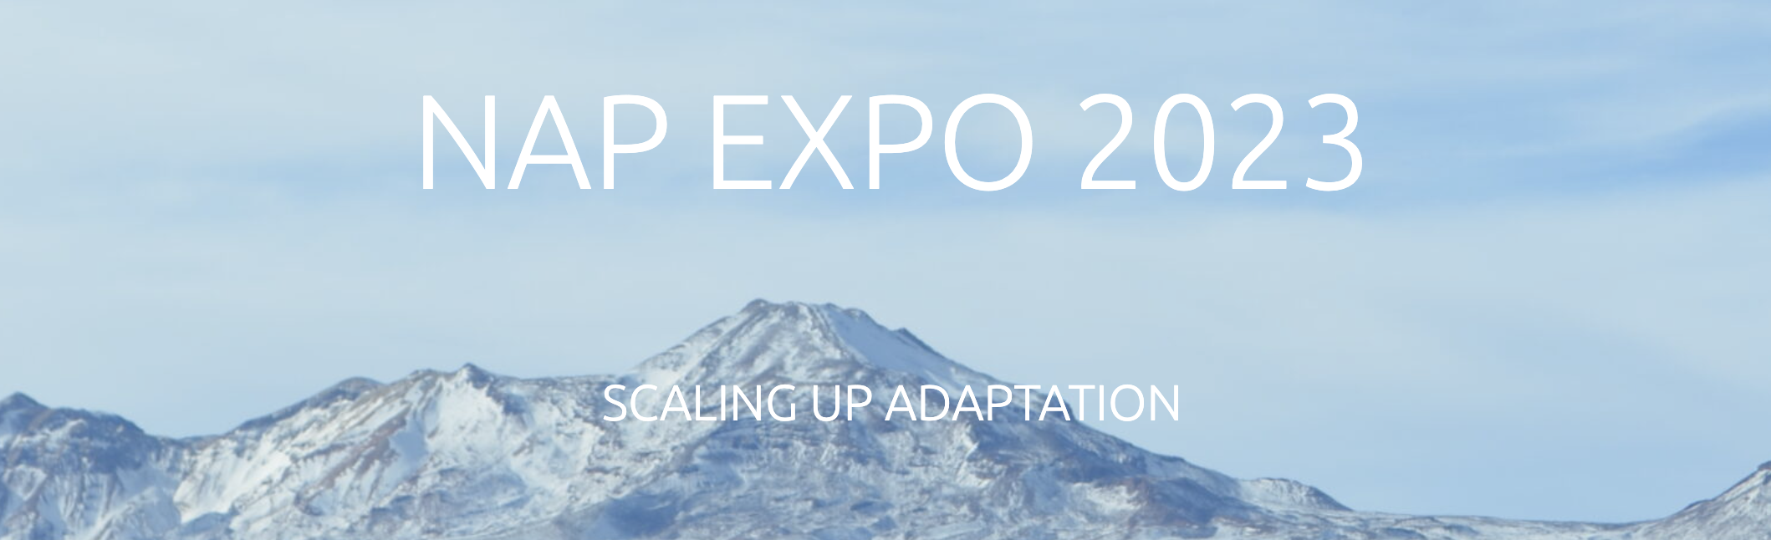
Upcoming work on Adaptation
UNFCCC NAP Expo 2023, 27-30 March, Santiago – Chile
Dissemination of GEO NAP guidance
3 GEO sessions on use of EO for adaptation in agriculture, coastal zones, and LAC region, including space-based activities
Opportunities to work with countries to scale up EO activities – CEOS to support?
Development of supplementary guidelines on using EO for adaptation
coastal zones
water management
Continued engagement with NAP Technical Working Group under the UNFCCC
Entry point for GEO in UNFCCC negotiations other than RSO

Slide 8
Upcoming work on Mitigation
Information note “EO in support of National GHG inventories: requirements, opportunities, and challenges”
Developed by Lucia Perugini CC-WG Co-chair, including CEOS members’ contribution
Finalised, to be published on GEO website
Collaboration with IRENA
Interest in getting GEO support for Global Atlas on Renewable Energy, and energy transition efforts of Small Island Developing States (SIDS) with data and monitoring (tbd)
Collaboration with UNEP - International Methane Emissions Observatory (IMEO)
Interest in user uptake activities of new initiative Methane Alert and Response System (MARS), capacity building, distribution within GEO network (tbd)

Slide 9
Preparations for COP28
Early engagement with COP28 Presidency
GEO participated in Abu Dhabi Space Debate in December 2022 and World Government Summit 2023 in February 2023 in UAE and connected with UAE Space Agency and COP28 Presidency High Level Champion
GEO to submit proposal to UAESA on EO Task Force to coordinate EO activities at COP28, including Space Pavilion – CEOS to support proposal?
Input to Global Stocktake
GEO Sec contributing text and user stories to CEOS Handbook (to be finalised by Nov 2023)
Possible side event on EO input to GST at SB June session and COP28 in December – CEOS via ESA to lead side event submission?

Slide 10
Collaboration with WMO
WMO – GCF Regional Training Workshop, 19-23 June - Indonesia
Need GEO speaker on satellite information to fill data gaps for climate science information for Green Climate Fund project proposals – CEOS representative to join?
Contribution to State of Climate Services Report - Health
Case studies from NASA (cholera risk monitoring), e-shape (EarlY WArning System for Mosquito-borne Diseases (EYWA), EXTREMA Global (GUOI)
Horizon Europe funding to improve collaboration between WMO, IPCC, GCOS and GEO
Open call for proposal to develop joint action plan on climate observations (2M EUR): proposal to be submitted at the end of March
Early Warning for All Initiative
GEO contributing to disaster risk knowledge, observations and forecasting
Global GHG Monitoring Infrastructure
This requires involvement of examples of user programmes on AFOLU (e.g. GEOGLAM, GFOI) and marine observations (e.g. MBON, Blue Planet) showing practical involvement of GEO community (not just GEO Sec)

Slide 11
Upcoming GEO events
GEO Symposium, 13-14 June, Geneva - Switzerland
Opportunities for GEO partners to showcase work – any interest by CEOS members?
Thematic sessions on:
Biodiversity and Nature
Urban Resilience for Heat and Health
Multi-Hazard Risks and Impact via the GEO Work Programme
Operational services via the GEO Work Programme
Flash talks on:
Enablers for scaling the impact of the GEO Work Programme
Mobilizing resources for the GEO Work Programme
Open Data and Open Knowledge Workshop, 15-16 June, Geneva – Switzerland
Includes discussions on EO data gaps (VHR Space-based EO Data, in situ, statistical data) and needs
GEO Week and Ministerial, 6-10 November, Cape Town – South Africa
Plenary sessions on climate (tbd)
Opportunities for GEO partners to showcase work (tbd)
Ministerial Declaration and adoption of GEO post-2025 strategy – CEOS members are part of the post-2025 WG
Notes:
GEO Symposium 2023
The following topics (exact titles to be defined) for the thematic sessions:
• Biodiversity and Nature: In this session, GEO’s efforts to create the world’s first Global Ecosystem Atlas will be examined, via the showcase of a few illustrative applications. The Global Ecosystem Atlas is a GEO post-2025 incubator.
• Urban Resilience for Heat and Health: The session will describe GEO plans to develop an integrated heat and health service built upon state-of-the-art Earth observations for urban resilience against climate change. This service is a GEO post-2025 incubator.
• Multi-Hazard Risks and Impact via the GEO Work Programme: Through this session, the GEO Work Programme activities focused on systemic risks will discuss how, why and where GEO is best positioned to deliver impact for countries and local communities.
• Operational services via the GEO Work Programme: The objective of this session will be to unpack the key characteristics of effective operational service from the perspective of users and partners and identify challenges and opportunities for the GEO Work Programme activities to become more operational and focused.
The flash talks will be on the two topics below:
• Enablers for scaling the impact of the GEO Work Programme; and
• Mobilizing resources for the GEO Work Programme.

