Slide 1
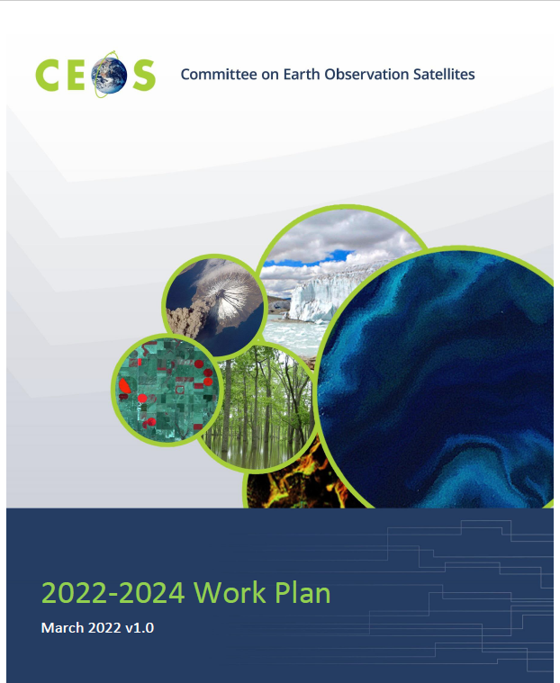
CEOS 2023-2025 Work Plan
CEOS Executive Officer coordinates annual updates
  CEOS/SIT Chairs, VCs, WGs, AHGs, TTs, offices provide sections
    Defines major activities and deliverables
  Presented to SIT for approval in March
    Draft v1 currently out for review

Slide 2
WGClimate Work Plan Elements
During 2023, WGClimate will:
• Update and exploit the comprehensive Essential Climate Variable (ECV) Inventory of Climate Data Records (CDRs) and implement actions arising from Gap Analysis.
• Complete the Version 4 Gap Analysis Report, and deliver it to the Agriculture, Forestry and Other Land Uses (AFOLU) Team, GHG Task Team, and CEOS Oceans
• Examine the Inventory to identify issues in the future availability of measurements for ECVs as described in the 2022 GCOS Implementation Plan. As issues are found, WGClimate will initiate mitigation actions by improving coordination on long-term mission planning.
• Coordinate CEOS and CGMS activities towards the definition and implementation of an integrated operational global carbon observing system, and coordinate progress on and provide updates to tasks in the Greenhouse Gas Roadmap (v2.4) Annex, including partnering with UNFCCC/SBSTA.
• Continue the activity on demonstration of use cases for climate data records
• Complete a CDR Definitions manuscript, conduct review with peer organizations (e.g., GCOS, WGCV), and submit for publication.
• Develop and provide the Space Agency Response to the 2022 GCOS Implementation Plan.
• Provide oversight to continuing implementation of GHG monitoring activities (2018 Coordinated Action Plan: Actions 11 (coordinate CO2 CDRs); 13 (plan for stratospheric CH4 profiles); and 14 (coordinate CH4 CDRs).

Slide 3
WGClimate Work Plan Elements
During 2023, WGClimate will:
• Update and exploit the comprehensive Essential Climate Variable (ECV) Inventory of Climate Data Records (CDRs) and implement actions arising from Gap Analysis.
• Complete the Version 4 Gap Analysis Report, and deliver it to the Agriculture, Forestry and Other Land Uses (AFOLU) Team, GHG Task Team, and CEOS Oceans
• Examine the Inventory to identify issues in the future availability of measurements for ECVs as described in the 2022 GCOS Implementation Plan. As issues are found, WGClimate will initiate mitigation actions by improving coordination on long-term mission planning.
• Coordinate CEOS and CGMS activities towards the definition and implementation of an integrated operational global carbon observing system, and coordinate progress on and provide updates to tasks in the Greenhouse Gas Roadmap (v2.4) Annex, including partnering with UNFCCC/SBSTA.
• Continue the activity on demonstration of use cases for climate data records
• Complete a CDR Definitions manuscript, conduct review with peer organizations (e.g., GCOS, WGCV), and submit for publication.
• Develop and provide the Space Agency Response to the 2022 GCOS Implementation Plan.
• Provide oversight to continuing implementation of GHG monitoring activities (2018 Coordinated Action Plan: Actions 11 (coordinate CO2 CDRs); 13 (plan for stratospheric CH4 profiles); and 14 (coordinate CH4 CDRs).
• Proposed: Update WGClimate’s Coordinated Action Plan

Slide 4
WGClimate Work Plan Elements
During 2023, WGClimate will:
• Update and exploit the comprehensive Essential Climate Variable (ECV) Inventory of Climate Data Records (CDRs) and implement actions arising from Gap Analysis.
• Complete the Version 4 Gap Analysis Report, and deliver it to the Agriculture, Forestry and Other Land Uses (AFOLU) Team, GHG Task Team, and CEOS Oceans
• Examine the Inventory to identify issues in the future availability of measurements for ECVs as described in the 2022 GCOS Implementation Plan. As issues are found, WGClimate will initiate mitigation actions by improving coordination on long-term mission planning.
• Coordinate CEOS and CGMS activities towards the definition and implementation of an integrated operational global carbon observing system, and coordinate progress on and provide updates to tasks in the Greenhouse Gas Roadmap (v2.4) Annex, including partnering with UNFCCC/SBSTA.
• Continue the activity on demonstration of use cases for climate data records
• Complete a CDR Definitions manuscript, conduct review with peer organizations (e.g., GCOS, WGCV), and submit for publication.
• Develop and provide the Space Agency Response to the 2022 GCOS Implementation Plan.
• Provide oversight to continuing implementation of GHG monitoring activities (2018 Coordinated Action Plan: Actions 11 (coordinate CO2 CDRs); 13 (plan for stratospheric CH4 profiles); and 14 (coordinate CH4 CDRs).
• Proposed: Update WGClimate’s Coordinated Action Plan
For 2024-2025, significant outputs will be:
• Updated versions of the ECV Inventory, Gap Analysis Report and Coordinated Action Plan.
• Continue enhanced engagement with UNFCCC/SBSTA to better facilitate CEOS contributions beyond atmospheric CO2 monitoring, including AFOLU.
• The publication of use cases on the ECV inventory web portal

Slide 5
WGC’s Open CEOS Deliverables
number | completion_date | title | description
CMRS-19-04 | 9/30/2026 | Provide oversight to the implementation of the greenhouse gas monitoring activities (Coordinated Actions 11;13;and 14). | Three tasks: 1. Establish a roadmap for the development of a GHG monitoring system, 2. Deliver first data from a prototype GHG monitoring system to the Global Stocktake 2023 and engage users with it, 3. Develop the initial operational GHG monitoring system
CMRS-19-05 | 6/30/2023 | Document new/updated definitions for FCDR;CDR;ICDR (2018 Coordinated Action Plan: Action 1) | Update defininitions for Fundamental Climate Data Records;Climate Data Records for GCOS ECVs and Interim Climate Data Records for both typs of data records.
CMRS-19-06 | 6/30/2024 | Provide cost-benefit recommendations and path forward of Coordinated Actions 5 (establish FCDR Inventory) and 10 (international CDR metadata standards) | Assess value on technical upgrade to ECV Inventory for Level 1 base data records (FCDRs) and on working with CEOS agencies on documenting CDR meta data standards
CMRS-22-02 | 9/30/2023 | Provide condensed feedback from the Gap Analysis to the GHG task team and AFOLU allowing refinement of their work plan | A dedicated excerpt shall be condensed to support GHG task team&nbsp;and AFOLU in updating their roadmap/work plan. The excerpt shall be genrated in close cooperation with both teams.
CMRS-22-03 | 9/30/2023 | Provide condensed feedback from the Gap Analysis in support of the Ocean community within CEOS in support of the CEOS GST Strategy | A dedicated excerpt shall be condensed to support the CEOS Ocean tasks reletd to GST in close cooperation with the stakeholders of other CEOS entities.

Slide 6
WGC’s New CEOS Deliverables
Title | Completion Date | Description
Provide COP-27 SBSTA Statement for CEOS Chair Delegation | 9/30/2023 | Annual deliverable
Provide COP-28 SBSTA Statement for CEOS Chair Delegation | 9/30/2024 | Annual deliverable
Provide COP-29 SBSTA Statement for CEOS Chair Delegation | 9/30/2025 | Annual deliverable
Provide Agency Response to GCOP IP | 11/13/2023 | Status updates and comments focused on Space Supplement

Slide 7
Definitions Work
Presented poster at AMS in Denver in January
Led to some additional changes in definitions and inputs
Not many visitors to the poster, but those that visited were very engaged and supportive
  Some research teams had run into same problem
One issue raised by Joerg and also by visitors:
  Use of “CDRs” to denote both the general category and thematic CDRs
Request: converge on the definitions here/now so only need to finish manuscript

Slide 8
Thank You

