Slide 1
Space for Climate Observatory
CEOS WG Climate
F. Bretar

Slide 2
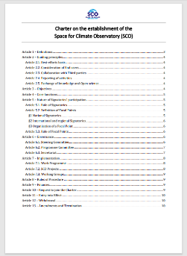
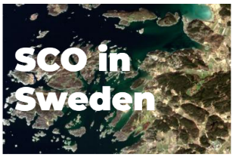
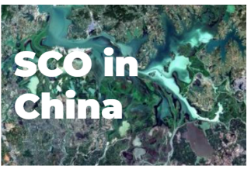
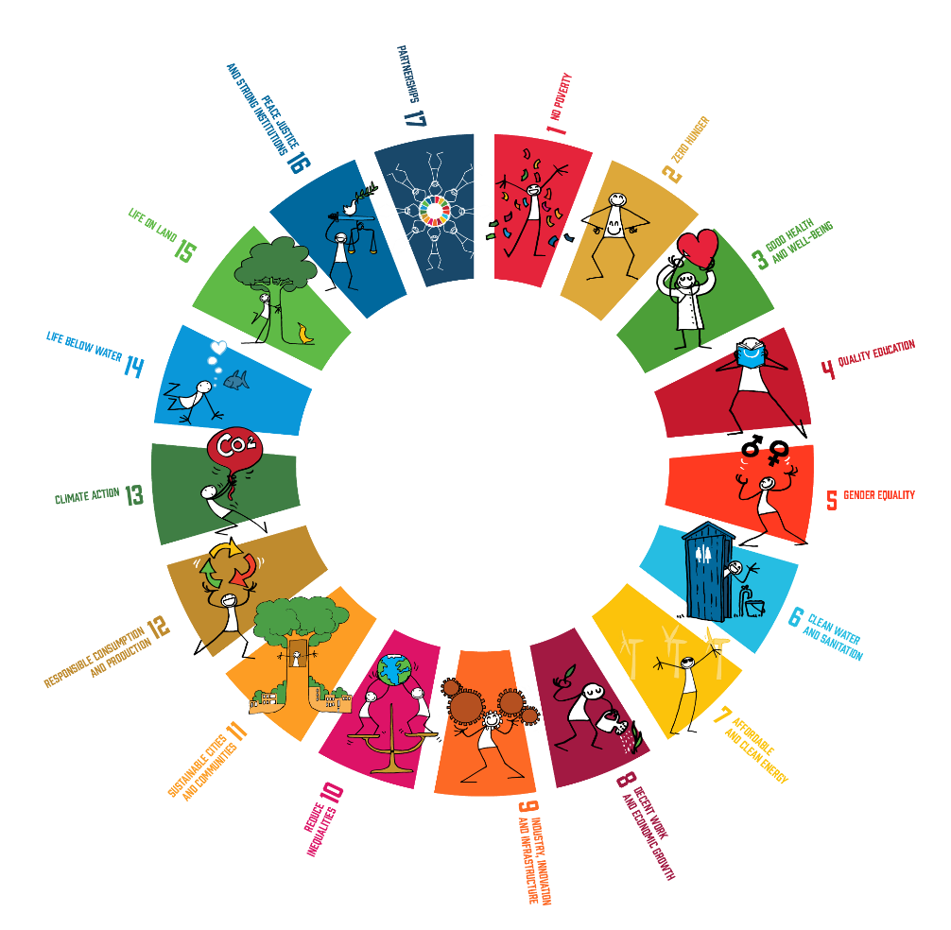
I. THE SCO INTERNATIONAL ALLIANCE
35 SIGNATORIES
Charter on the establishment of the SCO
entry into force on 1st Sept. 2022
SCO LOCAL IMPLEMENTATIONS
SCO international network
SCO INTERNATIONAL OBJECTIVES
Provide operational tools (SCO projects) and studies to help decision-makers to adapt to climate change.
Foster cooperation around these applications to favour their reuse and communicate on them
Build a network for space agencies and public and private entities involved in the use of EO data for operational climate action
Notes:
The creation of the SCO international initiative on best effort-basis dates back to 2017 within the framework of the One Planet Summit by the French Republic President, Emmanuel MACRON, but it was not officially launched until June 2019 when thirty-six space agencies and international organisations signed a declaration of interest. In the continuity, SCO members worked together under the coordination of UNOOSA to clearly define the nature of SCO and formalize its governance through the Charter on the establishment of the Space for Climate Observatory, which entered into force on 1st September 2022.
During its first three years of existence, the SCO progressively expanded: new space agencies joined the initiative, currently 34 members and the organisation of multiple annual calls for projects resulted in the emergence of about sixty SCO Projects.
In order to make the best use of satellite data and digital technologies for climate action, the SCO aims at coordinating international efforts, while gathering public and private entities involved in Earth Observation (EO) sector, to support the emergence of operational tools for climate monitoring, mitigation and adaptation addressed to decision-makers and the wide public.
SCO members are the Signatories of the Charter on the establishment of the Space for Climate Observatory. Furthermore, in every country, a single public entity assumes the role of Focal Point, responsible for the organisation of SCO activities at the national level. Therefore, the space agencies that have signed the SCO Charter are responsible for coordinating with national institutions whose missions are related to climate issues, promoting cooperation between partners to establish national SCOs, and structuring the link with public authorities managing local territories. Consequently, SCO members work toward the creation of several national SCO implementations: such as SCO Sweden, SCO Gabon, SCO China or SCO France.
SCO France for instance : As the SCO initiative was born in June 2019 at the instigation of France, the French Space Agency CNES (Centre National d’Études spatiales) was immediately entrusted with the implementation of the SCO in France. This national implementation aims at rallying the creation of other SCOs in other countries, and has therefore created a general model – in terms of global structuring, organization and animation – to be shared with other Signatories.

Slide 3
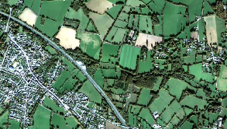
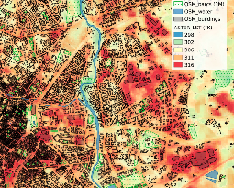
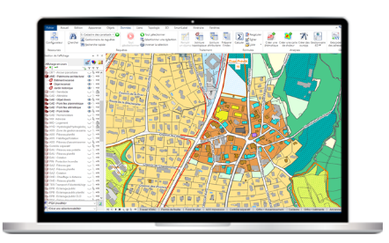
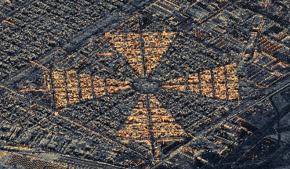
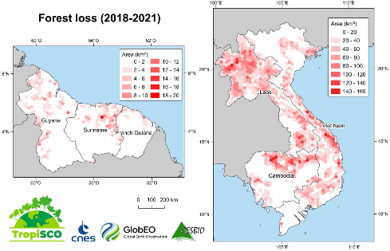
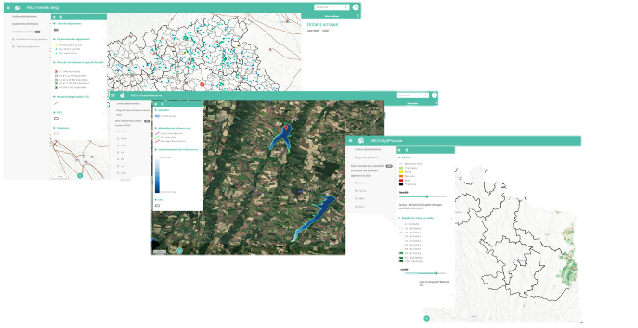
A use case approach
Users
Labs
Service Provider/
Company
SCO PROJECT
Operational Climate Service/Prototype
With High Techno/scientific content
Operational in 2 years
Satellite Data
In Situ Data
SCO PROJECTS CRITERIA
Addressing the needs of end users within a specific geographic area;
Proposing operational and practical software(s);
Making the best use of available satellite, environmental, climate, in situ and socio-economic data, at a resolution adapted to the problem;
Building on (pre-)operational and research infrastructures, services and local data provision;
Having a built-in potential for extending to several geographic areas.
8
Notes:
The SCO supports the development of operational tools addressed to decision-makers and the wider audience, to fully leverage the potential of satellite data together with socio-economic data in helping towards climate monitoring, mitigation and adaptation at the local scale. These tools must be co-designed with their end-users to answer specific needs, and should be easily modified to be adapted to other geographic areas facing similar climate stakes.
In addition to these projects, the SCO also aims at enhancing international coordination around operational applications based on space technologies for climate, highlighting such tools and acting as an international forum to discuss and advocate for these solutions.
SCO Projects designate satellite-based applications for climate change monitoring, mitigation and adaptation supported by SCO Signatories and meeting the following criteria:
C1. Addressing the needs of end users within a specific geographic area;
C2. Proposing operational and practical software(s);
C3. Making the best use of available satellite, environmental, climate, in situ and socio-economic data, at a resolution adapted to the problem;
C4. Building on (pre-)operational and research infrastructures, services and local data provision;
C5. Having a built-in potential for extending to several geographic areas.

Slide 4
SCO GOVERNANCE OVERVIEW ON BEST-EFFORT BASIS (ART.6 of the CHARTER)
Steering Committee
Decision-making body
Programme Committee
overseeing the implementation of the SCO activities
Secretariat
Support SCO subsidiary bodies
Working Groups
consultative bodies
Mandate
Nomination of the Programme Committee;
Approval of the Work Programme (SCO projects-related activities);
Approval of Working Groups establishment;
Examination of requests to join the Charter
Mandate
Drafting the Work Programme
Ensuring that SCO Projects match the required criteria
Monitoring the work achieved within dedicated Working Groups
Monitoring the progress of SCO Projects and Working Groups activities towards the achievement of the objectives of the SCO defined in Art.3 Charter).
Mandate
Supporting and coordinating activities to facilitate the implementation of the Steering Committee decisions;
Providing substantive secretariat services to the meetings of all subsidiary bodies;
Gathering, compiling and publishing information related to the SCO activities and the progress made by every Signatories;
Handling the overall communication of the SCO and its website;
Enabling international cooperation and collaboration by being the entry point for any inquiries related to the SCO.
Mandate
explore, discuss and/or provide recommendations on how to address specific themes relevant to the SCO objectives.
Functionning
All Signatories can take part in the activities of the Working Groups.
Requests to form a Working Group are notified to the Secretariat and are examined by the Steering Committee. Their approval requires a two-thirds majority.
The activities of the Working Groups can be supported by Third parties upon invitation of Focal Points.
Functionning
Holds ordinary meetings 2/year + extraordinary meetings (remotely or physically during IAC for instance).
Vote : 2/3 majority
Functionning
In construction : a pre-figured Programme Committee is established for 2023 and will be voted by the Steering Committee.
Holds ordinary monthly meetings 4x/year
Composition
Focal points: “Focal Points act as intermediaries for the implementation of SCO activities. This role is assumed by Signatories of public nature whether the Signatory is attached to a country, or is an international or regional organization” Art.5.2 of the Charter.
Functionning
The Secretariat is under the responsibility of one Signatory, who provides it as an in-kind contribution
To ensure an efficient launch of SCO activities under this Charter, and given its role as initiator of the Joint Declaration for a Space Climate Observatory, it is proposed that the Secretariat be first provided by CNES.
Focus on Sharing Knowledge and expertise :
Experts developing an operational tool on a specific topic (ex: mangroves).
Public local actors sharing problematics and needs on a spefic geographical areas.
Composition
Restricted number of Focal points depending on the total number of Signatories.
Nominations take place on a rotating basis, ensuring fair geographical representation
The composition of the Programme Committee is approved by a two-thirds majority decision of the Focal Points in the Steering Committee.
Notes:
Costs incurred by the functioning of the Secretariat include, but are not limited to, human resources costs related to (i) technical secretariat services for the meetings of all subsidiary bodies, (ii) the coordination of activities aimed at facilitating the implementation of the the Steering Committee decisions, (iii) the support of the Working Groups and their meetings as much as possible, (iv) the management of the SCO global communication and its website (https://www.spaceclimateobservatory.org/), (v) SCO-related inquiries management as entry SCO point of contact for all, (vi) the international network animation services, (vii) the management and archiving of SCO legal documentation.

Slide 5
Notes:
Illustration of SCO international operational tools around the world to help decision-makers to adapt to climate change.

Slide 6
SCO Projects
Valorisation of research
Open source
Service development /
Tech transfert –
Acces to commercial data with fees
Output
3
11
Notes:
SCO projects integrate the SCO community and intend to contribute to its enrichment for the benefit of all.
These benefits are identified as:
Science Value : generating new knowledge and enhance research infrastructures, especially European ones, when possible. In this sense, the scientific community provides concrete solutions based on the analysis and modeling of available data, satellite and other sources of data which are valued through SCO projects. In deed, these projects aims to rely on research and available database such as Data Terra, Copernicus, DIAS, Geoportal, existing GIS platforms...) as well as operational services (Copernicus etc.).
Service development : Enhancing and combining local authorities knowledge of the territory with territorial engineering technical expertise and private companies operational capacity in SCO projects.
Service development and technology transfert : Enable the duplication/adaptation of tools on several territories (scaling up) by disseminating methods, tools and results to many actors as possible. The data sharing guidelines of SCO projects aims to promote the use of open-source data and open-source tools and move towards an open final tool to stimulate international expertise in monitoring, mitigation and adaptation to climate change impacts.

Slide 7
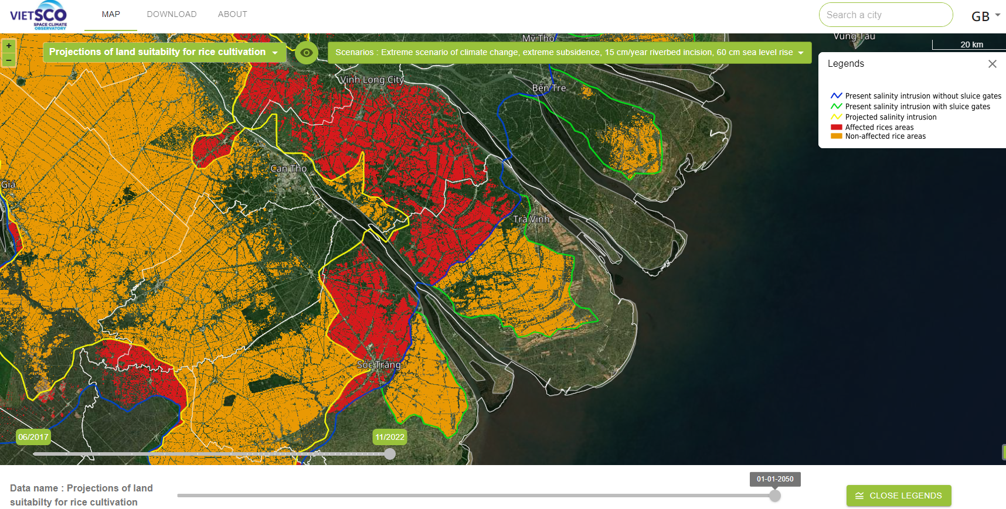
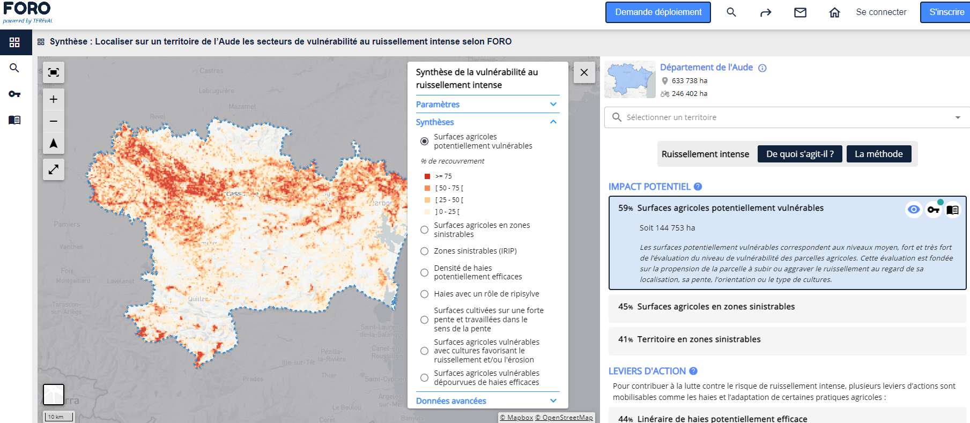
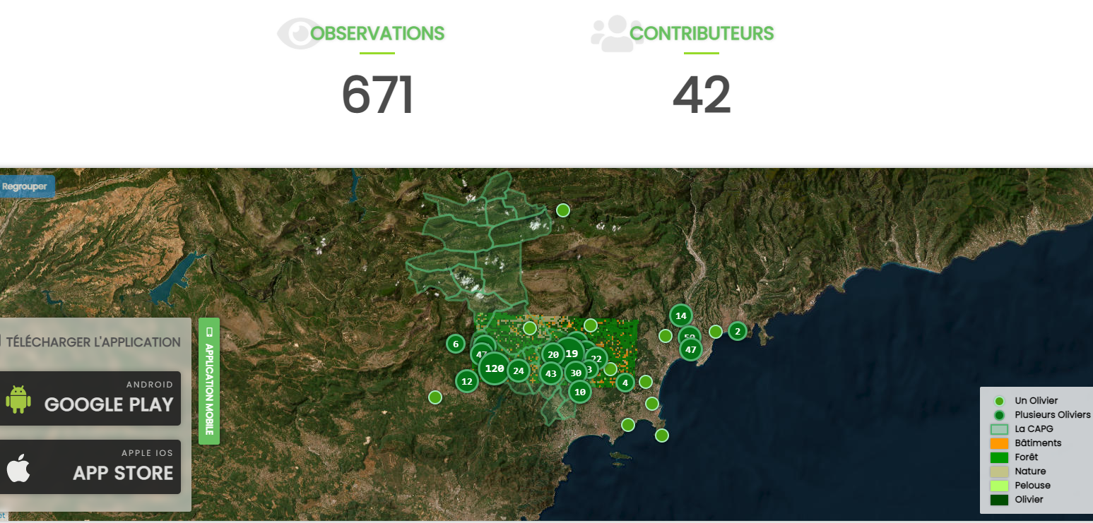
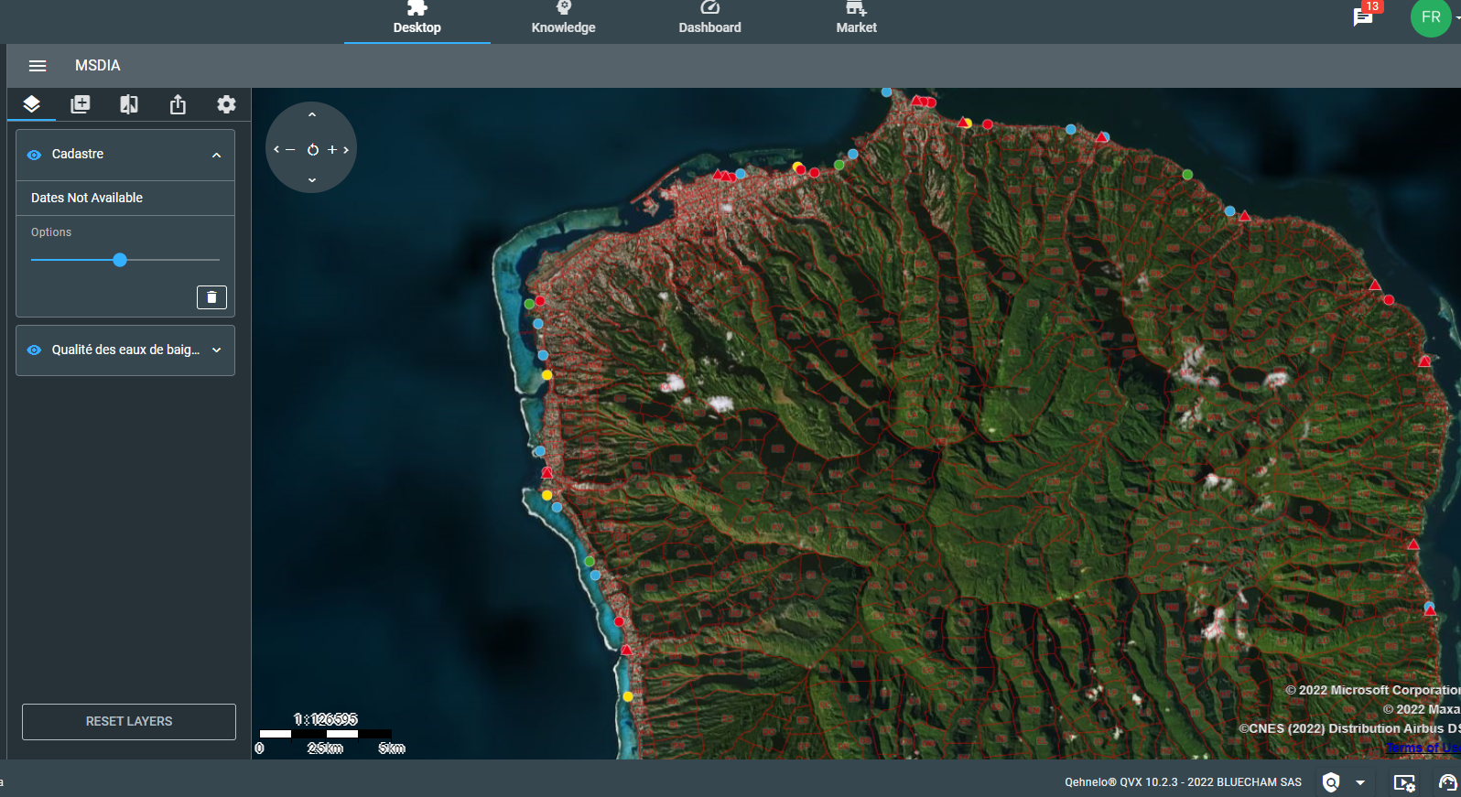
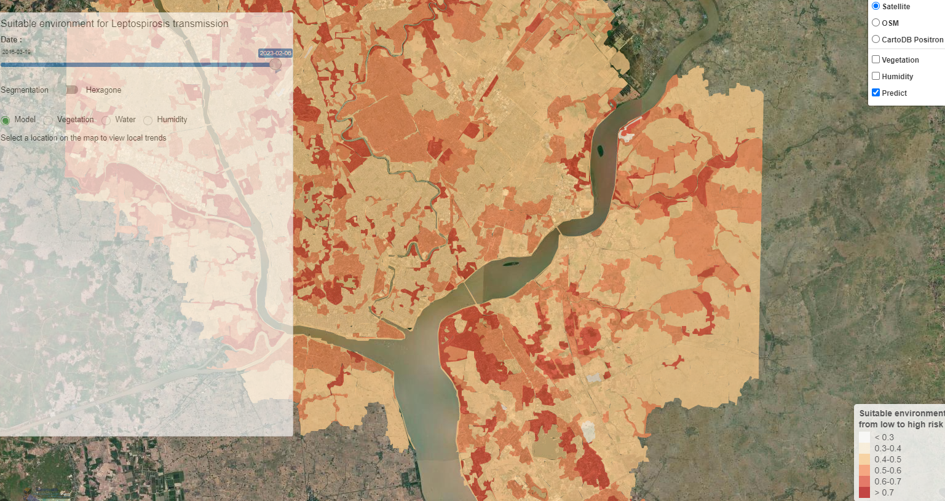
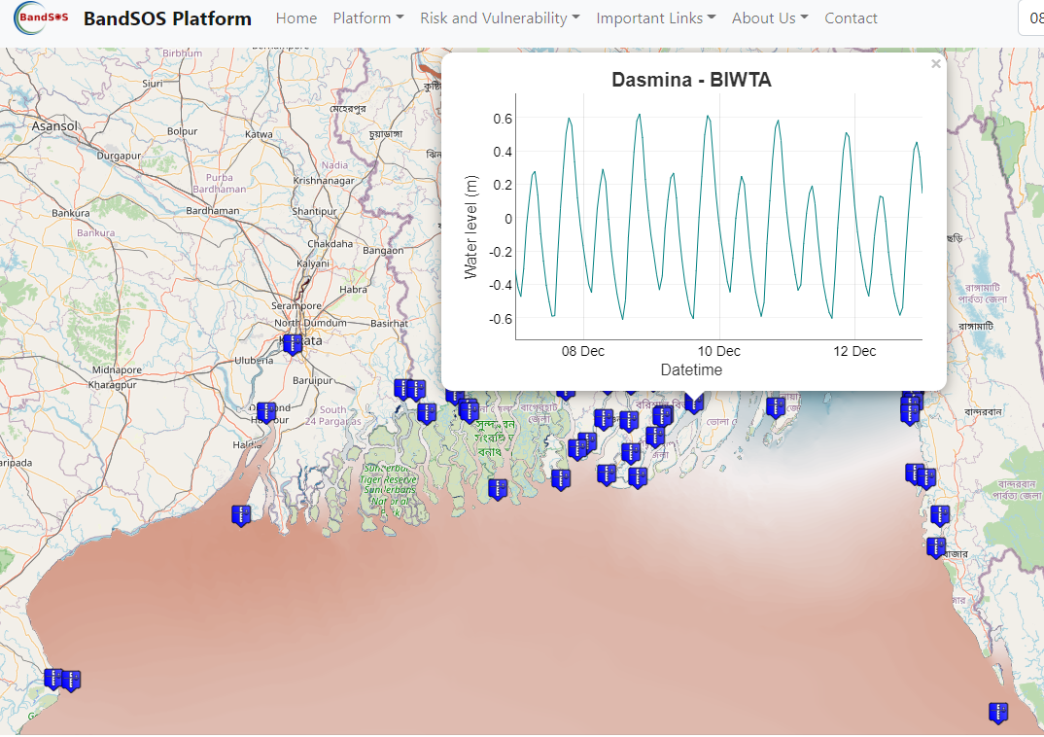
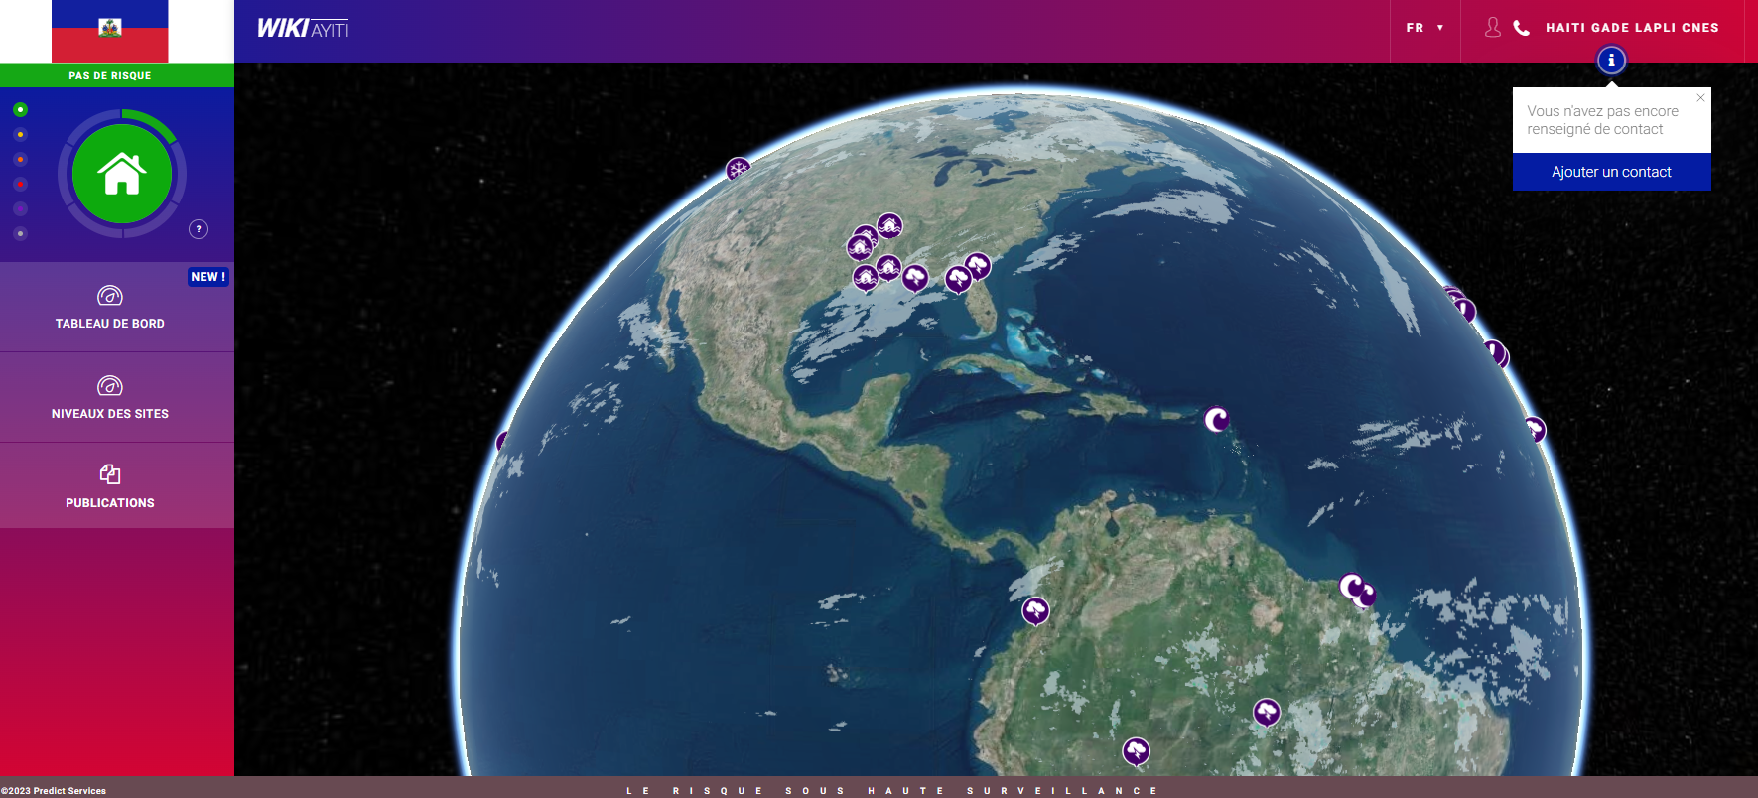
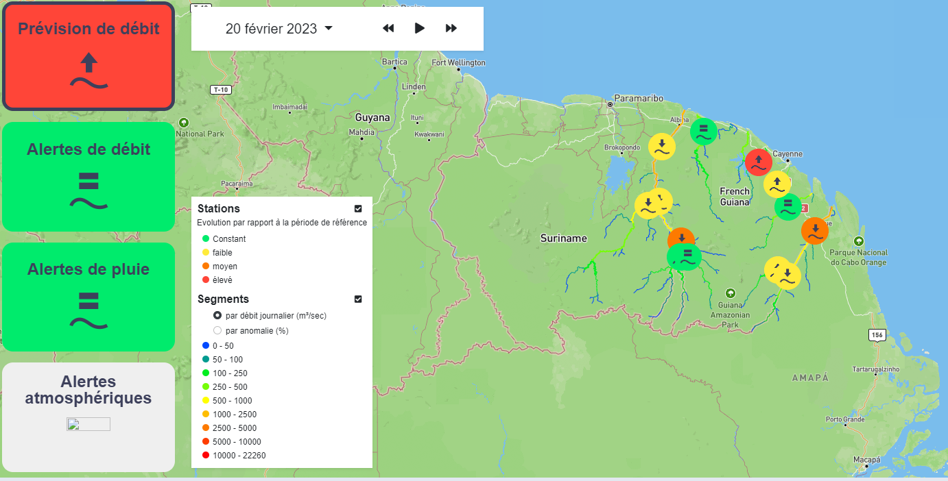
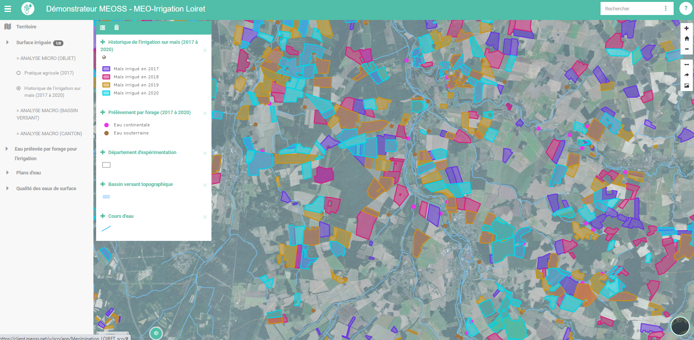
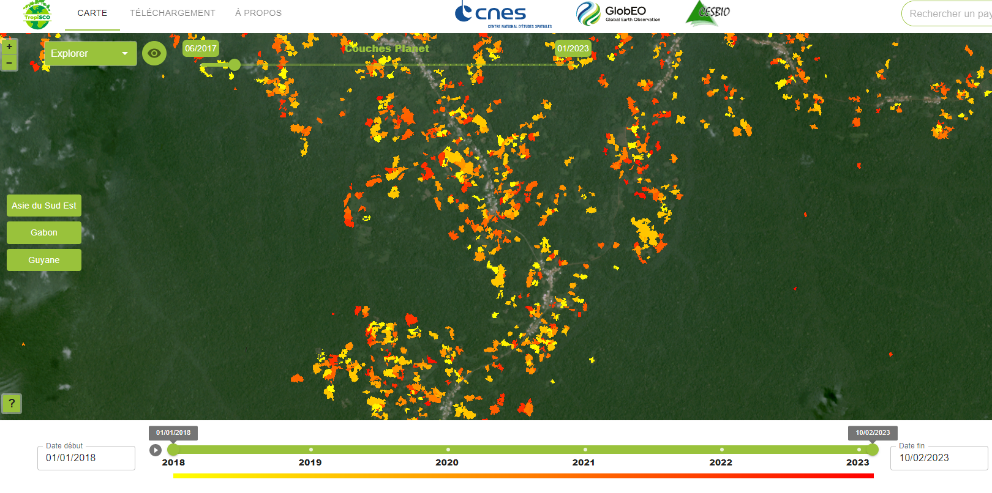
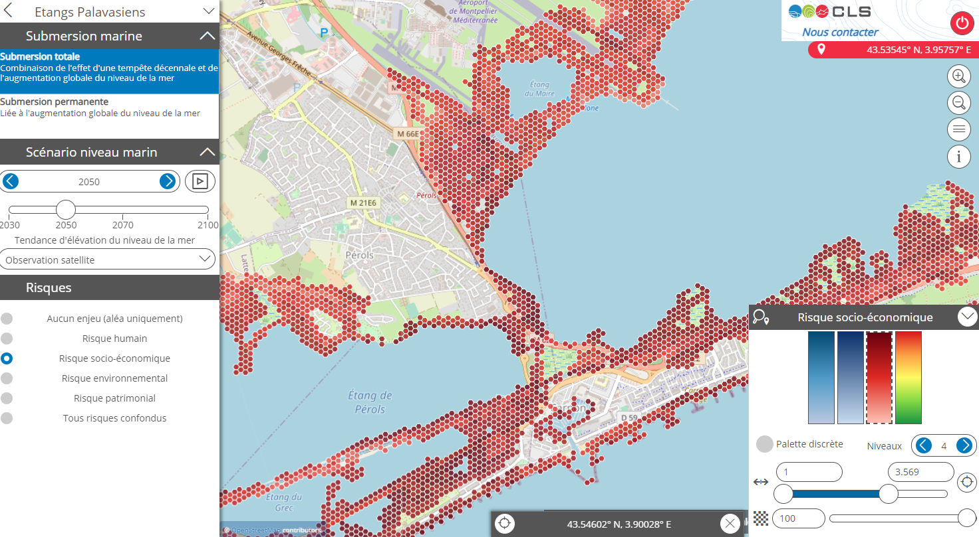
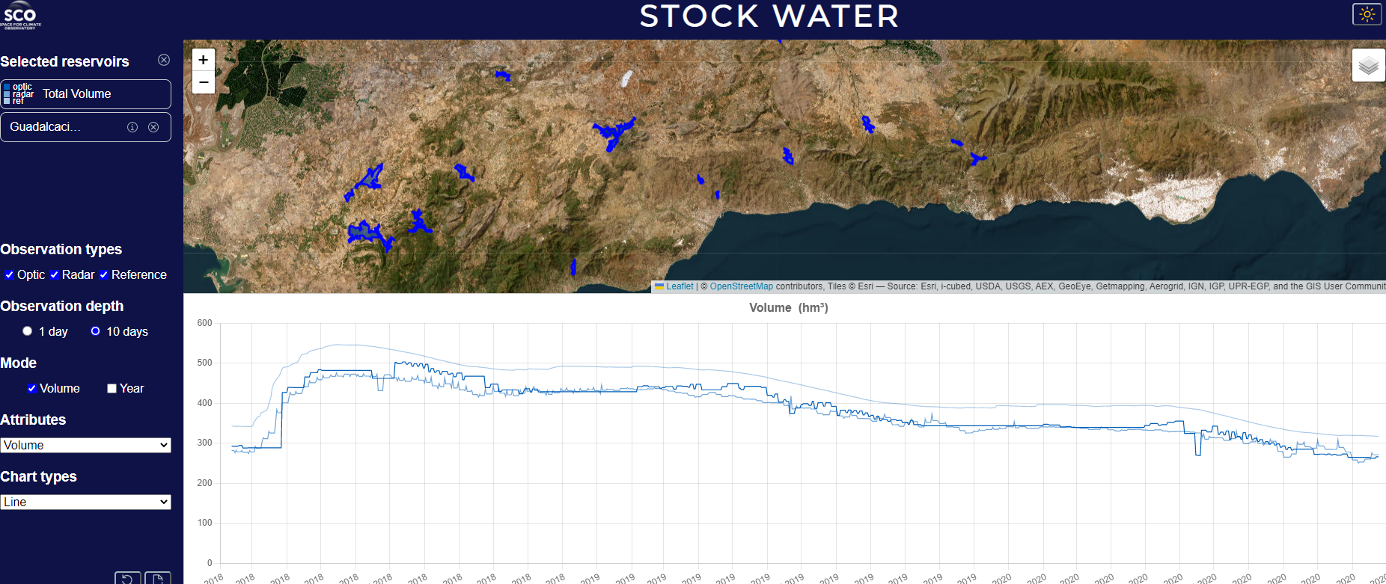
SCO-tree
Science as a Service
Software as a Service (Business Model)
SCOlive
VietSCO
FORO
BandSOS
TAHATAI
ClimHealth
OpHyse
GADE LAPLI
MEOSS
TropiSCO
Littoscope
Stock Water

Slide 8
Cooperation
Natural synergies between SCO and CEOS WG Climate
There are common members
People participating to SCO and WG Climate activities
GEO: Sara Venturi
ESA: Susanne Mecklenberg
NOAA: Jeff Private
ECMWF: Carlo Buentempo
Etc….

Slide 9
Cooperation: proposals from SCO
participating to the Accreditation process
30 reviewers (4y of SCO experience)
international call for proposals
Pool of Reviewers
SCO Portfolio
Participating to Governance activities
Organising Common communication activities

Slide 10
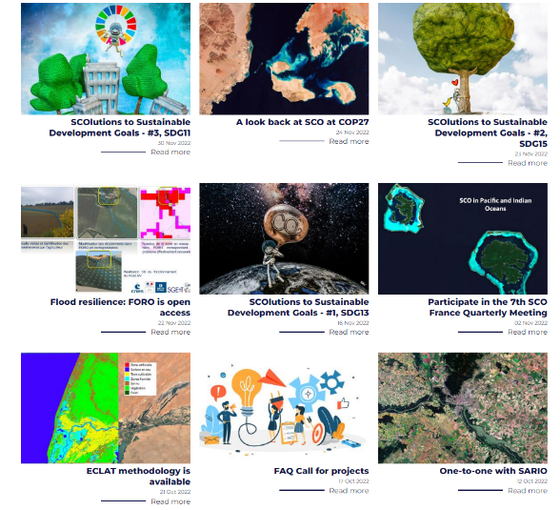
FIND US ONLINE
Subscribe to our newsletter
www.spaceclimateobservatory.org/newsletter
https://www.linkedin.com/company/sco-space-for-climate-observatory/
19

