Slide 1
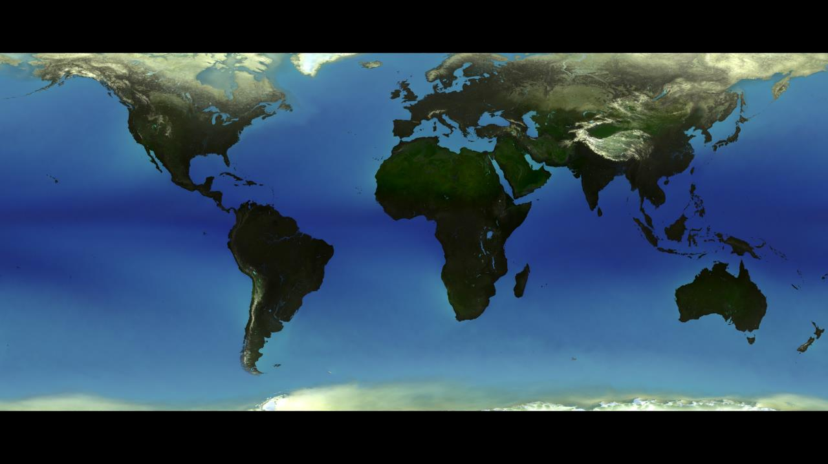
ECV Inventory Case Study:
Precipitation Data Sets
Chris Kidd
Earth System Science Interdisciplinary Center, University of Maryland/
NASA/Goddard Space Flight Center

Slide 2


Introduction
Water and precipitation are:
essential to life on Earth - the only planet (we know) that has abundant, usable water.
a fundamental component of the Earth’s energy and water cycle, redistributing energy through evaporation and condensation across the Earth’s surface and its’ atmosphere.
critical to our social and economic well being: too much or too little can be disastrous.
increasingly important politically: water resources transcend national boundaries.
Quantifying precipitation, its accuracies and errors is problematic due to its’ temporal and spatial variability: Issues affecting and influencing the observation and measurement of precipitation include:
characteristics of the precipitation being observed;
observational capability of the instrument;
interpretation of the measurements/observations and derived parameters, and;
perceived versus real requirements of subsequent applications.
18th Meeting of Joint CEOS/CGMS WG on Climate, 28 Feb-02 Mar 2023
Goddard Space
Flight Center

Slide 3
Factors impacting long-term satellite data records
Orbits, many drifting → non-uniform sampling (esp. non-sun-sync);
Different sensors, channels, resolutions;
Observations vs ‘samples’ vs independent samples;
Sampling period is small - ‘snapshots’ (0-20 min), but are deemed representative of the precipitation (and processes) over a certain temporal/spatial domain;
Different products using different techniques & different sampling (only IR provides ‘regular & frequent’ sampling);
Accumulation period vs natural cycles (e.g. monthly vs MJO) - ‘split’ rainfall events over sampling period.
4
4
18th Meeting of Joint CEOS/CGMS WG on Climate, 28 Feb-02 Mar 2023
Goddard Space
Flight Center

Slide 4
Precipitation data records: considerations for climate use
Suitability of precipitation products depends largely upon user requirements:
Spatial resolution: field-of-view to 2.5°x2.5°
Temporal resolution: instantaneous to seasonal
Latency of product: hours-months-years
Coverage: (quasi-) global, land/ocean, ice-free
Longevity: short duration through climate-scale
Data sources: single source, multi-sourced combined - homogeneity
Maturity: peer-reviewed, identification and quantification of errors and sources
Data access and readability: online sources and standard (ARD) formats
18th Meeting of Joint CEOS/CGMS WG on Climate, 28 Feb-02 Mar 2023
Goddard Space
Flight Center

Slide 5
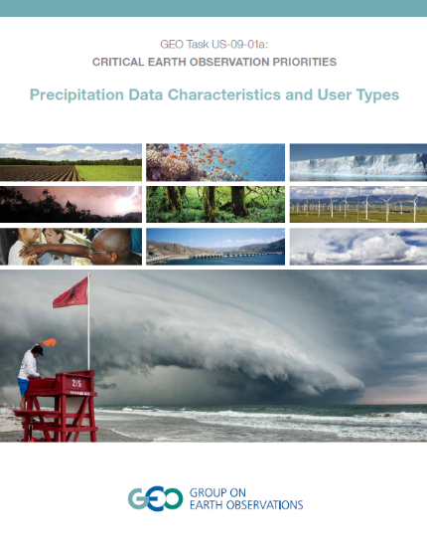
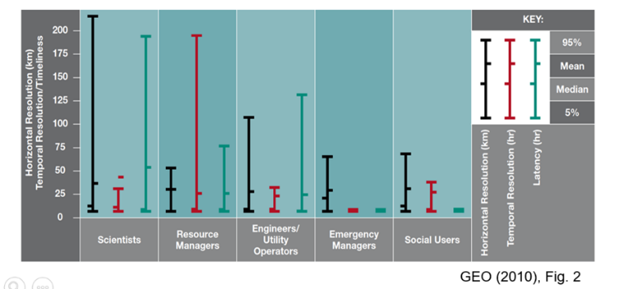
Precipitation user requirements
Wide range of users - wide range of requirements:
Spatial resolutions: 300 m to 50 km;
Temporal scales: 18 mins to 15 days;
Latency (acquisition): 6 mins to 24 hours.
There is no ‘one-size fits all’
18th Meeting of Joint CEOS/CGMS WG on Climate, 28 Feb-02 Mar 2023
Goddard Space
Flight Center

Slide 6
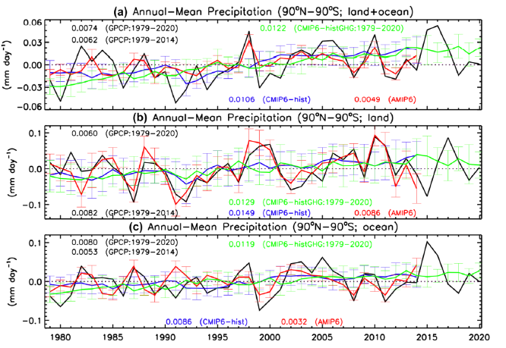
Climate data records
‘Traditional’ long-term global accumulation/anomalies.
But also:
instantaneous/high-spatial resolution products – crucial for extreme events.
fine temporal resolution for event history (floods/doughts) and hydrological studies.
Sub-daily for diurnal studies – timing of maximum precipitation.
Global annual mean precipitation anomalies in GPCP, AMPS6 CMIP6-hist and CMIP6-histGHG. (Gu & Adler, Climate Dynamics 2022)
18th Meeting of Joint CEOS/CGMS WG on Climate, 28 Feb-02 Mar 2023
Goddard Space
Flight Center

Slide 7
Surface & Satellite Observing Systems
 | Instrument | Temporal | Spatial | Notes
 | Gauges: accumulation | Variable | Point | Temporal scale depends upon frequency of observation
 | Gauges: Tipping Bucket | Quantised | Point | Quantisation of bucket (0.1, 0.2 mm or 1/100”) and data logger
 | Distrometers | Instantaneous | Point | Individual drop measurements
 | Micro rain radar | Instantaneous | Point | Vertical profiles up to 256 levels/10 s sampling
 | Weather radar | Instantaneous | Radial | Radial measurements of dBZ converted to a Cartesian grid
 | Microwave links | Instantaneous | Linear | Line of sight measurements along length of link
 | Visible imagery | Instantaneous | 1-4 km | Intermittent (LEO) 15 min sampling (GEO)
 | Infrared imagery | Instantaneous | 1-4 km | Intermittent (LEO) 15 min sampling (GEO)
 | Passive Microwave Imagers | Column | 5-25 km | Intermittent sampling (LEO) Resolution = frequency dependent
 | Passive Microwave Sounders | Column | 16-48 km | Intermittent sampling (LEO) Resolution = frequency/scan position dependent
 | Active Microwave (radar) | Instantaneous | 5 km | c.80 vertical levels; Limited intermittent sampling (LEO)
Surface
Satellite
Note the different spatial and temporal sampling of each sensor.
18th Meeting of Joint CEOS/CGMS WG on Climate, 28 Feb-02 Mar 2023
Goddard Space
Flight Center

Slide 8
Surface & Satellite Observing Systems
Visible/
infrared
PMW
imagers
PMW
sounders
AMW/radar
(rain)
gauge
Surface
radar
Micro Rain
Radar
Microwave
Links
HF
Atmosphere
20 minutes
LF
?
clutter
Different systems observe things differently – spatially, temporally and physically:
there are good, fundamental reasons why precipitation measurements should vary.
18th Meeting of Joint CEOS/CGMS WG on Climate, 28 Feb-02 Mar 2023
Goddard Space
Flight Center

Slide 9
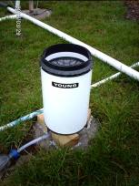
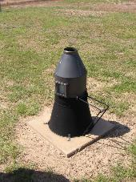
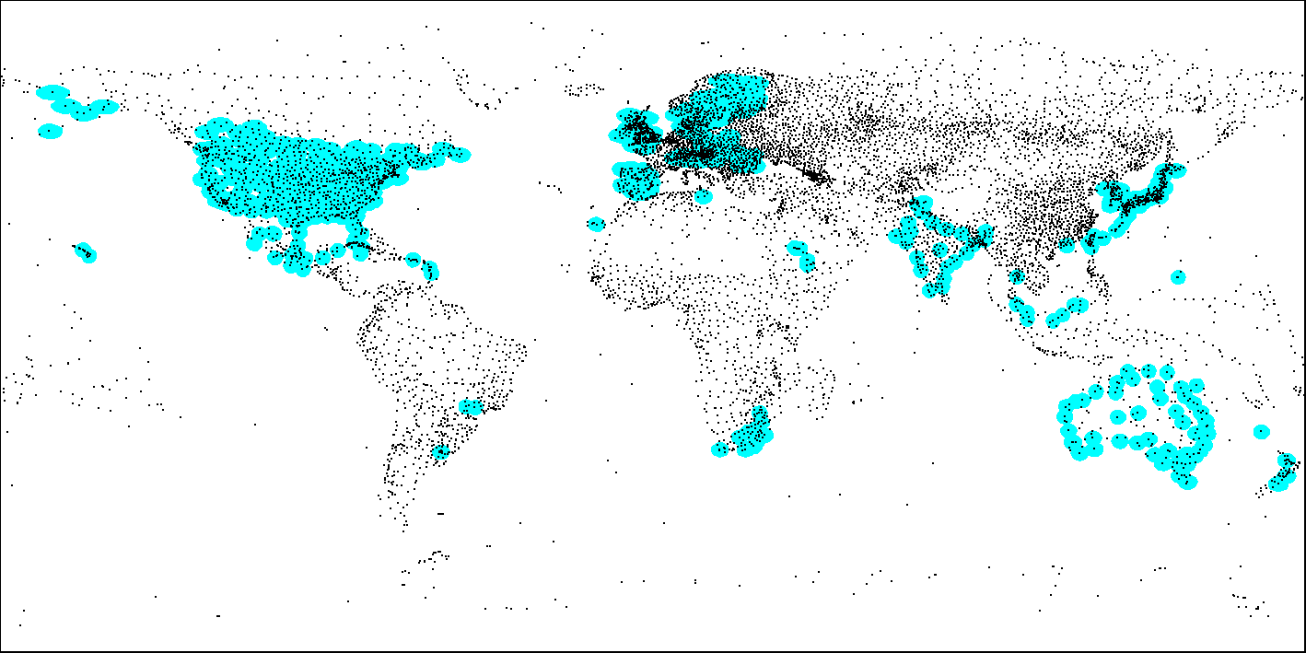
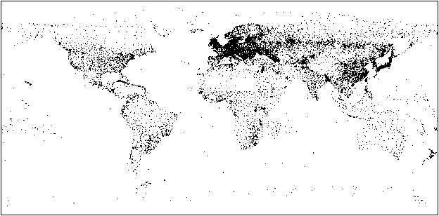
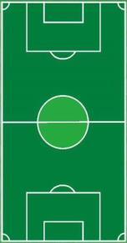
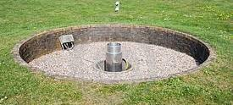
Conventional Observations
20,000
Rain
gauges
Sevruk & Klaman identified 50 types of daily, manually-read gauges worldwide
Radar duplicates rain-gauge coverage
Gauges are a critical part of global precipitation measurement
Satellites can provide consistent, regular observations, with global coverage and real-time delivery of data
18th Meeting of Joint CEOS/CGMS WG on Climate, 28 Feb-02 Mar 2023
Goddard Space
Flight Center

Slide 10
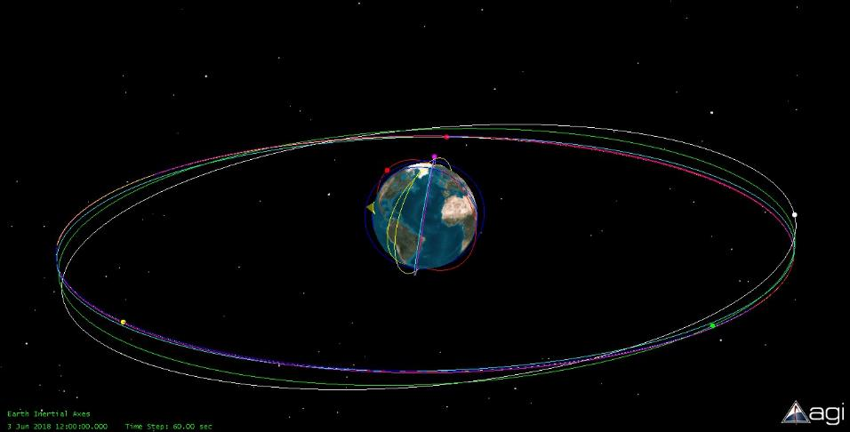




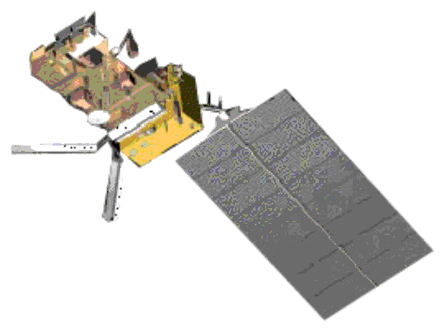
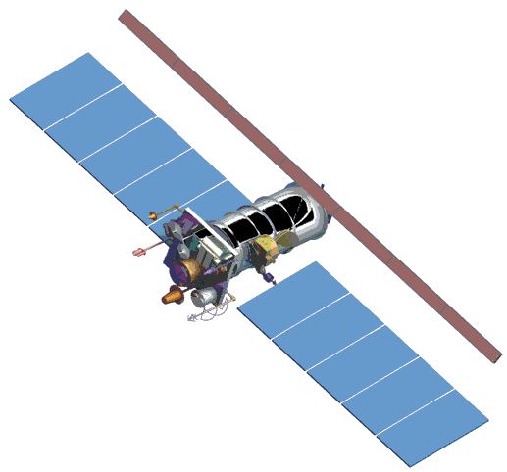

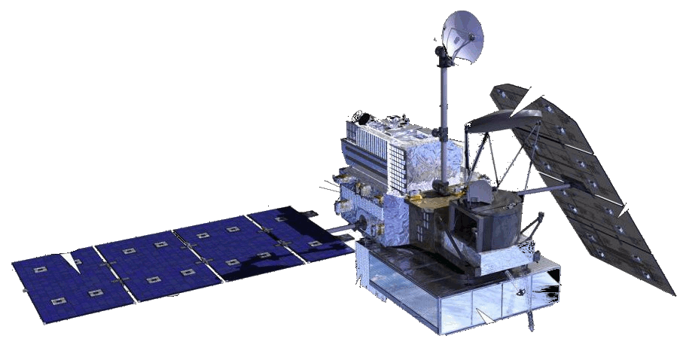
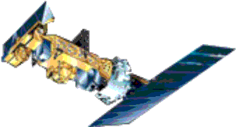
EARTH OBSERVATION SATELLITE SYSTEM (Met)
FY-2
(China)
105° E.
Himawari
(Japan)
140° E.
ELECTRO
(Russia)
76° E.
GOES-W
135° W.
METEOSAT-8
41.5° E.
МЕТЕОR
(Russia)
METOP
(EUMETSAT)
35800 km
GPM
(NASA/JAXA)
DMSP
(USA)
850 km
FY-1
(China)
NOAA
(USA)
GOES-17
90° W.
METEOSAT-9
(EUMETSAT)
9.5° E.
METEOSAT-10
(EUMETSAT)
0° E.
GOES-E
(USA)
75° W.
needs updating – but essentially: Low Earth Orbiting systems and Geostationary systems

Slide 11
Observation availability
Spectral Region | Availability | Cycle (current) | Res.*
Visible (least direct) | Since start of satellite era | Geostationary, <15 mins Polar orbiters, ca.6-hourly | 250 m+
Infrared (indirect) | Shortly after start of satellite era ~ calibrated since 1979 | Geostationary, <15 mins Polar orbiters, ca.6-hourly | 1 km+
Passive Microwave (more direct) | Experimental 1972/1975 Uncalibrated 1978-1987 Calibrated since 1987 | Polar orbiters, 6-hourly + Low Earth orbiter (GPM/GMI) | 4 km+
Active Microwave (radar - most direct) | 13.8 GHz since 1997 94 GHz since 2006 13.8 & 35.5 GHz since 2014 | Low Earth Orbiter (DPR) Polar orbiter (Cloudsat) | 4 km 1.5 km
* Resolutions vary greatly with scan angle, frequency, sensor etc
Precipitation retrievals may be single-sensor or multi-sensor
depending upon user/application preferences
18th Meeting of Joint CEOS/CGMS WG on Climate, 28 Feb-02 Mar 2023
Goddard Space
Flight Center

Slide 12
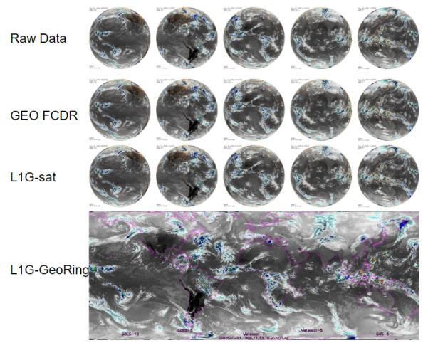
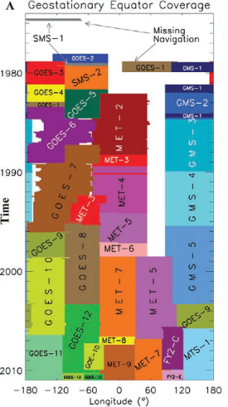
Geostationary observations
Geostationary observations in the Vis/WV/IR available since early 1980’s
(easily) available combined products – for IR at least – from 2000 onwards (e.g. CPC Global-IR 4km)
New effort to provide multi-spectral data through GEO-Ring project for whole Geo-period.
Vis/IR GEO-observations are an integral part of global precipitation measurement
primarily due to their temporal sampling and good spatial resolution
18th Meeting of Joint CEOS/CGMS WG on Climate, 28 Feb-02 Mar 2023
Goddard Space
Flight Center

Slide 13
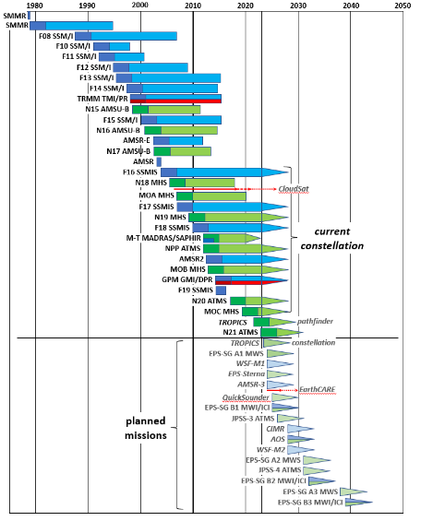
Microwave Instruments (US/Euope/Japan)
Microwave instruments for precipitation
Earliest (passive) microwave (imager) missions 1968 (Soviet), 1972 (ESMR-5) and 1975 (ESMR-6).
SMMR (1978) initiated the start of the long-term, systematic global passive microwave imaging era.
Only two missions, TRMM and GPM, have been precipitation-focused.
The precipitation science community has become very adept at adopting and utilizing a range of satellite observations to provide the necessary (temporal and spatial) products to meet user requirements.
18th Meeting of Joint CEOS/CGMS WG on Climate, 28 Feb-02 Mar 2023
Goddard Space
Flight Center

Slide 14
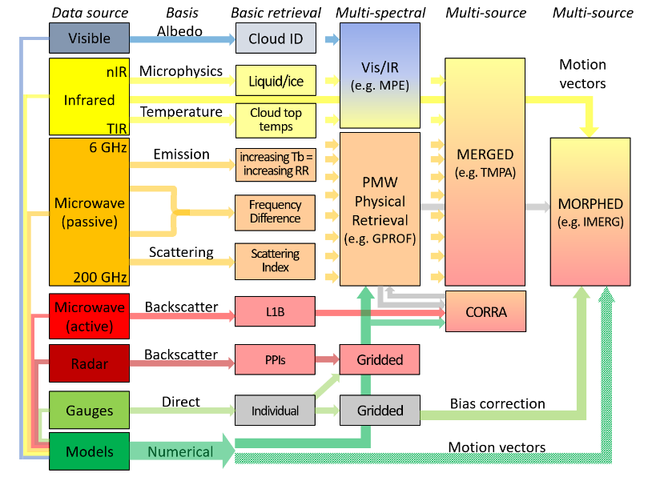
Satellite precipitation estimation
Satellite estimates of precipitation encompass a wide range of frequencies together with auxiliary data.
Retrieval of precipitation from satellite observations is complex since the range of precipitation properties and characteristics is large (cloud, rainfall, snowfall, hail).
Requires a multi-spectral, multi-satellite, multi-sensor approach
18th Meeting of Joint CEOS/CGMS WG on Climate, 28 Feb-02 Mar 2023
Goddard Space
Flight Center

Slide 15
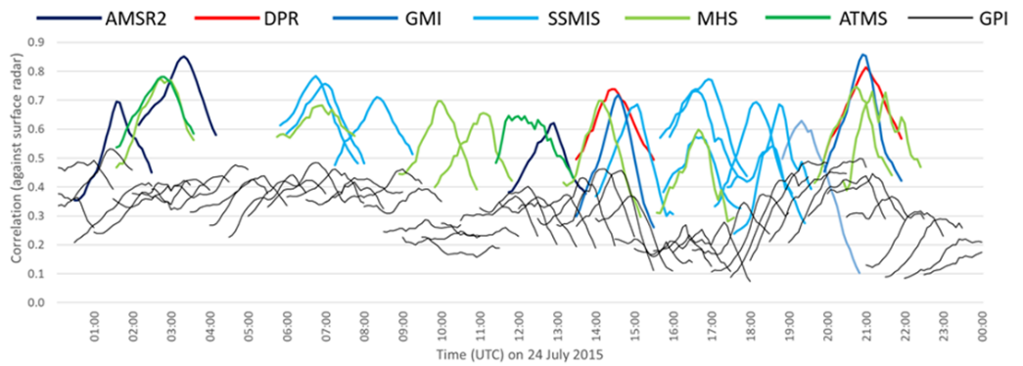
Why the reliance on passive microwave?
Satellite:surface correlations peak at time of observation
correlations decline markedly away from time of observation
PMW
IR
Radar-calibrated IR retrievals never match those of the PMW
Instantaneous passive microwave retrievals are more direct than IR retrievals
and are generally very good but temporal sampling greatly decreases their impact
18th Meeting of Joint CEOS/CGMS WG on Climate, 28 Feb-02 Mar 2023
Goddard Space
Flight Center

Slide 16
Existing/planned ECV precipitation inventory
Domain=Atmosphere, ECVName=Precipitation, ECVProduct=Estimates of liquid and solid precipitation
RecID | PhysQuantity | Status | ResponsibleOrg
10121 | Liquid precipitation | Existing | NASA | 2016 | SSMI SSMIS | Wentz/RSS | netcdf | ocean | 1 d | 0.25 deg | 35+ yrs
10301 | Liquid precipitation | Existing | NOAA/NESDIS/NCEI | 2014 | GeoIR | PERSIANN-CDR | netcdf | land ocean | 1 d | 0.25 deg | 44+ yrs
10318 | Precipitation (liquid and solid) | Existing | EUMETSAT (CM SAF) | 2012 | SSMI | HOAPS 3.2 | netcdf | ice-free ocean | 1 mo | 0.25 deg | 20 yrs
10320 | Precipitation (liquid and solid) | Existing | EUMETSAT (CM SAF) | 2017 | SSMI SSMIS | HOAPS 4.0 | netcdf | ice-free ocean | 1 mo | 0.25 deg | 28 yrs
10785 | Precipitation (liquid and solid) | Existing | NASA-NOAA-EUMETSAT-CNES | 2016 | AMR | Jason-3 | netcdf | ocean | 10 d | 0.25 deg | 1 yr
10786 | Precipitation (liquid and solid) | Existing | NASA-NOAA-EUMETSAT-CNES | 2016 | AMR | Jason-2 | netcdf | ocean | 10 d | 0.25 deg | 8 yrs
10787 | Precipitation (liquid and solid) | Existing | NASA - CNES | 2016 | AMR | Jason-1 | netcdf | ocean | 10 d | 0.25 deg | 12 yrs
10788 | Precipitation (liquid and solid) | Existing | NASA - CNES | 2016 | TMR | Topex/Poseiden | netcdf | ocean | 10 d | 0.25 deg | 14 yrs
10789 | Precipitation (liquid and solid) | Existing | ISRO - CNES | 2016 |  | SARAL/AltiKa | netcdf | ocean | 35 d | 7x35 km | 4 yrs
11527 | Liquid precipitation | Existing | NASA | 2016 | SSMI SSMIS | Wentz/RSS | netcdf | ocean | 7 dy | 0.25 deg | 35+ yrs
11528 | Liquid precipitation | Existing | NASA | 2016 | SSMI SSMIS | Wentz/RSS | netcdf | ocean | 7 dy | 0.25 deg | 35+ yrs
11529 | Liquid precipitation | Existing | NASA | 2016 | SSMI SSMIS | Wentz/RSS | netcdf | ocean | 1 mo | 0.25 deg | 35+ yrs
11623 | Precipitation (liquid and solid) | Existing | NOAA/NESDIS/NCEI | 2016 | Multi-sensor | GPCP 2.3 | netcdf | global (all) | 1 mo | 2.5 deg | 44+ yrs
11627 | Precipitation (liquid and solid) | Existing | NOAA/NESDIS/NCEI | 2016 | Multi-sensor | GPCP 3.1 | netcdf | global (all) | 1d | 1 deg | 44+ yrs
11648 | Liquid precipitation | Existing | NOAA/NESDIS/NCEI | 2016 | PMW sounders | MSPPS | netcdf | global (all) | 2/6 d | 48/16 km | 22+ yrs
10321 | Precipitation (liquid and solid) | Planned | EUMETSAT (CM SAF) | 2024 | PMW imagers | HOAPS 5.0 |  | ice-free ocean |  | 0.5 deg | 33 yrs
10440 | Precipitation (liquid and solid) | Planned | EUMETSAT (CM SAF) | 2023 | PMW (I+S) & IR | GIRAFE |  |  |  | 1.0 deg
11839 | Precipitation (liquid and solid) | Planned | EC (Copernicus C3S) |  | PMW (I+S) | CM-SAF/H-SAF |  | global | 1 d | 1.0 deg
11856 | Precipitation (liquid and solid) | Planned | EC (Copernicus C3S) |  | PMW (I+S) |  |  | global | 1 mo | 1.0 deg
18th Meeting of Joint CEOS/CGMS WG on Climate, 28 Feb-02 Mar 2023
Goddard Space
Flight Center

Slide 17
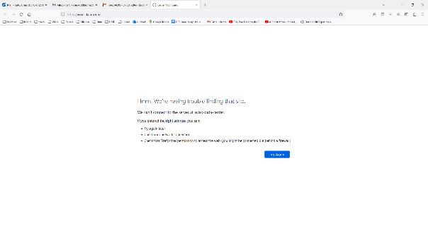
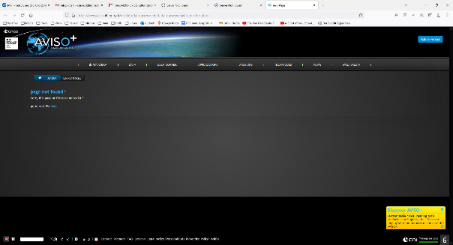
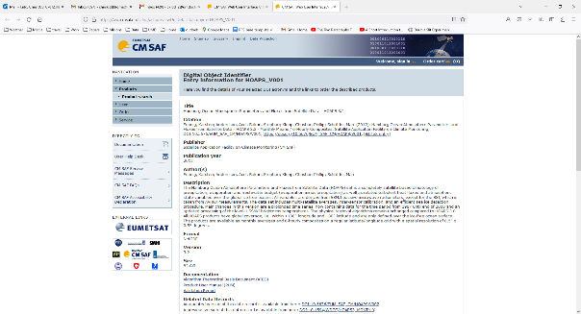
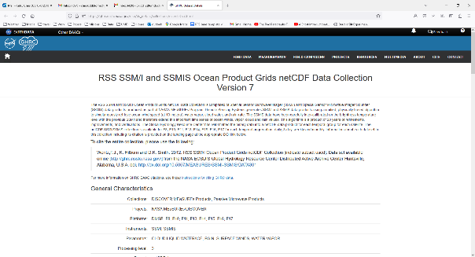
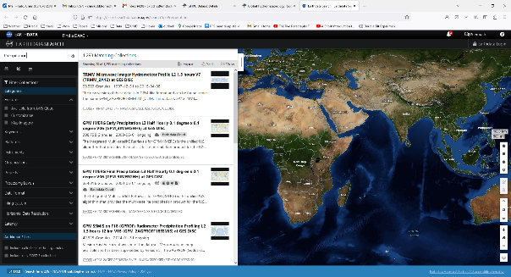
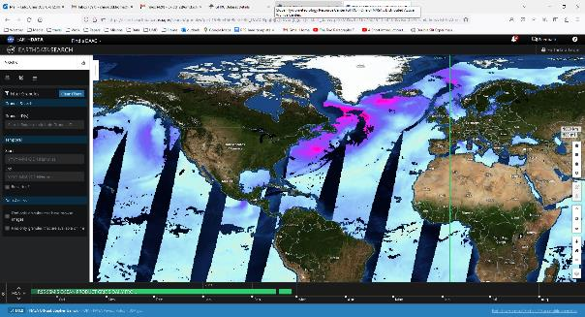
Existing Precipitation ECVs (v4.10)
Data sets often difficult to specify.
No legend for images
RecordID 10785
RecordID 10785
RecordID 10318
RecordID 11527
RecordID 11527 – Earthdata search
Earthdata search – “precipitation” “RSS SSMIS OCEAN PRODUCT GRIDS DAILY”
Needs updating…
Suitability for different users/applications
User interface (at various levels of expertise)
18th Meeting of Joint CEOS/CGMS WG on Climate, 28 Feb-02 Mar 2023
Goddard Space
Flight Center

Slide 18
Precipitation Data sets
A multitude of precipitation data sets from surface, satellite, model and combined.
CGMS/IPWG identified 89 data products (http://ipwg.isac.cnr.it/data.html):
Combination datasets with gauge data (21 products)
0.04°x0.04° to 2.5°x2.5°, 30min to seasonal, lat-range/Africa to global.
Satellite combination datasets (22 products)
2x2 km to 2.5°x2.5°, 10min to 5-day, lat-range/regional/disk to global
Single-source datasets (32 products)
FOV to 2.5°x2.5°, instantaneous to monthly, lat-range/regional/disk to global
Precipitation gauge analysis (14 products)
(individual) 0.25°x0.25° to 2.5°x3.75°, daily to monthly, regional to quasi-global.
Total of 89 identified ”publicly-available” products (+many more)
2x2 km to 2.5°x2.5°, instantaneous to seasonal, regional to global.
Many thanks to George Huffman!
18th Meeting of Joint CEOS/CGMS WG on Climate, 28 Feb-02 Mar 2023
Goddard Space
Flight Center

Slide 19
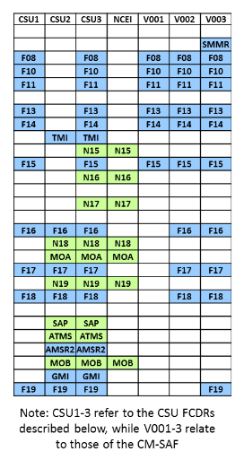
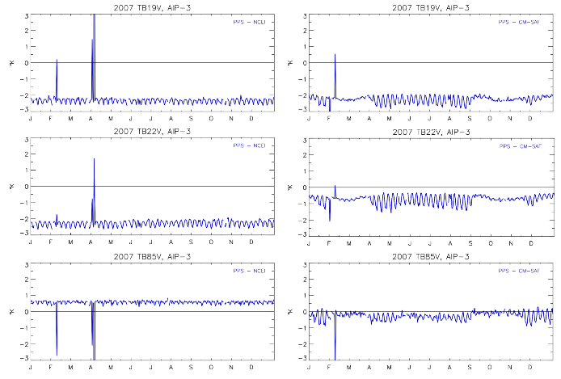
Fundamental Climate Data Records (PMW Tbs)
Level 1 data is crucial – but variations exist between ‘calibrated’ data sets
CSU/NASA
CM-SAF
Differences between the CDR Tbs tend to be consistent.
Fluctuations with ranges of about 1K.
Spikes in the difference generally relate to episodes where one scheme set data to missing
Differences between the NASA PPS Tb data record for the SSMI sensor for the 19V, 22V and 85V channels over the AIP-3 region.
18th Meeting of Joint CEOS/CGMS WG on Climate, 28 Feb-02 Mar 2023
Goddard Space
Flight Center

Slide 20
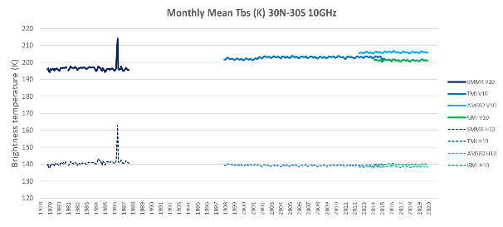
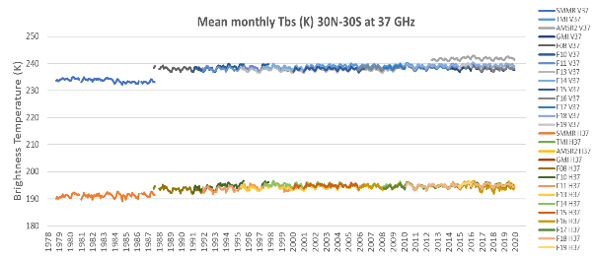
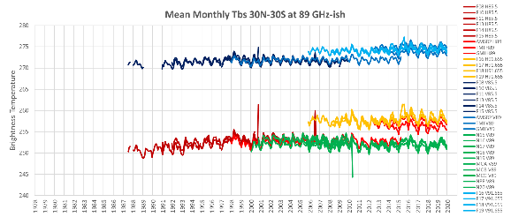
Long-term Tb observations (NASA-PPS)
SMMR data
SMMR data
‘Consistent’ calibration vv ‘inter-calibration’: - differences generally related to Earth Incidence Angle or differences in channel frequency.
18th Meeting of Joint CEOS/CGMS WG on Climate, 28 Feb-02 Mar 2023
Goddard Space
Flight Center

Slide 21
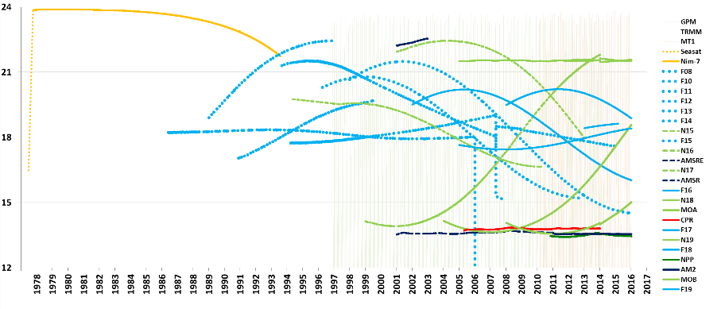
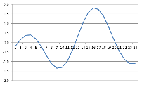
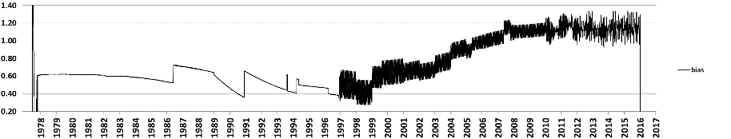
Drifting Orbits – and diurnal biases
12
9
6
3
12
Overpass local time (AM/PM)
Exemplar diurnal cycle
Bias
GPM
M-T
TRMM
Year
18th Meeting of Joint CEOS/CGMS WG on Climate, 28 Feb-02 Mar 2023
Goddard Space
Flight Center

Slide 22
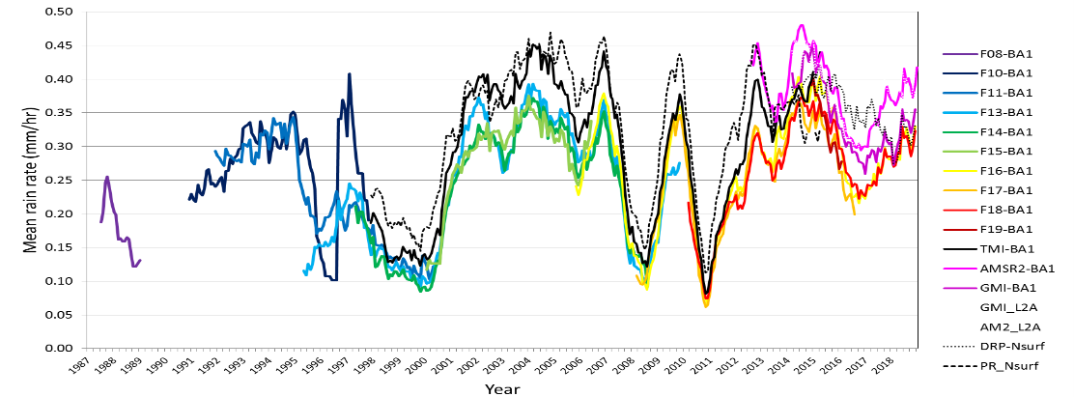
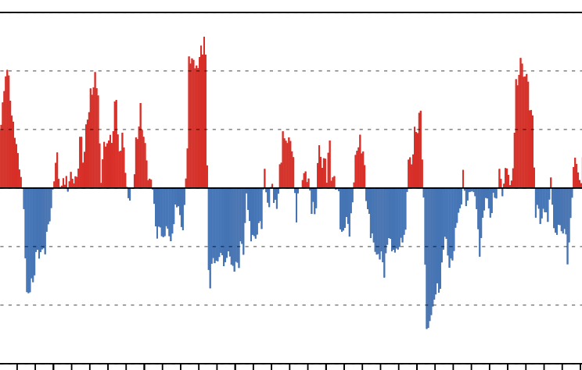
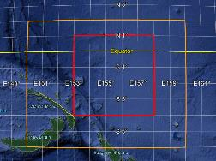
AIP-3 region mean monthly precipitation
GPM
era
Periods of agreement – and disagreement
18th Meeting of Joint CEOS/CGMS WG on Climate, 28 Feb-02 Mar 2023
Goddard Space
Flight Center

Slide 23
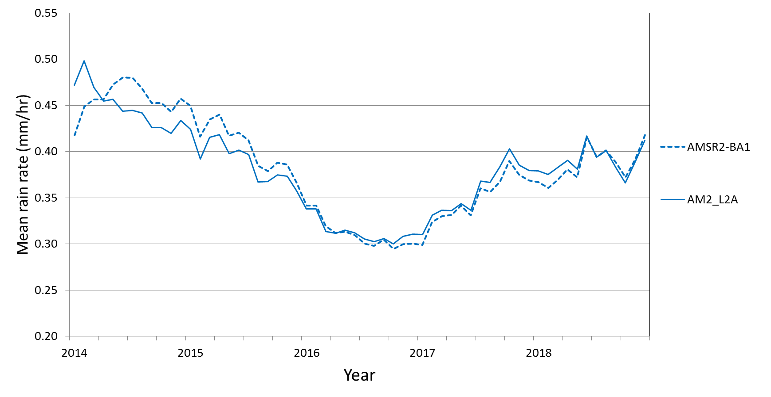
AIP-3 region, AMSR-2 retrievals, 2014-2018
AMSR2 BA1
AMSR2 GPROF
18th Meeting of Joint CEOS/CGMS WG on Climate, 28 Feb-02 Mar 2023
Goddard Space
Flight Center

Slide 24
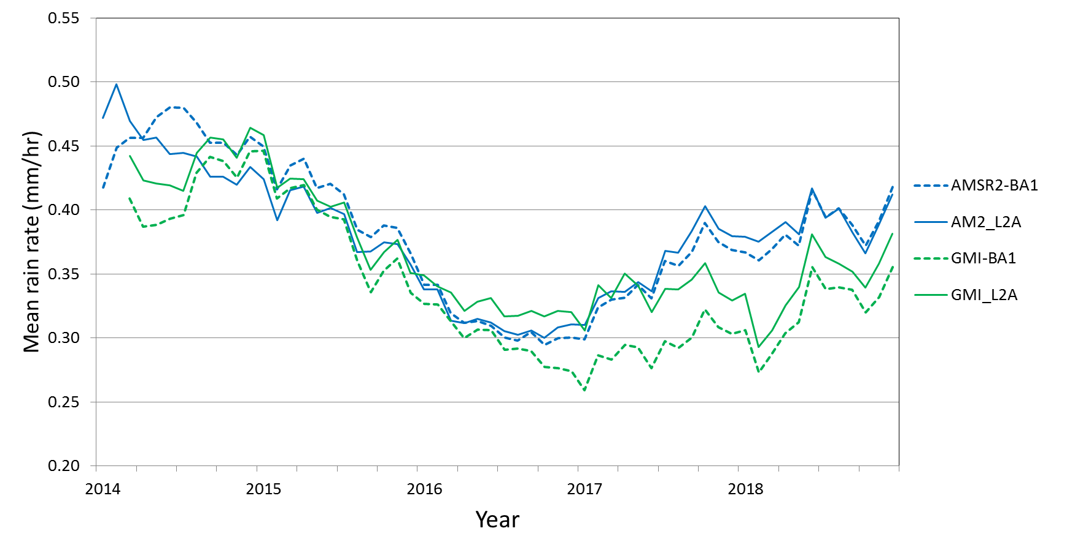
AIP-3 region, AMSR-2 & GMI retrievals, 2014-2018
AMSR2 BA1
AMSR2 GPROF
GMI BA1
GMI GPROF
18th Meeting of Joint CEOS/CGMS WG on Climate, 28 Feb-02 Mar 2023
Goddard Space
Flight Center

Slide 25
AIP-3 region, AMSR-2 & GMI retrievals, 2014-2018
AMSR2 BA1
AMSR2 GPROF
GMI BA1
GMI GPROF
18th Meeting of Joint CEOS/CGMS WG on Climate, 28 Feb-02 Mar 2023
Goddard Space
Flight Center

Slide 26
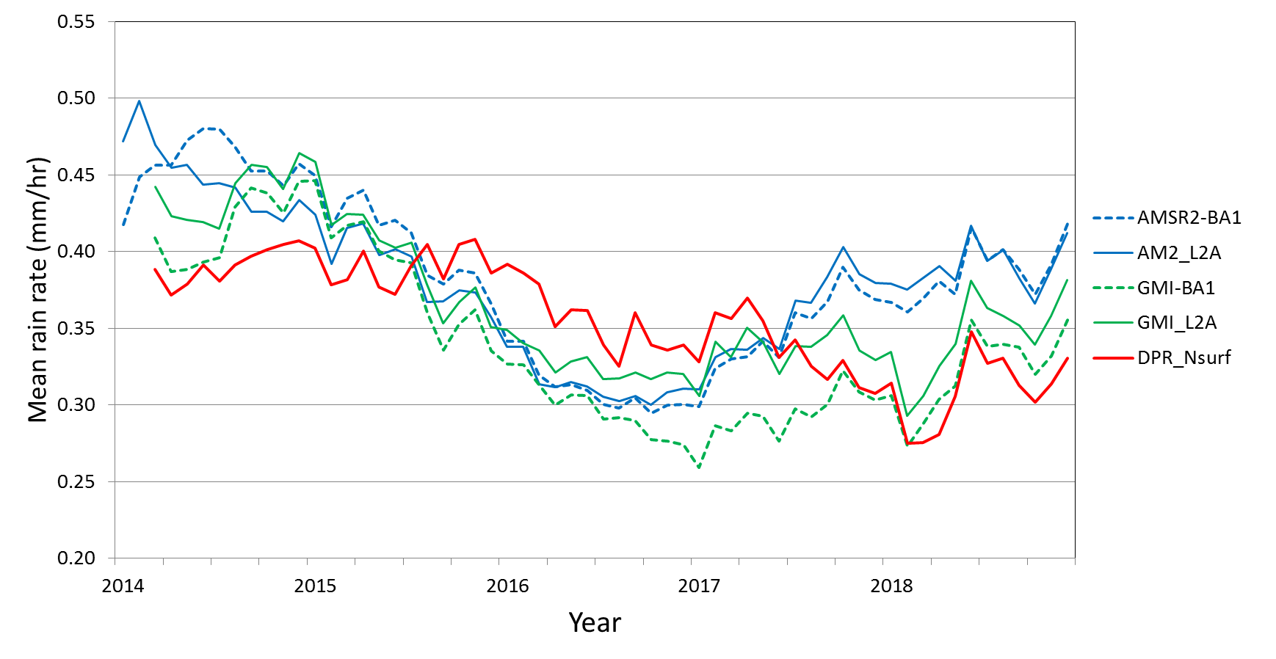
AIP-3 region AMSR-2, GMI and DPR 2014-2018
GPROF and ‘BA1’ for AMSR2 are very similar,
but not for GMI. DPR is not like either (!).
AMSR2 BA1
AMSR2 GPROF
GMI BA1
GMI GPROF
DPR Near surface
18th Meeting of Joint CEOS/CGMS WG on Climate, 28 Feb-02 Mar 2023
Goddard Space
Flight Center

Slide 27
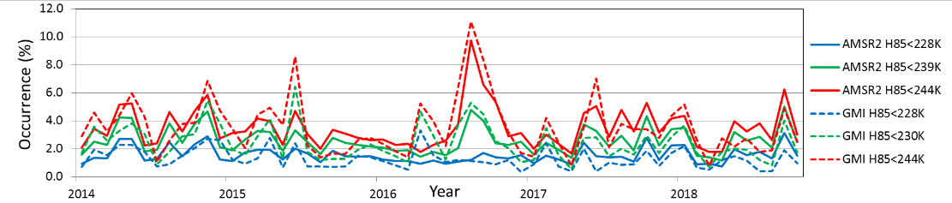
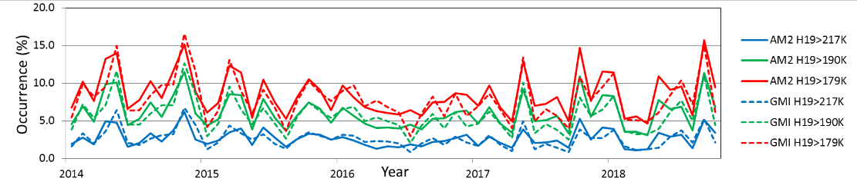
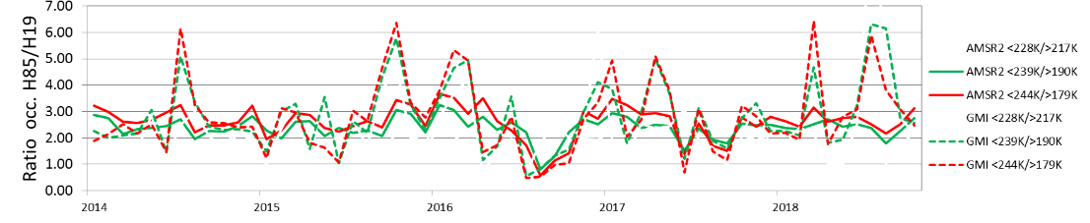
WHY?
Scattering emission Ratio
Late 2016 – different regime to other periods
18th Meeting of Joint CEOS/CGMS WG on Climate, 28 Feb-02 Mar 2023
Goddard Space
Flight Center

Slide 28
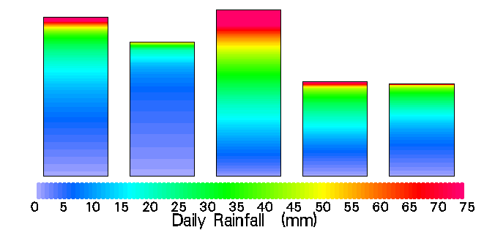
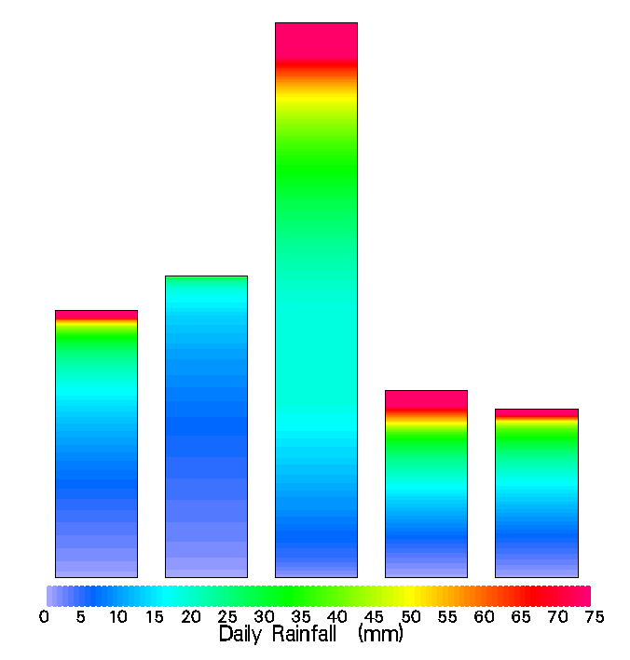
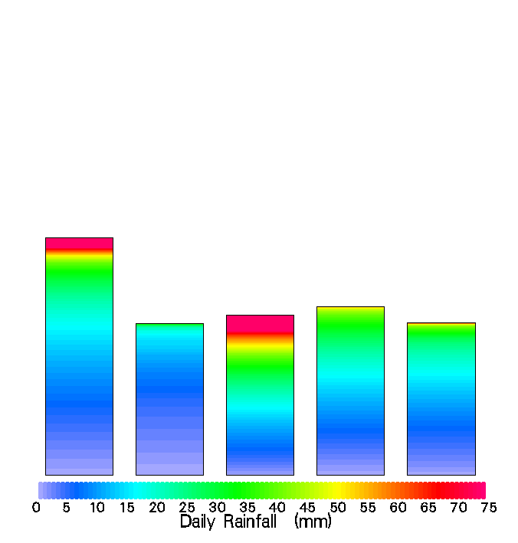
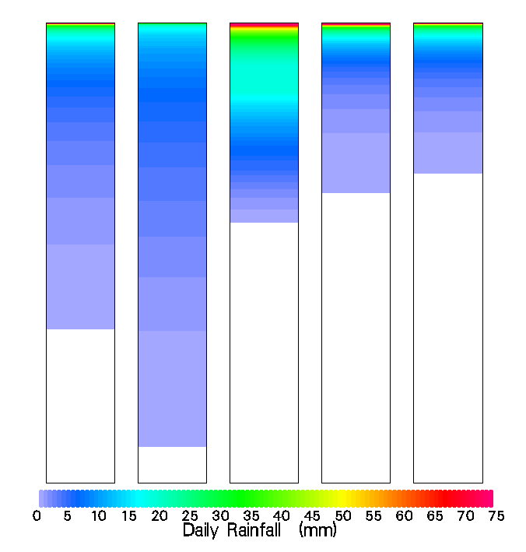
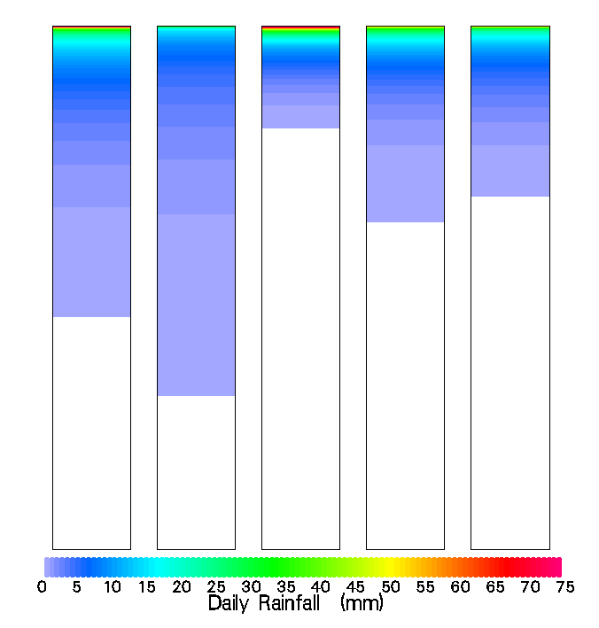
“Ideal” algorithms
All algorithms produce identical results to any validation data set…
Algorithms tend to be tuned to minimise long-term biases –are they ‘correct’?
The make-up of the ‘intensities’ to the total is very important:
radar
e40
3B40
3B41
3B42
radar
3B40
3B40
e40
radar
e40
3B41
3B42
3B41
3B42
Accumulation
Accumulation
Accumulation
Jan 2004
Jun 2004
Jan 2004
Jun 2004
Radar e40 3B40 3B41 3B42
Radar e40 3B40 3B41 3B42
Radar e40 3B40 3B41 3B42
Radar e40 3B40 3B41 3B42
Trends in Global Water Cycle Variables, UNESCO, Paris. 3-5 November 2004
18th Meeting of Joint CEOS/CGMS WG on Climate, 28 Feb-02 Mar 2023
Goddard Space
Flight Center

Slide 29
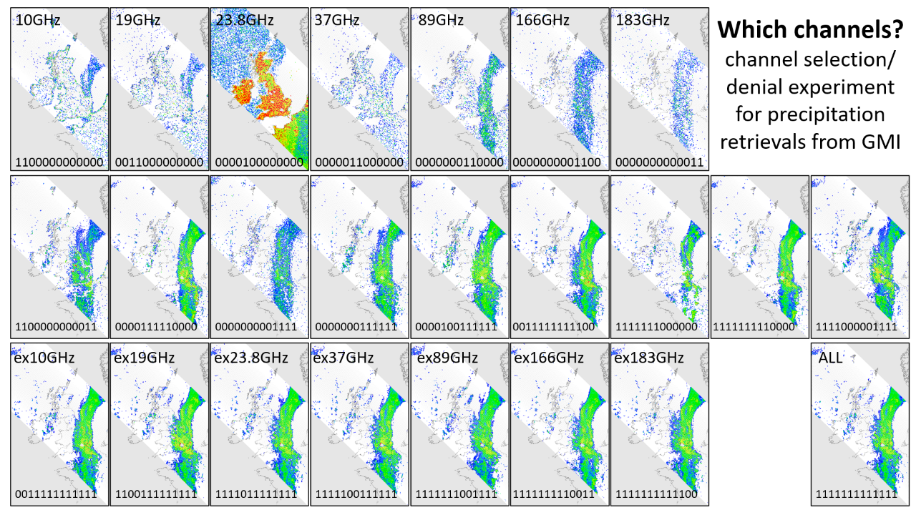

Slide 30
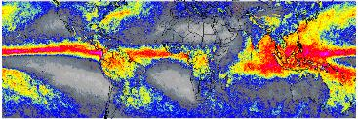




The rise of the cubesat/smallsats
New technology has enabled smaller PMW sensors to be developed – as demonstrated by the TEMPEST and TROPICS-TMS sensors.
Operating at frequencies from ca.89 to 183.31/204.8 GHz with resolutions similar to current PMW sounding instruments.
Results to date are very encouraging, showing that basic retrievals are comparable with retrievals from current sensors.
Results currently being fully evaluated (e.g. HF retrievals vs all-channel retrievals).
Mean annual precipitation (Aug’21-’22)
Monthly: August 2022
Hurricane Ian
TROPICS-TMS
TEMPEST-H8
2022-09-28 PM
PRPS-TEMPEST-H8
GPROF-NOAA19
GPROF-NOAA20
2022-09-28 PM
GPROF-N20-ATMS
18th Meeting of Joint CEOS/CGMS WG on Climate, 28 Feb-02 Mar 2023
Goddard Space
Flight Center

Slide 31

Future PMW radiometer constellation ca.2028-2030
Overpass clock
210 minutes
00
There are significant temporal gaps in coverage which could be filled with smallsats/cubesats.
AMSR-3,
JPSS
Sterna
FY-3F
FY-3H
EPS SG-A/B
CIMR
Drifting orbits
Drifting orbits
F15
N19
A low-inclination ‘calibrator’ sensor(s) is critical for any constellation – but may not be available.
FY-3G
GPM
FY-3J
09
03
F16
Sterna
Sterna
F18
210 minutes
Note: this assumes:
no orbital drift (newer missions?)
no continuation of current missions
no Russian Meteor series
F17
2030
2020
240 minutes
06
QuickSounder
WSF-M, FY-3I
18th Meeting of Joint CEOS/CGMS WG on Climate, 28 Feb-02 Mar 2023
Goddard Space
Flight Center

Slide 32
Channel loss/selection & Errors and Uncertainties
 | Source | Quantificaiton | Verification | Status | Impact
Sensors | Channel selection | More/diverse = better (?) | scores against best available sensor | Good | Moderate
 | Resolution | Commensurate with precipitation system (high frequency channels) | Simulations using high quality (1-km) surface radar data | Good | Moderate
 | Tb precision | Measure of instrument noise – from intercalibration team | Cross-sensor and known targets | V.Good | Medium
Retrieval scheme | Channel utilisation | Channel denial simulations | Verification against high quality GV | Okay | Medium
 | Retrieval scheme | Ability to capture precipitation occurrence and intensity | Validation against high quality GV and cross-sensor comparisons | Okay | Moderate
 | External data | Errors and uncertainties within these data sets | Results of noise simulations within external data sets | Okay | Moderate
Products | Grid box sampling | Number of samples and distribution within each grid box | Simulations using high quality (1-km) surface radar data | Okay | Medium
 | Temporal sampling | Representativeness of satellite samples re. | Comparisons with surface GV and model data sets | Okay | High
 | Inherited E&Us | Additive/multiplicative E&Us | Verification against GV | Poor | High
Status/Impact is only general – varies by individual sensors, schemes, regions and meteorology
18th Meeting of Joint CEOS/CGMS WG on Climate, 28 Feb-02 Mar 2023
Goddard Space
Flight Center

Slide 33
Future challenges
Fundamental is an understanding of the properties and characteristics of what you are measuring, and how it relates to your application.
Precipitation (rain/snow) is highly variable in time and space, is heavily skewed towards zero intensity, with temporal/spatial scales are intrinsically linked.
Providing observations at scales that reflect the natural variability of precipitation is key to improving the measurements – and our understanding of changes.
Consistency of observations through ‘baseline’ sensors providing a reference source for other sensors, including smallsats/cubesats.
Additional long-term precipitation data products* need to be sourced and included, not just ‘climate averages’, but products that can be used for wider applications, such as for extreme events.
(*e.g. see p54 ECV-Inventory Gap Analysis Report, 2018)
18th Meeting of Joint CEOS/CGMS WG on Climate, 28 Feb-02 Mar 2023
Goddard Space
Flight Center

