Slide 1
WGCV Overview
Akihiko KUZE and Philippe GORYL
WGClimate
October 21, 2022
(Darmstadt)

Slide 2
WGCV Recent Topics
WGCV will nominate Cody Anderson of USGS as VICE chair 2023-2024 (WGCV-51)
CAL-VAL portal update
WGCV to ‘New Space’ – legacy experience, infrastructure, tools (SIT-TW)
Action on CEOS Interoperability Framework (SIT-TW)
Collaboration with the International Methane Emissions Observatory (IMEO),
SITsat coordination
The Global Climate Observing System (GCOS) Implementation Plan

Slide 3
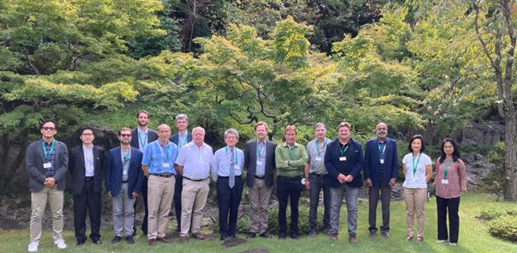
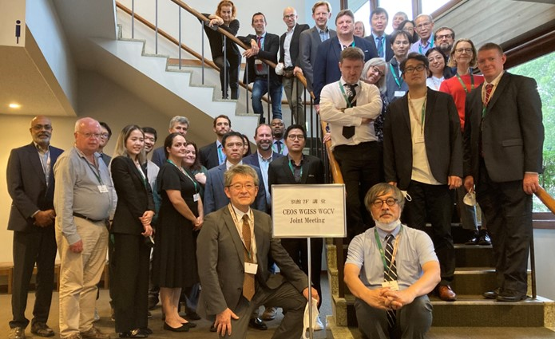

WGCV Recent Meeting
WGCV-51: October 3, 4, 5, and 6 in Tokyo
The first in-person meeting after 3-year interval
October 5, WGCV –WGISS joint session
Joint session discussion topics: Support for ARD, ALOS-2 PALSAR 2 ARD peer review in progress, Instruments, Measurements (MIM) database, Maturity Matrix (data quality/validation), terminology (CEOS online common dictionary)

Slide 4
WGCV Sub Groups
Atmospheric Composition (ACSG)
Infrared Visible Optical Sensors (IVOS)
Land Product Validation (LPV)
Microwave Sensors (MSSG)
Synthetic Aperture Radar (SAR)
Terrain Mapping (TMSG)

Slide 5
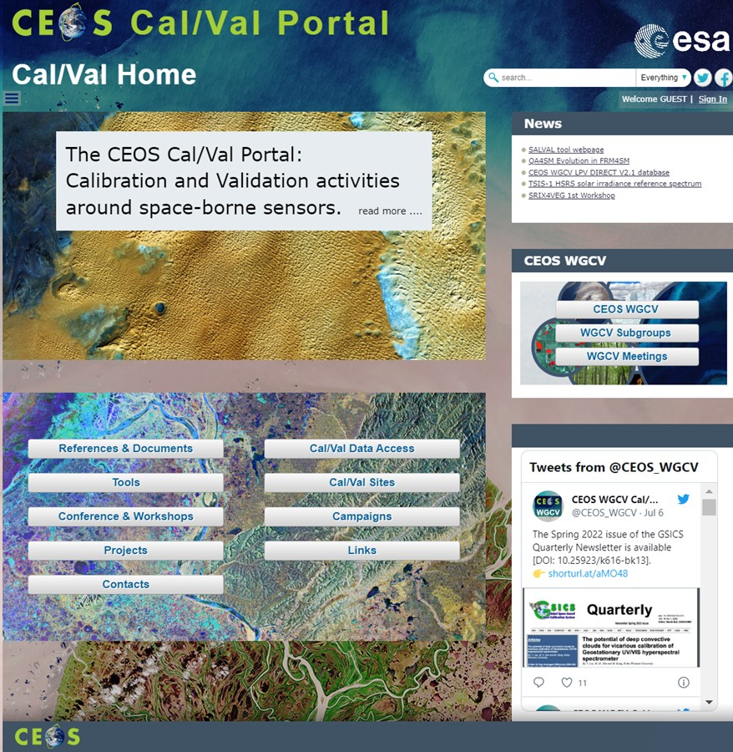
WGCV Cal-VAL portal
Tools for satellite data analysis
Campaign and meeting information
Support to “new space”

Slide 6
CNES CEOS Chair Priorities 2022 and WGCV
Priority #1: Paths to Sustainability – Demonstrating Outcomes of CEOS Strategic Plans, Efforts on Disaster Risk Reduction and Response, and Capacity Building
Priority #2: CEOS Strategy for Support to the UNFCCC Global Stocktake: to ensure its planned missions, such as MicroCARB, provide practical support to the Global Stocktake data requirements (October-November, 2022), Prelaunch test in Toulouse, intercomparison between MicroCARB in the vacuum chamber, EM-27 FTS on the ground, OCO-2, OCO-3, GOSAT, GOSAT-2
Priority #3: Support to Cal-Val Initiatives: to support the cross-calibration of thermal infrared measurements from future CEOS Agency missions

Slide 7
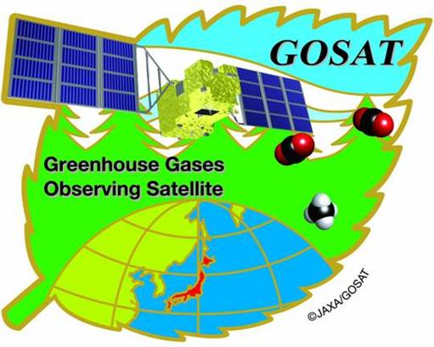




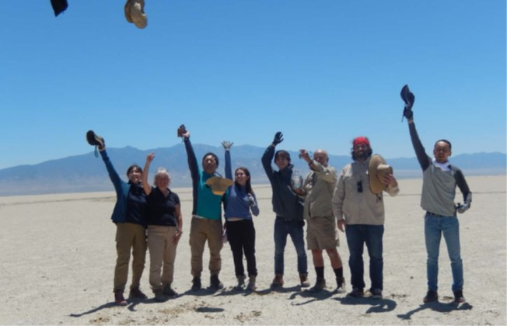
Joint RRV 2022 Nevada campaign
14th annual vicarious calibration campaign was successfully completed in June 2022, Railroad valley Nevada.
Coincident measurements of GOSAT, GOSAT-2, OCO-2 (partially cloud), OCO-3, TROPOMI (everyday).

Slide 8
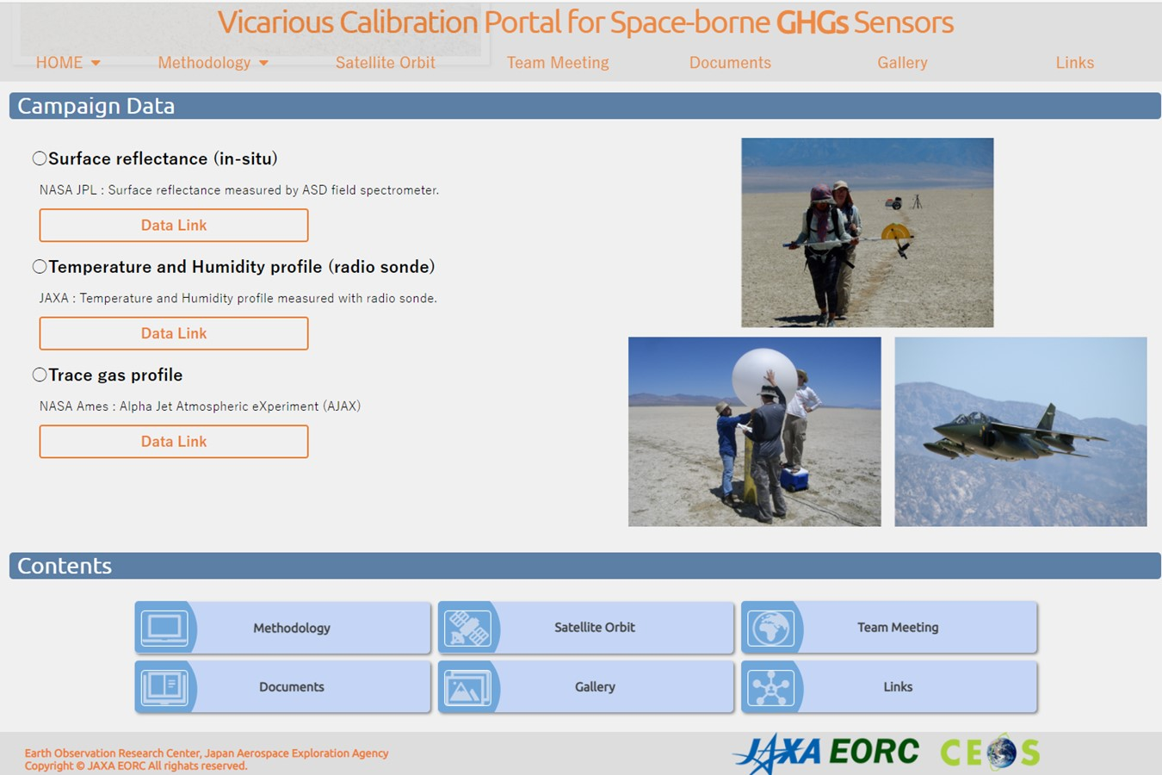
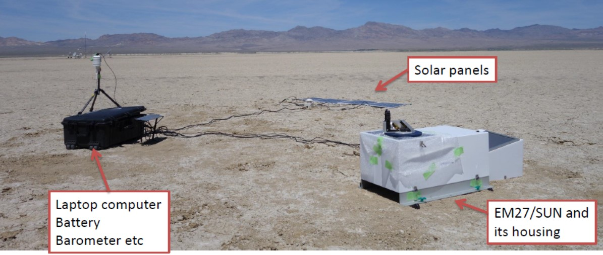
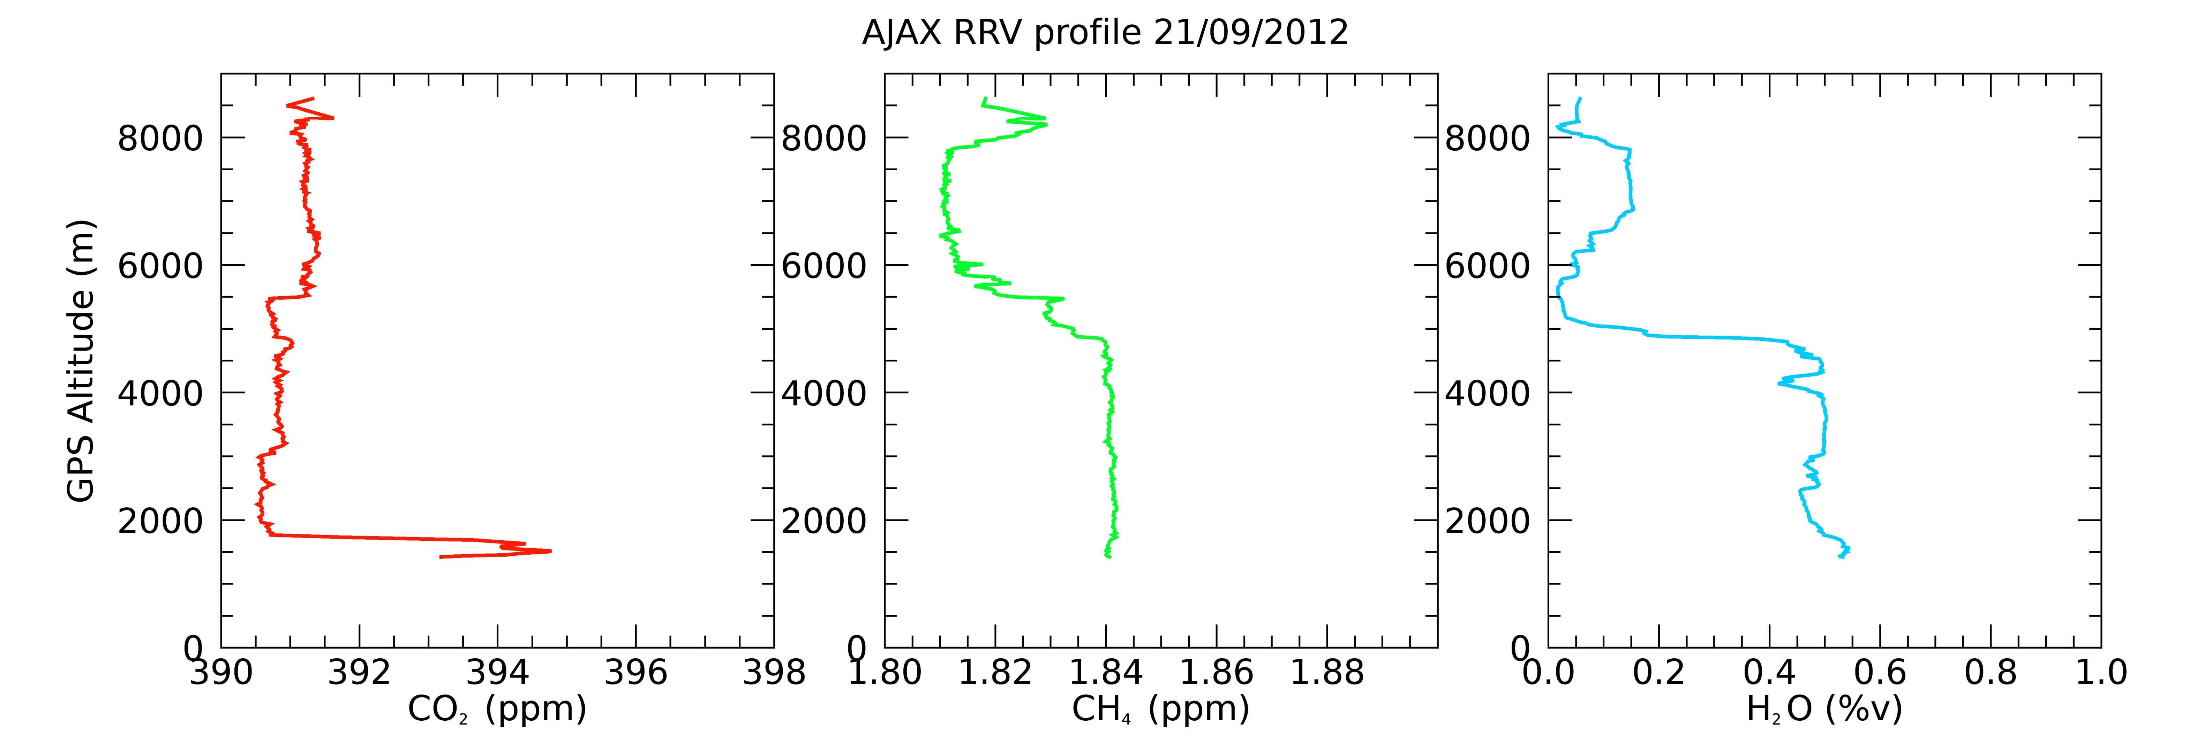
GHG VCAL Portal (Validation)
The GHG VCAL Portal site provides
14-year joint Nevada campaign data for CAL-VAL: surface albedo, radiosonde, XCO₂, XCH₄ by surface EM27-FTS,
Alpha jet vertical profile CO₂, CH₄, H₂O
(by NASA Ames)
Analytical results from various type of spectrometers: GOSAT FTS, OCO, S5P TROPOMI…
Linked with CEOS https://www.eorc.jaxa.jp/GOSAT/GHGs_Vical/index.html
Slide 8

Slide 9
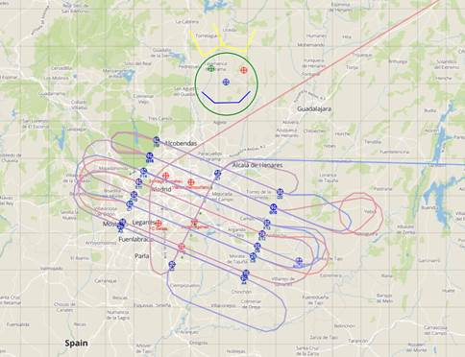
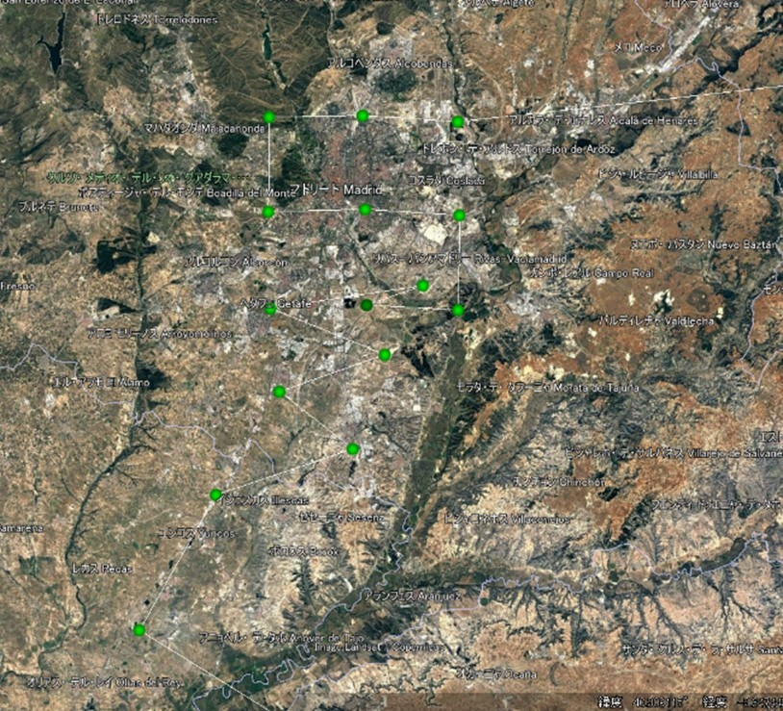
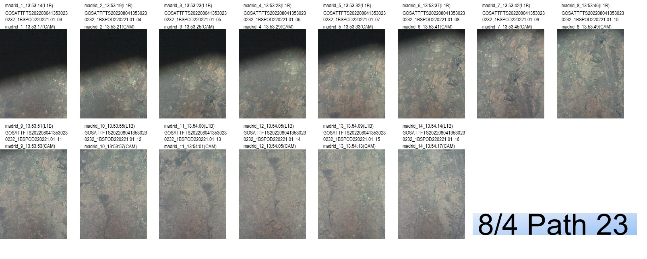
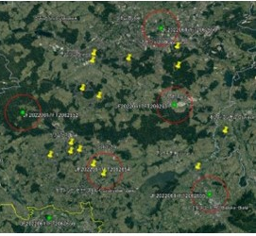
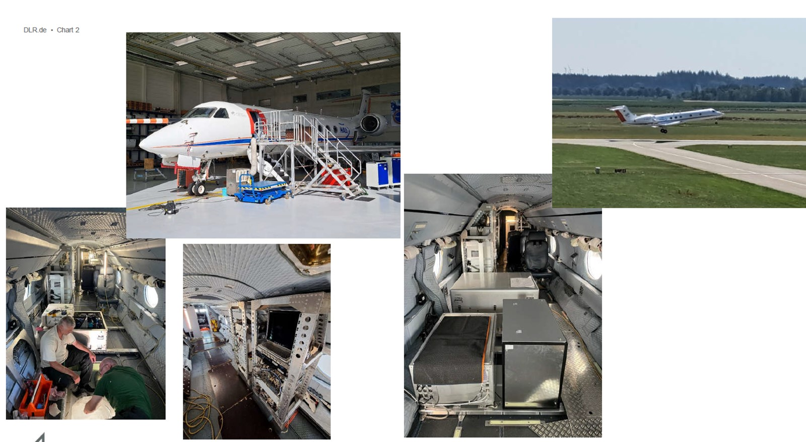


2022 Summer Methane Campaign
Satellites and airplane coincident measurements
Madrid CoMet 2.0
August 4 GOSAT, GOSAT-2
S5P TROPOMI GHGsat
(Courtesy of Andreas fix)
(2) Katowice Poland
ESA Methane campaign in August
(3)Albert Canada Oil and Gas DLR CoMt2.0 Arctic
GOSAT, GOSAT-2 in August
(Courtesy of Andreas fix, DLR)
(4) MicroCarb prelaunch test over Toulouse (October)
Over Landfills, CoMet flight pattern, GOSAT-2 pointing pattern, GOSAT onboard camera image over landfills in Madrid
GOSAT pointing pattern over coal mines

Slide 10

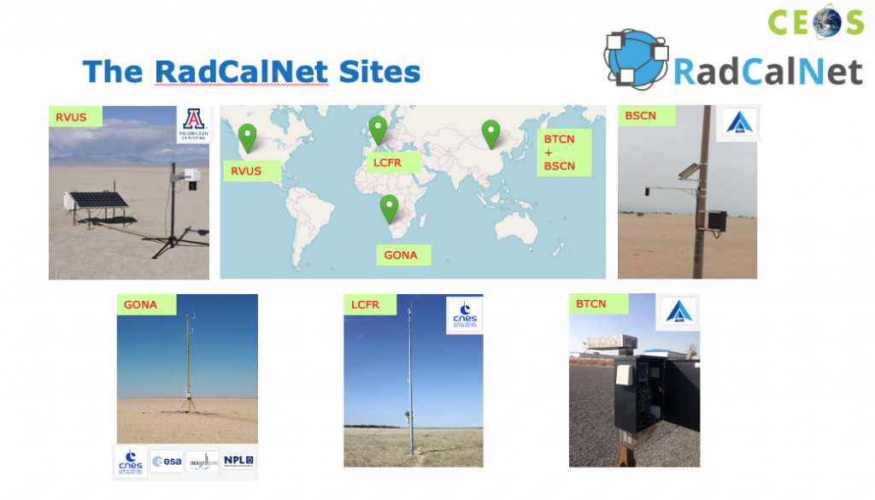
WGCV support for CEOS Chair Priority: Calibration
Discussed in WGCV-51 meeting
(1) Provide Brightness temperature at the top of Atmosphere for TIR calibration
a new network of instrumented sites dedicated to the radiometric calibration of Earth Observation Thermal IR optical sensors
(2) Self-assessment of Fiducial Reference Measurements (FRM)
documented SI traceability, uncertainty budget, accessible to researchers, ……
RadCalNet The Marine Optical BuoY (MOBY)

Slide 11
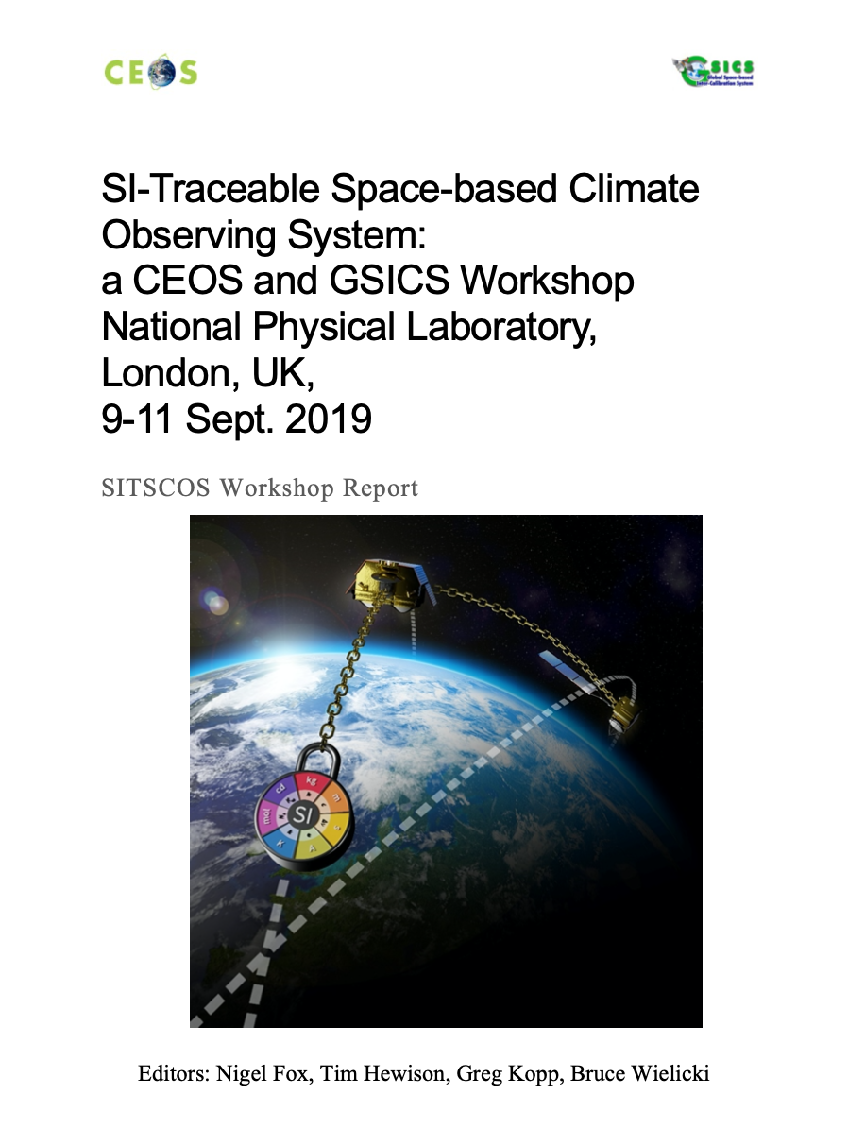
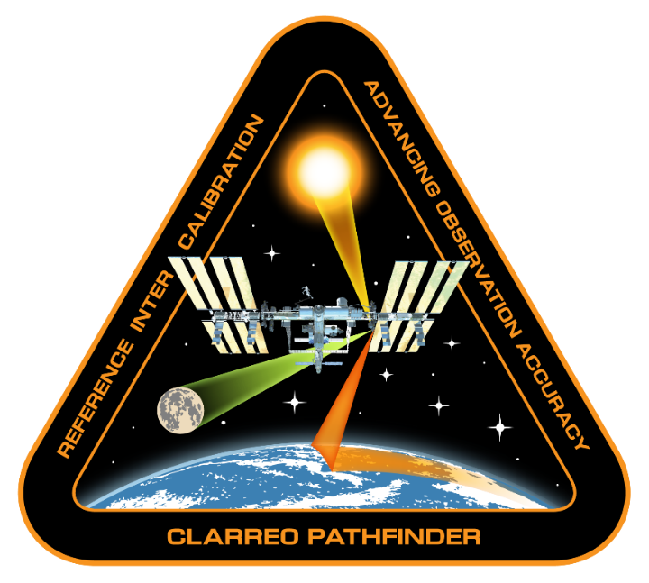
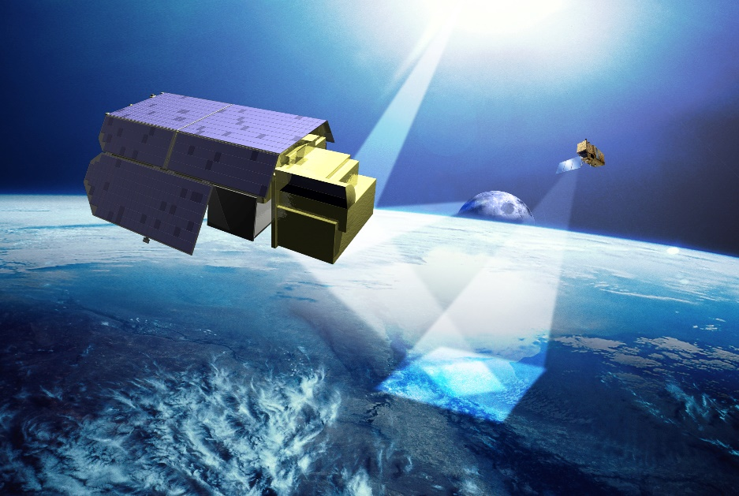
Information: SITSAT coordination (discussion started)
Confidence from metrological traceability to international standards (SI) at location of measurement metrological traceability.
SITSAT: Space borne missions specifically designed, characterized and documented to provide high accuracy SI-Traceable ‘reference’ measurements.’ (Evidencing comprehensive uncertainty to SI, ‘in-space’, of all contributors to observations made from the satellite
TRUTHS
Courtesy of Nigel FOX (UKSA)

