Slide 1
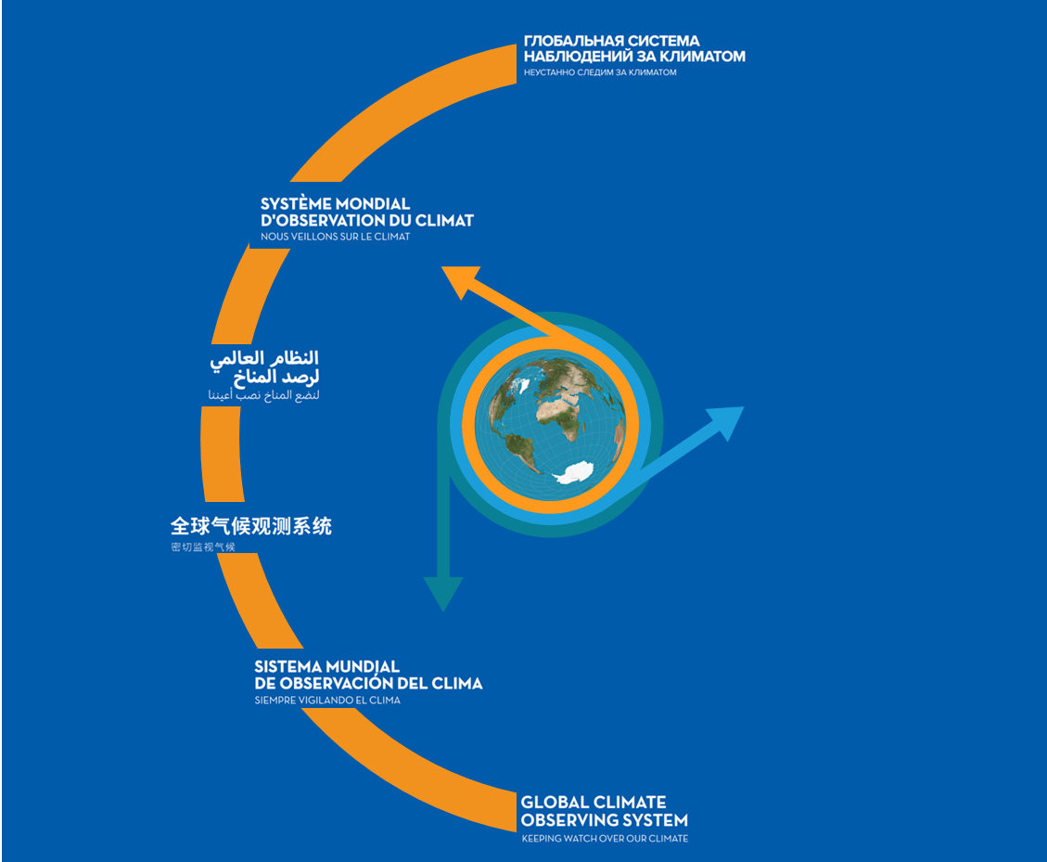
WGClimate-17
(Darmstadt, 20 October 2022)
The GCOS Implementation Plan
2022
Caterina Tassone (GCOS Secretariat)

Slide 2
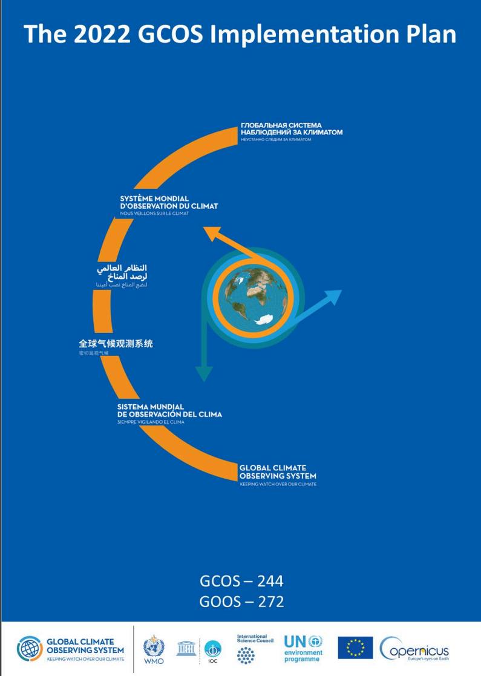
GCOS Implementation Plan
Produced every 5-6 years, GCOS Implementation Plans:
  Are submitted to UNFCCC and the GCOS sponsors.
  Provide recommendations for a sustained and fit for purpose Global Climate Observing System.
  Cover climate monitoring needs over the entire Earth system from the atmosphere to the oceans, from the cryosphere to the biosphere.
  Encompass the water, energy and carbon cycles.
This 2022 GCOS Implementation Plan has a different form to earlier plans, it has:
  Fewer, more focused, and integrated actions.
  Clearer means of assessment.
  Clearer identification of the stakeholders who need to respond to the actions.
  The updated ECVs requirements are presented in a separate document - The 2022 GCOS ECVs Requirements (GCOS 245).

Slide 3
Producing the plan
GCOS has a cycle for monitoring the climate observing system → status reports → implementation plans
based on extensive consultation and public review
drafted by expert panels and drafting team, overseen by editorial board and GCOS Steering Committee
GCOS Status Report
2021
Consultations
  GCOS expert Panels get inputs from their communities
Earlier Status Reports and plans
2016 Implementation Plan
2021 Status report
GCOS monitors performance of global climate observing system
2015 Status Report
Preparation of supplements for specific communities.
Drafting
  Led by a writing team
  Panels identify main actions needed in next 5-10 years
2022 GCOS Implementation Plan
Publication
  Published by GCOS
  Submitted to Sponsors and UNFCCC
Revision
  all comments addressed
  final checks by panels, writing team, and GCOS Steering Committee
Review
  Public review as broad as possible

Slide 4
Wide range of views and inputs condensed into 6 themes
Ensuring Sustainability
Addressing in situ and satellite observations that are currently at risk.
Consultations with observing community
Filling Data Gaps
Observations are consistently deficient in parts of Africa, South America, Southeast Asia, the deep oceans and polar regions.
The GCOS 2021 Status Report
The UNFCCC Paris Agreement
Improving data quality, availability and utility, including reprocessing
Improvements in transforming observations into user-relevant information
Drafting by GCOS
Managing Data
Ensuring data is well-curated, discoverable, open and freely available and permanently archived
Implications of the IPCC 6th Assessment Report and Special Reports
Scientific studies of the climate cycles of carbon, water and energy
Engaging with Countries
Coordinating national efforts with global systems and support, understanding national needs.
Public Review
Other Emerging Needs
Some new needs can already be identified and adressed (e.g. for adaptation and mitigation)
Main Inputs → Broad Engagement → Themes for Action

Slide 5
Next Steps
Who has to act?
GCOS will
  WMO
  NMHS
  Space agencies
  GOOS
  Reanalysis Centres
  Global Data Centres
  Research organizations
  National Agencies
  Parties to UNFCCC
  Academia
  Funding Agencies
  GCOS
Prepare supplements for 5 of these groups summarising the relevant actions.
Address actions allocated to it in Implementation Plan.
Identify additional needs arising from Paris Agreement (i.e. adaptation & mitigation).
Continue to monitor performance of global climate observing system.
Facilitate reviews of observations of climate cycles.
Review adequacy of ECV requirements.
Promote national engagement in GCOS.

Slide 6
GCOS IP Supplements
GCOS has produced 5 supplements: WMO/NMHS, Space Agencies, GOOS, Research Organization, National Agencies
Table of the Space agencies Actions
Theme | Actions
A: ENSURING SUSTAINABILITY | A2. Address gaps in satellite observations likely to occur in the near future
 | A3. Prepare follow-on plans for critical satellite missions
B: FILLING DATA GAPS | B1. Development of reference networks (in situ and satellite Fiducial Reference Measurement (FRM) programs)
 | B3. New Earth observing satellite missions to fill gaps in the observing systems
 | B5. Implementing global hydrological networks
 | B6. Expand and build a fully integrated global ocean observing system
 | B9. Improve estimates of latent and sensible heat fluxes and wind stress
C: IMPROVING DATA QUALITY, AVAILABILITY AND UTILITY, INCLUDING REPROCESSING | C1. Develop monitoring standards, guidance and best practices for each ECV
 | C2. General improvements to satellite data processing methods
 | C4. New and improved reanalysis products
 | C5. ECV-specific satellite data processing method improvements
D: MANAGING DATA | D4. Create a facility to access co-located in situ cal/val observations and satellite data for quality assurance of satellite products
F: OTHER EMERGING NEEDS | F1. Responding to user needs for higher resolution, real time data
 | F2. Improved ECV satellite observations in polar regions
 | F3. Improve monitoring of coastal and Exclusive Economic Zones
 | F5. Develop an Integrated Operational Global GHG Monitoring System

Slide 7
Actions
Action F2: High Level Action
Activities | 1. 2. ...
Issue/Benefits | 1. 2. ..
Implementers | 1. 2. …
Means of Assessing Progress | From 1 to 3:
Additional Details
Links with other IP Actions

Slide 8
A: ENSURING SUSTAINABILITY
Action A2: Address gaps in satellite observations likely to occur in the near future
Activities | Urgent actions are needed to ensure continuity of the following satellite observations: Altimetry in the polar regions. Gravimetry missions. Biomass measurements. Limb-sounding missions capable of measuring several ECV species in the Upper Troposphere/Lower Stratosphere (UTLS) and stratosphere. Sea Surface Salinity (SSS) measurements. Wind lidar. Global scale ice surface elevation.
Issue/Benefits | Monitoring of many ECVs which are critically important to climate science are now dependent on satellite observations. There is a real danger that some observations will stop in the next 5-10 years, or even sooner for missions that have already exceeded their expected lifetime. The continuity of these measurements is essential to develop and extend the long time series needed for climate monitoring.
Implementers | From 1 to 7: Space agencies.
Means of Assessing Progress | From 1 to 7: Established plans of Space agencies that ensure the continuation of satellite missions for altimetry, gravimetry, biomass, limb-sounding, sea surface salinity, wind lidar, global scale ice surface elevation.
Action A3: Prepare follow-on plans for critical satellite missions
Activities | Develop follow-on plans to ensure medium and long-term continuity of the following satellite observations: Earth Radiation Budget (ERB) measurements. Cloud profiling. Cloud lidar. Global Precipitation Measurement (GPM) consisting of a dual-frequency precipitation radar and passive microwave measurements to provide sufficient temporal and spatial sampling of rain areas. Sea ice and icebergs (or floating ice).
Issue/Benefits | Monitoring of many ECVs which are critically important to climate science are now dependent on satellite observations. The lack of confirmed plans for follow-on missions for some of these observations leaves the climate data records for some ECVs at risk. The continuity of these measurements is essential to develop and extend the long time series needed for climate monitoring.
Implementers | From 1 to 5: Space agencies.
Means of Assessing Progress | From 1 to 5: Established (long-term) plans of Space agencies demonstrating the continuation of satellite missions for earth radiation budget, cloud profiling radar, cloud lidar, GPM and floating ice.

Slide 9
B: FILLING Data GAPS
Action B3: New Earth observing satellite missions to fill gaps in the observing systems
Activities | Improve diurnal sampling of observations and coverage of GHGs, precursor aerosols, and solar-induced fluorescence (SIF) to improve estimation of emissions and vegetation carbon uptake. Explore new ways to improve estimates of Earth’s Energy Imbalance (EEI) with novel remote sensing techniques and with very well calibrated hyperspectral measurements over the full spectrum of the outgoing longwave and shortwave radiation. Provide direct measurements of ocean surface currents from space. Explore and demonstrate the feasibility of satellite missions based on new satellite technologies for climate monitoring. Develop operational techniques to estimate permafrost extent.
Issue/Benefits | Improving the coverage and spatio-temporal resolution of GHG, precursor aerosols and SIF measurements can be facilitated by constellations of low-earth-orbiting (LEO) satellite with varying overpass times, or observations from geostationary (low and mid-latitudes) and highly elliptical (high latitudes) orbits. High temporal frequency measurements are required for better diurnal characterization of GHG lifecycles, carbon cycle components and improved emission estimation in synergy with expanded in situ systems. Direct measurements of the EEI need to be improved to the extent possible. However, the EEI cannot currently be determined from space-borne broad-band radiometers with sufficient accuracy. Direct measurements indicative of EEI from space would allow us to quantify and track Earth's energy uptake responsible for global climate change. On the one hand, new approaches based on hyperspectral longwave and shortwave radiances could provide the insight sought to understand the temporal change of the EEI. On the other hand, novel techniques that measure radiation pressure accelerations in orbit are expected to exceed accuracy limitations of broadband radiometry, but are currently at the concept stage of development. Ocean surface currents play an important role in redistributing heat, salt, passive tracers, and ocean pollutants in the surface layer of the ocean. These currents have significant implications to climate, weather, sea state, marine biology, ecosystems, and biogeochemistry. Currently, space-based estimates of near-surface currents are produced by combining surface geostrophic currents derived from altimetry and Ekman Current derived from ocean-surface wind stress (e.g., from scatterometers). They are more representative of mixed-layer currents than surface currents. Moreover, the geostrophic and Ekman theories break down near the equator, preventing reliable estimates of the currents from altimetry and scatterometry measurements. Direct measurements of surface currents from space are thus needed. It is important to take climate related requirements directly into account during the development and implementation of new satellite missions. Therefore, it is necessary to proceed with exploration and demonstration of new satellite missions to be compatible with climate monitoring needs (Stephens et al., 2020). Knowledge of changes in permafrost extent are important to adapt infrastructure and minimize losses due to melting permafrost.
Implementers | From 1 to 5: Space agencies.
Means of assessing progress | From 1 to 3 and 5: Feasibility studies addressing mission concepts relevant to observation and mission gaps. Solicitations by Space agencies for satellite mission development relevant to the above points. 4. Number of publications on new potential satellite climate observations.

Slide 10
Action B1: Development of reference networks (in situ and satellite Fiducial Reference Measurement (FRM) programs)
Activities | Continue development of GRUAN. Implement the GSRN. Better align the satellite FRM program to the reference tier of tiered networks and enhance / expand FRM to fill gaps in satellite cal/val. Develop further the concept of a reference network tier across all earth observation domains. Establish a long-term space-based reference calibration system to enhance the quality and traceability of earth observations. The following measurables are to be considered: high-resolution spectral radiances in the reflected solar (RS) and infrared (IR) wave bands, as well as GNSS radio occultations.
Issue/Benefits | The FRM programs of satellite agencies have been carried out independent of broader concerns around tiered network design, yet these measurements should be sustained as part of reference networks and not be funded or considered separately from broader observational strategies. There is also a need to undertake additional FRM measurements to fill critical cal/val capability gaps for some ECVs. Enabling traceable Earth observations from satellites will improve the accuracy and quality of many ECV data sets. In addition to meeting crucial inter-calibration needs, this effort will aid in better understanding climate relevant processes and their spectral signatures.
Means of Assessing Progress | 3a) Alignment of FRM programs into the tiered network of networks concept 3b) Additional FRM measurements to fill gaps to support satellite cal/val of ECVs such as Above Ground Biomass, albedo, FAPAR, LAI and burned area. 5. Implementation of CLARREO pathfinder, TRUTHS and Prefire. Plans for long-term follow-on missions to the short-term (~1 year) pathfinder missions (CLARREO and Prefire) and long-term continuous measurements.
Action B9: Improve estimates of latent and sensible heat fluxes and wind stress
Activities | This action focuses on ice-free oceans and the terrestrial land surface. 1-3: in-situ measurements 4. Develop new approaches and improved methods to better exploit relevant ECV measurements to estimate ocean surface heat, moisture and momentum flux including: Better integration of in situ and satellite measurements, data assimilation, fusion techniques, ensuring consistency between different types of measurements and their harmonisation; Development and deployment of new satellite missions that are tuned to maximise the sensitivity to the state variables needed to estimate heat flux over the ocean and land; Increase and improvements in satellite observations that target both the surface parameters and the near-surface air-parameters; Simultaneously use of an approach based on high resolution numerical models (Large Eddy Simulation (LES)) to augment satellite product validations; Include in future intercomparison campaigns of latent and sensible heat fluxes measurements inferred from simultaneous observations with a water vapour differential absorption lidar (WVDIAL), a Doppler wind lidar and temperature from rotational Raman lidar.
Issue/Benefits | Understanding and estimating surface fluxes is essential for improving projections of climate change and planning adaptation and response measures. Improvement of estimates of ocean surface heat, moisture and momentum flux requires integrating in situ and satellite observations, use of data assimilation and fusion techniques. New and improved methods need to be developed to better achieve this integration.
Means of Assessing Progress | 4a) Reduced uncertainty in both air-sea and land-atmosphere flux products; 4b) Scoping and development of satellite missions to better optimise measurements in the Planetary Boundary Layer.

Slide 11
C: Improving data quality, availability and utility, including reprocessing
Action C2: General improvements to satellite data processing methods
Activities | Improve radiance measurement records and Radiative Transfer (RT) models for simulating them. Improve uncertainty quantification of satellite retrievals. Periodically reprocess full satellite data records whenever an update of underlying methods occurs, especially when those risks introducing discontinuities into the time series. Consolidate satellite observations into instrument-independent space-time grids for easy intercomparisons and fusion. Ensure harmonisation and quality of ancillary data used to generate satellite products such as solar irradiance and meteorological data.
Issue/Benefits | Many data products depend on extended processing streams from observations to data products. Improving data processing methods facilitates ease of use, regular reprocessing and robust uncertainty quantification of available observations. This action identifies key areas for improvements. Ensuring the availability of relevant, high-quality estimates with long-term continuity across multiple instruments and satellites results in better quality of the satellite climate data records.
Implementers | From 1 to 5: Space agencies, Academia, Research organizations.
Means of Assessing Progress | For 1 and 2: New publications showing improvements in radiative transfer and uncertainty characterisation. Increased number of available reprocessed Fundamental Climate Data Records (FCDRs). Increased number of available consolidated gridded satellite datasets. Products with consistent traceability to ancillary data and associated quality assessment.
Action C5: ECV-specific satellite data processing method improvements
Activities | Generate timely permafrost, land cover change, burnt area, and fire severity/burning efficiency products from high resolution data satellite observations (e.g. Sentinel1/-2 and Landsat). Produce harmonised and validated Above Ground Biomass (AGB) and change datasets from different satellite data streams, for enhancing aboveground biomass estimation at global and (sub-national) levels. Ensure that the Bidirectional Reflectance Distribution Function (BRDF) parameters are provided together with surface albedo. Reprocess the LEO NASA 25+ year Lightning Imaging Sensor (LIS) data set from the Optical Transient Detector (OTD, 1995-2000), LIS on the Tropical Rainfall Measuring Mission (TRMM-LIS, 1997-2015) and International Space Station (ISS-LIS, 2017-Present). Reprocess the GEO Geostationary Lightning Mapper (GLM) on GOES-16/17/18 (2017‑Present). Improve consistency of the inter-dependent land products.
Means of Assessing Progress | Improved and validated permafrost, land cover and change products and updated, and higher resolution, burnt area and fire severity products. Global harmonised biomass and change datasets, with validated estimates at sub-national levels. Provision of the isotropic BRDF spectral parameters used in surface albedo retrieval at the same spatial and temporal scale of the products and the uncertainties error budget associated to the surface albedo products. Validated and updated 0.1 x 0.1 deg product for satellites and ground-based lightning RF data sets (GLD360, WWLLN); and ThunderHour grids (derived from the satellite lightning detection) for GLD360, ENGLN, WWLLN, GLM. Validated and updated space and RF ground-based lightning data at 0.1 x 0.1 deg grids. Maps of all biospheric ECVs using a common geographic definition, at the same temporal/spatial scale as climate models with plant functional types.

Slide 12
D:MANAGING DATA
Action D4: Create a facility to access co-located in situ cal/val observations and satellite data for quality assurance of satellite products
Activities | Improve access to co-located satellite and reference quality in situ observations, as well as tools for evaluation purposes. This facility will use data from reference networks and FRM programs for a broad range of ECVs for calibration/validation of satellite programs. Develop tools to use the co-located data collection developed under Activity 1 to undertake various analyses of satellite-based measurements.
Issue/Benefits | The uncertainty for satellite measurements of ECVs are determined and/or verified through intercomparison against in situ measurements. These intercomparison field experiments also provide test bed opportunities for assessing measurement capabilities of new technologies, for testing and developing best practices, and to assess uncertainties in Numerical Weather Prediction and Climate Models. The current limited availability of co-located in situ and satellite data for calibration and validation data restricts the ability of users to assess the quality of satellite products. This action will improve the ability to exploit high quality reference measurement sites/networks including, but not limited to, FRM programs (see Action B1) to provide such calibration and validation data for a broad range of satellite products. What is required is a database of reference measurements and co-located satellite measurements to enable cal/val activities along with provision of a suite of tools. The provision of a centralised facility would minimise overall cost while maximising overall exploitation potential and is therefore preferable to such efforts at the satellite mission-level. It also enables applications which may wish to consider multiple ECVs from multiple satellites and their data fusion. A centralised well-supported facility would enable the long-term satellite cal/val capability necessary to extract the value from considerable investments in satellites and reference networks including FRM programs on a sustained basis.
Implementers | From 1 to 2: Space agencies, WMO, NMHS, Research organizations.
Means of Assessing Progress | Establishment of a unified database of and access to co-located, reference quality, ground-based measurements suitable for satellite cal/val. Increased number of available compatible satellite and in situ datasets.

Slide 13
F: Other Emerging Needs
Action F1: Responding to user needs for higher resolution, near real time data
Activities | 2. Improve biomass, land cover, land surface temperature, and fire data with sub-annual observations and improved local detail and quality.
Issue/Benefits | High-resolution and near-real time information of ECV-based climate information at global, regional and local scales allows planning to consider the full range of possible impacts. High-resolution data (in space and time), which, for many ECVs are currently not available, will allow rapid monitoring of changes in the climate system. This will allow the tracking of sustainable mitigation and adaptation measures. Improved high-resolution and near-real-time ECV data will allow improved understanding of CIDs.
Means of Assessing Progress | 2. Availability of key terrestrial ECVs at resolutions of 10-30 m stored in long term archives; Availability of Near Real Time (NRT) sub-annual data for critical land changes and to identify extremes stored in long term archives.
Action F2: Improved ECV satellite observations in polar regions
Activities | Improve satellite observations of: Sea Surface Salinity of polar oceans. Greenhouse gases at high latitudes with a focus on the permafrost regions in wintertime. Sea-ice thickness. Surface temperatures of all surfaces (sea, ice, land). Atmospheric ECVs at the very highest latitudes. Albedo for all surfaces (land and sea-ice).
Issue/Benefits | Satellite missions in polar regions present particular challenges and this action highlights some of them affecting the measurement of certain ECVs.
Implementers | From 1 to 6: Research organizations, Academia, Space agencies.
Means of Assessing Progress | From 1 to 3: Proof of concept for new technologies and new methodologies to measure SSS, sea-ice thickness and GHGs at high latitudes, particularly in wintertime. For 4 and 6: Feasibility study for true pole-to-pole orbital mission to measure changes at the very high latitudes for a set of targets ECVs. For 5: Feasibility studies on current and potential future satellite constellations or instrument combinations to improve satellite observations at the very highest latitudes for atmospheric ECVs.

Slide 14
Action F3: Improve monitoring of coastal and Exclusive Economic Zones
Activities | Expand global ocean climate in situ observations and satellite products into Exclusive Economic Zones (EEZs) and coastal zones. Develop new satellite-based products for coastal biogeochemistry. Produce land cover datasets in coastal areas without land surface masks and in near real time, including uncertainties.
Issue/Benefits | Monitoring of coastal zones and EEZs is necessary to allow policies and measures to be developed to protect the significant vulnerable populations, infrastructure and ecosystems in these areas.
Implementers | GOOS, Space agencies, NMHS. Space agencies, Research organizations, Academia. Space agencies
Means of Assessing Progress | Increased density of observations and reprocessed products in EEZ and coastal waters, and related uncertainties. Number of global operational biogeochemical products in coastal areas. Number of land-cover data sets produced without masks
Action F5: Develop an Integrated Operational Global GHG Monitoring System
Activities | The overall aim here is to develop an integrated operational global greenhouse gas monitoring infrastructure. 2. Design a constellation of operational satellites to provide near-real time global coverage of CO₂ and CH₄ column observations (and profiles to the extent possible). 4. Improve and coordinate measurements of relevant ECVs at anthropogenic emissions hotspots (large cities, powerplants) to support emission monitoring and the validation of tropospheric measurements by satellites.
Issue/Benefits | The Paris Agreement requests Parties to regularly provide estimates of anthropogenic emissions by sources and removals by sinks of greenhouse gases, and information necessary to track progress made in implementing and achieving their nationally determined contribution under Article 4. The proposed global greenhouse gas monitoring infrastructure would support the development of these estimates (i.e. emission inventories); validate national and regional achievement of Parties’ commitments in their National Adaptation Plans (NAPs); and monitor changes to the cycles of GHG that may impact the achievement of the temperature goal of the Paris Agreement. Remote monitoring of atmospheric composition can quantify and identify major emission sources. Anthropogenic emission hotspots like cities and industrial facilities and power plants contribute strongly to the global GHG emissions and to emission of key ozone and aerosol precursors (SO₂, VOCs). Reliable remote observations of these emission hotspots in synergy with source detection models can contribute to verifying emission estimates and monitor and guide mitigation efforts (link to Flux ECV).
Implementers | 2. Space agencies, National agencies, Research organizations, Academia. 4. GCOS, Space agencies, National agencies.
Means of Assessing Progress | 2. Designs and plans for in situ and satellite observations. 4a)Improved satellite retrievals in the presence of varying aerosol loadings in urban and hotspot conditions. Improved uncertainty quantification of GHG retrievals in the presence of aerosols; 4b) Number of emission detection studies using in situ and satellite data near hot spots.

Slide 15
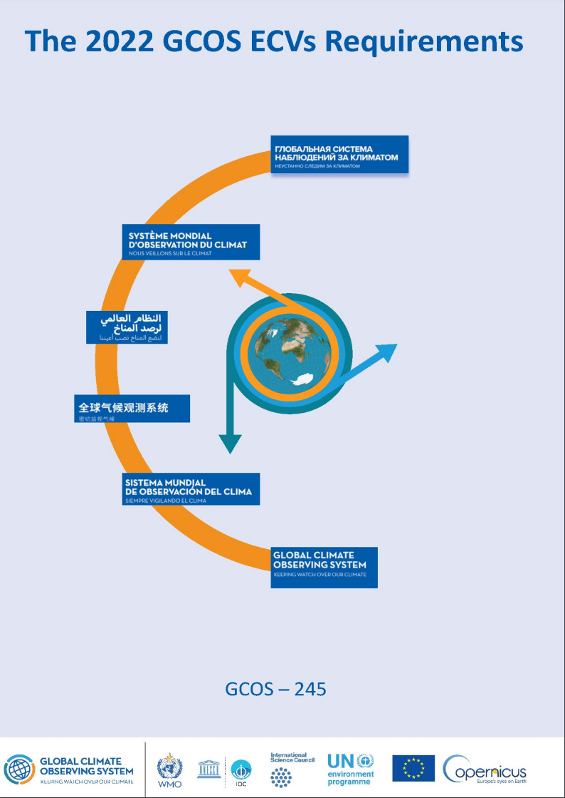
ECV Requirements
GCOS specifies 54 ECV variables, for most of the ECVs there are one or more ECV products.
  ECV product: measurable parameter needed to characterize the ECV.
GCOS routinely maintain, review and revise the list of ECV product requirements.
The 2022 GCOS ECV Requirements presents ECV product requirements
covering all ECV products.
GCOS provides requirements for the RRR Application area: Climate monitoring
Requirements were defined by GCOS expert panels members, informed by the wider community.
1st public review in 2020: comments were addressed by panel members
2nd public review in 2022 as part of the GCOS IP
WGClimate provided several comments that were addressed by experts

Slide 16
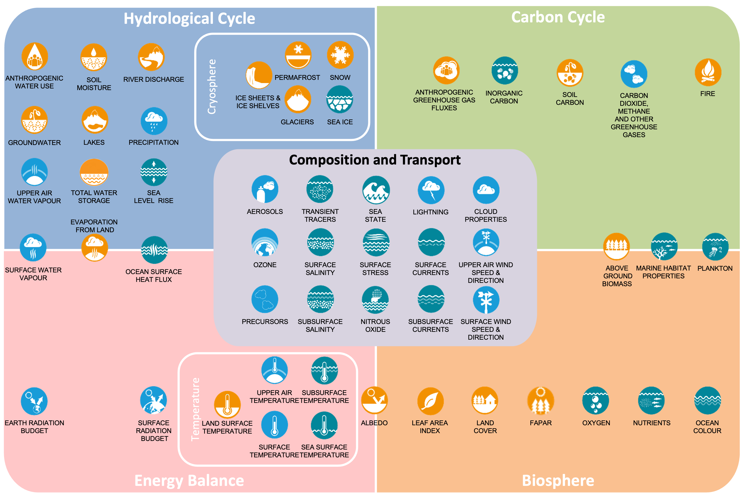
ECVs
Essential Climate Variables and the climate cycles (See section 2.4). Many ECV contribute to understanding several different cycles – this only indicates the main links.
ECVs belong to three panel domains: l Atmosphere ECVs (AOPC); l Ocean ECVs (OOPC); l Terrestrial ECVs (TOPC)

Slide 17
What is new in the 2022 ECV requirements
Compared to the GCOS-200:
GCOS has worked together with WMO to homogenize names and definitions.
Updated names and definitions for atmospheric ECVs were first agreed within AOPC and then approved by JET-EOSDE.
For each ECV product:
Names, definition, units, spatial and temporal resolution, timeliness, uncertainty (2-sigma) and stability.
Requirements are specified for goal, breakthrough and threshold.
References are added for traceability.
New ECVs:
Terrestrial Water Storage (the total amount of water stored in all continental storage compartments: ice caps, glaciers, snow cover, soil moisture, groundwater, surface water bodies, water in biomass).
Several ECV products for existing ECVs were added or modified.

Slide 18
What is new in the 2022 ECV requirements
AOPC and GAW have worked together: for all Atmospheric composition ECVs for the Application Area ‘Climate Monitoring’ and the GAW AA ‘Monitoring Atmospheric Composition’ names, definitions and units were agreed.
OOPC and GCW have worked together to define new ECV products and requirements for the ECV “Sea Ice”.
OOPC has worked with the Global Ocean Observing System (GOOS) BioEco and Biogeochemistry experts panels to provide requirements for biological and biogeochemical ocean ECVs.
Ocean ECVs constitute the climate component of the Essential Ocean Variables, which also encompass ocean health and operational applications.

Slide 19
Atmospheric ECVs product - example

Slide 20
Thank you

