Slide 1
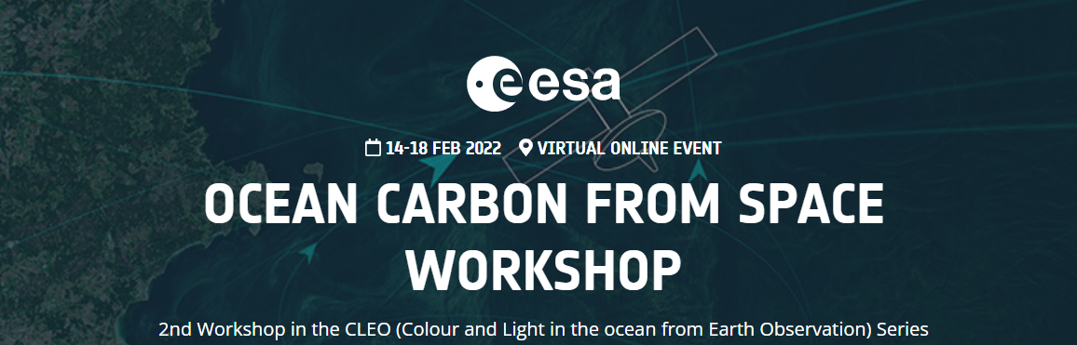
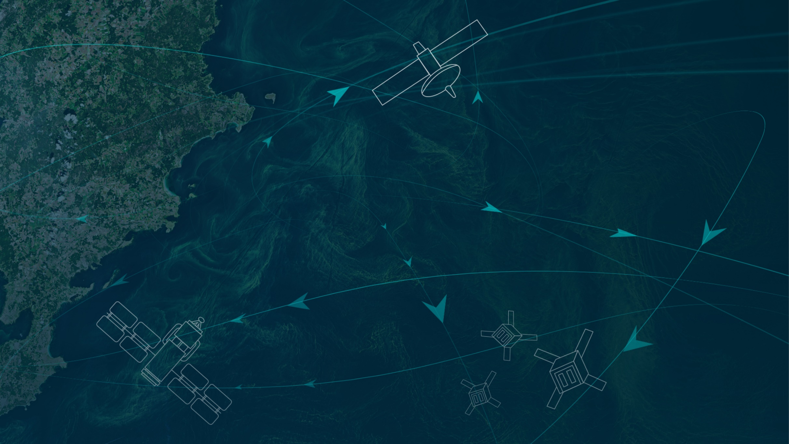
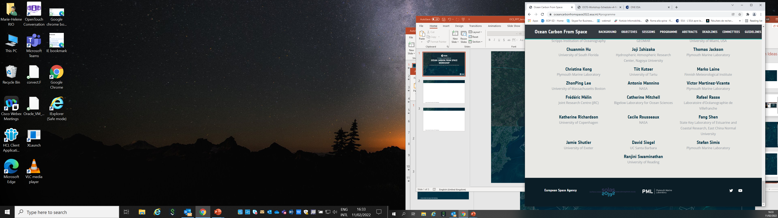

Marie-Helene RIO, ESRIN-ESA
https://oceancarbonfromspace2022.esa.int/

Slide 2
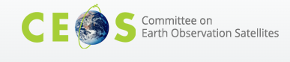
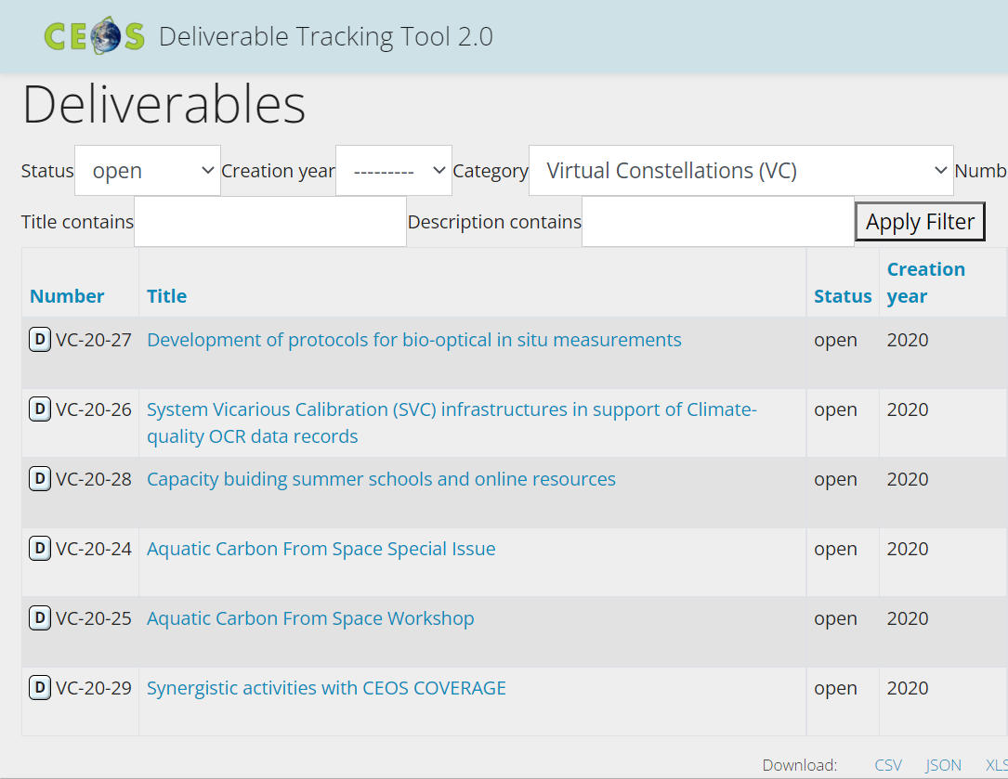
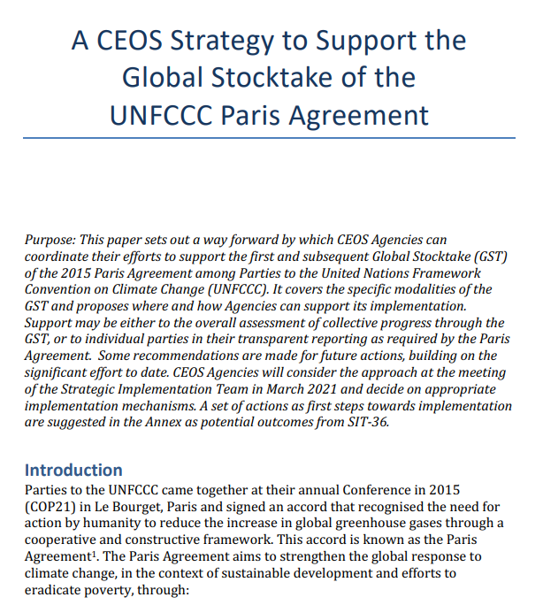
The Ocean Carbon From Space Workshop
A contribution to the CEOS 2020-2022 Workplan
CEOS GHG (Green House Gas ) Roadmap
CEOS AFOLU (Agriculture, Forestry and Other Land Uses) Roadmap
CEOS Aquatic Carbon Roadmap ?
CEOS Global Stocktake strategy paper
-> demonstrate the value of Earth Observation satellite datasets to support the Global Stocktake process

Slide 3


ESA Ocean Science Cluster Projects (>35 on-going)
ARI - PRIMUS
Ocean Health - Marine Heatwaves
Ocean Health - Open Ocean Biodiversity
BiCOME
Physioglob
MAXSS
Ocean Health - Acidification
OceanSODA
CYMS
Polar Lows Prediction
DTEp - MHW
MedEOS
Sargassum
AMT4OceanSatFlux
BICEP
Baltic+Salinity
Coastal Erosion
Aeolus+AOC
Sentinel Coastal Charting
ARI - DUST
S5P+OC
Aeolus+COLOR
SOON
CIRCOL
Baltic+SEAL
POSEIDON
EO4SIBS
Baltic+SeaLaBio
Coastal Hazards
OceanFlux - GHG
Space4SafeSea
World Ocean Circulation
ARI-OHC
PYROPLANKTON
S-6 JTEX
S-1 Doppler
ESA UNCLASSIFIED – For Official Use
Hydrocoastal
European Space Agency

Slide 4
ESA Ocean Science Cluster Projects (>35 on-going)
ARI - PRIMUS
Ocean Health - Marine Heatwaves
Ocean Health - Open Ocean Biodiversity
BiCOME
Physioglob
MAXSS
Ocean Health - Acidification
OceanSODA
CYMS
Polar Lows Prediction
DTEp - MHW
MedEOS
Sargassum
AMT4OceanSatFlux
BICEP
Baltic+Salinity
Coastal Erosion
Aeolus+AOC
Sentinel Coastal Charting
ARI - DUST
S5P+OC
Aeolus+COLOR
SOON
CIRCOL
Baltic+SEAL
POSEIDON
EO4SIBS
Baltic+SeaLaBio
Coastal Hazards
OceanFlux - GHG
Space4SafeSea
World Ocean Circulation
ARI-OHC
PYROPLANKTON
S-6 JTEX
S-1 Doppler
ESA UNCLASSIFIED – For Official Use
Hydrocoastal
European Space Agency

Slide 5
Ocean Carbon Projects: Pools, fluxes and processes that form the ocean solubility and biological carbon pump
OceanSODA
Ocean Health - Acidification
BICEP*
Aeolus+
S5P+OC
ARI-EBUS-PRIMUS
Physioglob
AMT4OceanSatFlux
OceanFlux-ghg
SeaLaBio
From Brewin et al, 2021. Sensing the ocean biological carbon pump from space: A review of capabilities, concepts, research gaps and future developments, Earth-Science Reviews 217 (2021) 103604.
*BICEP= Biological Pump and Carbon Exchange Processes

Slide 6
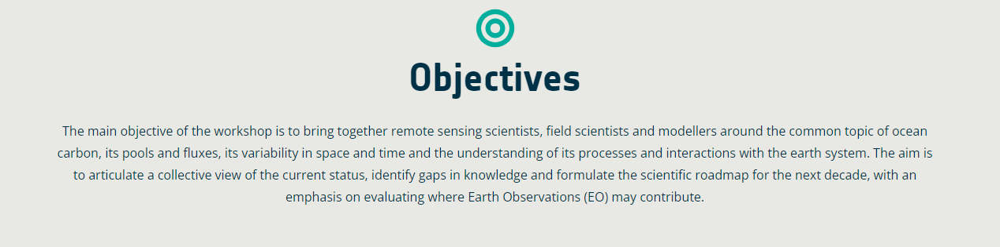
Ocean Carbon From Space 2022 Workshop
Community white paper gathering the workshop’s outcome and recommendations
Prepare for a large ESA Ocean Carbon project, in synergy with other existing initiatives, in particular with existing and future EC projects
Next ESA ITT in preparation

Slide 7
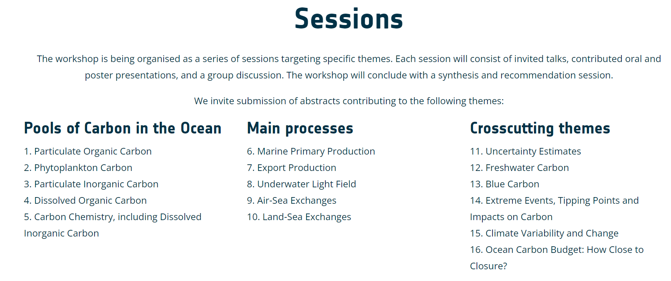
Ocean Carbon From Space 2022 Workshop

Slide 8
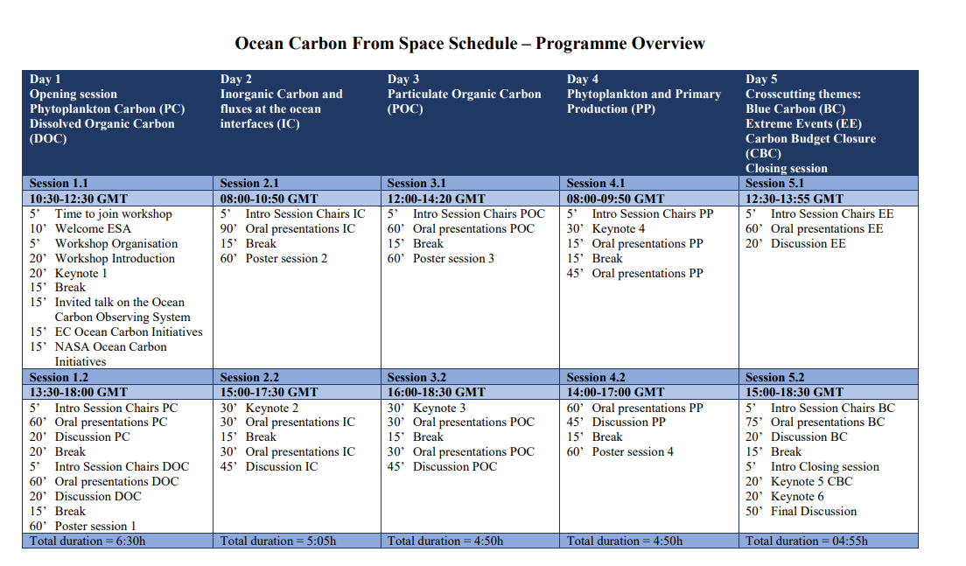

Slide 9
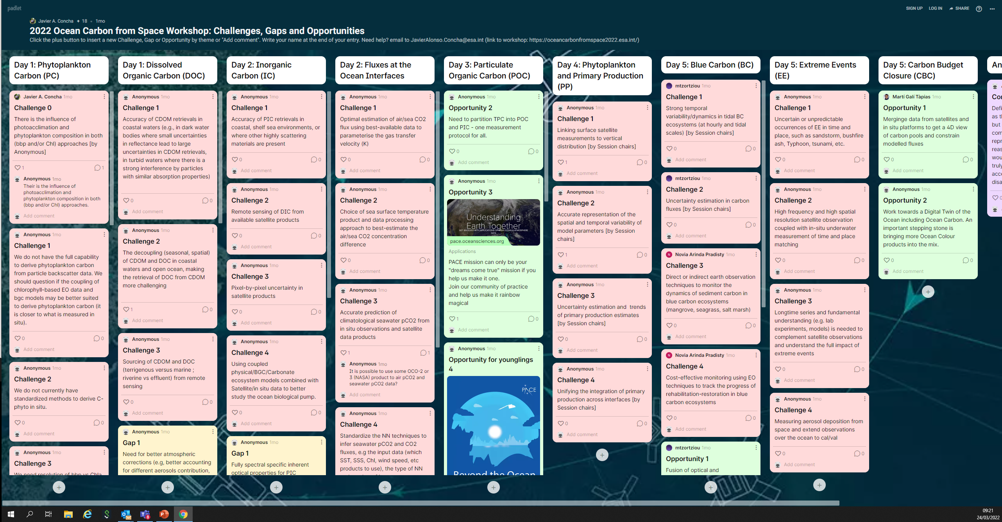
https://padlet.com/JavierAlonsoConcha/OceanCarbonFromSpace

Slide 10
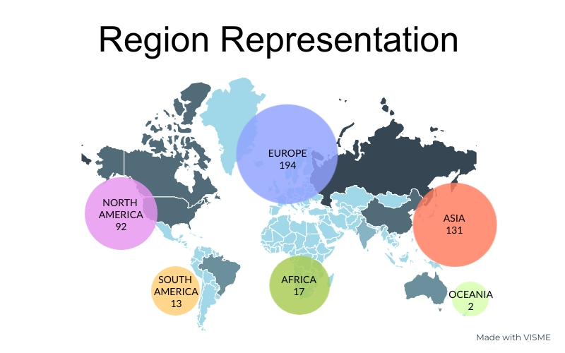

The Workshop in Numbers
Gender Distribution
Total Registration: 449
International Day of Woman and Girls in Science
Prepared by: Javier Alonso Concha and Sabrina Lodadio

Slide 11
Workshop Outcomes : Challenges
Limitations of algorithms retrieval and validation in coastal/shelf sea environments/optically complex waters
Understanding uncertainty budget including propagation from satellite and in-situ observations to L3/L4 products
Using coupled physical/BGC/Carbonate ecosystem models combined with Satellite/in situ data to better study the ocean biological pump.
Linking surface satellite measurements to vertical distribution. High frequency and high spatial resolution satellite observation coupled with in-situ underwater measurement of time and place matching
Capturing the high spatial and temporal variability, in particular in coastal areas
Capturing diurnal or sub-diurnal processes with temporal resolution of current sensors
Better understand differences between models and observations
Better understand the different sensing depths between remote sensing and in-situ data
Bridging spatial and temporal scales between satellite data, in situ observations and models
Improve Predictability
Reduce the (Ocean) Carbon Community Carbon footprint

Slide 12
Workshop Outcomes: Gaps
Lack of high quality in-situ data (coastal, at depth, high latitudes, under-ice, seasonal gaps, higher spatial and temporal resolution) for validating and improving satellite products
Lack of good reporting of protocols used in measuring the in-situ data in current data repositories
Need for standardisation of methods (but not only!)
Lack of Pixel-by-pixel uncertainty in satellite products / Flagging
Need for Long-term consistency of satellite records and derived biogeochemical data products
Need for better connecting biology and physics
Lack of integrative and systematic observations in both physical and biogeochemical parameters;
Need for improved upper-ocean dynamics/high resolution coastal circulation models
Improve connection between the communities
Need for higher spatial and temporal resolution products
Need for higher spectral resolution of satellite measurements
Need for better atmospheric corrections in nearshore/coastal waters
Need for consistent Open Ocean – Coastal – Land products
Need for enhanced observation-based model development/ Data assimilation /Nesting approaches

Slide 13
Workshop Outcomes: Opportunities
Upcoming sensors with improved spectral range/resolutions (UV, hyperspectral) and temporal resolutions (geostationary): PACE (2024) and GLIMR (2027), EnMAP (DESIS, PRISMA), ESA Fluorescence Explorer (FLEX, 2023), S-4 UV/Visible/Near-infrared Geostationary over European waters (2022), S-5 (2024), S2-Next Generation, Copernicus Hyperspectral Imaging Mission for the Environment (CHIME, 2030),
Lidars (Aeolus, EarthCare (2023))
Upcoming Wide-Swath altimetry SWOT (2022)
New in-situ platforms (Ferrybox, coastal Argo floats,…)
Further exploit synergies between sensors (in-situ, satellites), multi-platform approach
Exploitation of existing satellites to further understand the interactions between the different components of the Earth System
Intercalibration and intercomparison exercise with goal of establishing standard measuring protocols for key parameters
Use existing capability to demonstrate capability/prepare exploitation of future missions (GOCI, GOCI II, PRISMA,…)
Further leverage on AI/ML methods (But: in a changing climate, validity of the approach for future projection when based on training dataset at a given time period)
Use of models to perform Observing System Simulation Experiments (OSSE), to evaluate the impact of undersampled observing systems on obtained results, or evaluate the value of new observing systems / design optimal sampling strategies

Slide 14
Next steps
https://oceancarbonfromspace2022.esa.int/
All presentations and posters are available on the workshop website, together with the synthesis, by every chairs of their session’s discussion outcomes.
Community white paper gathering the workshop’s outcome and recommendations
To be published in the upcoming Earth System Reviews Aquatic Carbon From Space Special Issue (deadline May 2022)
Special Issue in Frontiers in Marine Science:
Colour and Light in the Ocean from Earth Observations (CLEO) Volume 2
Deadline for submission of manuscripts: September 2022

Slide 15
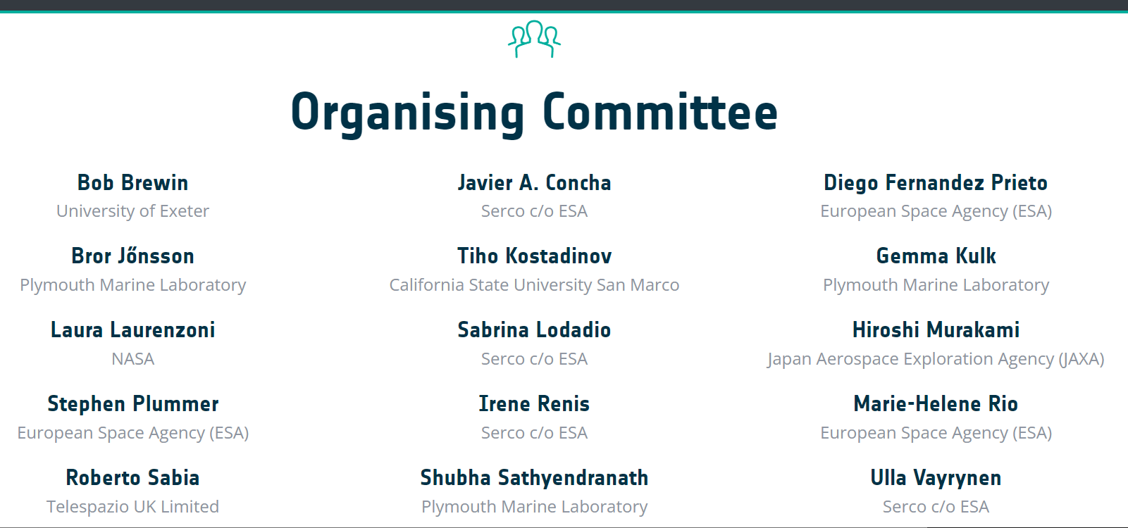
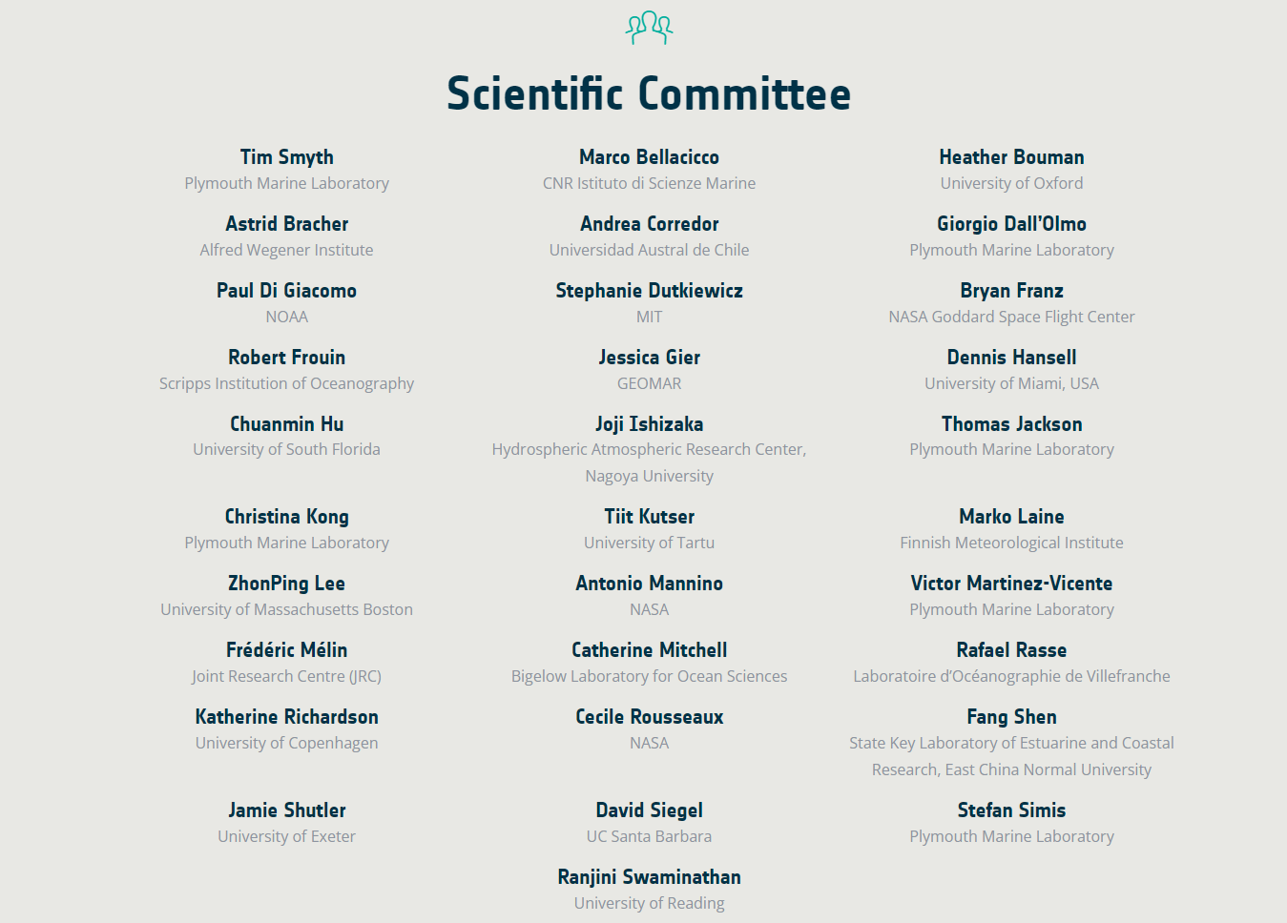
https://oceancarbonfromspace2022.esa.int/

