Slide 1
CEOS AFOLU Roadmap
2021 Progress and Next Steps
Osamu Ochiai (JAXA) Frank Martin Seifert (ESA)
Ben Poulter (NASA)
Joint CEOS-CGMS WGClimate
24 March 2022

Slide 2
AFOLU Team Participation
LSI Forest & Biomass SG
Co-Lead: Osamu Ochiai, JAXA & GFOI Co-Lead
Co-Lead: Frank Martin Seifert, ESA & GFOI Co-Lead
Co-Lead: Benjamin Poulter, NASA
Member
Shanti Reddy, Australia
Kostas Papathanassiou, DLR
Martin Bachmann, DLR
Richard Lucas, ESA/CCI
Shaun Quegan, UK & ESA/CCI
Heather Kay, ESA/CCI
Zoltan Szantoi, ESA & LSI VC
Ian Jarvis, GEOGLAM
Alyssa Whitcraft, GEOGLAM
Martin Herold, GOFC-GOLD
Stephen Ward, JAXA
Ake Rosenqvist, JAXA
Takeo Tadono, JAXA
Michael Falkowski, NASA
Krishna P Vadrevu, NASA
Sassan Saatchi, NASA
Laura Duncanson, UMD
Ritvik Sahajpal, UMD
Brad Doorn, NASA
Christine McMahon-Bognar, NASA
Brian Killough, NASA
Kevin P Gallo, NOAA
Steven Labahn, USGS
Tim Stryker, USGS
Sylvia Wilson, USGS
Joana Melo, UK & ESA/CCI
John Remedios, UKSA
Richard Engelen, ECMWF
Alessandro Cescatti, EC/JRC
Nancy Harris, WRI
Fred Stolle, WRI
SIT Vice Chair
Ivan Petiteville, ESA
Stephen Briggs, ESA
GHG Task Team
David Crisp, ex-JPL/NASA
Mark Dowell, EC/JRC
WGClimate
Albrecht Von-Bergen, DLR
Slide 2

Slide 3
Global Stocktake
Space agencies (CEOS & CGMS) have emphasised ECVs and Physical Climate via the GCOS framework very effectively for the past decade
The importance of NDCs to Paris Agreement, and specifically the Global StockTake (GST), raises new challenges around country needs and implications for using EO data with greater emphasis on mitigation and adaptation, and national-level datasets
A whole new dimension to our climate coordination - both a huge opportunity and a significant challenge
“...if Land Use, Land Use Change and Forestry targets involved in the initial NDCs were implemented in full, this would represent approximately a quarter of pledged mitigation efforts up to 2030“
SIT-35 action: JAXA and ESA explore the development of a CEOS AFOLU (Agriculture, Forestry and Other Land Uses) Roadmap. The aim of the Roadmap is to assess the will, direction and capability of the relevant CEOS Agencies, with the SIT Chair team supporting communications with Principals and identifying team nominees.
Slide 3

Slide 4
Heritage & 2021 Approach
Discussion Paper prepared for October 2020 Plenary
A CEOS AFOLU Initiative for the UNFCCC Global Stocktake Process:
A Discussion Paper for CEOS Plenary to explore the development of a CEOS AFOLU Roadmap
2021 accomplishments (well-recognized by CEOS-35 Plenary)
Assessment of latest AFOLU products that could be readied for COP-26
Engagement of relevant product teams and identification of team leads for our purposes
Coordination with SIT Chair Team and GHG Team to establish a working template for each dataset and its inclusion on the new CEOS GST Portal – as a unified point of entry to explain and offer our data
New engagement axis with national inventory users, building on our GFOI experience and in the spirit of the ambition cycle of the Paris Agreement to learn together and grow together
AFOLU as an input to the Systematic Observation Synthesis Report submission to GST

Slide 5
AFOLU Dataset Summary
 | COP-26 (Nov 2021) | GST1 (2021-23) | Beyond (2024+)
Forest - Above Ground Biomass | Individual existing datasets Synthesised biomass product providing estimates at a jurisdictional level globally | Synthesized, jurisdictional level biomass, emission factors (and prototype biomass change) | Synthesized spatially explicit, annual biomass, emission factors and biomass change
Land Cover & Forest (Area) | - Copernicus annual global land cover - C3S/CCI Land Cover - WorldCover, HILDA+ - Global Forest Watch tree cover loss and forest fluxes | Synthesised map products and estimates of land cover and change at regional, and global levels Global tree cover and forest emissions and removals | Statistically robust activity data estimates (6 IPCC classes) at national and global levels Global annual forest emissions and removals at 30-100 m resolution.
Mangroves & Wetlands | - Global Mangrove Watch cover and change (1996-2020) - Global Mangrove biomass (2000) | - Global mangrove cover and change at 25 m (1996-2022) - Global mangrove biomass at 12 m (2015) | Global annual mangrove emissions and removals at 10-25 m resolution.
Agriculture | Demonstration WorldCereal products for at least 5 countries (Argentina, Spain, France, Ukraine and Tanzania) | Initial WorldCereal map and analytical system. On-going seasonal analysis products | Continual system improvement and production of seasonal state and change products
Indicates off the shelf datasets possible. Indicates additional resources needed.
Slide 5

Slide 6
Our AFOLU Offering for the GST Portal
Above Ground Biomass
Land Cover
Future - synthesised biomass product providing estimates at a jurisdictional level globally
Global Land Cover
HILDA+
Forests
Mangroves
Agriculture
Refer to ceos.org/gst for further details on individual datasets & their application

Slide 7
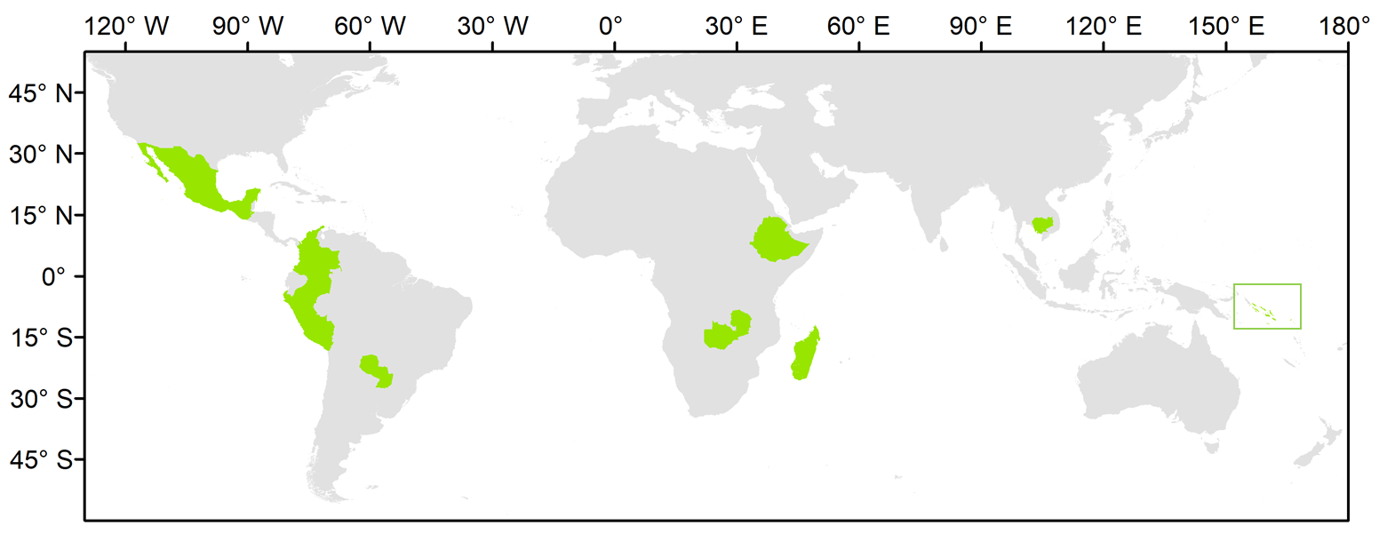
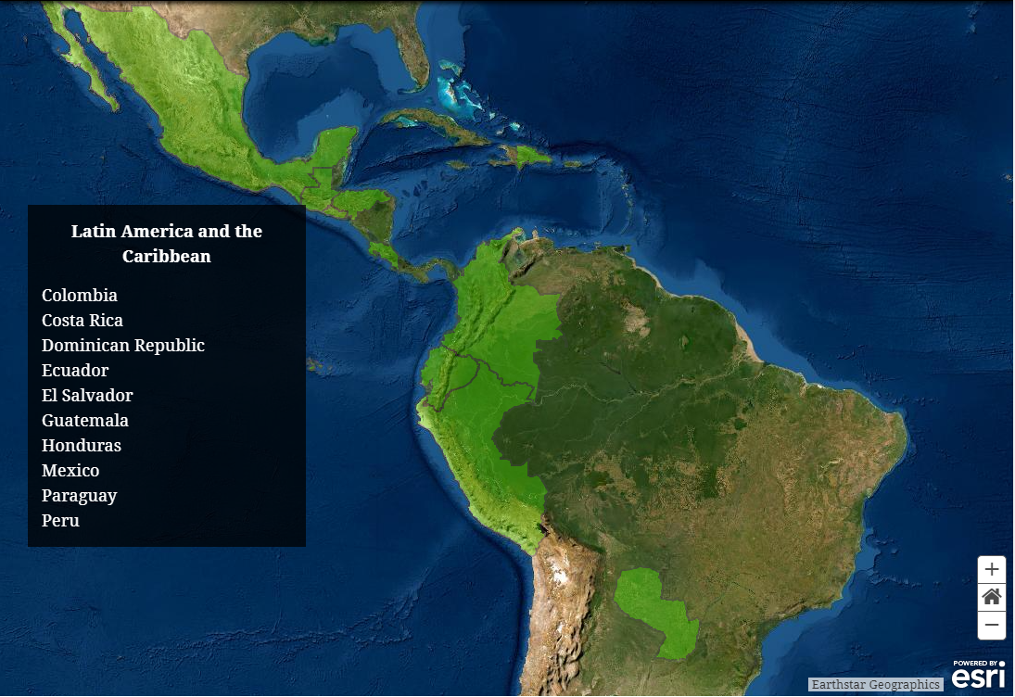
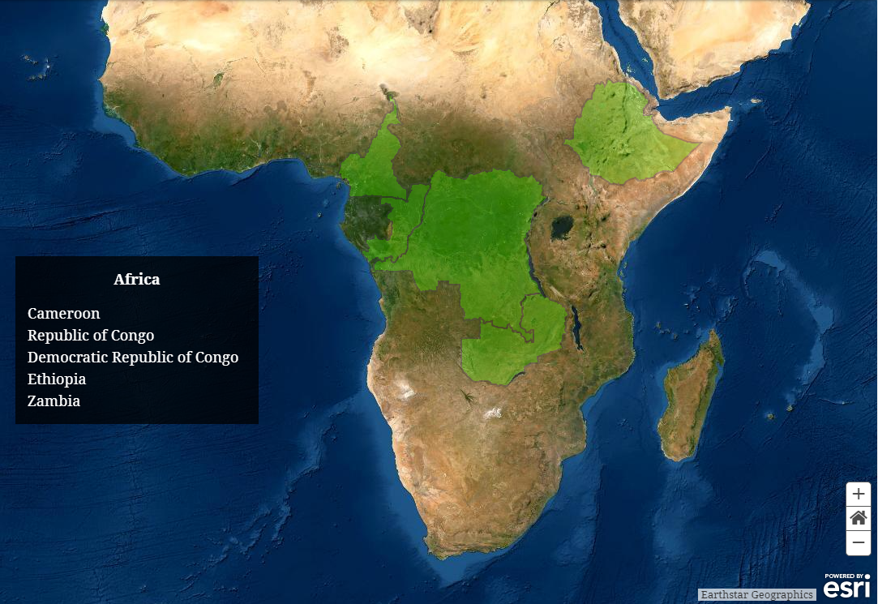
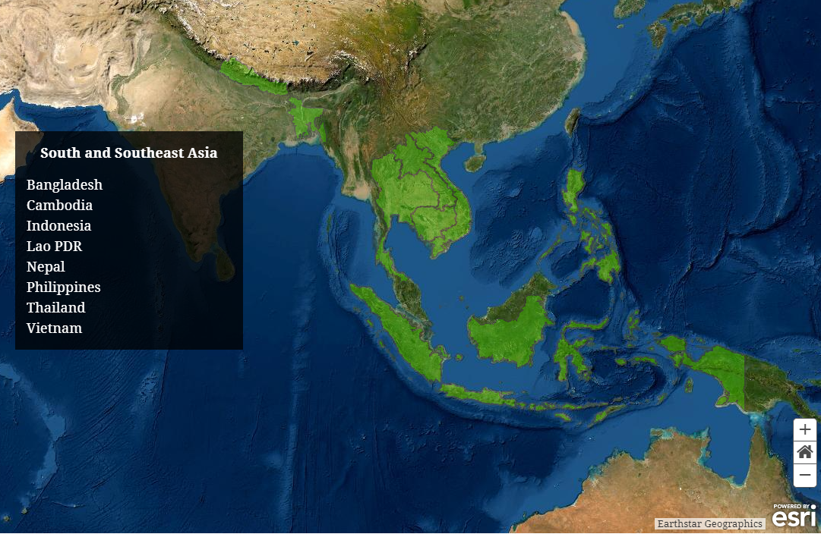
National User Engagement
Demonstration of uptake of satellite-based data and derived products in country reporting to the UNFCCC
 |  |  | indicators of MRV capacity
Country | Region | Status | FREL | BUR REDD+ Annex | BUR | NIR | NFI
Cambodia | Asia | LDC | 2017; 2021 | 2020 | 2020 | 2020 | No
Colombia | Latin American | n.a. | 2015; 2020 | 2016, 2019 | 2015, 2018 | 2019 | Yes
Ethiopia | Africa | n.a. | 2016 | n.a. | n.a. | n.a. | ?
Guatemala | Latin American | n.a. | n.a. | n.a. | n.a. | n.a. | Yes
Madagascar | Africa | LDC | 2017; 2018 | n.a. | n.a. | n.a. | Yes
Mexico | Latin America | n.a. | 2015; 2020 | n.a. | 2015, 2019 | 2019 | Yes
Paraguay | Latin America | n.a. | 2016 | 2019 | 2015, 2018 | n.a. | Yes
Peru | Latin America | n.a. | 2016; 2021 | n.a. | 2014, 2019 | 2019 | Yes
Solomon Islands | Asia | LDC | 2019 | n.a. | n.a. | n.a. | No
Zambia | Africa | LDC | 2016; 2021 | n.a. | 2020 | n.a. | Yes
validation of the harmonized biomass map (additional NFI data)
Solomon Islands

Slide 8
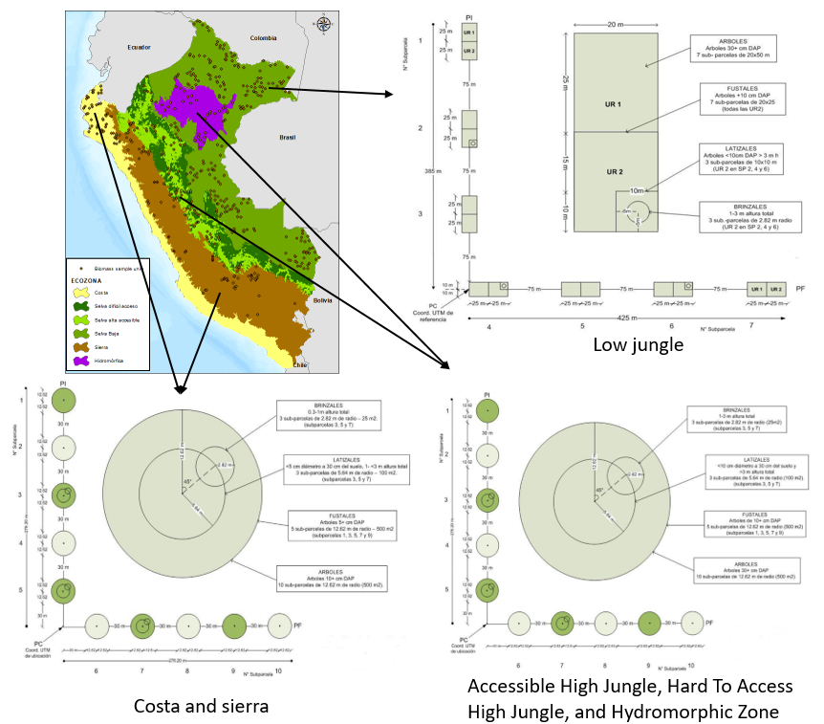
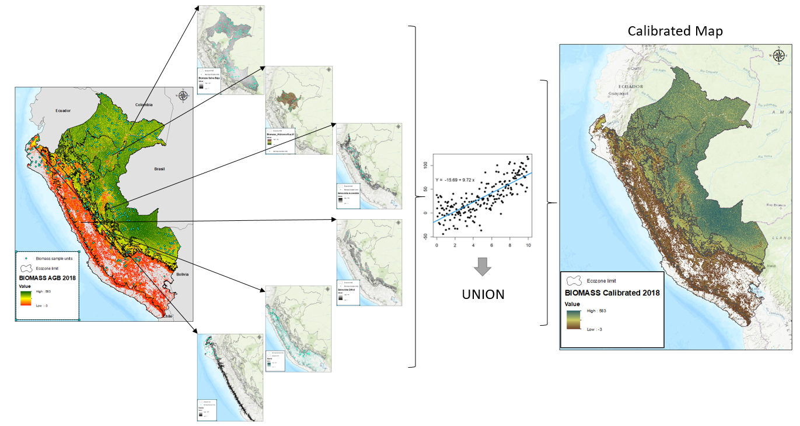
Biomass – Calibration of Global CCI Biomass Map in Peru
Current work:
1. Peru is using the CCI biomass map (AGB) to update ecozone emission factors in the Peruvian Amazon.
2. calibrating these maps using parcel field data to obtain a spatially explicit biomass map for all ecozones in Peru.
The carbon stored in the forests of Peru is measured from NFI Data by ecozones:
Coast,
Highlands
Accessible High Forest
High Forest of Difficult Access
Low Forest

Slide 9
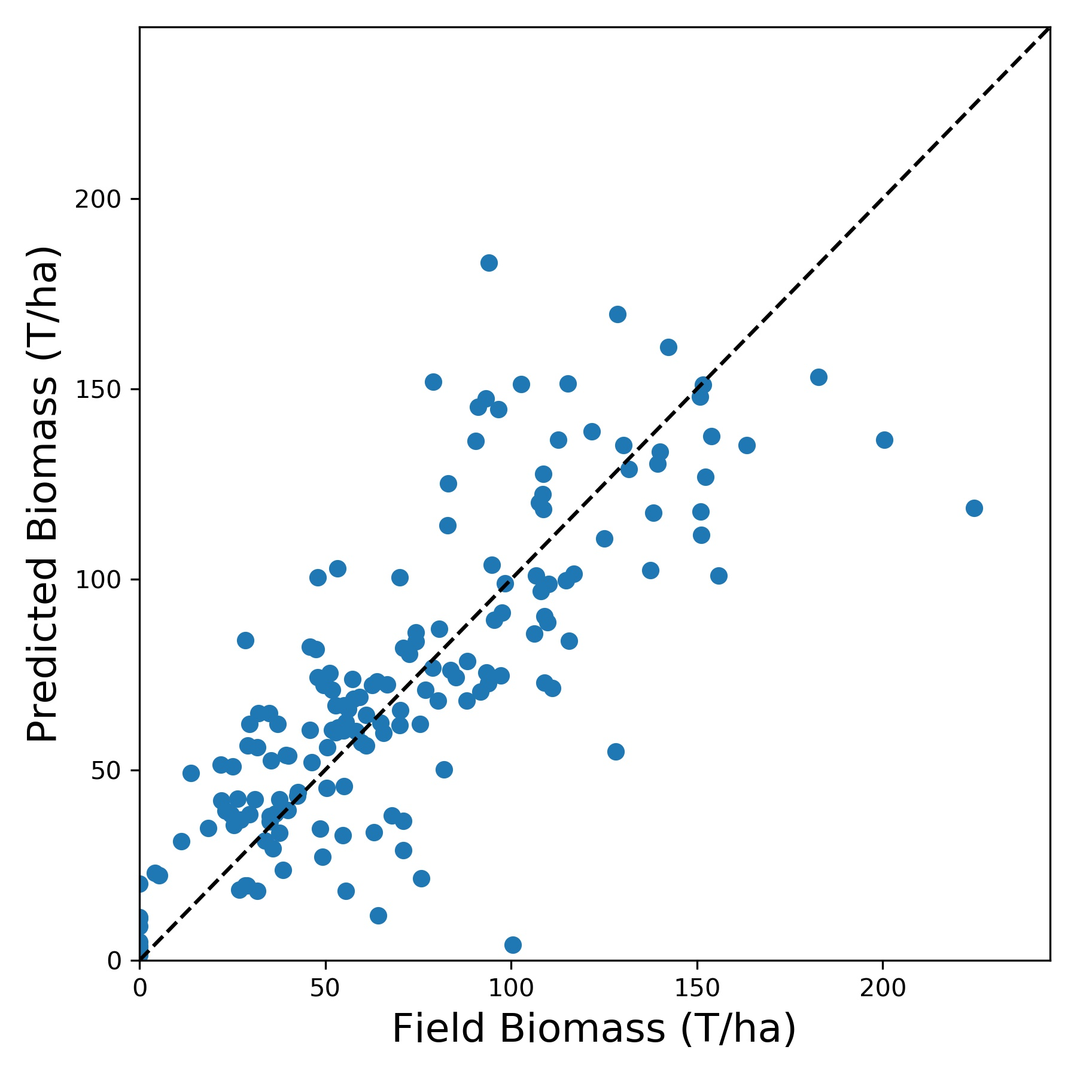
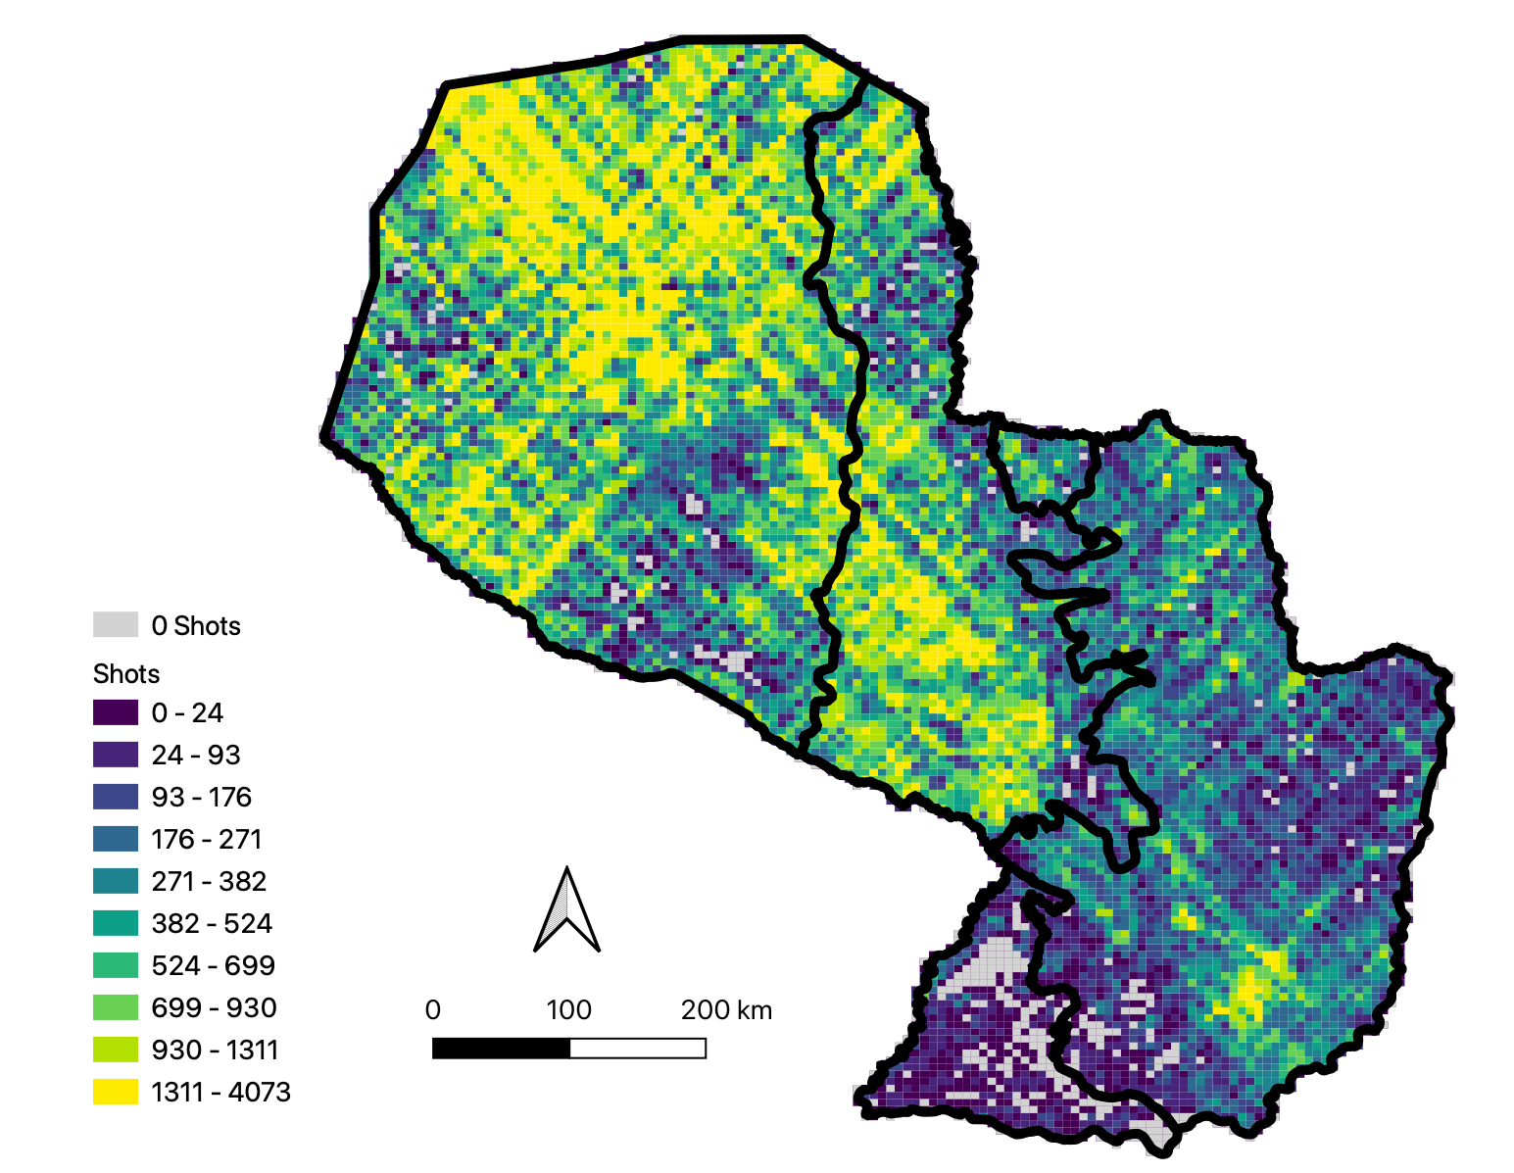
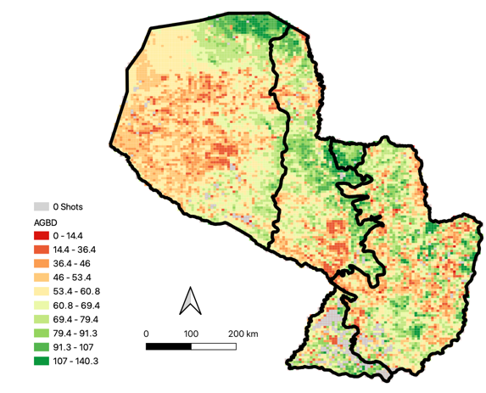
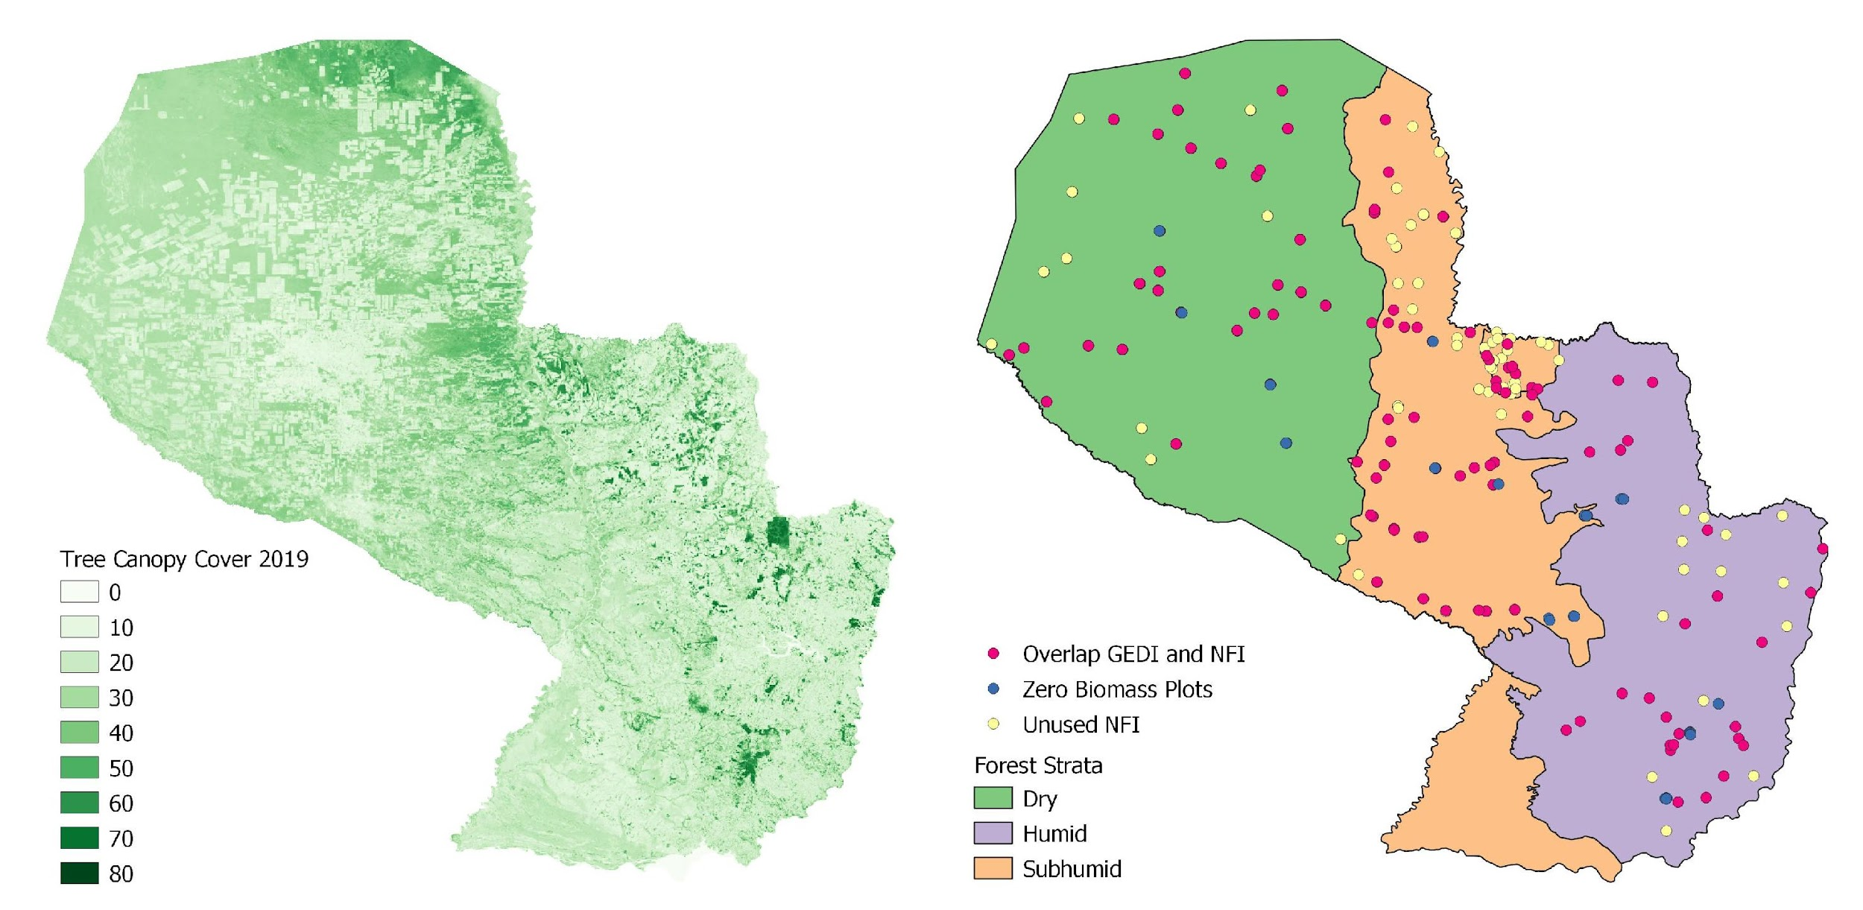
Model Overview
Paraguay GEDI Inclusion on
Emission Factors
Two primary outputs:
Map of biomass at 6 km pixel resolution
Statistical estimate of mean biomass and margin of error
Updates biomass estimates from inventory to 2020
Estimate can be made at national, regional, local, or forest scale
Applicable in remote and inaccessible forests and in countries without a well-established forest inventory
Statistical estimation of mean biomass and margin of error
Remote sensing datasets calibrated with forest inventory data
Inputs: Field measurements of biomass, GEDI data, canopy cover, and forest strata
Predicted Versus Observed Biomass
GEDI
Tree Canopy Cover
Forest Strata and Field Plots
Notes:
We are piloting a methodology in Paraguay that integrates remote sensing and forest inventory data into a model to estimate aboveground forest biomass.
The model uses LiDAR measurements from the GEDI mission, a Landsat tree canopy cover dataset, and forest type information to predict biomass at our field plots. These datasets are spatially explicit and therefore cover the entirety of Paraguay’s vast and often inaccessible forests.

Slide 10
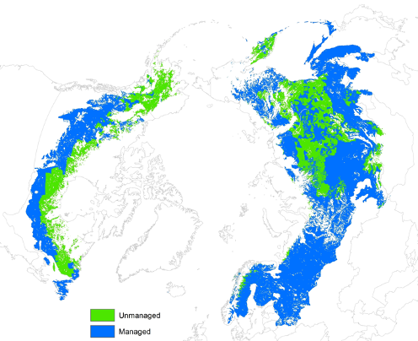
AFOLU Roadmap 2022 Plans & Agency Support
Slide 10

Slide 11
AFOLU Roadmap Scope and Objectives
Provide a framework for long-term (~ 15+ years) coordination of CEOS agency observing programmes in support of the needs of society for AFOLU-related information, with a focus on the needs and ambition cycle of the Global Stocktake of the Paris Climate Agreement. A guiding vision for long term space agency coordination around AFOLU. Characterises the needs, the services and applications required, the products and observing systems that can support. Explain the need to plan for ground segment, space segment and services.
An effective means for communicating our intentions to society, UNFCCC, national inventory community etc
Addresses basic observation continuity and the necessary agency coordination to achieve it
Identifies questions to be answered in circa 2035 and reverse engineers the value chain necessary for the required observations.
Provides guidance to Agencies as to the technologies and capabilities that will be needed in 15 years time to ensure policy relevance of public EO
Strategic and authoritative but not exhaustive. Identify issues like the continuity outlook, known technology trends and what these will provide, and offer expert assessment for each thematic area as to the adequacy of the CEOS plans and what further should be encouraged.
National inventory user community a key readership but also need to cover global assessments
Slide 11

Slide 12
AFOLU Roadmap Outline
Section 1: Background, Motivation & Objectives
Section 2: CEOS AFOLU activity
Section 3: CEOS GHG and CEOS AFOLU integration (CO2, CH4, N2O)
Section 4: User engagement
Section 5: Beyond CEOS
Section 6: Implementation
Section Leads: Team Co-leads (Ben, Osamu, Frank Martin), Stephen Briggs, Martin Herold, Ian Jarvis, Ake Rosenqvist, Richard Lucas, Shaun Quegan, Laura Duncanson, Sylvia Wilson, Stephen Ward - with help from many others …!

