Slide 1
The Global Ocean Observing System
The Global Ocean Observing System
www.goosocean.org
Toste Tanhua
GEOMAR Helmholtz Centre for Ocean Research Kiel
GOOS SC co-chair

Slide 2
What is GOOS?
A healthy and safe ocean is fundamental to the Earth; it regulates climate and provides transport, food, livelihoods, and space for recreation. Long-term ocean observing is essential to our ability to provide relevant information to support a sustainable ocean.
The Global Ocean Observing System (GOOS) is a permanent programme coordinating the functioning of a long-term, sustained ocean observing system serving societal needs for climate, operational services and ocean health.
Since 1991, GOOS has created an extensive global system, based on contributions from a large number of organizations and nations, from which nations and people all over the world benefit.
https://goosocean.org/

Slide 3
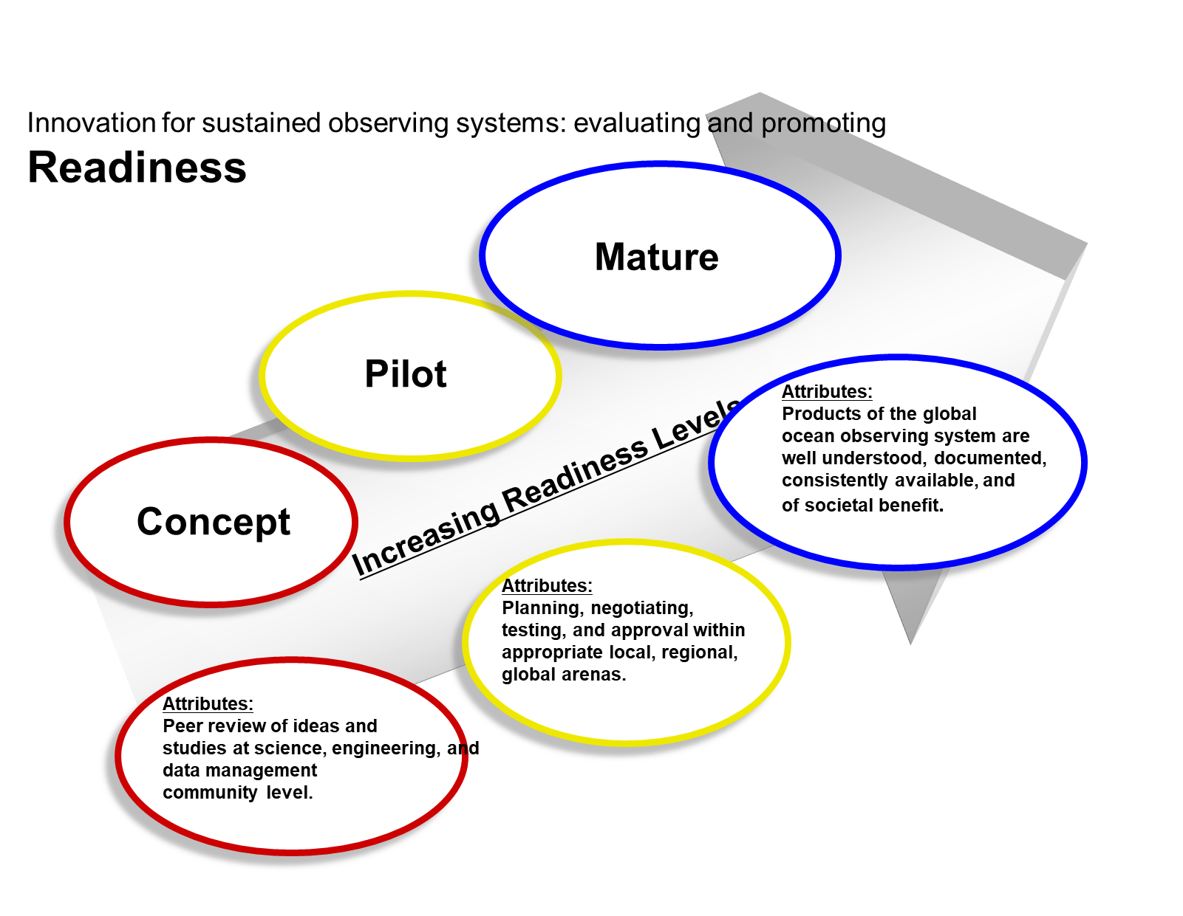
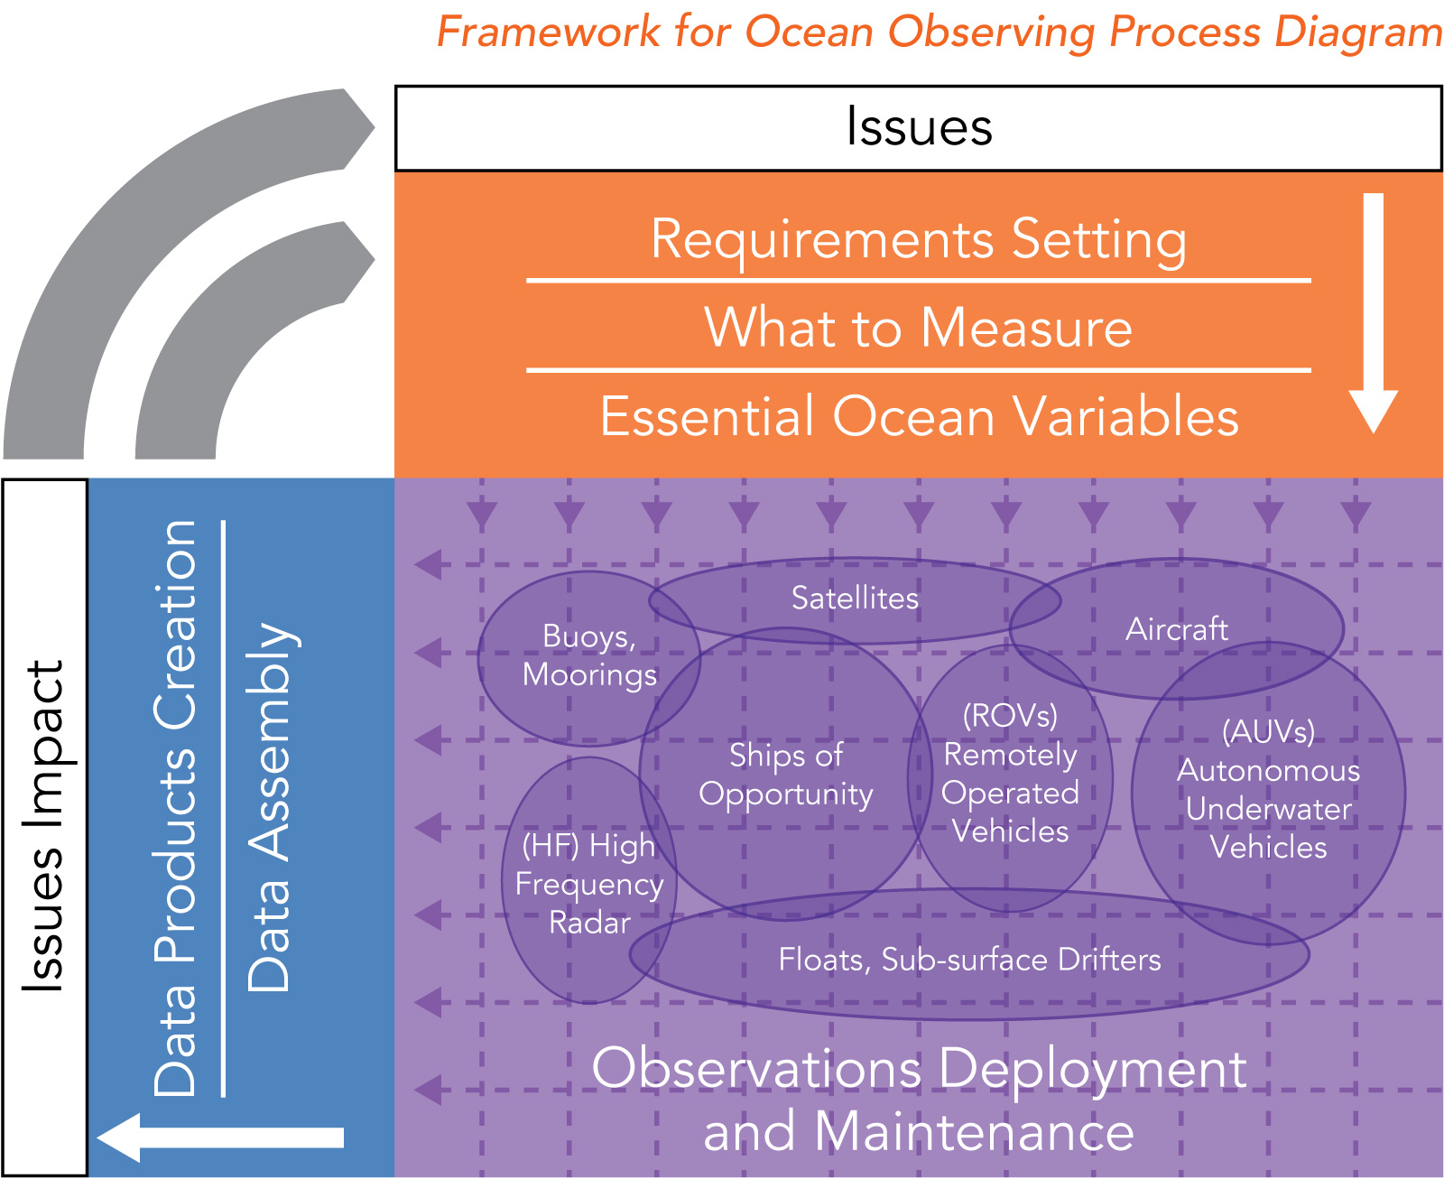
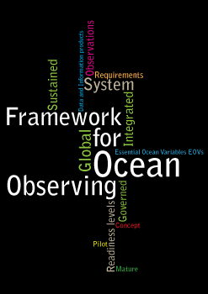
The Framework of Ocean Observing (FOO); A central document to GOOS

Slide 4
Essential Ocean Variables (EOVs); a central element of the FOO

Slide 5
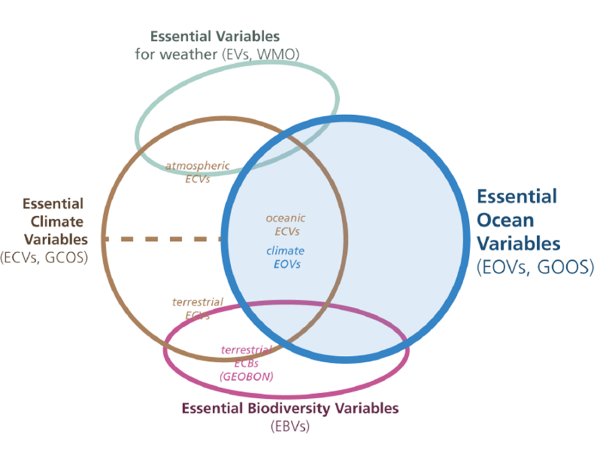
Essential Variables: A concept to guide planning and implementation of observing
Lindstrom, E., Gunn, J., Fischer, A., McCurdy, A., Glover, L., Alverson, K., et al. (2012). A Framework for Ocean Observing. By the Task Team for an Integrated Framework for Sustained Ocean Observing. Paris: UNESCO. doi: 10.5270/OceanObs09-FOO
Notes:
Working increasingly closely with MBON (EBVs) and GCOS (ECVs). Many commonalities and complementarities and understand that we will make most progress by working together to promote the biological essential variables.

Slide 6
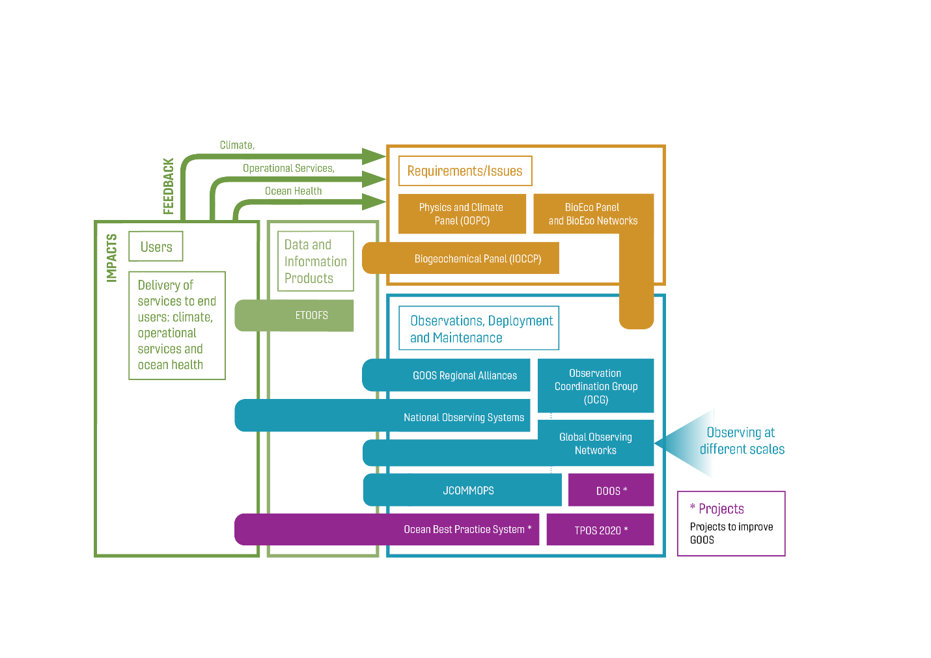
GOOS structures today
Notes:
Point out that this conceptual model against the Framework for Ocean Observing diagram is not perfect. BioEco is working hard to get EOV-based observing networks off the ground, GRAs work in the space of requirements, evaluation, and data; and the link with national observing systems and programmes needs to be developed.

Slide 7
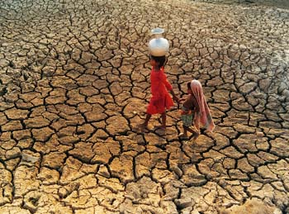
Delivery across 3 target application areas
Climate
Operational services
Ocean health
mitigation and adaptation, seasonal forecasts
supporting the marine economy and reducing risk
sustainability of ocean ecosystem services
Notes:
The system was developed to support climate science and to be the observational backbone for forecasting systems
Now focused on 3 delivery areas; Ocean Health, Climate and Operational Services

Slide 8
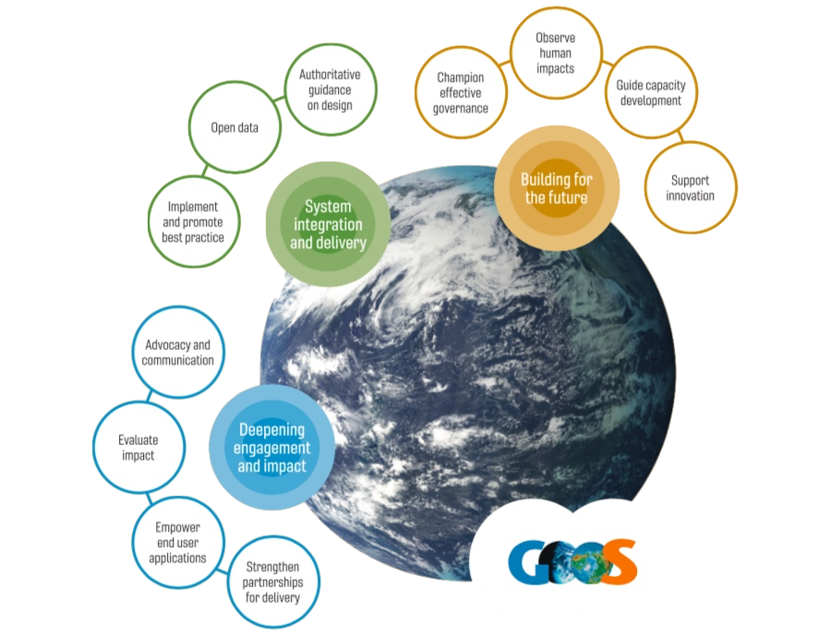
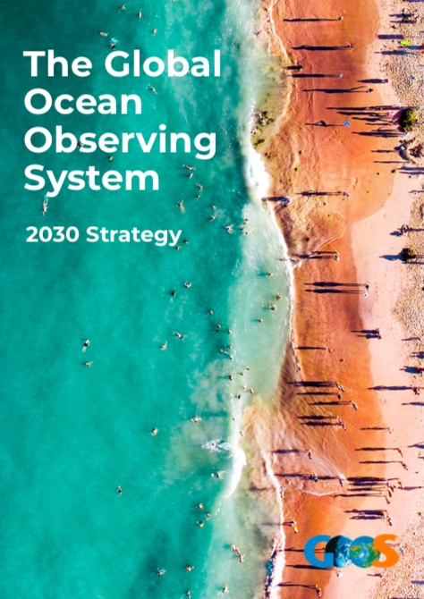
Vision
A truly global ocean observing system that delivers the essential information needed for our sustainable development, safety, wellbeing and prosperity
Mission
To lead the ocean observing community and create the partnerships to grow an integrated, responsive and sustained observing system

Slide 9
An ambitious strategy for the Global Ocean Observing System
Implementing this strategy will demand a step change in the level of effectiveness of partnerships across the scientific and end-user communities.

Slide 10
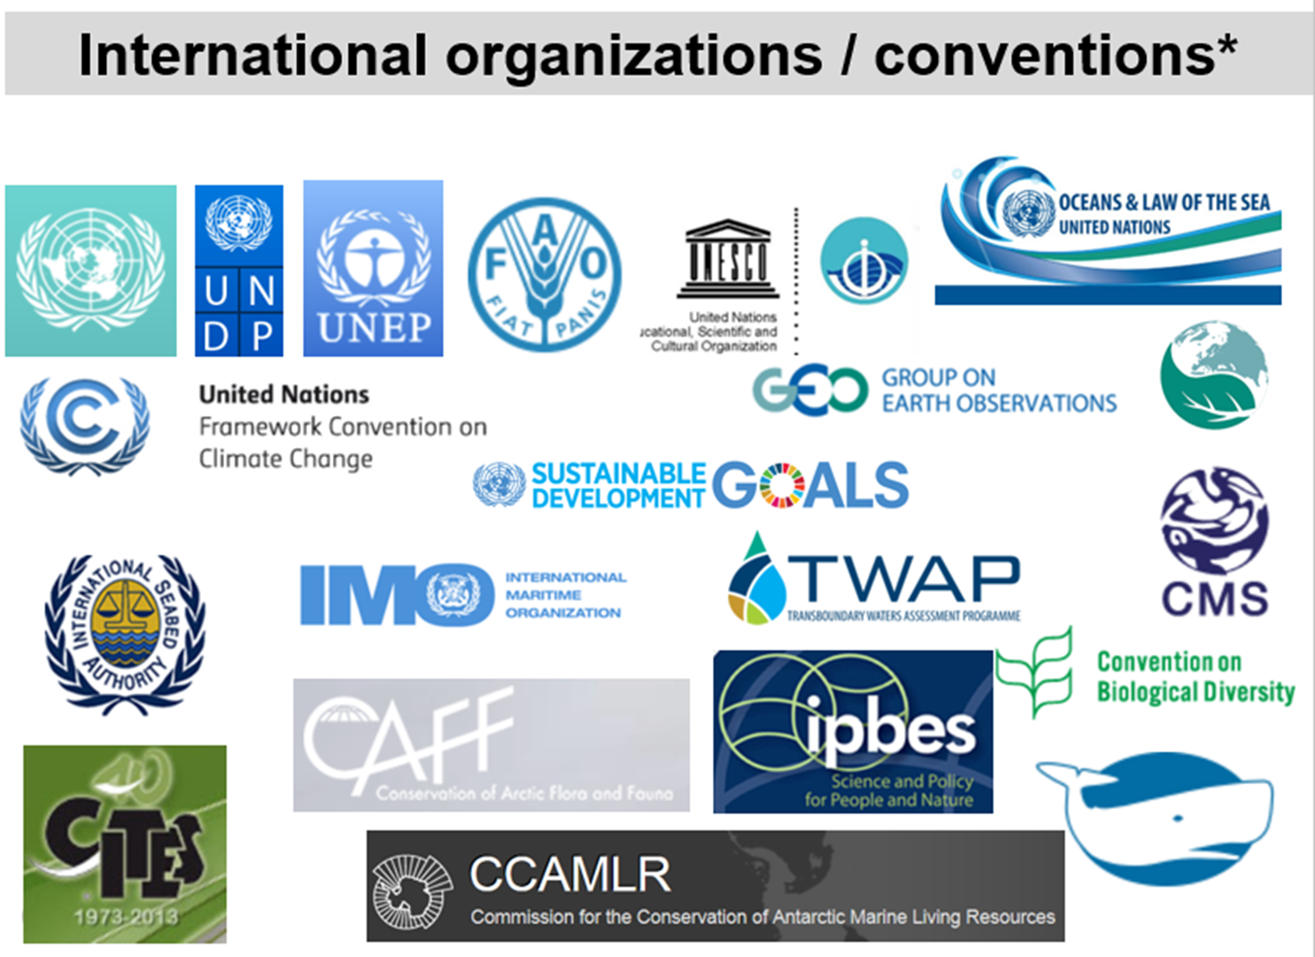
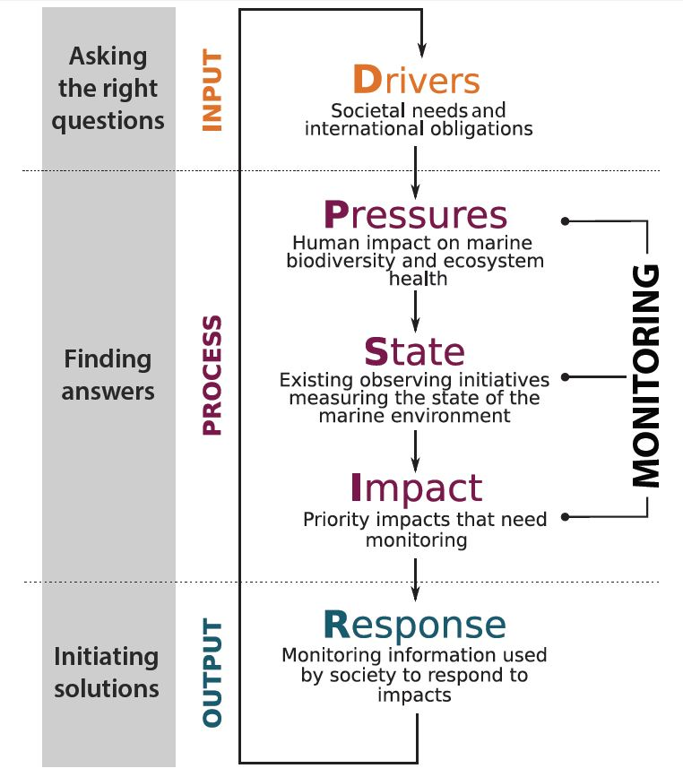
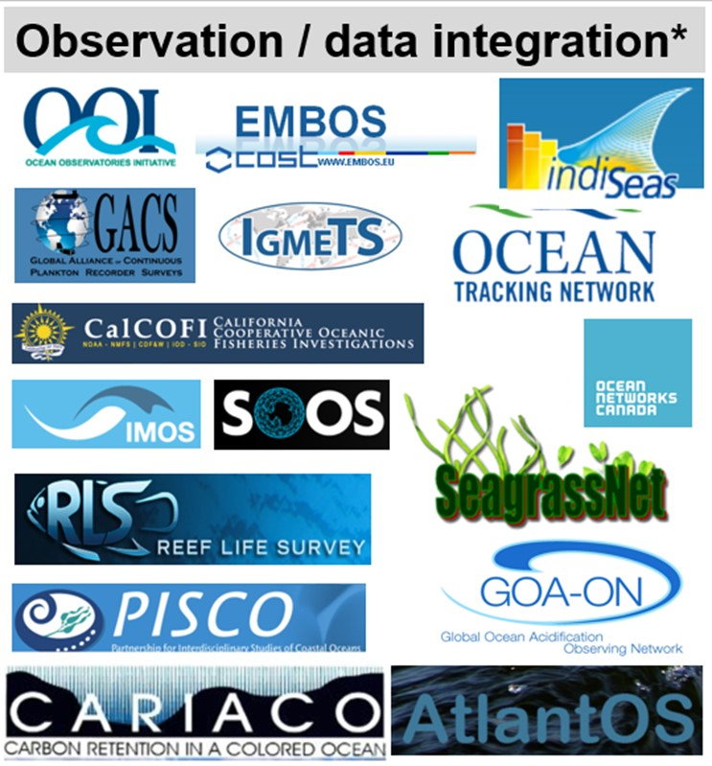
Defining Essential Ocean Variables: Biology EOV
Bio-Eco Panel
Based on the Framework for Ocean Observing (OceanObs ‘09):
Conventions and National requirements
Observing programs
?
IPCC (GCOS), CBD, SDGs, MBON, GEO Blue Planet
Miloslavich, P., et. al. (2018). Essential Ocean Variables for sustained observations of marine biodiversity and ecosystems. Global Change Biology. DOI: 10.1111/gcb.14108.
Redrawn by Frank Muller-Karger
Notes:
D what are the societal questions, sectoral trends, national and international obligations and that Drive the need to
monitor marine biodiversity and ecosystem health
P what are the human Pressures affecting the environment that are or will impact marine biodiversity and ecosystem
health
S what are the existing initiatives that could be built on to measure the State of the marine environment
I what are the priority Impacts on the marine environment that need to be monitored and how well do existing initiatives
address those needs – what are the key gaps
R which monitoring information is most likely to be used to help society Respond to identified impacts

Slide 11
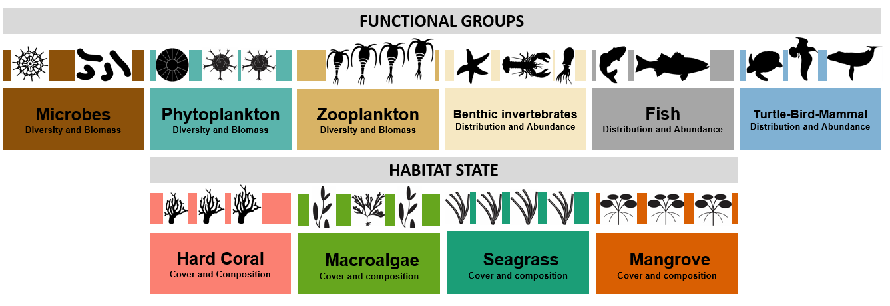
Biological Essential Ocean Variables (EOVs)

Slide 12
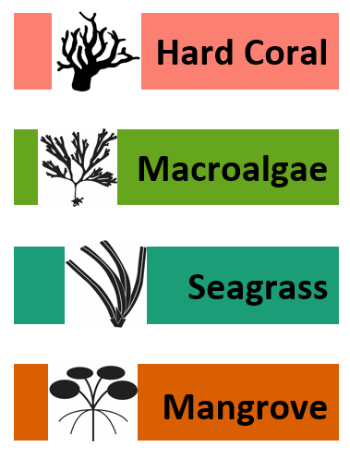
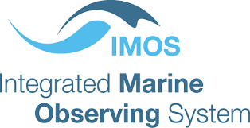
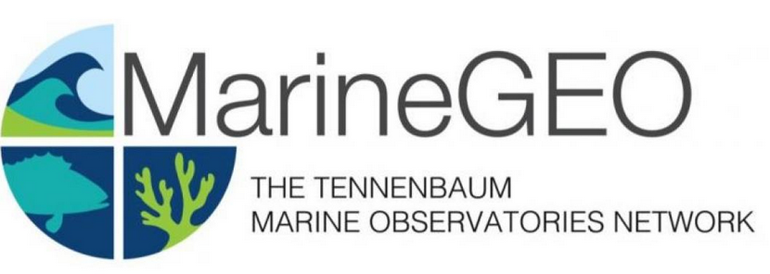
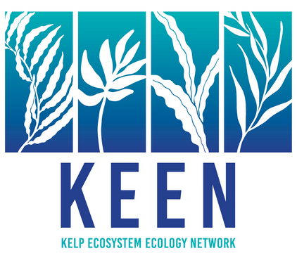
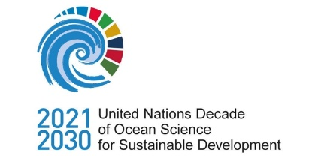
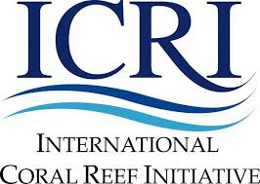
Biological Essential Ocean Variables (EOVs)
Implementation
BIOLOGICAL EOVS
THE CHAMPIONS
THE PARTNERS
THE USERS
David Obura
CORDIO - Kenya
Lisandro Benedetti-Cecchi
University of Pisa - Italy
Emmett Duffy
Smithsonian - USA
Lisa María Rebelo
IWMI - Lao

Slide 13
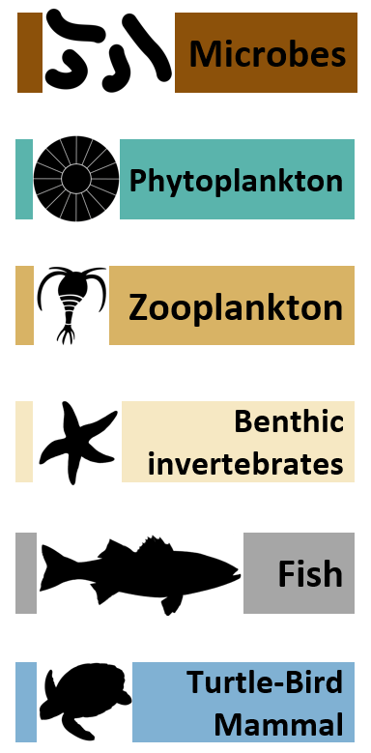
Biological Essential Ocean Variables (EOVs)
Implementation
BIOLOGICAL EOVS
THE CHAMPIONS
THE PARTNERS
THE USERS
Pier Luigi Buttigieg
Max Planck-Germany
Frank Muller-Karger / Raphael Kudela
USF-USA / UCSC - USA
Sonia Batten / Sanae Chiba
MBA-Canada / JAMSTEC-Japan
Looking for a champion!
Potential link to DOOS
Rick Stuart-Smith/Anthony Bernard
UTAS-France / SAIAB- South Africa
San Simmons/Karen Evans/Daniel Dunn
MMC-USA/CSIRO-Australia/UQ-Australia
Notes:
Need to consider deep sea - discussing with DOOS opportunity to take on benthic invertebrate EOV and become formal member of Panel.
Refreshed Panel membership in December 2019

Slide 14
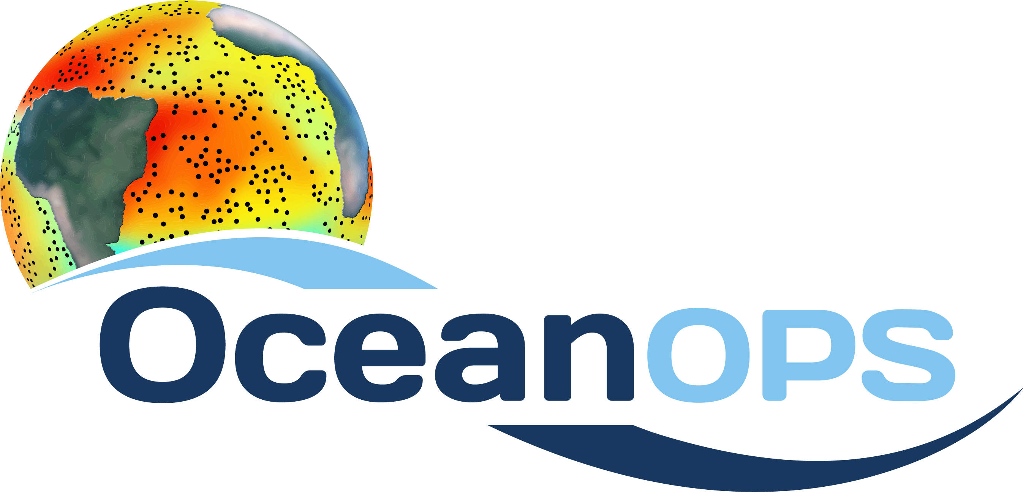
Major delivery areas
Climate: climate change modeling, warming, acidification
Real time services: weather forecasts and early warning for ocean related hazards, maritime economy
Ocean health: productivity, species diversity and resilience
Notes:
OOPC: Ocean Observations for Physics and Climate
IOCCP: International Ocean Carbon Coordination Project
JCOMM: Joint Technical Commission for Oceanography and Marine Meteorology
NEAR-GOOS: The North-East Asian Regional GOOS (NEAR-GOOS) is a regional pilot project of the Global Ocean Observing System (GOOS), and is implemented by China, Japan, the Republic of Korea and the Russian Federation.
JCOMM: is an intergovernmental body of technical experts that provides a mechanism for international coordination of oceanographic and marine meteorological observing, data management and services, combining the expertise, technologies and capacity building capabilities of the meteorological and oceanographic communities. Under the IOC and the WMO. Established in 1999.
TPOS: advance understanding of tropical Pacific physical and biogeochemical variability and predictability aimed to provide data on the ENSO signals
ATLANTOS: EU Horizon 2010 project - Optimising and Enhancing the Integrated Atlantic Ocean Observing Systems (Europe/USA/ some countries in South America and Africa) / Integration of ocean observing activities across all disciplines for the Atlantic
DOOS: focused on the creation of a strategy or the development of a common statement of requirements and an initial strategy for sustained global deep ocean observations; considering all Essential Ocean Variables, regions, and technologies so as to extract high impact, feasibility, and GOOS fit-for-purpose actions for the next 5-10 years. Questions: 1) What observations are most needed from the deep ocean? 2) Which of those are we most technologically equipped to implement at this time?
GOAON: collaborative international approach to document the status and progress of ocean acidification in open-ocean, coastal, and estuarine environments, to understand the drivers and impacts of ocean acidification on marine ecosystems, and to provide spatially and temporally resolved biogeochemical data necessary to optimize modeling for ocean acidification.

