Slide 1
Systematic Observations Community Synthesis Report for GST
SO Writing Team
Frank Martin Seifert (ESA)
CEOS WGClimate 8 October 2021
1 mins
Committee on Earth Observation Satellites

Slide 2
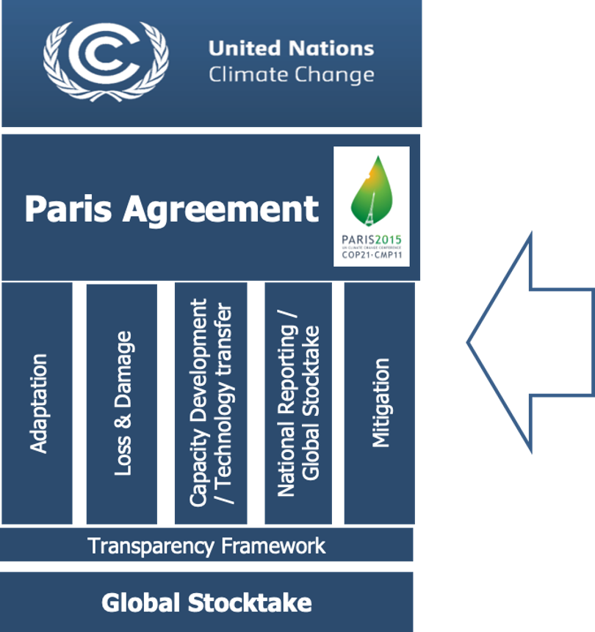
CEOS and the Systematic
Observation Community

Slide 3
Global Stocktake
Thematic Areas

Slide 4
Systematic Observations Community Synthesis Report for GST (1)
Synthesis Report (SR) of the Systematic Observation Community (SOC) will be part of UNFCCC’s information collection and preparation phase for GST, and feed into the technical assessment
SOC established in May a writing team (12 participants), several calls since then
SB Chairs issued a "non-paper" in June, and updated it in September with dedicated questions for synthesis reports.
How can the Systematic Observation Community support the GST on global and national level?

Slide 5
Systematic Observations Community Synthesis Report for GST (2) Members
Albrecht von Bargen (DLR)
Anthony Rea (WMO/GCOS)
Carlo Buontempo (ECMWF)
Crisp, David (NASA/JPL)
Frank Martin Seifert (ESA)
Helen Findlay (PML)
Jörg Schulz (Eumetsat)
María José Sanz Sánchez (BC3)
Mark Dowell (EC/JRC)
Maxx Dilley (WMO)
Osamu Ochiai (JAXA)
Sara Venturini (GEO)

Slide 6
Systematic Observations Community Synthesis Report for GST (2)
Synthesis Report aims to be a concise, standalone document integrating bottom-up and top-down approaches:
SO for Mitigation – GHG, AFOLU, … (CEOS lead)
SO for Adaptation – impacts, risks and vulnerability for different regions and sectors, … (WMO lead)
Means of integration and support (finance, technology, CB) in M&A
Crosscutting e.g. Loss & Damage, Equity (GEO lead)
Next Steps:
Case studies on results of SO to Parties
Addressing gaps to make observations useful
Addressing differences in scales: global obs. to local adaptation
Reaching out to other areas such as NDCs and NAPs
➔ Draft for COP26, first version for Spring 2022 TA

