Slide 1
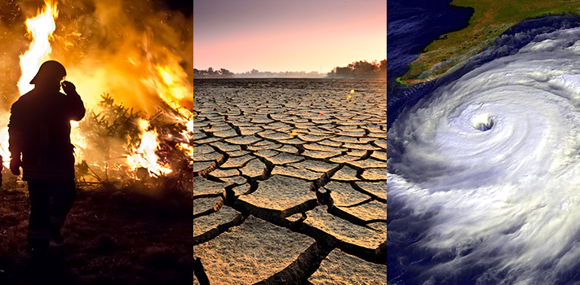


Status of Use Cases
Wenying Su (NASA)
Guangxin He, Ken Holmlund (WMO)
Jörg Schulz, Alexandra Nunes (EUMETSAT)
Albrecht Von Bargen (DLR)
Jeff Privette (NOAA)
WGClimate #14
April 14, 2021

Slide 2
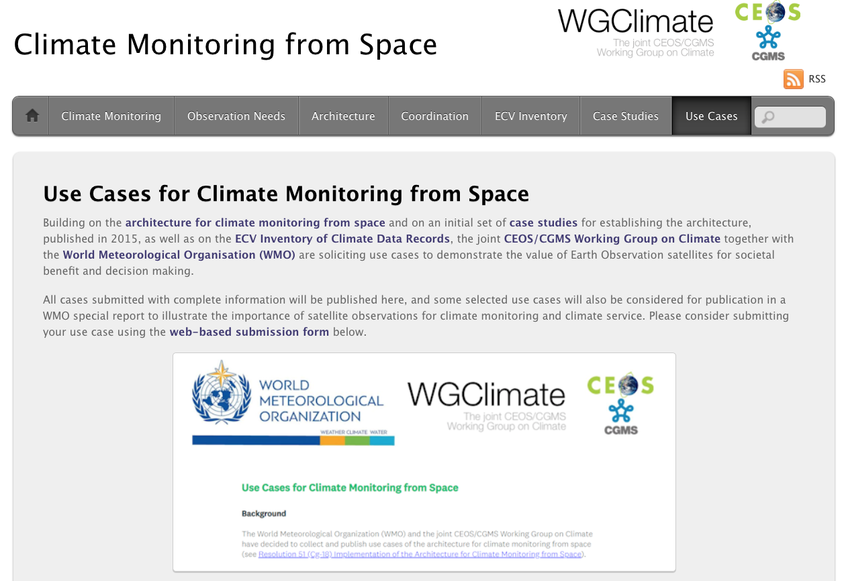
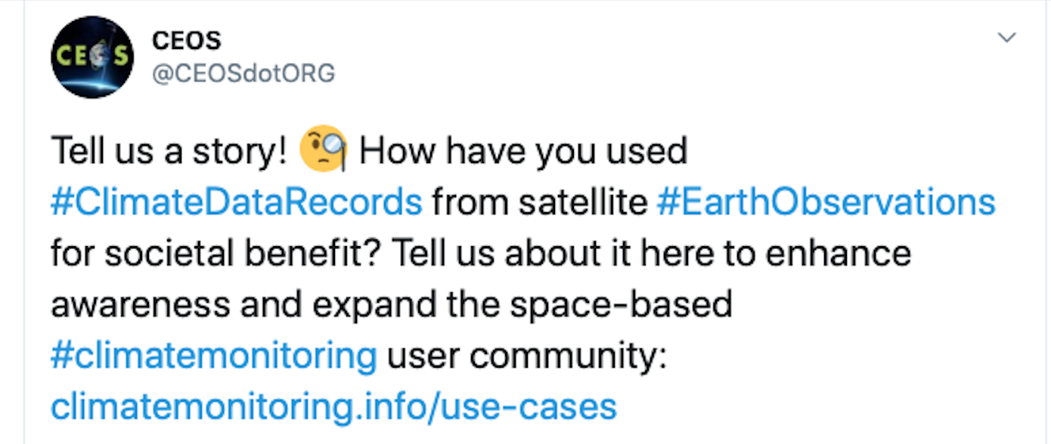
Use Cases for Climate Data Records
WGClimate#12 in May 2020 decided to start a new routine activity on collecting use cases for climate data records.
Use Case gathering tool, developed by WMO Space Programme Office, has been integrated into climate “Use Cases” web page (https://climatemonitoring.info/use-cases), which was opened on July 27, 2020 for submission with widespread distribution on social media.
All cases submitted with complete information will be published here, and some selected use cases will also be considered for publication in a WMO special report to illustrate the importance of satellite observations for climate monitoring and climate service.

Slide 3
Eight Use Cases Received So Far
Coastal Risk Information Service (C_RISe): Satellite oceanographic consultants, UK
Parametric insurance for agricultural communities using weather and climate information: Agvesto/NASA (GPM application coordinator--Andrea Portier)
Satellites remote sensing monitoring of the agricultural situation in the main producing region of winter wheat of China: CMA, China
NOAA Climate Data Record informs food security decisions to manage global famine: NOAA/NESDIS/NCEI
Alaska Disasters: Development of a Snowmelt Monitoring Tool Using NASA MODIS and NOAA Climate Data Records to Aid Wildfire Managers in Alaska: NOAA/NESDIS/NCEI
Impact of wildfires on air quality in Sub-Saharan African: South African National Space Agency
Space-based weather and climate extremes monitoring: JAXA/NOAA/BoM/WMO
Hail risk assessment using space-borne remote sensing and reanalysis: NASA

Slide 4
Boost the contributions of use case
Albrecht to send a letter to CEOS principles to encourage agencies to support use case activity.
Encourage contributions from CGMS agencies at the CGMS WGII meeting.
WGClimate members can serve as focal points to coordinate their agencies’ contribution, and please spread the words to other end users.

Slide 5
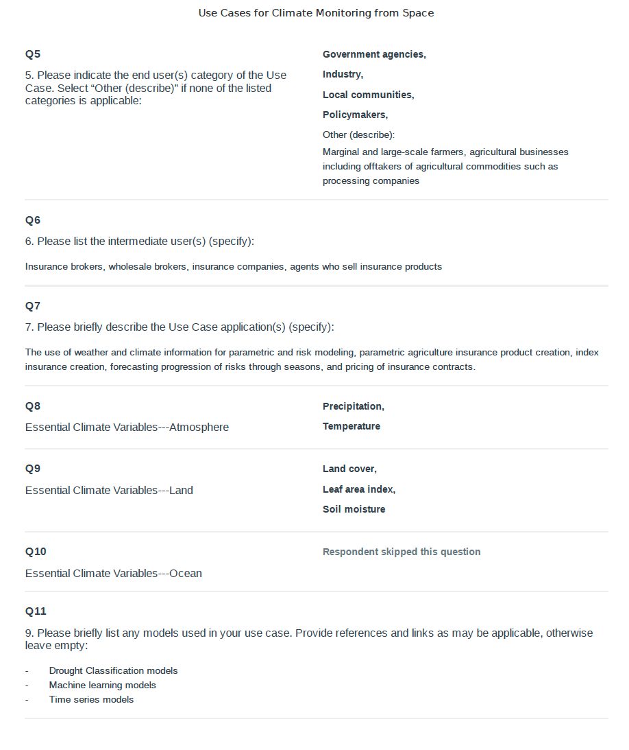

Publish the cases on climatemonitoring.info
Publish the cases received on https://climatemonitoring.info/use-cases.
All cases will need to be reformatted with better graphic design before they can be published online. Many thanks to Jeff and NOAA colleagues for offering their help to format these cases for publication.
Guangxin compiled a spreadsheet with information of all submitted cases. We invite all to populate the spreadsheet with potential contributions.
Once we have sufficient number of use cases that cover a variety of application areas, we can select some for a WMO publication.
However, our work doesn’t stop here! Use case is a continuous activity and your continued support is greatly appreciated!

Slide 6
Use Cases for Climate Data Records: Major Objectives
Demonstrate the value of climate data records for decision/policy making, e.g., usage of satellite data in a use case with UNFCCC Parties to support the Global Stocktakes
Understand the application needs to provide feedbacks towards quality improvements for the ECV requirements defined by GCOS
Validate the top-down architecture for climate monitoring from space with a down-top approach ensuring traceability from usage to space-based observing system
Optimize the use of climate data records in applications relevant for climate services and science
Support capacity building by providing/receiving use cases for/from training activities, e.g., for developing countries (link to CGMS and CEOS capacity building activities)
Take Earth observations from space
Decision Making
Create Climate Data Records/
Indicators
Use Climate Data Records
Use information derived from Climate Data Records
Sensing
CDR Making
Application
Tailored information (Reports)
Tailored Data
Observations

Slide 7
Submission of Use Case
Organization, focal point name and email
Title and short abstract
Service/Thematic area(s) of the Use Case (i.e. adaptation, disaster risk reduction, food security, agriculture, coastal management, energy, adaptation, mitigation, etc.)
End user category (i.e. government, public, researcher, policymaker, etc.)
Intermediate users
Use case applications
GCOS ECVs used
Models used
Are the CDRs used already listed in the ECV Inventory
CDRs used and their DOI
Agencies/organizations produce the CDRs and the satellite obs. used
Sustainability of the Use Case (demonstration, operational)

Slide 8
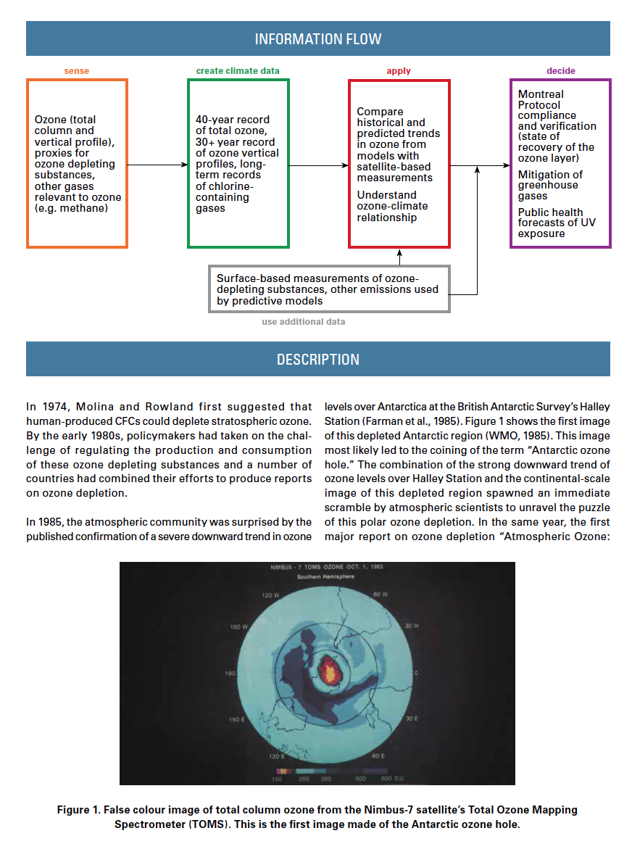
Submission of Use Case
Full description of the Use Case
Description of the four pillars defined in the Architecture for Climate monitoring from Space
How the use case could be improved and what data/tools could help
Up to four figures supporting the use case
Additional information

