Slide 1
Next Gap Analysis
¹Jörg Schulz and ²Alexandra Nunes
¹EUMETSAT, ²HAMTEC

Slide 2
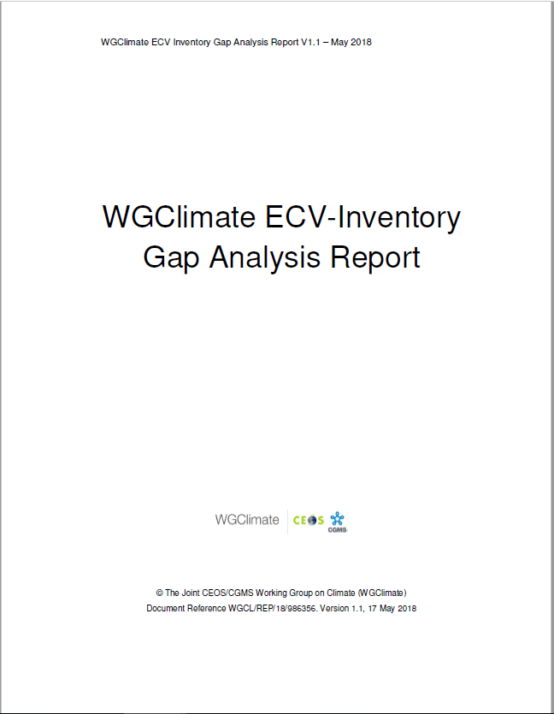
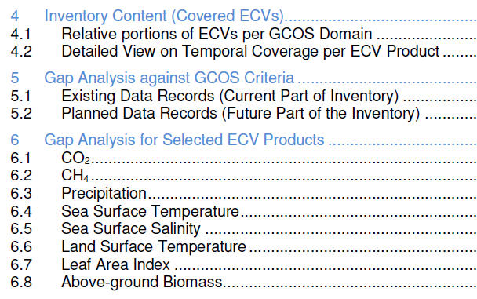
Gap analysis concept on ECV Inventory v3
Automatic assessment
Statistical analysis tools and graphical display
Statistical analysis tools and graphical display on the web interface
Analysis of delta to version #2
Detailed analysis per ECV / ECV Product:
Assesses progress for 8 ECVs addressed for V2.0
Selected 13 additional ECVs (5 atmosphere, 5 land, 3 ocean) not addressed before that are specifically part of 2016 GCOS-IP actions
Postponed 2 land (FAPAR, Glaciers) and 1 atmosphere (Lightning) due to missing support and late availability of Inventory inputs
Addressed are: Aerosols, Surface winds, Upper-Air Winds, Water Vapour (UT/LS), Fire, Land Cover, Soil Moisture, Sea Level, Sea State, and Ocean Surface Heat Flux

Slide 3
GCOS ECVs addressed so far
First Round
6.1 CO₂
6.2 CH₄
6.3 Precipitation
6.4 Sea Surface Temperature
6.5 Sea Surface Salinity
6.6 Land Surface Temperature
6.7 Leaf Area Index
6.8 Above-ground Biomass
Second Round
7.1 Aerosols
7.2 Surface Winds
7.3 Upper-air winds
7.4 Water Vapour UT/LS
7.5 Fire
7.6 Land Cover
7.7 Soil Moisture
7.8 Sea Level
7.9 Sea State
7.10 Ocean-surface heat flux

Slide 4
From WGClimate#14 in March
Still need to finish Cycle 3 Gap Analysis
Gap analysis process needs to be further rationalised to ensure affordability. It will involve an annual workshop to which agencies are requested to send experts on ECVs
Encouraged CEOS members to inform us about particular needs for gap analysis that are most useful for them - did not hear from anybody
Need to identify, discuss and decide on topics for V4 gap analysis shortly after next meeting
Action to WGClimate members: Send your ideas and expectations to me and I will present a proposal at the meeting in April

Slide 5
What could it be?
Just strive for more completeness on GCOS ECVs?
Address a specific topic of high interest, e.g., all data possible to be provided for the Paris Agreement Global Stock Take Activity?
This would contain several additional ECVs to be addressed: GHG, Inorganic Carbon, AGB, Land Cover, Soil Carbon, Fire, Anthropogenic GHG fluxes, River Discharge, Permafrost as part of Soil Carbon?, Ozone + Precursors for aerosol and ozone?, …
If we do Carbon Cycle in support of the GHG GST: Shall the gap analysis kept strictly an ECV Inventory GA Report or look wider, e.g., highlight more specific topics such as cycle related or specifically GST-related?

Slide 6
Logistics
Plan is to issue ECV Inventory v4.0 in June, but GA WS likely to occur earliest in November/December 2021 only: could consider a potential v4.1 issue in case of gaps still needing to be closed in advance?
How do we select the experts? How many per variable?
In general would expect a 4 day workshop (“physical”)
“Physical” vs. online meeting is a critical decision to be made, as working together in small groups and gather back in bigger groups is much easier in a physical meeting

Slide 7
SPARES

Slide 8
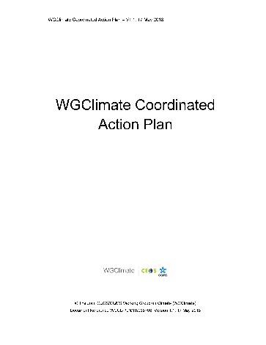
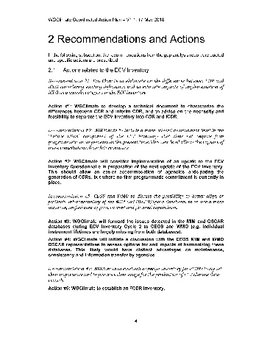
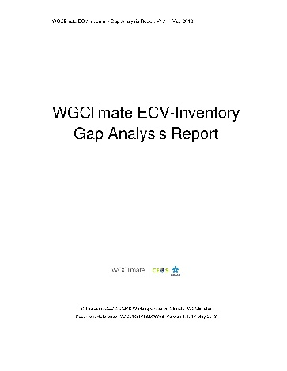
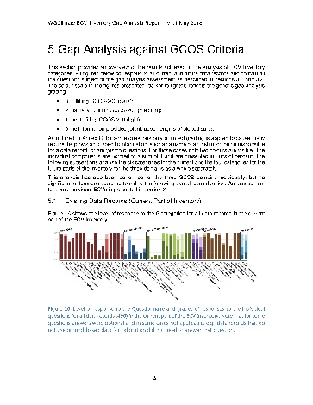
Sustaining Space Capabilities for Climate
Actions
Creation of conditions to deliver climate data records
The ECV Inventory fully describes current and planned implementation arrangements for ECVs
Everybody with an internet connection can download the ECV Inventory content for their own analysis, find direct access points to climate data records in the Inventory, and get access to WG Climate gap analysis results and resulting actions
Recommendations to mitigate gaps
ECV Inventory
Population
Content Verification
Gap Analysis
Completeness of ECV Products
Sustainability of space segment
Missed data usage opportunities
https://climatemonitoring.info/ecvinventory/
Notes:
Talking points:
Apart from GHG, the joint CEOS/CGMS Working Group Climate is working on sustaining and further evolving the space-based capabilities to monitor climate variability and change
An integral part is the web-based inventory of existing and planned climate data records for GCOS Essential Climate Variables. First bullet.
This is used for a gap analysis addressing (say what is on the slide). One outcome is second bullet
The Working Group makes recommendation and implements actions to remedy gaps.
Third bullet
Fourth bullet

Slide 9
Evolution of ECV Inventory since v3.0
Status ~ WGC#14 ← (continuous data collection) ← [*] delta wrt. WGC#13 [10.2020]
[*] delta wrt. v3.0 [07.2020]
Progress in contributions since publication of v3.0 (highlights):
MODIS Land (Albedo, LAI, FAPAR, Fire, Land Cover, Land Surface Temperature, Snow, Above-ground Biomass (Gross/Net Primary Production)), Atmosphere (Clouds, Aerosols), and Ocean (Sea Ice) products (NASA)
Existing entries on Temperature of deep atmospheric layers (MSU) (NOAA)
CMA is contributing its first entries
JAXA and KMA expanding and consolidating contributions
C3S and CCI started update process
1782 records in the database ↑ [+96*] [+180**]
1650 records “available” ↕ [+93*] [+177**]
1478 records “submitted” ↕ [+84*] [+75**]
132 records “deleted”
172 records “in progress”
1064 records “verified” ↕ [-16*] [-73**]
414 records “TBC”
[GCOS-200 (space-observed): 37 ECVs = 13 Atmosphere + 15 Land + 9 Ocean]
ECV Inventory (“submitted”): 35 ECVs = 13 Atmosphere + 14 Land + 8 Ocean
Total gaps [Level of ECV]: 0 Atmosphere + 1 Land (Anthropogenic GHG fluxes) + 1 Ocean (Surface currents) >> try to close gap for v4.0!
(Additional) Partial gaps [Level of ECV Product]: 0 Atmosphere + 6 Land (Albedo, LAI, FAPAR, Glaciers, Lakes, Soil moisture) + 1 Ocean (Ocean-surface heat flux (radiative flux))
Notes:
Table: the up and down arrows indicate that the numbers can go up and down as users delete / create new / un-submit to update / submit (again), which can also cause the number of verified entries to go down (once un-submitted, the entry is tagged as not yet verified); Records published in July as verified in v2.0 or v3.0 that have in the meantime been un-submitted for update (and same already re-submitted and undergoing review) result in negative “deltas” for the verified:
Bottom text box:
Numbers refer to GCOS-200 only, and not anymore to the leftovers of GCOS-154 (even though they are still allowed in the DB);
We (or I, at least) do not know if we can close the total gap on Land (Anthropogenic GHG fluxes), but the Ocean Surface currents might be possible (CMEMS or CCI/C3S, TBC);
NOAA has provided 1-2 existing entries for Temperature of deep atmospheric layers, thus closing the partial gap on Atmosphere; no news yet regarding the remaining gaps at the level of ECV Product… but may need to check the inputs to the GA Report to see whether there are any hints or remarks there.
ECV Marine Habitats – ECV Product Mangrove Forests Cover might be added to the lot of space-observable GCOS ECVs: JAXA submitted an entry tagged as Land Cover, still under review.
The gaps mentioned for the submitted records are TBD, as changes in ECV Product (sometimes even ECV) sometimes happen during the verification process.
Right text box:
Contribution from NASA registered as AGB is still TBD, as those are Gross / Net Primary Production MODIS products; MODIS Land Cover also includes NDVI datasets, and some other were not attributed ECVs; JAXA’s review is underway – 2nd iteration; KMA still to start; CMA has made some progress in input, but review has not yet started.

