Slide 1
Data Rescue Challenge AVHHR LAC
¹Jörg Schulz, ²Simon Pinnock, and ²Susanne Mecklenburg
¹EUMETSAT, ²ESA

Slide 2
Needs and Aims
AVHRR is a very useful instrument for many GCOS ECVs and is used by many agencies
Global data come at the so called Global Area Coverage with roughly 4 km spatial resolution
The instrument itself has a spatial resolution of 1 km at nadir view (so called Local Area Coverage (LAC) data), but this type of data was only received by ground stations because the data volume was too large to be stored on the satellite until downloaded every orbit. This has only changed with the Metop satellites in 2006 since
High resolution data may provide improved quality for some of the GCOS ECVs if complete and consistently calibrated
Several activities in the past have been conducted by 1CCRS/CCMEO, NOAA, ESA, EUMETSAT and maybe others to collect AVHRR LAC/HRPT data. However, data are still scattered, not complete, and not consistently calibrated, wrt. the global AVHRR data (see report by EUM CM SAF: Technical note on the availability of AVHRR LAC data, by Helga Weber, Oeschger Center for Climate Change Research and Institute of Geography, University of Bern, Bern, Switzerland
¹Canada Centre for Remote Sensing (CCRS) of the Canada Centre for Mapping and Earth Observation (CCMEO)

Slide 3
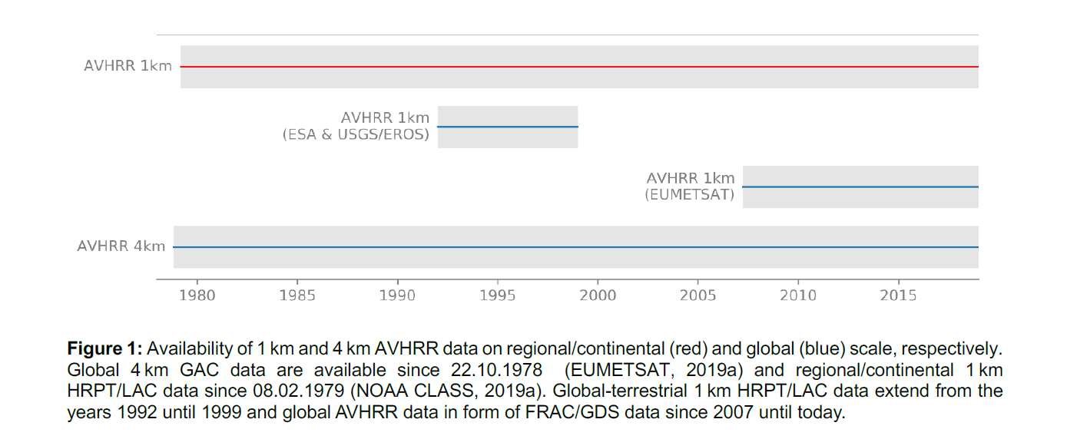
Availability of AVHRR LAC and GAC data

Slide 4
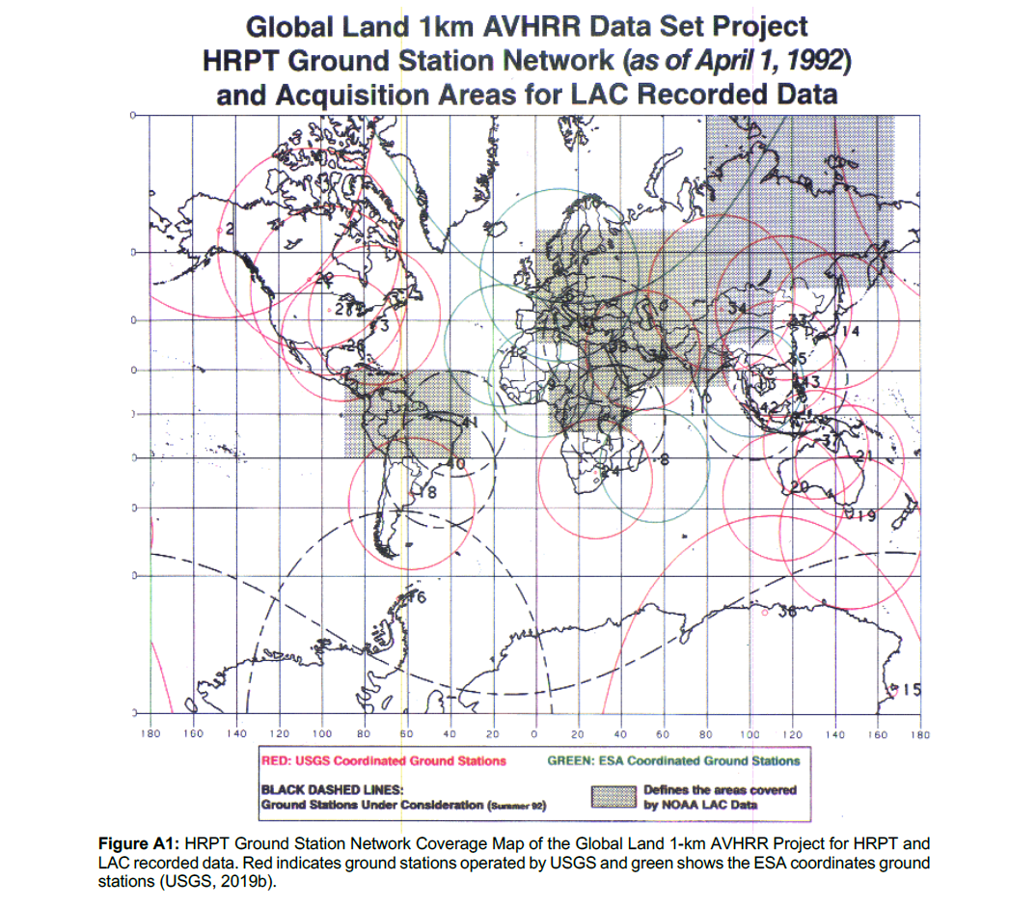

Slide 5
Proposal
The main aim at this stage is to see which agencies might be interested to discuss further on needs and potential activities. Topics for this could be:
WGClimate participating agencies with AVHRR/LAC HRPT receiving stations to locate and enable access to archived data
Devise a way forward to build up a consistent global data set, including coordinated calibration and validation activities and how to make that available to potential users

