Slide 1
Status of ECV Inventory, Gap Analysis and Coordinated Action Plan
¹Jörg Schulz and ²Alexandra Nunes
¹EUMETSAT, ²HAMTEC

Slide 2
Evolution of ECV Inventory since v3.0
Status ~ WGC#14 ← (continuous data collection) ← [*] delta wrt. WGC#13 [10.2020]
[*] delta wrt. v3.0 [07.2020]
Progress in contributions since publication of v3.0 (highlights):
MODIS Land (Albedo, LAI, FAPAR, Fire, Land Cover, Land Surface Temperature, Snow, Above-ground Biomass (Gross/Net Primary Production)), Atmosphere (Clouds, Aerosols), and Ocean (Sea Ice) products (NASA)
Existing entries on Temperature of deep atmospheric layers (MSU) (NOAA)
CMA is contributing its first entries
JAXA and KMA expanding and consolidating contributions
C3S and CCI started update process
1782 records in the database ↑ [+96*] [+180**]
1650 records “available” ↕ [+93*] [+177**]
1478 records “submitted” ↕ [+84*] [+75**]
132 records “deleted”
172 records “in progress”
1064 records “verified” ↕ [-16*] [-73**]
414 records “TBC”
[GCOS-200 (space-observed): 37 ECVs = 13 Atmosphere + 15 Land + 9 Ocean]
ECV Inventory (“submitted”): 35 ECVs = 13 Atmosphere + 14 Land + 8 Ocean
Total gaps [Level of ECV]: 0 Atmosphere + 1 Land (Anthropogenic GHG fluxes) + 1 Ocean (Surface currents) >> try to close gap for v4.0!
(Additional) Partial gaps [Level of ECV Product]: 0 Atmosphere + 6 Land (Albedo, LAI, FAPAR, Glaciers, Lakes, Soil moisture) + 1 Ocean (Ocean-surface heat flux (radiative flux))
Notes:
Table: the up and down arrows indicate that the numbers can go up and down as users delete / create new / un-submit to update / submit (again), which can also cause the number of verified entries to go down (once un-submitted, the entry is tagged as not yet verified); Records published in July as verified in v2.0 or v3.0 that have in the meantime been un-submitted for update (and same already re-submitted and undergoing review) result in negative “deltas” for the verified:
Bottom text box:
Numbers refer to GCOS-200 only, and not anymore to the leftovers of GCOS-154 (even though they are still allowed in the DB);
We (or I, at least) do not know if we can close the total gap on Land (Anthropogenic GHG fluxes), but the Ocean Surface currents might be possible (CMEMS or CCI/C3S, TBC);
NOAA has provided 1-2 existing entries for Temperature of deep atmospheric layers, thus closing the partial gap on Atmosphere; no news yet regarding the remaining gaps at the level of ECV Product… but may need to check the inputs to the GA Report to see whether there are any hints or remarks there.
ECV Marine Habitats – ECV Product Mangrove Forests Cover might be added to the lot of space-observable GCOS ECVs: JAXA submitted an entry tagged as Land Cover, still under review.
The gaps mentioned for the submitted records are TBD, as changes in ECV Product (sometimes even ECV) sometimes happen during the verification process.
Right text box:
Contribution from NASA registered as AGB is still TBD, as those are Gross / Net Primary Production MODIS products; MODIS Land Cover also includes NDVI datasets, and some other were not attributed ECVs; JAXA’s review is underway – 2nd iteration; KMA still to start; CMA has made some progress in input, but review has not yet started.

Slide 3
Evolution into ECV Inventory v4.0
Progress / changes on technical side:
Migration to new server [ongoing] with increased security and certification, and potentially “cleaner” maintenance -- following results of pen-testing in Q3.2020 that revealed potential exposure to hackers
triggered the need to update some of the web-interface tools
Update of DB structure and tools to accommodate coexisting versions of database (v2.0, v3.0, v4.0, …)
Publication: field ‘Last verified at version’ allows the display of previously verified entries that are undergoing update/review by the time of publication, but “previously verified contents” need to be available and adapted as needed to an evolving DB structure
Gap Analysis: comparison of DB versions (single entries and full DBs) and re-use of assessments against GCOS criteria (single entries)
WMO OSCAR: development of API to connect ECV Inventory (EUM/WMO joint effort) [status delayed to end of 2021] – if unsuccessful, semi-manual process to be adjusted to retrieve information from OSCAR/Space Version 2.5 (released in Q4.2020)
New URL (version-independent) to be made available to users when all the tools undergoing updates are ready for deployment
Additional technical developments have been on hold due to scarcity of resources and impact of COVID-19 Lockdown on contractors
v4.0:
Verification process was resumed in Q4.2020, aiming at publishing at end of Q2.2021
Backlog from pre-v3.0, emerging ECVs, and new contributors are being given priority in the review process
Notes:
Notes:
WMO OSCAR: Peter hasn’t heard from Guillaume Aubert since October, but there might be developments. I dropped Guillaume an e-mail this morning – should have done so earlier – to ask about the current status / prospects, and will let you know as soon as I hear back. In October, a SoW or WP was being prepared for a Contractor to execute, with potential deadline for March 2021, if all would go well.
Scarcity of resources: Childcare issues have been the main problem on my side; Kobus has been having similar problems, plus additional family issues – another loss, last month: his younger brother died in an accident. Mike has been helping a lot on the new server, Peter provides some support here and there when Kobus gets too stuck in Peter’s tools. Even simple “maintenance” – which requires basic updates as we move forward – has been quite heavy due to increased complexity of co-existing instances of entries/database.

Slide 4
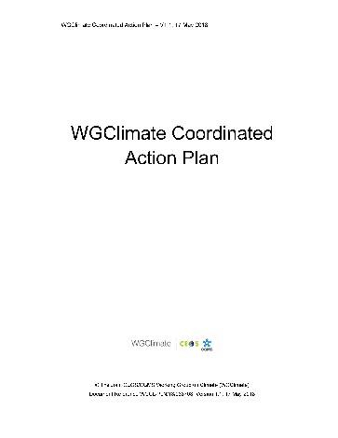
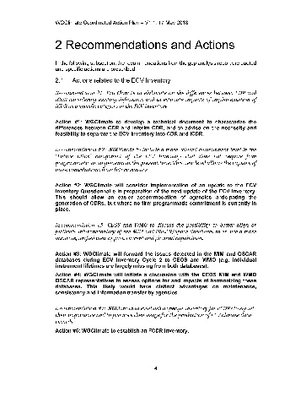
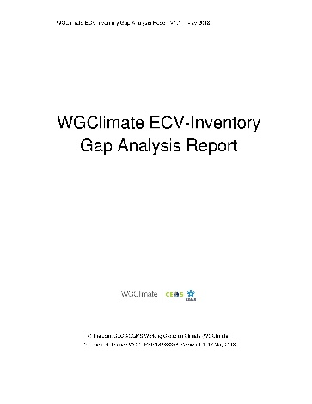
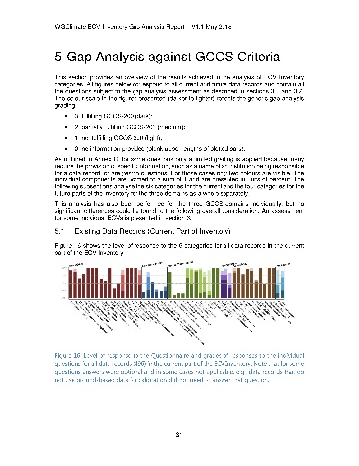
Sustaining Space Capabilities for Climate
Actions
Creation of conditions to deliver climate data records
The ECV Inventory fully describes current and planned implementation arrangements for ECVs
Everybody with an internet connection can download the ECV Inventory content for their own analysis, find direct access points to climate data records in the Inventory, and get access to WG Climate gap analysis results and resulting actions
Recommendations to mitigate gaps
ECV Inventory
Population
Content Verification
Gap Analysis
Completeness of ECV Products
Sustainability of space segment
Missed data usage opportunities
https://climatemonitoring.info/ecvinventory/
Notes:
Talking points:
Apart from GHG, the joint CEOS/CGMS Working Group Climate is working on sustaining and further evolving the space-based capabilities to monitor climate variability and change
An integral part is the web-based inventory of existing and planned climate data records for GCOS Essential Climate Variables. First bullet.
This is used for a gap analysis addressing (say what is on the slide). One outcome is second bullet
The Working Group makes recommendation and implements actions to remedy gaps.
Third bullet
Fourth bullet

Slide 5
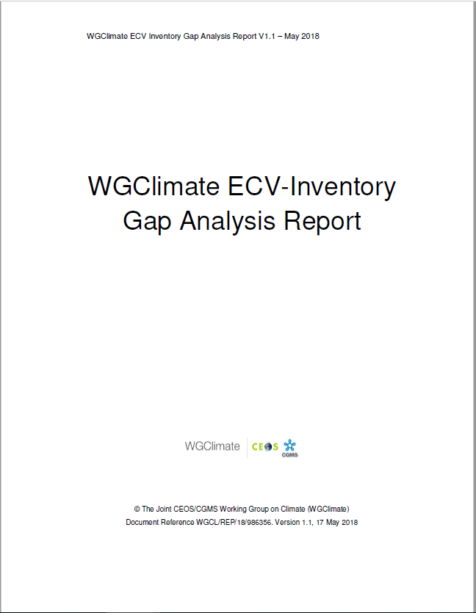
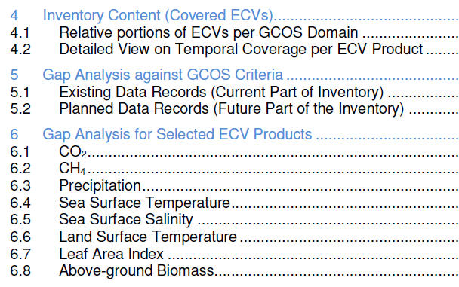
Gap analysis concept on ECV Inventory v3
Automatic assessment
Statistical analysis tools and graphical display
Statistical analysis tools and graphical display on the web interface
Analysis of delta to version #2
Detailed analysis per ECV / ECV Product:
Assesses progress for 8 ECVs addressed for V2.0
Selected 13 additional ECVs (5 atmosphere, 5 land, 3 ocean) not addressed before that are specifically part of 2016 GCOS-IP actions
Postponed 2 land (FAPAR, Glaciers) and 1 atmosphere (Lightning) due to missing support and late availability of Inventory inputs
Addressed are: Aerosols, Surface winds, Upper-Air Winds, Water Vapour (UT/LS), Fire, Land Cover, Soil Moisture, Sea Level, Sea State, and Ocean Surface Heat Flux

Slide 6
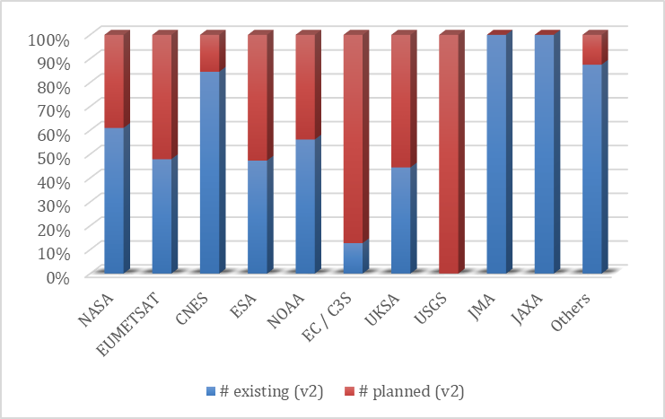
Relative number of existing and planned data records per agency
ECV Inventory #2
ECV Inventory #3

Slide 7
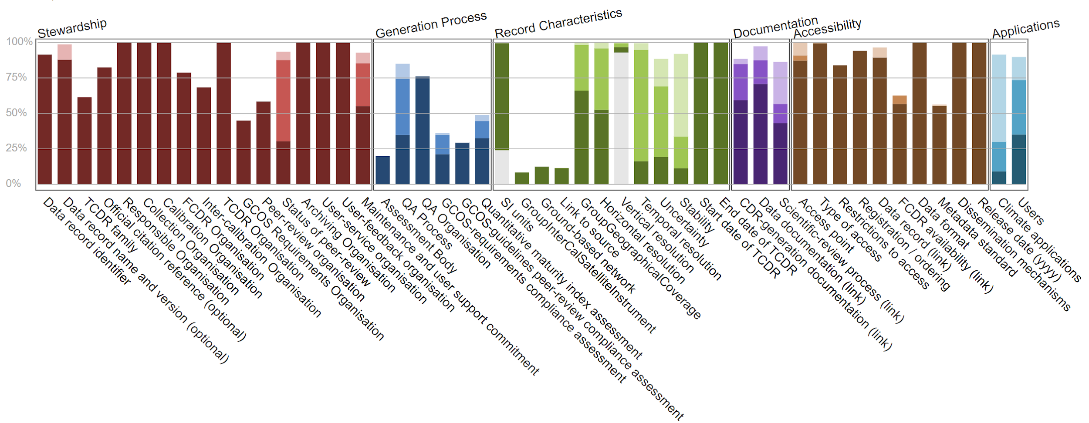
Assessment of GCOS Criteria for existing data records
x
x
x
x
x
x
x
x
x

Slide 8
Other key findings -1
Gaps in the ECV Inventory have been detected for ECVs aerosol, sea level, soil moisture, land cover, and fire (burnt area)
Detected issues in WMO OSCAR concerning the relevance category of missions for aerosol retrieval
Maintenance of existing and non delayed launch of new multi-channel passive microwave radiometers (AMSR-3, MWI, Weather Satellite Follow-on – Microwave (WSF-M)) is needed to avoid gaps for several ECV data records. The earliest next launch is in 2022
For upper air winds there is a big potential to use instruments that haven’t been used including Russian and Indian imagers, and sounders for 3D winds
After demonstration of positive impact on NWP Aeolus type missions should be operationalised to build long term records
Notes:
Aerosol: MODIS gets only medium rating, air quality sensors Sentinel-4, TEMPO etc high ratings and polarimeter such as 3MI lower ratings. This needs review and change.

Slide 9
Other key findings - 2
For ECV water vapour, there is an impending gap in water vapour measurements from stratospheric limb sounders used for profiling, e.g., from solar occultation, limb scattering, or limb emission
For ECV aerosol, lacking cross-sensor consistency for long-term multi-sensor CDRs is a principal issue which is due to responsibilities at space agencies being assigned on single mission level (e.g. ATSR-2 / AATSR / SLSTR or MODIS /VIIRS series) – planning of future instruments should consider this aspect.
For ECV sea level raw data (FCDR) quality is affected by the change of measurement approach, it will be essential to ensure the production of the Sentinel-6/Jason-CS FCDR based on the historical Low Resolution Mode measurements to support climate applications
Altimetry data could play a stronger role deriving sea ice extent and snow thickness, which should be encouraged for cross comparisons and reduction of uncertainty in all products

Slide 10
Gap analysis and coordinated action plan
The delivery of the Cycle 3 Gap Analysis and Coordinated Action Plan has moved to spring 2021 (due to continuous COVID-19 impact), virtual endorsement until end of 2020 wasn’t possible
Major gap is the progress on ECVs we analysed in the first gap analysis, but we are working on it
Gap analysis process will be further rationalised to ensure affordability. It will involve an annual workshop to which agencies are requested to send experts on ECVs
Encouraged CEOS members to inform us about particular needs for gap analysis that are most useful for them - did not hear from anybody
Need to identify, discuss and decide on topics for V4 gap analysis shortly after next meeting
Action to WGClimate members: Send your ideas and expectations to me and I will present a proposal at the meeting in April
Many of the Coordinated Actions found their way into the CEOS work plan, not all though
Need to make effort to integrate or close coordinated actions, should have time in next meeting in April to discuss those and take decisions

Slide 11
Miscellaneous
GCOS Status Report Review – Who is doing it, making comments on Facts about the ECV Inventory and Actions related to WGClimate?
More GCOS ECVs could be addressed with space data:
River discharge
ECV Marine Habitats – ECV Product Mangrove Forests Cover might be added to the lot of space-observable GCOS ECVs: JAXA submitted an entry tagged as Land Cover, still under review
Still need to decide on data records from space for non ECVs:
NDVI (discussed this 11th meeting but did not take a decision)
New things could be catalogues of:
F(C)DR
obs4MIPs data sets (indicator of existing data records)
Data sets used for GHG and AFOLU

