Slide 1
WMO Space Programme
Werner Balogh
WMO Space Programme Office
WG-Climate-10, Marrakech, Morocco
21 March 2019

Slide 2
1. History and Background

Slide 3
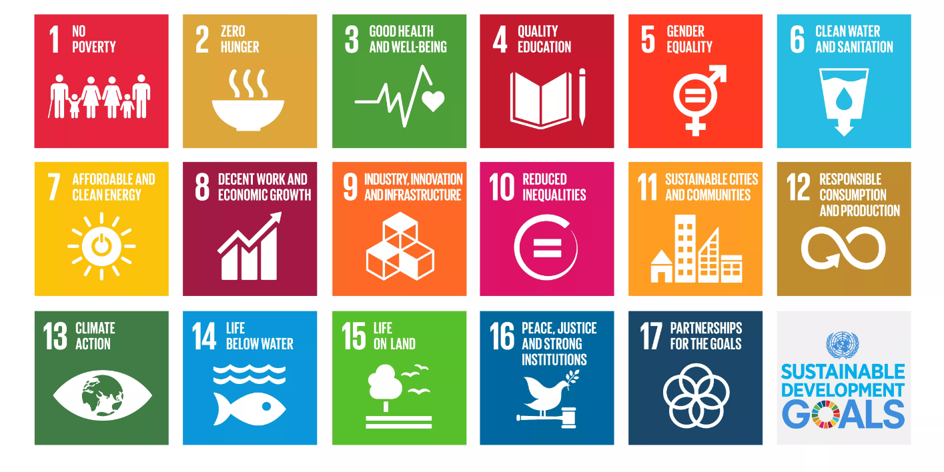
2030 Agenda for Sustainable Development
WMO contributes to 12 of the 17 SDGs and is the co-custodian of SDG 13 on Climate Action
https://public.wmo.int/en/our-mandate/what-we-do/wmo-contributing-sustainable-development-goals-sdgs

Slide 4

United Nations and Outer Space
Launch of Sputnik in 1957 - beginning of space activities
It raises many questions:
  Arms race in outer space?
  Rules and regulations for activities in outer space?
  Space activities?
UN Member States decide to establish the Committee on the Peaceful Uses of Outer Space (UNCOPUOS)
WMO, as a specialized UN agency, is invited to participate in the sessions of the UN Committee on the Peaceful Uses of Outer Space

Slide 5


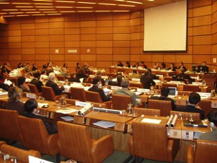
Origin of the World Weather Watch
In 1961, UNGA Resolution 1721 (XVI) C requests WMO to report to COPUOS on how it could utilize space technology in its work
US President John F. Kennedy proposes to launch “cooperative efforts between all the nations in weather prediction and eventually in weather control” making use of space-based observations from satellites.
In response to this request, WMO prepares the proposal for the World Weather Watch (WWW), which is subsequently endorsed by UNGA Resolution 1963 (XVIII) III in 1963
Implementation of WWW from 1967
See https://public.wmo.int/en/bulletin/global-satellite-observing-system-success-story

Slide 6
Global Observing System (GOS) -1961
Observing System Element of WWW
TIROS-I – First weather satellite image (April 1960)
Space-based Global Observing System (GOS) in 1961

Slide 7
Global Observing System (GOS) - 2021
WWW/GOS now integrated in WIGOS

Slide 8
Recent ITU News Magazine Article
See https://www.itu.int/en/itunews/Documents/2019/2019-01/2019_ITUNews01-en.pdf

Slide 9
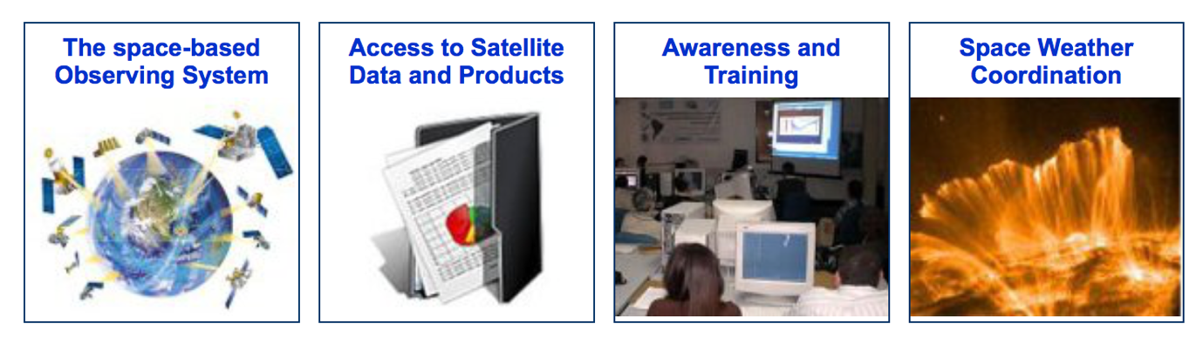
WMO Space Programme (WSP)
Established by Resolution 5 (Cg-XIV) of the 14th WMO Congress in 2003
Supported by WMO Space Programme Office (SAT)
Promote availability and utilization of satellite data and products for weather, climate, water and related applications.
Coordinate environmental satellite matters and activities throughout all WMO Programmes.
16th WMO Congress in 2011 confirmed four main components:
See http://www.wmo.int/sat

Slide 10
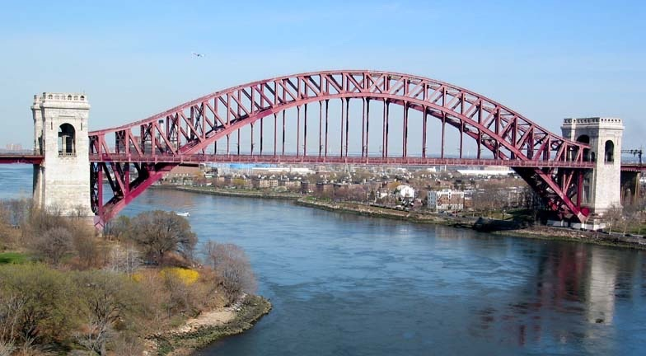






WMO Space Programme Value Chain
Satellite Operators
Calibrated
data sets
Quality-controlled products
Data collection, Dissemination & Access
Awareness & training
Users
WIS
DBNet

Slide 11
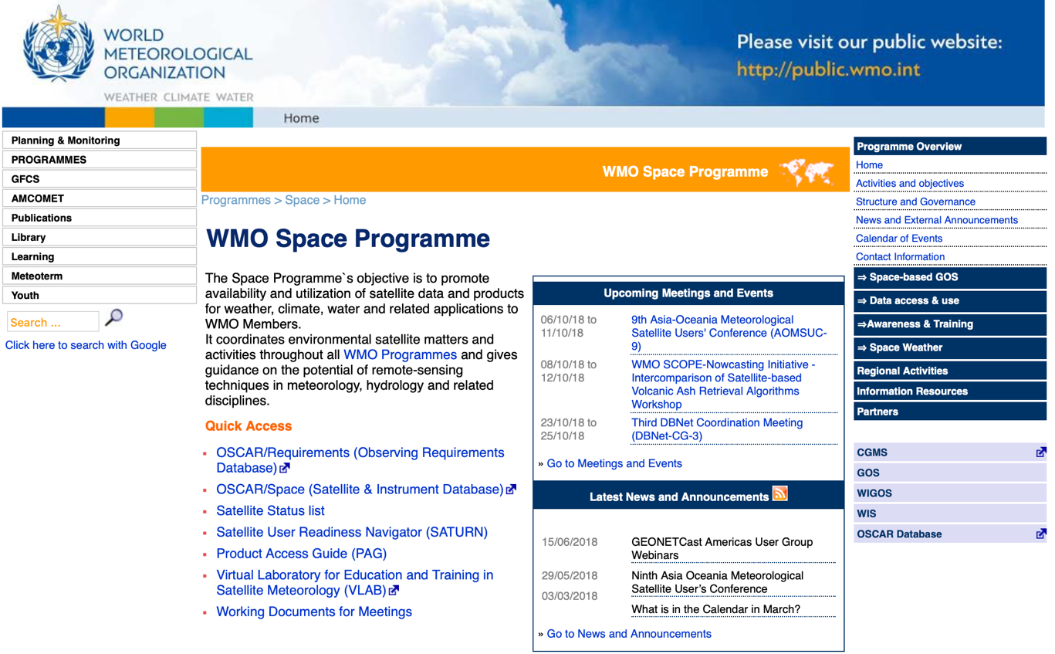
Space Programme Website
See http://www.wmo.int/sat

Slide 12
WMO Space Programme Office
C/SBOS
T.Kurino
C/SDU
W.Balogh
SO/SDU
Vacant
D/SAT
Vacant
D/OBS
F.Belda

Slide 13
Space Programme Expert Teams
ET-SAT
Expert Team on Satellite Systems
IPET-SUP
Inter-Programme Expert Team on Satellite Utilization and Products
IPT-SWeISS
Inter-Programme Team on Space Weather Information, Systems and Services
Established under the Open Programme Area Group on Integrated Observing Systems of the Commission for Basic Systems
Members nominated by Permanent Representatives
IPET-SUP
  Membership: http://www.wmo.int/pages/prog/www/CBS/Lists_WorkGroups/CBS/ICT-IOS/IPET-SUP/members
  Terms of Reference: http://www.wmo.int/pages/prog/www/CBS/Lists_WorkGroups/CBS/ICT-IOS/IPET-SUP/tors

Slide 14
2. Space-based
Observing System

Slide 15
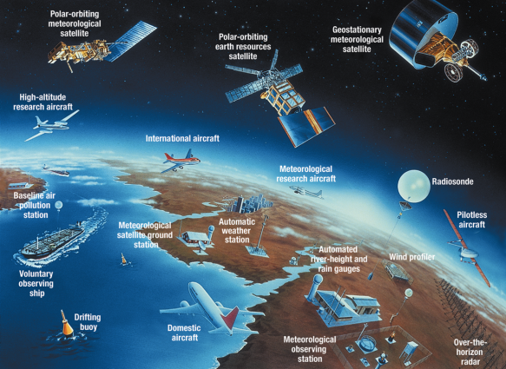
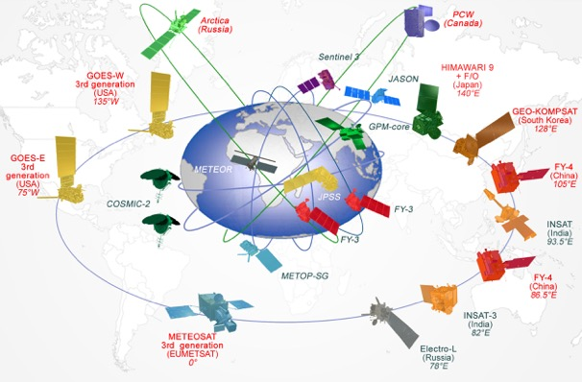
WMO Integrated Global Observing System
World Weather Watch (WWW), established in 1963.
Need to upgrade observation system in response to societal changes, addressing weather, water, climate and environmental issues:
  WMO Integrated Global Observing System (WIGOS)
  WMO Information System (WIS)
A common regulatory and management framework.

Slide 16
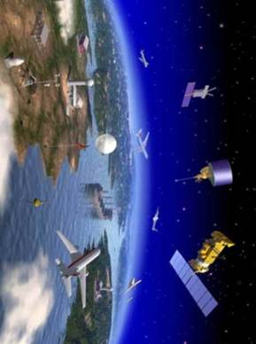
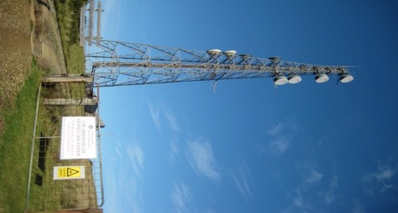
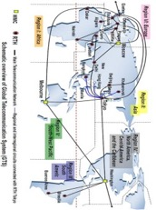
WMO Integrated Global Observing System
World Weather Watch
GAW
WIGOS
GCW
Hydro OS
GOS
GCOS
Partners
GDPFS
Co-sponsors
WMO Information System -WIS
GTS

Slide 17
WMO Application Areas
1) | Global numerical weather prediction
2) | High-resolution numerical weather prediction
3) | Nowcasting and very short range forecasting
4) | Sub-seasonal to longer predictions
5) | Aeronautical meteorology
6) | Forecasting atmospheric composition
7) | Monitoring atmospheric composition
8) | Atmospheric composition for urban applications
9) | Ocean applications
10) | Agricultural meteorology
11) | Hydrology
12) | Climate monitoring (GCOS)
13) | Space weather
14) | Climate science
See http://www.wmo.int/pages/prog/www/OSY/GOS-RRR.html

Slide 18
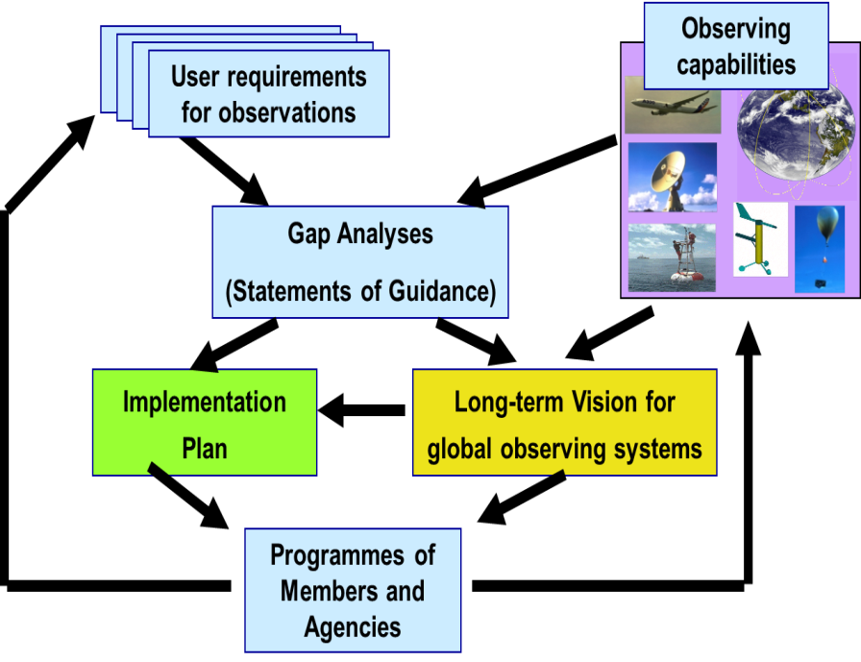
Rolling Review of Requirements
OSCAR/Space
OSCAR/Surface
OSCAR/
Requirements
WIGOS Vision 2040

Slide 19
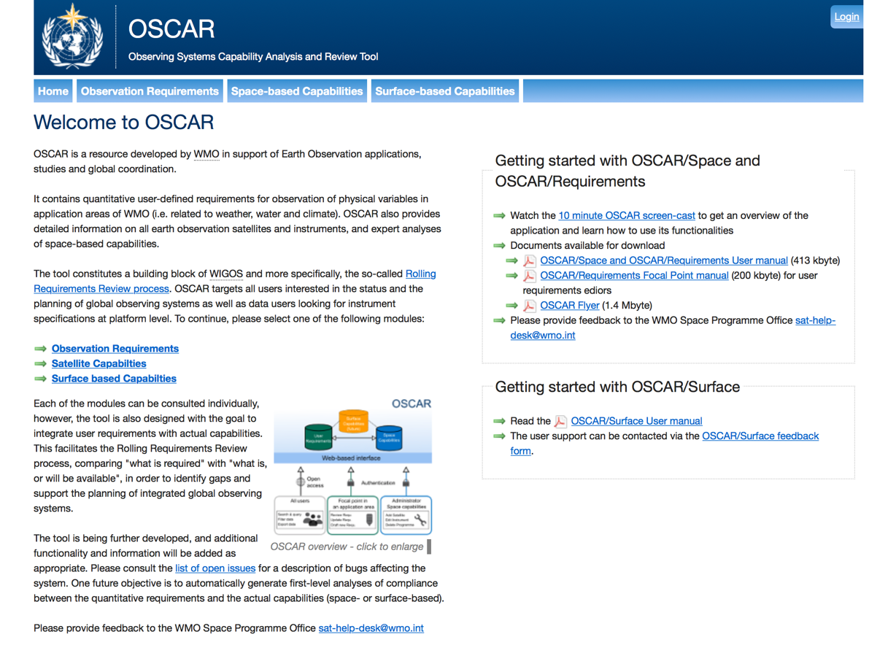
Observing System Capability Analysis and Review Tool
See http://oscar.wmo.int

Slide 20
3. Access to
Satellite Data and Products

Slide 21
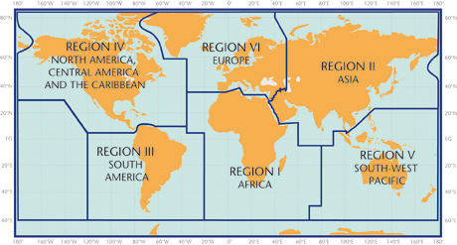
Regional Satellite Data Requirements Groups
RA I (Africa): Dissemination Expert Group (RAIDEG)
RA II (Asia): WIGOS Project Coordination Group
RA III/IV (Americas): Coordination Group
RA V (SW Pacific): Task Team on Satellite Utilization
Bringing together:
Operational users
Satellite providers
Training centres (VLab CoEs)
Scientific users
Others
Objectives:
User-provider dialogue
Expressing user requirements
Coordinating data distribution
Identifying training needs
Implementing WIGOS/WIS
See http://www.wmo.int/pages/prog/sat/index_en.php (Regional Activities)

Slide 22
Global and Regional Data Use Surveys
See https://library.wmo.int/index.php?lvl=notice_display&id=20787

Slide 23
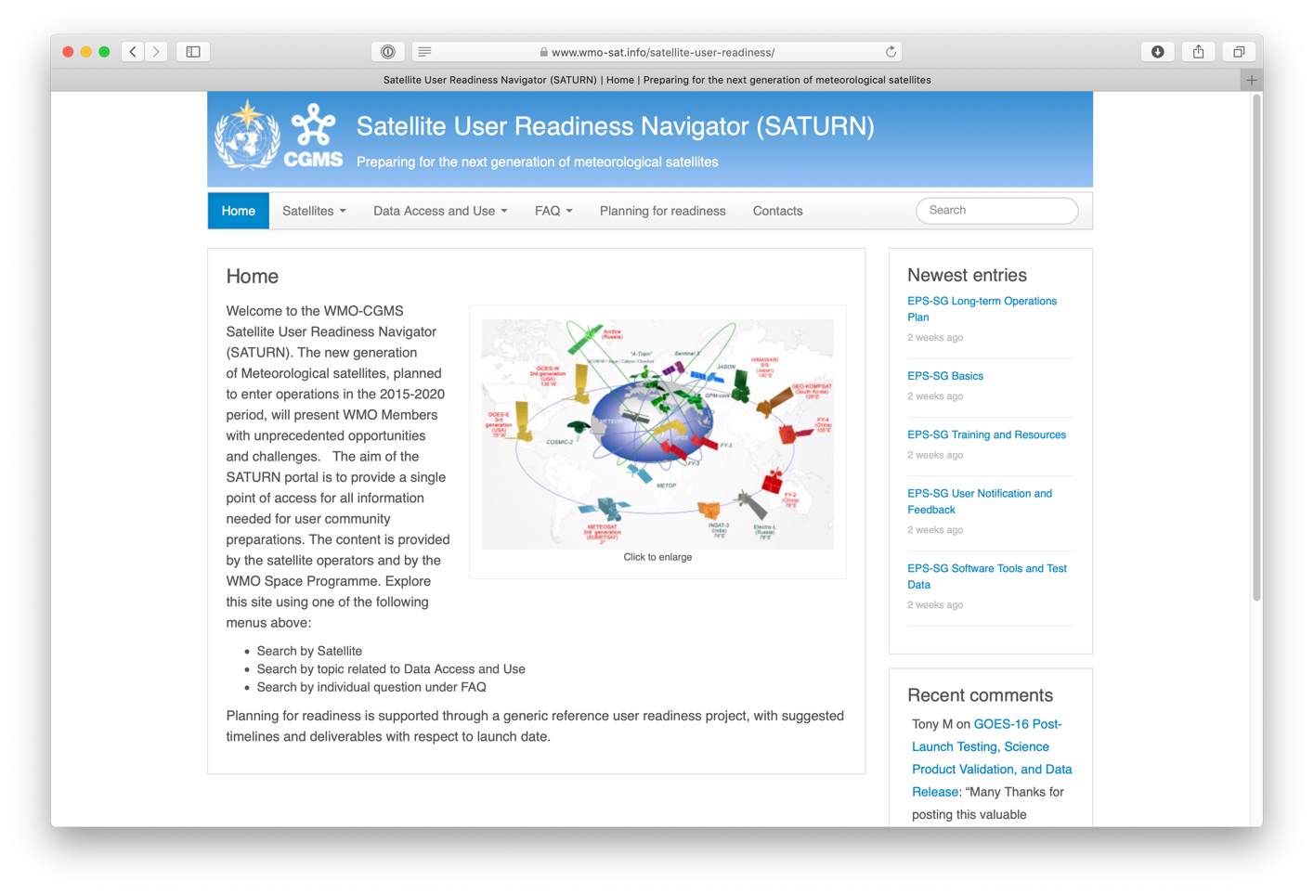
Satellite User Readiness Navigator (SATURN)
See https://www.wmo-sat.info/satellite-user-readiness/

Slide 24
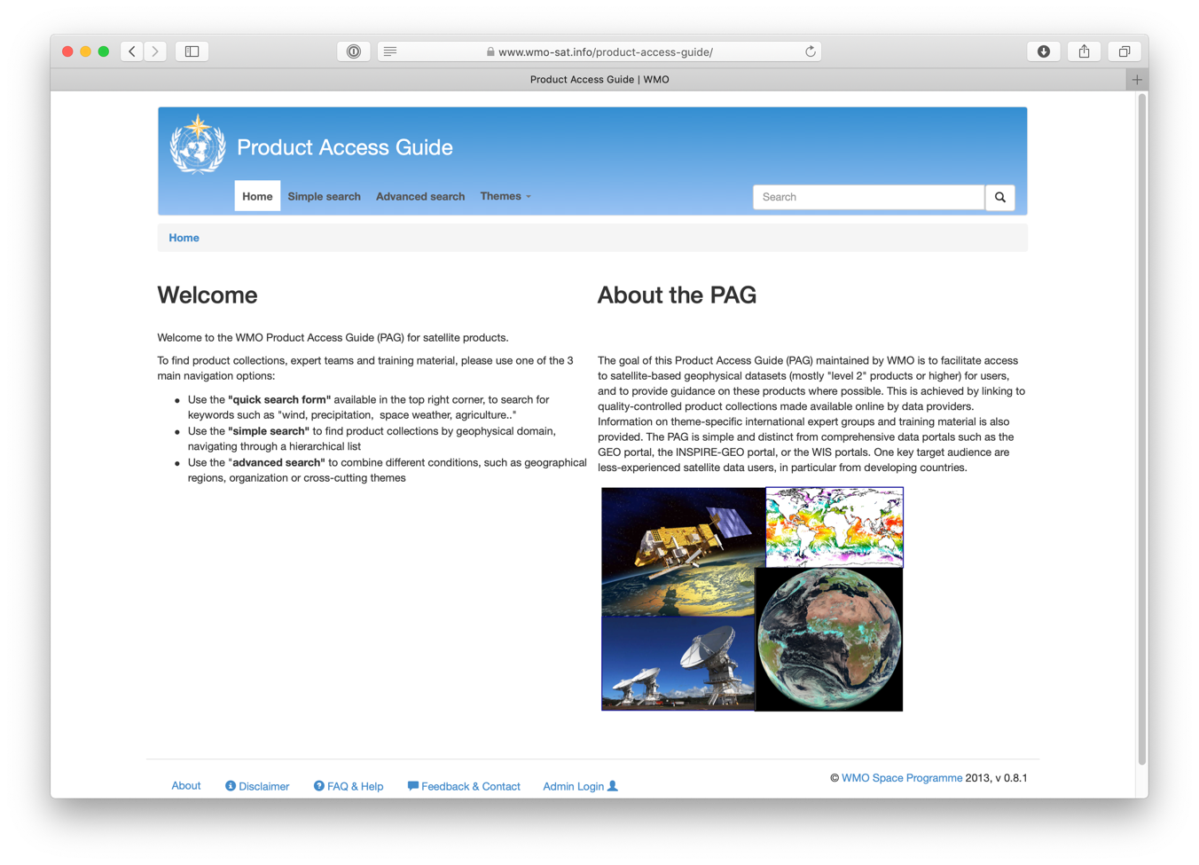
Product Access Guide (PAG)
See https://www.wmo-sat.info/product-access-guide/

Slide 25
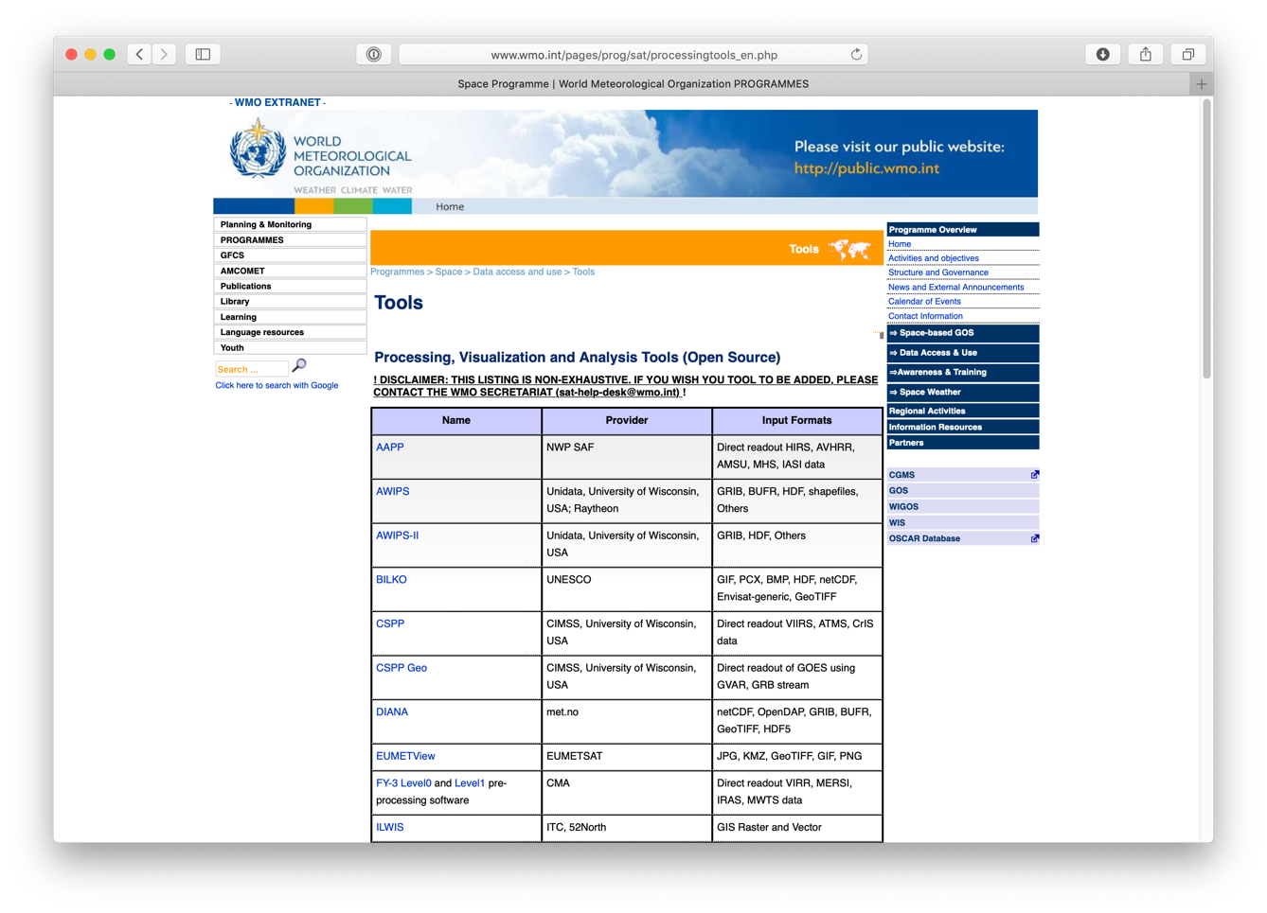
Processing, Visualization and Analysis Tools
See http://www.wmo.int/pages/prog/sat/processingtools_en.php

Slide 26
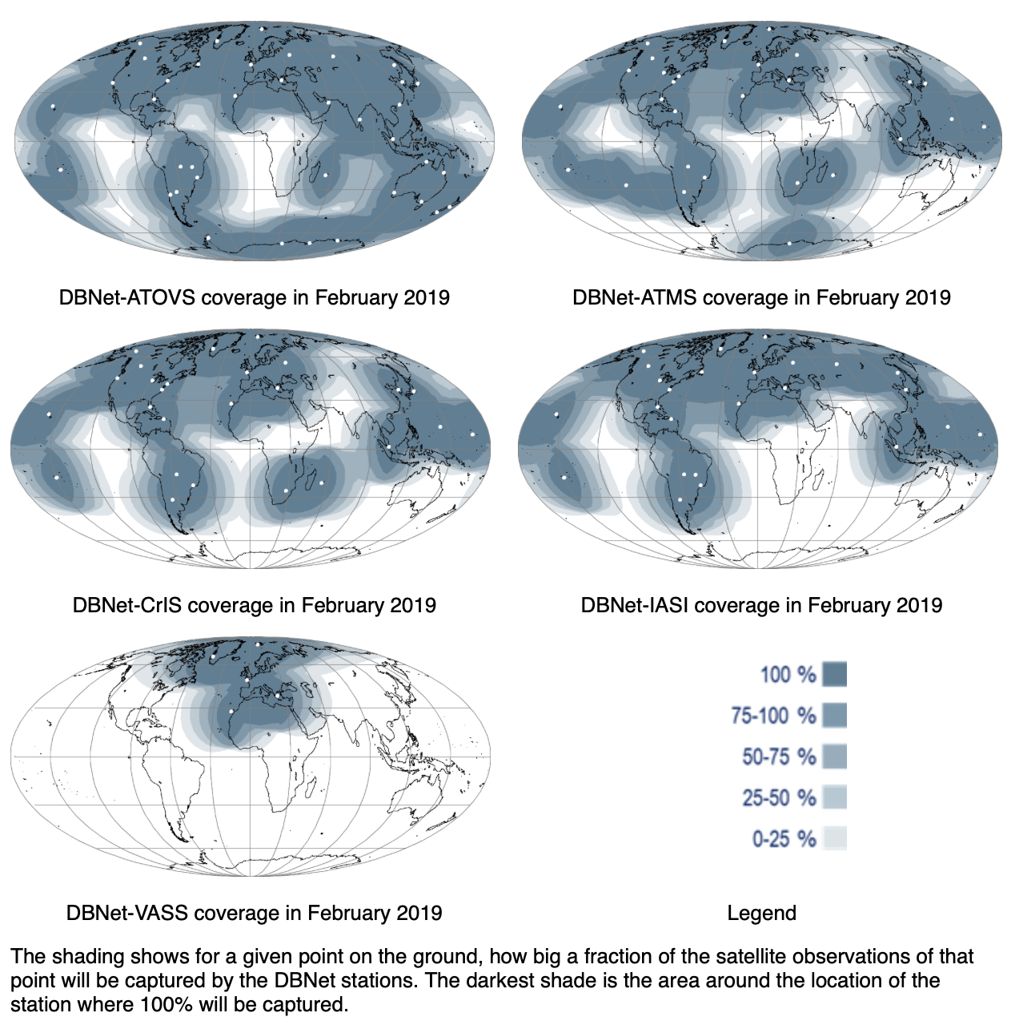
Direct Broadcast Network (DBNet)
See http://www.wmo.int/pages/prog/sat/dbnet-implementation_en.php#DBNetstatus

Slide 27
4. Capacity Development

Slide 28
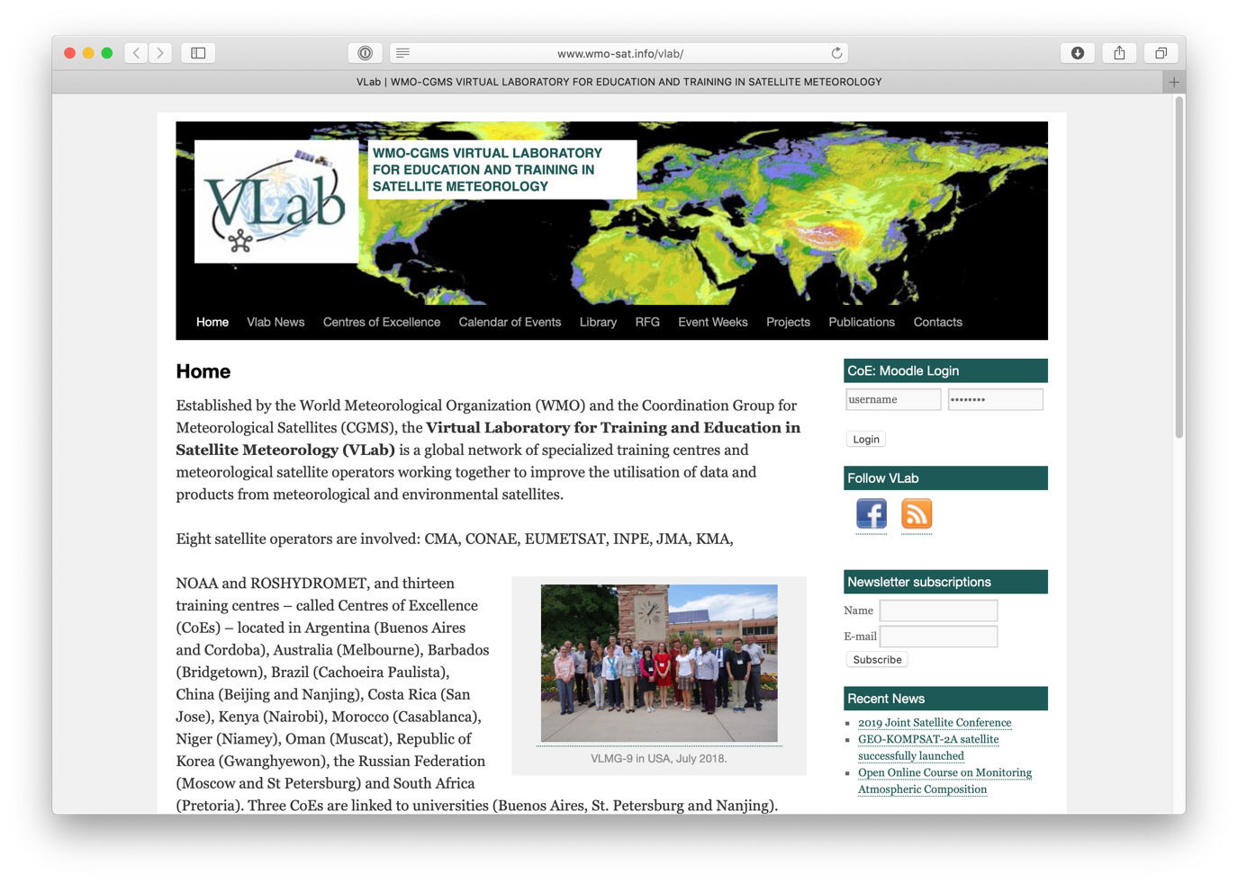
Virtual Laboratory for Training and Education in Satellite Meteorology (VLab)
See https://www.wmo-sat.info/vlab/

Slide 29
5. Space Weather
Coordination

Slide 30
WMO and Space Weather
Supported by IPT-SWeISS
Space Weather and OSCAR/Space
Space Weather Portal (see https://www.wmo-sat.info/product-access-guide/theme/space-weather)
Working with ICAO to select providers for space weather information services for aviation
Space Weather Warnings and GMAS

Slide 31
6. WMO Governance Reform

Slide 32
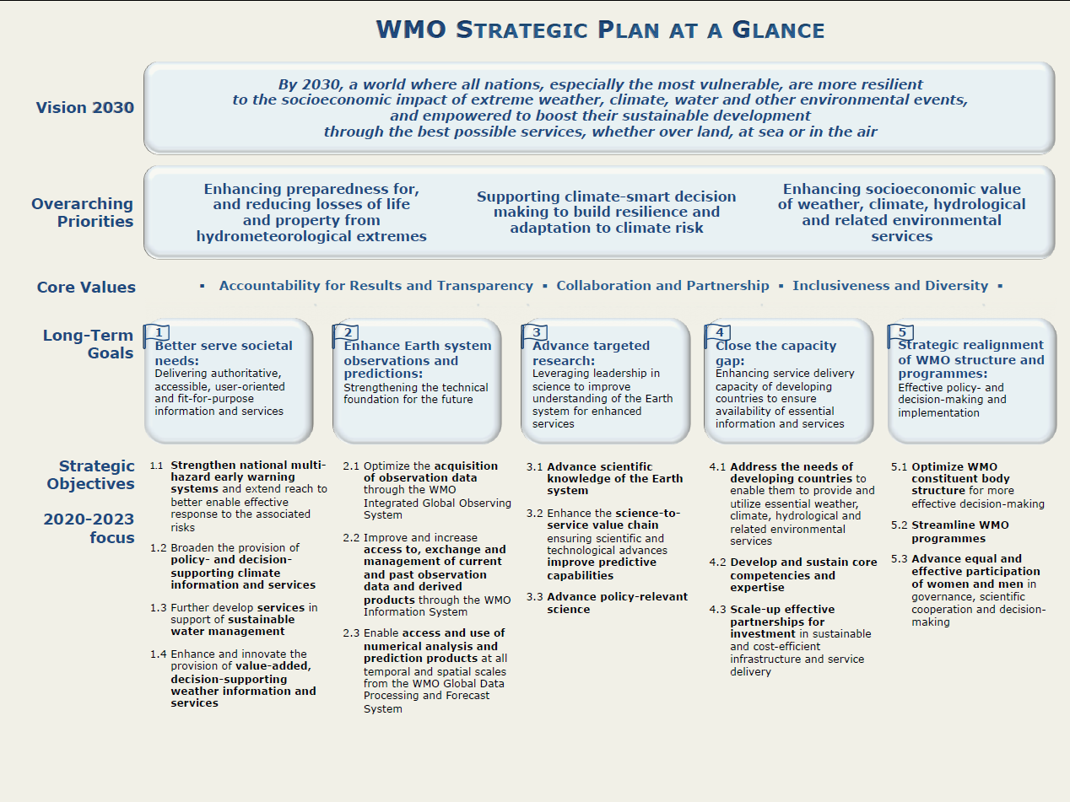
Strategic Plan 2020-2023

Slide 33
WMO Governance Reform
See https://public.wmo.int/en/governance-reform

Slide 34
Challenges & Opportunities
Create benefits from the space-based observing system and help achieve global development agendas
Enlarge user community and integrate space-based data and information into decision-making processes
Implement space-based WIGOS Vision 2040, including the architecture for climate monitoring from space
Maintain and promote open and free access to data
Sustain OSCAR and routinely conduct RRR
Help bridging gap between space agencies and NMHSs
Assist NMHSs with capacity development
Engage with the Global Weather Enterprise

Slide 35
WMO Space Programme
http://www.wmo.int/sat

