Slide 1
ECMWF research
Andy Brown

Slide 2
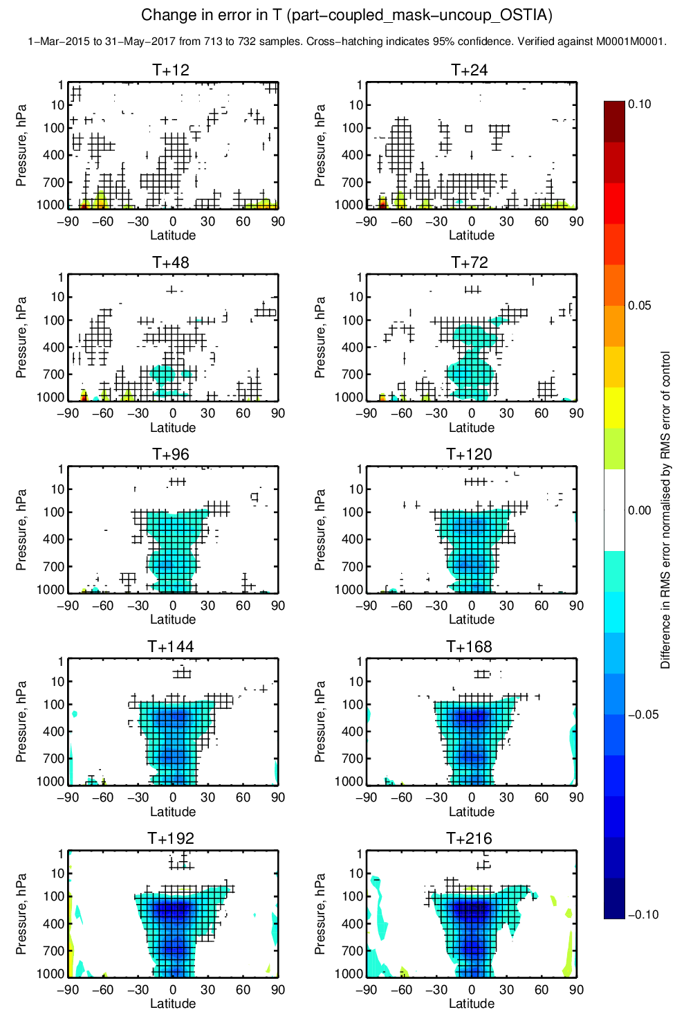
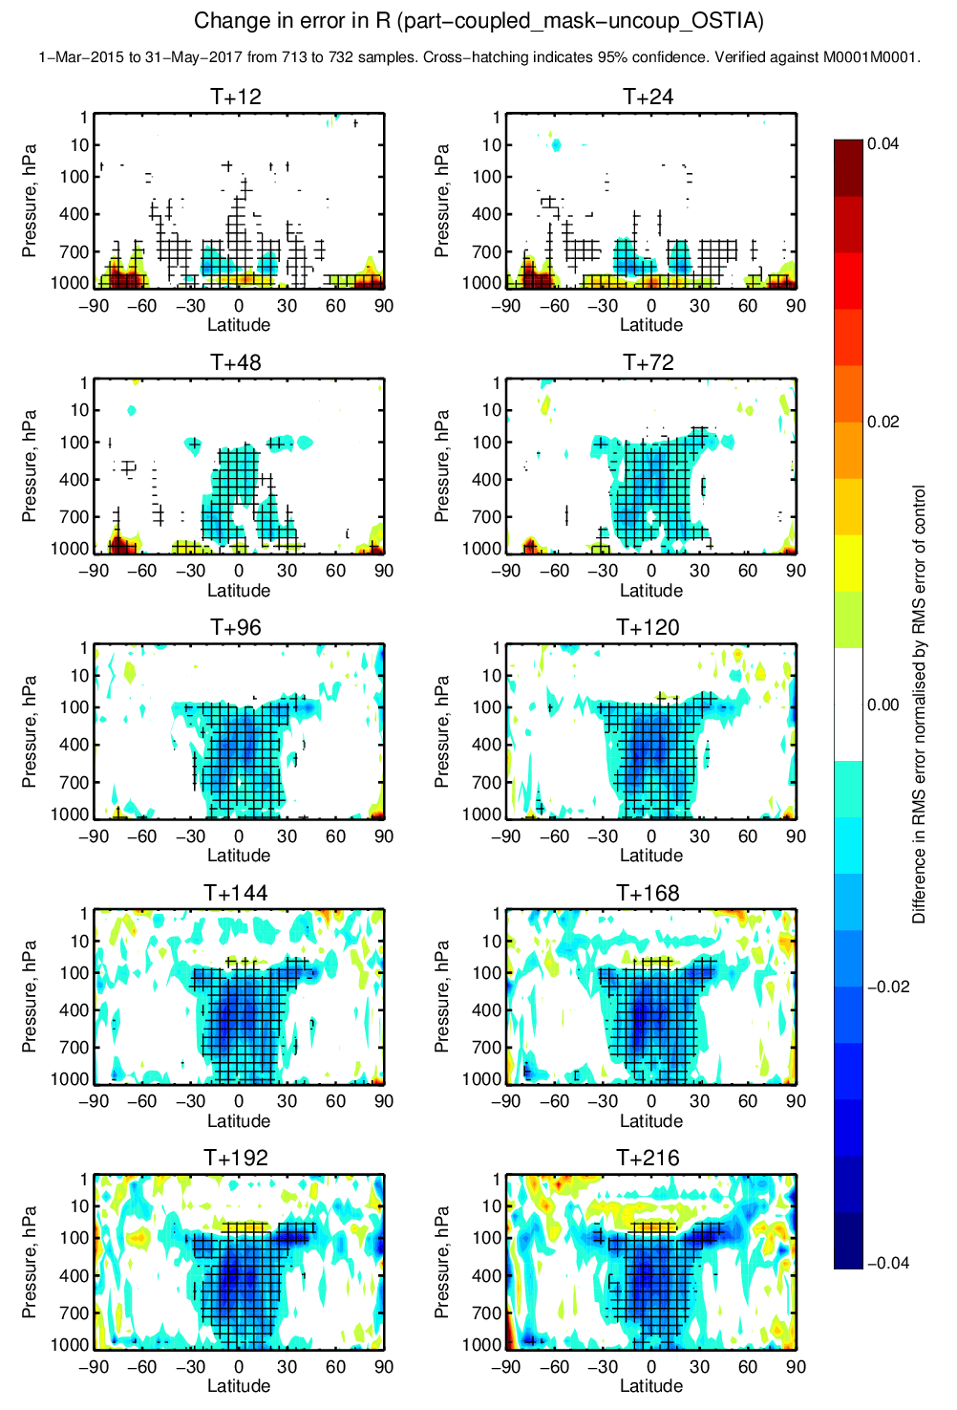
45r1 – June 2018 0.25 degree Ocean coupled to HRES
Temperature
Humidity
Temperature
Geopotential

Slide 3
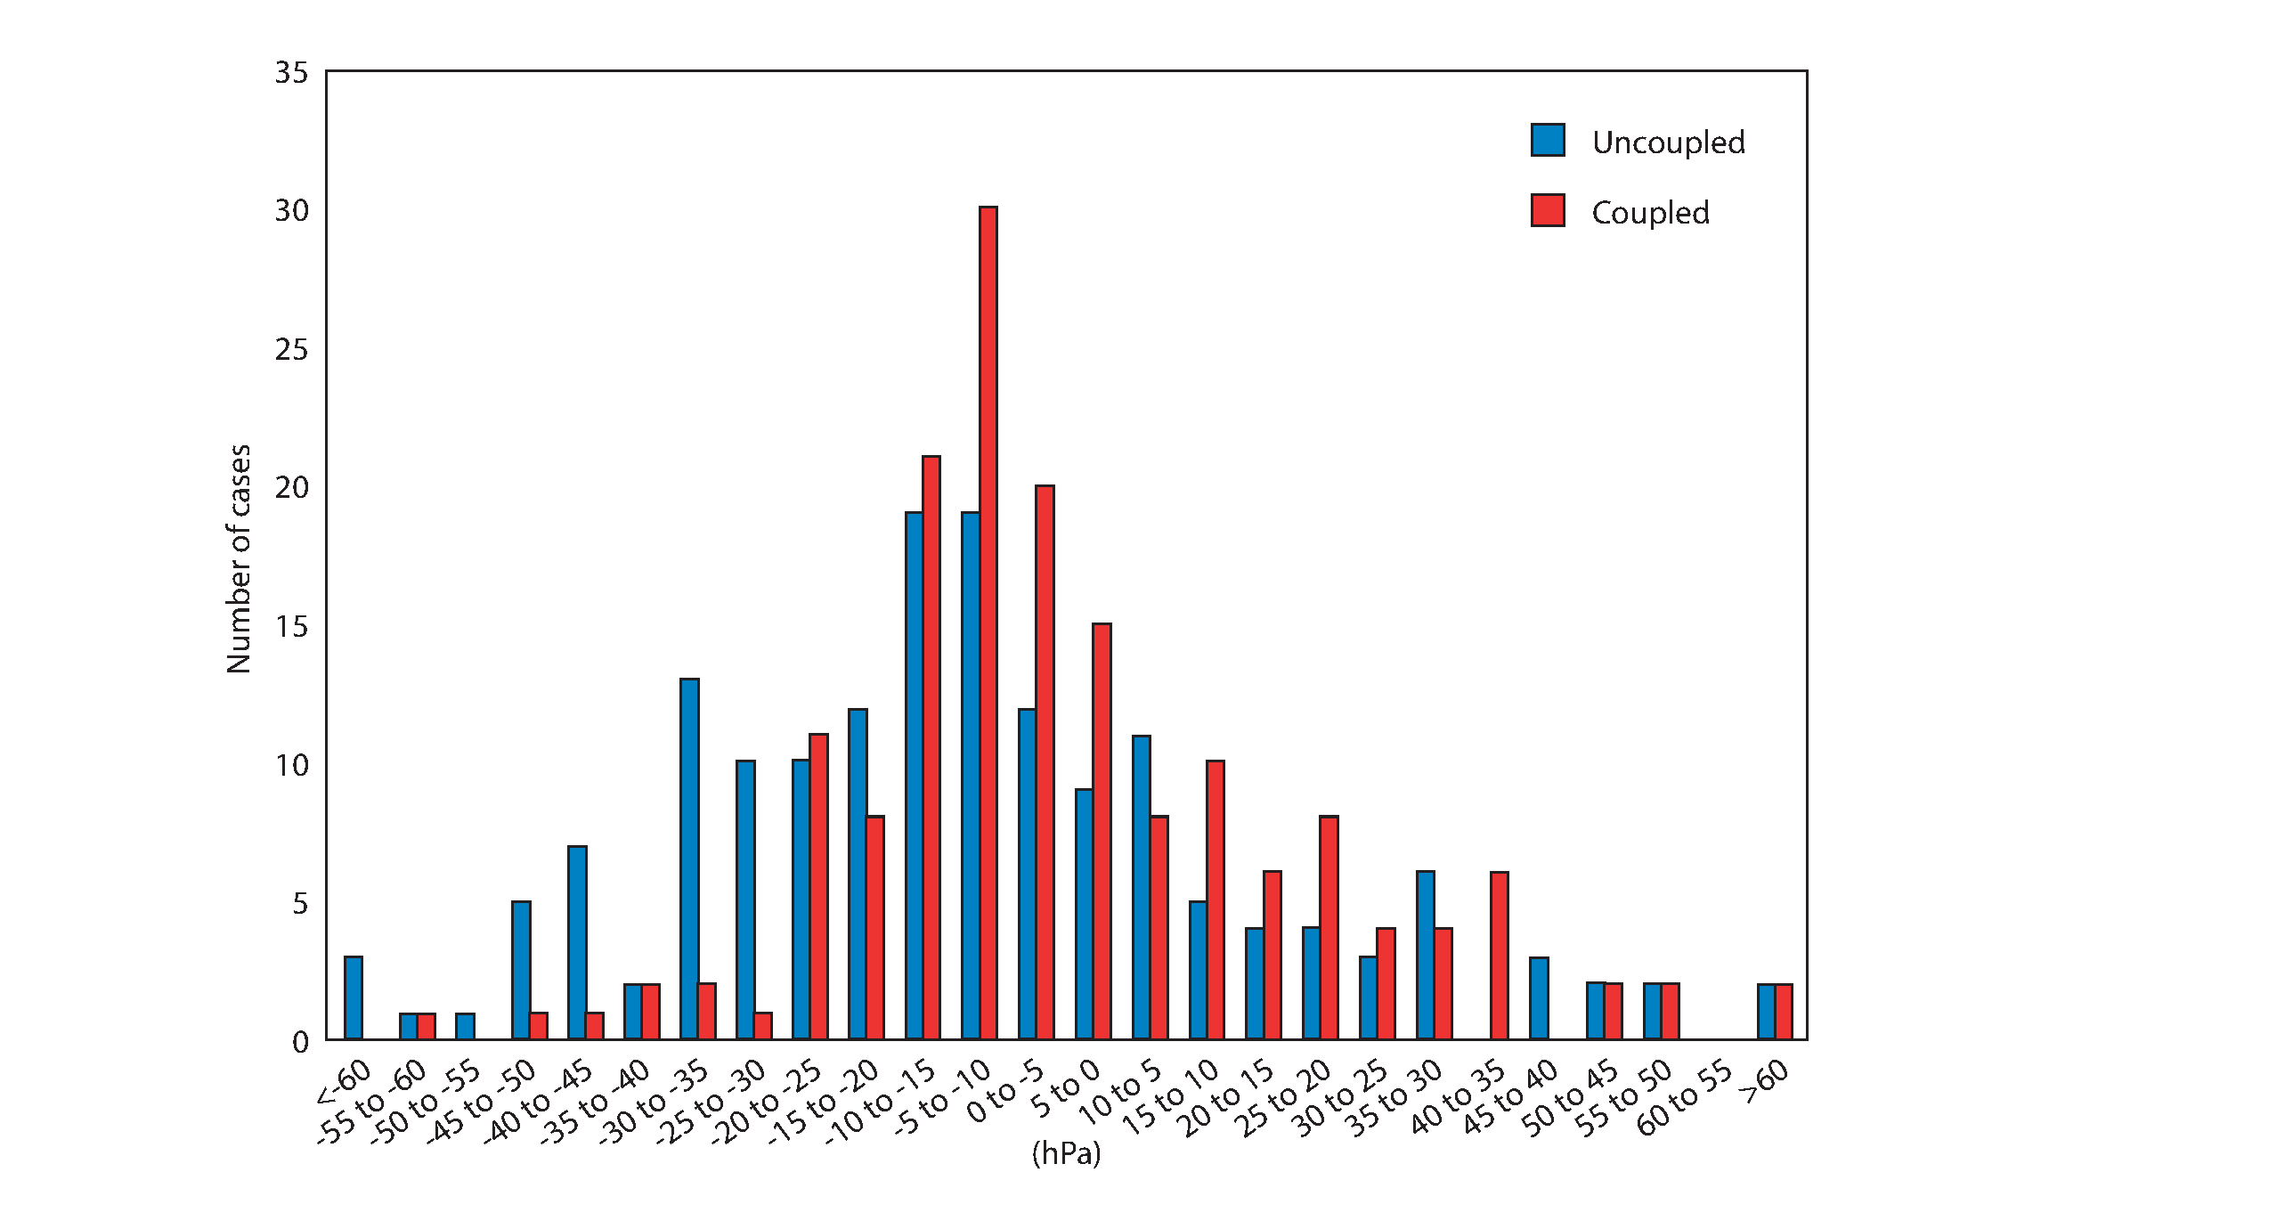
Does the ocean coupling actually matter for a large sample of TC’s?
Distribution of 7-day TC intensity forecast errors for coupled and uncoupled high-resolution forecast experiments.
The experiments cover the period of March 2015 to June 2017 and were carried out over all basins for a total of 163 TCs.
The number of over predictions is reduced in the coupled forecasts compared to the uncoupled forecasts.

Slide 4
46r1 Data assimilation and observation highlights
Continuous Data Assimilation
Ensemble of Data Assimilations (EDA) increased from 25 members to 50 members
New ENS initialization from 50-member EDA – members now exchangeable
More efficient and more coupled soil moisture analysis (EDA Jacobians in SEKF)
Assimilation of SMOS neural network soil moisture product
New microwave channels assimilated (e.g. 150, 166GHz SSMIS F-17) and improved data usage
Increased and improved use of geostationary radiance data
RTTOV upgraded from v12.1 to v12.2
Weakly coupled data assimilation introduced for sea-surface temperature in the tropics
Consistent spatial interpolation of the model to observation locations in trajectories and minimisations

Slide 5
Continuous data assimilation
obs
Min1
Min2
Min3
Current
Effective cut-off time is 30 minutes later
Min1
Min2
Min3
Extra obs
Min(n-3)
Min(n-2)
Min(n-1)
Min(n)
Extra obs, start earlier
Key point: Start running data assimilation before all of the observations have arrived:
  Most of the assimilation is removed from the time critical path
  Configurations which were previously unaffordable can now be considered

Slide 6
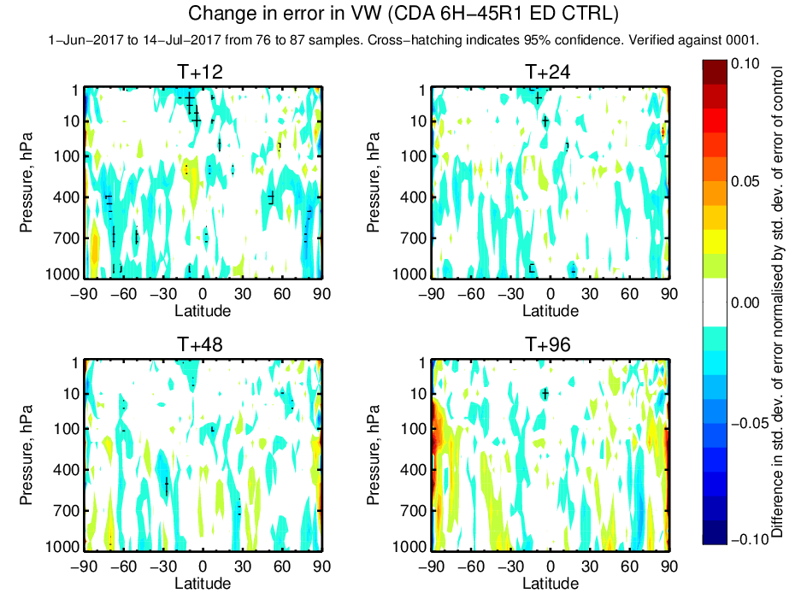
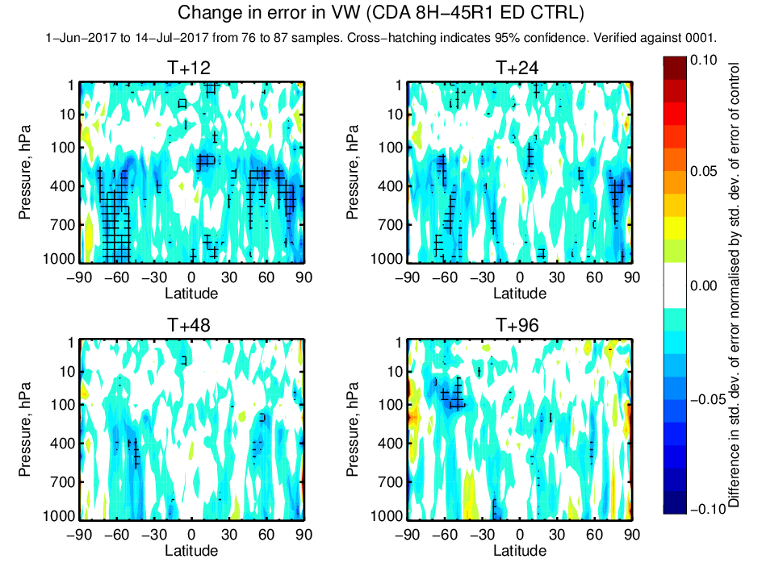
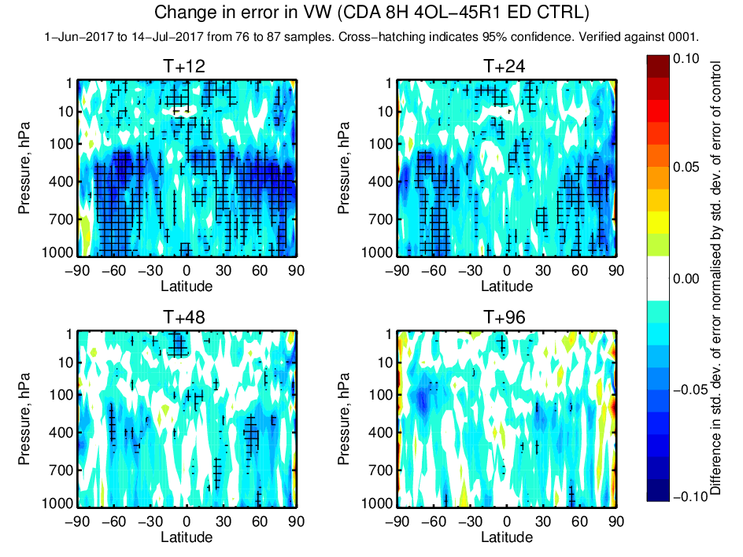
Continuous DA
Preliminary results (Wind Vector error stdev, 1/6/17 – 14/7/17)
A: Late obs – 6h window
B: Late obs – 8h window
C: B + 4 outer loops

Slide 7
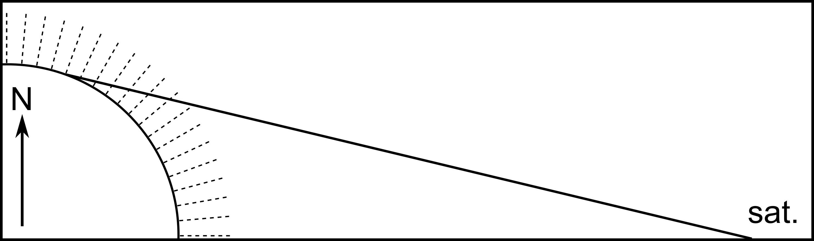
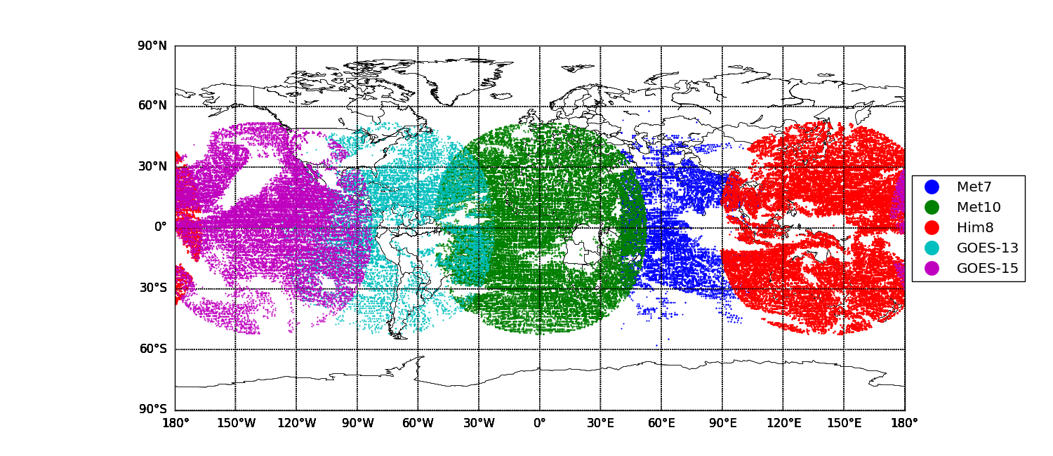
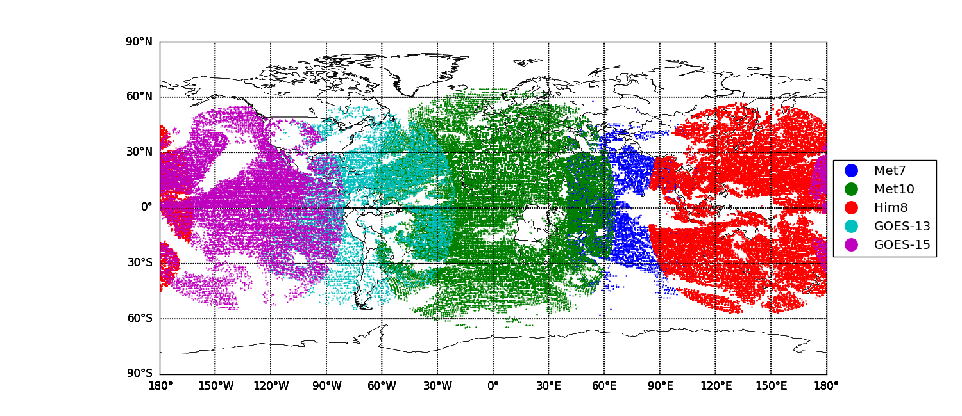


Geostationary radiances
Diagnosed inter-channel error correlations for the water vapour channels on SEVIRI, AHI and ABI. E.g.
Slant path radiative transfer – this improves forward-modelling at high zenith angles:
Increased use of data at high zenith angles beyond 60° (assisted by the slant path processing):
$$R_{SEVIRI}=\left(\begin{matrix}0.46 & 0.20 \\ 0.20 & 0.30\end{matrix}\right)$$
$$R_{AHI}=\left(\begin{matrix}0.55 & 0.43 & 0.22 \\ 0.43 & 0.46 & 0.31 \\ 0.22 & 0.31 & 0.35\end{matrix}\right)$$
Notes:
Similarly interchannel observation error correlations have been introduced for geostationary water vapour
channels. The current instruments with multiple water vapour channels are SEVIRI (Meteosat Second
Generation) (2 WV channels), and AHI (Himawari) (3 WV channels). The Desroziers diagnostic R ma-
trix has been computed for each of these instruments (plus the GOES IMAGER which has just one WV
channel), and the resulting error variances have been scaled by a factor of 6 in order to provide the best
first guess fit to water vapour channels on other instruments (as well as impact at longer lead times). A
further upgrade to the use of geostationary radiances is to extend their use to higher zenith angles (i.e.
at the edge of the disk). At these high angles, line of sight of the satellite passes through a number of
model columns. In order to improve the representation of these observations, the “slant path” method is
used to perform the radiative transfer calculation along the line of sight. The configuration for CY45R1
used only vertical information from a single location. Currently, geostationary radiances are rejected in
the blacklist if the satellite zenith angle is greater than 60 degrees. This change allows data to be used up
to zenith angles of 74 degrees, thus improving coverage at the edges of the geostationary disks. This is
particularly significant in the North Atlantic, where a significant amount of Meteosat-10 data is currently
not being used. These changes to geos improved the first-guess fits to independent humidity-sensitive
satellite observations, and the short range forecast of relative humidity and vector wind was improved at
the 200hPa level as verified against operational analyses.

Slide 8
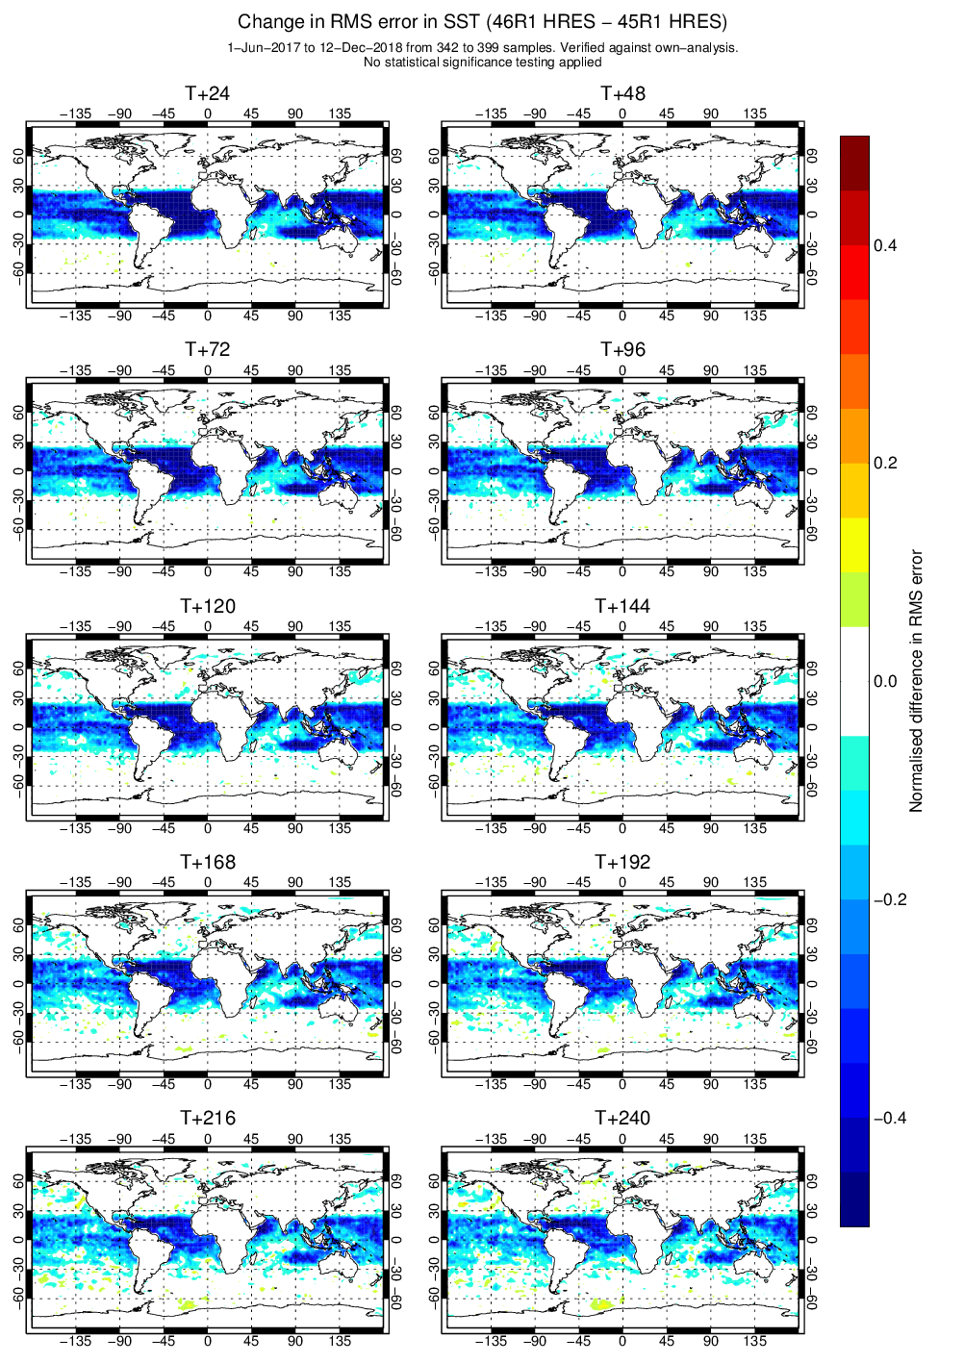
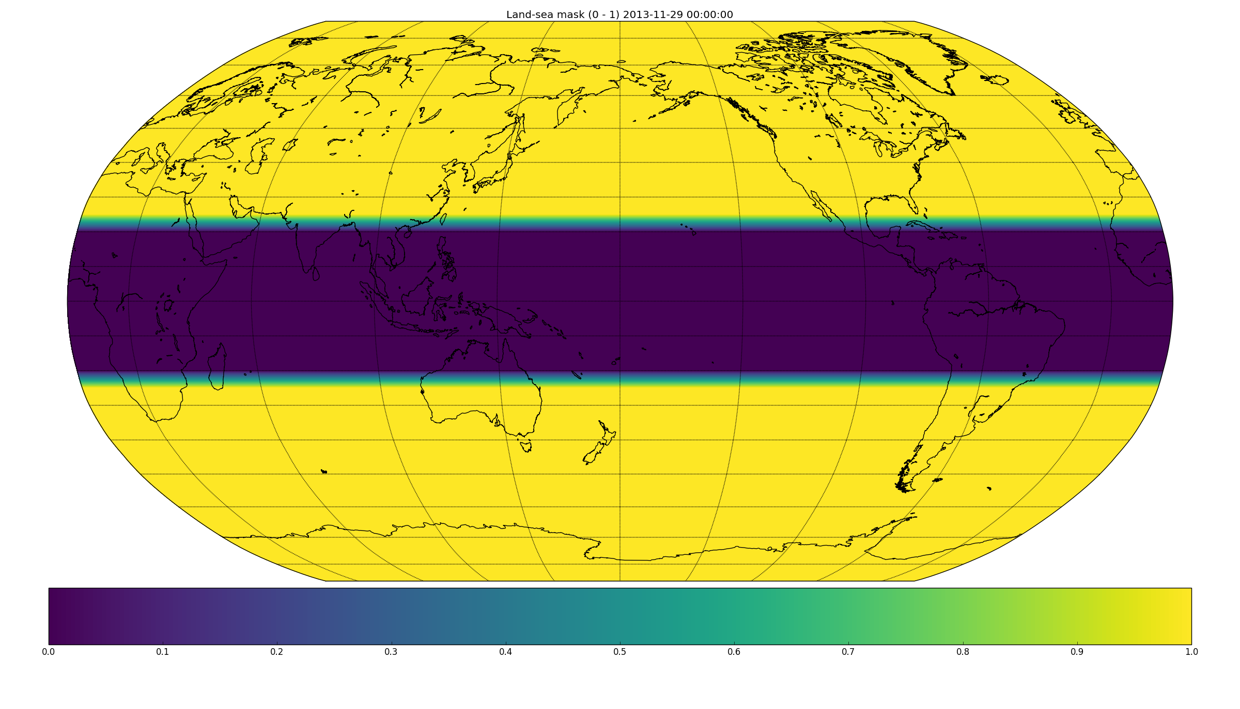
Weakly coupled SST assimilation
At 45R1:
From 46R1:
OSTIA
OCEAN5
OSTIA
Atmospheric analysis now ‘sees’ ECMWF OCEAN5-NRT SST in the tropics
Notes:
In a progressive step in ocean–atmosphere weakly coupled assimilation, the atmospheric analysis sea-surface
temperature in the tropics is now taken from the ECMWF OCEAN5-NRT analysis rather than using the
OSTIA product directly [Browne et al., 2019]. This gives improvements to forecast scores of near-surface
temperatures and humidity in the tropics.

Slide 9
46r1 Model highlights
1-hour radiation update frequency (timestep) in the ENS (same as in the HRES)
LW radiation scattering by clouds is turned on
2D CAMS aerosol climatology has been replaced by a new 3D climatology
Convection scheme:
  Increase in the entrainment of the test parcel
  A RH dependent area fraction for evaporation replaces a constant value in the shallow convection scheme
TL/AD improvements (convection; semi-Lagrangian departure point scheme near the poles)
Adjustment of wet skin tile conductivity
Improvement in the snow scheme by correctly computing the rain amount that can refreeze
New version on wave physics based on Ardhuin et al 2010
New calculation of wave fluxes for NEMO + use of surface currents when coupled to NEMO
Limit on wave spectrum for very shallow water and minimum depth set to 3m
European Centre for Medium-Range Weather Forecasts
9

Slide 10
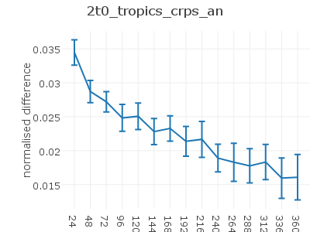
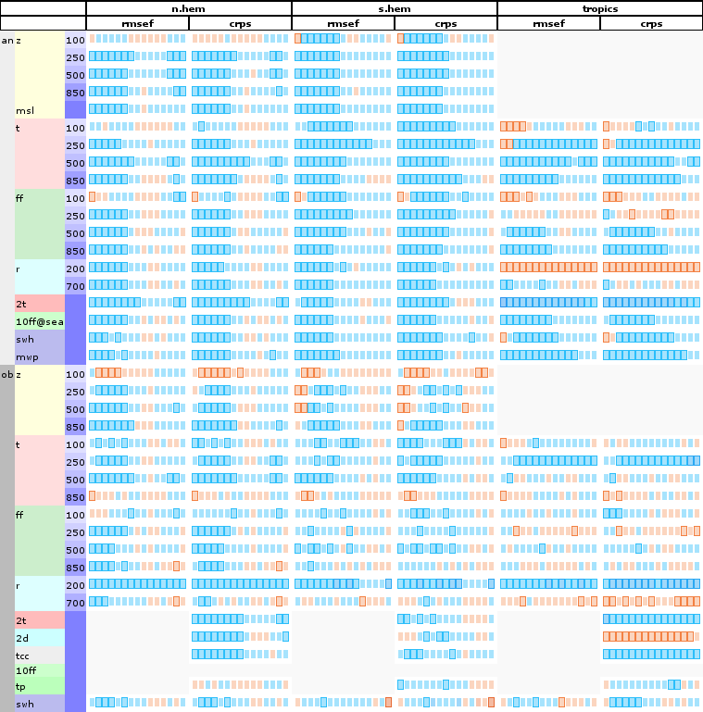
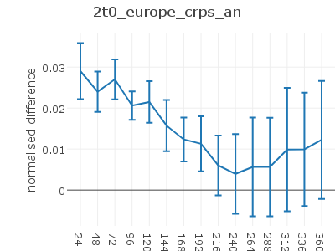
Impact of 1 hourly radiation on ENS
1 hourly
radiation
is better
1 hourly
radiation
is worse

Slide 11
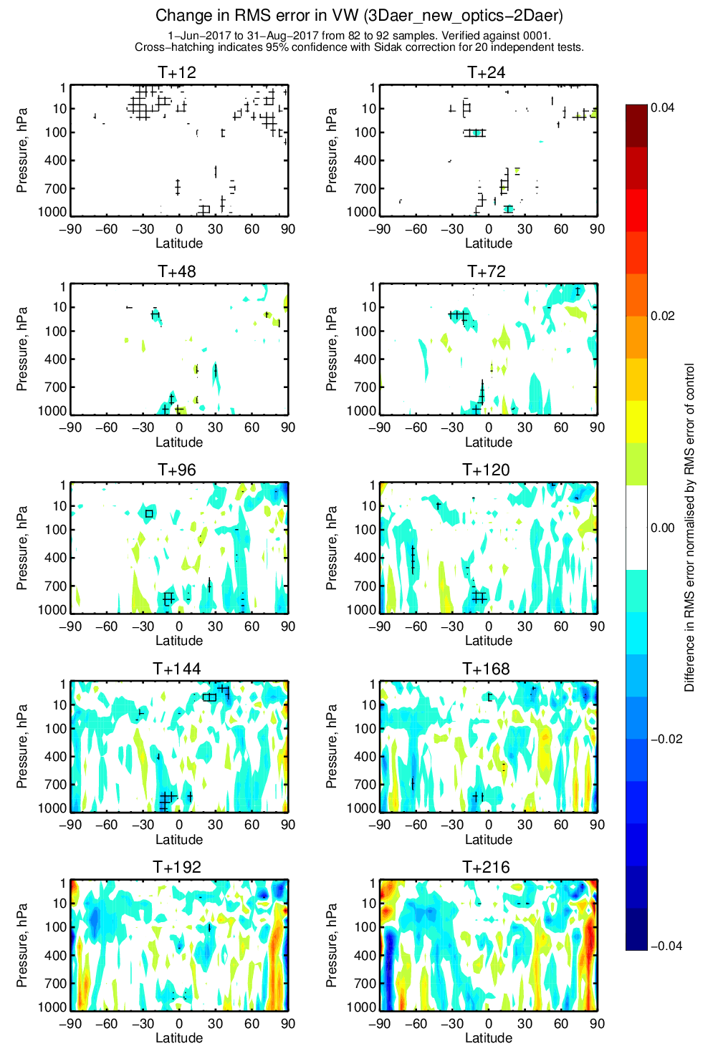
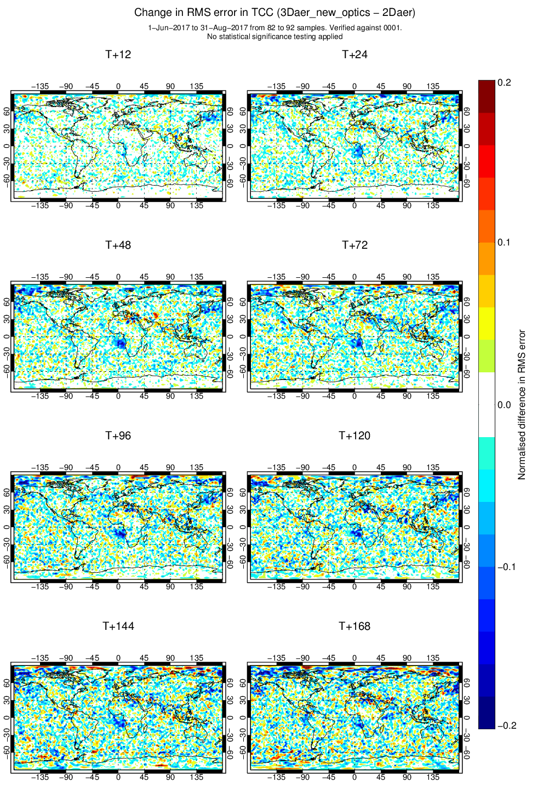
Upgrade to 3D aerosol climatology
- last step in aerosol climatology revision: 3D climatology
  Reduced number of parameters needed to describe aerosol distribution
  Easier to compare to full prognostic fields
  Limited impact, some interesting local effects (e.g. mid Atlantic clouds and winds)
- update aerosol climatology to CAMS reanalysis , harmonized aerosol optics RD-CAMS, working towards flexible prognostic aerosols for use in IFS

Slide 12
Atmospheric Composition for NWP (2018 SAC topic)
Aim: Recommend AC priority developments useful for NWP forecasting (up to seasonal time scales) to be implemented by 2022.
Leverage available and foreseen IFS developments.
The aim is not to homogenise the treatment of these AC species, but rather to understand through thorough testing what level of complexity and/or coupling these AC species need to have to impact the NWP forecasts;
New improved diagnostic & products could become available.
Modelling aspects
Ozone
CO₂
Infrastructure
Diagnostics (R2O)
Aerosols
DA aspects

Slide 13
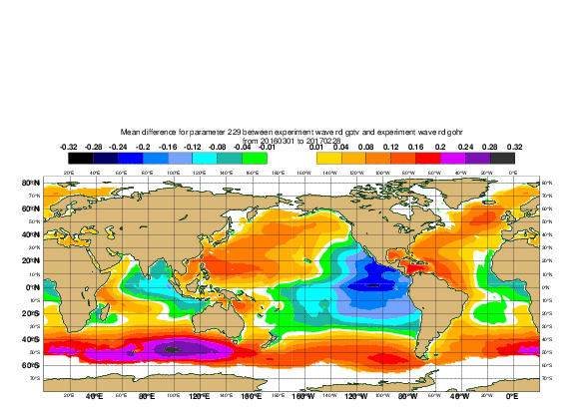
Modified wave physics
The wave model has the tendency to produce
- too much swell in the deep Tropics
- too little waves in the stormy/windy areas.
The modified wave physics, based on the work of Ardhuin et al. 2010 generally addresses this issue:
new – default
Stand alone hindcast for 1 year, forced by ECMWF analysis winds: Mean Significant wave height difference (m)
Notes:
A new wave physics parameterisation for wind input and open ocean dissipation was implemented in
CY46R1. It is based on the work of Ardhuin et al. [2010] and the initial implementation of it into
the MeteoFrance version of the wave model code. It has been adapted and optimised to run efficiently
with the latest version of the code. Because the wave model is coupled to the atmosphere, the new
configuration was set up to yield similar level of feedback in the form of a sea state dependent Charnock
coefficient. Note however, that the overall distribution of the Charnock parameter is bit tighter and yields
slightly larger ocean surface roughness under typical tropical wind conditions. Impact on the ocean
circulation, in the fully coupled system was also evaluated.
The main benefit of the changes is on the waves parameters, partly addressing the issue of over-prediction
of long swell energy and the small under-estimation in the storm tracks. The Figure shows the annual mean
difference in significant wave height (SWH) between the new wave physics and the old. Generally, SWH
is reduced in the deep tropics and enhanced in extra-tropics.

Slide 14
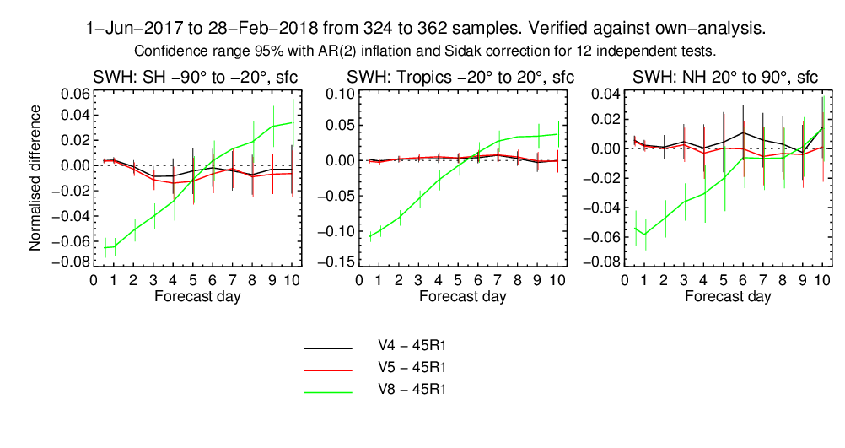
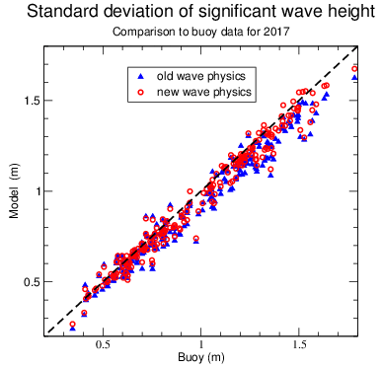
Wave model improvements: impact on “significant wave height” (SWH)
Green line shows the positive impact of wave model changes in SWH
Increased RMSE error at +6d and beyond is due to increased model activity. However, ACC remains positive (not shown here)

Slide 15
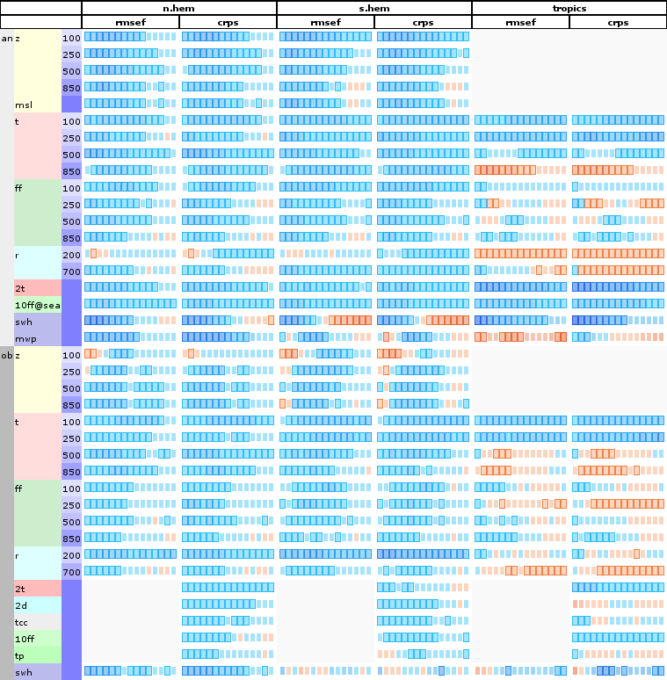
RD esuite ENS scorecard (full 46r1)
Notes:
EVERYTHING FROM GABOR’S SUMMER/WINTER/HANDOVER EXPERIMENTS
Scorecard available here:
file:///perm/rd/diad/share/pre_46r1/46r1_45r1_oa_control_combined3.html
file:///O:///perm/rd/diad/share/pre_46r1/46r1_45r1_oa_control_combined3.html

Slide 16
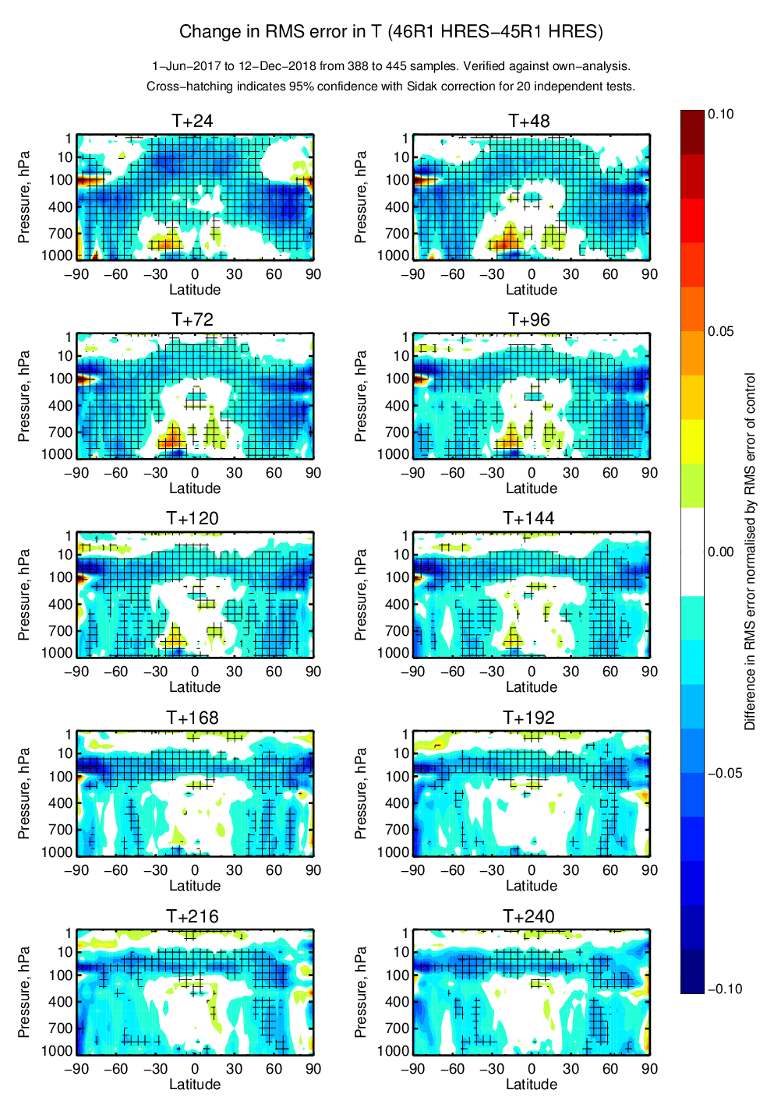
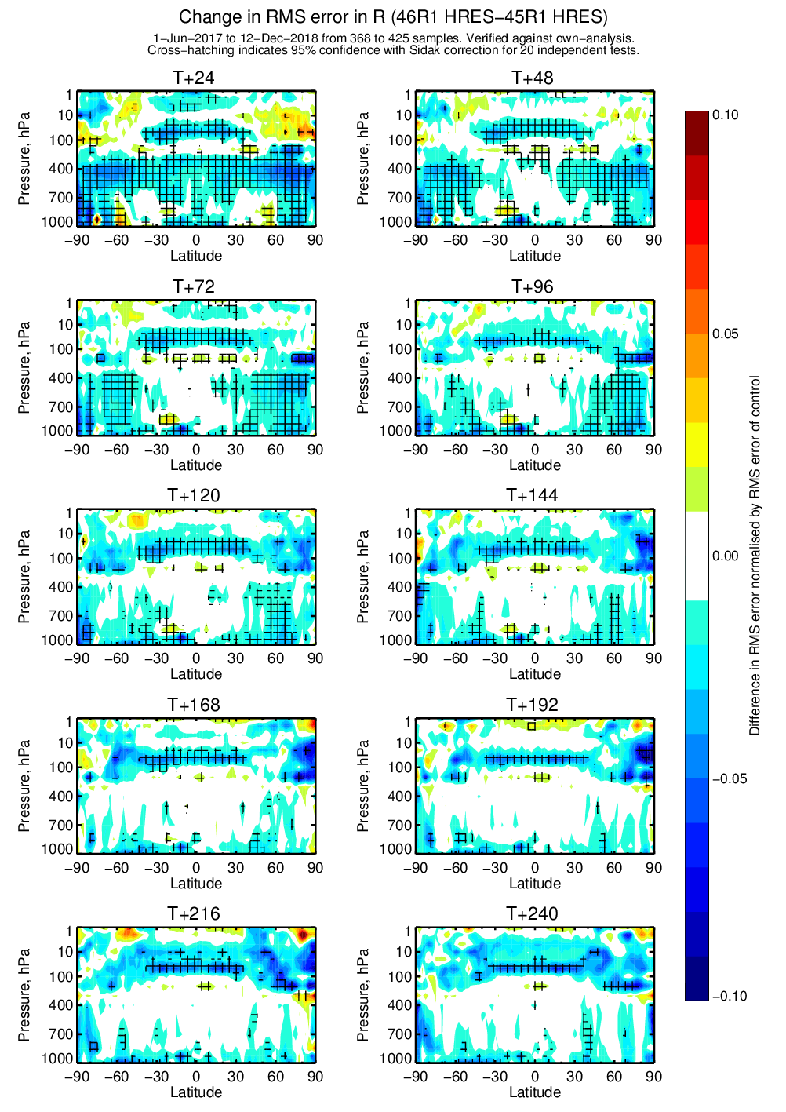
RD esuite zonally averaged forecast errors T and R
Notes:
EVERYTHING FROM GABOR’S SUMMER/WINTER/HANDOVER EXPERIMENTS
Iver results available here:
file:///perm/rd/dipb/iver/plots/46r1_hres_merge3_own/index.html
file:///O:/perm/rd/dipb/iver/plots/46r1_hres_merge3_own/index.html

Slide 17
Further ahead
Scalability / FVM
Exploitation of existing and new observations
Suites for Bologna
Coupled modelling and DA
Extended range
Carbon monitoring roadmap

Slide 18





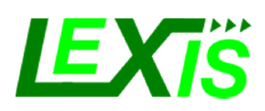




Scalability: ECMWF computing and data roadmap in H2020
Novel algorithms and benchmarks
Feature applications
New technologies
Cross-disciplinary Flagships
| 2016 | 2017 | 2018 | 2019 | 2020 | 2021 | 2022 |
EuroHPC

Slide 19
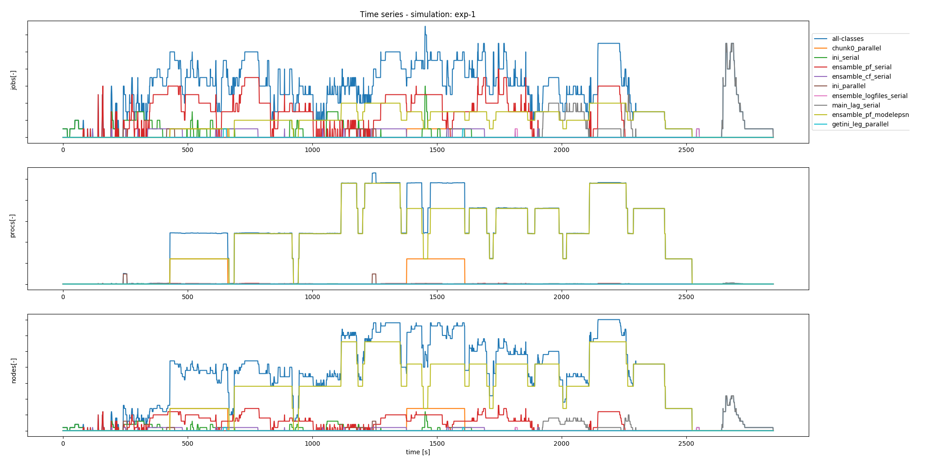

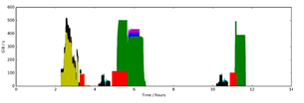
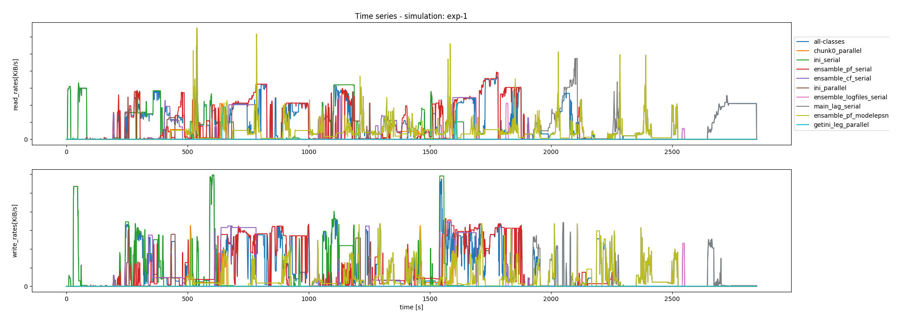
Kronos workload simulator as a HPC benchmark
Kronos tests HPC systems by deploying realistic workloads:
  a workload model is generated from HPC workload profiling data
  the workload model is then translated (and scaled) into a schedule of representative and easily-portable applications
  Kronos models and tests Compute, Interconnect, I/O subsystems
Post-processing
Workload Model
E.g. Workload execution profiles
Synthetic
Applications
HPC Workload profiles
HPC prototype to be tested
Kronos
E.g. I/O time-profiles
[Antonino Bonanni, Tiago Quintino]

Slide 20
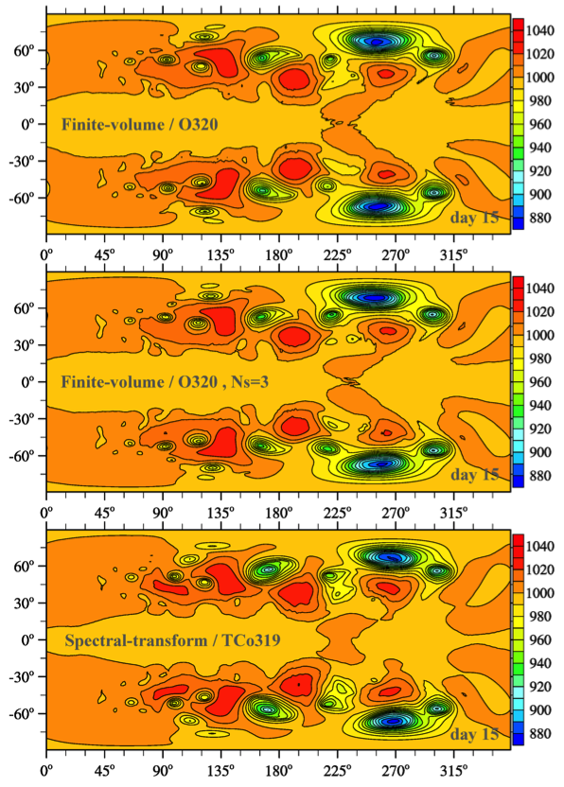
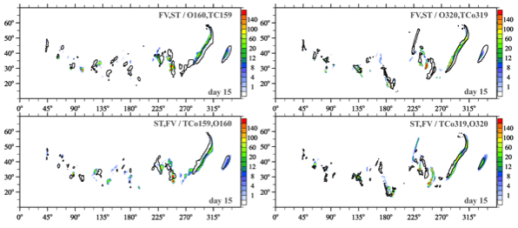
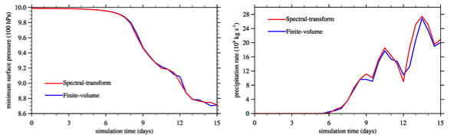
Finite-Volume Module of IFS: moist-precipitating dynamics and coupling to IFS physical parametrisations
Results for IFS-FVM coupled to IFS cloud parametrisation

Slide 21
Finite-Volume Module of IFS: computational efficiency
IFS-FVM substantially improved in terms of computational efficiency (Kühnlein et al. 2018)
improvement result of various developments, e.g. horizontal-vertical split advection scheme, preconditioning of elliptic solver, variable time step, coding implementation (cache, latency,…)
IFS-FVM already faster then the nonhydrostatic spectral-transform IFS
IFS-FVM still slower than the hydrostatic spectral-transform IFS, but gradually getting closer
IFS-FVM is becoming competitive to current operational formulation while using local discretisation (and smaller time steps)
O1280/TCo1279 and L137 using dry dycore
on 350 nodes of ECMWF‘s Cray XC40

Slide 22
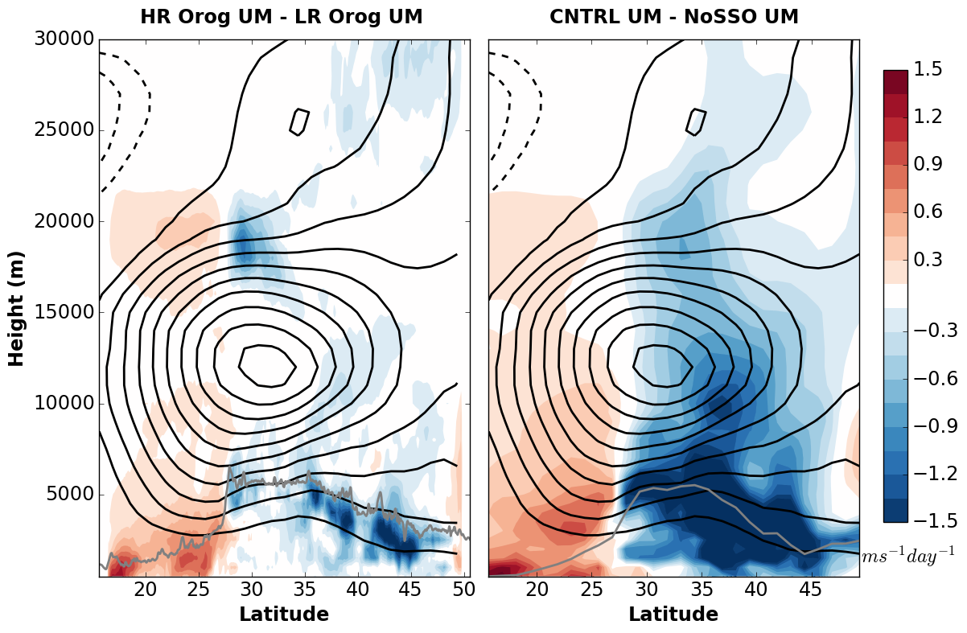
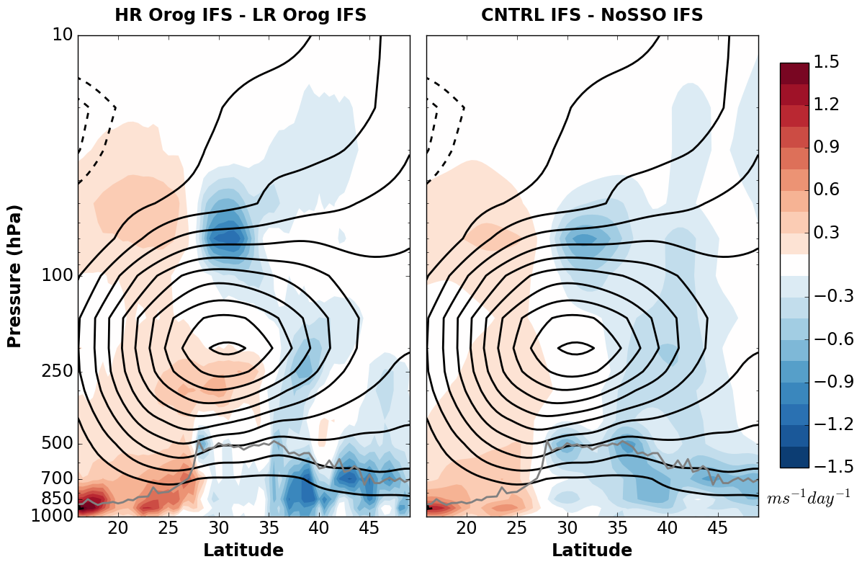


Physics/dynamics as f(resolution)
Circulation response to resolved vs parametrized orographic drag
Change in winds after 24 hours due to :
explicit orography
parametrized orography
(m/s/day)
UM 4km
UM 150 km
IFS 150 km
Errors in the circulation response induced by orographic drag at low/intermediate resolution are due to both the parametrizations and their coupling with the dynamics
Height (m)
van Niekerk, Sandu and Vosper, JAMES, 2018
20N 50N
20N 50N
20N 50N
Latitude
New GASS/WGNE intercomparison
(DWD, Meteo-France, CMC, JMA,
KIAPS, NOAA/NCEP)
Notes:
Another impressive and in my view ground breaking piece of work is also work I’ve been doing with annelize van Niekerk and simon vosper from the metoffice – in which we used again the um lam to simulate the Himalayas at 4km resolution at which most of the effects are resolved, and we came up with the a method allowing to assess the impact on the winds (as a proxy for impact on the circulation) induced by explicitely simulating the mountain, or by using a coarse resolution mountain plus a parametrization – what you see on the left is an acceleration/respectively a deceleration of the zonal wind south/north flanks of the Himalayas when we explicitely resolve the mountain by doing the 4km simulation , and on the right the impact of using a coarse mountain like this one and a parametrization – if the parametrization would work well the middle and righ figures will look like the left one. What we find is that, while there are some similarities, they are quite different at low levels, where low-level deceleration from orography occurs. We also see some indication of gravity wave drag deceleration in the upper atmosphere but the drag from the SSO appears to be too small in the upper atmosphere. – and we showed this is has to do as much with the parametrization itself as with the coupling between the physics and dynamics. And the same stands for other resolutions used for ensemble, monthly or seasonal simulations.
This setup is now proposed as an intercomparison exercise in the framework of the gass and wgne working groups and already aroused lots of interest with participation confirmed from ….
22

Slide 23
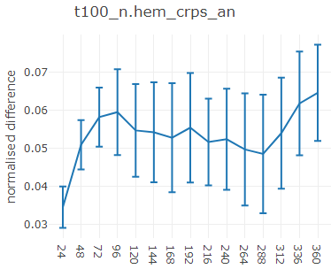
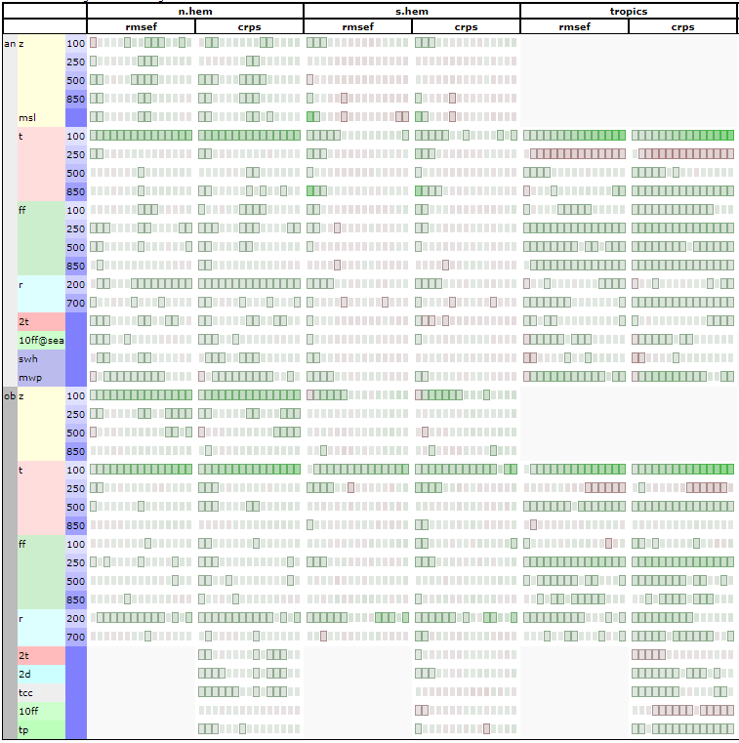
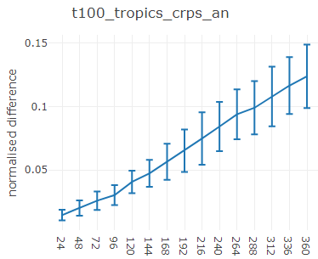
137 levels vs 91 levels ENS scores
Experiments: TCo639, 10 members, 91 levels, June-August, 44 inidates

Slide 24
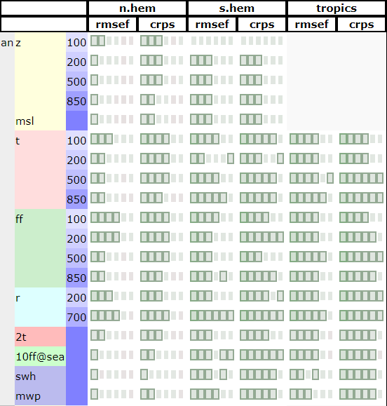
Re-centring with multiple centre analyses
TCo639 experiments Analysis + ENS, verified against Oper
Here: centre on a small number of HRES like analyses with different satellite obs selection for thinning. No model unc. representation and obs perturbations in the centre analyses to limit sampling uncertainty (see Hólm, 2018 for details).
Re-centre perturbations on single Analysis
Re-centre perturbations on multiple Analyses

Slide 25
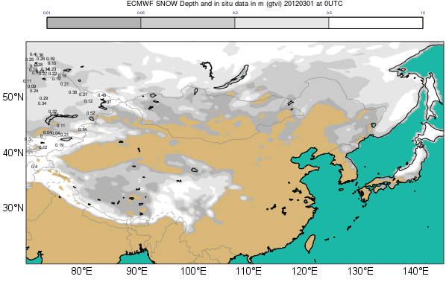
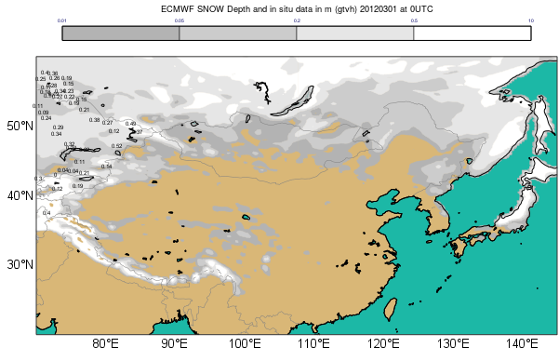
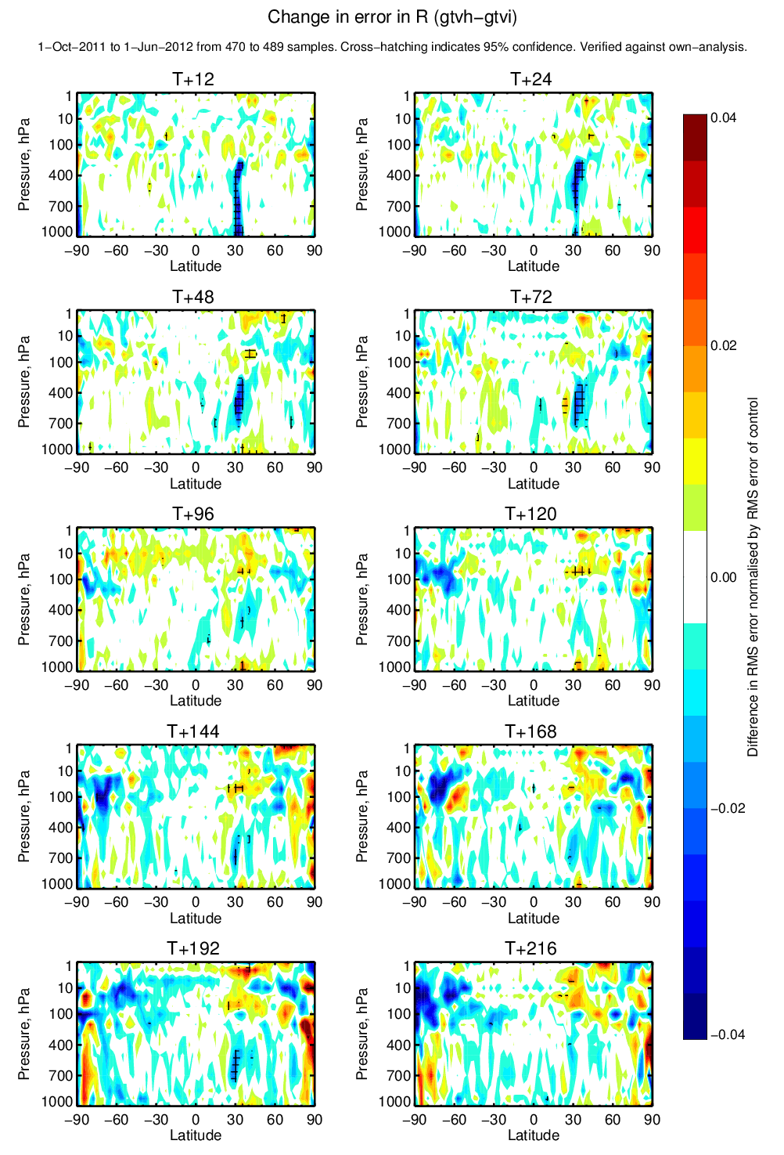
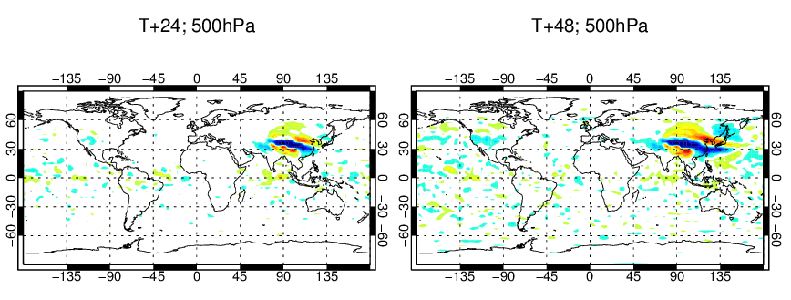
Snow cover data assimilation over the HTP
Impact on albedo and momentum
Modifies the jet circulation
Change in error R
Oct 2011 – June 2012
CTRL
Overestimate snow
Test (snow cover DA)
More realistic snow
Change in error T
Oct 2011 – June 2012
☺

Slide 26
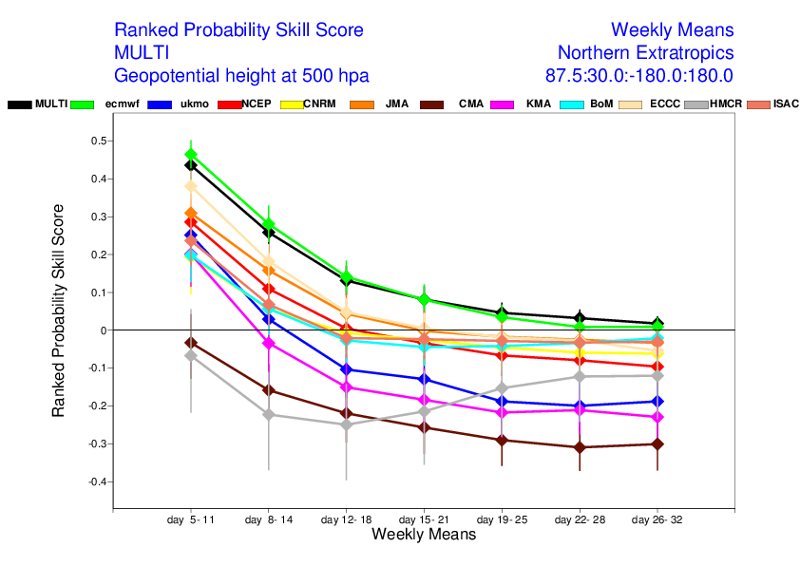

Collaborations and serving community: S2S project

Slide 27
ROADMAP FOR AN OPERATIONAL CO₂ EMISSIONS MONITORING SERVICE
RESEARCH
OPERATIONS
SPACE COMPONENT
China
AEMS
Chinese operational
missions
GF-5
FY-3D/-3G
Japan
TANSAT/-2
GOSAT-1 / -2
USA
OCO-2/-3
GEOCARB?
EU
MICROCARB
SENTINEL CO₂
2018
2019
2020
2021
2022
2023
2024
2025
SERVICE COMPONENT
EU
CHE
VERIFY
SPACE-5-EO-2019
COPERNICUS CO₂ SERVICE
System performance analysis
Definition of system components, spatial temporal scales
Early Prototype, country / region emissions
Prototype system(s) for hot spot emissions and country-region scale emissions
Pre-operational system
Operational system
In-situ network design

Slide 28
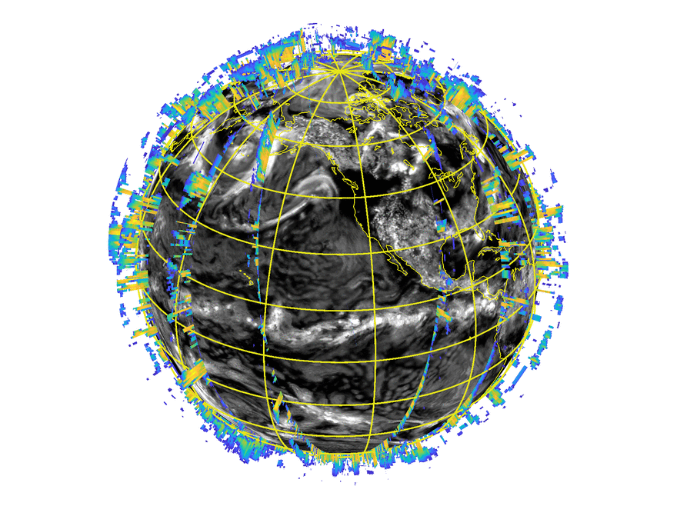
First-ever direct 4D-Var assimilation of space-borne cloud radar and lidar in NWP
Novel observation type: challenge to implement and for 4D-Var linearized cloud physics, but promising results
Enables observation monitoring:
  simplify model evaluation
  real-time monitoring could help detect instrument issues faster than observations alone
12 hour Cloudsat coverage on model cloud field

Slide 29
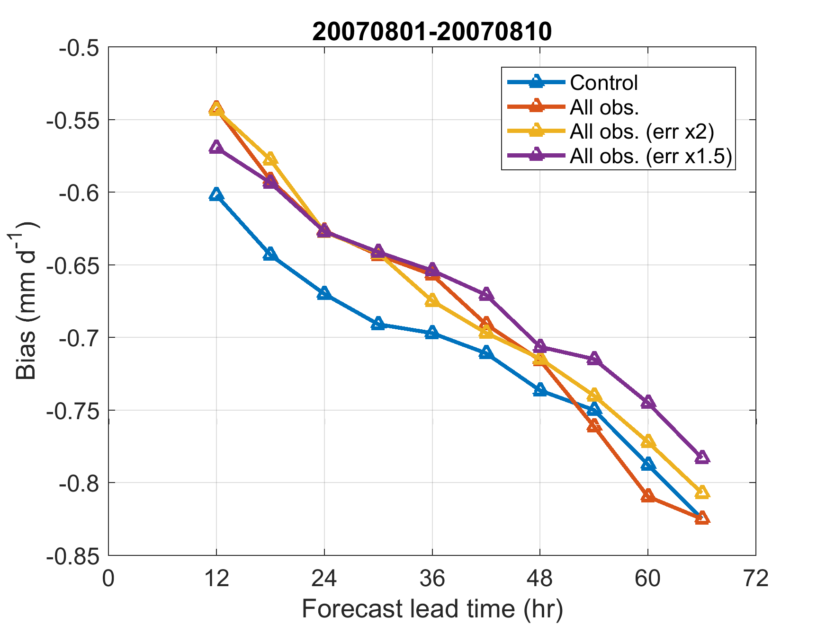
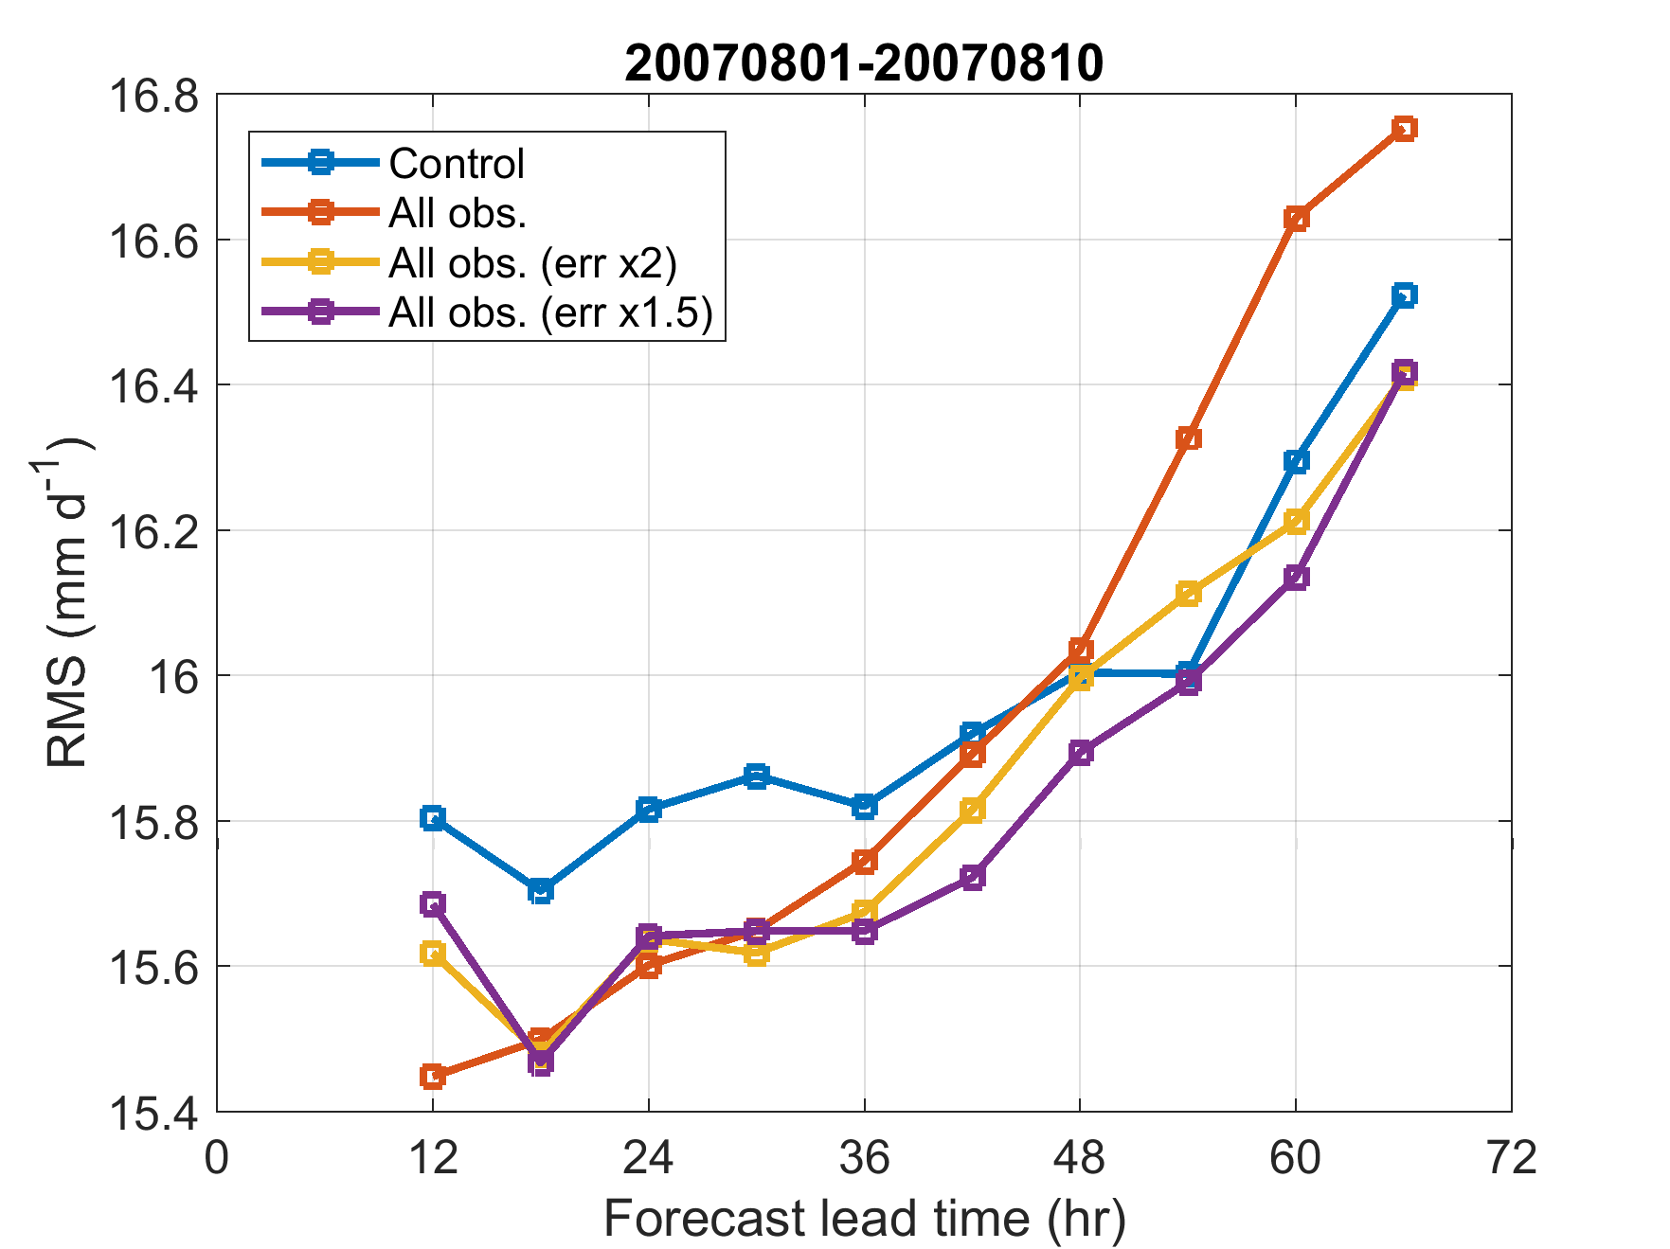
4D-Var using new observations – impact on subsequent forecast
Verification of forecast against TRMM data for 10 days of 4D-Var cycling: 20070801 - 20070810
better
worse
worse
better
Assimilation of CloudSat and CALIPSO obs:
  a positive impact on analysis fit to observations and subsequent short-term forecast
  improving forecast of rain rates in Tropics
CONTROL – all standard observations
EXP – all standard obs + cloud
radar&lidar:
- single obs error
- double obs error
- 1.5 obs error

