Slide 1
ESA Earth Observation - Update
WGClimate #10
Marrakesh, 21 March 2019
Simon Pinnock
ESA Climate Office

Slide 2
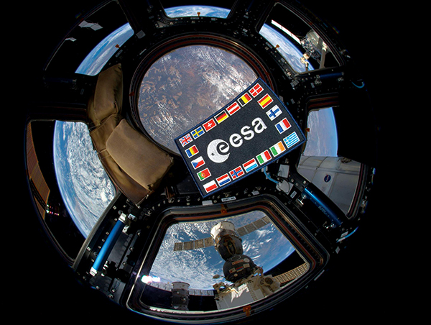
ESA facts and figures
Over 50 years of experience
22 Member States
Eight sites/facilities in Europe, about 2300 staff
5.6 billion Euro budget (2018) of which ~25% is for EO
Over 80 satellites designed, tested and operated in flight

Slide 3
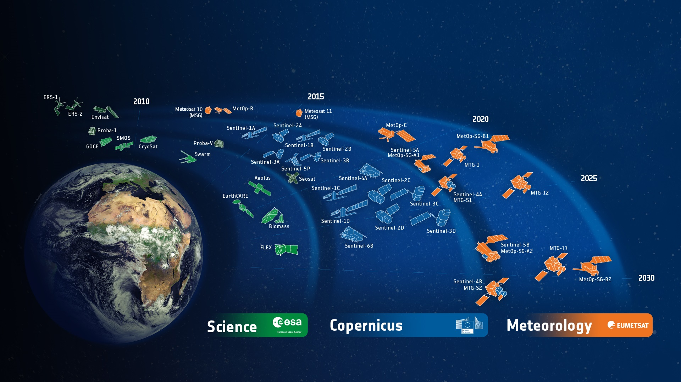
ESA Developed Earth Observation Missions
Satellites
25 under development
15 in operation
Notes:
D/EOP has three main lines of activities: Earth Science, Copernicus and Meteorology
Since the latest launch of Aeolus on 22 Aug. 2018, we have 25 satellites in development and 15 satellites in operation.

Slide 4
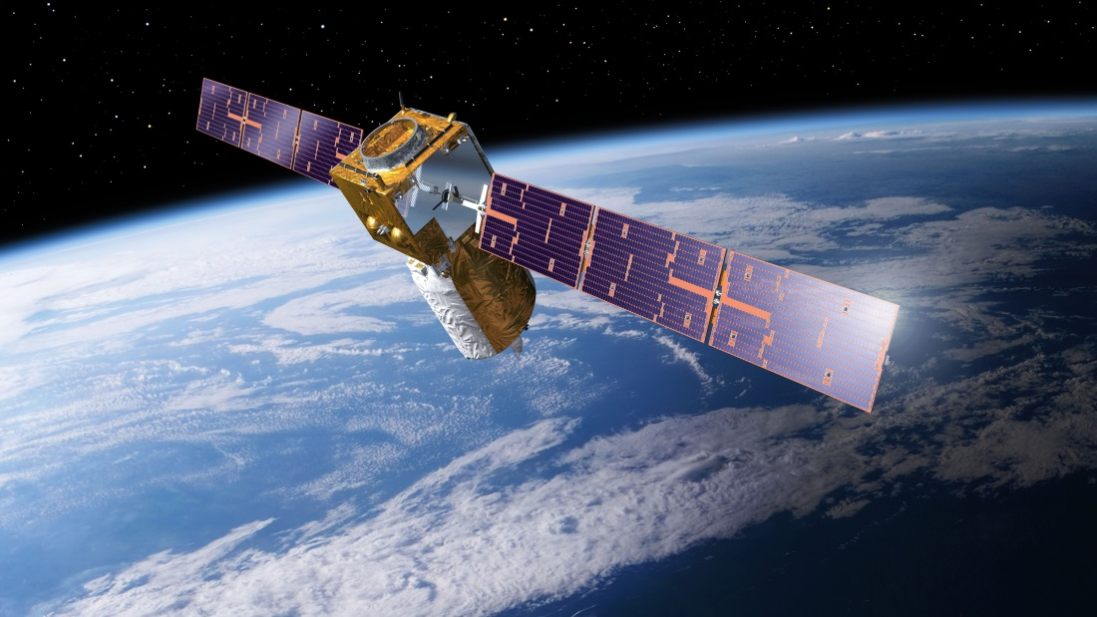
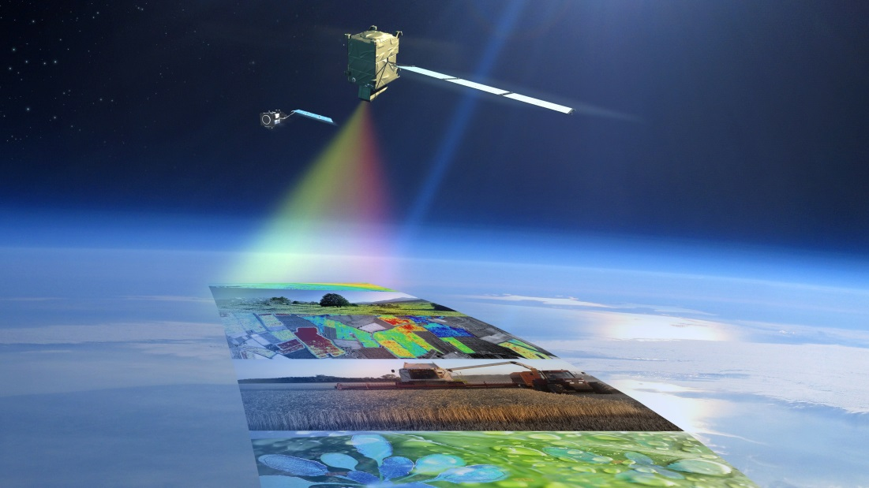
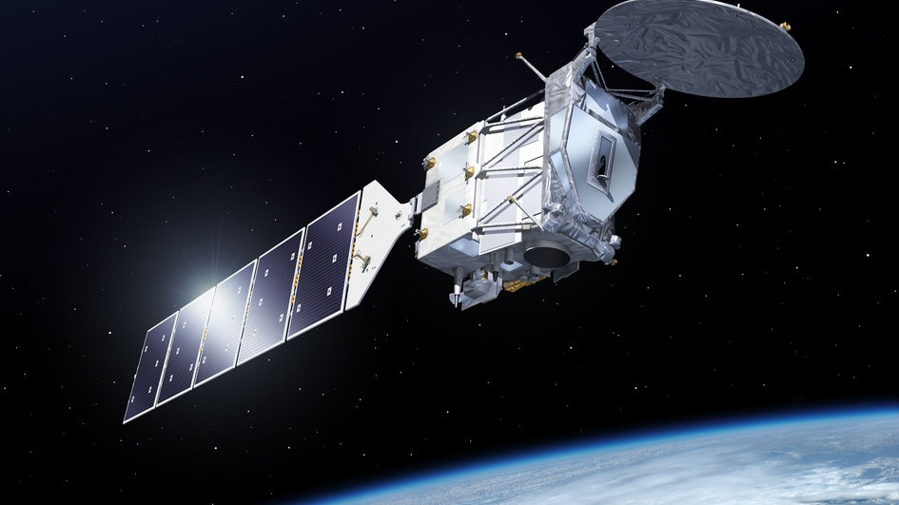
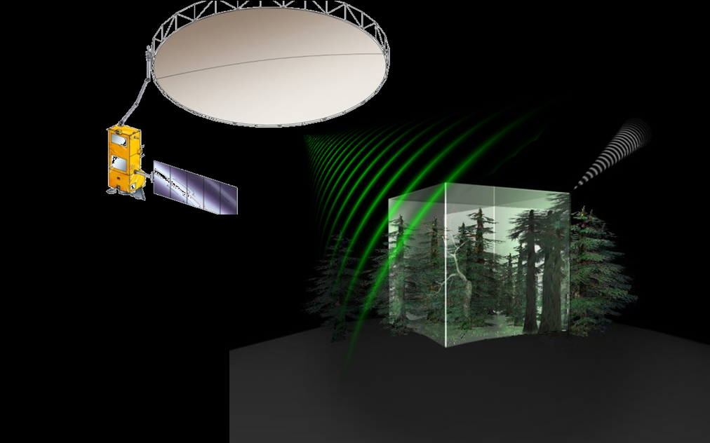
Earth Explorers

Slide 5
Science: Earth Explorers
Notes:
The Earth science missions “Earth Explorers” allow us to understand the Earth System and its diverse aspects in more and more detail.

Slide 6
Aeolus
Mission | Wind profiling
Payload | ALADIN UV lidar
Orbit | SSO, alt: 320 km LTAN: 18h00
Consortium | Prime: ADS-UK Aladin: ADS-FR
Launch date | 22 Aug. 2018
Lifetime | 3 years
Notes:
ALADIN Doppler wind lidar operated at 355 nm; separate detection of molecular and particle backscatter (high-spectral resolution)
Vertical profiles of wind, aerosol and clouds from 0-30km altitude
NRT observations will improve the accuracy of numerical weather and climate prediction and advance our understanding of tropical dynamics and processes relevant to climate variability.
Wind profile retrieval being developed by ECMWF

Slide 7
Aeolus addresses our ‘Blind Spot’
Wind
© ESA/ATG medialab

Slide 8
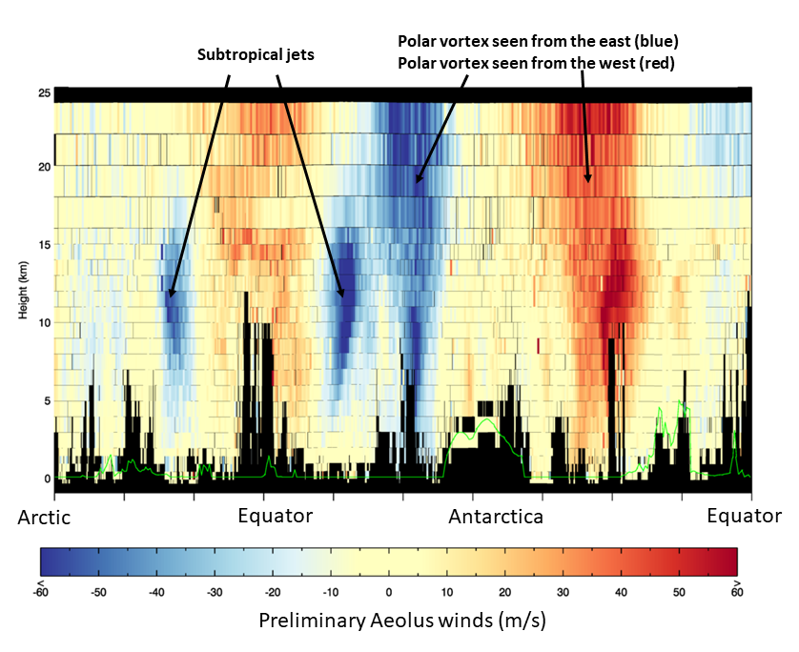
Aeolus
12 September
2018
© ESA/ECMWF
Notes:
First wind data from ESA’s Aeolus satellite. These data are from three quarters of one orbit around Earth.
The image shows large-scale easterly and westerly winds between Earth’s surface and the lower stratosphere, including jet streams.
As the satellite orbits from the Arctic towards the Antarctic, it senses, for example, strong westerly winds called subtropical jets (shown in blue) each side of the equator.
Orbiting further towards the Antarctic, Aeolus senses the strong westerly winds (shown in blue left of Antarctica and in red right of Antarctica) circling the Antarctic continent in the troposphere and stratosphere (stratospheric polar vortex).
The overall direction of the wind is the same along the polar vortex, but because the Aeolus wind product is related to the viewing direction of the satellite, the colour changes from blue to red as the satellite passes the Antarctic continent.

Slide 9
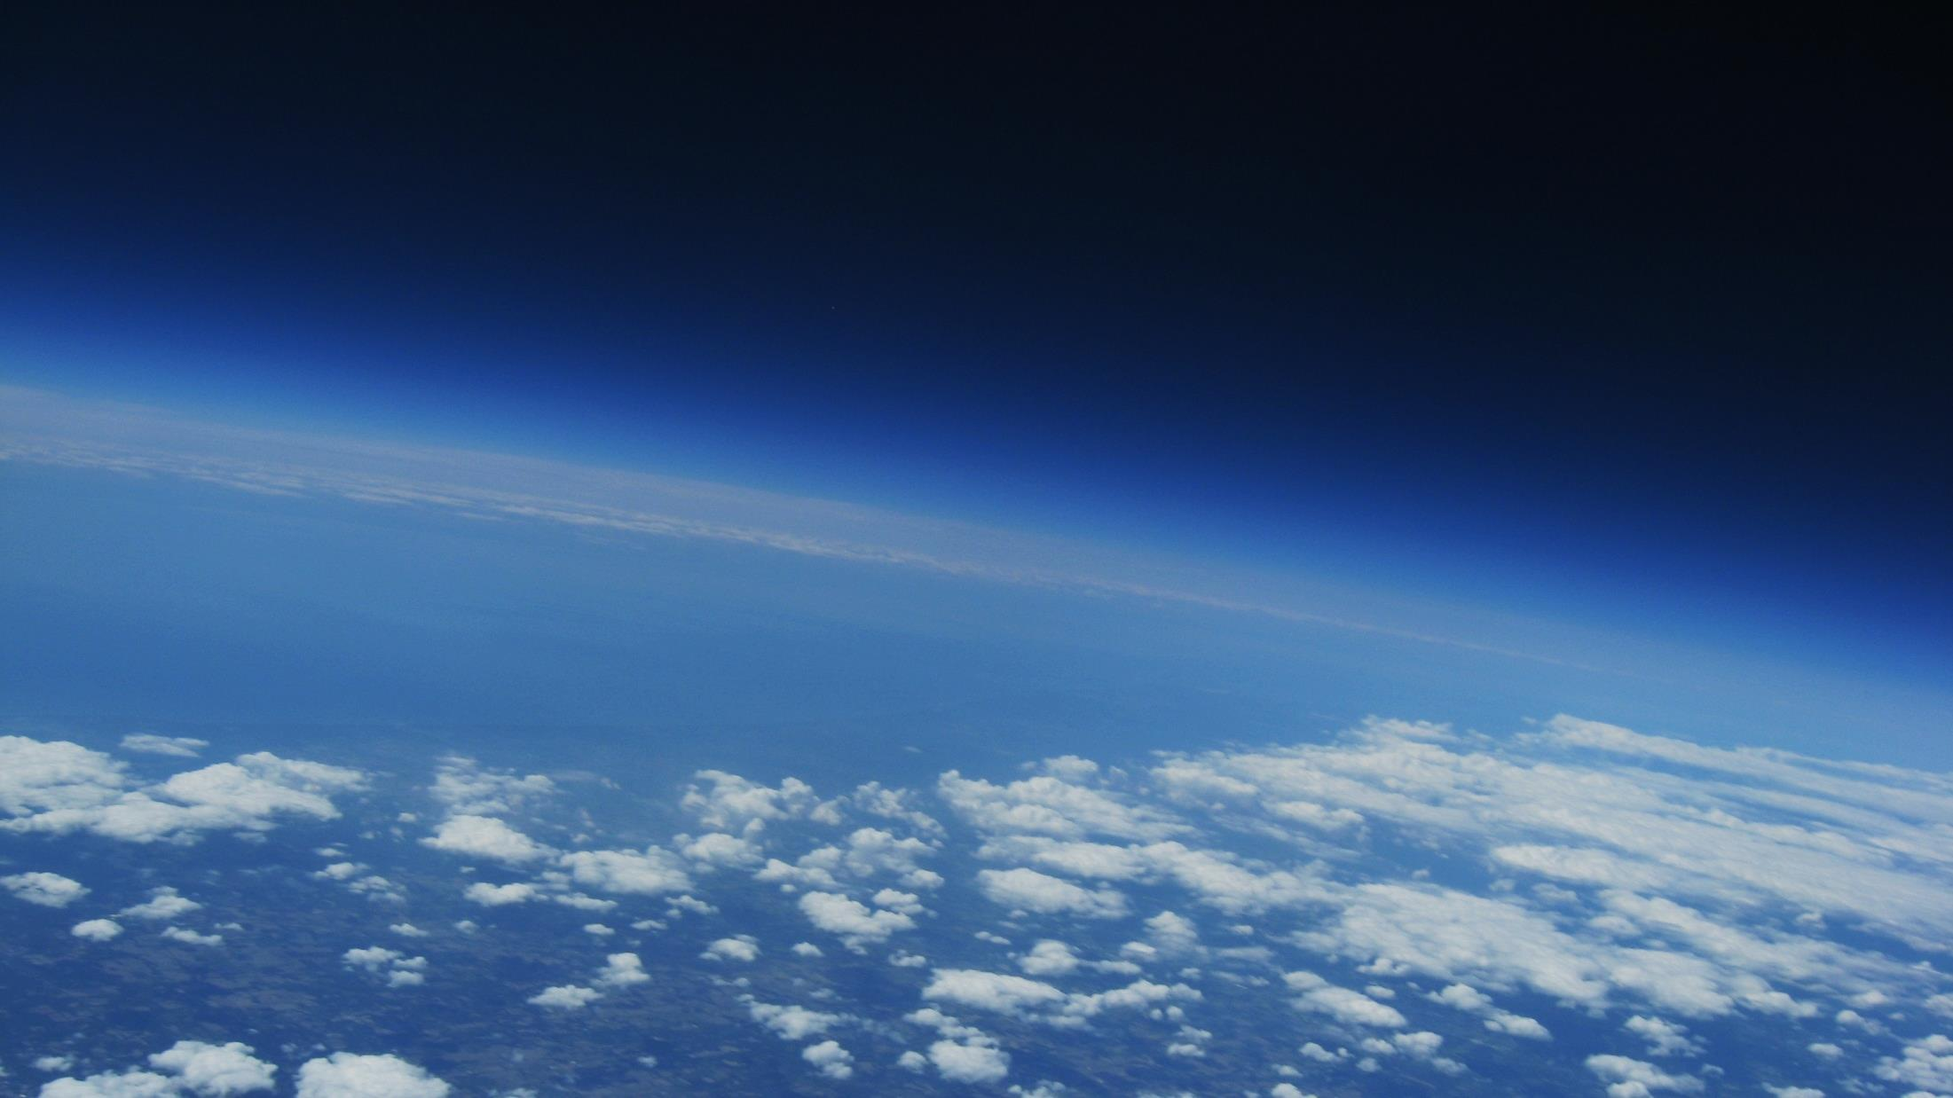
EarthCARE
Mission
Study of aerosols and high altitude clouds, Earth radiative budget (cooperation with JAXA)
Payload
ALTLID: UV lidar, CPR: Cloud Profiling Radar (94 Ghz) from JAXA, MSI: Multi-spectral Imager, BBR Broad Band radiometer
Consortium
Prime: ADS-DE, ATLID: ADS-FR, CPR: NEC, MSI: ADS-UK, BBR: TAS-UK
Orbit | SSO, alt: 393 km; LTDN: 14h00
Satellite | 1950 Kg
Launch date | 2021
Notes:
Measures 3D structure of clouds and aerosols
plus observations of solar shortwave and terrestrial longwave radiation
Polarization of backscatter is measured to retrive info on the scattering particle shapes
The combination of lidar and radar allows for the observation of the full cloud profile. Furthermore, the radar utilises the Doppler Effect providing information on convective motions as well as ice and rain fall speed, leading to improved drizzle, rainfall, and snowfall rates.

Slide 10
BIOMASS
Mission | Measure of forest biomass and height (200 m. pixel resolution)
Payload | P-Band radar
Orbit | SSO, alt: 666 km; LTAN: 6h00
Satellite | 1250 Kg
Consortium | Prime: ADS-UK, Instrument: ADS-DE
Launch date | 2022
Lifetime | 5.5 years
Notes:
Map and monitor forest biomass and forest height at 200m resolution
Land carbon cycle and REDD
In addition, the mission will have an experimental ‘tomographic’ phase to provide 3D views of forests.

Slide 11
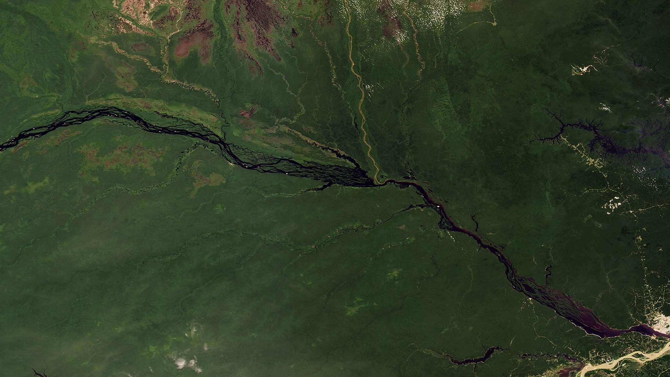
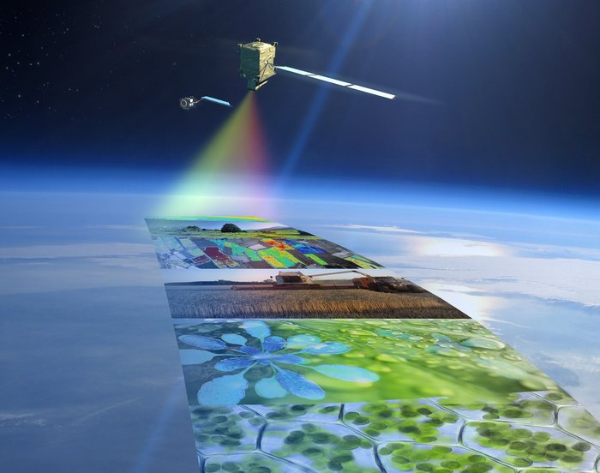
FLEX
Mission | Study & monitoring of fluorescence signal linked to vegetation stress; pixel 300m.
Swath | 150 km
Payload | FLORIS, 2 channels spectrometers (O₂ lines)
Orbit | SSO, alt: 814 km; LTDN: 10h00
Satellite | 470 Kg
Consortium | Prime: TAS Instrument: Leonardo
Launch date | end 2022
Lifetime | 3.5 years
Notes:
Land C-cycle, vegetation stress,
Will fly in tandem with Sentinel-3

Slide 12
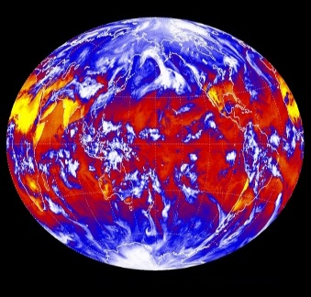
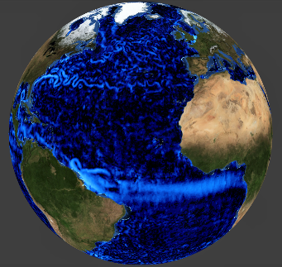
Earth Explorer 9 – Two Candidates
Launch around 2025
FORUM
Far-infrared Outgoing Radiation Understanding and Monitoring
Benchmark measurements will improve our understanding of the greenhouse effect and contribute to climate change assessments accuracy
SKIM
Sea-surface Kinematics
Multiscale monitoring
Will carry novel wide-swath scanning multibeam radar altimeter to measure ocean-surface currents with Doppler technique
Notes:
EE9 General Info:
Targeted overall cost 260 M€ (150 sat; 25 Ground Segment; 25 launcher; 40 ESA cost; 20 margin)
13 proposals were received by mid-2017
2 candidates selected at Nov. 2017 PBEO
FORUM:
Far-infrared Outgoing Radiation Understanding and Monitoring
Its benchmark measurements will improve our understanding of the greenhouse effect and, importantly, contribute to the accuracy of climate change assessments that form the basis for policy decisions.
SKIM:
Sea-surface Kinematics Multiscale monitoring
Will carry novel wide-swath scanning multibeam radar altimeter to measure ocean-surface currents
uses a Doppler technique, which offers more direct measurements than conventional satellite altimeters.
EE10:
Call for Ideas Phase
Letters of intent due in Dec. 2017
Mission idea proposals by Mar. 2018
Launch around 2027/28

Slide 13
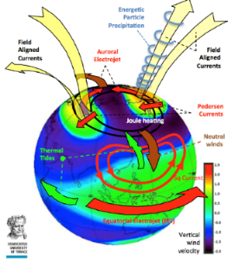
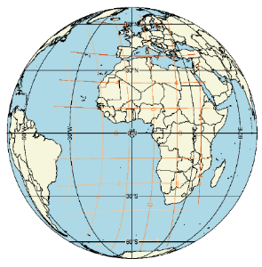
Earth Explorer 10 – Three Candidates
STEREOID
Daedalus
G-CLASS: H₂O
Explore mesosphere, lower thermosphere & Ionosphere
Science on daily water cycle
Bistatic SAR as passive followers of Sentinel-1
Two <500kg spacecraft
Applications
Cryosphere
Oceanography
Geosphere
Four cubesats
at 120 km altitude
Focus on temperature, heating processes & composition structure
Geostationary
C-band SAR
Benefits for weather forecasting, hydrology, mountain cryosphere
Notes:
ACEO recommended three Mission Ideas for further assessment studies at pre-feasibility level, i.e. phase 0 study (without order of priority)
STEREOID: mission dedicated to largely augment the Sentinel-1 capabilities to help precisely quantify small scale motion and deformation fields of the ocean surface, glaciers and ice sheets, and solid Earth. The space segment of the mission consists of two identical sub-500kg class spacecraft carrying a receive-only radar instrument as a main payload, flying in a formation with Sentinel-1C or D, which will be used as illuminator. The mission will be organised in several phases, with different formation configurations optimised for the retrieval of deformations fields over land, ice and oceans, and topography changes over land and ice, respectively.
Platform: Two passive followers to Sentinel-1, flying ~250 km in front and behind, offering simultaneous views of surface from 3x vantage points
Payload: Bistatic SAR with 3D Doppler and backscatter measurements. Secondary optical TIR/VNIR payload to assist interpretation of SAR observations
Orbit: Different configurations of constellation offer along-track and across-track interferometric observation capability
Applications: Cryosphere (Glacier mass balance, dynamics of sea ice and marginal ice zone), Oceanography (Sub-mesoscale ocean dynamics/circulation (< 10 km) for coastal models, extreme weather events) and, Geosphere (3-D deformation fields and topography changes relating to landslides, post-seismic deformation, volcanism)
Daedalus: true ‘explorer’: first systematic, simultaneous measurement of Joule heating and EPP, leading to unambiguous MLTI heating estimates under varying conditions. First systematic, simultaneous measurement of key dynamical and energetic parameters in this region (down to altitude below 150 km, which is an unexplored region, the so-called “ignorosphere”). New measurements that can be used by lower atmosphere models as well as magnetospheric models as boundary conditions.
Platform and Orbit: single platform flying in a highly elliptical orbit with an inclination above 85 deg.
Payload: Ion Drift Meter & Retarding Particle Analyzer, Ion & Neutral Mass Spectrometer, Ram Wind Sensor, Cross Track Wind Sensor, Accelerometer, Particle Detector Suite, Electric Field Instrument, Magnetic Field Instrument, GNSS Receiver
Four deployable Cubesats that are released at 120 km altitude at selected perigee passes.
G-CLASS: H₂O: exciting mission concept which offers a remarkable range of capabilities and which could have a significant impact on the sciences of weather forecasting, hydrology, and the mountain cryosphere, as well as providing direct benefits to society. G-Class stands for Geosynchronous – Continental Land-Atmosphere Sensing System and is designed to help scientists unravel details of the daily water cycle:
Improve the prediction capability of intense rainfall and related flooding and landslides
Improve our understanding of the diurnal water cycle especially of soil moisture in dry environments and snowmelt/re-freeze
Enable the near real time prediction of ground motion
Platform: Single platform in a geosynchronous orbit slot positioned over Africa/Europe that allows for long, variable integration times from minutes to ~1 hour.
Payload: C-band Synthetic Aperture Radar, with spot beams formed by 7 m diameter antenna.
Orbit: launch is into a geosynchronous Low Earth Orbit (LEO). The altitude is gradually raised by electric propulsion during the first year.

Slide 14
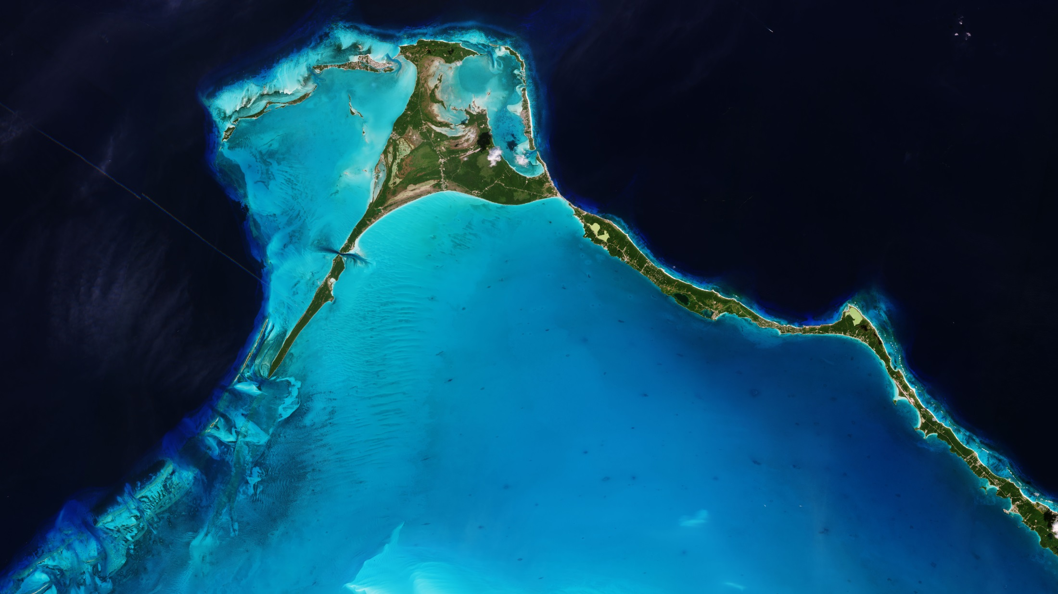
Copernicus
Notes:
Examples in the areas of Earth, Air, Water & Fire applications

Slide 15
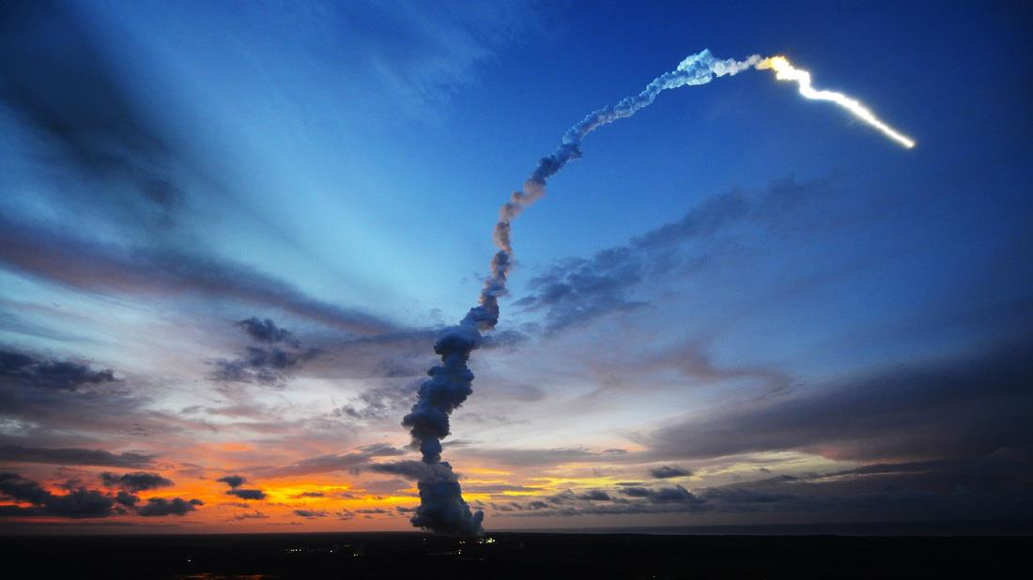
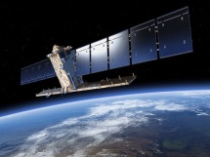
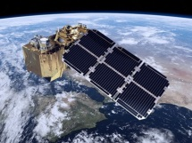
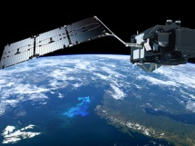
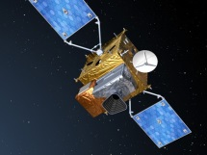
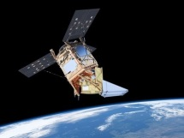
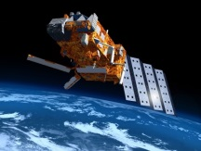
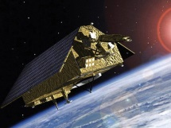
Copernicus Sentinel Status
S-1
S-2
S-3
S-4
S-5P
S-5
S-6
Radar
High Res. Optical
Medium Res. Optical & Altimetry
Atmospheric Chemistry (GEO)
Atmospheric Chemistry (LEO)
Atmospheric Chemistry (LEO)
Altimetry
A
3 Apr. 2014
A
23 Jun. 2015
A
16 Feb. 2016
A
2022
A
13 Oct. 2017
A
2021
A
2020
B
25 Apr. 2016
B
6 Mar. 2017
B
25 Apr. 2018
B
2027
B
2027
B
2025
C
2022/23
C
2022/23
C
2023
C
> 2027
D
> 2022/23
D
> 2022/23
D
> 2023
Open Data Policy, delivering 150 Tbyte/day
Notes:
Today that all land masses are observed every 5 days at 10m with Sentinel 2 and every 12 days at 20m with Sentinel 1. This never happened before.
Open Data Policy
150Tbytes of data per day are distributed to users
Supports the 6 Copernicus operational services: Land, Atmos, Ocean, Climate, Disaster, Security.

Slide 16
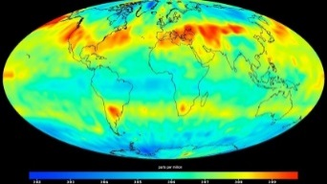
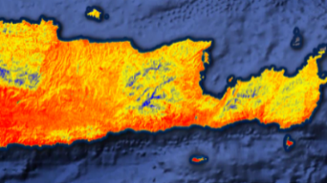
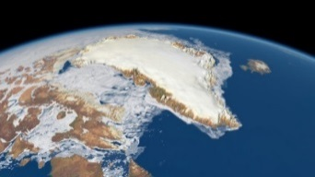
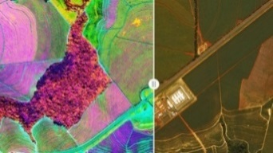
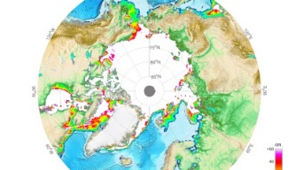
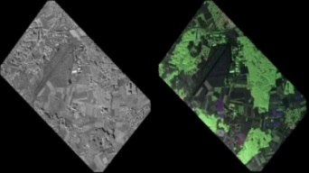
Copernicus 2.0 – New Monitoring Missions
Anthropogenic CO₂
Land Surface Temperature
Causes of Climate Change |  | Agriculture & Water Productivity
Polar Ice & Snow Topography
CHIME – Hyperspectral Imaging
Effects of Climate Change |  | Food Security, Soil, Biodiversity
CIMR – Passive Microwave
L-band SAR
Sea: Surface Temp. & Ice Concentration |  | Vegetation & Ground Motion & Moisture
Notes:
Kick-Off & Progress
Potential Sentinel expansion system study activities initiated
End-to-end performance simulation campaigns
Scientific studies in support of mission requirements definition
Pre-developments of most critical technologies.
Copernicus Long Term Scenario
20 new spacecraft
6 new mission domains: CO₂ imaging spectrometry, thermal / hyperspectral / microwave imaging, etc.
Integration of NewSpace and national mission data
Sophisticated, operational data access
Cost Estimate for Space: 8 Bn Euro (EU MFF + ESA CM)
CM19 proposal: 1,4 bn Euro (+0,6 bn at CM22/25)

Slide 17
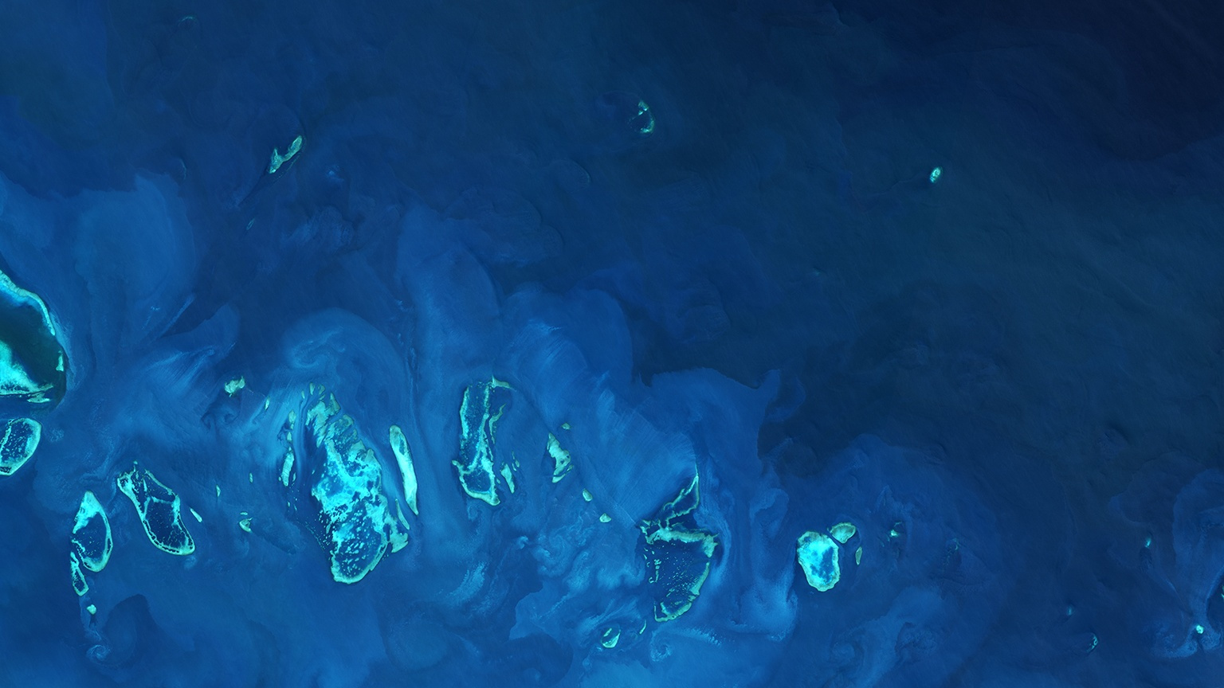
Climate Change Initiative
Notes:
Examples in the areas of Earth, Air, Water & Fire applications

Slide 18
ESA Climate Change Initiative
ç
UNFCCC requires systematic climate monitoring via Essential Climate Variables defined by GCOS
Climate Change Initiative
research, development, qualification and delivery of pre-operational 21 ECV products
definition, sizing and demonstration of ECV processing systems
transfer of ECV production to operational entities outside ESA e.g. C3S
Comprises
23 parallel ECV projects
Climate Modelling User Group
Sea Level Budget Closure
Regional Carbon Cycle (RECCAP-2)
Open Data Portal
CCI Toolbox
cci.esa.int | @esaclimate
Notes:
The ESA CCI programme directly responds to requirements for satellite-observed Essential Climate Variables defined by GCOS on behalf of UNFCCC
Activity is driven by climate user requirements defined by GCOS, under authoritative advice from CSAB, and strong coordination with the international Space Agencies response to GCOS via the Joint CEOS/CGMS Working Group on Climate (WGClimate).
The CCI programme objectives
research, development, qualification and delivery to users of pre-operational ECV products i.e robust, long-term, global Climate Data Records
definition, sizing and demonstration of ECV processing systems
transfer of ECV production to operational entities outside ESA (13 to C3S to date)
involves over 100 European research and private sector organizations and 450 climate scientists and technical specialists
exploits ESA’s c40 years EO data archive; data from ongoing and planned ESA missions, the Copernicus Sentinel constellation and Third-party missions
CCI comprises
23 parallel ECV projects (new projects started in 2018)
CMUG - a Dedicated climate modeling user project for assessment of the data products AND support research spanning ECVs (cross ECV research)
Open Data Portal - providing free and open access to all CCI data products
CCI Toolbox – a platform to facilitate the scientific analysis and visualization of the CCI ECV data products
Plus two cross-ECV projects: → Sea level budget closure project and RECCAP-2 ( which is supporting the analysis of regional carbon budgets)

Slide 19
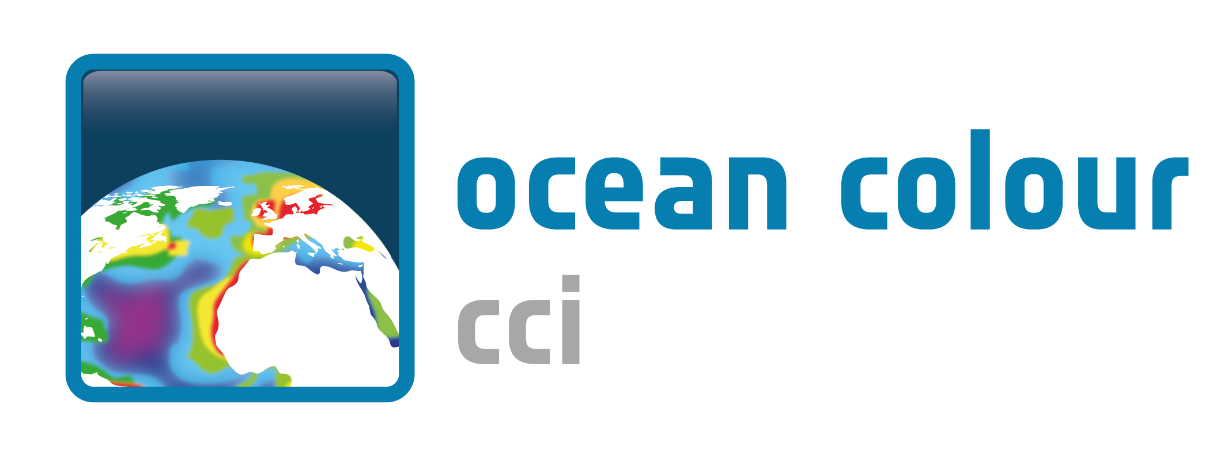
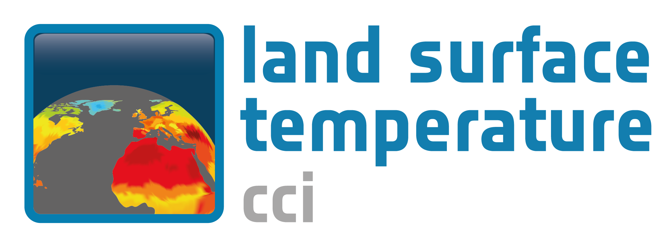
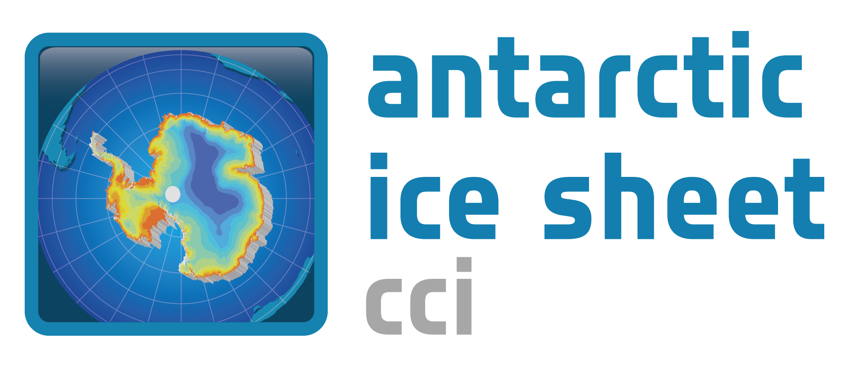
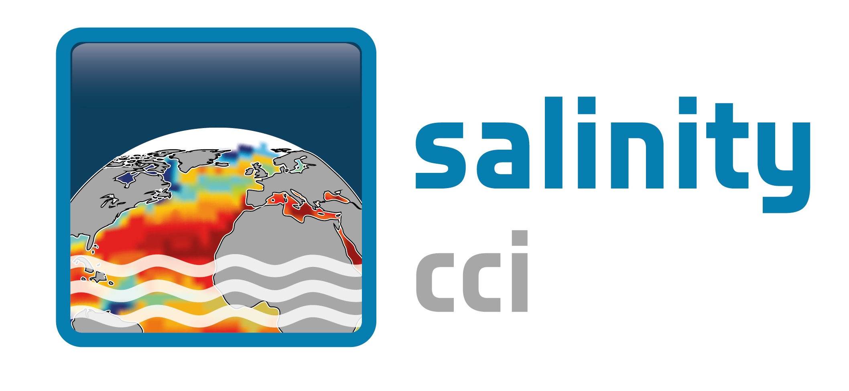
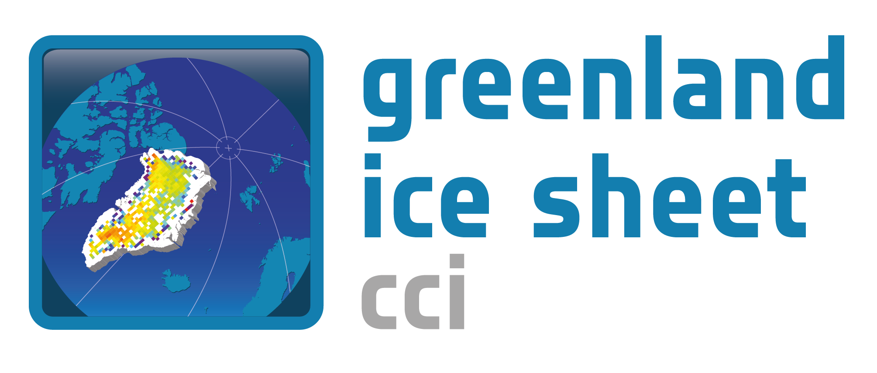
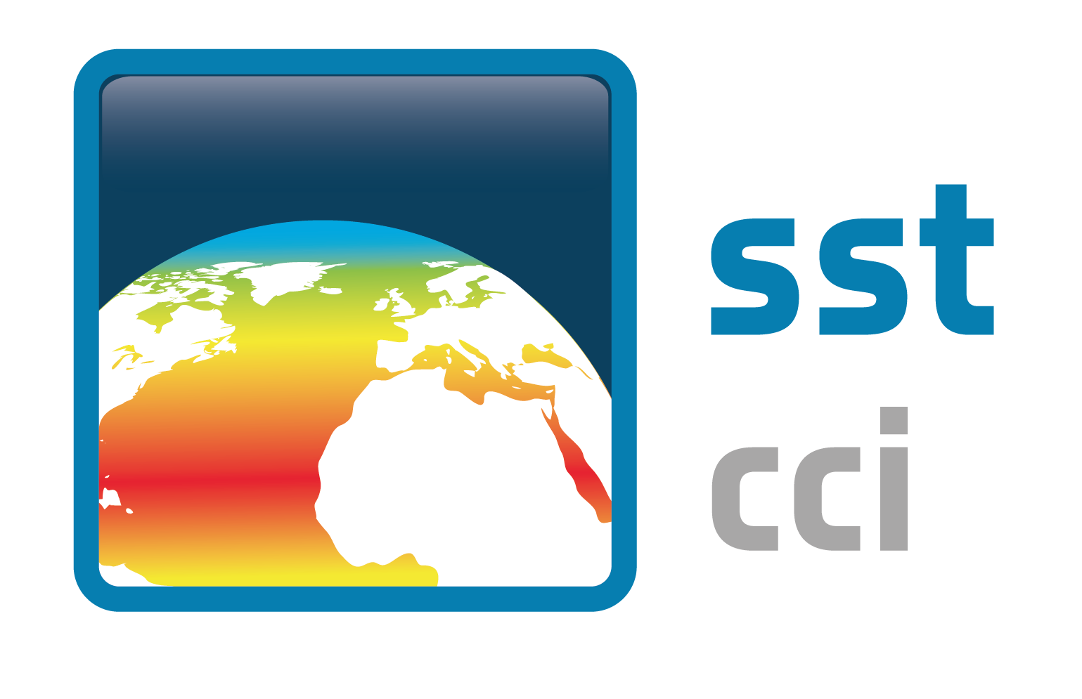
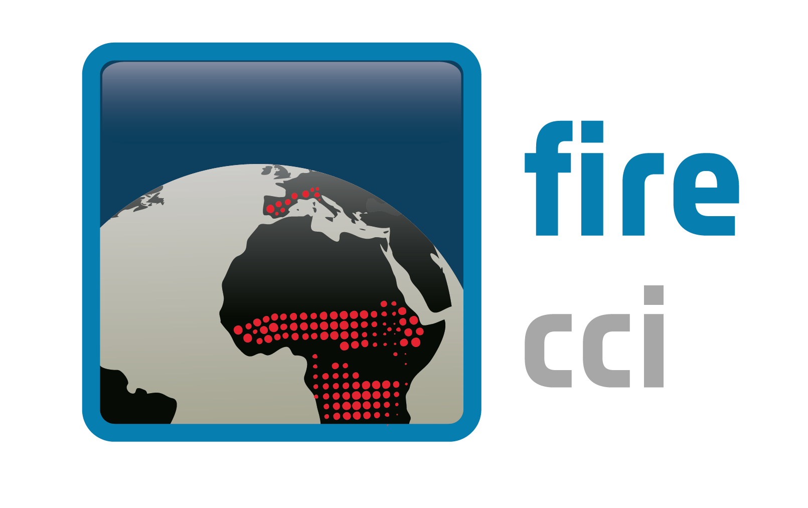
Climate Change Initiative projects

Slide 20
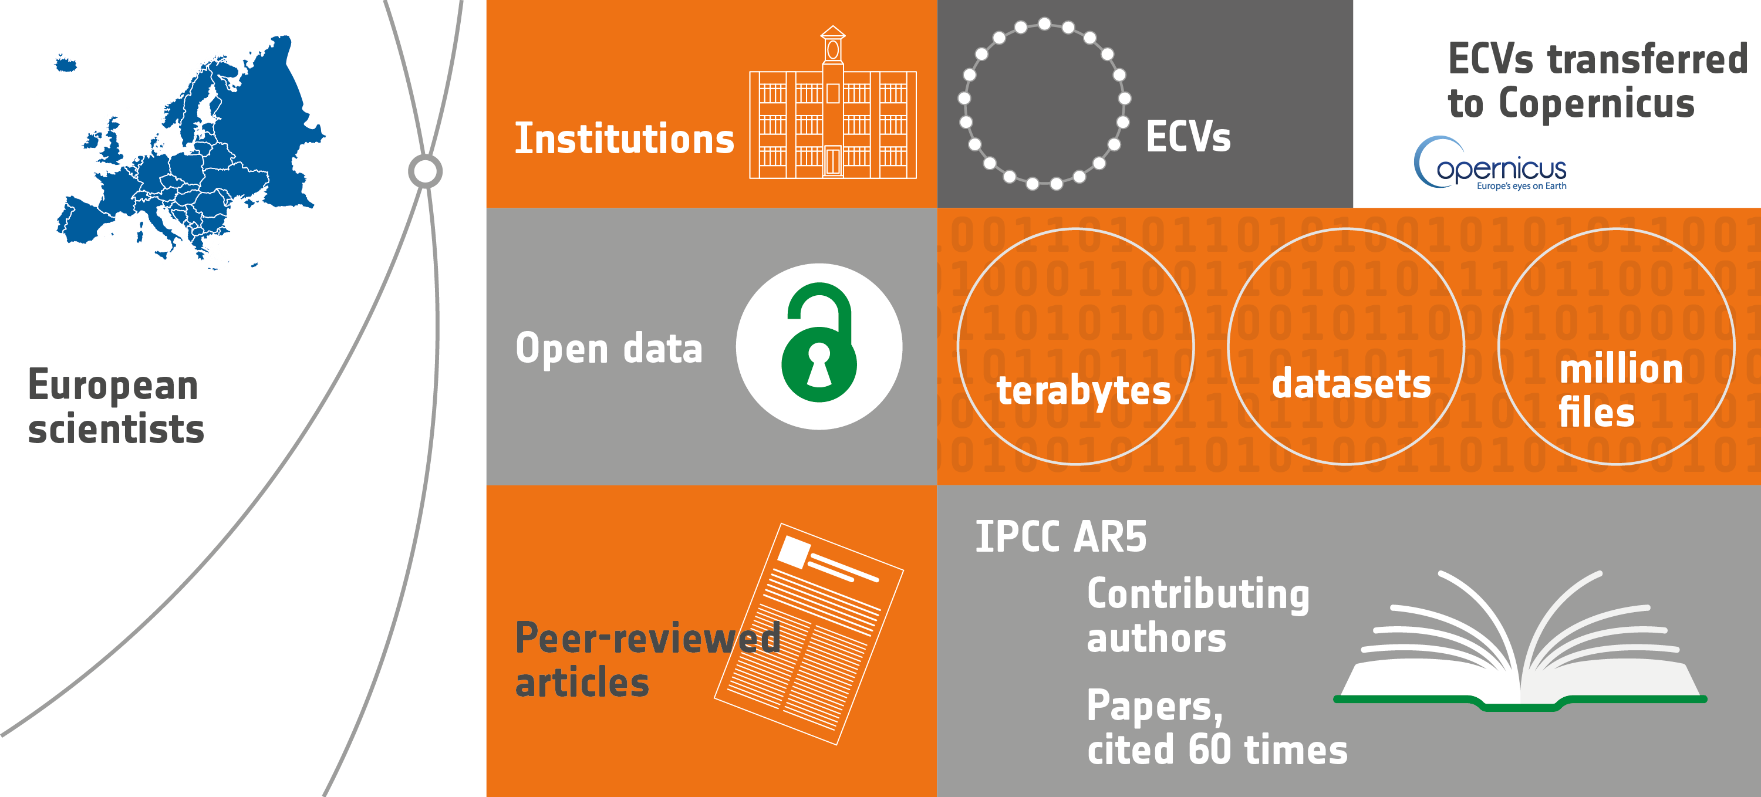
CCI Achievements to date
178
21
13
4.2
450
133
100+
610
28
15
Notes:
This ESA programme has been instrumental in bringing impetus to Space Agencies collective response to requirements of the Global Climate Observing System (GCOS)
Brought together and harnessed the climate knowledge and technical capabilities across ESA Member states – 450 European scientists across 178 institutions (academic and private sector)
21 CCI projects are undertaking the R&D to produce global, consistent long term data records from the satellite EO archive that work towards or meet the stringent requirements specified by GCOS
13 ECVs completed and transferred to operational use with Copernicus Climate Change Service. C3S will continue operational generation for many of the ECV data records devised and generated via the ESA CCI
Open data → Please access this wealth of data
CCI ECVs are advancing understanding of climate and earth system processes. To Oct 2018, CCI projects have produced 610 papers
Results already cited in the IPCC 5th Assessment report which informed the Paris COP21 and working to contribute to AR6
The ECVs produced by the are pre-operational involving proof of concept R&D. The aim is to transfer this knowledge and data into an operational environment. The Copernicus Climate Service now being set-up by EU will continue operational generation for many of the ECV data records started by the ESA CCI (13 ECVs transferred already)

Slide 21
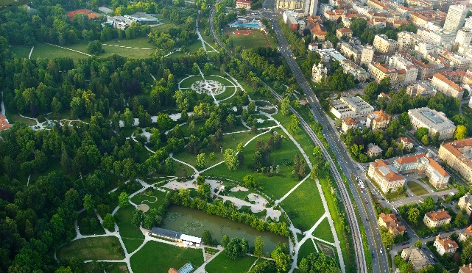
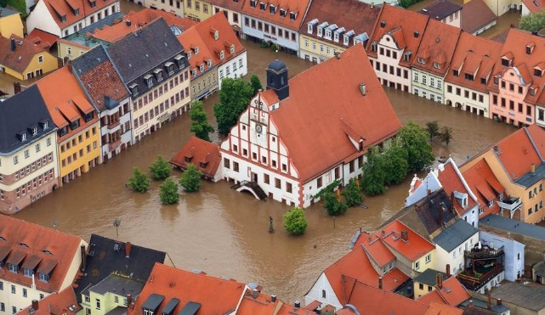
EOEP Supporting Global Policies
Sustainable Development
Environmental Threats to Society
Official Development Assistance
UN SDGs
Sendai Framework
Develop & implement EO SDG monitoring in MS
Strengthen European Resilience through novelty
Facilitating Development Worldwide
Notes:
Objective
EO solutions addressing societal needs & UN SDGs
Partners
IFI’s, UN Agencies, Nat. European development entities, EO service industry
Milestones
Official Development Aid accreditation from OECD in mid-2018

Slide 22
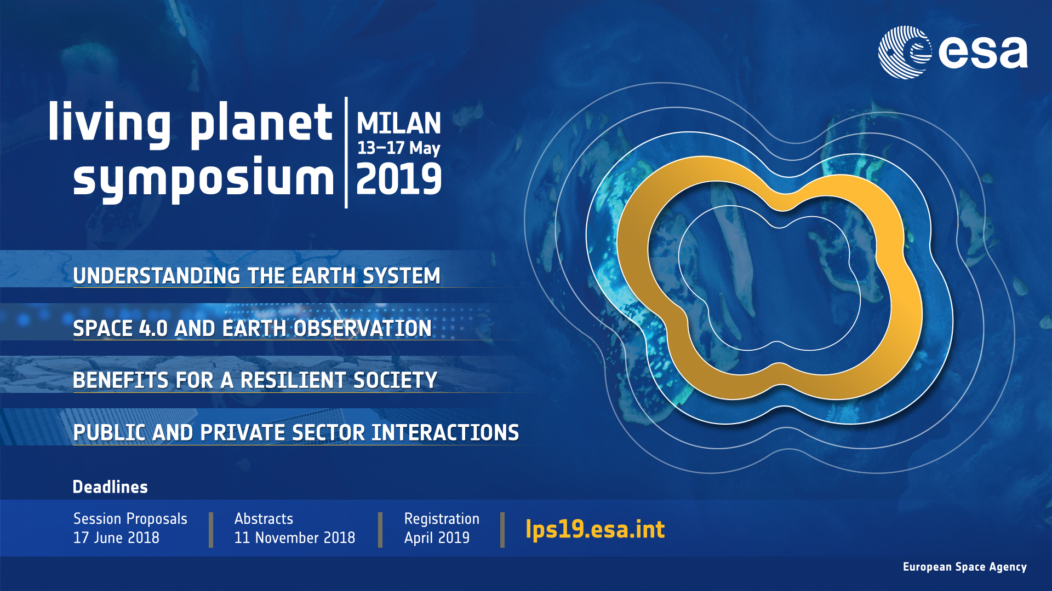

Slide 23
Thank you for your attention
www.esa.int

