Slide 1

Registration of ECV Inventory CDRs in the CEOS International Directory Network (IDN)
Mirko Albani, Andrea Della Vecchia, Iolanda Maggio
ESA - WGISS
WGClimate Meeting#10
Marrakech, Morocco
21 March 2019
Committee on Earth Observation Satellites

Slide 2
WGISS Scope
Data Preservation and Stewardship
Interoperability and Use (including FDA)
WGISS promotes collaboration in the development of systems and services that manage and supply Earth Observation data
Data Discovery and Access
Technology
Exploration

Slide 3



Discovery & Access
WGISS accomplishes its Data Discovery and Access efforts through the WGISS Connected Data Assets System Level Team (SLT)

Slide 4
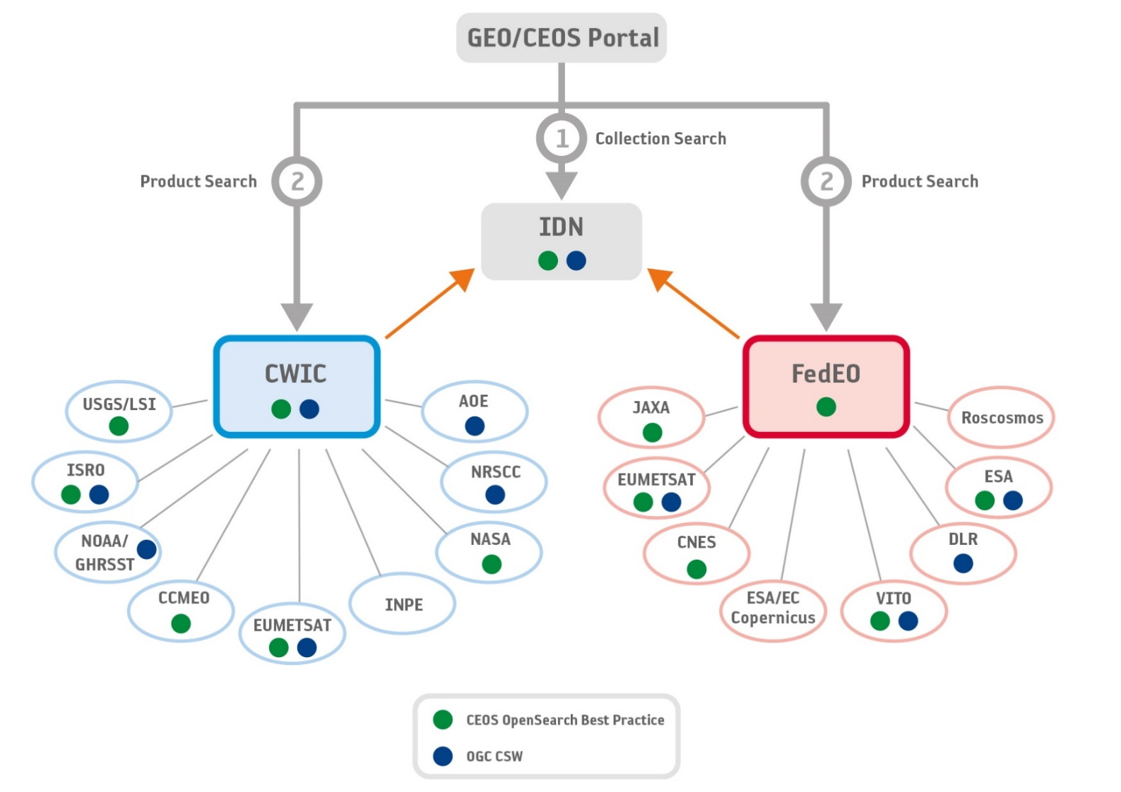
WGISS Connected Data Assets (CDA)
Relying on IDN/CWIC/FedEO components, provides a single entry point for external clients to discover and access CEOS agencies data
Search over 32,000 collections in the IDN (International Directory Network)
Access over 5500 collections with associated over 300+ million granules (granule search)
Notes:
CEOS International Directory Network (IDN) - a Gateway to the world of Earth Science data. The CEOS IDN is an international effort developed to assist researchers in locating information on available datasets. The directory is sponsored as a service to the Earth science community.

Slide 5
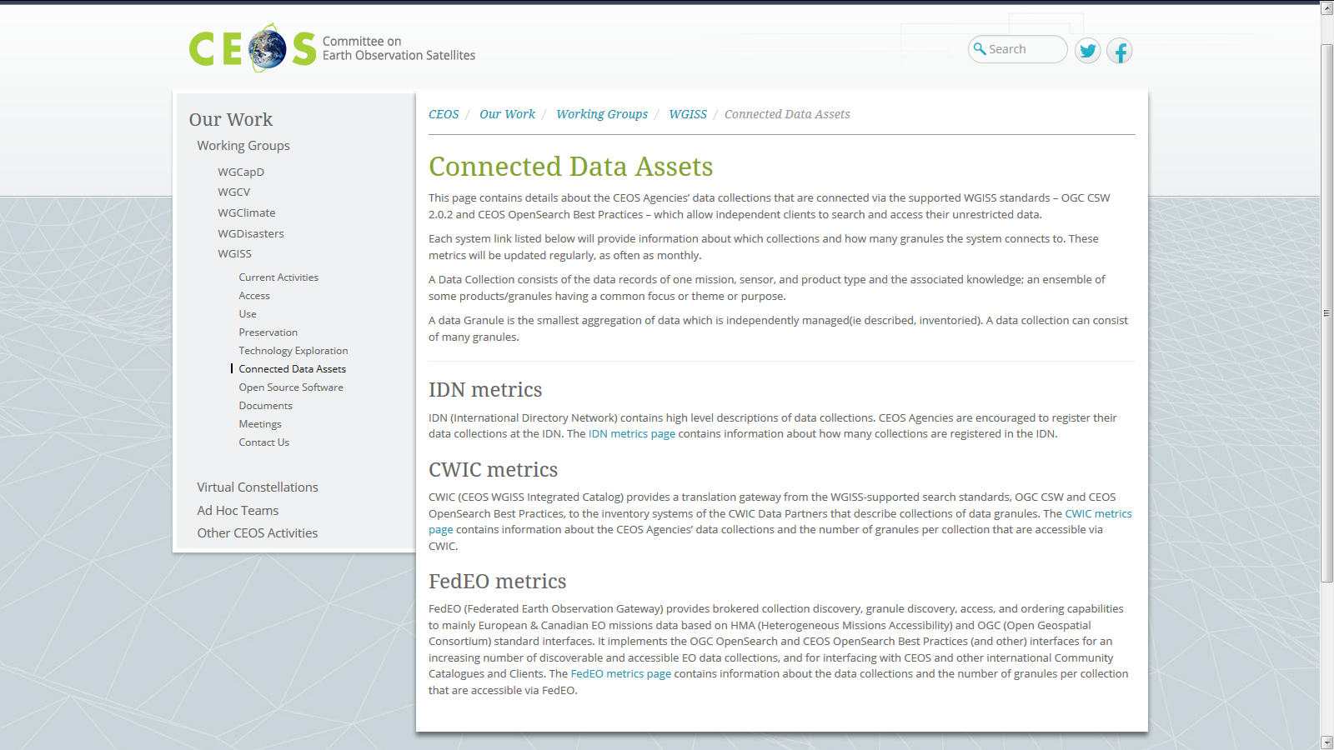
WGISS Connected Data Assets (CDA)
System Level Team (SLT) coordinates maintenance and operations
Client Portals: GEOSS Platform (GEO Portal), AMERIGEOSS Portal, ESA EOPortal, CEOS COVE Tool, CEOS Carbon Portal
Additional data partners can be added to FedEO and CWIC federations
Additional data collections/granules continuously being added from heritage and current EO missions
WGISS webpage provides list of the data collections accessible from IDN, FedEO, and CWIC
Notes:
WGISS Connected Data Assets Operational Systems (IDN, CWIC, FedEO):
Is maintained and operated in coordination among different agencies (System Level Team) and implements the OpenSearch Interoperability Best Practice defined in WGISS.
Provides a single entry point for GEO (GEOPortal) to discover and access CEOS agencies data.
Is being enlarged with new partners and continuously populated with additional Collections (e.g. ECVs/CDRs inventories from WGClimate).

Slide 6
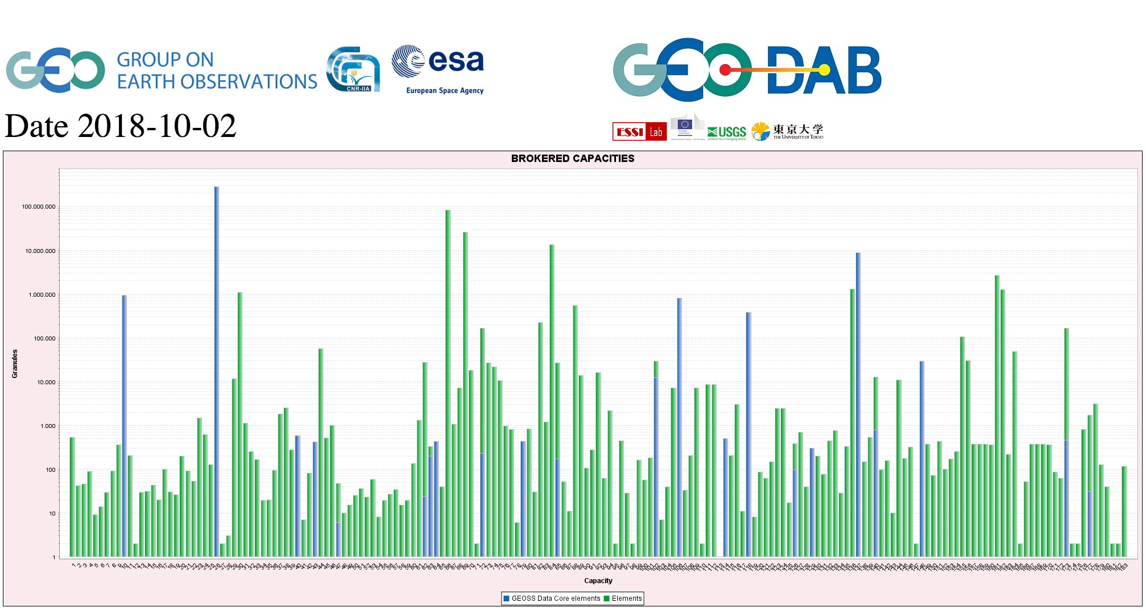
CEOS data in GEOSS
GEOSS PLATFORM DISCOVERABLE DATA PRODUCTS
CWIC
FedEO

Slide 7
ECVs/CDRs Discovery and Access through WGISS CDA Systems
Objective: facilitate discoverability and accessibility of ECV Products and space-born CDRs relevant for the CEOS Carbon Action via WGISS Interoperability Systems & Standards (FedEO/CWIC/IDN, OpenSearch) → ACTION DATA-9
Approach: start from WGClimate ECV Inventory V2.0, assess what data records are already discoverable/accessible through WGISS CDA, fill gaps.
204 ECV/CDRs from ECV Inventory V2.0 to be made accessible through FedEO
CWIC Team (NASA) addressing remaining ones
Some actions started at beg. 2018 to address the 204 datasets through FedEO: scattered replies, slow progress.
WGISS & WGClimate Chair agreed to comprehensively address registration of all ECV/CDRs into IDN together with ECV Inventory update to V3.0
Notes:
Carbon Portal prototype

Slide 8
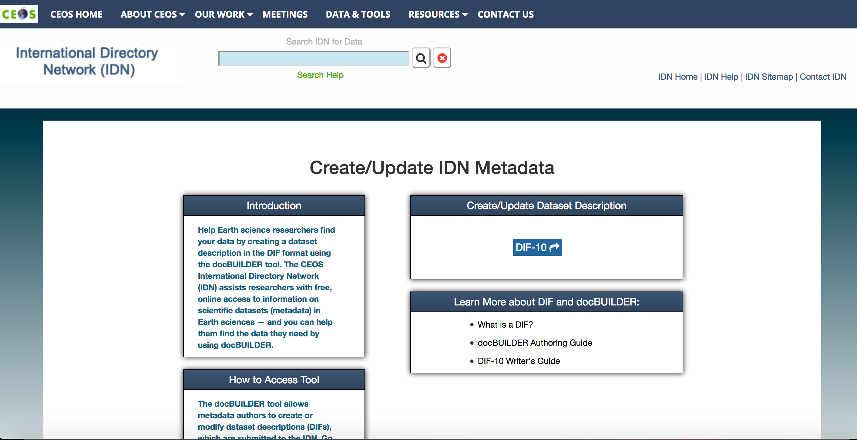
Registration of ECV/CDR Collections into IDN
Data Providers need to register and fill the DIF-10 metadata fields for the specific collection
Second step (access to data products) to be implemented via CWIC/FedEO
Notes:
Carbon Portal prototype

Slide 9
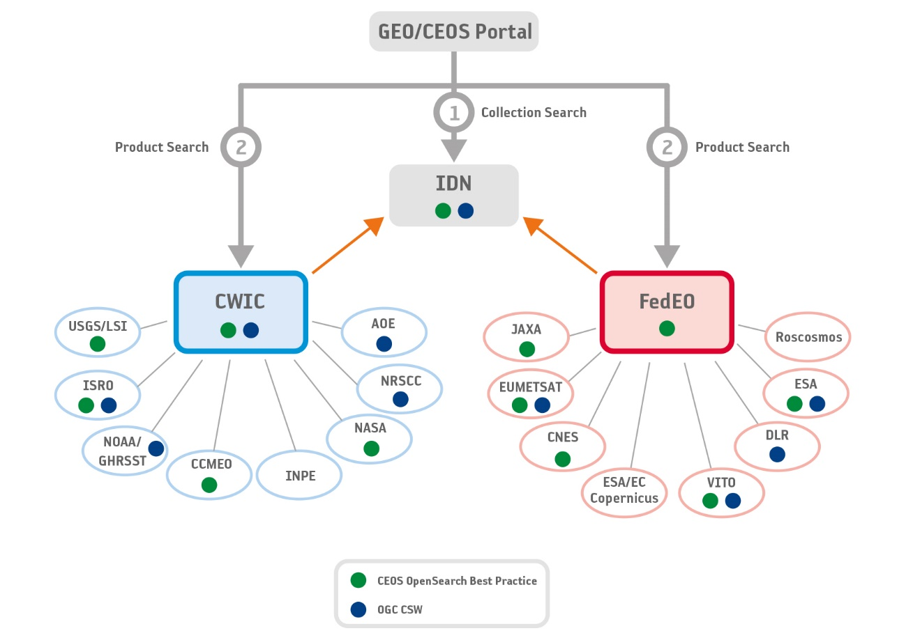
Registration of ECV/CDR Collections into IDN via FedEO
Option-1: Data Providers not having a remotely accessible catalogue
ECV collection owner shall:
a) Fill up an excel template requiring mandatory information to create valid FedEO/IDN entries
FedEO team shall:
Ingest excel files into the FedEO catalogue
Check consistency wrt IDN requirements (e.g., metadata completeness)
Export into IDN repository, in agreement with DIF-10 encoding
Pro: Procedure can be set in place in case of catalogue unavailability
Cons: Slow, time consuming, manual procedure. High risk of inconsistency in time. Evolution of the ECV collections need to be reported in FedEO via a new Excel file.

Slide 10
Registration of ECV/CDR Collections into IDN via FedEO
Option-2: Data Providers having a remotely accessible catalogue
FedEO team shall:
Harvest remote ECV/CDR catalogue (e.g., CEDA CCI)
Check consistency wrt IDN best practice (e.g. metadata completeness)
Export only valid metadata into IDN, in agreement with DIF-10 metadata encoding
Pro: Automatic procedure
Cons: FedEO team not responsible about information content completeness wrt IDN requirements. To get valid IDN entries, a number of exchanges between FedEO and metadata owner teams, may be required (Time/Budget consuming)
CEDA CCI Catalog
Name | CEDA CCI Catalog
Collection Catalog Endpoint | https://csw.ceda.ac.uk/geonetwork/srv/eng/csw-CEDA-CCI
# records | 125
# ECV records | 8 out of
User interface | https://esgf-index1.ceda.ac.uk/search/esacci-ceda/
Contact point | victoria.bennett@stfc.ac.uk

Slide 11
Registration of ECV/CDR Collections into IDN via FedEO
Option-3: Optimal Solution
ECV collection owner shall:
Prepare ECV collection entry, in agreement with IDN guideline on information content (e.g., mandatory metadata fields)
http://climatemonitoring.info/ecvinventory/ shall make available the metadata collection via public API, for machine to machine interaction
FedEO team shall:
Harvest remote catalogue (e.g., http://climatemonitoring.info/ecvinventory/)
Check consistency wrt IDN best practice (e.g. metadata completeness)
Export only valid metadata into IDN, in agreement with DIF-10 encoding
Pro: Automatic procedure. Completeness of information content as ECV collections creator are also responsible of metadata completeness wrt ECV and IDN domains. FedEO responsible for metadata encoding, DIF-10 requested from IDN catalogue
Cons: Some effort for ECV metadata owner to follow IDN metadata guidelines
ECV Master Repository

Slide 12
Proposed way forward
Option 3 proposed as way forward to accomplish CEOS Work Plan Action DATA-09
ECV/CDR data owners should provide ECV collection entries in alignment with IDN guideline on information content; entries should be provided together with the information requested for ECV Inventory update to V3.0
http://climatemonitoring.info/ecvinventory/ shall make available the collection entries via public API, for machine to machine interaction
FedEO team will harvest information and complete registration in IDN
Schedule

Slide 13
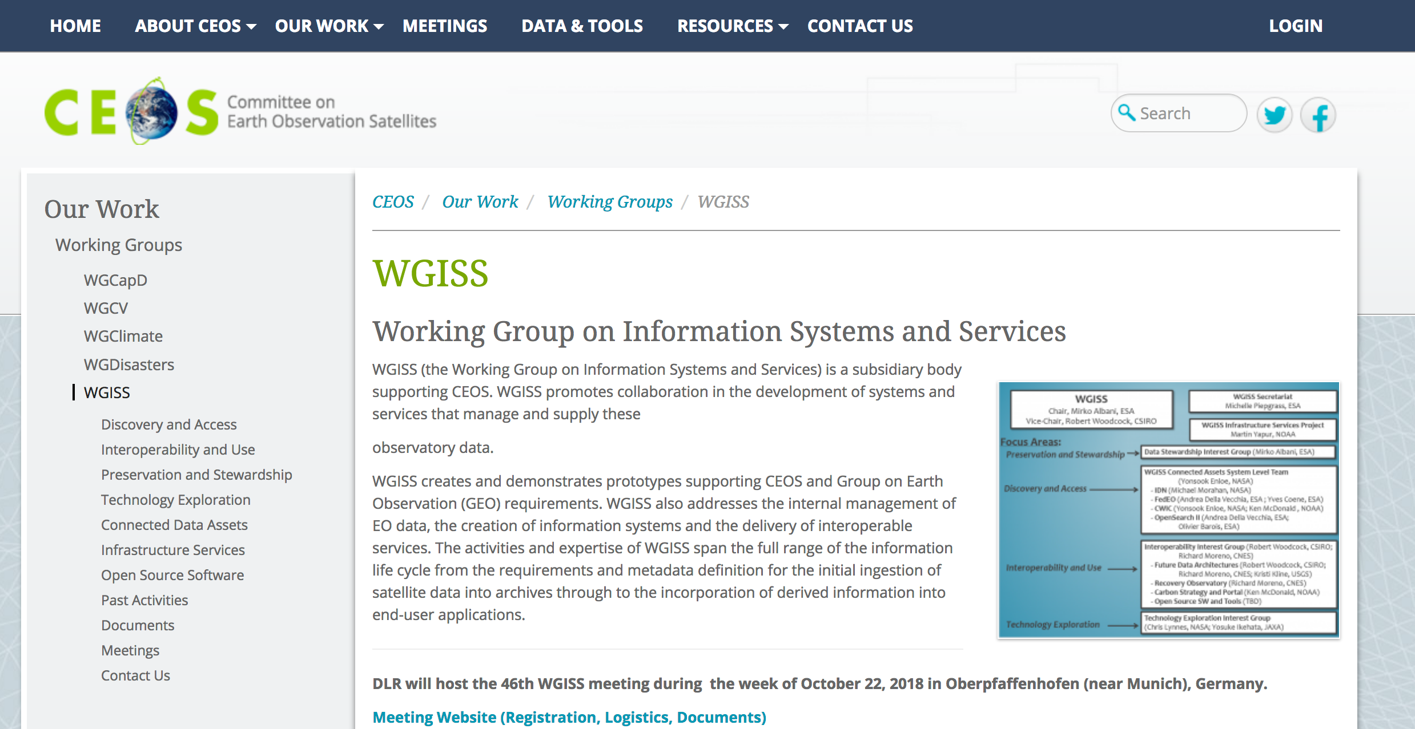
WGISS Information
http://ceos.org/ourwork/workinggroups/wgiss/

Slide 14


Upcoming WGISS Meeting
WGISS#47 hosted by NOAA - Silver Spring, USA (29 April- 2 May 2019)
FDA & Interoperability Workshop
Artificial Intelligence and Machine Learning sessions

Slide 15

Contact:
Mirko.Albani@esa.int

Slide 16
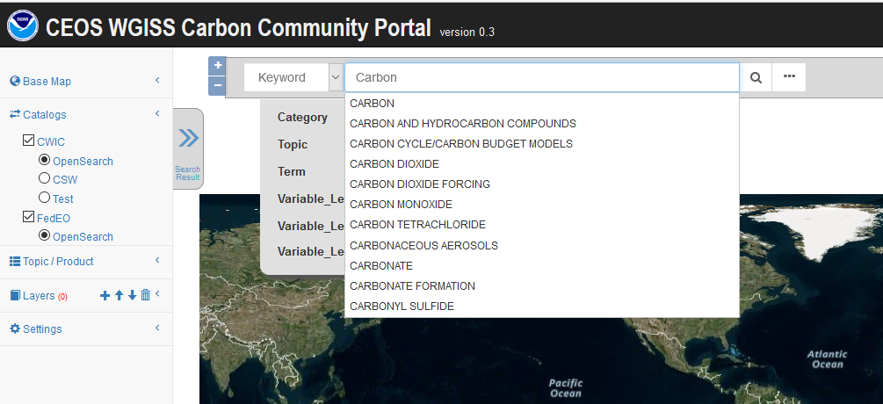
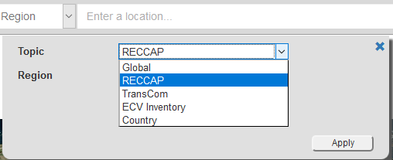
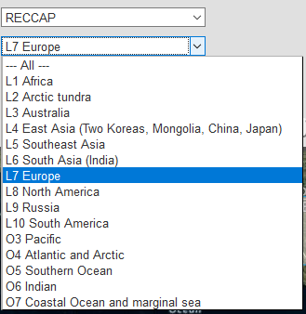
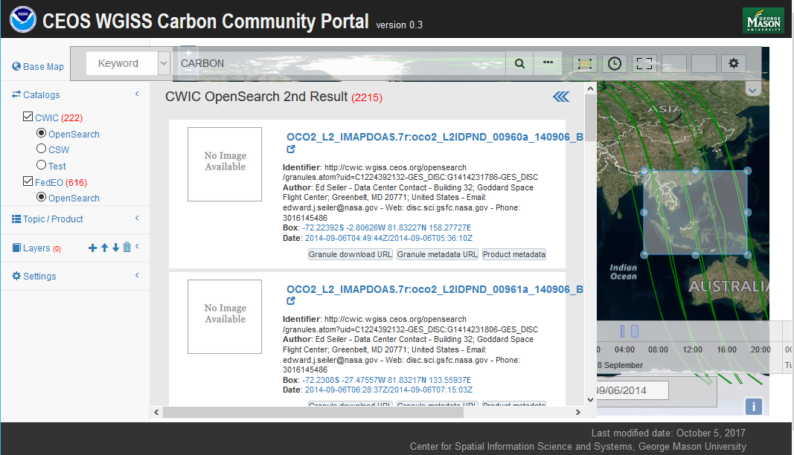
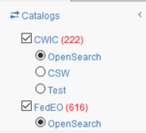
WGISS Carbon Community Portal
Special regions: Global, RECCAP, TransCom, Country Names, ECV Inventory)
Temporal Searches: support for time range and specific date
Pre-defined Carbon topics/datasets: (Atmospheric, Ecosystem, Ocean, Mixed-Theme)
Keywords (auto-completion with IDN Science Keywords)
Return records from both CWIC and FedEO
Notes:
Objective: Implement a prototype carbon data portal to facilitate the discoverability and accessibility of ECV products and space-borne CDRs. The portal will seamlessly access data both in CWIC and FedEO to provide necessary data and services to the carbon science community of both CEOS and GEOSS.
Approach: prototype developed by WGISS in coordination with CEOS Carbon Team and WGClimate Carbon (requirements and use cases provision/validation).
Status: Several iterations held between WGISS and Carbon teams. Carbon Portal latest version (August 2018) with Carbon Team for review/feedback.
Next steps: 1) Improve discoverability of ECV/CDR key datasets for Carbon Community and functionalities based on received feedback; 2) Open-up portal to wider user community to gather additional feedback (target end October 2018).

