Slide 1


Gap Analysis 2019: organisation
WGClimate
The Joint CEOS/CGMS
Working Group on Climate
Alexandra Nunes¹, Jörg Schulz²
¹ Hamtec Consulting c/o EUMETSAT, ² EUMETSAT

Slide 2
Outline
  Main targets
    Comparative analysis #2 / #3
    Set of ECVs for detailed analysis
    GCOS-IP/other actions (other items for analysis)
  Process and timeline
    Approach
    Schedule
  Commitments
    Teams and team leaders
    Writing team

Slide 3
Main targets: comparison #2/#3
  Overall analysis contents of the ECV Inventory: population (distribution per domain, existing / planned), absolute gaps, agencies’ contributions
  General scenario with respect to assessment against GCOS criteria
  Revisit set of ECVs / ECV Products targeted by the previous gap analysis (CO2, CH4, Precipitation, Land Surface Temperature, Leaf Area Index, Above-Ground Biomass, Sea Surface Temperature, Sea Surface Salinity) and assess evolution, cross-referencing with the Recommendations and Actions

Slide 4
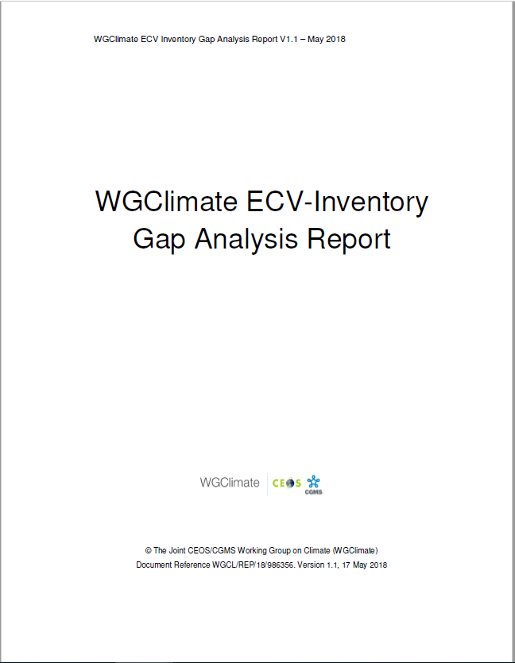
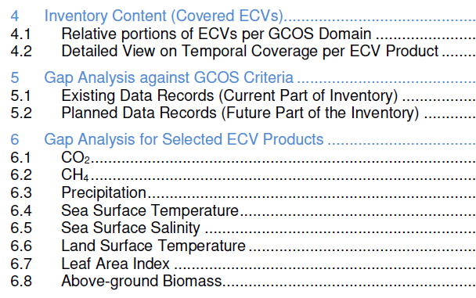
Process and timeline: Approach (1)
  Similar to 2018 GA exercise
  New set of ECVs
  Work on the “delta”
  Add comparative analysis

Slide 5
Process and timeline: Approach (2)
  Automatic assessment
  Statistical analysis tools and graphical display
  Individual CDRs
  Assessment tools on the web interface (GA teams of experts) > “delta”
  Statistical analysis tools and graphical display
  Detailed analysis per ECV / ECV Product
    Missed known CDRs > GA Teams, VCs
    Overview of analysis against GCOS criteria > resulting from previous phase
    Missed opportunities (OSCAR, MIM) > EUMETSAT + GA Teams
    Missing measurements for future > EUMETSAT + GA Teams

Slide 6
Process and timeline: cycle and constraints
Upstream constraints
  Data collection timeline
  Verification process
  Update of web interface tools
Now: agreement on scope, approach and definition of teams
Downstream constraints
  Writing and reviewing of GA Report & Coordinated Action Plan
  CGMS and CEOS Plenaries
Action Plan & Creation of conditions to deliver CDRs
ECV Inventory
Gap Analysis & Recommendations

Slide 7
Process and timeline: proposed schedule
March
September
October
April
May
August
June
July
Preparation
Analysis
Reporting
Update of web interface, verification process, definition of teams
Analysis of ECV Inventory contents and assessment of individual CDRs
Draft versions of 2019 GA Report and Coordinated Action Plan
2019 submission versions of GAR and CAP
Detailed Analysis for selected ECVs / ECV Products
WGClimate #10
Intermediate results at the CGMS Plenary
Publication of ECV Inventory v3.0
Submission of Reports to CEOS Plenary
WGClimate #11

Slide 8
Status: a provisional (pre-verification) snapshot in numbers
1394 records | 976* inherited (#2) | 33 removed
 |  | 943 available | 649 existing | 817 existing + 481 planned | 1298 records
 |  |  | 294 planned
 | 418 new (#3) | 355 available | 168 existing
 |  |  | 187 planned
 |  | 63 removed
892 Atmosphere | 688 (#2) | 486 existing | 590 existing + 302 planned | 801 existing + 472 planned | 1273 records
 |  | 202 planned
 | 204 (#3) | 104 existing
 |  | 100 planned
235 Land | 139 (#2) | 84 existing | 120 existing + 115 planned
 |  | 55 planned
 | 96 (#3) | 36 existing
 |  | 60 planned
146 Ocean | 111 (#2) | 74 existing | 91 existing + 55 planned
 |  | 37 planned
 | 35 (#3) | 17 existing
 |  | 18 planned
25 ?

Slide 9
Status: a provisional (pre-verification) snapshot in numbers
Atmosphere | Aerosol properties | Aerosol optical depth
 |  | Aerosol-extinction coefficient profile
 |  | Single-scattering albedo
 |  | Aerosol-layer height
 | Cloud properties | Cloud optical depth
 |  | Cloud-top pressure
 |  | Cloud effective particle radius (liquid and ice)
 |  | Cloud water path (liquid and ice)
 |  | Cloud-top temperature
 |  | Cloud amount
 | Water vapour | Total column water vapour
 |  | Upper tropospheric humidity
 |  | Tropospheric and lower-stratospheric profiles of water vapour
 | Earth radiation budget | Top-of-atmosphere ERB long-wave
 |  | Top-of-atmosphere ERB short-wave (reflected)
 |  | Solar spectral irradiance
 |  | Total solar irradiance
 | Ozone | Total column ozone
 |  | Troposphere ozone profile
 |  | Ozone profile in upper troposphere and lower stratosphere
 |  | Ozone profile in upper stratosphere and mesosphere
 | Precursors supporting the Ozone and Aerosol ECVs | CO tropospheric column
 |  | SO2, HCHO tropospheric columns
 |  | CO tropospheric profile
 |  | NO2 tropospheric column
 | Carbon Dioxide, Methane and other greenhouse gases | Tropospheric CH4 column
 |  | Tropospheric CO2 column
 |  | Tropospheric CO2 profile
 |  | Tropospheric CH4 profile
 |  | Stratospheric CH4 profile
 | Surface wind speed and direction | Surface wind speed and direction
 | Wind speed and direction (upper-air) | Upper-air wind retrievals
 | Precipitation | Estimates of liquid and solid precipitation
 | Surface radiation budget | Surface ERB short-wave
 |  | Surface ERB long-wave
 | Temperature (upper-air) | Tropospheric temperature profile
 |  | Temperature of deep atmospheric layers
 |  | Stratospheric temperature profile
 | Lightning | Lightning
  Atmosphere
Temperature (upper-air) | Tropospheric temperature profile
 | Temperature of deep atmospheric layers
 | Stratospheric temperature profile
Lightning | Lightning

Slide 10
Status: a provisional (pre-verification) snapshot in numbers
Land | Anthropogenic greenhouse-gas fluxes | Estimated fluxes by inversions of observed atmospheric composition - continental
 |  | Estimated fluxes by inversions of observed atmospheric composition - national
 |  | High-resolution CO₂ column concentrations to monitor point sources
 | Ice sheets and ice shelves | Ice mass change
 |  | Ice velocity
 |  | Surface elevation change
 |  | Grounding line location and thickness
 | FAPAR | Maps of FAPAR for modelling
 |  | Maps of FAPAR for adaptation
 |  | FAPAR (GCOS-154)
 | Leaf area index | Maps of LAI for modelling
 |  | Maps of LAI for adaptation
 |  | LAI (GCOS-154)
 | Albedo | Black-sky Albedo (GCOS-154)
 |  | Maps of DHR albedo for modelling
 |  | Maps of DHR albedo for adaptation
 |  | White-sky Albedo (GCOS-154)
 |  | Maps of BHR albedo for modelling
 |  | Maps of BHR albedo for adaptation
 | Fire | Burnt areas
 |  | Fire radiative power
 |  | Active fire maps
 | Soil moisture | Surface soil moisture
 |  | Freeze/thaw
 |  | Root-zone soil moisture
 |  | Surface inundation
 |  | Vegetation optical depth
 | Land cover | Maps of land cover
 |  | Maps of high-resolution land cover
 | Land-surface temperature | Maps of land-surface temperature
 | Glaciers | Glacier elevation change
 |  | Glacier area
 |  | Glacier mass change
 | Lakes | Lake colour (Lake water-leaving reflectance)
 |  | Lake-ice cover
 |  | Water extent
 |  | Lake surface-water temperature
 |  | Lake water level
 |  | Lake-ice thickness
 | Permafrost | Permafrost temperature
 |  | Depth of active layer
 | Snow | Area covered by snow
 |  | Snow water equivalent
 | Groundwater | Groundwater volume change
 | Above-ground biomass | Maps of AGB
Anthropogenic greenhouse-gas fluxes | Estimated fluxes by inversions of observed atmospheric composition - continental
 | Estimated fluxes by inversions of observed atmospheric composition - national
 | High-resolution CO₂ column concentrations to monitor point sources
  Land
Soil moisture | Surface soil moisture
 | Freeze/thaw
 | Root-zone soil moisture
 | Surface inundation
 | Vegetation optical depth
FAPAR | Maps of FAPAR for modelling
 | Maps of FAPAR for adaptation
 | FAPAR (GCOS-154)
Leaf area index | Maps of LAI for modelling
 | Maps of LAI for adaptation
 | LAI (GCOS-154)
Albedo | Black-sky Albedo (GCOS-154)
 | Maps of DHR albedo for modelling
 | Maps of DHR albedo for adaptation
 | White-sky Albedo (GCOS-154)
 | Maps of BHR albedo for modelling
 | Maps of BHR albedo for adaptation
Glaciers | Glacier elevation change
 | Glacier area
 | Glacier mass change
Lakes | Lake colour (Lake water-leaving reflectance)
 | Lake-ice cover
 | Water extent
 | Lake surface-water temperature
 | Lake water level
 | Lake-ice thickness

Slide 11
Status: a provisional (pre-verification) snapshot in numbers
Ocean | Sea level | Global mean sea level
 |  | Regional sea level
 | Sea state | Wave height
 | Sea-surface temperature | Sea-surface temperature
 | Sea ice | Sea-ice thickness
 |  | Sea-ice extent/edge
 |  | Sea-ice concentration
 |  | Sea-ice drift
 | Ocean-surface heat flux | Latent heat flux
 |  | Radiative heat flux
 |  | Sensible heat flux
 | Sea-surface salinity | Sea-surface salinity
 | Ocean colour | Chlorophyll-a concentration
 |  | Water leaving radiance
 | Surface stress | Surface stress
 | Surface currents | Surface geostrophic currents
  Ocean

Slide 12
Main targets: ECVs for detailed analysis (1)
  Draft proposal, based on analysis of GCOS-IP actions
    Atmosphere
      Aerosols > Simon, Wenying
      Lightning > Wenying
      Surface Winds > Wenying
      Upper-air winds > Jörg
      Water Vapour UT/LS > Jörg (Susanne)
    Land
      Fire > Jeff
      Land Cover > Jeff
      Soil Moisture > Jeff
      FAPAR > Jörg (Nadine?)
      Glaciers > Simon
    Ocean
      Sea Level > Simon
      Sea State > Simon
      Ocean-surface heat flux > Jörg
  Considerations
    Workload
    Expertise
    Other (relevance, cycles, …) > Scatterometry? Limb sounding?

Slide 13
Main targets: ECVs for detailed analysis (2)
Domain | ECV | ECV Product | # records
Atmosphere (78 + 99) | Aerosol properties (73) | Aerosol optical depth | 58
 |  | Aerosol-extinction coefficient profile | 5
 |  | Single-scattering albedo | 3
 |  | Aerosol-layer height | 7
 | Carbon Dioxide, Methane and other greenhouse gases (75) | Tropospheric CH4 column | 20
 |  | Tropospheric CO2 column | 31
 |  | Tropospheric CO2 profile | 2
 |  | Tropospheric CH4 profile | 21
 |  | Stratospheric CH4 profile | 1
 | Wind speed and direction (upper-air) (5) | Upper-air wind retrievals | 5
 | Precipitation (24) | Estimates of liquid and solid precipitation | 24
 | Lightning (0) | Lightning | 0

Slide 14
Main targets: ECVs for detailed analysis (3)
Domain | ECV | ECV Product | # records
Land (75 + 61) | FAPAR (10) | Maps of FAPAR for modelling | 7
 |  | Maps of FAPAR for adaptation | 0
 |  | FAPAR (GCOS-154) | 3
 | Leaf area index (10) | Maps of LAI for modelling | 7
 |  | Maps of LAI for adaptation | 0
 |  | LAI (GCOS-154) | 3
 | Fire (20) | Burnt areas | 16
 |  | Fire radiative power | 3
 |  | Active fire maps | 1
 | Soil moisture (31) | Surface soil moisture | 30
 |  | Freeze/thaw | 1
 |  | Root-zone soil moisture | 0
 |  | Surface inundation | 0
 |  | Vegetation optical depth | 0
 | Land-surface temperature (50) | Maps of land-surface temperature | 50
 | Glaciers (2) | Glacier elevation change | 1
 |  | Glacier mass change | 0
 |  | Glacier area | 1
 | Permafrost (2) | Permafrost temperature | 1
 |  | Depth of active layer | 1
 | Above-ground biomass (1) | Maps of AGB | 1
 | Land cover (10) | Maps of high-resolution land cover | 1
 |  | Maps of land cover | 9

Slide 15
Main targets: ECVs for detailed analysis (4)
Domain | ECV | ECV Product | # records
Ocean (39 + 38) | Sea level (20) | Global mean sea level | 5
 |  | Regional sea level | 15
 | Sea state (13) | Wave height | 13
 | Ocean-surface heat flux (6) | Latent heat flux | 4
 |  | Radiative heat flux | 0
 |  | Sensible heat flux | 2
 | Sea-surface salinity (4) | Sea-surface salinity | 4
 | Sea surface temperature (34) | Sea surface temperature | 34

Slide 16
Commitments: Teams
  Atmosphere
    2018 team, dropouts
    2019 team (leaders, members / needs, distribution of ECVs / expertise)
  Land
    2018 team, dropouts
    2019 team (leaders, members / needs, distribution of ECVs / expertise)
  Ocean
    2018 team, dropouts
    2019 team (leaders, members / needs, distribution of ECVs / expertise)

