Slide 1
ECV Inventory #3: context and status
WGClimate
The Joint CEOS/CGMS
Working Group on Climate
Alexandra Nunes¹, Jörg Schulz²
¹ Hamtec Consulting c/o EUMETSAT, ² EUMETSAT

Slide 2
Context and evolution
“ECV Inventory”: a database of information about satellite-derived (Thematic) Climate Data Records addressing geophysical quantities contributing to the GCOS-defined space-observable ECVs / ECV Products.
Capture the largest possible number of existing and planned satellite-derived CDRs addressing GCOS ECVs
Get the most accurate information concerning the data records: Stewardship, (Generation Process,) Record Characteristics, (Documentation,) Accessibility, Applications
Ensure completeness and consistency of information provided
Data call through WGClimate CEOS and CGMS space agencies’ Focal Points
Direct involvement of data producers identified by the space agencies; Questionnaire Guide and individual support
Verification / consolidation process by individual interaction with the ECV Inventory Responders

Slide 3
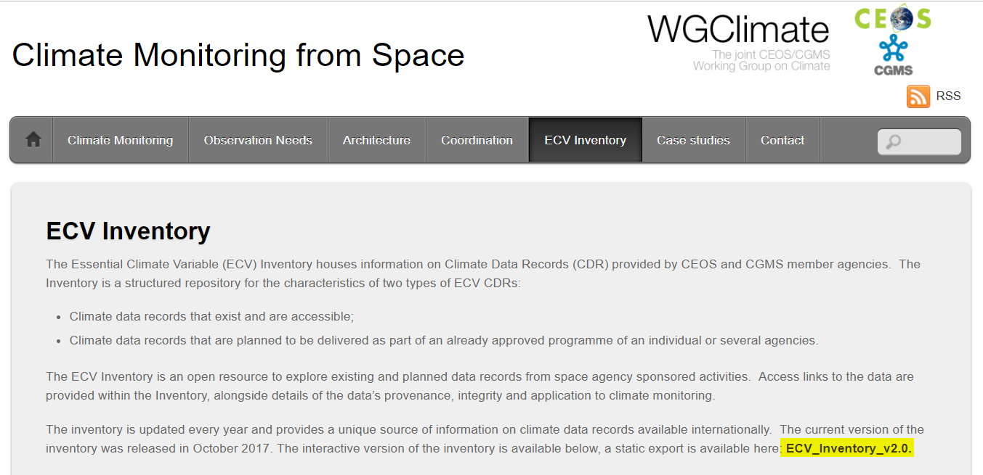
Evolution: a steep learning curve…
Cycle #1 ( - 2014)
Cycle #2 (2016-2018)
‘Cycle’ #3 (2018 - )
… with good results!
913 records (496 existing + 417 planned) contributed by ~ one hundred Responders from 10 agencies
Domain | Total | Current | Future
All | 913 | 496 | 417
Atmosphere | 658 | 376 | 282
Land | 135 | 56 | 79
Ocean | 120 | 64 | 56

Slide 4
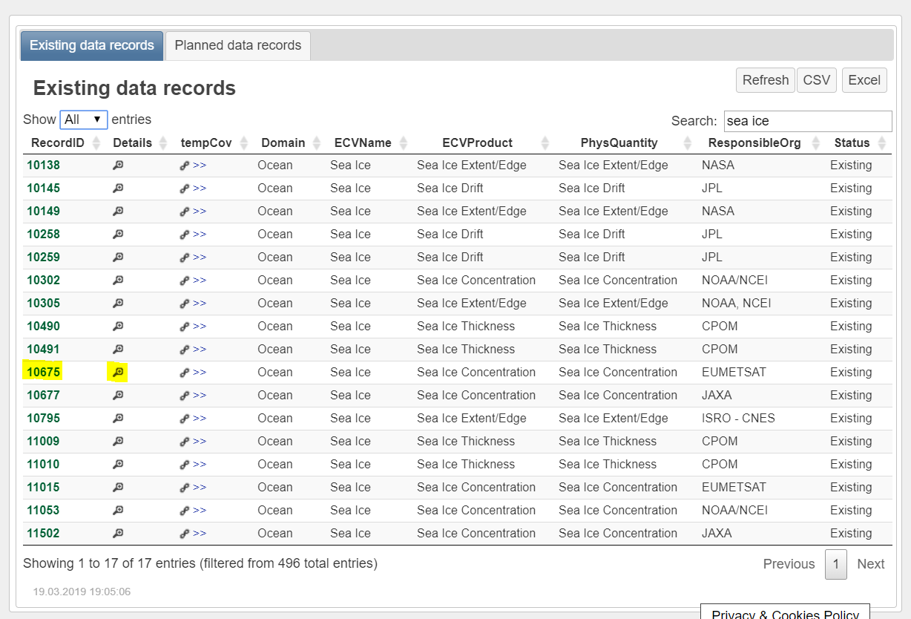
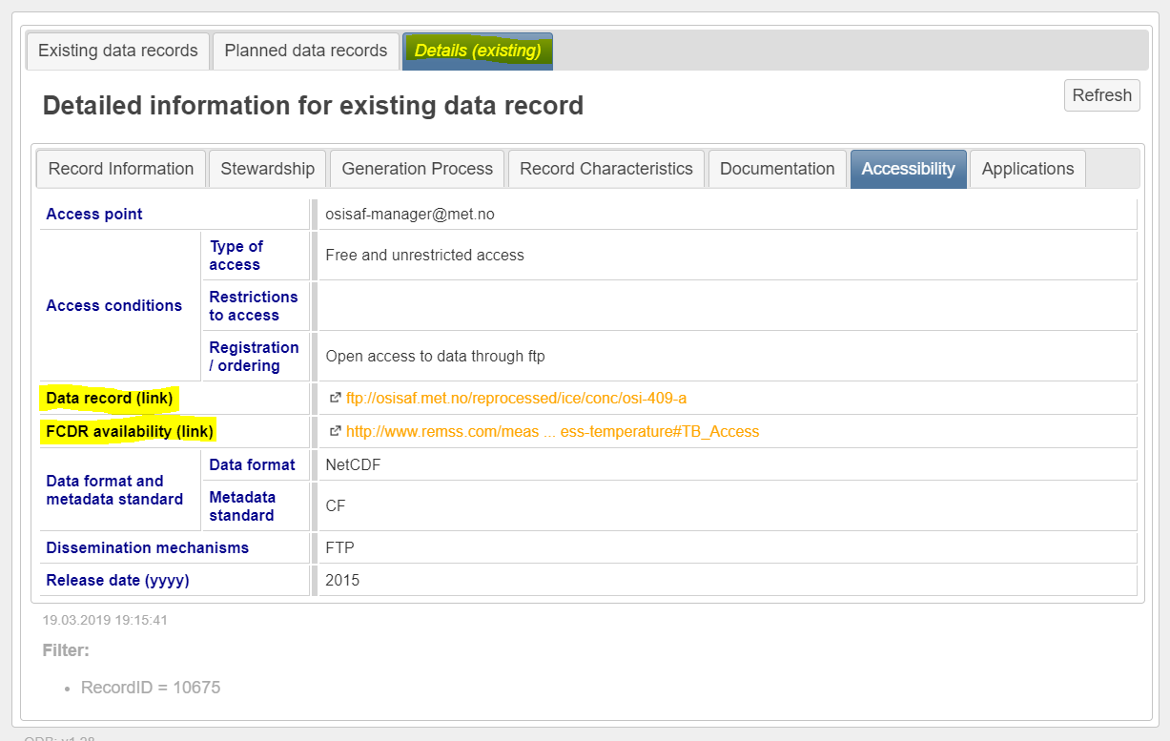
Evolution: …with good published results!
http://climatemonitoring.info/ecvinventory/
version 2.0 (10 / 2017)
Download
Browsing
Direct links to data

Slide 5
Evolution: ... and followed by a flatter stretch
Cycle #1 ( - 2014)
Cycle #2 (2016 - 2018 )
‘Cycle #3’ (2018 - )
Continuous data collection (update*), with cut-off dates for reference versions of the annual ECV Inventory, Gap Analysis, and Coordinated Action Plan
Conversion of planned into existing
Update of information for v2.0
Deletion of obsolete / redundant content
Registration of new content
Lessons learnt from data collection, verification process, and gap analysis:
Minor changes to the questionnaire and terminology
Different approach for registration of ICDR-like datasets
Relaxation of commitment constraints for planned CDRs

Slide 6
Status: timeline for 2019
November
Q3.2019
Q4.2019
December
January
Q2.2019
February
March
Preparation (piecewise continuous)
Data collection and Verification (continuous)
Analysis and Reporting (annually)
Update of web interface, Questionnaire (GCOS-200)
Registration of new Responders and population of the database: update of pre-existing entries (contacts, URLs, deletion of obsolete/redundant content – e.g. new approach to ICDR-like data records, conversion planned > existing) + input of new entries
2019 Gap Analysis
2019 GA Report and Coordinated Action Plan
Verification of submitted contents for completeness and consistency, in preparation for publication and Gap Analysis
1st deadline for the cut-off of data collection for v3.0
Final cut-off date of data collection for v3.0
Intermediate results at the CGMS Plenary
Publication of ECV Inventory v3.0
Submission of Reports to CEOS Plenary
WGClimate #10

Slide 7
Status: a provisional* snapshot in numbers
* pre-verification process
1394 entries
418 new
976 inherited (913 published + 63 non finished/verified from Cycle #2)
1298 entries “available”
817 existing + 481 planned
892 Atmosphere + 235 Land + 146 Ocean (+25)
~ two hundred Responders, Co-editors, Observers
60 + 6 new registered Responders
New input on e.g. Above-Ground Biomass and Sea-surface Salinity (previous “gaps”)
New / Stronger contributors: KMA (new), JAXA and JMA (stronger)
New programs: ESA CCI+, C3S-funded Projects – planned CDRs
… and still growing

Slide 8
Status: a provisional (pre-verification) snapshot in numbers
1394 records | 976* inherited (#2) | 33 removed
 |  | 943 available | 649 existing | 817 existing + 481 planned | 1298 records
 |  |  | 294 planned
 | 418 new (#3) | 355 available | 168 existing
 |  |  | 187 planned
 |  | 63 removed
892 Atmosphere | 688 (#2) | 486 existing | 590 existing + 302 planned | 801 existing + 472 planned | 1273 records
 |  | 202 planned
 | 204 (#3) | 104 existing
 |  | 100 planned
235 Land | 139 (#2) | 84 existing | 120 existing + 115 planned
 |  | 55 planned
 | 96 (#3) | 36 existing
 |  | 60 planned
146 Ocean | 111 (#2) | 74 existing | 91 existing + 55 planned
 |  | 37 planned
 | 35 (#3) | 17 existing
 |  | 18 planned
25 ?

Slide 9
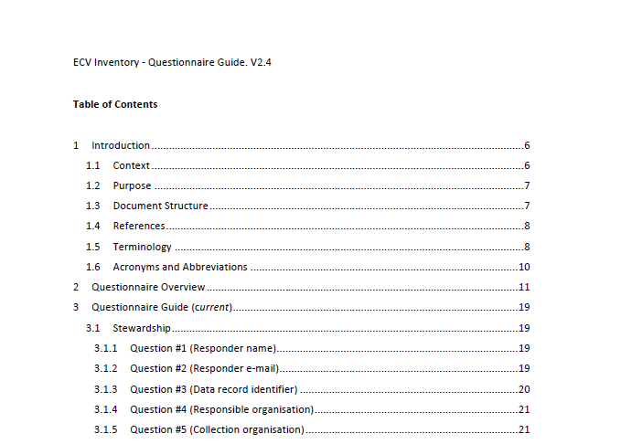
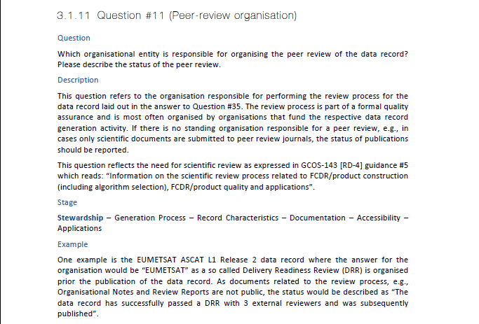
Implementation: Questionnaire Guide

Slide 10
Implementation: Questionnaire Guide (Topics)
Questionnaire topics:
Stewardship: CDR curator(s), responsible organisation, data record identification (DOI, name and version, reference), organisation(s) responsible for collection, calibration, FCDR, inter-calibration, TCDR, peer-review, archiving, user-service and feedback, maintenance, …
Generation Process: information on quality assurance, assessment of GCOS requirements and guidelines, use of quantitative maturity matrix, …
Record Characteristics: ECV, ECV Product, physical quantity, satellites/instruments, spatial/temporal resolution and coverage, accuracy, stability, (inter-)calibration, …
Documentation: regarding generation, calibration, validation, scientific review, …
Accessibility: contact, type of access, URL for access, data dissemination, format, …
Applications: climate applications, users.

