Slide 1


ECV Inventory #3: context and status
WGClimate
The Joint CEOS/CGMS
Working Group on Climate
Alexandra Nunes¹, Jörg Schulz²
¹ Hamtec Consulting c/o EUMETSAT, ² EUMETSAT

Slide 2
Outline
  [“ECV Inventory”: a database of information about satellite-derived (Thematic) Climate Data Records addressing geophysical quantities contributing to the GCOS-defined space-observable ECVs / ECV Products.]
  Context
    Aims and implementation
    Heritage and evolution
  Status
    The provisional numbers
    the outlook ahead

Slide 3
Aims and implementation (1)
  Capture the largest possible number of existing and planned satellite-derived CDRs addressing GCOS ECVs
  Get the most accurate information concerning the data records: Stewardship, (Generation Process,) Record Characteristics, (Documentation,) Accessibility, Applications
  Ensure completeness and consistency of information provided
  Data call through WGClimate CEOS and CGMS space agencies’ Focal Points
  Direct involvement of data producers identified by the space agencies; Questionnaire Guide and individual support
  Verification / consolidation process by individual interaction with the ECV Inventory Responders

Slide 4
Aims and implementation (2)
Action Plan & Creation of conditions to deliver CDRs
ECV Inventory
Gap Analysis & Recommendations
ECV Inventory describes current and planned implementation arrangements (ECV-by-ECV) within the Architecture
Verified information about data records (including direct access links when available)
Updated continuously with yearly versions of Inventory, Gap Analysis, and Action Plan (with approval from CEOS and CGMS)
Recommendations and Coordinated Actions inform space agency planning, improve availability and interoperability of climate data
Feeds material for all future responses to the GCOS IP

Slide 5
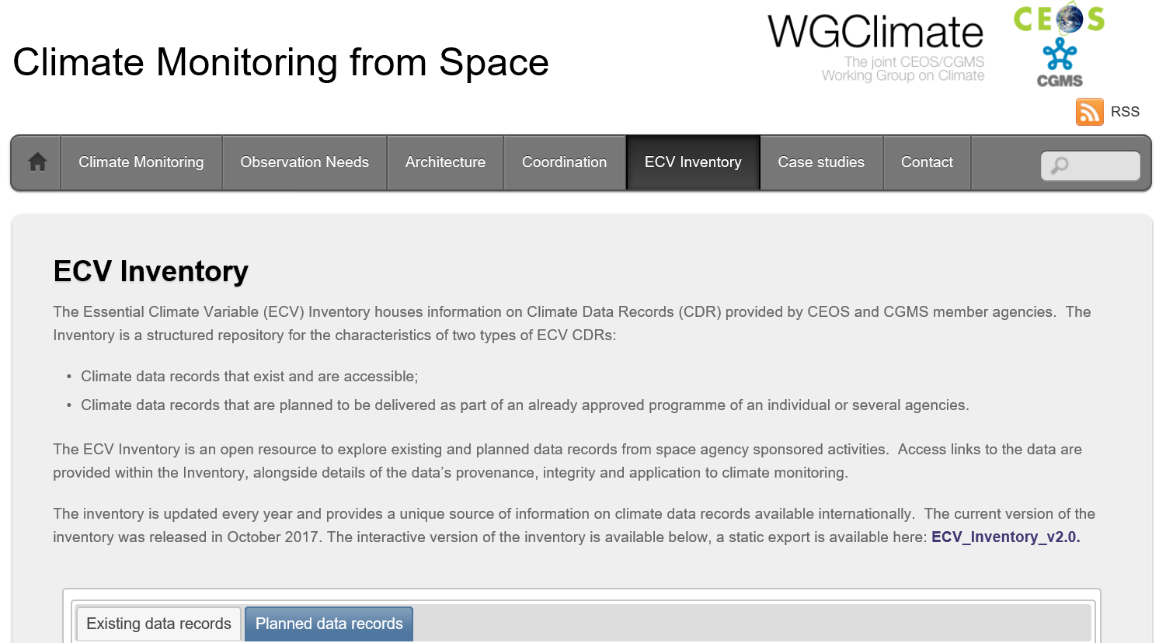
Heritage and evolution: A steep learning curve…
Cycle #1 ( - 2015)
Cycle #2 (2016-2018)
  Unpopulated / poorly populated fields
  Inconsistent / insufficient input of information
  Guide to the Questionnaire
  1-to-1 interactions with Responders
  Verification of contents
  ECV Inventory v2.0 publicly available (browsing and download) since October 2017
  913 records (496 existing + 417 planned) contributed by ~ one hundred Responders from xx agencies
http://climatemonitoring.info/ecvinventory/

Slide 6
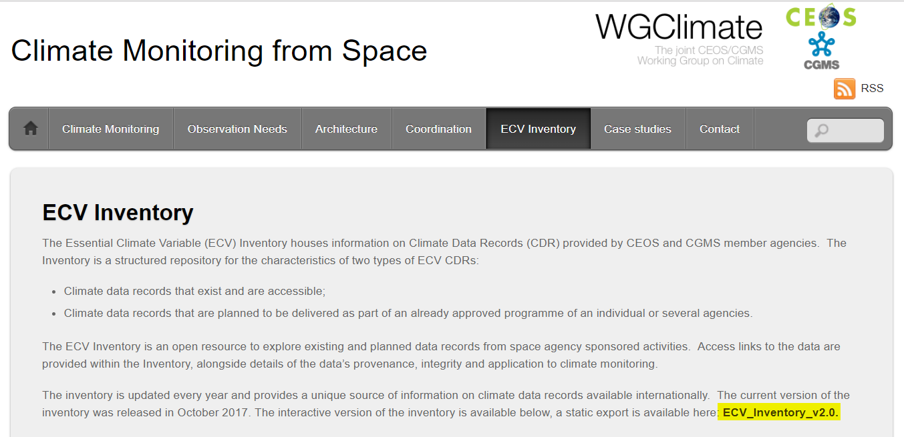
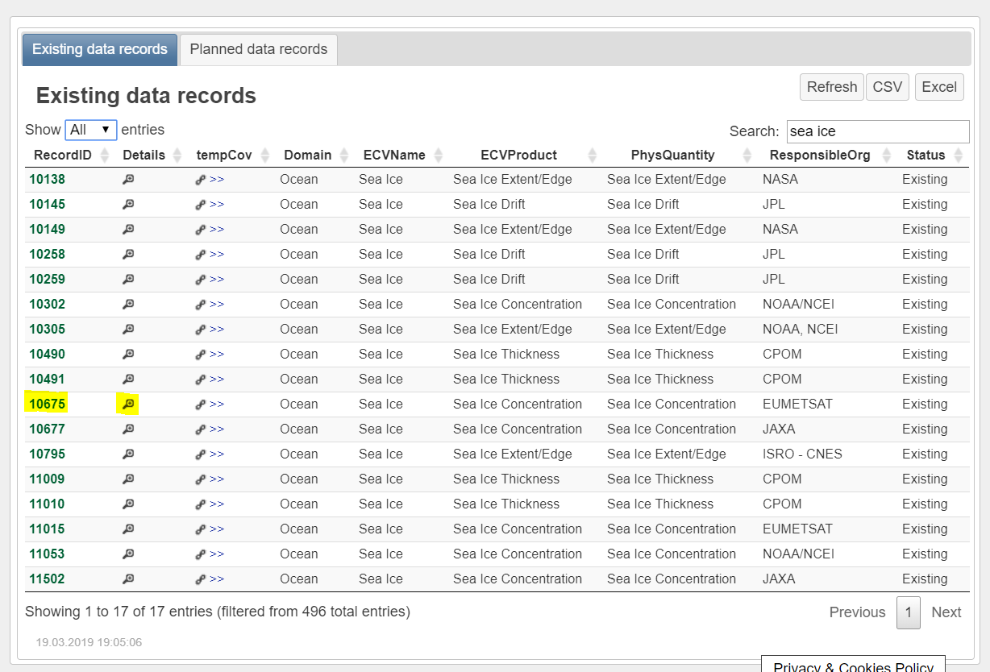
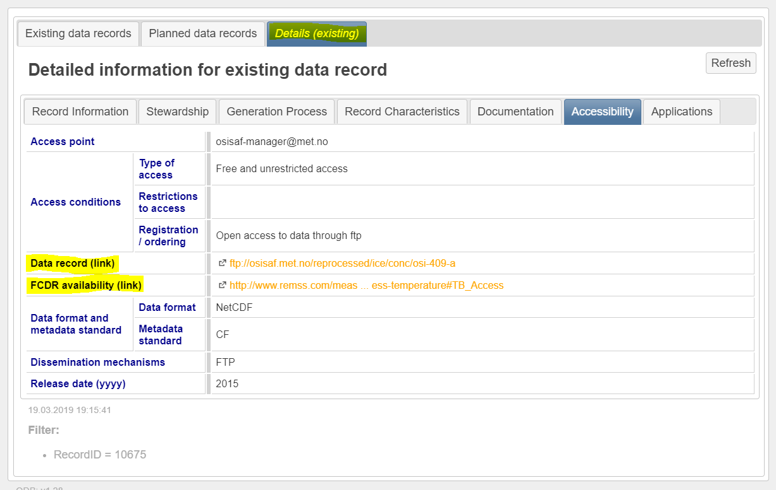
Heritage and evolution: A steep learning curve…
  ECV Inventory v2.0 publicly available (browsing and download) since October 2017
  913 records (496 existing + 417 planned) contributed by ~ one hundred Responders from xx agencies

Slide 7
Heritage and evolution: … with good results…
Cycle #2 (2016-2018)
Domain | Total | Current | Future
All | 913 | 496 | 417
Atmosphere | 658 | 376 | 282
Land | 135 | 56 | 79
Ocean | 120 | 64 | 56
  ECV Inventory v2.0 publicly available (browsing and download) since October 2017
  913 records (496 existing + 417 planned) contributed by ~ one hundred Responders from xx agencies

Slide 8
Heritage and evolution: … with good results…
  ECV Inventory v2.0 publicly available (browsing and download) since October 2017
  913 records (496 existing + 417 planned) contributed by ~ one hundred Responders from xx agencies
Cycle #2 (2016-2018)

Slide 9
Heritage and evolution: … with good results…
Cycle #2 (2016-2018)

Slide 10
Heritage and evolution: … with good results…
Cycle #2 (2016-2018)

Slide 11
Heritage and evolution: ... with some flatter stretches
Cycle #1 ( - 2013)
Cycle #2 (2016-2018)
‘Cycle #3’ (2018 - )
  Continuous data collection (update), with cut-off dates for reference versions of the annual ECV Inventory, Gap Analysis, and Coordinated Action Plan
  Lessons learnt from data collection, verification process, and gap analysis:
    Minor changes to the questionnaire and terminology
    Different approach for registration of ICDR-like datasets
    Relaxation of commitment constraints for planned CDRs

Slide 12
Status: timeline for 2019
November
Q3.2019
Q4.2019
December
January
Q2.2019
February
March
Preparation (piecewise continuous)
Data collection and Verification (continuous)
Analysis and Reporting (annually)
Update of web interface, Questionnaire (GCOS-200)
Registration of new Responders and population of the database: update of pre-existing entries (contacts, URLs, deletion of obsolete/redundant content – e.g. new approach to ICDR-like data records, conversion planned > existing) + input of new entries
2019 Gap Analysis
2019 GA Report and Coordinated Action Plan
Verification of submitted contents for completeness and consistency, in preparation for publication and Gap Analysis
1st deadline for the cut-off of data collection for v3.0
Final cut-off date of data collection for v3.0
Intermediate results at the CGMS Plenary
Publication of ECV Inventory v3.0
Submission of Reports to CEOS Plenary
WGClimate #10

Slide 13
Status: a provisional* snapshot in numbers
  * pre-verification process
  1394 entries
    418 new (
    976 inherited (913 published + 63 non finished/verified from Cycle #2)
    138 new entries: 81 existing + 57 planned
      (Update on https://oecvinv01.eumetsat.int/ECV_Inventory_v3/ecv/; Contact ecv_inventory@eumetsat.int)
      (~1/3 submitted, the rest is ongoing work)
    53 new registered Responders (of which 5 are replacements for Cycle #2)
      … and still growing! Cut-off date for ECV Inventory v3.0 and 2019 Gap Analysis: 28.02
    Expected new input on e.g. Above-Ground Biomass and Sea-surface Salinity (“gaps”)
    New / Stronger contributors: KMA (new), JAXA and JMA (stronger)
    New programs: ESA CCI+, C3S-funded Projects – planned CDRs

Slide 14
Status: a provisional (pre-verification) snapshot in numbers
1394 records | 976* inherited (#2) | 33 removed
 |  | 943 available | 649 existing | 817 existing + 481 planned | 1298 records
 |  |  | 294 planned
 | 418 new (#3) | 355 available | 168 existing
 |  |  | 187 planned
 |  | 63 removed
892 Atmosphere | 688 (#2) | 486 existing | 590 existing + 302 planned | 801 existing + 472 planned | 1273 records
 |  | 202 planned
 | 204 (#3) | 104 existing
 |  | 100 planned
235 Land | 139 (#2) | 84 existing | 120 existing + 115 planned
 |  | 55 planned
 | 96 (#3) | 36 existing
 |  | 60 planned
146 Ocean | 111 (#2) | 74 existing | 91 existing + 55 planned
 |  | 37 planned
 | 35 (#3) | 17 existing
 |  | 18 planned
25 ?

Slide 15
Status: a provisional (pre-verification) snapshot in numbers
Atmosphere | Aerosol properties | Aerosol optical depth
 |  | Aerosol-extinction coefficient profile
 |  | Single-scattering albedo
 |  | Aerosol-layer height
 | Cloud properties | Cloud optical depth
 |  | Cloud-top pressure
 |  | Cloud effective particle radius (liquid and ice)
 |  | Cloud water path (liquid and ice)
 |  | Cloud-top temperature
 |  | Cloud amount
 | Water vapour | Total column water vapour
 |  | Upper tropospheric humidity
 |  | Tropospheric and lower-stratospheric profiles of water vapour
 | Earth radiation budget | Top-of-atmosphere ERB long-wave
 |  | Top-of-atmosphere ERB short-wave (reflected)
 |  | Solar spectral irradiance
 |  | Total solar irradiance
 | Ozone | Total column ozone
 |  | Troposphere ozone profile
 |  | Ozone profile in upper troposphere and lower stratosphere
 |  | Ozone profile in upper stratosphere and mesosphere
 | Precursors supporting the Ozone and Aerosol ECVs | CO tropospheric column
 |  | SO2, HCHO tropospheric columns
 |  | CO tropospheric profile
 |  | NO2 tropospheric column
 | Carbon Dioxide, Methane and other greenhouse gases | Tropospheric CH4 column
 |  | Tropospheric CO2 column
 |  | Tropospheric CO2 profile
 |  | Tropospheric CH4 profile
 |  | Stratospheric CH4 profile
 | Surface wind speed and direction | Surface wind speed and direction
 | Wind speed and direction (upper-air) | Upper-air wind retrievals
 | Precipitation | Estimates of liquid and solid precipitation
 | Surface radiation budget | Surface ERB short-wave
 |  | Surface ERB long-wave
 | Temperature (upper-air) | Tropospheric temperature profile
 |  | Temperature of deep atmospheric layers
 |  | Stratospheric temperature profile
 | Lightning | Lightning
Temperature (upper-air) | Tropospheric temperature profile
 | Temperature of deep atmospheric layers
 | Stratospheric temperature profile
Lightning | Lightning

Slide 16
Status: a provisional (pre-verification) snapshot in numbers
Land | Anthropogenic greenhouse-gas fluxes | Estimated fluxes by inversions of observed atmospheric composition - continental
 |  | Estimated fluxes by inversions of observed atmospheric composition - national
 |  | High-resolution CO₂ column concentrations to monitor point sources
 | Ice sheets and ice shelves | Ice mass change
 |  | Ice velocity
 |  | Surface elevation change
 |  | Grounding line location and thickness
 | FAPAR | Maps of FAPAR for modelling
 |  | Maps of FAPAR for adaptation
 |  | FAPAR (GCOS-154)
 | Leaf area index | Maps of LAI for modelling
 |  | Maps of LAI for adaptation
 |  | LAI (GCOS-154)
 | Albedo | Black-sky Albedo (GCOS-154)
 |  | Maps of DHR albedo for modelling
 |  | Maps of DHR albedo for adaptation
 |  | White-sky Albedo (GCOS-154)
 |  | Maps of BHR albedo for modelling
 |  | Maps of BHR albedo for adaptation
 | Fire | Burnt areas
 |  | Fire radiative power
 |  | Active fire maps
 | Soil moisture | Surface soil moisture
 |  | Freeze/thaw
 |  | Root-zone soil moisture
 |  | Surface inundation
 |  | Vegetation optical depth
 | Land cover | Maps of land cover
 |  | Maps of high-resolution land cover
 | Land-surface temperature | Maps of land-surface temperature
 | Glaciers | Glacier elevation change
 |  | Glacier area
 |  | Glacier mass change
 | Lakes | Lake colour (Lake water-leaving reflectance)
 |  | Lake-ice cover
 |  | Water extent
 |  | Lake surface-water temperature
 |  | Lake water level
 |  | Lake-ice thickness
 | Permafrost | Permafrost temperature
 |  | Depth of active layer
 | Snow | Area covered by snow
 |  | Snow water equivalent
 | Groundwater | Groundwater volume change
 | Above-ground biomass | Maps of AGB
Anthropogenic greenhouse-gas fluxes | Estimated fluxes by inversions of observed atmospheric composition - continental
 | Estimated fluxes by inversions of observed atmospheric composition - national
 | High-resolution CO₂ column concentrations to monitor point sources
Soil moisture | Surface soil moisture
 | Freeze/thaw
 | Root-zone soil moisture
 | Surface inundation
 | Vegetation optical depth
FAPAR | Maps of FAPAR for modelling
 | Maps of FAPAR for adaptation
 | FAPAR (GCOS-154)
Leaf area index | Maps of LAI for modelling
 | Maps of LAI for adaptation
 | LAI (GCOS-154)
Albedo | Black-sky Albedo (GCOS-154)
 | Maps of DHR albedo for modelling
 | Maps of DHR albedo for adaptation
 | White-sky Albedo (GCOS-154)
 | Maps of BHR albedo for modelling
 | Maps of BHR albedo for adaptation
Glaciers | Glacier elevation change
 | Glacier area
 | Glacier mass change
Lakes | Lake colour (Lake water-leaving reflectance)
 | Lake-ice cover
 | Water extent
 | Lake surface-water temperature
 | Lake water level
 | Lake-ice thickness

Slide 17
Status: a provisional (pre-verification) snapshot in numbers
Ocean | Sea level | Global mean sea level
 |  | Regional sea level
 | Sea state | Wave height
 | Sea-surface temperature | Sea-surface temperature
 | Sea ice | Sea-ice thickness
 |  | Sea-ice extent/edge
 |  | Sea-ice concentration
 |  | Sea-ice drift
 | Ocean-surface heat flux | Latent heat flux
 |  | Radiative heat flux
 |  | Sensible heat flux
 | Sea-surface salinity | Sea-surface salinity
 | Ocean colour | Chlorophyll-a concentration
 |  | Water leaving radiance
 | Surface stress | Surface stress
 | Surface currents | Surface geostrophic currents

Slide 18
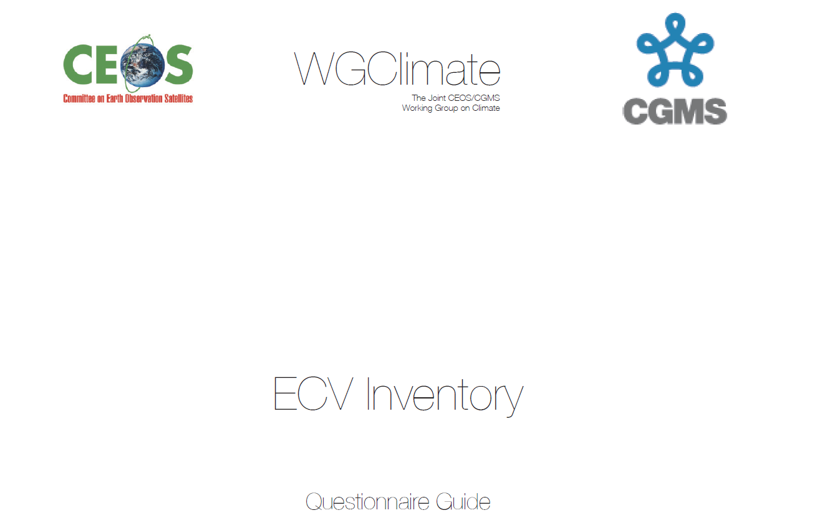
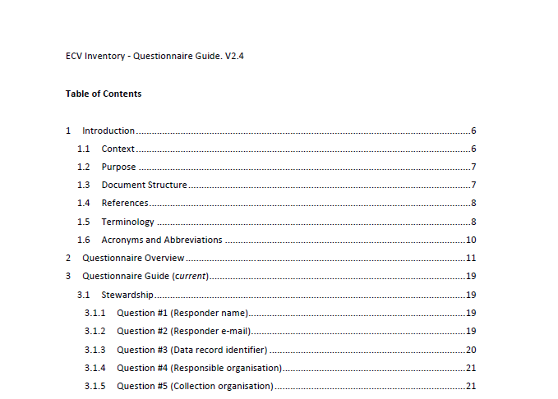
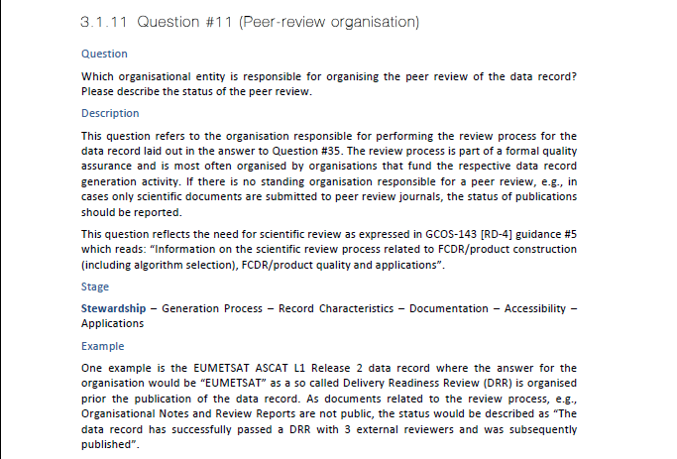
Implementation: Questionnaire Guide

Slide 19
Implementation: Questionnaire Guide (Topics)
  Questionnaire topics:
    Stewardship: CDR curator(s), responsible organisation, data record identification (DOI, name and version, reference), organisation(s) responsible for collection, calibration, FCDR, inter-calibration, TCDR, peer-review, archiving, user-service and feedback, maintenance, …
    Generation Process: information on quality assurance, assessment of GCOS requirements and guidelines, use of quantitative maturity matrix, …
    Record Characteristics: ECV, ECV Product, physical quantity, satellites/instruments, spatial/temporal resolution and coverage, accuracy, stability, (inter-)calibration, …
    Documentation: regarding generation, calibration, validation, scientific review, …
    Accessibility: contact, type of access, URL for access, data dissemination, format, …
    Applications: climate applications, users.

Slide 20
Status in numbers: the big picture
  ~ 300 people (directly) contacted
    WGClimate members, Focal Points, Responders
  150 “Responders” registered / ~90 active
  20 CEOS/CGMS Agencies contacted
    18 participants: no response from ASI, Roshydromet
    11 contributors: feedback without input from CMA, DLR, KMA, INPE, ISRO, NSC, UKMO
  756 entries: 524 ‘current’, 232 ‘future’
    Numbers are still changing (Verification Process)
  76 (+5) physical quantities covered, under
  13 A + 15 L + 8 O ECVs >
  The number of entries is much higher than expected → the verification process takes longer.
  WGCLIMATE members please pass on a big THANK YOU!!! to the responders in your agency: without them this would have been impossible!

Slide 21
Status: preliminary concluding remarks
  Continuous learning / development process
    Adapt / adjust “on the fly”
    … Improvements for Cycle #3
  What the numbers show
    Outstanding participation / contribution
    Highly-demanding tasks for all players
  What these numbers / plots are not telling
    Completeness / consistency of information provided
    Space / Time coverage of TCDRs
    Detailed characteristics of TCDRs (accuracy, stability, resolutions…)
    Full coverage (all physical quantities) of ECVs
    ‘Current’ / ‘Future’ coverage per ECV
    …

